Slide 1

SLAC
EPICS PVA Gateway
Stress Testing
Bruce Hill, May 31, 2019
Notes:
1

Slide 2
PVA Gateway Improvement Project
As of summer 2018, an existing PVA Gateway prototype in C++, pva2pva, was being developed by Michael Davidsaver of Osprey DCS. Michael also had a python prototype, p4p. Both were lacking features, particularly Access Security, needed for production use at SLAC.
Fall 2018: SLAC approves SOW for PVA Gateway Improvements. Project put out for bid and awarded to Osprey DCS.
Jan 2019: Michael Davidsaver begins work on PVA Gateway Improvement Project.
2
Notes:
2

Slide 3
PVA Access Security Status
Access Security Features implemented on p4p gateway as of June 2019:
User name
User Access Group UAG
Posix User Groups
Host IP for CA Client
Host Access Group
PV Name Patterns
Not done yet:
Access control via PVA variable
PVA Access control on IOC
3
Notes:
3

Slide 4
Authentication
Authentication deals with how does the EPICS server determine the UserId and Host IP of the client.
First generation PVA Access Security plugin gets username from client, but derive thes hostname from the ethernet socket connection.
Second generation PVA Access Security plugin will use a password based authentication to ensure the client UserId is valid.
Currently favored authentication method is to use Kerberos tickets.
4
Notes:
4

Slide 5
Access Configuration
CA Access Security is configured by an access configuration file, ACF, that allows EPICS developers to define the following building blocks for determining what level of access is granted to a CA client.
UAG, User Access Group, a list of usernames and/or group
HAG, Host Access Group, a list of hostnames
ASG, Access Security Group, a list of rules governing access for different UAG and HAG
In the IOC, each record has an ASG field which determines which Access Security Group rules are used for its access security.
In the gateway, a pvlist file is used to determine which ASG to use.
PVA Access Security supports CA configuration files.
5
Notes:
5

Slide 6
PVA Gateway Caching and Channel Sharing
Gateway caching monitors the upstream server and uses a single update from the server to server multiple downstream clients.
Gateway caching
Configurable gateway caching
Channel Sharing for identical PVA requests
Channel Sharing for PVA requests with different subsets of channel fields
6
Notes:
6

Slide 7
PVA Gateway Data Reduction Strategies
Gateway data reduction involves configurable rate limits for both upstream and downstream connections to avoid some connections consuming most of the available bandwidth.
Upstream rate limiting
Downstream rate limiting
Another strategy for data reduction is for the client to only request a subset of an array.
PVA Gateway supports CA Filter notation PV.[-5,-1]
7
Notes:
7

Slide 8
PVA Gateway Diagnostics
Gateway diagnostics currently only readable from downstream.
EPICS style alarm limits, severity and status for each monitor PV
Number of client side PVA connections
Number of server side PVA connections
Total client bandwidth by host and by pv
Total server bandwidth by host and by pv
CPU and Memory usage
Thread count for both client side and server side
8
Notes:
8

Slide 9
PVA Gateway Logging
Gateway doesn’t currently have an option to specify a log file, but uses python logging module so it should be easy to specify a log file.
CA style put logs are not yet supported.
9
Notes:
9

Slide 10
PVA Gateway Documentation
Some classes and methods have python docs, but more is needed.
Also need some additional high level docs including:
Threading model
Deployment examples
10
Notes:
10

Slide 11
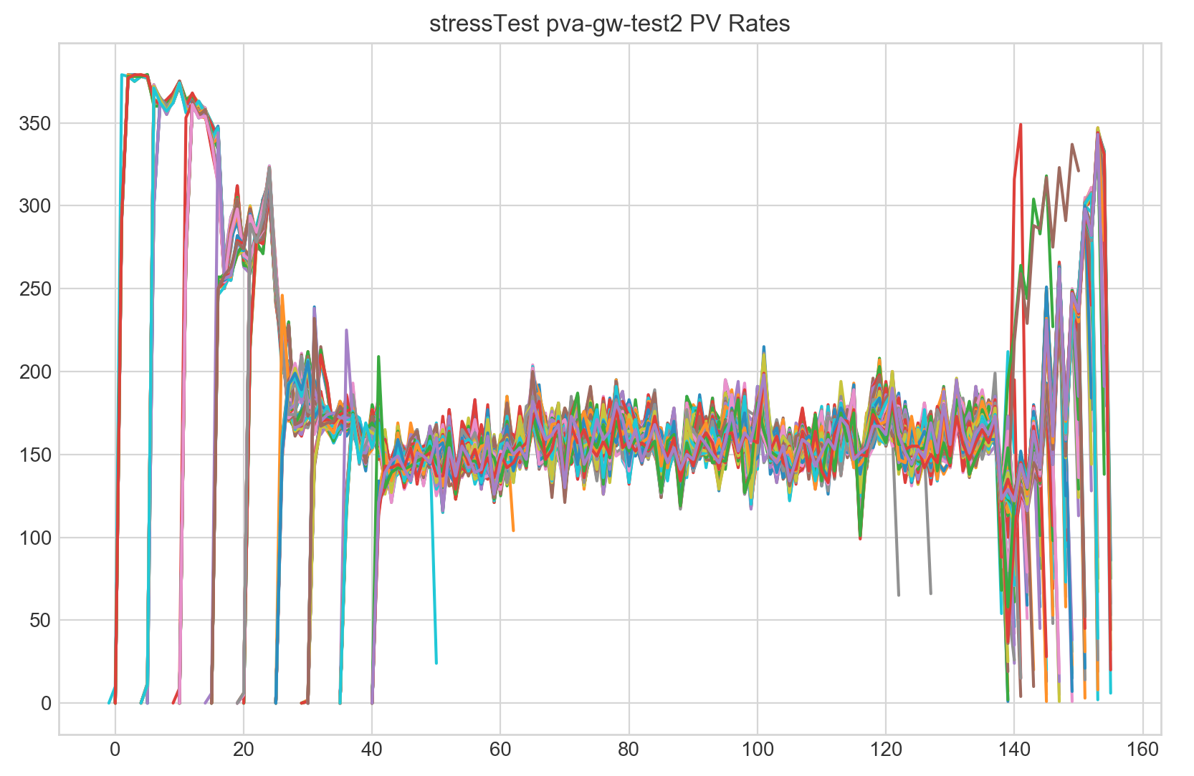
Stress Test
Content
11
Notes:
11

Slide 12
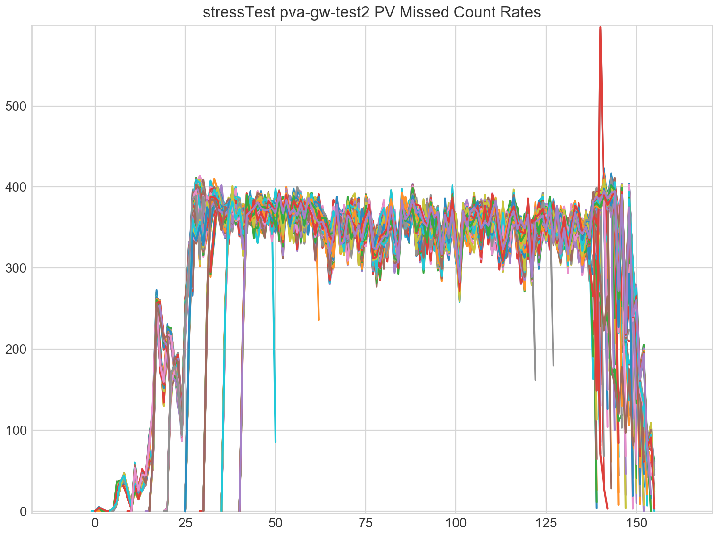
Missed Counter Updates
Content
12
Notes:
12

Slide 13
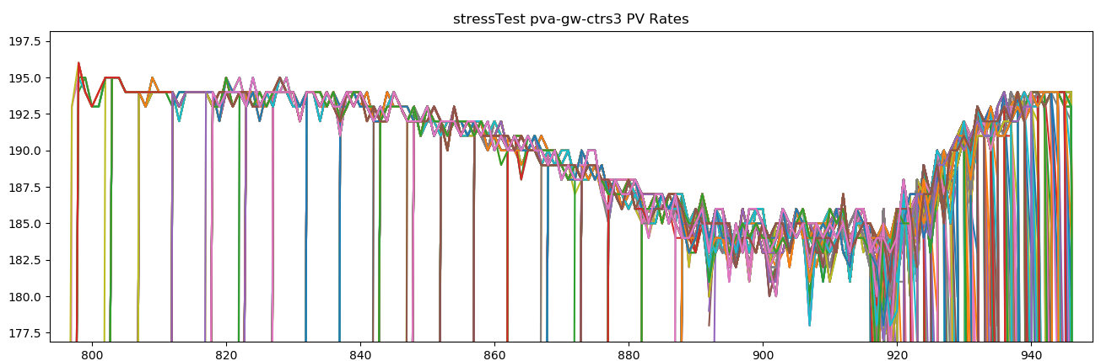
Slide Topic
Content
13
Notes:
13

Slide 14
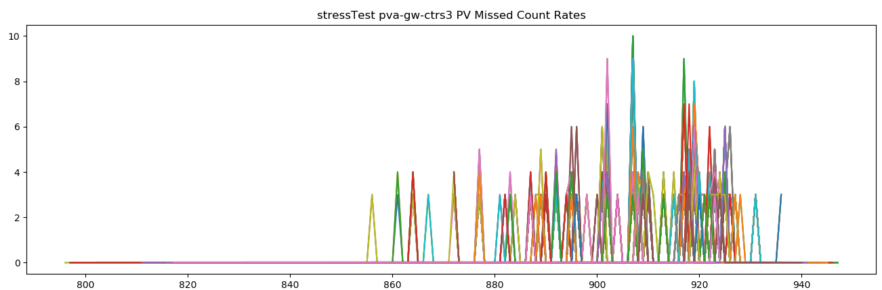
Slide Topic
Content
14
Notes:
14

Slide 15
Slide Topic
Content
15
Notes:
15

Slide 16
Reference Documents
EPICS Application Developers Guide
https://epics.anl.gov/base/R3-15/5-docs/AppDevGuide/AccessSecurity.html
EPICS Gateway Users Guide
https://epics.anl.gov/EpicsDocumentation/ExtensionsManuals/Gateway/Gateway.html#AccessSecurity
16
Notes:
16

