Slide 1
High Energy Photon Source (HEPS) Controls Status Report
Paul Chu
Institute of High Energy Physics

Slide 2
Outline
Introduction
Controls Overview
Control System Components
High-level Platforms and Applications
Summary

Slide 3
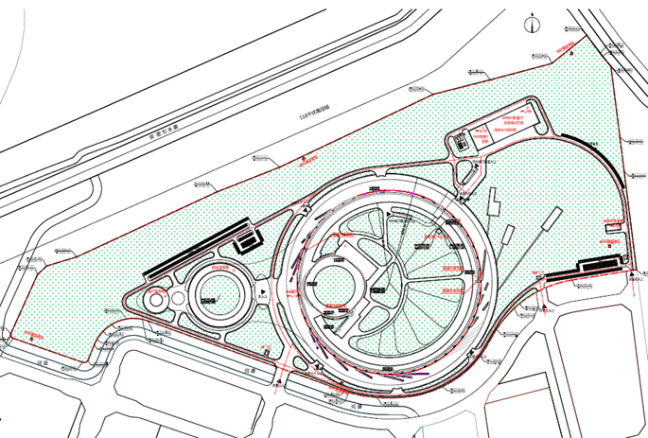
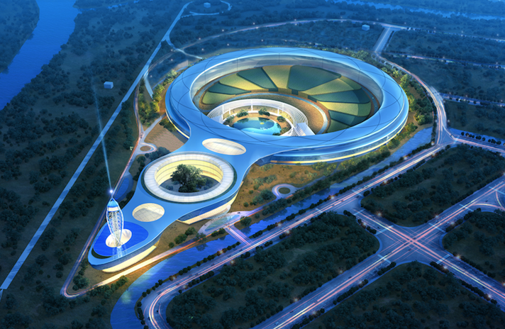
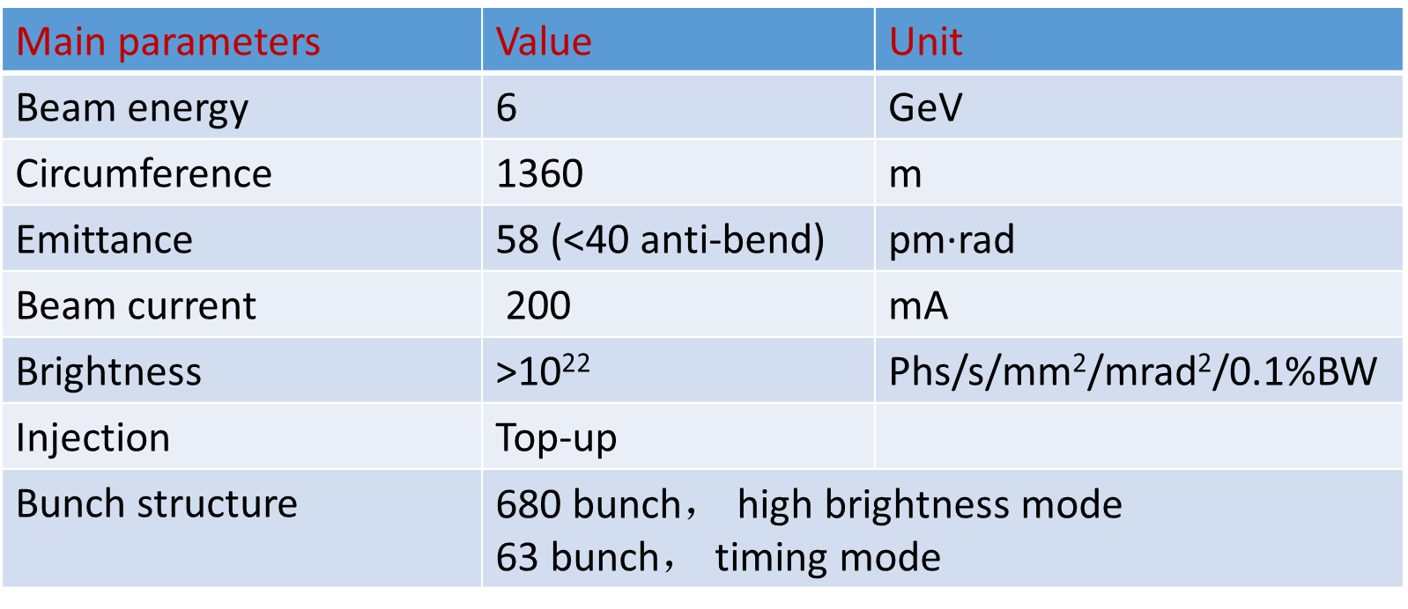
Introduction
HEPS– 4th generation synchrotron light source, 7BA-lattice
  14+1 beamlines for phase 1
Construction period – Jun. 2019 – Dec. 2025, ~US$700M

Slide 4
Controls Approaches
Top-down architecture design with overall considerations
EPICS based distributed control systems
Industrial standard to save cost
Expandability consideration
  Modular design for easier upgrade and deployment
For better construction project quality control:
  Tracking project progress closely
Data centric approach
Collaboration with others

Slide 5
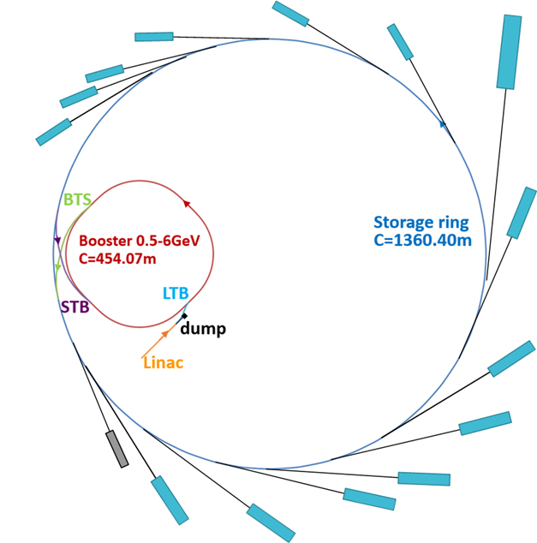
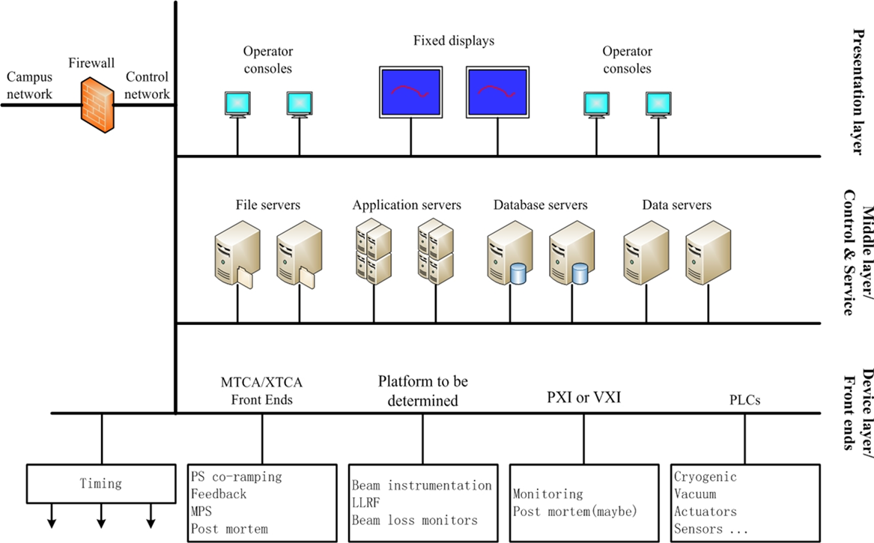
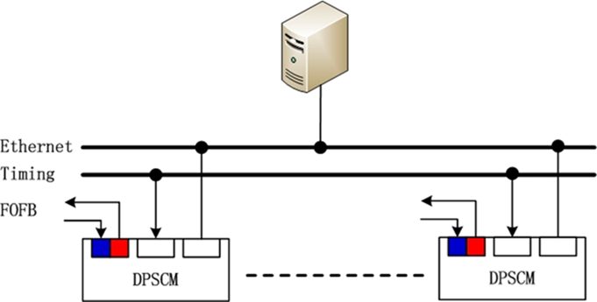
Accelerator Controls
EPICS v3 based for now
Standard interface to equipment
Global Timing System
Test bench for EPICS
Machine Learning study

Slide 6
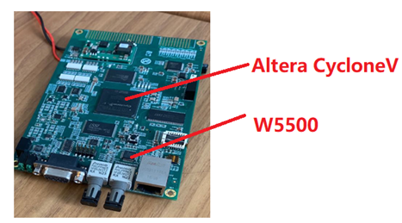
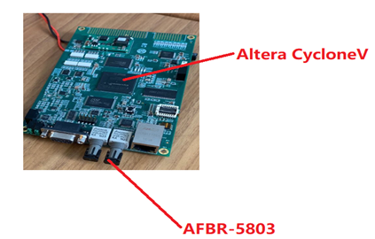
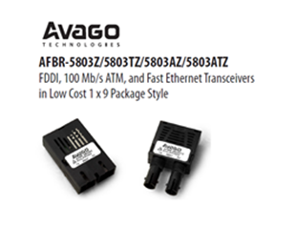
Magnet Power Supply Control [1]
DPSCM-II Remote Control System
  Generic power supply and fast orbit feedback system power supply control board architecture
    Generic power supply core architecture ： FPGA （Altera Cyclone 5 ）+ hard core Ethernet ( W5500 ) interface
    Fast orbit feedback system power supply ：FPGA （Altera Cyclone 5 ）+ fiber interface （AFBR-5803TZ）

Slide 7
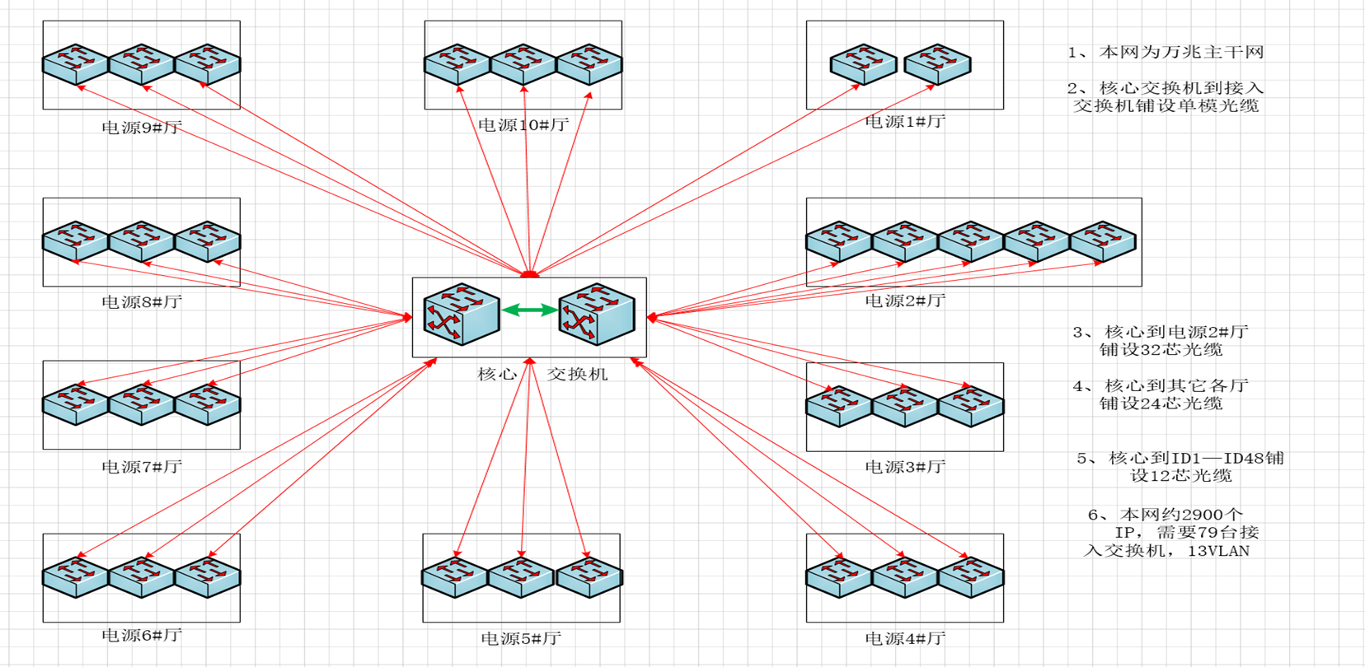
Magnet Power Supply Control [2]
Over 2800 power supplies!
42-53 IOCs (8U servers, each with 16 PS), 238 embedded MOXA DA720 (2U, each with 14 PS)
  Distributed
  Redundancy
  Geographically Networked
  Cost considered
Testing with EPICS 3.14.12

Slide 8
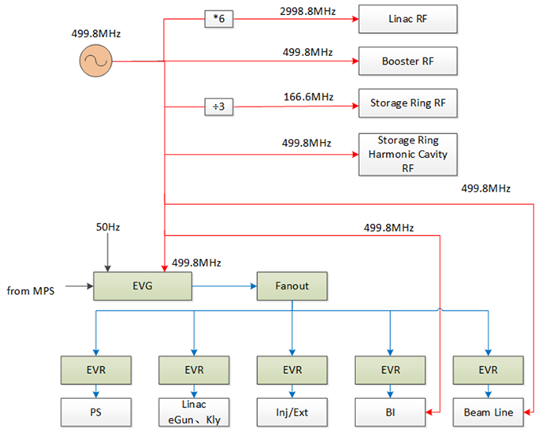
Global Timing System [1]
Provide timing for accelerator systems, beamlines and experiments
  including clock, trigger and timestamp
Less than 1 ps RMS jitter RF CLK signal distributed to linac, booster and storage ring RF and BPM system
Event based trigger distribution system. Accuracy need to reach 20ps

Slide 9
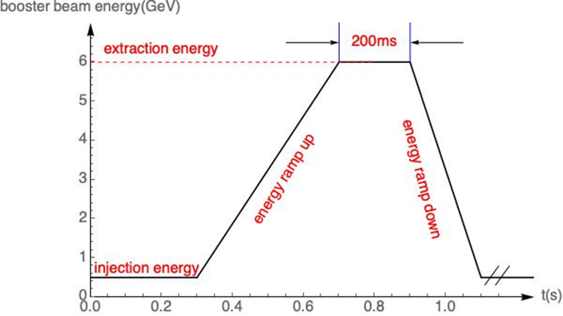
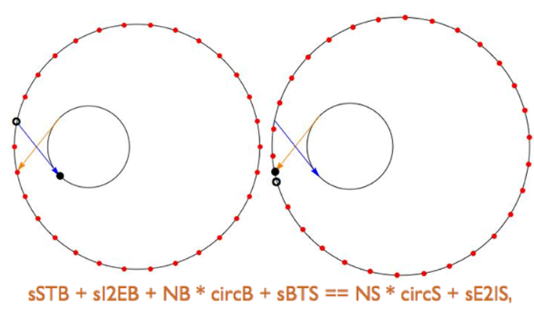
Global Timing System [2]
2 operating modes and complexed Injection & Extraction
  high brightness mode: 680 bunches @200 mA: 1.33 nC/bunch, 6 ns bunch spacing
  high bunch charge mode: 63 bunches @ 200 mA: 14.4 nC/bunch, 72 ns spacing

Slide 10
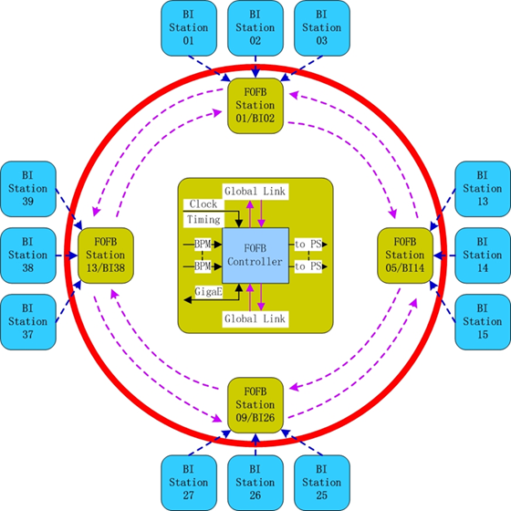
Fast Orbit Feedback (FOFB)
300 Hz – 1 kHz bandwidth
576 BPMs, 192 horizonal/vertical correctors
16 FOFB nodes
  Each as star topology
  16 connected as ring topology
FPGA for fast computation
Gigabit Transceiver for data communication

Slide 11
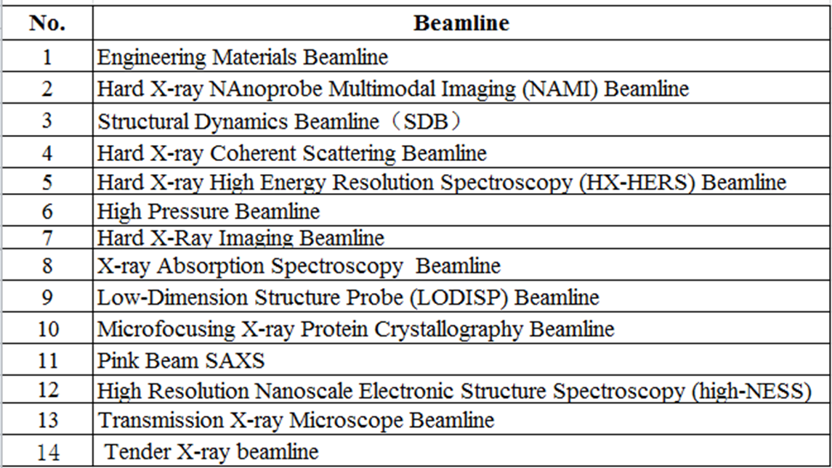
Beamline Controls [1]
14 Beamlines+1 testing beamline

Slide 12
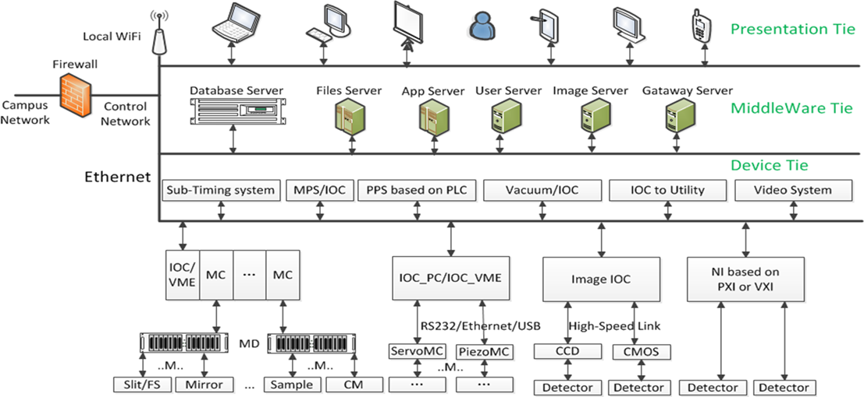
Beamline Controls [2]
EPICS based, possibly v7
Trying to standardize equipment
Designing data flow architecture, Integrating with scientific computing
  Common data format, e.g. HDF5
  Data preprocessing
  Online analysis
  Smart control w/ IoT

Slide 13
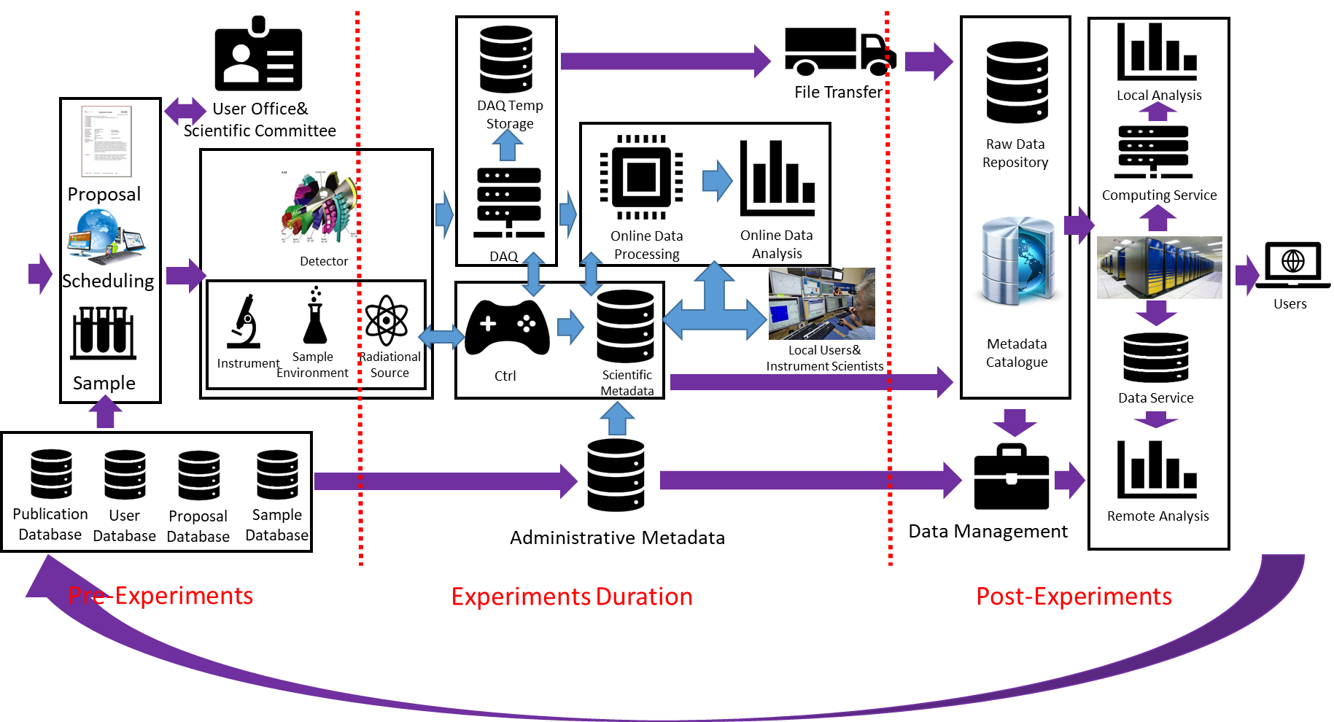
HEPS User Facility Software Architecture

Slide 14
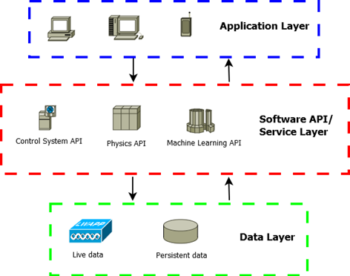
High-level Application Platforms [1]
Code reusability
Physics applications
  Open XAL, AP Toolbox
General-purpose applications
  CS-Studio
Machine learning applications
  Scikit-Learn, TensorFlow
Python, MATLAB support
  Quick prototyping
  Flexible controls/apps
Mobile apps support

Slide 15
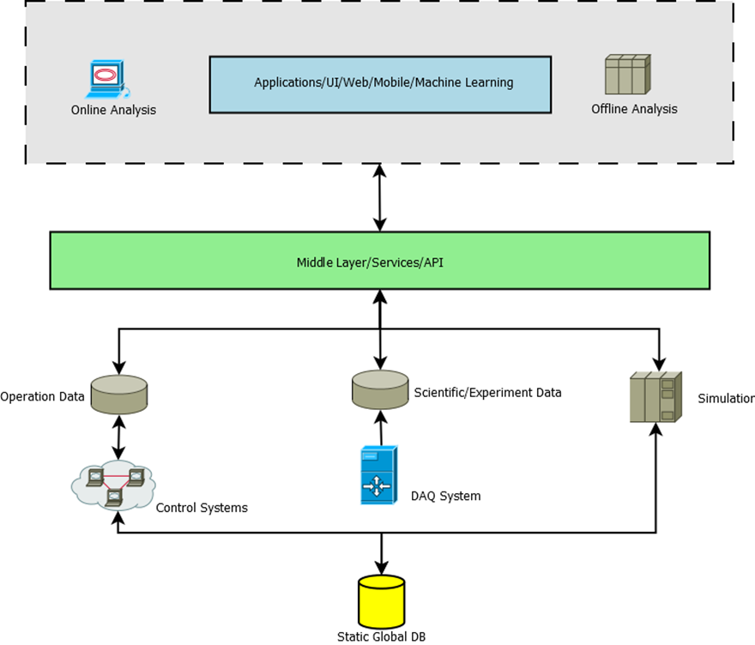
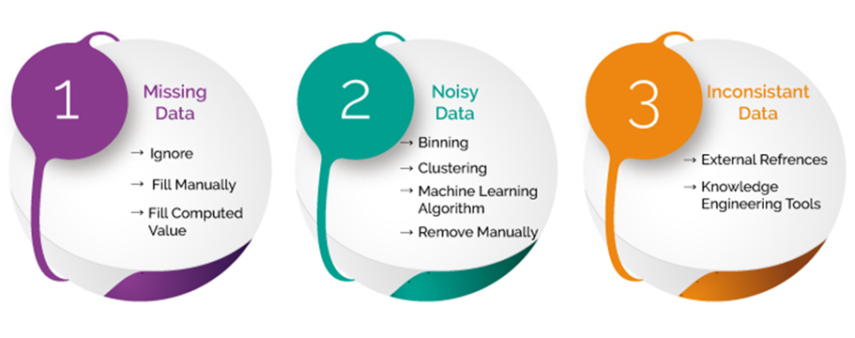
High-level Application Platforms [2]
Data Layer
Middle Layer
Applications
Data processing for ML Platform

Slide 16
ML Platform General Ideas
Machine Learning in Python
Scikit-learn/TensorFlow
Simple and efficient tool for data mining & data analysis
Built on NumPy, SciPy, and matplotlib
Open source, commercially usable - BSD license
Machine Learning in MATLAB
MATLAB Machine Learning Toolbox

Slide 17
Data Handling
Data Sources
EPICS live data
TXT/Excel Files
EPICS Channel Archiver
EPISC Archiver Appliance
Other data sources (e.g. PVLogger)
Output Data Format
Pandas DataFrame
TXT/Excel Files
Other format: HDFS
Code Snippet
pvnames=['BIBPM:R1OBPM02:XPOS','BIBPM:R1OBPM03:XPOS','BIBPM:R1OBPM04:XPOS]
#also can load pvnames from files
engine=LoadData.getKey(server_addr,pvnames)
data=LoadData.getFormatChanArch(server_addr,engine,pvnames,start_time='11/30/2018 14:15:00’,end_time='11/30/2018 14:16:00’,merge_type='outer’,interpolation_type='linear’, fillna_type=None,how=0)

Slide 18
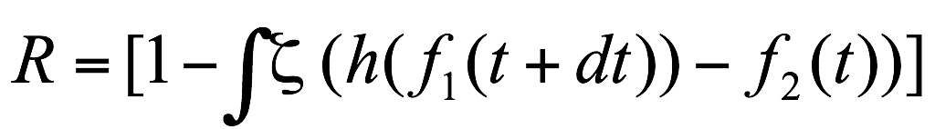

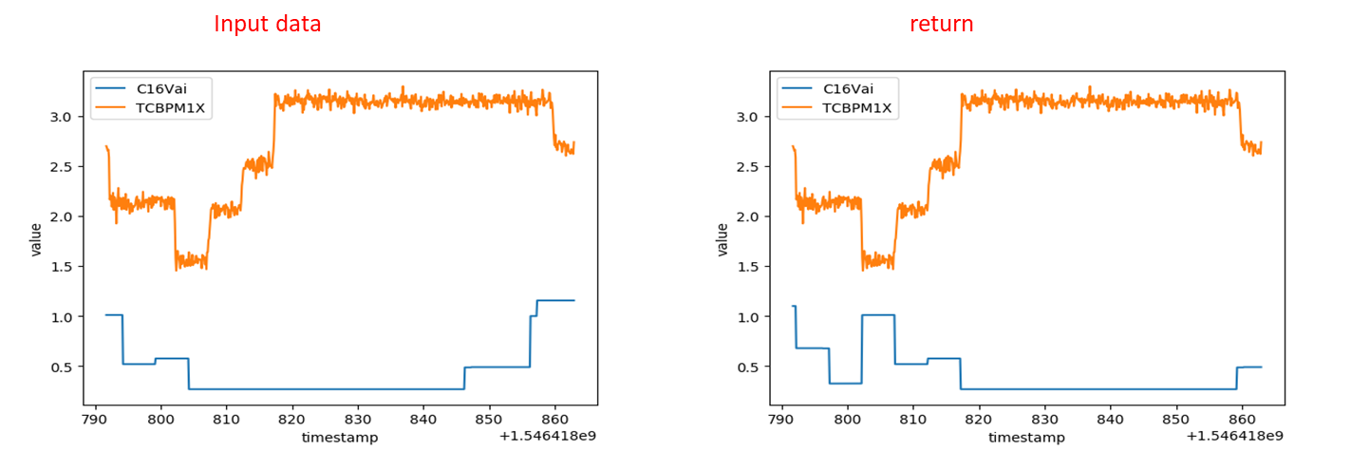
Machine Learning at Work
A test for BEPC-II timestamp correction
  Correlation function
  Objective function
f1(t)&f2(t) : The relation between 'value' and 'timestamp' of two systems(such as correctors with BPM).
h(): Projection of one group of value to another.
ζ(): Integral coefficient. (Remove interference and noise. Keep normalization)

Slide 19
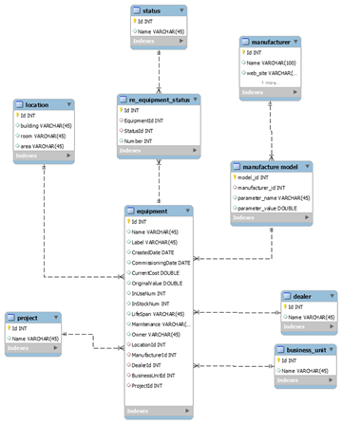
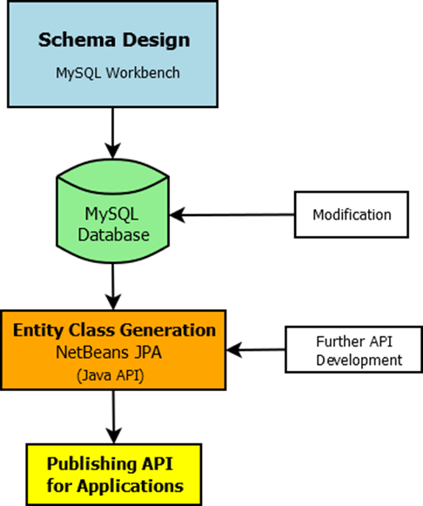
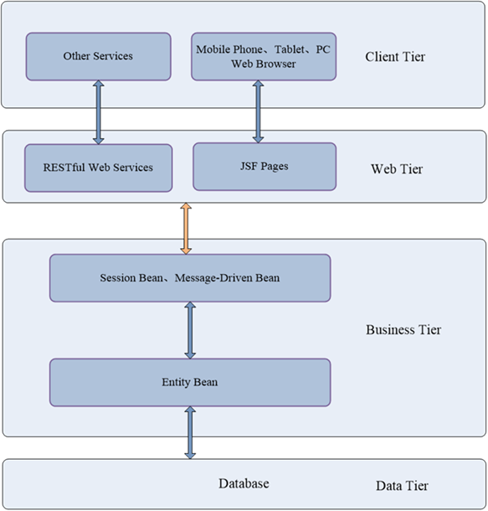
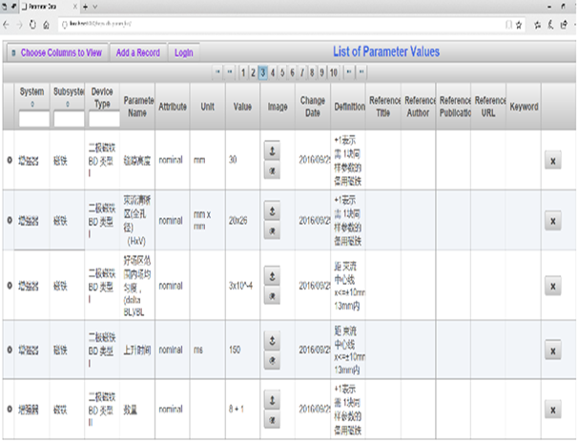
Databases
17 database domains in plan
MySQL or Microsoft SharePoint/SQL
Parameter List | Logbook and Issue Tracking | Cable
Naming Convention | Maintenance/Operation | Security
Magnet | Inventory | Alarm
Accelerator Model/Lattice | Survey and Alignment | Machine Protection/Interlock
Equipment and Configuration | Work Flow Control/Traveler | MPS Postmortem
Physics Data and Machine State | Document DB

Slide 20
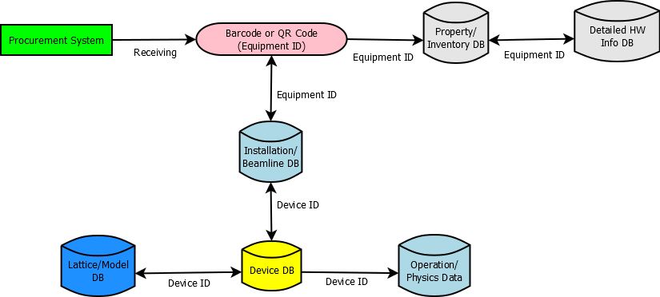
Project Control
Procurement, Equipment
Issue Tracking System, Maintenance, Operation Logbook…
Work Breakdown Structure (WBS) for project management
  Cost and schedule control/monitoring
SharePoint based document system
  Project Web site
  Work flow control
  Document and data sharing

Slide 21
Summary
HEPS Control Systems have initial design
Overall consideration, modularized implementation
Integration with project business sector
Data centric approach
Tough challenge for large amount of devices being controlled, large data sizes, control precision and speed
Software platforms for applications
Collaborations are welcome
Thank you for your help and support!

