Slide 1
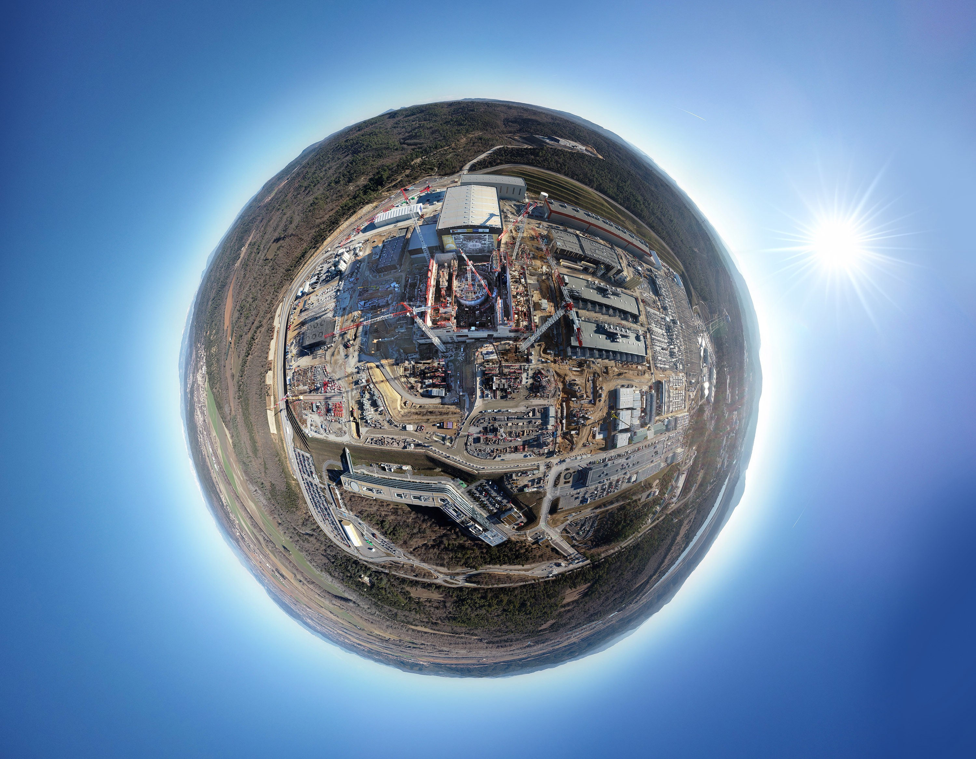
Welcome
on
Planet ITER

Slide 2
EPICS Collaboration Meeting
03-07 June 2019

Slide 3

We would like to thank our sponsors
Gold level: Cosylab

Slide 4


We would like to thank our sponsors
Silver level: D-TACQ Solutions Ltd.
Silver level: Observatory Sciences Ltd.

Slide 5



We would like to thank our sponsors
Silver level: I2A2 Research Group at the TU Madrid
Silver level: Tessella Ltd.

Slide 6
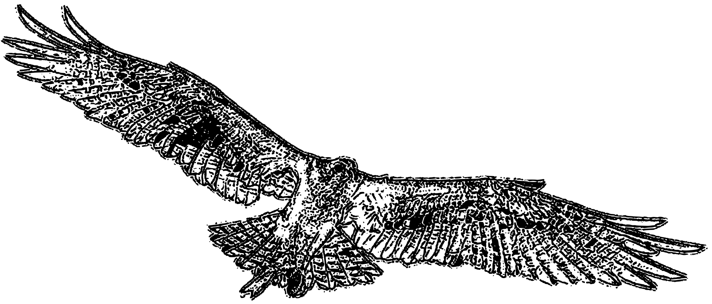
We would like to thank our sponsors
Bronze level: Micro-Research Finland Oy
Special sponsor: Osprey DCS

Slide 7
Presentation timetable
Up-to-date schedule is on the meeting website
We can still make room for another talk
Please upload your presentations in time!
  If direct upload does not work for you, use https://user.iter.org/filesharing/FileUpload.aspx

Slide 8
Logistics
WiFi: “Just works.”™
  Open Guest network with transparent proxy
Lunch: Please avoid the restaurant rush hour
  Our lunch break is 12h45 – 14h00
Special: Virtual Reality room visits 13h30-14h00
  20 seats: put your name down in the morning coffee break
Construction site visit (Wed morning)
  Starts at 09h00 in the foyer, using two buses
  Dress code: covered legs, robust shoes

Slide 9
Safety
ITER is not in operation, the installations at CEA are
General rules:
If you hear sirens outside → stay inside
If you hear sirens inside → leave to a meeting point
  Our meeting point: the big staff parking lot below the entrance
  Siren tests: every Thurday at 13h00 (lunch)
There are VIP visitor photo shoots in the lobby
  Today from 09:25 to 09:40 & from 14:00 to 14:15
  Thursday from 13:30 to 13:40 & from 14:00 to 14:15

Slide 10
Now
Enjoy the meeting!

