Slide 1

ICALEPCS 2019 Poster
https://icalepcs2019.bnl.gov/

Slide 2
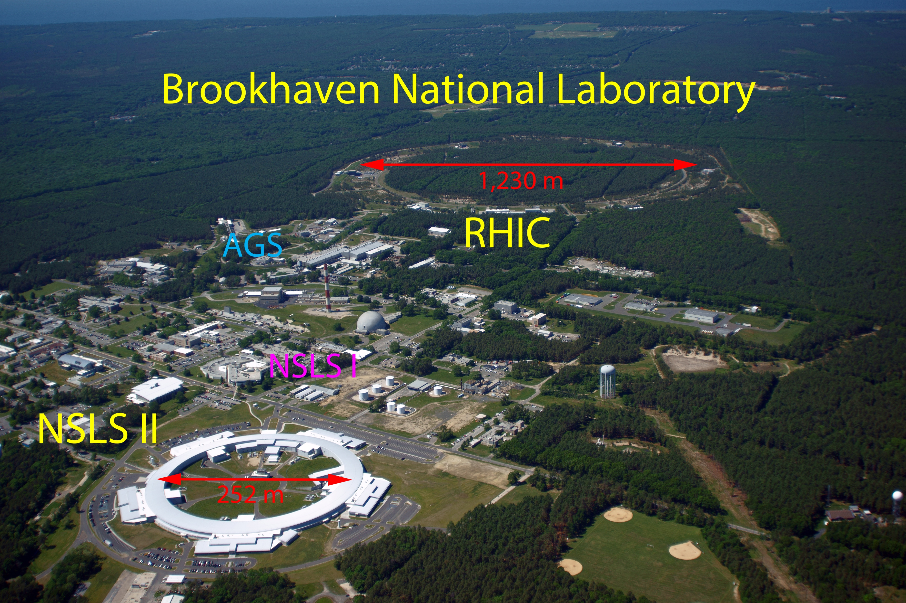
The Hosts!

Slide 3
Diversity, Inclusion, & Education
Inclusivity
Diversity is important to ICALEPCS 2019. The key components in our effort to diversify the ICALEPCS community and improve inclusivity are providing opportunities to all who attend, respecting our differences and celebrating diversity. The ICALEPCS conference series gives us a great platform to spread this message.
Code of Conduct
ICALEPCS 2019 is dedicated to providing an inclusive in every respect conference experience for everyone, regardless of national origin, age, gender, sexual identity, disability, physical appearance, race, or religion. As a conference that aims to share ideas and freedom of thought and expression, the Conference organizers expect all interactions, including those on social media and on-line, between participants at the Conference to be respectful and constructive.
Reporting
Please promptly report disrespectful behavior to a staff member of the Conference organizers.
Commitment
ICALEPCS 2019 will investigate all incidents reported. ICALEPCS 2019 reserves the right to bar or remove any person who violates our Code of Conduct from attending ICALEPCS 2019 and/or to cancel the registration of the person without refund.
We are also offering a number of ways for students to participate and become involved with our community, including student poster sessions, a reduced rate for student registrants and a limited number of free one day passes for students.

Slide 4
General
Project Status Reports
Control System Upgrades
Device Control and Integrating Diverse Systems
Experiment Control
Software
Software Technology Evolution
User Interfaces, User Perspective, and User Experience(UX)
Data Management
Data Analytics
Hardware
Hardware Technology
Timing and Synchronization
Control System Infrastructure
Subsystems
Systems Engineering, Collaborations, Project Management
Functional Safety Systems for Machine Protection, Personnel Safety
Feedback Control and Process Tuning
ICALEPCS 2019 Tracks

Slide 5
KEY DATES
February 1, 2019 | Abstract submission opens
April 8, 2019 | Online registration opens
April 30, 2019 | Abstract submission closes
July 6, 2019 | Deadline for award nominations
July 31, 2019 | Deadline for early registration
September 1, 2019 | Registration deadline for speakers
September 14, 2019 | Registration deadline for all presenters
September 30, 2019 | Deadline for paper submissions
October 5-6, 2019 | Satellite workshops
October 6, 2019 | Registration and welcome reception
October 7, 2019 | Conference begins

Slide 6
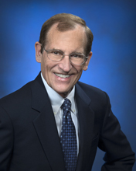
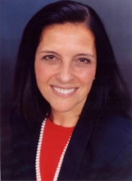

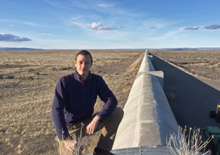
Keynote Speakers
Robert Tribble (Deputy Director for Science and Technology, BNL)
Florence D. Hudson (Founder & CEO of FDHint, LLC)
Allison Bishop (Co-Founder and President of Proof Trading)
Gabriele Vajente (CALTECH, Pasadena, California)
TBA
Build the Future Harnessing Advanced Technology Innovations and Inclusion
Why Cybersecurity Should Not Be Left to the Experts
Gravitational Wave Detectors: Controls at the Femtometer Level

Slide 7
Workshops (preliminary program)
Saturday Program
EPICS Satellite Meeting
FPGA Development Workshop
Jupyter Tutorial
TANGO Workshop
PLC Based Control Systems
Sunday Program
HDF5 and Data Format
Control System Cybersecurity Workshop
Motion Control Workshop
Sardana - Scientific SCADA Suite
MRF Timing Protocol Users Workshop
Data Science and Machine Learning Workshop
Containers in Controls
MicroTCA Standard and Applications
Both Saturday & Sunday
General Meeting Space (note: sign up first come/first serve at conference only)

Slide 8















SPONSORS (EXHIBITING)
Confirmed Exhibitors
SPONSORS (NON-EXHIBITING)
Endorsed by:

Slide 9
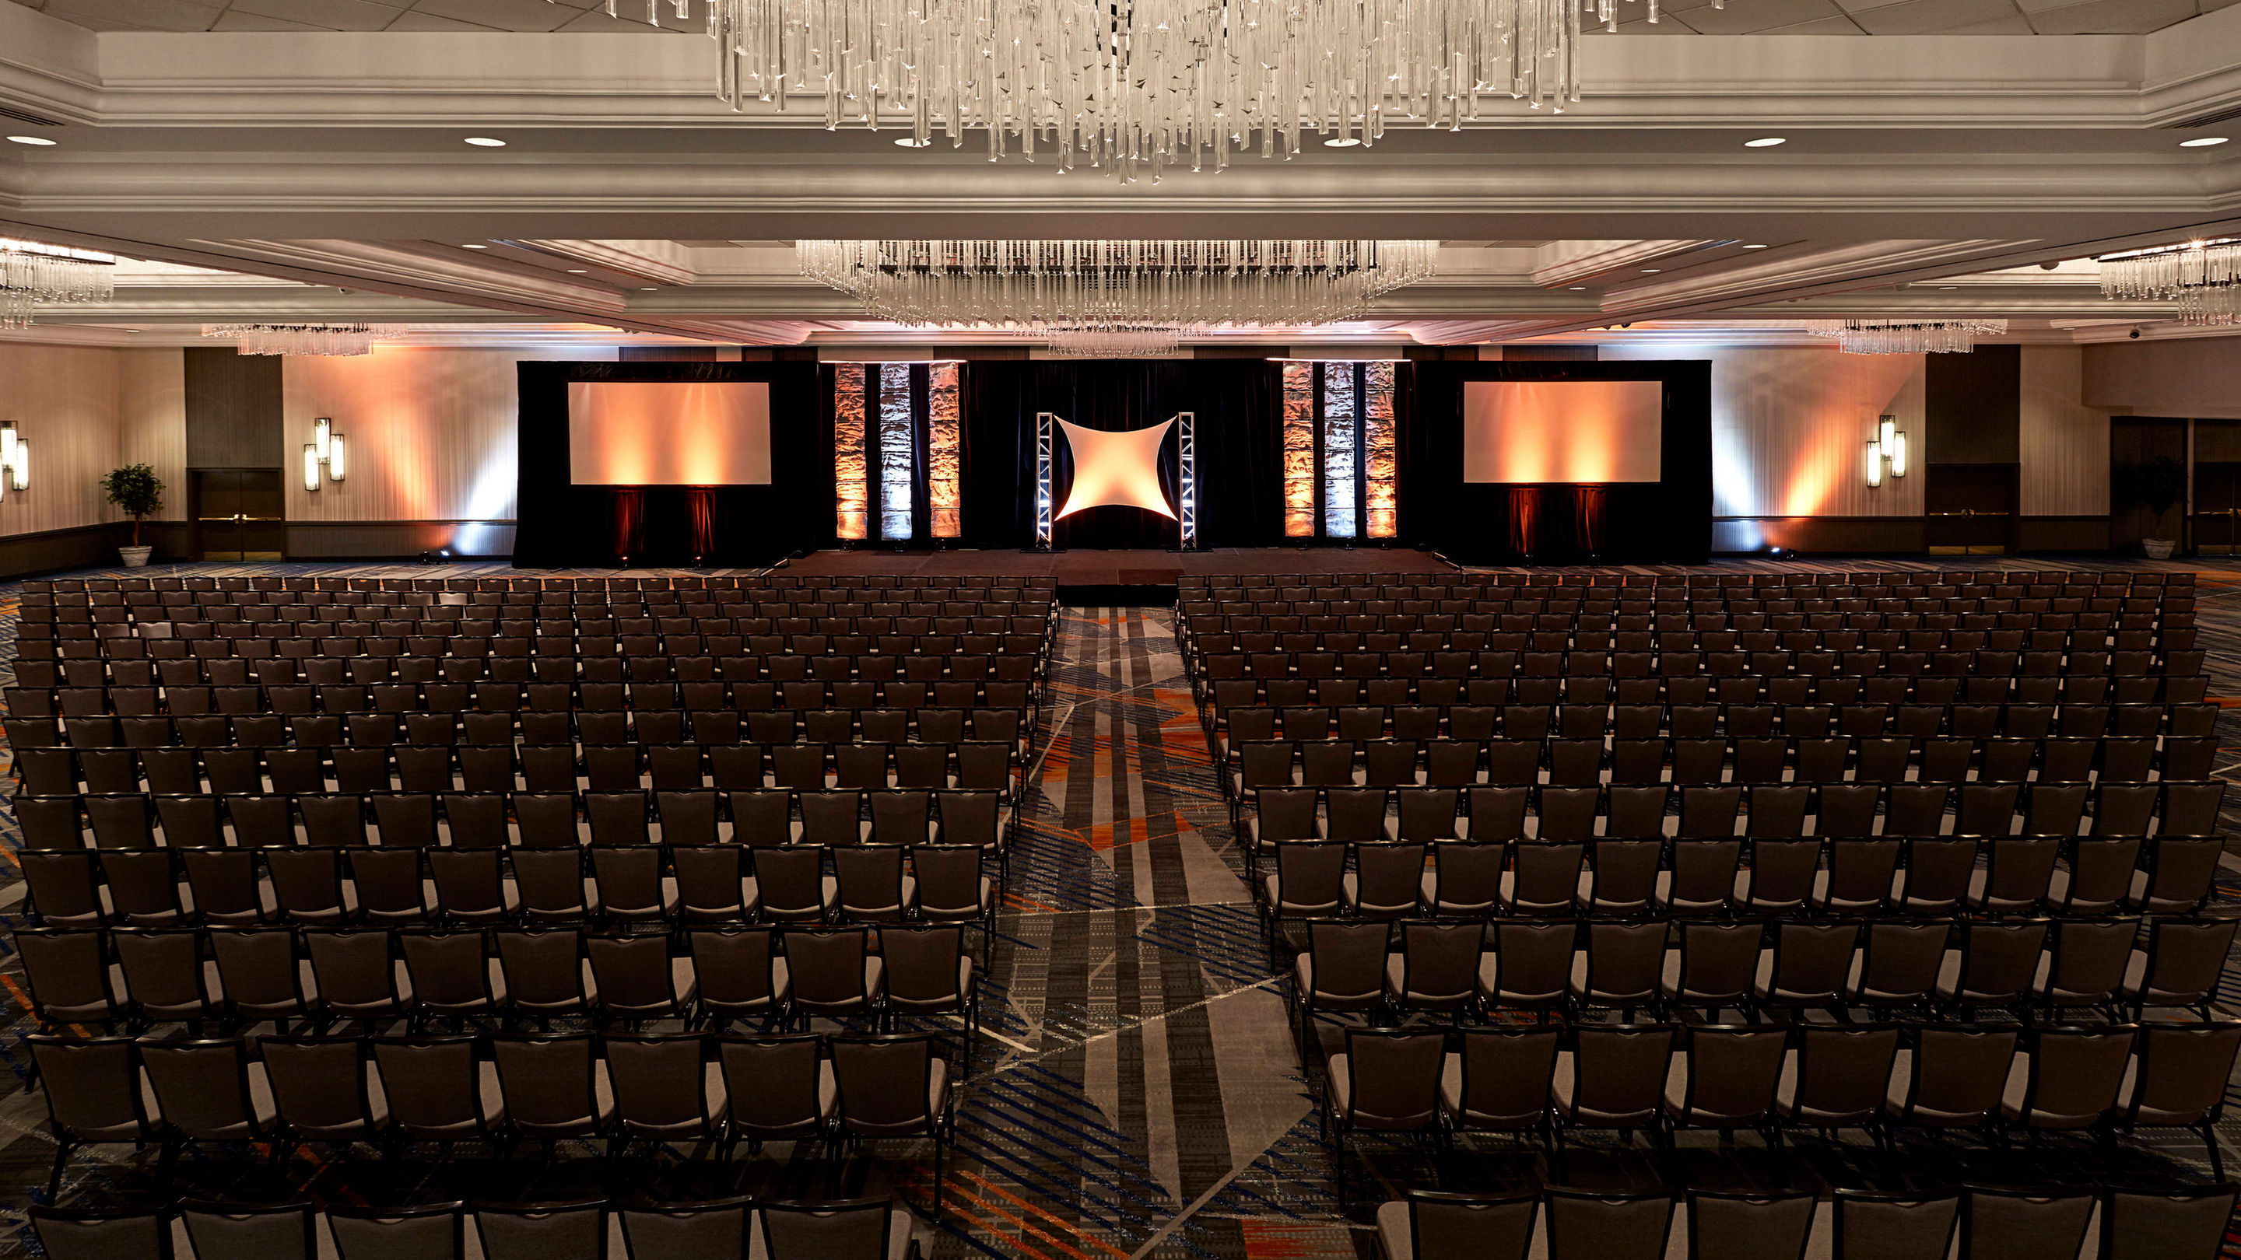
Venue: NY Marriott by the Brooklyn Bridge

Slide 10



Slide 11

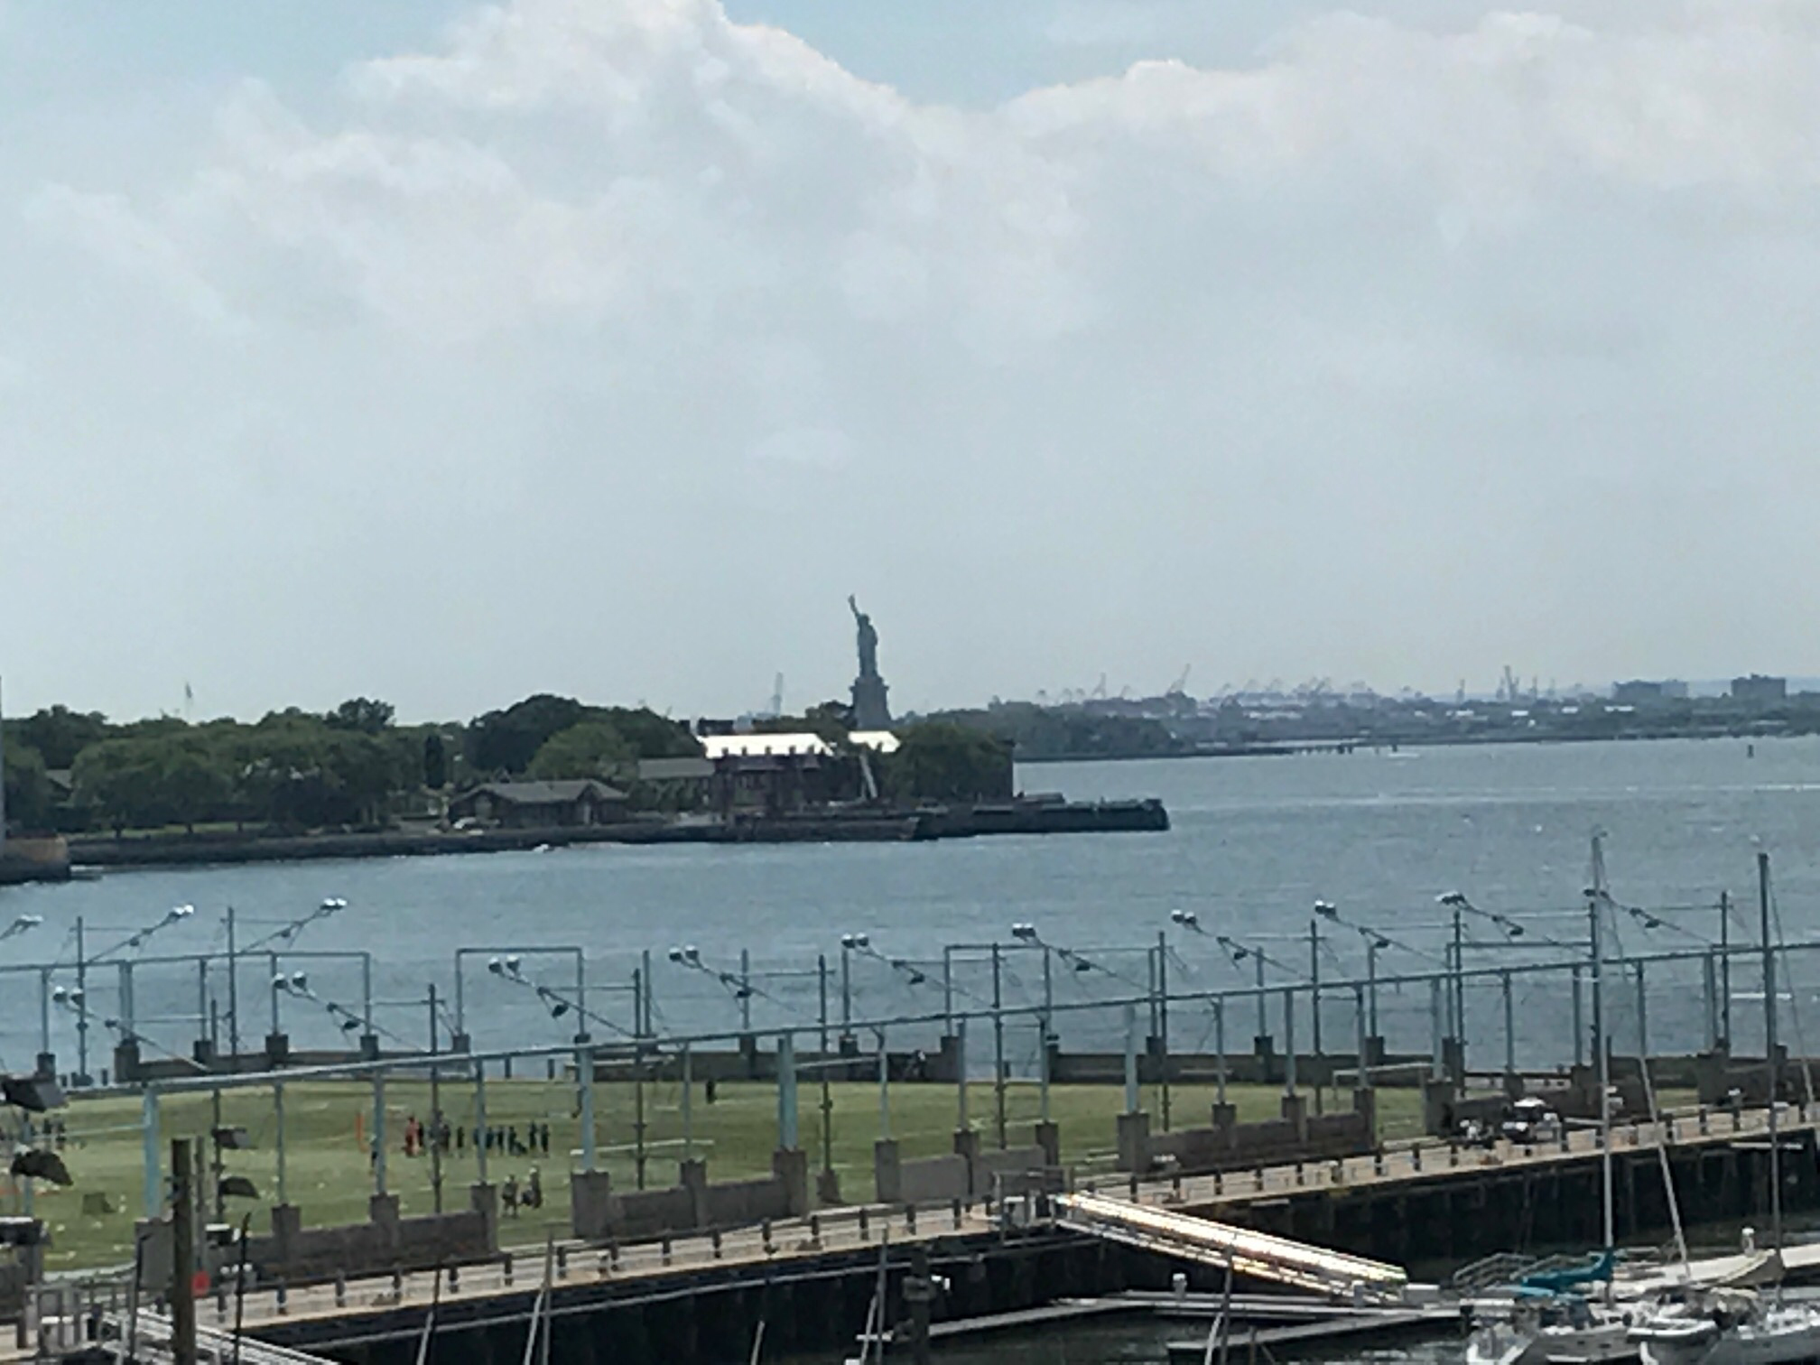
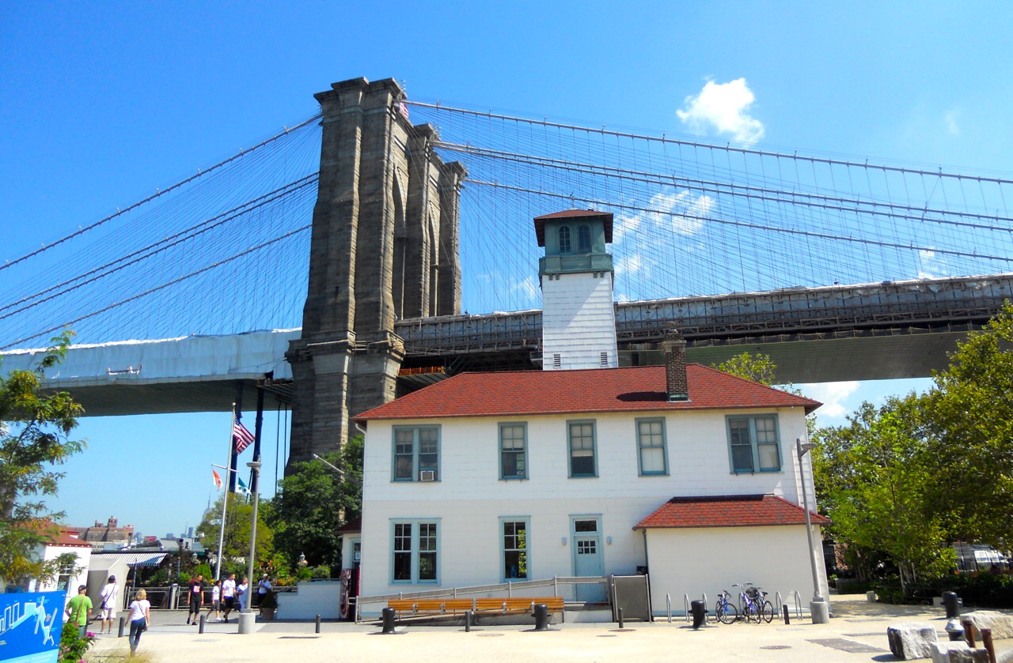


Slide 12
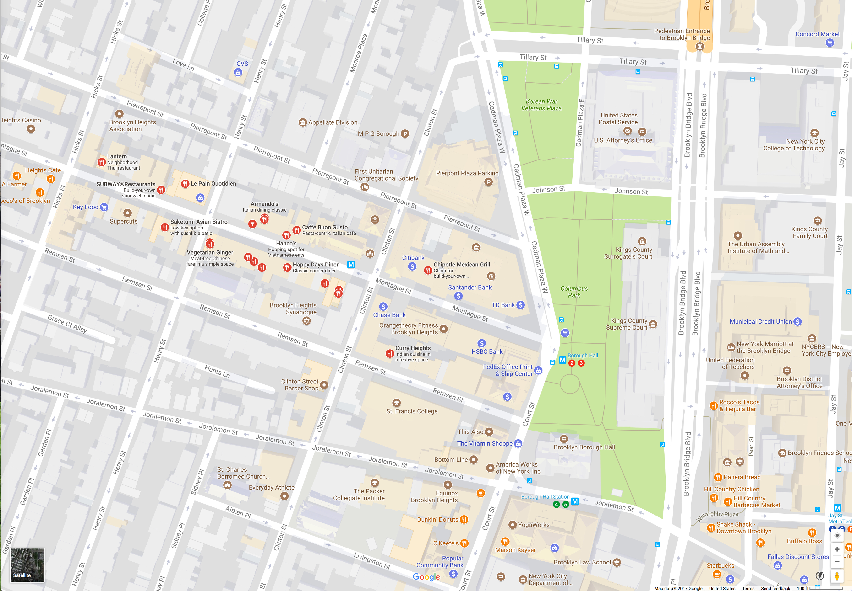

Venue:
New York Marriott at the Brooklyn Bridge

Slide 13
