Slide 1

MADMAX Critical Decisions:
Theory:
 | Theoretical Show stopper? |  |  | mid 2017
 | Influence of Clustering?
 | Classicality issue?
 | Phase space argument (gammas not normal to 10^-3 deg) |  |  | end 2017
 | Influence of "beam shape"
 | Do all disks have to be magnetized?

Slide 2
MADMAX Critical Decisions:
Experiment:
 | Magnet
 |  | What is the design (B^2 A, Length)? |  |  | Mid 2018
 |  | Prize and Time line? |  |  | Mid 2018
 |  | Fringe field? |  |  | Mid 2018
 |  |  | Homogeneity?
 | Booster
 |  | Noise tempreature and real temperature?
 |  | Tiling possible to 1m^2 with LaAlO3?
 |  | Precision of tiles?
 |  | Influence of Tiling on tan delta
 |  | Loss rate low enough?
 |  | Precision of disc placement good enough (extrapolated to many discs)

Slide 3
MADMAX Critical Decisions:
Experiment:
 | Receiver
 | Max. temperature |  |  |  |  | 2017
 | Technology for > 40 GHz? |  |  |  |  | 2018-2020
 | What resolution is needed for amplitude measurement (16bit as done at the moment? Could be lower?)
 | What frequency-bandwidth is needed?
 | Interface Booster-Receiver
 |  | Noise temperature of mirror, feedthrough, horn as fct of real temperature?

Slide 4
MADMAX Critical Decisions:
Experiment
 | Disc positioning
 |  | How long does the booster re-alignment last?
 | Calibration receiver and booster
 |  | How to calibrate?
 |  | How often to calibrate?
 | Prototype Test
 |  | Successful?

Slide 5
Some work packages:
Tasks
Theory
Mini Clustering
Influence of Clustering on search strategy
Influence of Magnet length
Influence of „beam shape“
Phase space argument (photon emission angle variations)
MPP, ZU, ?

Slide 6
Some work packages:
MPP, UHH, ??
MPP, UHH, ??
Tasks
Proof of Principle Experiment
Five disc Booster
20 disc Booster work in progress
Radiometer
Discs
Choice of material
Tiling
Fake Axion calibration
Antennas and mirrors
Tasks
Prototype booster
Design of prototype
Encapsulation (suitable for B-field)
Booster
Cryogenics for booster (see below)
Production of Prototype
Characterization
Needed Temperature of components known
Final Booster
Discs
Positioning System
Calibration/ Fake Axion

Slide 7
Some work packages:
MPP, Saclay
Tasks
Magnet
Start innovation partnership
contest for participation
Evaluation of applicants
Preparation of offers
Negotiations
Evaluation of final offer
Start of innovation partnership
Design Study
Decision on Magnet type
Build prototype
Build final magnet

Slide 8
Some work packages:
MPP, MPIfR, ??
Tasks
Receiver
Low Frequency (10-40 GHz)
High Frequency (35 - 100 GHz)

Slide 9
Work Packages:
UHH, DESY, ???
Tasks
Cryogenic System(s)
Design of cryogenic components
Mirrors and Feedthroughs
Site infrastructure
Definition of criteria for site
Selection of potential sites
Measurements at good sites
Decision on site
Preparation of contracts at site
Planning of site infrastructure
Preparation of site infrastructure
Interfaces and integration
Computing and Analysis
Slow Control

Slide 10
From the MADMAX persepctive:
Work Packages:
Tasks
Collaboration and Management
Committment Phase
Commitments above critical threshold
Collaboration Structure
MoU
Definition of management structure
MoU signed
Finances

Slide 11
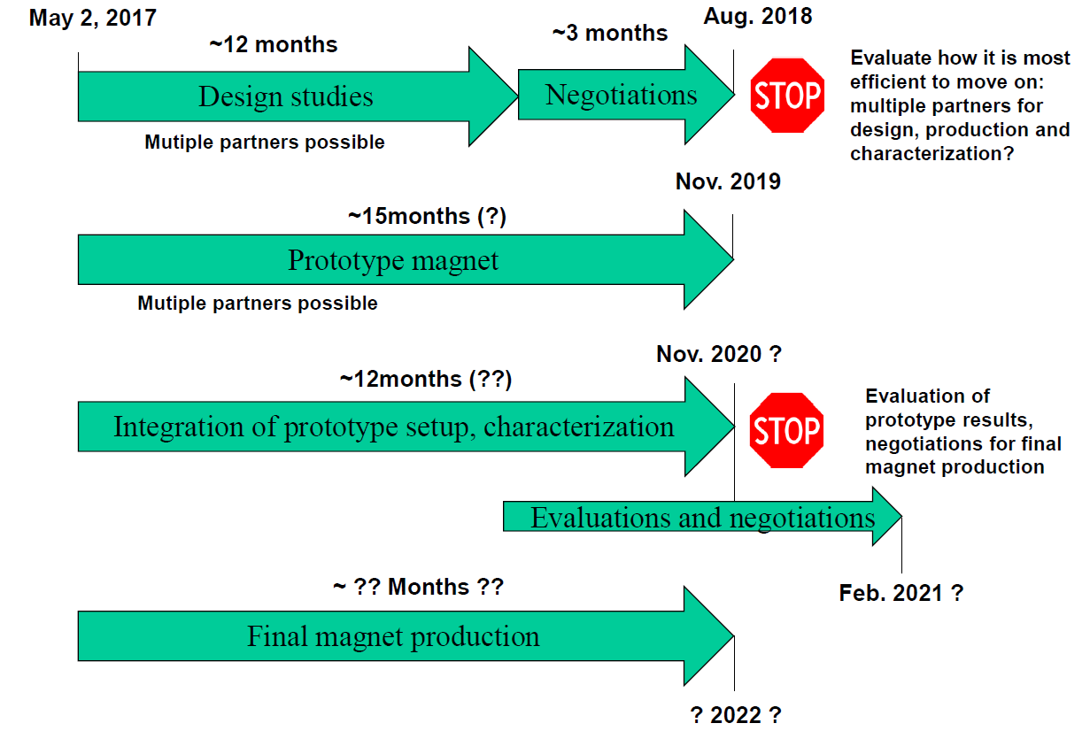
From the general persepctive:
Overall Time Schedule:
Will be driven by magnet time schedule
Start measurement in 2022(?) (with MADMAX magnet)

Slide 12
https://www.newscientist.com/article/mg23230974-700-physics-tweak-solves-five-of-the-biggest-problems-in-one-go/
http://www.nature.com/news/axion-alert-exotic-particle-detector-may-miss-out-on-dark-matter-1.20925
http://www.deccanherald.com/content/581069/an-exotic-article-detector-may.html
http://www.n24.de/n24/kolumnen/Prof-Ulrich-Walter-Wissenschaft/d/9390822/der-durchbruch-bei-der-dunklen-materie-.html

Slide 13
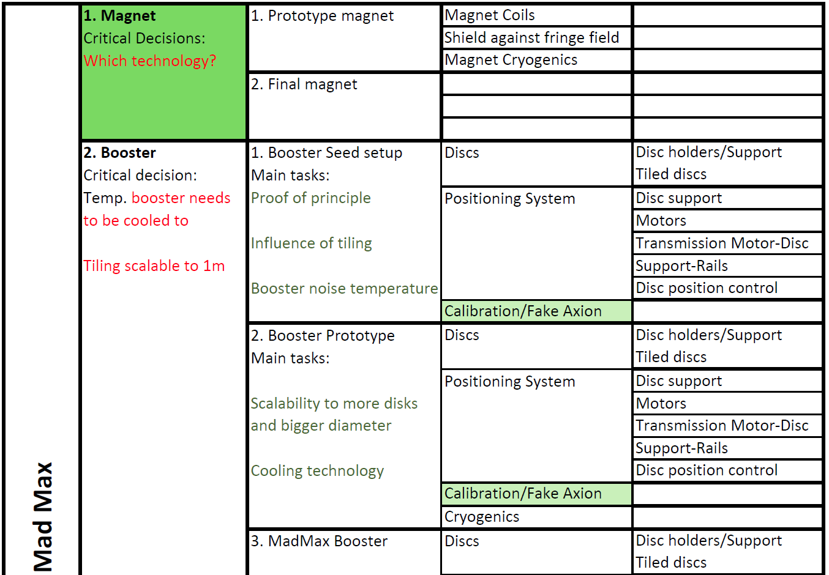
From the MADMAX persepctive:

Slide 14
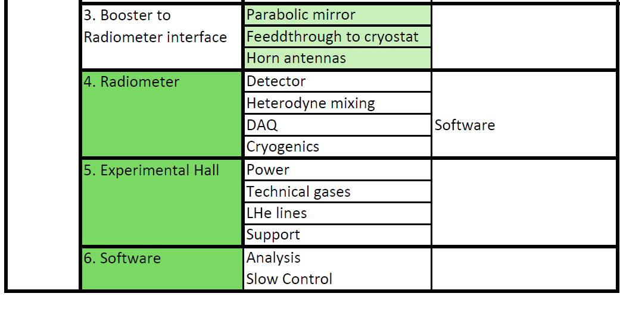

From the MADMAX persepctive:

