Slide 1

Further Magnet Project Time Plan:
May 2, 2017
~3 months
Aug. 2018
~12 months
Evaluate how it is most efficient to move on: multiple partners for design, production and characterization?
Design studies
Negotiations
Mutiple partners possible
Nov. 2019
~15months (?)
Prototype magnet
Mutiple partners possible
Nov. 2020 ?
~12months (??)
Integration of prototype setup, characterization
Evaluation of prototype results, negotiations for final magnet production
Evaluations and negotiations
~ ?? Months ??
Feb. 2021 ?
Final magnet production
? 2022 ?

Slide 2







Nov. 2016 Timeline:
This week
Jan. 18, 2017
Nov. 25, 2017
Participation competition
Evaluation of applicants
1. stage:
Jan. 27, 2017
Feb. 27, 2017
Invitation for offers
Offers available
Evaluation
2. stage:
Mar. 14, 2017
Mar. 24, 2017
Apr. 3 May 10, 2017
Negotiations
Final offers avialable
Evaluation
Apr. 10, 2017
May 2, 2017
Innovation partnership:
Publication of outcome
Begin of innovation partnership

Slide 3
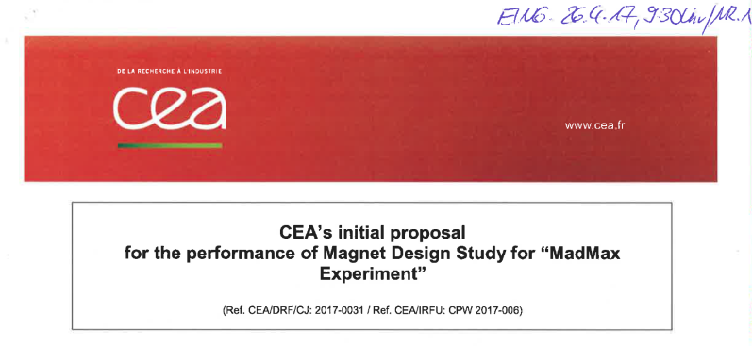
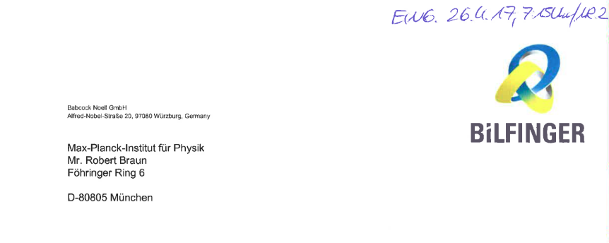
1st offers received 2nd of March 2017:
Negotiations of offers and draft contract at MPG general adminsitration & MPP Munich: 5&6 April 2017
CEA: Legal issue: needs special arrangement:
Heads of
Request for improved offer on 7th of April with deadline 26th of April

Slide 4
Legal issue with innovation partnership:
MADMAX Kollaboration
EURODAX Design report
Innovation partnership
Contractors:
purchaser
Ind. Partner 1
Ind. Partner 2
MPP
….
Saclay CEA: SACM + CEA Particle Physics Division
Uni Hamburg
Uni Zaragoza
DESY Hamburg
MPIfR

Slide 5
Legal issue with innovation partnership:
Sign contracts by two different representatives of the institution.
Signees at the same level in management structure
This has to be guaranteed in written form, i.e. be part of the contract.
Common superiors to both: agreed by contract, that he has no right of direction to the two representatives in matters that could lead to conflict of interest
MPP asked CEA to clarify the situation within CEA and to find out whether such a constellation could be arranged for.
Babcock Noell informed about the constellation: They agree to proposed solution

Slide 6

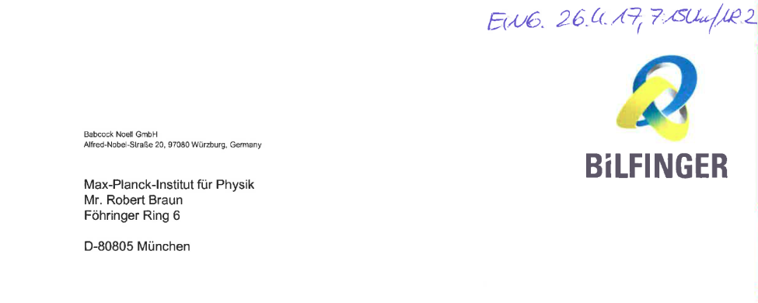
2nd offers received 26th of April 2017:
2nd iteration on draft contracts: Close to being finalized.
Once contract terms converged: Ask for final offer
(ready to do so for Babcock Noell)
We intend (and have the budget) to order both offers.
As soon as final offers available: Publication of outcome
Start of innovation partnership soon afterwards

