Slide 1
Measurement @ UHH
+ Comparison with DESY North-hall
MadMax-Workshop
Paris
O. Reimann for the MADMAX-Group
May 10, 2017

Slide 2
Outline
Requirements for the MadMax-experiment site
UHH measurements and comparison with DESY north-hall

Slide 3
Requirements (Reminder)
Low electromagnetic background
  < 10GHz: < -50dBm
  > 10 GHz: < -100dBm
  → Not very tight requirements

Slide 4
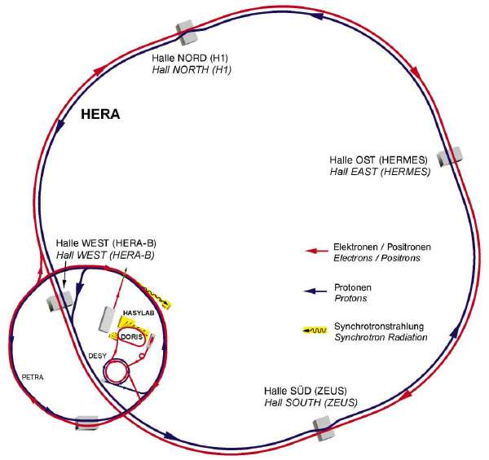
UHH Background Measurement
Test @ UHH Bunker
  Close to PETRA III experimental building
  At ground level
  2m thick concrete walls, but
  One “open” side (garage door)
First test run
  0Hz … 20GHz
  Looking for suspicious lines
Continuous run
  0Hz … 3GHz
  2 Days
Last time
Now we are here

Slide 5
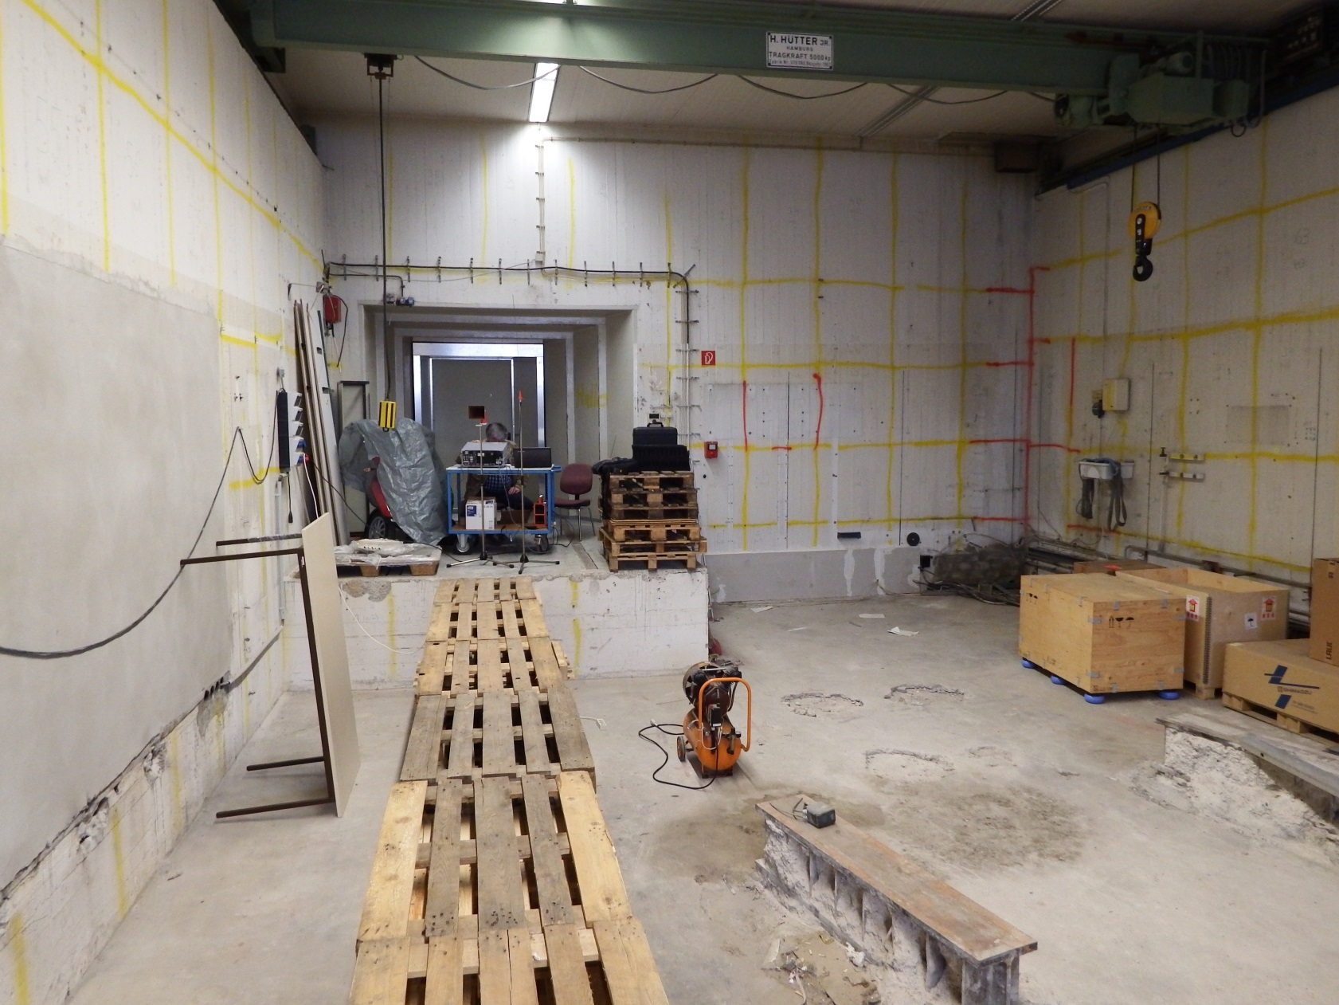
UHH Background Measurement

Slide 6
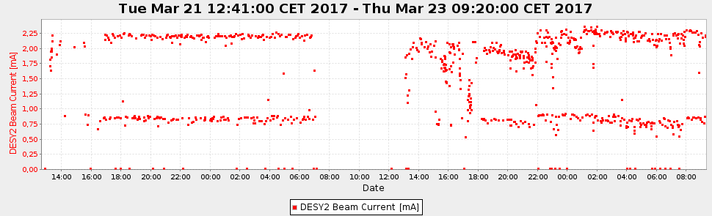
DESY-RF Activities
Lot of activity:
  DESY2-RF: 500MHz
  RF-data are not accessible

Slide 7
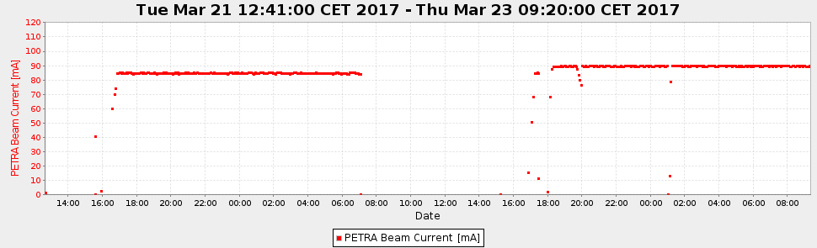
DESY-RF Activities
  Petra-RF: 499,564 MHZ
  Flash-RF: 1.3GHz (10MW Klystron)
    Unfortunately I was not able to download data from website (http://photon-science.desy.de/facilities/flash/operation_status/index_eng.html)

Slide 8
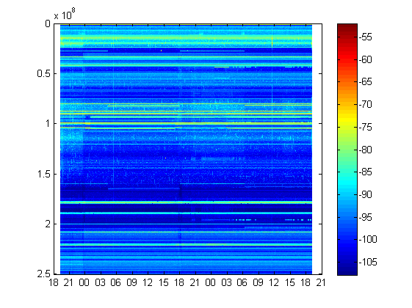
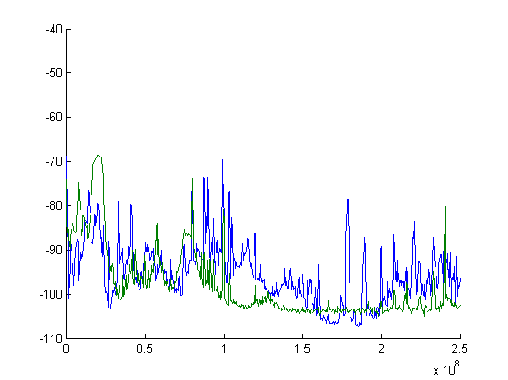
Measurement
0MHz – 250MHz
  More activity compared to DESY north-hall
Green: DESY north hall
Blue: UHH bunker
Frequency (Hz)
Power (dBm)
Time
Aug. 23, 19,25h
Aug. 25, 09.13h
Frequency (Hz)

Slide 9
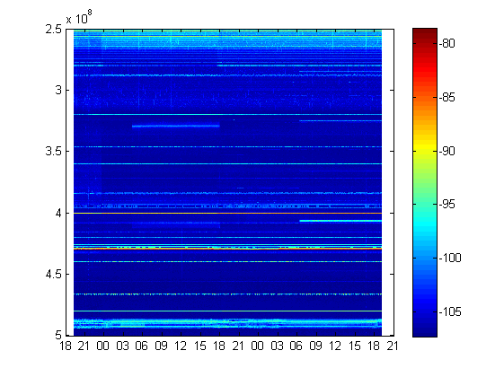
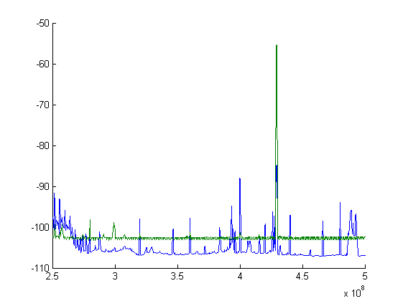
Measurement
250MHz – 500MHz
  Correlated signal with PETRA-RF? (I little bit time shifted)
Green: DESY north hall
Blue: UHH bunker
Frequency (Hz)
Power (dBm)
Time
Aug. 23, 19,25h
Aug. 25, 09.13h
Frequency (Hz)

Slide 10
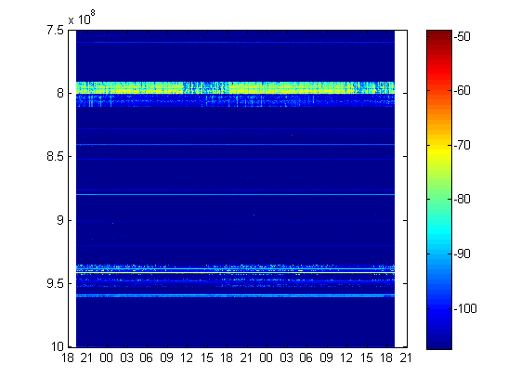
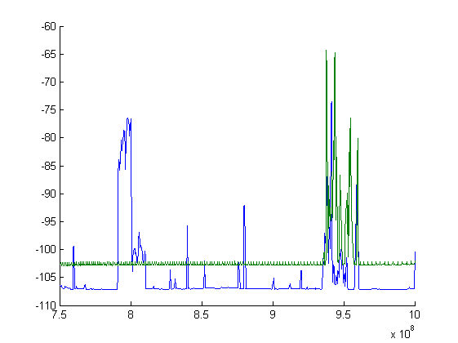
Measurement
750MHz – 1000MHz
  Telekom-transmitter
Green: DESY north hall
Blue: UHH bunker
Frequency (Hz)
Power (dBm)
Time
Aug. 23, 19,25h
Aug. 25, 09.13h
Frequency (Hz)

Slide 11
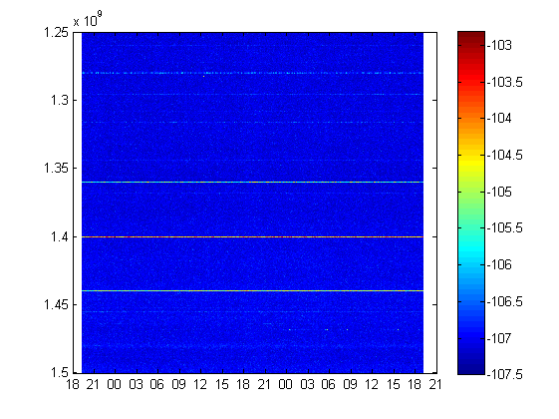
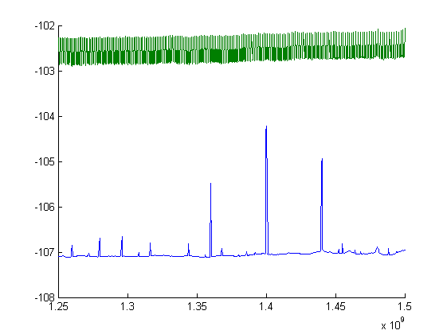
Measurement
1250MHz – 1500MHz
  Tiny signals (Not relevant)
  Same for higher frequencies
Green: DESY north hall
Blue: UHH bunker
Frequency (Hz)
Power (dBm)
Time
Aug. 23, 19,25h
Aug. 25, 09.13h
Frequency (Hz)

Slide 12
Conclusion
Requirements for the MadMax-experiment site
are not very tight
Maybe a signature from PETRA’s RF-systems?
(Small signal, not at a relevant level)
UHH bunker seems to be a acceptable candidate for the prototype experiment

