Slide 1
Detector/Receiver
“Cold” Measurements
MadMax-Workshop
MPP Munich
O. Reimann for the MADMAX-Group
May 10, 2017

Slide 2
Outline
Microwave radiometer (short reminder)
  Comparison between photon- and heterodyne detection
Current lab system
  Schematic
  First cold tests
Conclusion

Slide 3
Photon Detection Setups
Two principle ways:
  Photon counting
  Measurement of mean photon flux
Photon counting
  Limited by photon energy
  (Needs „high energy“ photons)
  Energy (frequency) resolution is limited
Photon flux measurement
  Not limited by low energy photons
  Excellent frequency (energy) resolution
  (easily it can be better than 10⁻⁹),
  because of usually used “coherent” detection
  (normally heterodyne detection)

Slide 4
Photon Detection Setups
Photon counting:
Photon flux measurement:
direct heterodyne (“coherent”)
Detector
Counter
Detector
Current
meter
Mixer
Bandpass
Detector
Current
meter
Oscillator

Slide 5
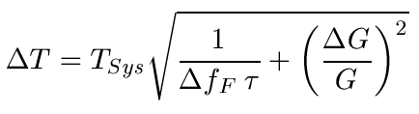



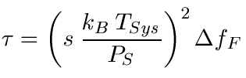

Choosing the Right Bandwidth
What is the detectable noise temperature for a given system noise temperature (Dicke-formula):
Detectable noise power (assuming no gain fluctuation)
Averaging time for a given signal/noise ratio:
Δf_{F}: Filter bandwidth
τ: Averaging time
T_{Sys}: Total system noise temp.
with
and
with

Slide 6
Choosing the Right Bandwidth
What is the best bandwidth for line detection
  Detectable background noise power increases with frequency
  (Square root)
  Signal noise increases with frequency
  (Linear, if rect. distribution)
  → Bandwidth should not
  be larger than line-
  width for best signal-
  noise ratio
Example
Receiver: T_{Sys}=5K
Signal: 10⁻²³W (1photon/s @ 15GHz),
linewidth 10kHz, equal distributed

Slide 7
Receiver
Axion mass range: 40 µeV … 400 µeV
Frequency range: 10 GHz … 100 GHz (λ = 3 cm … 3 mm)
Detection of signal line in frequency domain with
Δν_{A} = 10⁻⁶ ν_{A}
…

Slide 8
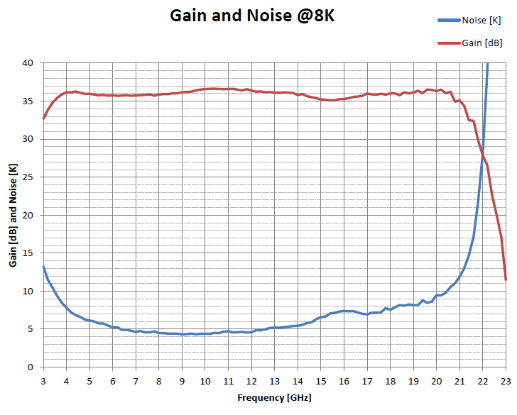
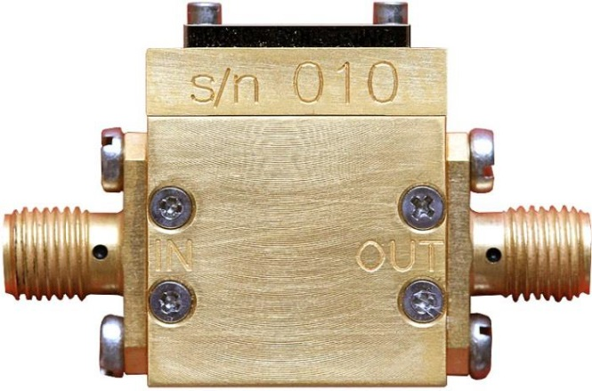
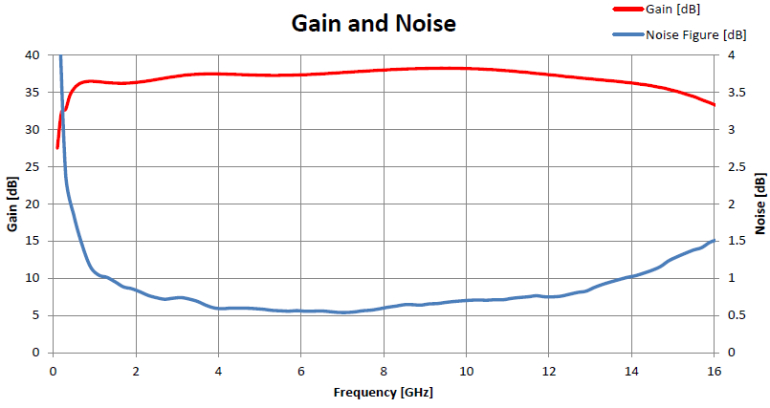
Low-Noise Amplifiers
2 different devices
(Low Noise Factory,
Chalmer University)
Same characteristics @ RT
but 1 is for cryo temperatures
cannot significantly reduced
(Nature Materials Nov. 10, 2014
6-20 GHz Cryogenic Low Noise Amplifier, 5K @ 8-10K
1-15 GHz Low Noise Amplifier, 75K @ RT
© Low Noise Factory

Slide 9
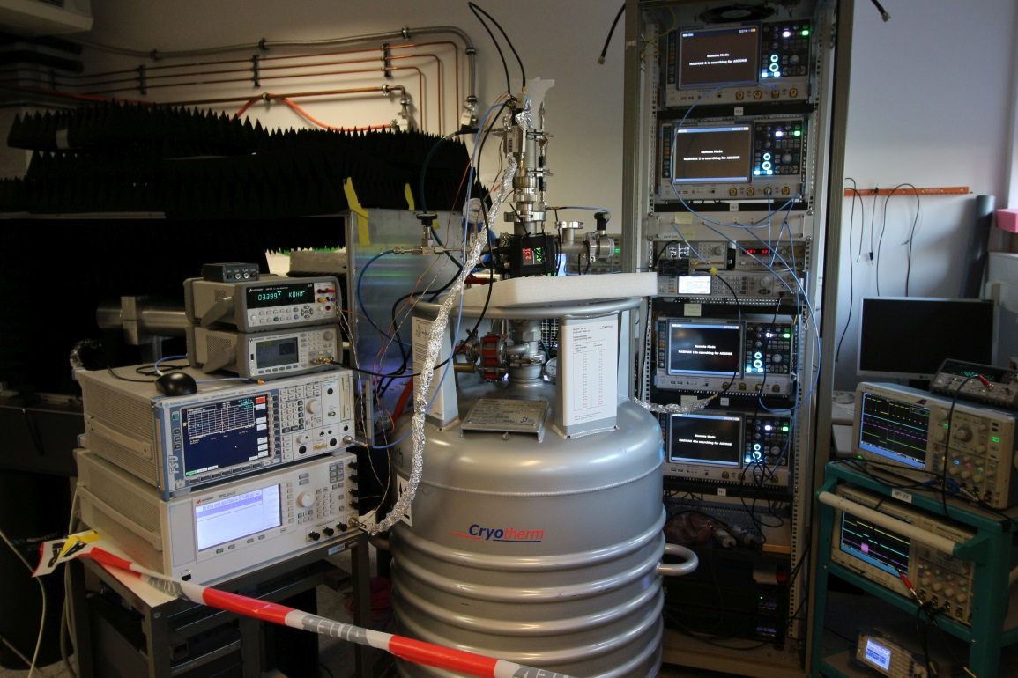
Heterodyne Detection
Her the reality is a little bit more complicated!
(FT-analysis)
Lab system:
Signal analyzer
(4 samplers, 1.4% dead time)
Front end mixers and amps
Fake axion
LHe bath → 4K T_{He} + 5.5K T_{Amp} = 9.5K T_{Sys}

Slide 10
Heterodyne Detection: First Cold Test
Inject fake axion signal with 1.2.10⁻²² W at LHe temp.
  Frequency: 18.85 GHz
  Frequency modulated with gaussian noise
  Signal bandwidth: 8 kHz, Lorentz-shaped

Slide 11
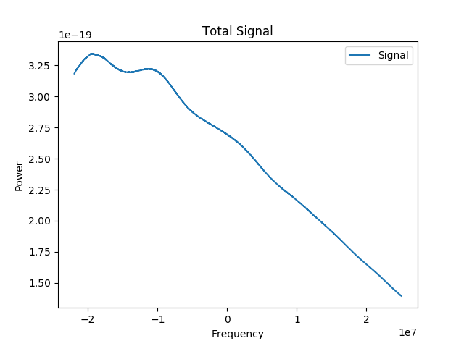
Heterodyne Detection: First Cold Test
Inject fake axion signal with 1.2.10⁻²² W at LHe temp.
  Frequency: 18.85 GHz
  Frequency modulated with gaussian noise
  Signal bandwidth: 8 kHz, Lorentz-shaped
  Received signal after
  28h measurement
  (averaged signal):

Slide 12
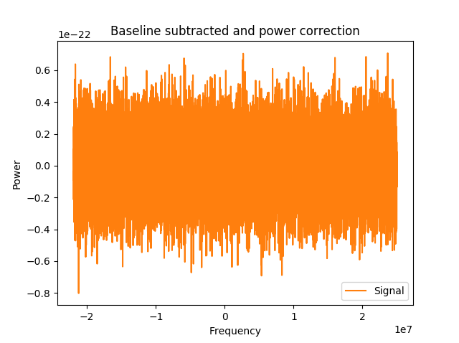
Heterodyne Detection: First Cold Test
Inject fake axion signal with 1.2.10⁻²² W at LHe temp.
  Frequency: 18.85 GHz
  Frequency modulated with gaussian noise
  Signal bandwidth: 8 kHz, Lorentz-shaped
  Received signal after
  baseline subtraction
  and gain correction:

Slide 13
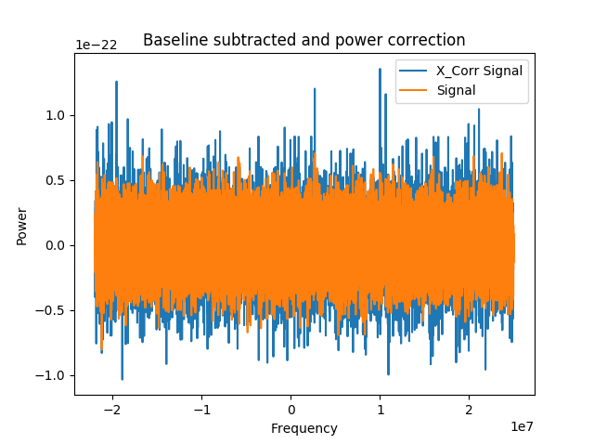

Heterodyne Detection: First Cold Test
Inject fake axion signal with 1.2.10⁻²² W at LHe temp.
  Frequency: 18.85 GHz
  Frequency modulated with gaussian noise
  Signal bandwidth: 8 kHz, Lorentz-shaped
  X-Correlation signal
  with 8kHz width:
  s: Signal
  T: Testfunction
  (Lorentz, Gauss, …)
Highest peak

Slide 14
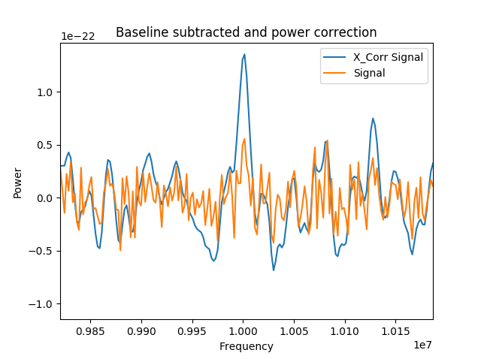
Heterodyne Detection: First Cold Test
Inject fake axion signal with 1.2.10⁻²² W at LHe temp.
  Frequency: 18.85 GHz
  Frequency modulated with gaussian noise
  Signal bandwidth: 8 kHz, Lorentz-shaped
  X-Correlation signal
  with 8kHz width (Zoom):

Slide 15
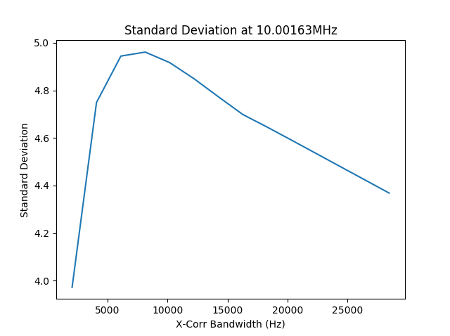
Heterodyne Detection: First Cold Test
Inject fake axion signal with 1.2.10⁻²² W at LHe temp.
  Frequency: 18.85 GHz
  Frequency modulated with gaussian noise
  Signal bandwidth: 8 kHz, Lorentz-shaped
  Why 8kHz Bandwidth?
  Algorithm is searching
  for best S/N-ratio:

Slide 16

Heterodyne Detection: First Cold Test
Inject fake axion signal with 1.2.10⁻²² W at LHe temp.
  Frequency: 18.85 GHz
  Frequency modulated with gaussian noise
  Signal bandwidth: 8 kHz, Lorentz-shaped
  Why 8kHz Bandwidth?
  Algorithm is searching
  for best S/N-ratio:
Best Filter in Hz
Bin #
Peak Freq. in Hz
X-corr. S/N
Signal #

Slide 17
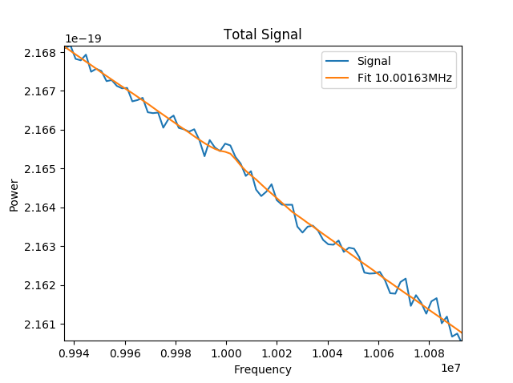
Heterodyne Detection: First Cold Test
Inject fake axion signal with 1.2.10⁻²² W at LHe temp.
  Frequency: 18.85 GHz
  Frequency modulated with gaussian noise
  Signal bandwidth: 8 kHz, Lorentz-shaped
  Signal +
  Lorentz-fit (8kHz):

Slide 18
Additional Facts:
Comparison with Allen’s run statistic algorithm showed good agreement
Cold tests are ongoing
  5.10⁻²³ W in 10kHz linewidth already reached
  within one week in 10K T_{sys} (Physical limit)
  Different tests runs should give a clearer insight to possible problems (quantization noise, …)

Slide 19
Conclusion
Receiver concept is OK
  Dead time 1,4%
  Sensitivity in warm and cold is OK
Next Tests:
  Systematic cold measurements
  Better Antenna measurements
  Cold background measurements in cryostat

Slide 20
Appendix

Slide 21
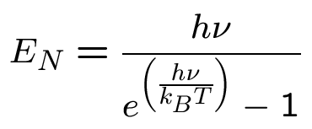
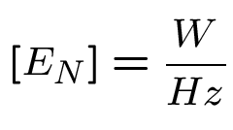
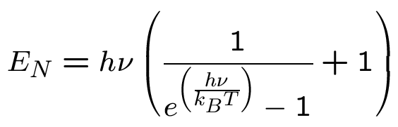

Spectral Power Density of (BB)-Noise
Contribution of a detector:
(no phase preservation)
Contribution of an amplifier or mixer:
(phase preservation)
Limit for low frequencies and/or high temperatures:
Noise temperature

Slide 22
Spectral Power Density of (BB)-Noise
Example:
  Spectral power density for different temperatures
400 K
Amplifier, Mixer
100 K
E_{N}(W Hz⁻¹)
10 K
Detector
100 K
1 K
“Quantum limit”
Frequency (Hz)

Slide 23


Noise Equivalent Power
System noise temperature T_{Sys} and bandwidth Δf_{F} are difficult to measure for broadband detectors
  Johnson noise
  Phonon-electron coupling
  Generation-recombination noise
  Background noise
  …
→ Using noise equivalent power (NEP):
Sometimes a little bit different NEP definitions are used, most of them have factor 2 or 2^{½} included
(Because of 2 polarizations or time to bandwidth conversion)

Slide 24
Broadband detectors
Types of broadband detectors
  Bolometers
  Microwave kinetic inductance detector (MKID)
  Double quantum well detectors
  Transition edge sensors (TES)
Usually they work good only at higher frequencies
(> 50 … 100 GHz)
Often the devices are background limited
  Example:
  Background temperature 300 K, bandwidth 50 GHz
  → NEP = 9.2 10⁻¹⁶ W Hz^{-½}
Temperature and bandwidth can be reduced, but then again the other noise sources start to dominate (see later)!

Slide 25
Comparison: Heterodyne ↔ Direct Det.
Noise equivalent power of a heterodyne system:
NEP (W Hz^{-½})
State-of-the-art
bolometer
Non-existing graphene
bolometer with 10 MHz
coupling bandwidth and
20 mK temperature [1].
Unrealistic!!!
Frequency (Hz)
[1] K.C. Fong and K.C. Schwab, “Ultra-sensitive and Wide Bandwidth Thermal Measurements of Graphene at Low Temperatures“, 2012

Slide 26
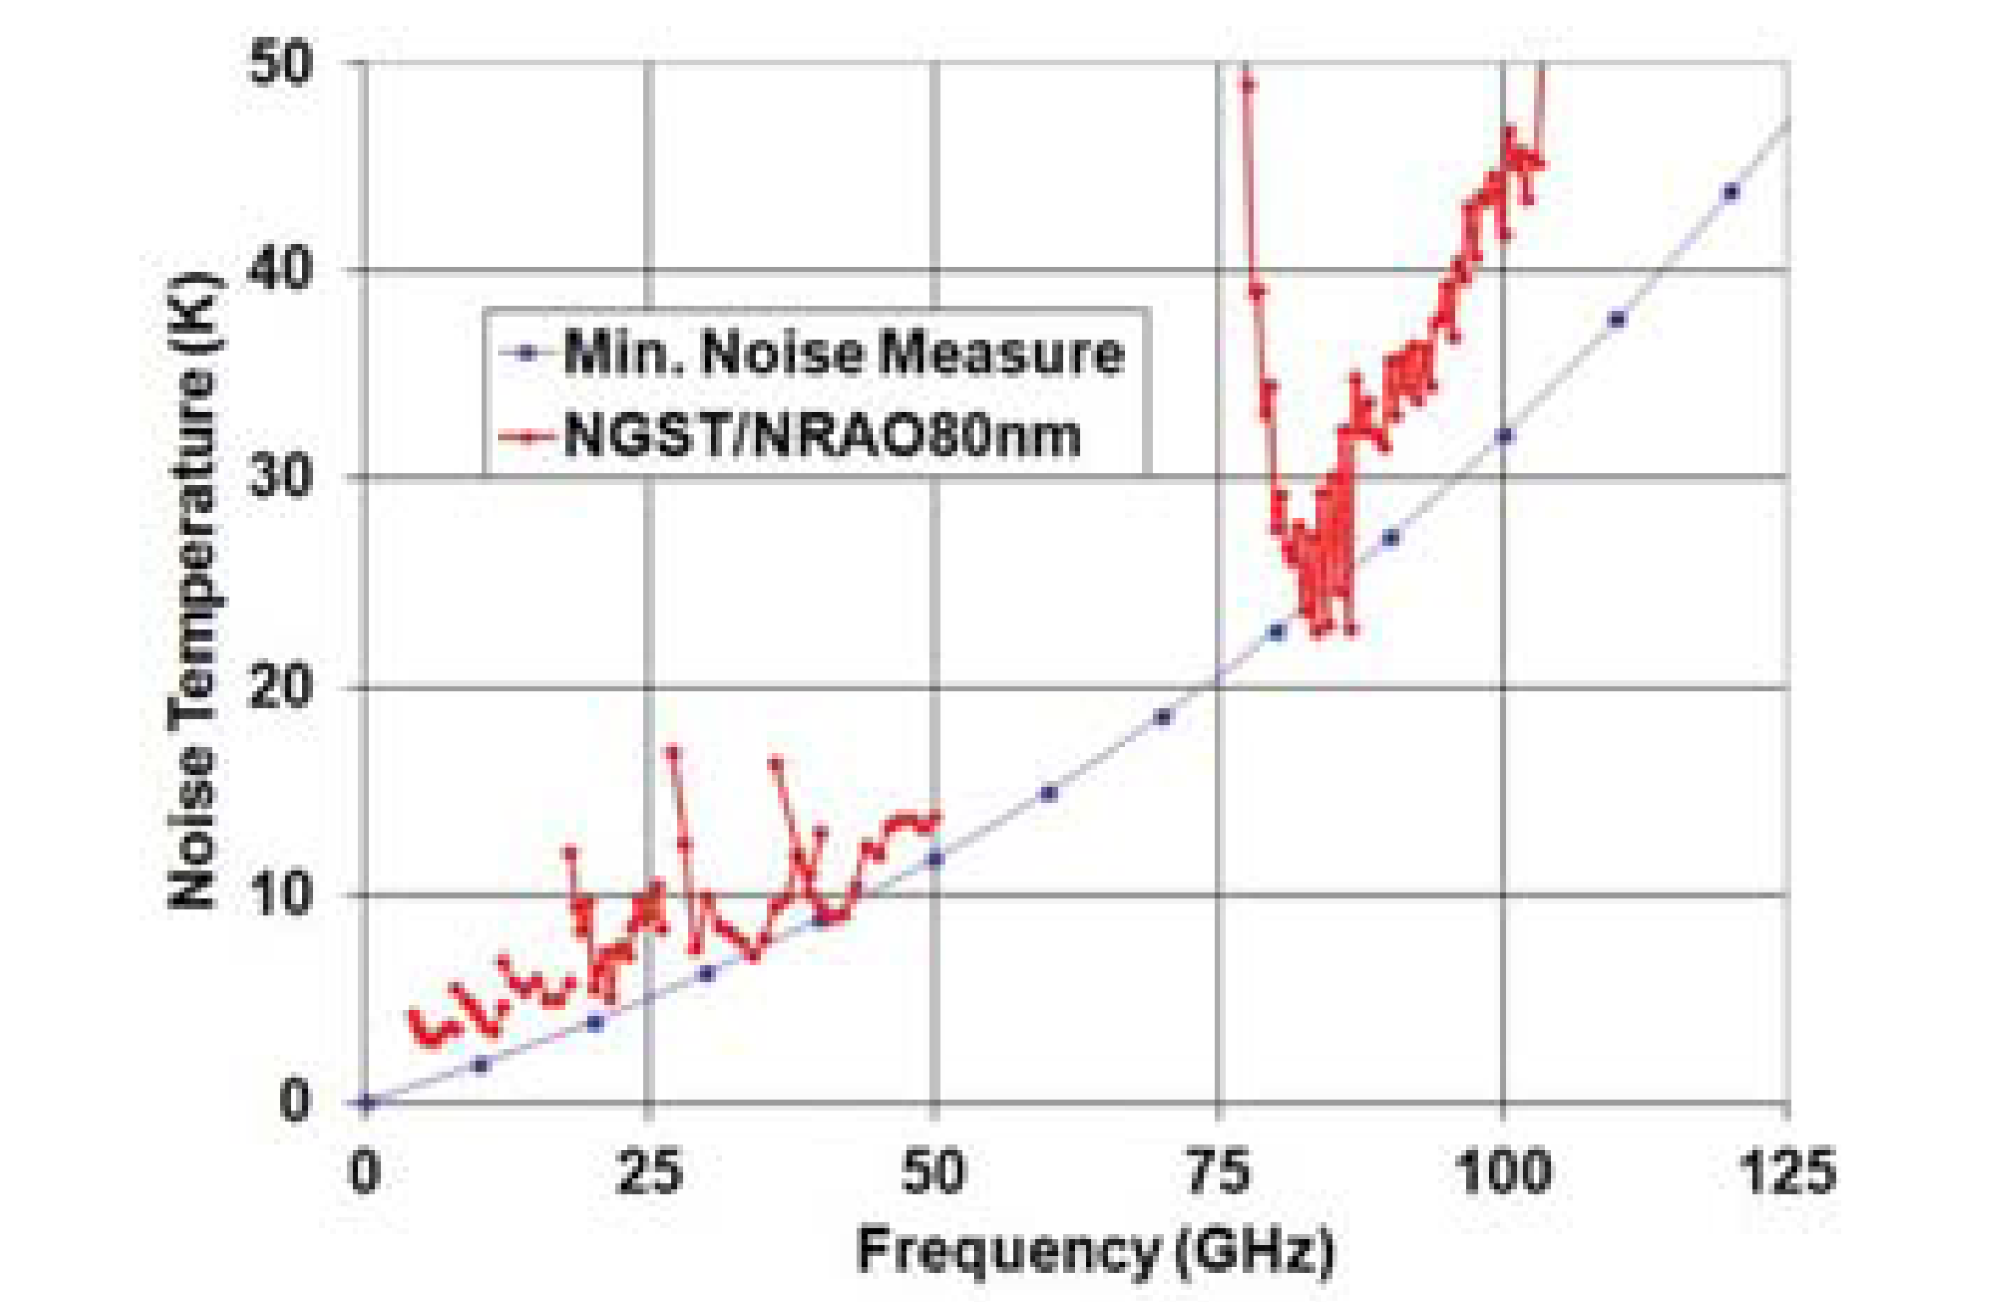
Heterodyne Detection: Real Devices
Noise temperature limit for InP devices:
  Mainly phonon self heating → Inner bulk black body radiator
InP-HFET,
Bryerton et. al.
“Ultra Low Noise Cryogenic Amplifiers for Radio Astronomy”, 2013
Shi, et. al.
A 100-GHz Fixed-Tuned Waveguide SIS Mixer Exhibiting Broad Bandwidth and Very Low Noise Temperature, 1997
InP-HEMT
Our amplifier, LNF

Slide 27
First Cold Measurement
First quick and dirty test:
  Very simple test in LHe-dewar
  Amplifier at LHe-temperature (4.1K)
Gain
Noise temperature
Room for improvement!

Slide 28
Run Optimization
Measurement time vs. analysis threshold level and power boost factor:
  80 disks, LaAlO₃, T_{sys}=8K, effectivity: 75%, 1day adjustment time
days/GHz

Slide 29
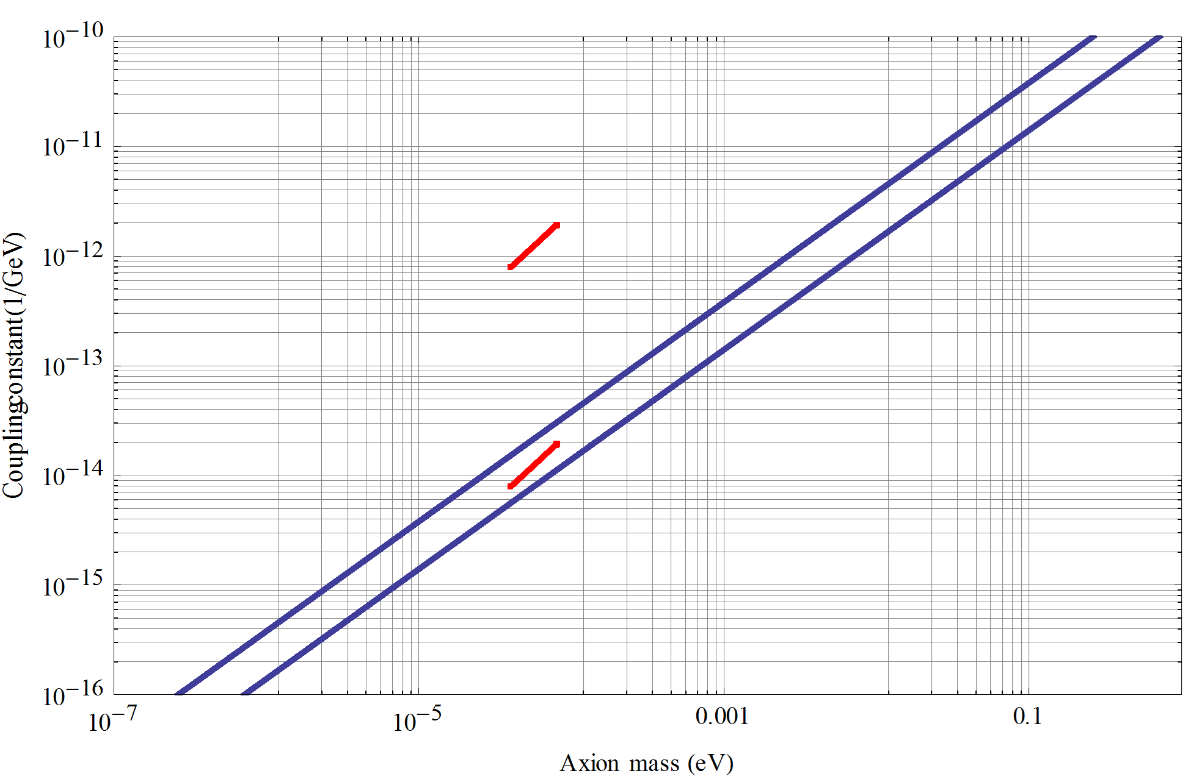
Sensitivity in terms of Axions
  80 disks (LaAlO₃)
  d=1m, B=10 T, τ=200 h, Δν_{A}=10⁻⁶ ν_{A}
  8K amplifier temperature
  4σ detection level
no boost
Scenario II
> 10⁴ boost needed!
QCD Axion DM prediction

Slide 30


Photon Noise Equivalent Power (NEP_{γ})
$E_{γ}=h$ν
Photon energy:
Noise equivalent power
“of a photon”:
n: Mean photon flux (background + signal) in 1/s
$${NEP}_{γ}=h\text{n} \sqrt{2n}$$
Frequency ν | Photon Energy E_{γ} | 1 γ/s = | NEP_{γ} for 1 γ/s
10 GHz | 6.62 10⁻²⁴ J (41.36 µeV) | 6.62 10⁻²⁴ W | 9.4 10⁻²⁴ W Hz^{-½}
20 GHz | 1.33 10⁻²³ J (82.71 µeV) | 1.33 10⁻²³ W | 1.87 10⁻²³ W Hz^{-½}
50 GHz | 3.31 10⁻²³ J (206.8 µeV) | 3.31 10⁻²³ W | 4.69 10⁻²³ W Hz^{-½}
100 GHz | 6.62 10⁻²³ J (413.6 µeV) | 6.62 10⁻²³ W | 9.4 10⁻²³ W Hz^{-½}

Slide 31
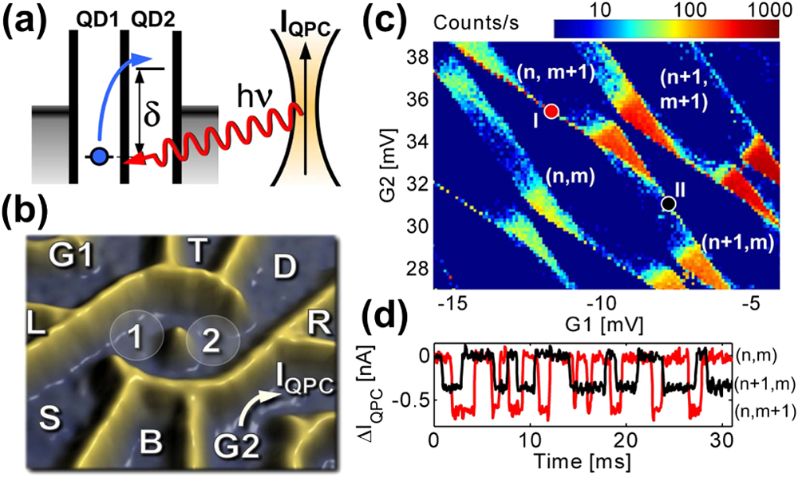
Double quantum dot
Function principle
  Absorption of photon with energy hν
  Electron in QD1 is excited to QD2 (tunneling)
  Electron can leave to drain lead and new electron enters from the source
  Then cycle can be repeated
  Current flow through the system
  δ can be changed by electric field

Slide 32
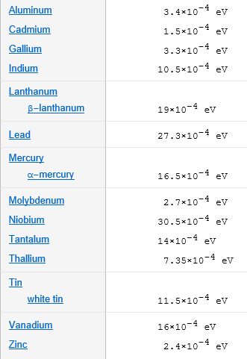
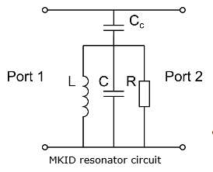
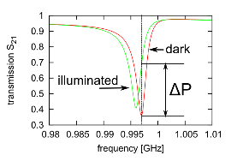
Microwave Kinetic Inductance Detector
Function principle:
  Breaking cooper pairs in a
  superconductor (inductor) by photons
  Stored energy (inner inductance) is
  changed
  Resonance frequency of the resonator
  shifts
Superconducting Gap Energy

Slide 33
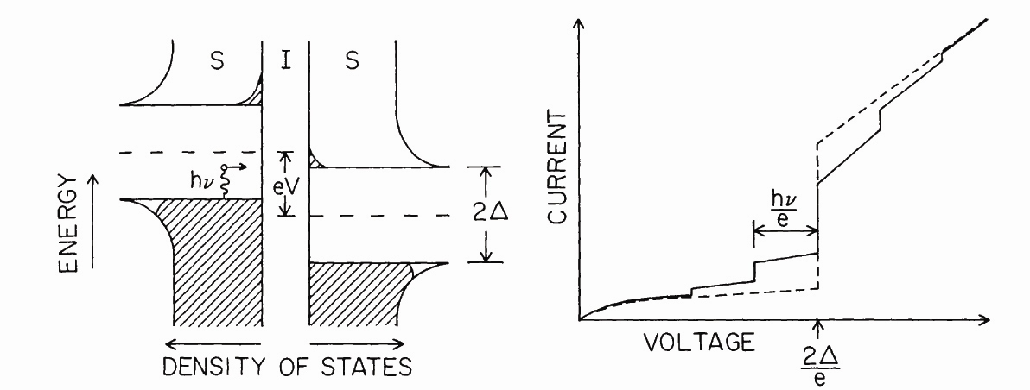
SIS-Mixer (Principle)
Cooper pairs break into quasi-particles and tunnel over the barrier
Using photon assistant tunneling for mixing
Slope of I-V curve has sharp discontinuity: efficient

Slide 34
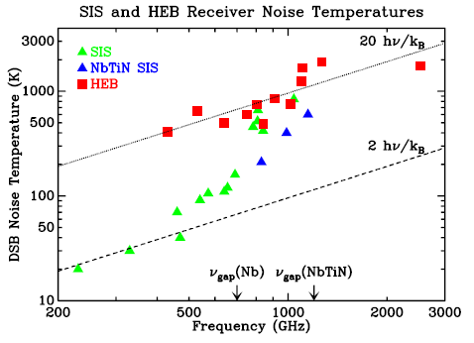
SIS-Mixer (Principle)
Mixer loss -> higher noise temperature
Double-sideband feature -> looking at two frequencies at the same time
J. Zmuidzinas, „COHERENT DETECTION AND SIS MIXERS”, 2002

Slide 35
Heterodyne Detection: First Tests
Detection of a broadband noise signal
  Frequency: 15 GHz
  Linewidth: 200 kHz
  Detection bandwidth: 10 kHz
Modulated signal @ 15 GHz with
0.8 10⁻¹⁹ W in 600 s and 77 K

Slide 36
Heterodyne Detection: First Tests
Real signal:
Detection of a line signal
(Examples)
  Frequency: 15 GHz
  Detection bandwidth: 10 kHz
Signal line @ 15 GHz with
-168,5 dBm (1.4 10⁻²⁰ W or 1421 γ/s)
in 17h @ RT
Signal line @ 15 GHz with
-160 dBm (10⁻¹⁹ W or 10⁴ γ/s) @ RT

