Slide 1
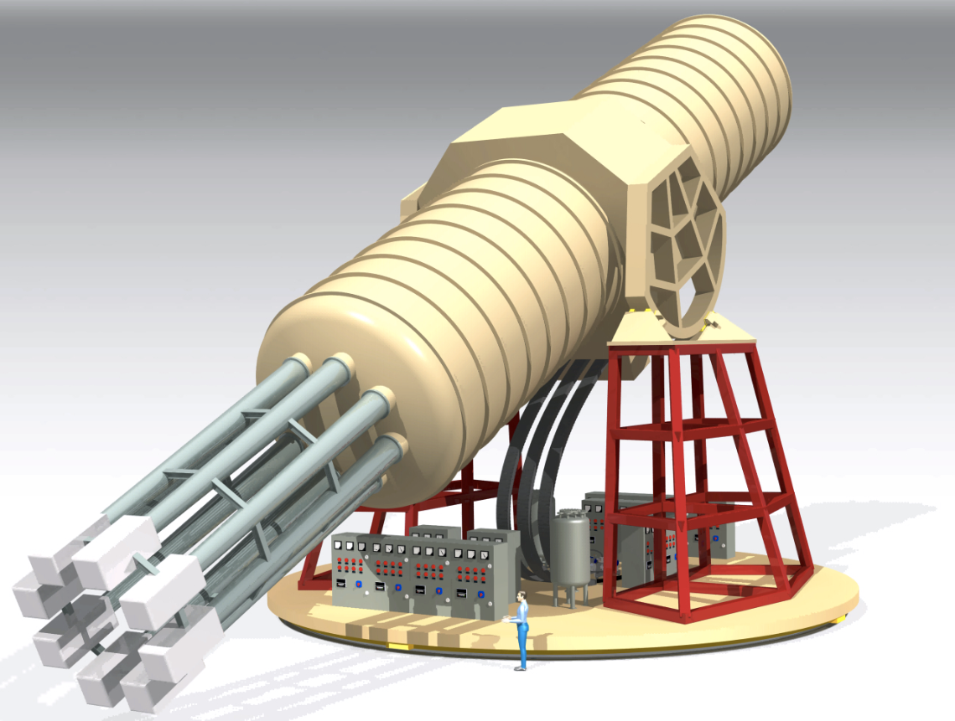

Status and Progress of the International Axion Observatory
Esther Ferrer Ribas
IRFU, CEA-Saclay
MADMAX meeting, Jussieu, Paris, 10 May 2017

Slide 2
IAXO: International AXion Observatory
Baseline search: solar axions
Why are we looking for axions?
  Most elegant solution to explain the apparent symmetry between matter and anti-matter in the strong interactions (CP violation);
  Predicted by SM extensions, neutral, very light, low interacting cross-section;
  Dark matter candidates;
  Astrophysical hints for axion/ALPs?
    Transparency of the Universe to UHE gammas;
    Anomalous cooling of different types of stars;
  Relevant axion/ALP parameter space at reach of current and near-future experiments;
  Still too little experimental effort devoted to axions when compared to WIMP;

Slide 3
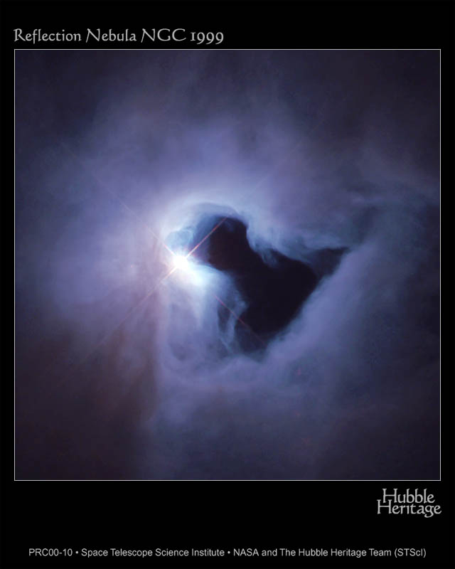
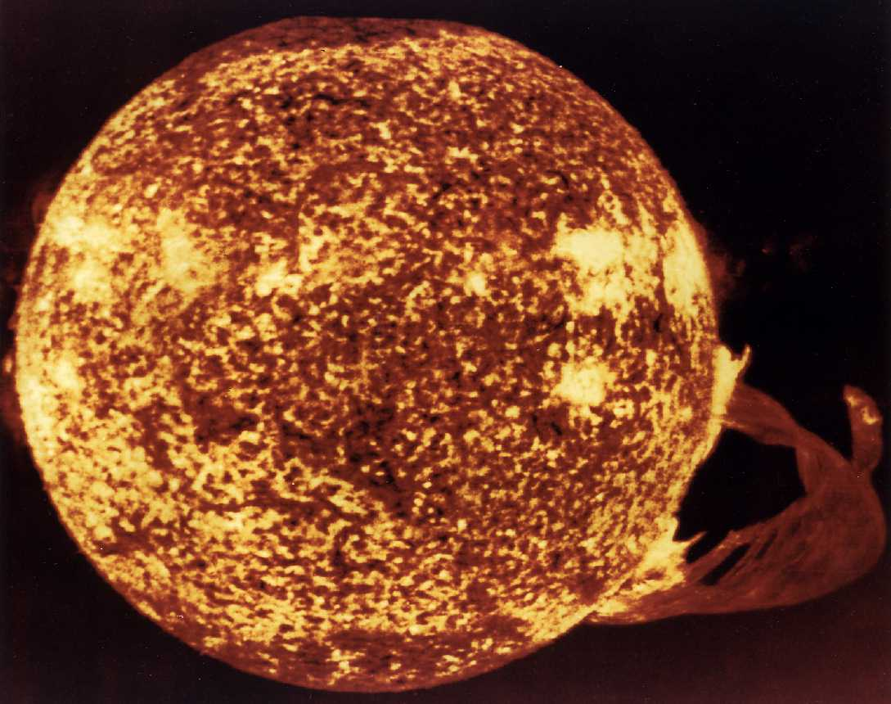
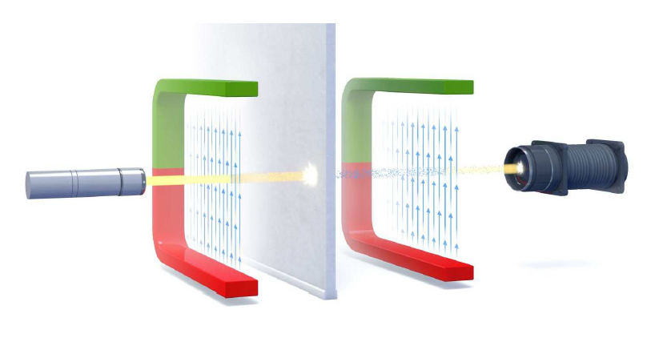
Search strategies
  Axions couple to photons in the presence of a magnetic field in all models.
Relic Axions
  Axions that are part of galactic dark matter halo:
    Axion Haloscopes (ADMX)
Solar Axions
  Emitted by the solar core.
    Axion Helioscopes (CAST → IAXO)
    Crystals
Axions in the laboratory
    “Light shinning through wall” experiments

Slide 4
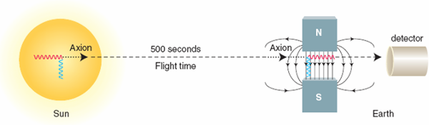
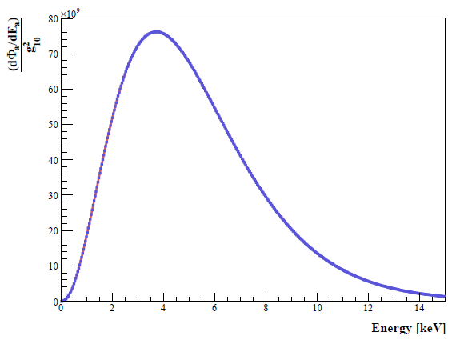
Helioscope Physics
Sikivie, Phys. Rev. Lett 51 (1983)
Production in the Sun
Conversion of thermal photons into axions via Primakoff effect in the solar core
Detection in the helioscope
Conversion of axions into photons via the inverse Primakoff effect in a strong magnetic field
Expected number of photons:
≈ 0.3 evts/hour
with g_{aγ}= 10⁻¹⁰ GeV⁻¹ and A = 14 cm²

Slide 5
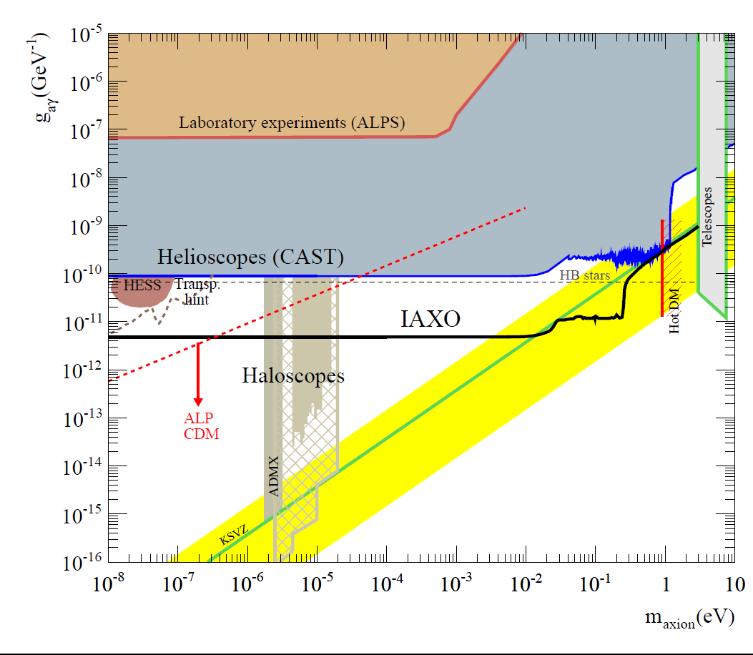
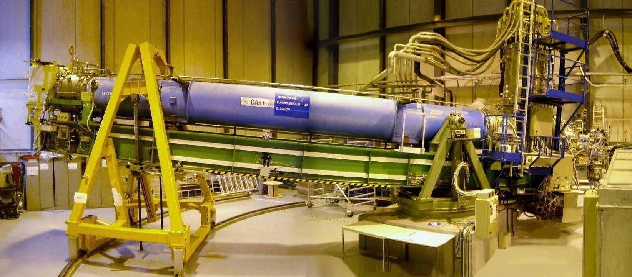
CAST: CERN Axion Solar Telescope
LHC dipôle : L = 9 m, B = 9 T
Rotating platform to follow the sun
2003 – 2004 | CAST phase I: vacuum in the magnet bores
2006 | CAST phase II - ⁴He Run: axion masses explored up to 0.39 eV (160 P-steps)
2007 | ³He Gas system implementation
2008 - 2011 | CAST phase II - ³He Run axion masses explored up to 1.17 eV bridging the hot dark matter limit
2012 | Revisit 4He Run with improved detectors
2013-2015 | Revisit vacuum phase with improved detectors Final QCD axion results
The axion has not been observed➔ limit on the coupling constant
Best world-wide limit for a wide range of masses
CAST Coll., JCAP 0704(2007) 010
CAST Coll., PRL (2005) 94, 121301
CAST Coll., JCAP 0902 (2009) 008
CAST Coll, PRL (2011) 107 261302
CAST Coll., Phys. Rev. D92 (2015) no2, 021101
CAST Coll, Nature Physics (2017) doi:10.1038/nphys4109

Slide 6
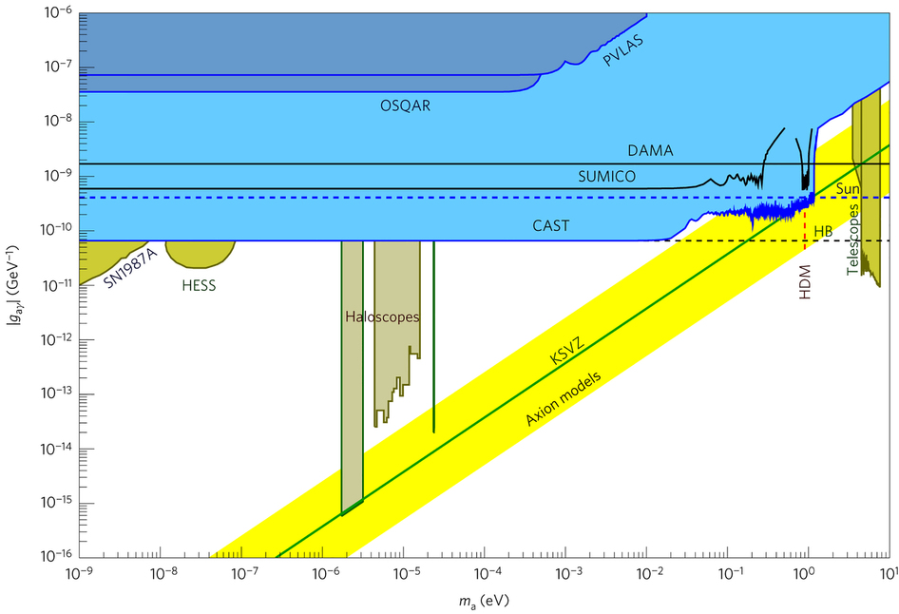
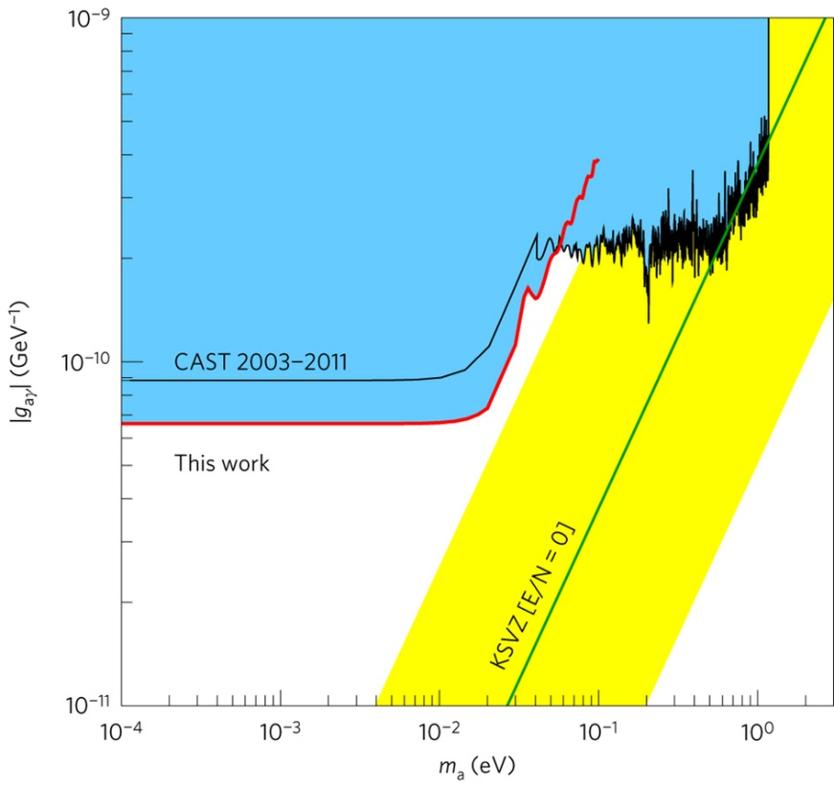
CAST Coll, Nature Physics (2017)

Slide 7
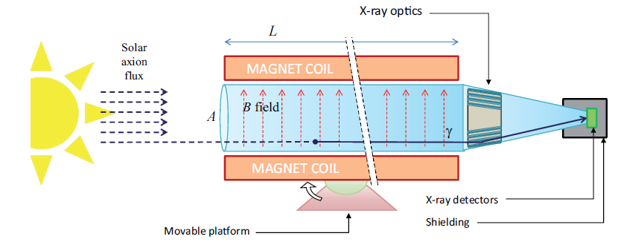
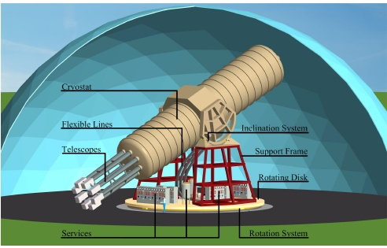
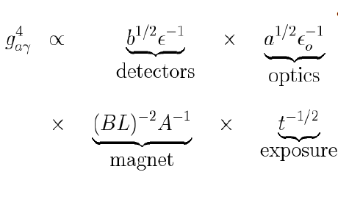
IAXO concept
No technology challenge (built on CAST experience)
  New dedicated superconducting magnet
  Use of X-ray focalisation over ~m² area
  Low background detectors (improve bck by 1-2 orders of magnitude)
8 coil magnet L= 20 m
8 bores: 600 mm diameter each
8 X-rays optics + 8 detection systems
Rotating platform with services
Goal: in terms of signal to background ratio 4-5 orders of magnitude more sensitive than CAST, which means sensitivity to axion-photon couplings down to a few ×10⁻¹² GeV⁻¹
I. Irastorza et al., JCAP 06 (2011) 013
E. Armengaud et al., JINST 9 (2014) T05002

Slide 8
IAXO Sensitivity
Transparency ALP hints
Accesible to IAXO & ALPS-II
Few meV scale QCD axion & anomaly cooling hints
accessible to IAXO

Slide 9
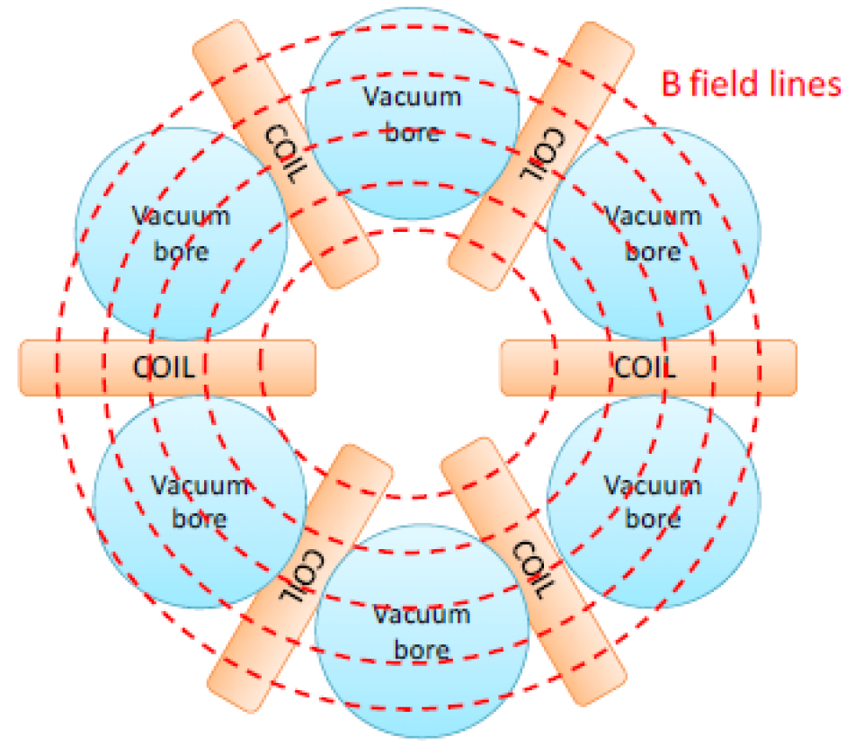
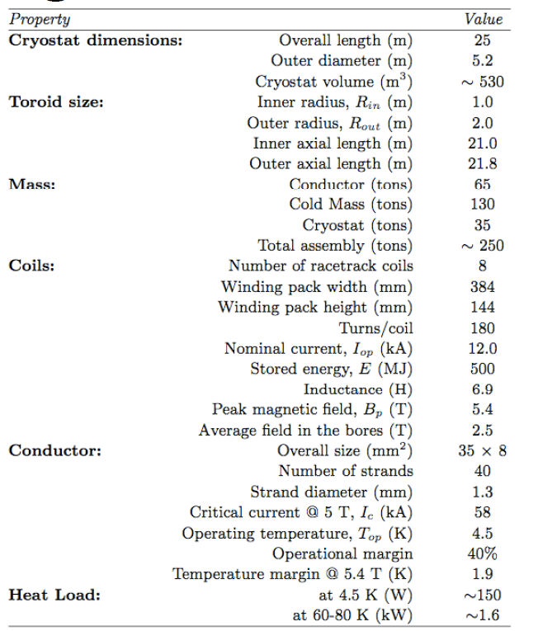
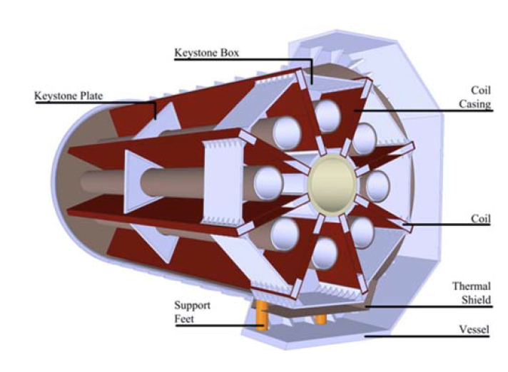
IAXO magnet
Optimised configuration: TOROIDAL with 8 bores 25 m long, 5 m diameter and a peak field of 5.4 T
Shilon et al. IEEE T. Ap. SupCond 23:4500604 (2013)
Shilon et al. AIP Conf. Proc. 1573:1574 (2014)
Shilon et al. IEEE T. Ap. SupCond 24:4500104 (2014)
(ATLAS toroid 26 m long, 20 m diameter, peak field 3.9 T)

Slide 10
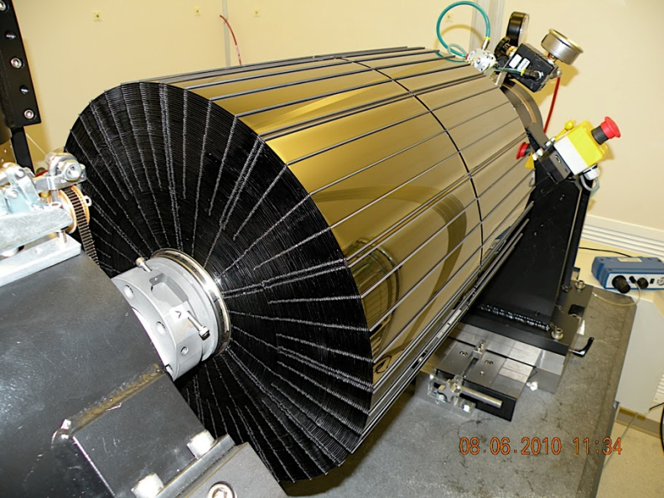
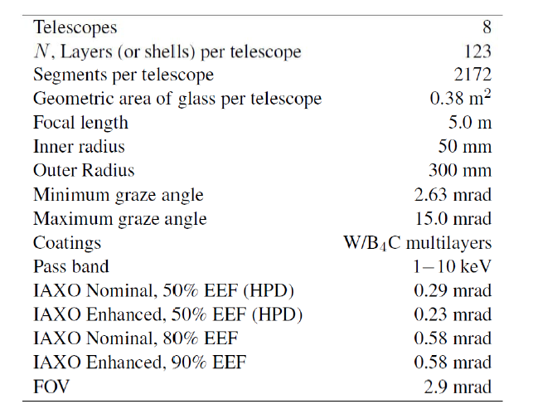
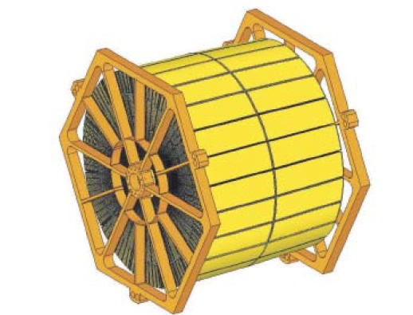
IAXO x-ray optics
Baseline : Use approach NASA’s NUSTAR satellite
Each bore equipped with an X-ray optics
8 systems of 600 mm diameter each
Specifications:
  Refined imaging not needed
  Need to cover large area (cost-effective)
  Good throughput (0.3-0.5)
  Small focal point (~1 cm²)
Jakobsen et al. Proc SPIE 8861:886113 (2013)

Slide 11
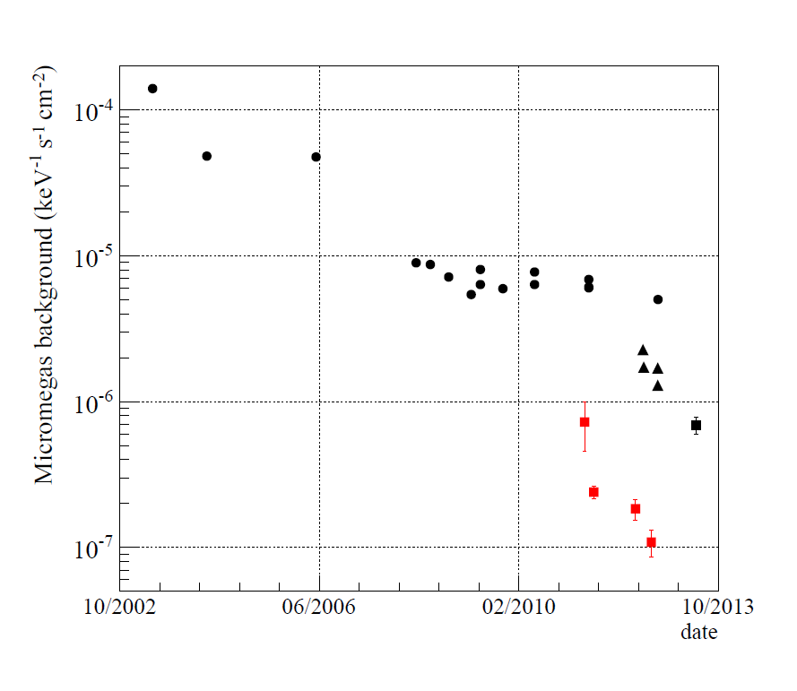
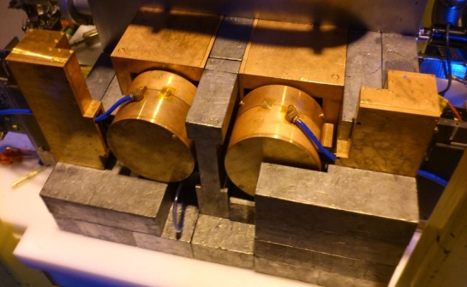
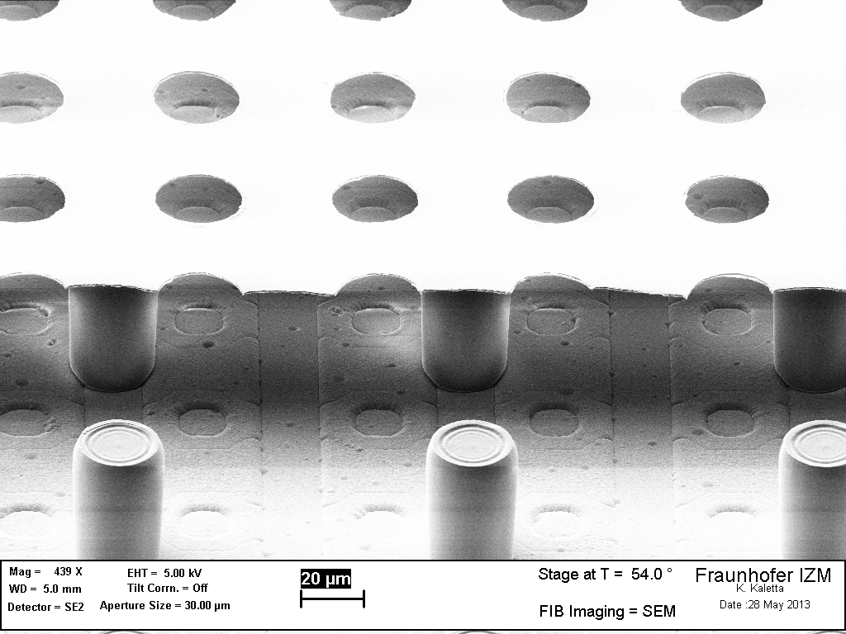
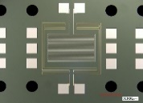
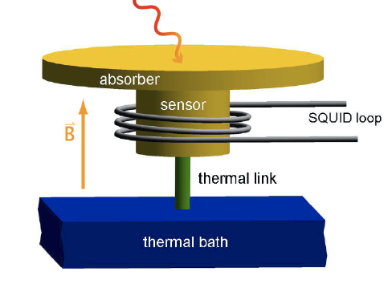
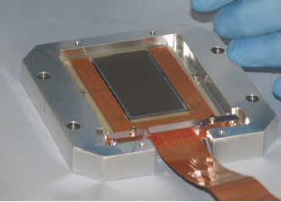
IAXO low background detectors
  Baseline: Micromegas detectors
  Goal: below 10⁻⁷ c/keV/s/cm²
Key elements:
Radiopure components
Shielding
Offline discrimination
Underground data
With optimised shielding
IAXO goals
IAXO Pathfinder system at CAST 2014-2015:
last generation of Microbulk detectors + optimised shielding + Xray telescope IAXO pathfinder ➔ CASTMM 2014 : 0.85 x 10⁻⁶ c/keV/s/cm²
S. Aune et al., JINST 9 (2014) 9 P01001
F. Aznar et al., JCAP 12 (2015) 9 008
Micromegas are the base-line for IAXO but additional technologies, Ingrid Micromegas, TES, MMC, CCD will also show their potential in the coming years

Slide 12
IAXO status of project
2011: First studies Irastorza et al. JCAP (2011) 1106:013
ASPERA/APPEC Roadmap acknowledges axion physics, CAST and recommends progress towards IAXO (C. Spiering Krakow 2012)
IAXO is also present in US roadmapping (Snowmass and P5 process) (december 2013)
2013: Conceptual Design: Armengaud et al. JINST 9 (2014) T05002
August 2013: Letter of Intent submitted to the CERN SPSC [CERN-SPSC-2013-022]
January 2014: Recommendations of CERN SPSC
2014-15: Transition phase towards TDR (technical design)
  Some IAXO preparatory activity already going on as part of CAST near term program: IAXO pathfinder system in CAST in 2014-15
  Preparation of a MoU to carry out TDR work.
  Strengthen collaboration, awareness actions, meetings, coordinated funding applications
  First discussion on long-term plan to construction
2017: Formal constitution of collaboration
  “Founding” IAXO collaboration meeting to happen 3-4th July 2017, DESY

Slide 13
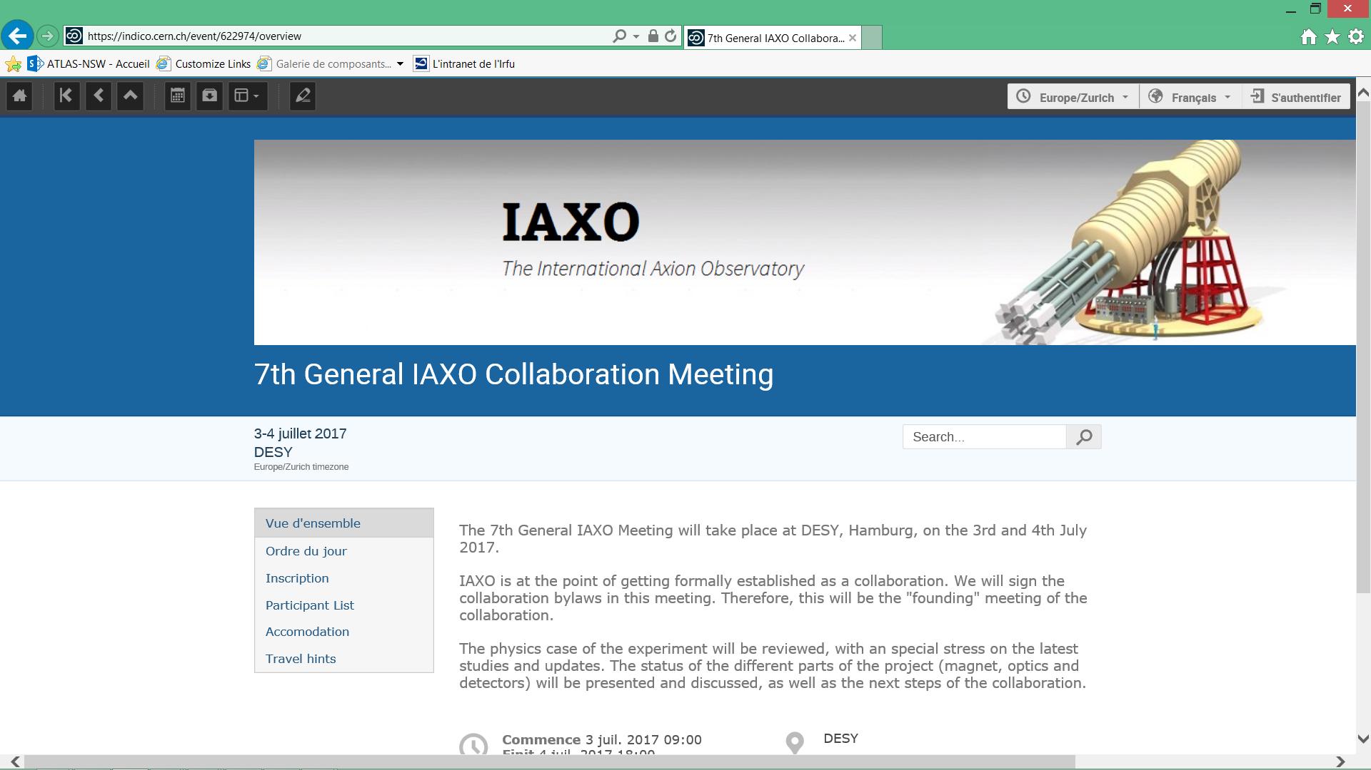
“Founding” IAXO collaboration 3-4th July: You are all welcome!!

Slide 14
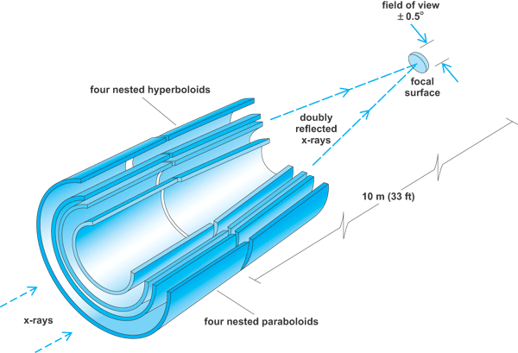
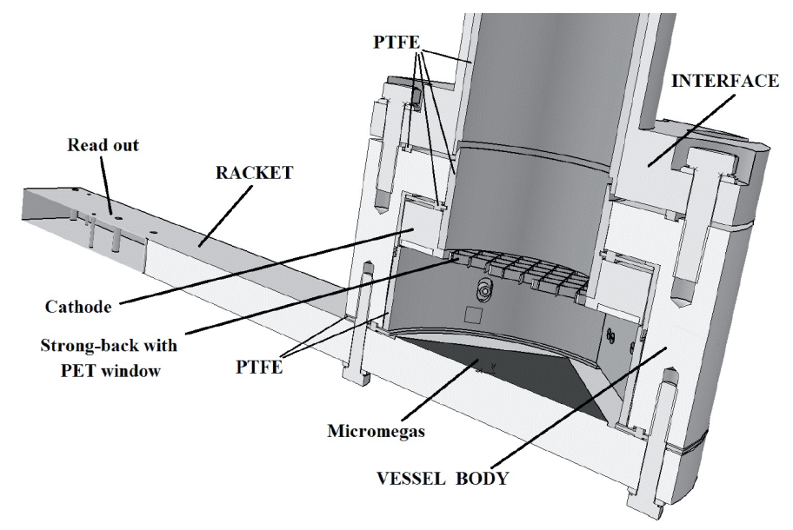
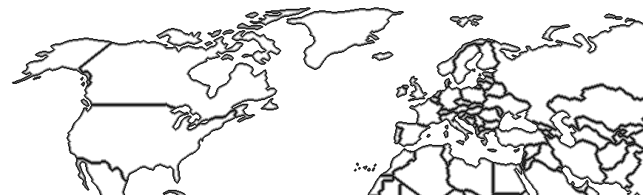
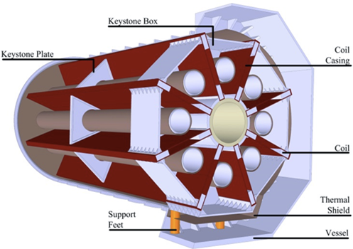
IAXO proto-collaboration
Big effort to strengthen collaboration → large consortium involved in a number of funding applications, covering all TDR needs
Zaragoza (Spain)
CEA-Saclay (France)
Mainz (Germany)
Bonn (Germany)
Heidelberg (Germany)
INR-Moscow (Russia)
LLNL
Columbia
MIT
INAF-Milano (Italy)
DTU (Denmark)
RBI (Croatia)
DESY (Germany)
U. Hamburg (Germany)
U.Valencia (Spain)
U. Cartagena (Spain)
INFN-Frascati, (Italy)
U. Barry
S. Carolina
+ …
CERN
CEA/Saclay (France)
New partners welcome…
(*) Only shown groups for which formal activity is ongoing or under discussion/preparation.
Potentiaal interest in more groups than shown

Slide 15
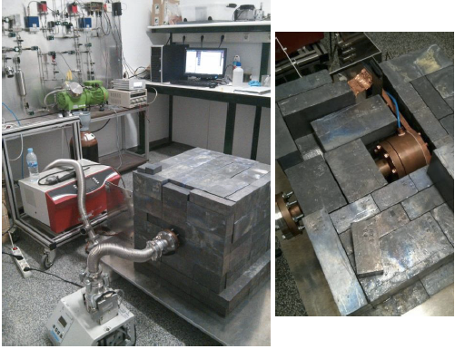
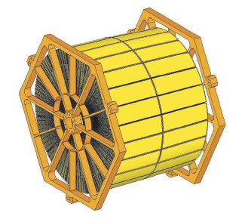
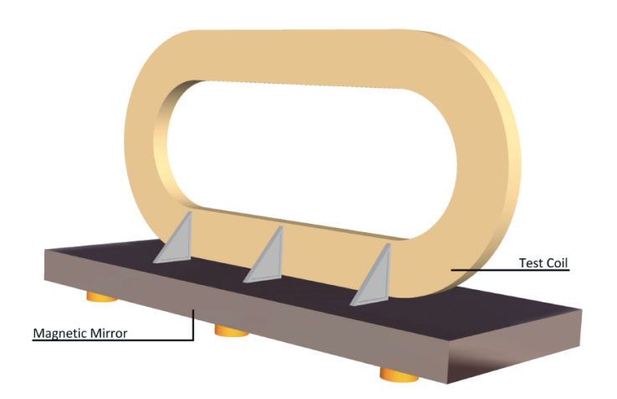
IAXO TDR baseline plans
IAXO-T0: demonstration coil magnet
IAXO-X0: prototype x-ray optics
IAXO-D0: prototype low background detector setup testing different technologies for detector
Studies to refine IAXO physics case
Additional physics potential (DM options)
Site studies
Consolidate and structure collaboration
IAXO-D0 Micromegas
IAXO-X0
IAXO-T0

Slide 16
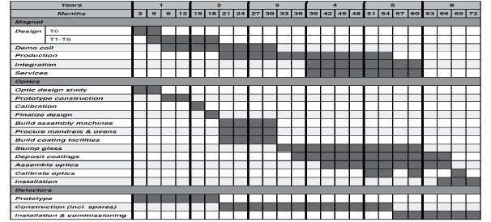
IAXO timeline
Construction
~ 2.5 years
Integration +
commissioning
~ 2.5 years
TDR:
~ 18 months

Slide 17
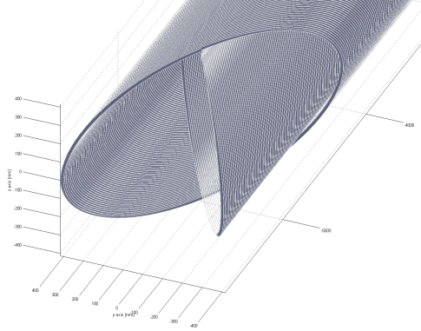
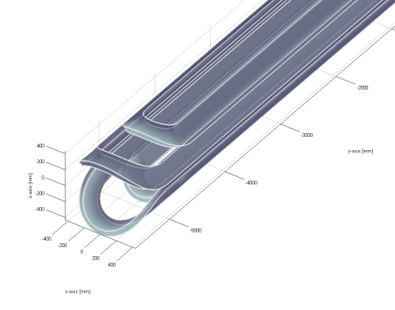
Extended TDR (→Mini-IAXO / BabyIAXO concept)
Alternative magnet designs
  Pros: higher FOM with less conductor, modularity
  Cons: higher risk → need intermediate demonstrating magnet prototype
BabyIAXO concept:
  Test magnet design at relevant scale (only 1 bore full diameter)
  Test bench for optics + detector
  Will deliver relevant physics (at intermediate level)
Will better mobilize community & increase interest
Better (and more staged) access to funding
Effect on near-term planning under study
Single 60-cm bore
Several conductor
configurations
under consideration

Slide 18
Conclusions and next steps
Axion searches→ strong physics case
Increasing experimental effort in the different axion searches strategies: solar axions, relic axions, laboratory axions…
CAST has been a very important milestone in axion research during the last decade
IAXO can probe deep into unexplored axion-ALP parameter space
IAXO could become next large project & a generic axion facility with discovery potential in the next decade
Need to continue with TDR & preparatory activities, formal endorsement & resources finding
MiniIAXO / BabyIAXO → new concept that can
  Enhance final FOM of experiment
  Catalize near-term activities in the collaboration towards an intermediate experiment with relevant physics outcome
Exciting work in front us: join us!

Slide 19
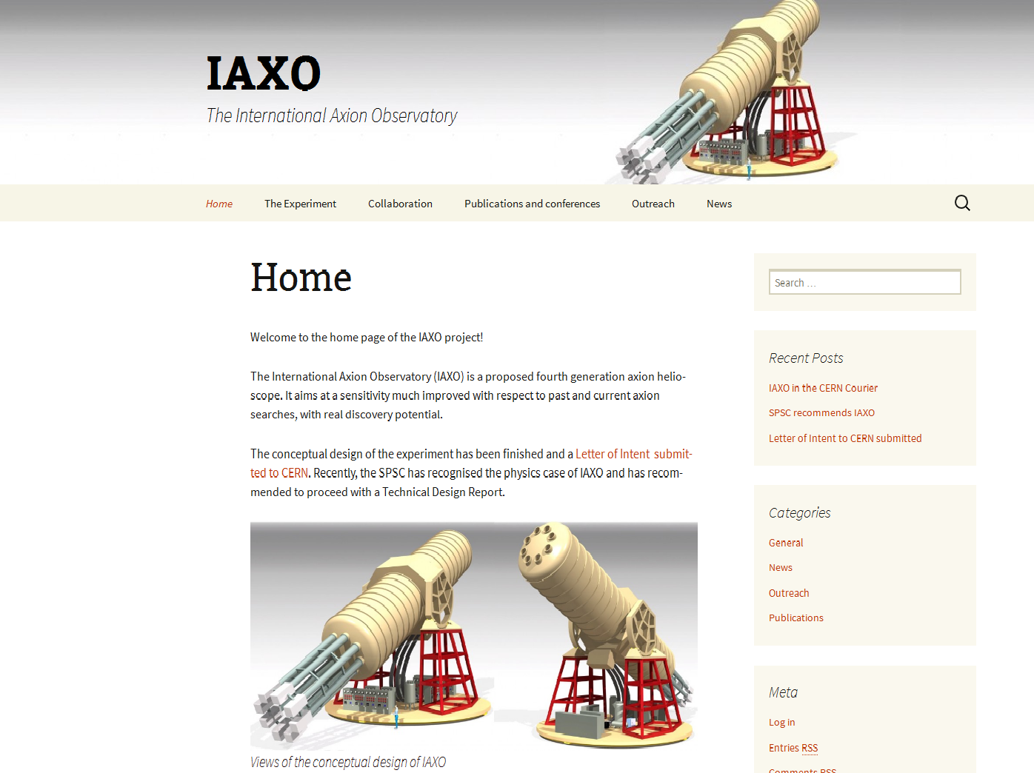
http://iaxo.web.cern.ch/iaxo/

Slide 20
IAXO Collaboration
~80 authors

Slide 21
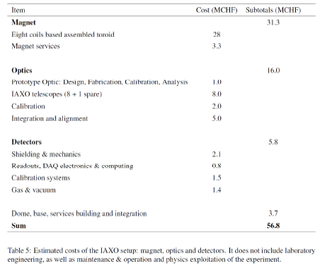
IAXO costs

Slide 22
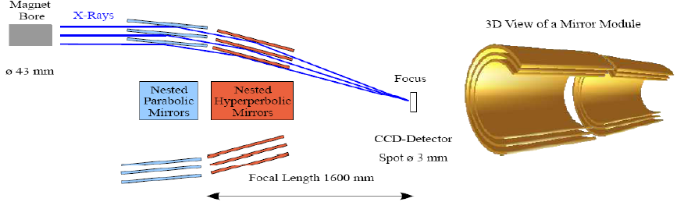
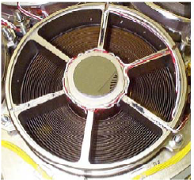
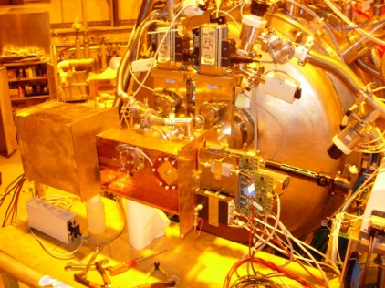
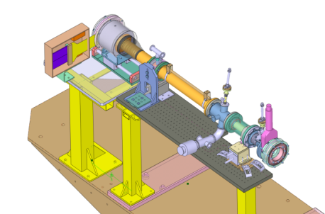
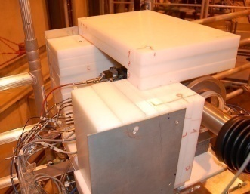
Originalities of CAST
Use of X-ray telescope ➔ increase S/B noise➔ sensitivity improved by a factor 150 by focusing a ø43 mm x-ray beam to ø3mm
Low background techniques➔ shieldings, low radioactive materials, simulation and modeling of backgrounds….

Slide 23
The WISPs zoo
Weakly Interacting Sub-eV Particles
(WISPs)
Axion Like particles
(ALPs)
Hidden Photons (HPs)
Stringy axion
Arion
Majoron
Mini Charged Particles
Axions
Chameleons
g_{aγ} and m_{a} are two independent “phenomenological” parameters

