Slide 1
COST Action CA15213 - Theory of hot matter and relativistic heavy-ion collisions
3rd Action Meeting
Cassia Azevedo – Paris – 10/11/2017

Slide 2


Content
1
News from COST
2
Status of the Action
3
Reimbursement Rules
4
Claims submission
5
Communication with COST Association

Slide 3

News from COST

Slide 4
Payment of the Grant
3rd payment
15%
2nd payment
35%
No carry over
of unspent funds
Sa1 1st payment
50%

Slide 5
STSM – Specific Provisions
Researchers from a Participating Inclusiveness Target Country (ITC)*:
50% of the grant upon completion of the 1st day
*Bosnia and Herzegovina, Bulgaria, Croatia, Cyprus, Czech Republic, Estonia, fYR Macedonia, Hungary, Latvia, Lithuania, Luxembourg, Malta, Montenegro, Poland, Portugal, Romania, Serbia, Slovakia, Slovenia, Turkey

Slide 6
ITC Conference Grants
PhD students and Early Career Investigators (ECI) with affiliation in a Participating Inclusiveness Target Country (ITC)
At least oral/poster presentation
Listed in the official programme
Pre-Approval by the MC

Slide 7
ITC Conference Grants – Financial Support
Maximum EUR 160 per day for accommodation and meals
Maximum EUR 2500 (including conference fees up to EUR 500)
Scientific report approved before payment

Slide 8
COST Branding for Dissemination
Reference: www.cost.eu/media/visualidentity
  New COST Logo
  EU Emblem
  Accompanying text
To be used for:
  Action website
  Promotional materials
  Publications
  Final Action Dissemination

Slide 9

MC Decisions
MC MEETINGS
WRITTEN PROCEDURE / E-VOTE
Initiated by MC Chair
All MC members
Vote open (7 days)
Majority vote with one vote per Participating COST Full Member/COST Cooperating Member
MC decision sent to COST Association and included in minutes of next MC Meeting
2/3 of Participating COST Full Members/COST Cooperating Member
Majority vote with one vote per Participating COST Full Member/COST Cooperating Member
MC decision minuted and sent to COST Association

Slide 10

COST Networking Tools

Slide 11

Reimbursement Rules

Slide 12
Meetings
Accept or Decline the invitation
Sign attendance list
Submit you claim online with relevant supporting documents
Claim Submission Deadline: 30 days

Slide 13
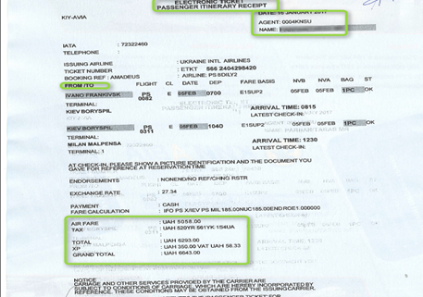
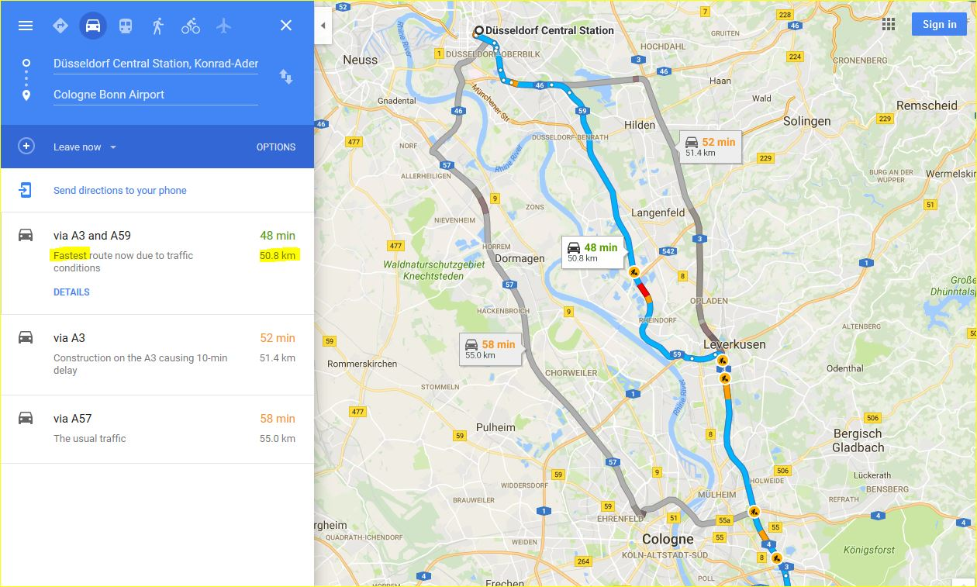

Long distance travel = cross border travel
Car travel expenses:
Maximum distance 2000 km at
  EUR 0.20 per km
  EUR 0.30 per km with 2 or more eligible participants
Proof of distance
Trains, bus and ferry expenses:
First, second and business class
You must submit
invoice / receipts
Flight expenses:
Economy class only
Max EUR 1200
Full travel itinerary
Ticket price
Name of passenger

Slide 14
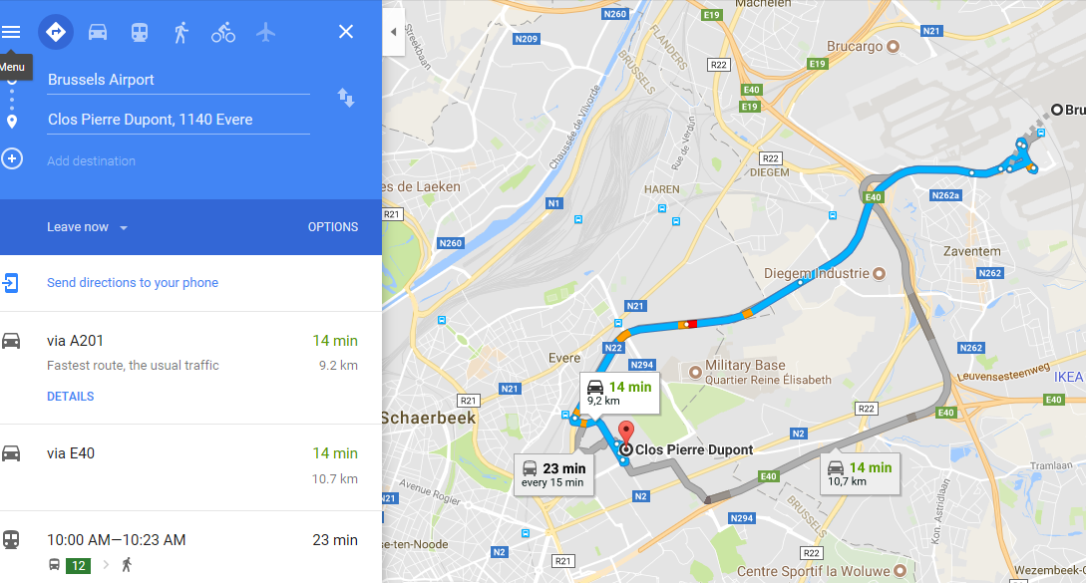
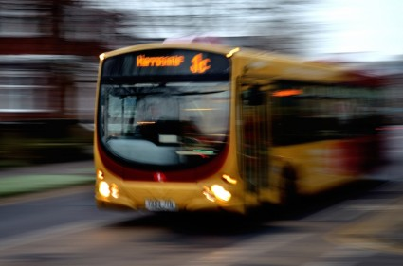
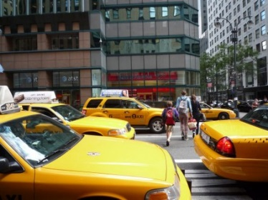
Local Transport – travel within 1 country
Public transport expenses (shuttle, ferry, bus, train, metro and tram):
Claimed amount
≤ EUR 25 → No receipts required
Claimed amount
> EUR 25 → All receipts required
Taxi expenses are allowed when:
No other means of public transport is available
To/From airport between 10pm and 7am
AND
Only up to a maximum of EUR 80 in total with receipts
Car travel expenses:
Same rules apply

Slide 15
Other travel eligible expenses
Luggage fees
Parking fees
Entry visa fee

Slide 16
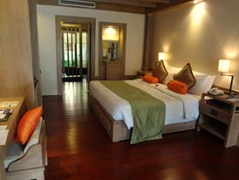
Accommodation expenses
Flat rate: EUR 120 per night
No receipts
Maximum nights = actual number of meeting days attended + 1 night before the event
MC decision: lower flat rate
Same flat rate

Slide 17
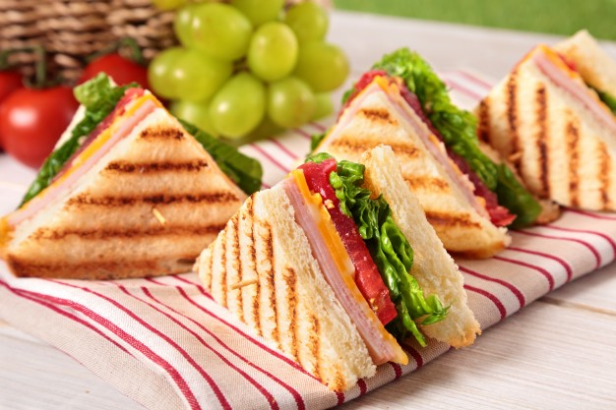
Meals expenses
Flat rate: EUR 20 for lunch and dinner
No receipts
Based on travel times
Offered meals by Local
Organiser Support (LOS)
MC decision: lower flat rate
Same flat rate

Slide 18
Non-eligible expenses
Registration, lecture fees and honoraria
Insurance (life, medical, health, luggage, etc.)
Fuel, road tolls and car rental
Charges for a rebooked travel ticket
Expenses associated with obtaining visas

Slide 19

How to submit your
Online Travel Reimbursement
Request (OTRR)

Slide 20

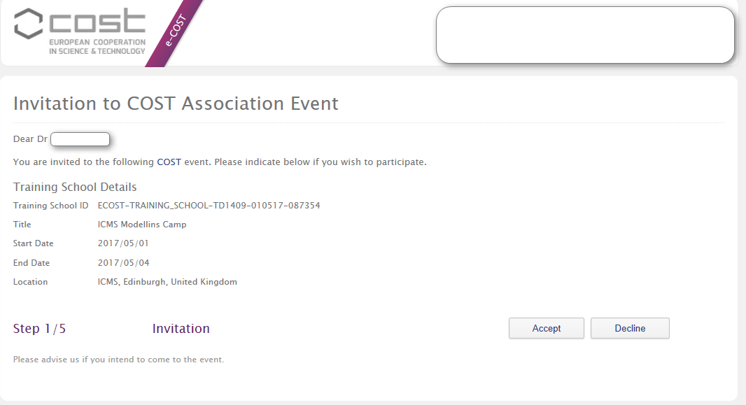
Step 1/5 Accept or Decline

Slide 21
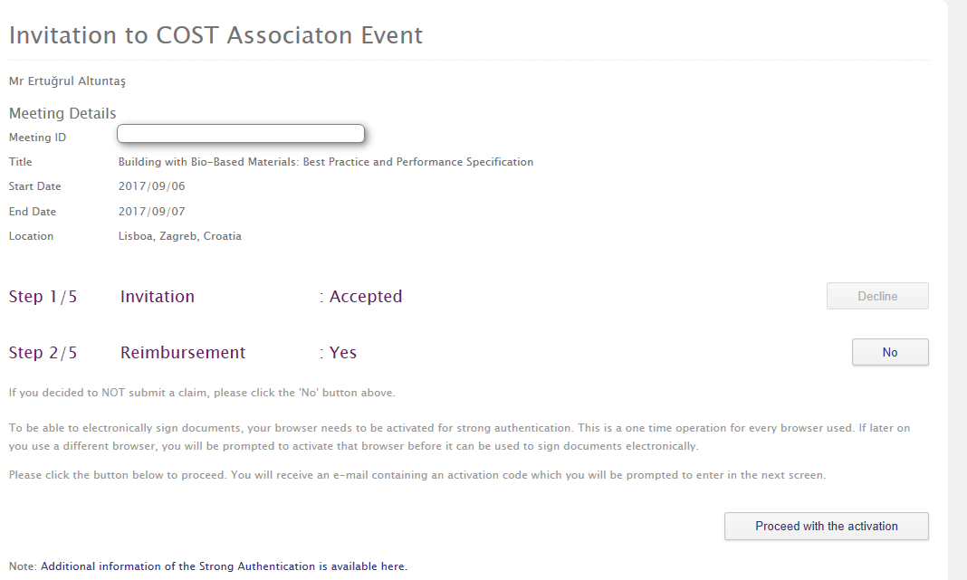
Step 2/5 Reimbursement?

Slide 22
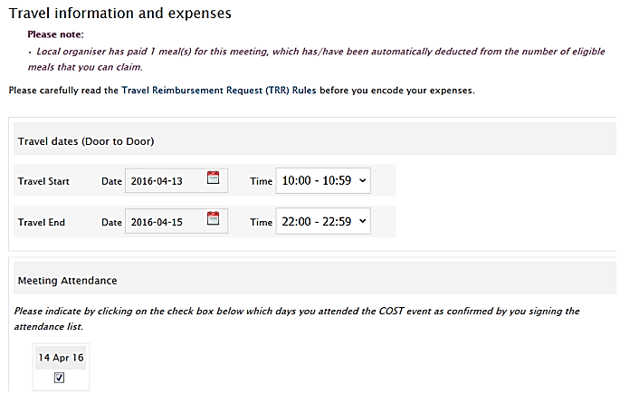
Step 3/5 Fill in your travel expenses

Slide 23
Upload receipts

Slide 24
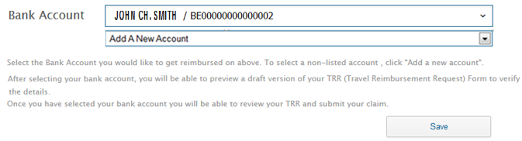
Step 4/5 Select Bank account

Slide 25
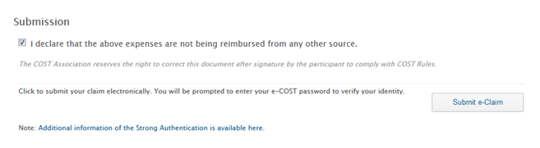
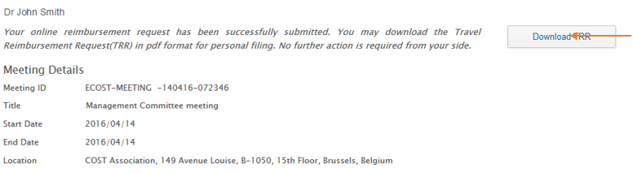
Step 5/5 Submission

Slide 26

Communicating with COST
Communicate only outcomes of MC decisions
Always indicate your Action number

Slide 27
Thank you

