Slide 1
Update from the COST Association to the
Management Committee
Dr. Fatima Bouchama - Science Officer

Slide 2
CONTACT POINTS@ COST
Science Officer Dr Fatima Bouchama fatima.bouchama@cost.eu
Tel: +32 (0)2 533 38 32
Administrative Officer Ms Cassia Azevedo cassia.azevedo@cost.eu
Tel: +32 (0)2 533 38 44
Communications Officer(new) Ms Silvia Alexe silvia.alexe@cost.eu Tel: +32 (0)2 533 3854

Slide 3
NEW : Science Communication Manager
Guidelines for Dissemination of COST Action Results and Outcomes
http://www.cost.eu/download/guidelines_action_dissemination_results_outcomes
The Action has to select one of its members as science communication manager.
- Stays in contact with Comms Officer (Ms. Silvia Alexe ) who can dissiminate through COST website important results/news of the Action and can help with drafting content (press releases, videos, etc.) with branding requirements & acknowledging COST.
- Can participate to science communication trainings organized by COST

Slide 4
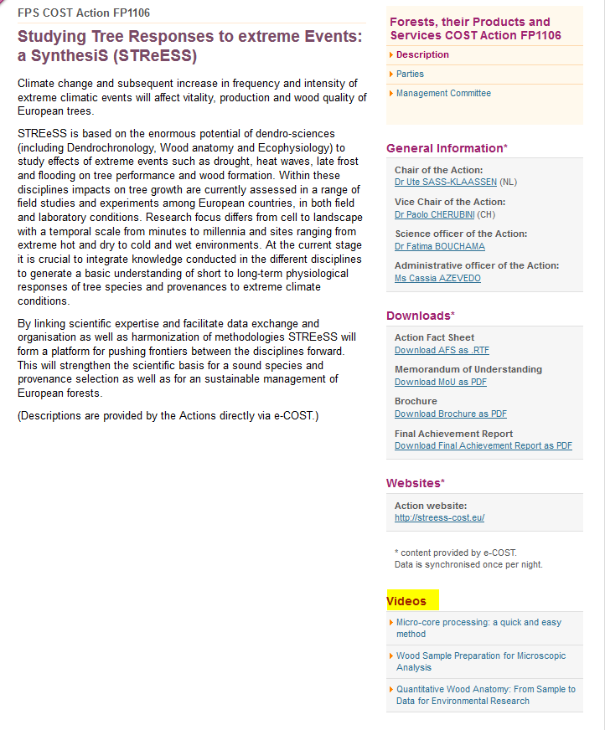

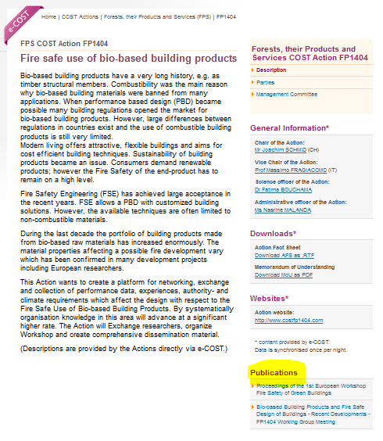
DISSEMINATION
COST WEBSITE :
- COST Action website : upload of material as publications, video, etc…
- COST news letter : events, success stories

Slide 5

Acknowledging COST Funds
It’s vital that you mention COST funding whenever you communicate your network’s achievements
It helps boost the programme’s visibility and impact (budget issues)
See our brand book for details on how to use our visual identity and acknowledge COST funding
http://www.cost.eu/media/dissemination-corporate-identity
Notes:
Insist again that when any type of activity is organised or co-organised by the Action it is mandatory to acknowledge COST and mention de Action name.

Slide 6
DISSEMINATION
Action Publication and Dissemination Activities
  Responsibility of the Management Committee
  Publication and dissemination strategy must be reflected in the Work and Budget plan of the specific Grant Period
  To be eligible the publication must be a direct result from the work performed by the Action and authored by participants from at least 3 different Participating COST Countries
  COST does not fund paid articles in magazines (advertising)
  Open Access is encouraged (gold or hybrid, green is welcome
Guidelines and Vademecum!

Slide 7
DISSEMINATION
Final Action Dissemination (FAD)
  Material (typically a publication) produced after the 4-years of the Action
  Additional grant (up to max 10 000 EUR) managed directly by Action GH
  Request 6 months before the official end date of the Action
  Published and Invoice is paid no later than 12 months after the official end of the Action
Guidelines and Vademecum!

Slide 8
SCIENTIFIC REPORTING
Monitor running Actions and assess ended Actions with regards to :
achievement of MoU objectives
provision of MoU deliverables
contribution to the COST Mission
implementation of COST policies

Slide 9
Monitoring and Final Assessment of Actions
Type | Time (months) | Content | Assessment/ Evaluation by
Progress Review 1 | 12 | Implementation of SC Recommendations & COST Policy on Excellence and Inclusiveness | Scientific Committee
Progress Review 2 | 24 | Progress Impacts and successes Dissemination & Exploitation Urgent needs for improvement | Independent External Expert
Final Assessment | 48 | MoU Achievements Expected Impact & Successes Dissemination & Exploitation Added value of the networking Success stories Emerging themes/ potentially important future developments | Independent External Expert

Slide 10
Progress Report 1: Month 12
Time line: October 2017
e-COST based reporting by Action Chair on behalf of MC
SC recommendation & COST policy on Excellence and Inclusiveness implementation analysis by the SC
“The proposed Action must develop and implement a specific plan to significantly improve gender balance and the participation of Early Career Investigators. The participation of Inclusiveness Target Countries should be monitored during the implementation as should potential industrial engagement. Consideration should be given to increasing the inter-disciplinarity of the network.”
SC analysis and outcome of PR1 :
In Progress

Slide 11
Progress Report 2: Month 24
Time line: End 2018
e-COST based reporting by Action Chair on behalf of MC
Check Deliverables list in e-COST
Review Type | Purpose and features | Reviewed by
Progress Review 2 (M24) | Monitors the progress (towards achievements), Impacts & Successes, Dissemination & Exploitation | Independent External Expert assigned by the COST Association
 | Identifies specific interventions / urgent needs for improvement
 | An Action Rapporteur will be appointed by the COST Association and will perform the evaluation remotely based on a report prepared by the Action Chair

Slide 12
GRANT PERIODS
Following Grant Periods:
GP1: 01 / 11 / 2016 → 30 / 04 / 2017
GP2: 01 / 05 / 2017 → 30 / 04 / 2018
GP3: 01 / 05 / 2018 → 30 / 04 / 2019
GP4: 01 / 05 / 2019 → 30 / 04 / 2020
GP5: 01 / 05 / 2020 → 16 / 10 / 2020 (Action end date)

Slide 13
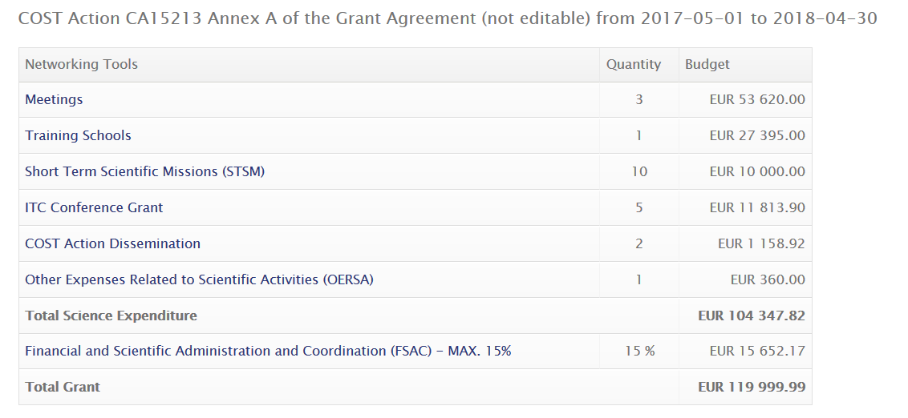
GP2: Amendment (top-up)
The COST Association has been granted extra budget (EUR 6.67 million) from the EC.
It has been decided to allocate this additional budget focussing on Networking Activities mainly by increasing the budget provided to all running COST Actions.
(new instrument ITC Conference Grants)
2nd Grant period: 01/05/2017 – 30/04/2018

Slide 14
NEW : ITC Conference Grants
User Guide : http://www.cost.eu/ITC_conferencegrants_userguide
MC can nominate a ITC Conference Grants coordinator (by default it is MC Chair)
Aimed at supporting PhD students and ECI researchers from Participating ITCs
to attend international science and technology related conferences not specifically organised by the COST Action.
The applicant must:
make an oral/poster presentation at the conference in question on the topic of the Action and must acknowledge COST
be listed in the official event/conference programme.
Fill an application form in e-cost/ complete a scientific report

Slide 15
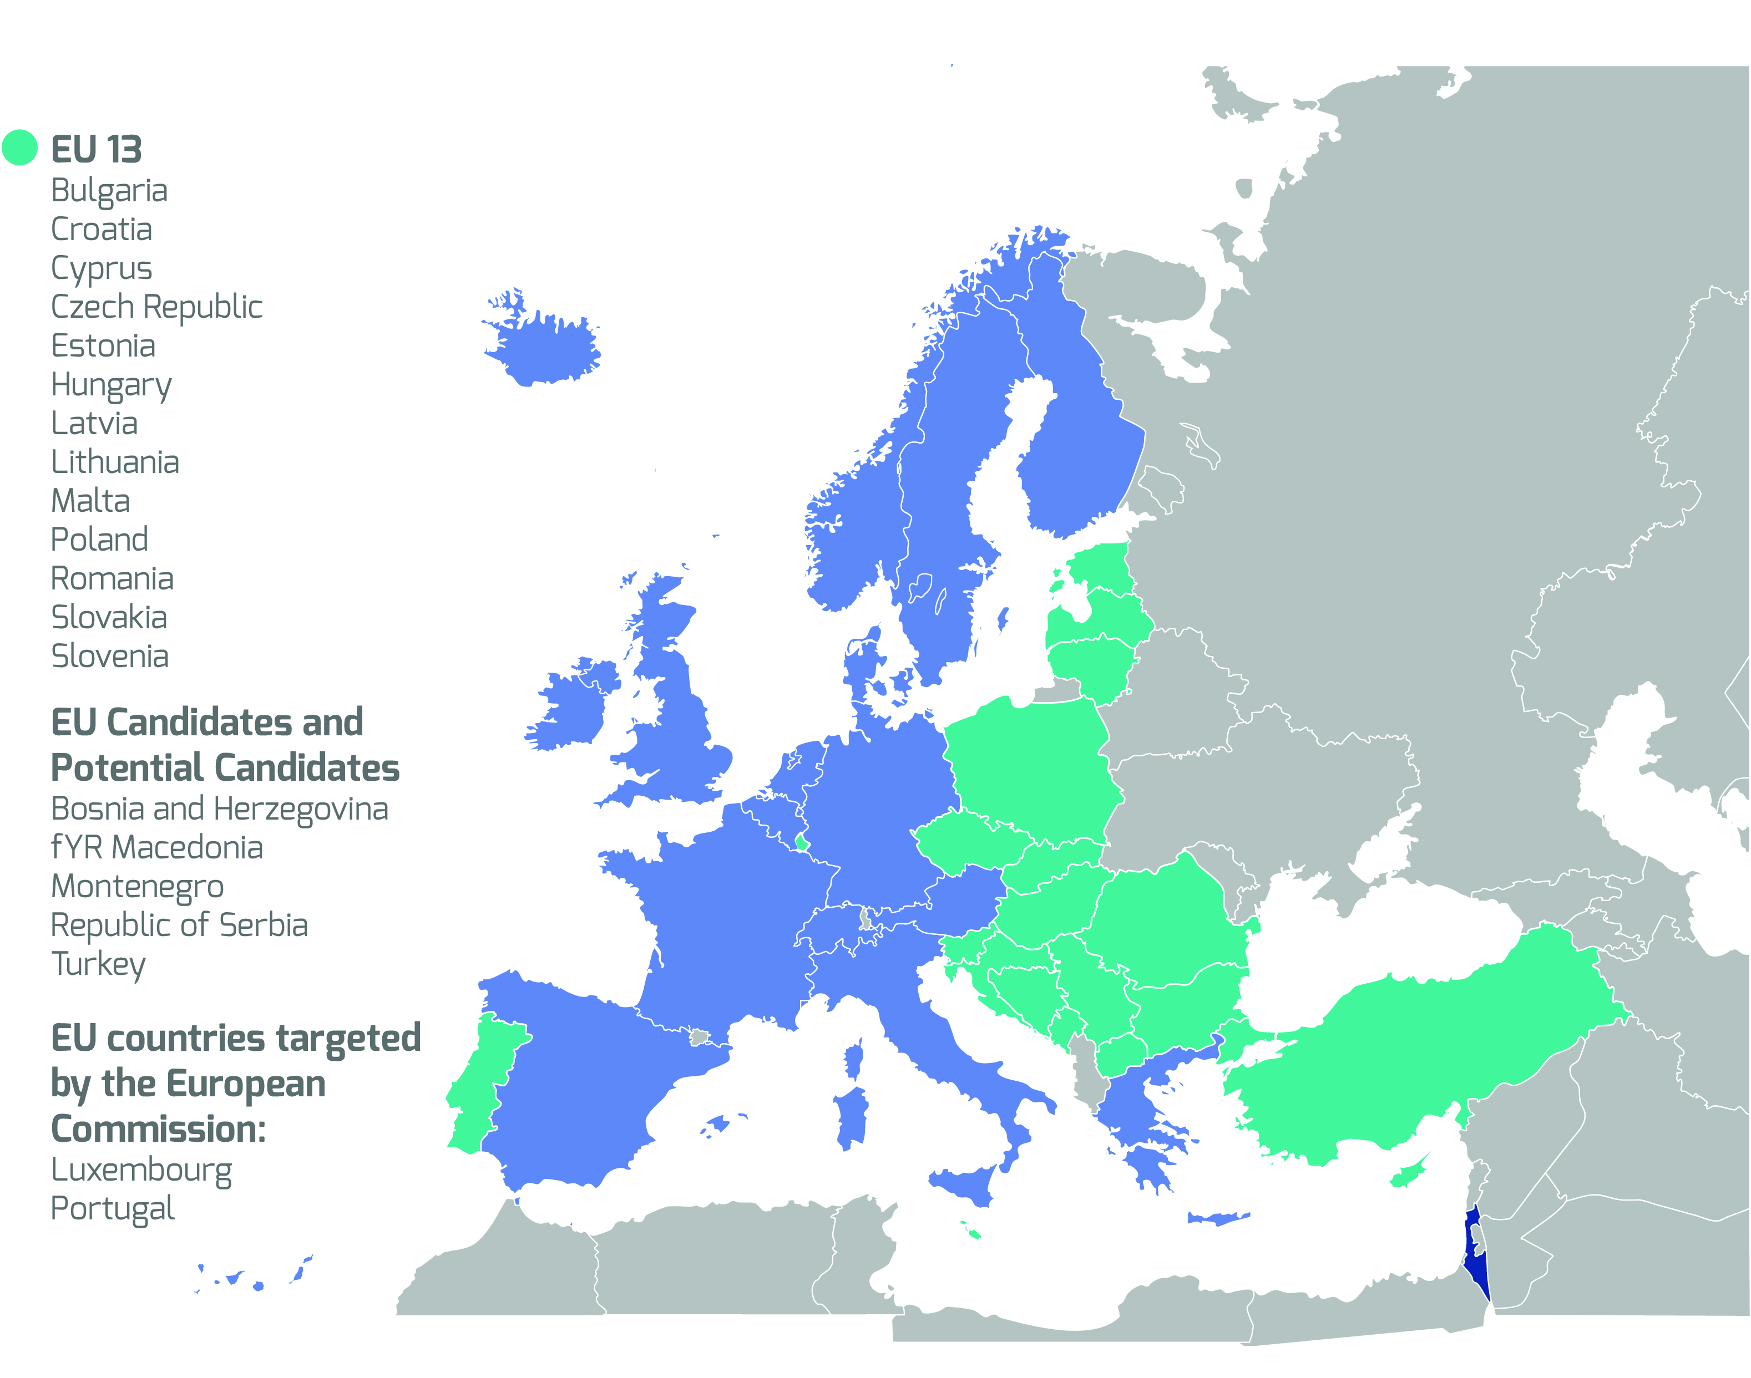
COST Inclusiveness
Target Countries (ITC)
Notes:
Updated 19/07/2017 with newest map

Slide 16
COST ASSOCIATION
New President : Prof Dr Sierd Cloetingh
New Director : Dr Ronald de Bruin
COST FP9 Position Paper published
35 new Actions approved under oc-2016-2
Increase of budget (EUR 6.67 million)
COST academy

Slide 17
UPDATES DOCUMENTS
See http://www.cost.eu/participate
Vademecum
http://www.cost.eu/download/COSTVademecum
Guidelines for Action Management, Monitoring and Assessment
http://www.cost.eu/download/Guidelines_Action_management_monitoring_assessment
Guidelines for Dissemination of COST Action Results and Outcomes
http://www.cost.eu/download/guidelines_action_dissemination_results_outcomes

Slide 18
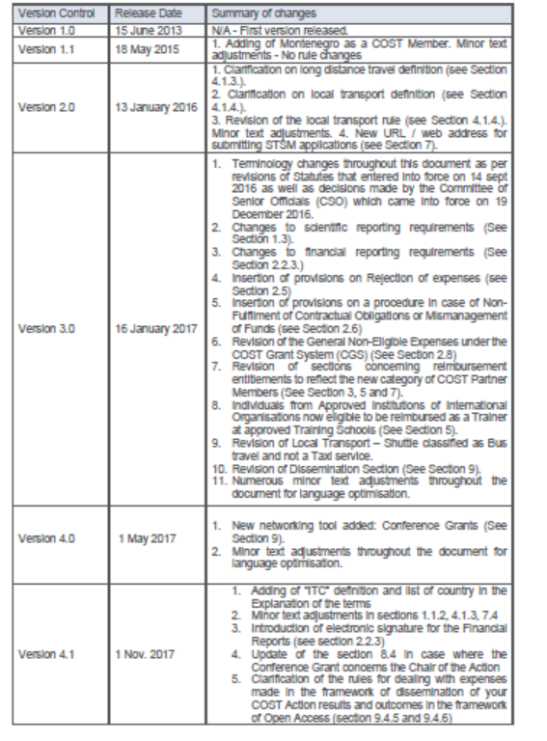
NEW : STSM tool & ITC Conference Grant
Vademecum
http://www.cost.eu/download/COSTVademecum
Short Term Scientific Mission (STSM) - http://www.cost.eu/STSM_userguide
ITC Conference Grants - http://www.cost.eu/ITC_conferencegrants_userguide

Slide 19
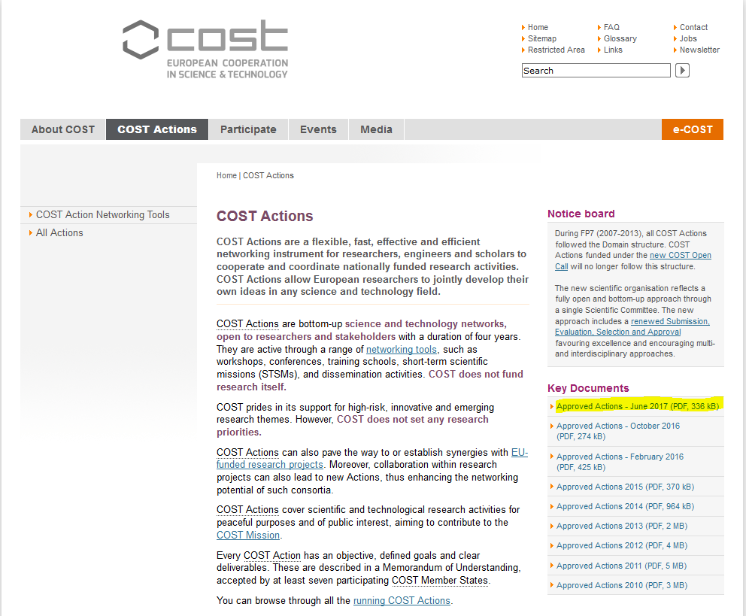
NEW ACTIONS: Full lists
http://www.cost.eu/COST_Actions

Slide 20
Become a COST Expert
As a COST expert, you will have opportunity to:
  Contribute to the evaluation of COST OC proposals;
  Participate in the assessment of Action results and outcomes;
  Take a part in the assessment of COST strategic activities.
New experts can express their interest via the COST Expert online registration form (www.cost.eu/experts)
An updated Curriculum Vitae with a list of publications is required to demonstrate competence in specific areas of expertise

Slide 21
Reminders
Always send to COST Association (SO and AO) the minutes of the MC meetings and upload them in e-COST
Any addition/revision of activities not in the approved WBP (Grant Agreement) needs MC and SO approval
Notes:
Also cancellation of meetings is possible, if needed. Action Chairs should keep their SO informed about such cases.

Slide 22





Thank you!
COST Association
Avenue Louise 149
1050 Brussels, Belgium
T: +32 (0)2 533 3800
F: +32 (0)2 533 3890
www.cost.eu

Slide 23
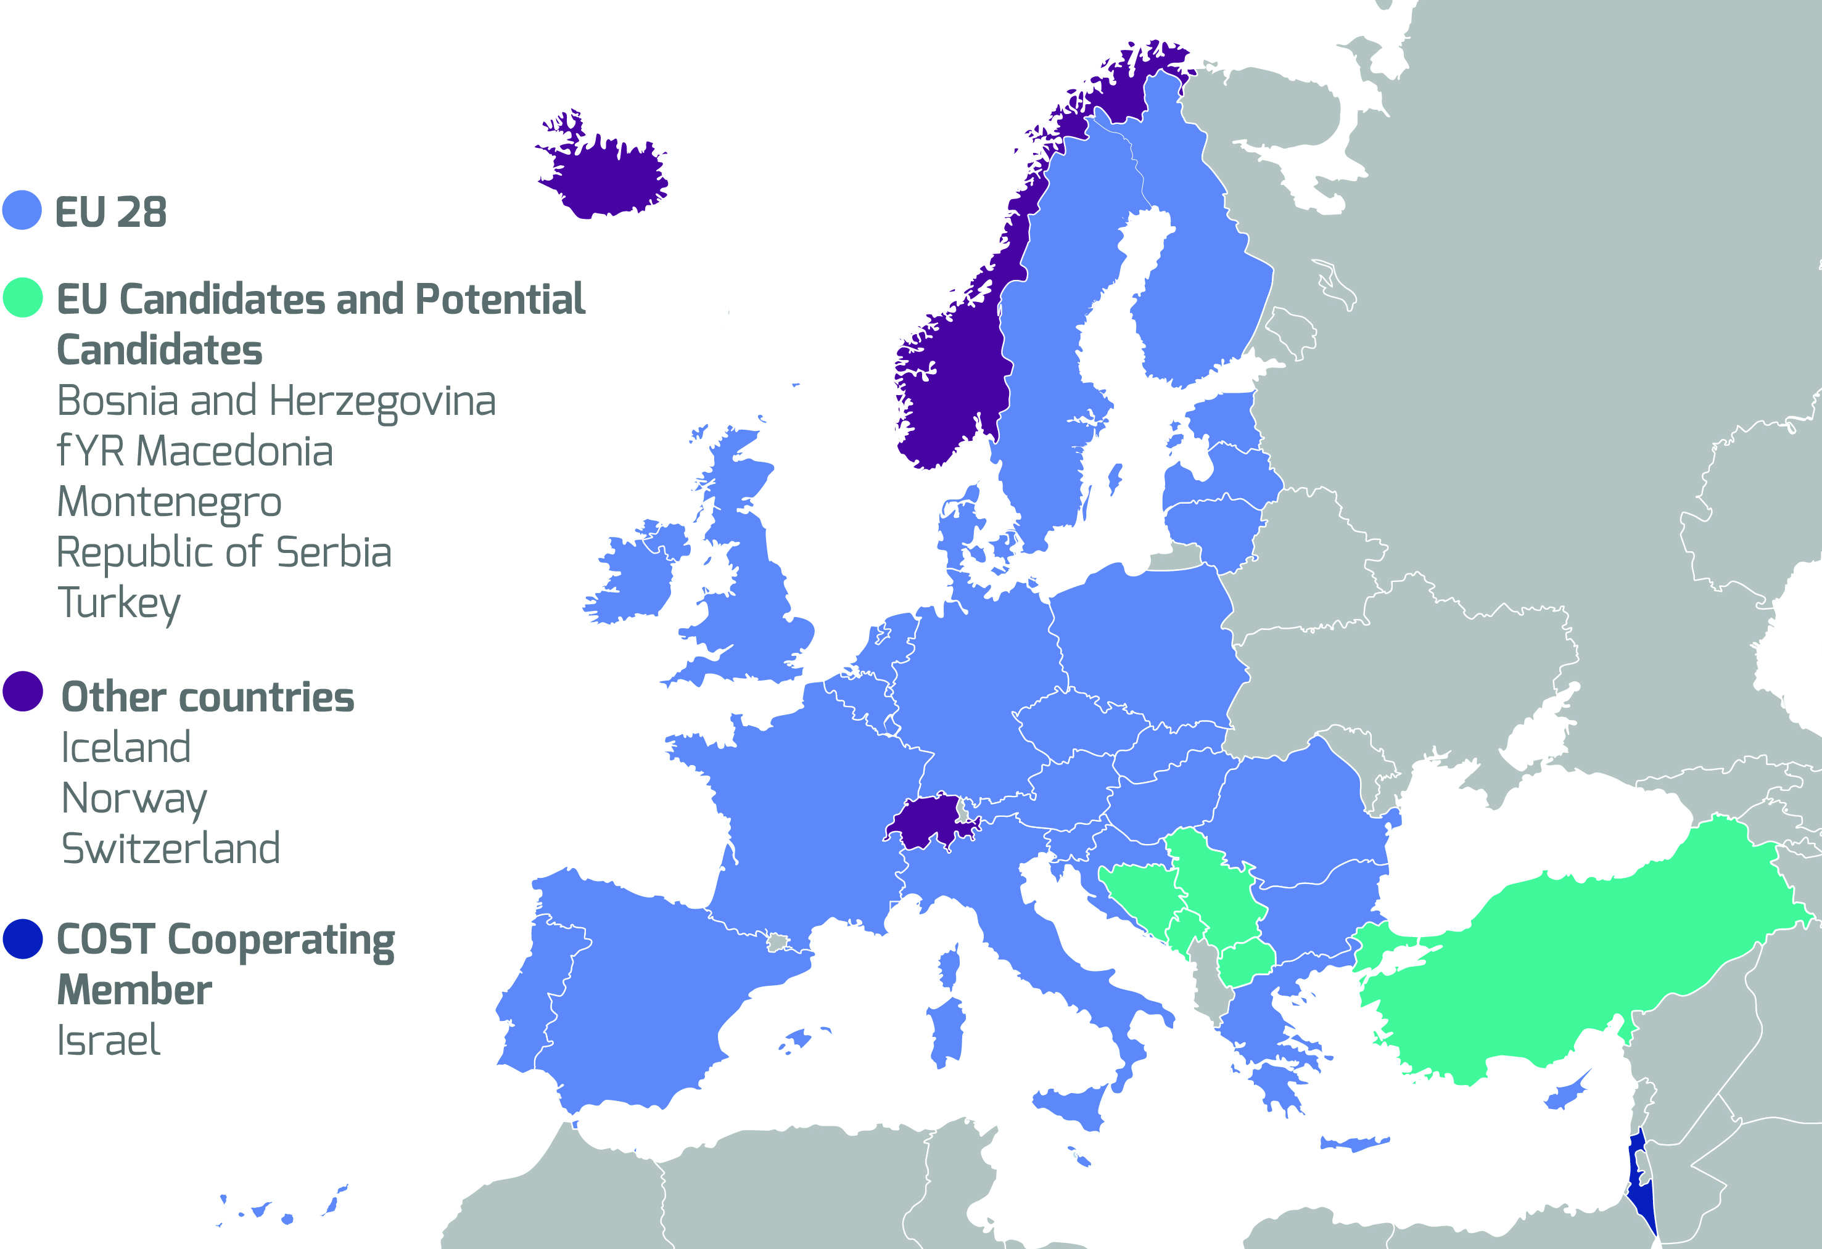
COST Member Countries

Slide 24
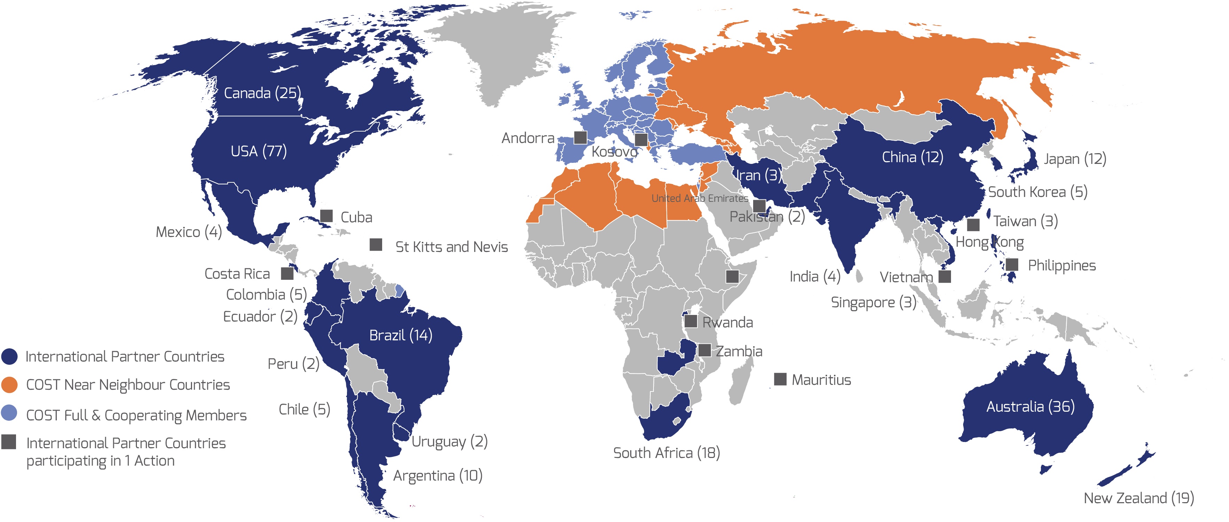
NNC and IPC
July 2017

