Slide 1

COST Action THOR
Theory of hot matter and relativistic heavy-ion collisions
Marcus Bleicher
Goethe-University
Frankfurt am Main
Germany
105 slides + 26 STSM + COST slides

Slide 2
1. Welcome

Slide 3
Welcome by Action Chair and COST representatives (Fatima Bouchama and Cassia Azevedo).
Short tour de table to introduce new MC members:
Bosnia & Herzegowina, Prof. Mirza Hadzimedhovic, U of Tuzla
Bulgaria, Prof. Dimitar Bakalov, Inst. for Nucl. Research., Prof. Vladimir Dobrev, Bulgarian Acad. of Sc.
Cyprus, Prof. Constantia Alexandrou, U of Cyprus
Denmark, Prof. Oleg Rucheyskiy, Niels Bohr Inst., Prof. Jens Jorgen Garrdhoje, Niels Bohr Inst.
Serbia, Prof. Magdalena Djordjevic, U of Belgrade

Slide 4
2. Verification of the presence of two-thirds of the participating COST Countries

Slide 5
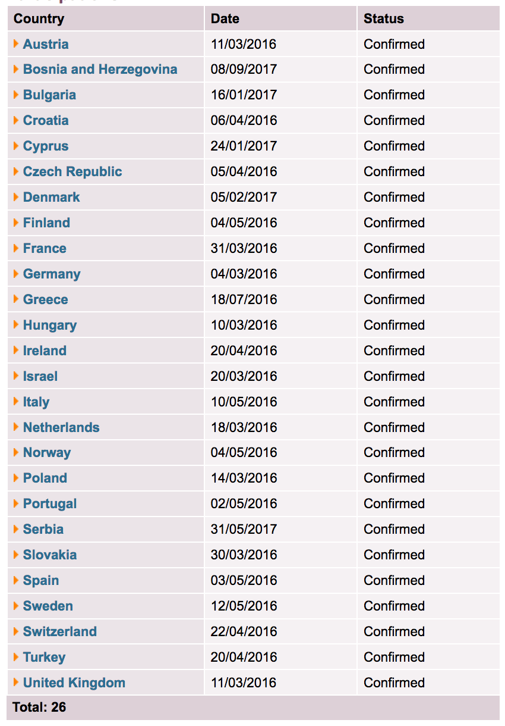
The quorum (2/3 of COST Countries participating in the Action) is 18 COST countries out of 26 COST countries that have accepted the MoU.

Slide 6
3. Adoption of the agenda

Slide 7
Proposal: Agenda is accepted

Slide 8
4. Approval of minutes and matters arising of last meeting

Slide 9
No comments on the MC1 minutes reached us
Proposal: Minutes are accepted

Slide 10
5. Update from the Action Chair
a) Status of Action: start and end dates of Action, participating COST countries, participating NNC/IPC institutions and Specific Organisations.

Slide 11
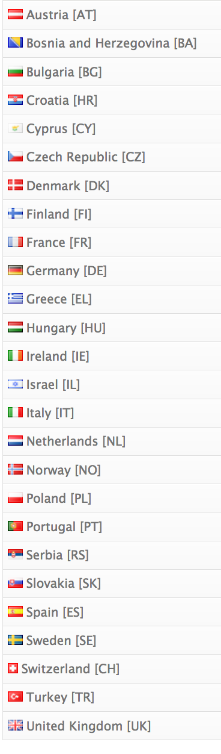
Current Status of the Action
Start date: 17/10/2016, End date: 16/10/2020
26 countries on board, of them 10 ITCs
2 NNCs (RUS, UKR)
Institutions: CERN and JINR

Slide 12
5. Update from the Action Chair
b) Short Term Scientific Missions (STSM): review of completed reports and new applications

Slide 13
Gergely’s slides

Slide 14
6. Update from the Grant Holder

Slide 15


CA15213 THOR
Update from the Grant Holder
2nd MC meeting, Paris - Orsay
10.11.2017
Boris Tomášik
Univerzita Mateja Bela, Banská Bystrica, Slovakia

Slide 16
THOR GH: overview
Grant Holder: Matej Bel University in Banská Bystrica
http://www.umb.sk
University Centre for International Projects
Grant Manager: Jana Kunická
Scientific Representative: Boris Tomášik
Legal Representative: Vladimír Hiadlovský (The Rector)
Financial Representative: Ladislav Monček (The Quaestor)
Participating countries (26):
Austria, Bosnia & Hercegovina, Bulgaria, Croatia, Cyprus, Czech Republic, Denmark, Finland, France, Germany, Greece, Hungary, Ireland, Israel, Italy, The Netherlands, Norway, Poland, Portugal, Serbia, Slovakia, Spain, Sweden, Switzerland, Turkey, UK

Slide 17
GP1: 1/11/2016 – 30/4/2017
Budgeted: 55 500 Eur / Spent: 55 331.49 Eur / Spending: 99.7%
 | Budgeted | Spent | Left over
Meetings | 16 852.00 | 5 937.98
Training schools | 8 000.00 | 13 450.00
STSMs | 23 092.00 | 27 568.81
ITS conference grants | 0 | 0
Dissemination | 0 | 1 000.00
Other (OERSA) | 316.87 | 157.55
Total networking expenditure | 48 260.87 | 48 114.34
FSAC | 7 239.13 | 7 217.15
Total eligible cost | 55 500.00 | 55 331.49
 |  |  | 168.51

Slide 18
GP2: 1/5/2017 – 30/4/2018
Budgeted: 119 999.99 Eur
Spent (by 31/10/2017, end of interim period): 32 715.18 Eur Remaining: 87 284.81 Eur
 | Budgeted | Spent | Left over
Meetings | 52 620.00 | 24 337.98
Training schools | 27 395.00 | 0
STSMs | 10 000.00 | 3 200.00
ITS conference grants | 11 813.90 | 910.00
Dissemination | 1 158.92 | 0
Other (OERSA) | 360.00 | 0
Total networking expenditure | 104 347.82 | 28 447.98
FSAC | 15 652.17 | 4 267.20
Total eligible cost | 119 999.99 | 32 715.18
 |  |  | 87 284.81

Slide 19
GP2 for planning purposes
 | WBP | spent 31/10/17 | approved | left
Mtg WG 2-3, Athens | 20 080,00 | 14 403,13
Mtg WG1, Swansea | 10 740,00 | 9 934,85
MCM 2, Paris | 22 800,00 | 0,00 |  | 29 282,02
Training Schools | 27 395,00 | 0,00 |  | 27 395,00
STSMs | 10 000,00 | 3 200,00 | 6 510,00 | 290,00
ITC CG | 11 813,90 | 910,00 | 1 470,00 | 9 433,90
Dissemination | 1 158,92 | 0,00 |  | 1 158,92
OERSA | 360,00 | 0,00 |  | 360,00
TOTAL NETWORKING | 104 347,82 | 28 447,98 |  | 75 899,84
FSAC | 15 652,17 | 4 267,20 |  | 11 384,97
GRAND TOTAL | 119 999,99 | 32 715,18 |  | 87 284,81

Slide 20
Discuss and vote how to spent leftover money.
Proposal:
Increase funds of training school due to high demand
Increase STSM budget

Slide 21
7. Update from the COST Association by COST representatives

Slide 22
COST slides from
Dr. Fatima Bouchama
Cassia Azevedo

Slide 23
8. Monitoring of the Action

Slide 24
Main Deliverables
Intermediate deliverables:
  Training Schools and Workshops
  Progress reports and recommendations
  Publications in peer reviewed journals
Final deliverables:
White papers presenting the current status of the field and identifying the needs for the next-generation research methodologies and how these needs can be addressed in practice on regional, national and European level

Slide 25
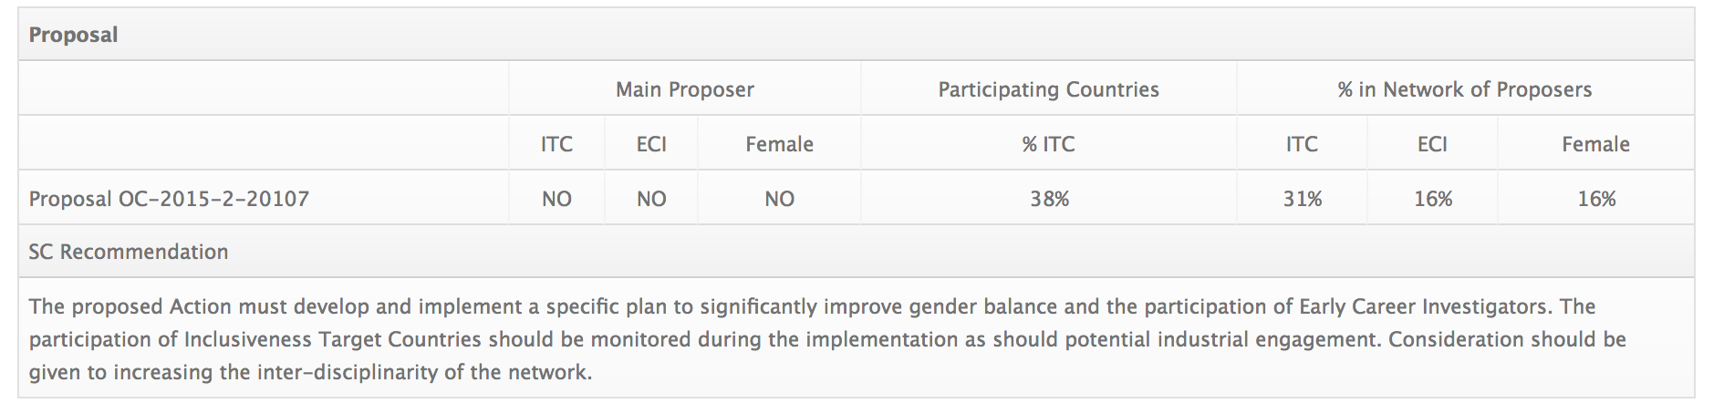
COST recommendations

Slide 26
9. Implementation of COST policies
a) Promotion of gender balance and Early Career Investigators (ECI)

Slide 27
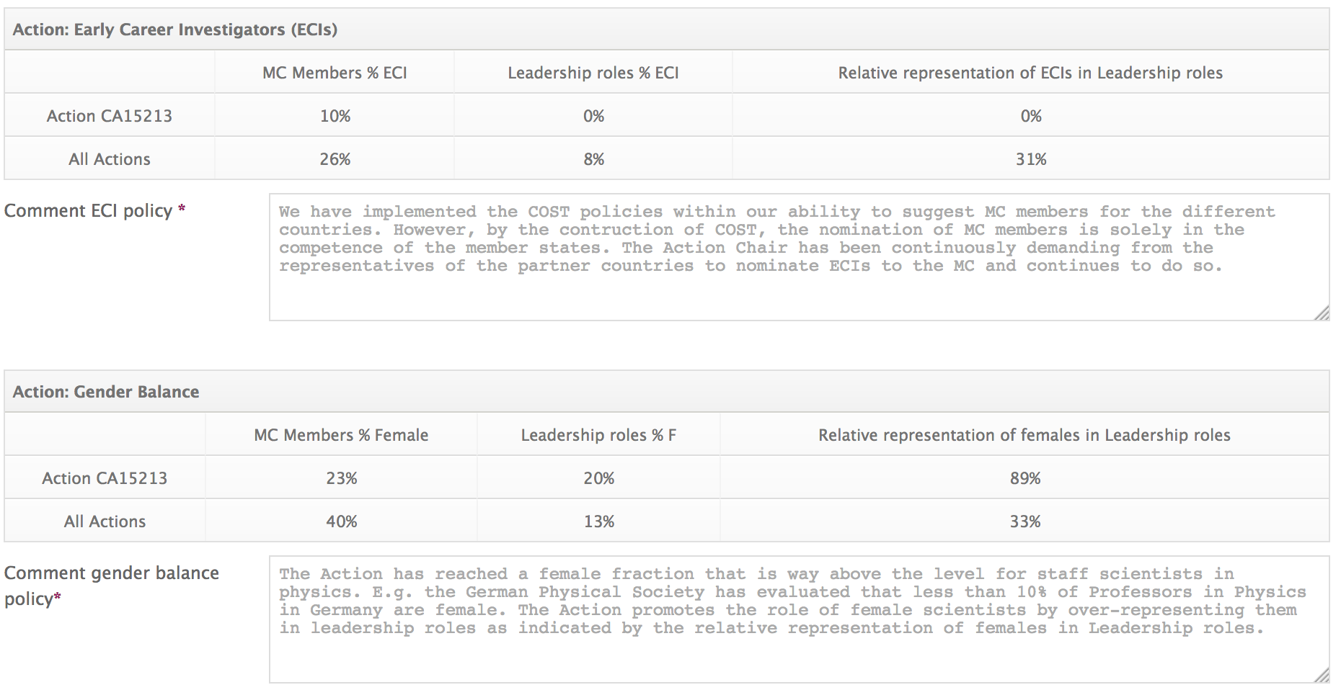
Status as of Oct. 2017
Improvement due to the very recent nominations of Sanjin BENIC (ECI), HR,
Marina MARINKOVIC (ECI,fem.), IE, Almedina MODRIC-SAHBAZOVIC (ECI, fem.), B&H

Slide 28
Strategy to improve...
Target ECI researchers and motivate them to join the action
Tell ECIs more about STSMs and (ITC) conference grants to avoid the often heard “its only for established scientists...”
Target female scientists to be nominated as MC members and substitutes (decision of countries!)
We have to improve !!!!

Slide 29
9. Implementation of COST policies
b) Inclusiveness and Excellence

Slide 30
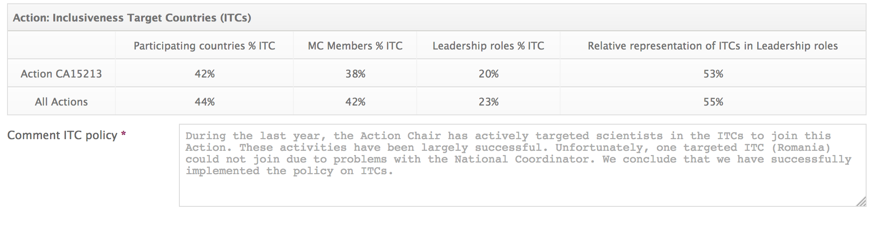
Status as of Oct. 2017
We have established connections with other COST actions, e.g. CANTATA (Gravity), COMPSTAR (Neutron stars)
Contact with medical physicists (application of ion therapy) has been established

Slide 31
ITC conference grants

Slide 32
Excellence
Majority of scientific leaders in the field on board
Clear focus on pressing and up-to-date questions in the field
(especially related to LHC, RHIC and FAIR)
Break-through potential by bringing together smaller groups in ITCs with established history in the field
Creation of a competitive and coordinated
pan-european community in the field

Slide 33
Side remark: networking works
Triggered by this COST Action, DAAD funding was attracted for a Symposium in B&H
COST was presented and as a result B&H joined 5 existing COST Actions (incl. THOR).
Common further EU applications are planned.
---
Additional funds acquired by Jan Cepila (Czech) that are only available to COST MC members

Slide 34
10. Follow-up of MoU objectives: progress report of working groups

Slide 35
Main Challenge
We want to
theoretically understand the properties of matter at the frontiers of temperature and density as it is created in violent collisions of protons and nuclei
We achieve this
by developing novel theoretical approaches and advanced numerical methods in two directions: ab-initio calculations and phenomenological approaches

Slide 36
Secondary Objectives:
Research Coordination
Development of simulation tools: Common development of the next generation of simulation tools for the modeling of heavy ion collisions and the interpretation of the experimental data.
Development of ab-initio approaches: Joint development of new theoretical concepts for the description of QCD matter in equilibrium and in vacuum.
Extraction of physical properties of QCD: Common development of specific signatures for the experimental measurement of specific properties of ultra hot and super dense QCD matter.
Understanding collectivity: Development of a common understanding of the thermalization and dynamics of small colliding systems (proton-proton, and proton-nucleus collisions).

Slide 37
Secondary Objectives:
Capacity Building
Providing a knowledge platform for the different communities to create a Europe wide community.
To support and strengthen atomized groups from the Inclusiveness Target Countries (ITC) by supporting their collaboration with international partners.
To improve the visibility of groups and public awareness about science in ITC in general by placing events there.
To foster scientific collaboration with and between the Near Neighbor Countries (NNC).
To promote the integration of Early Career Investigators (ECI) into managing and decision-making processes.
To promote female scientists as role models for the young generation by giving them positions in management, as lecturers at schools, and by making them visible in outreach.

Slide 38
Secondary Objectives:
Research Coordination
Synergy building: Merging knowledge of loosely connected European groups in the field working on complementary topics.
Wiki page preparation with current knowledge description.

Slide 39
Activities
Activities:
  Training Schools and Workshops
  Progress reports and recommendations
  Publications in peer reviewed journals
Final deliverables:
White papers presenting the current status of the field and identifying the needs for the next-generation research methodologies and how these needs can be addressed in practice on regional, national and European level

Slide 40
WG 1
WG Leader: Gert Aarts (UK)

Slide 41
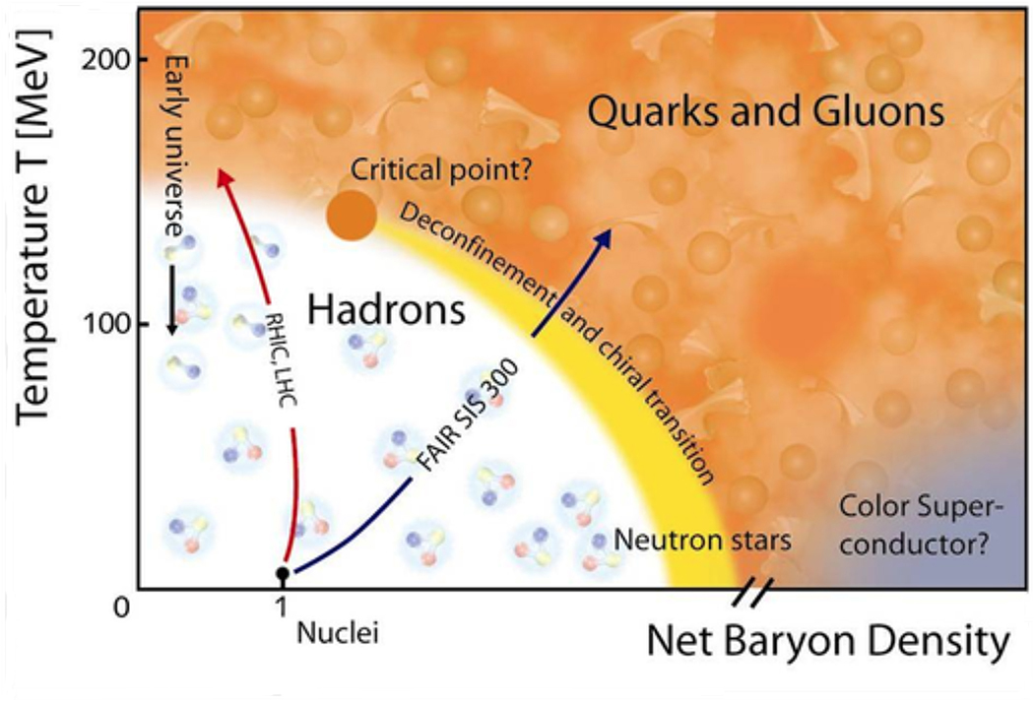
WG1: Phases of strongly interacting matter
WG1 coordinator: Gert Aarts (Swansea)
60 members registered on THOR website
Physics topics:
strongly interacting
matter in equilibrium
hadron properties in medium
ab initio lattice QCD calculations
effective models, statistical models

Slide 42
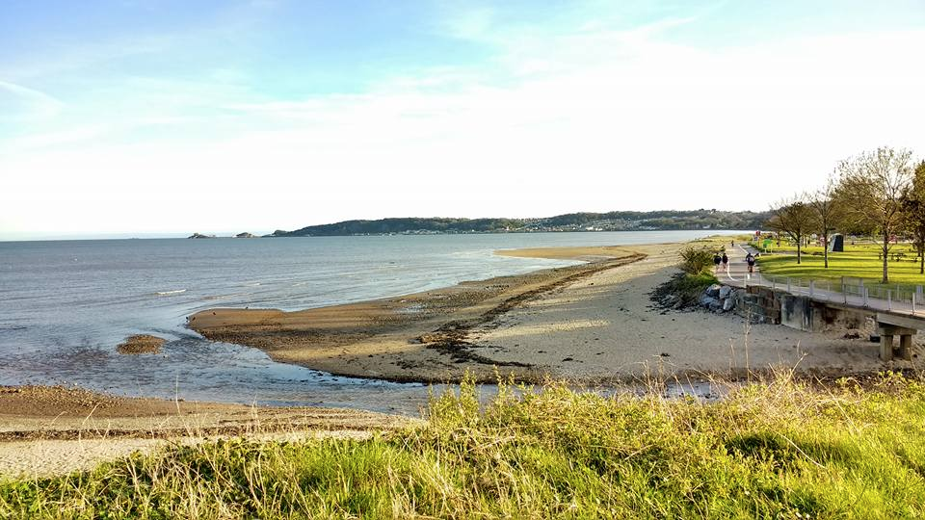
WG1 Meeting: Hadrons under extreme conditions
Swansea University, 12-14 Sept 2017
24 participants (10 via COST, 4F, 2ITC, 8ECI)
14 talks + 3 extended discussion sessions
See pyweb.swan.ac.uk/~aarts/thor-hadrons.html
Programme
organised according
to themes

Slide 43
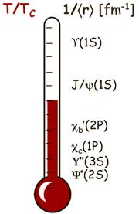
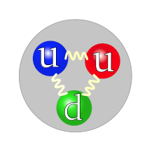
WG1 meeting: Extreme hadrons
Hadrons under extreme conditions
  What do we know/want to know? (Challenge)
  Hadronic gas vs quark-gluon plasma (RC1)
  Bottom-up vs top-down (RC3)
Heavy quarks and spectral reconstruction
  Quarkonia, imaginary and real time (RC3, RC4)
Baryons: lattice, models, holography (RC1, RC3, RC4)
  Parity doubling, resonance models,
  strangeness, dense nuclear matter

Slide 44
WG 2
WG Leader: Jörg Aichelin (France)

Slide 45
WG2 Report
Common working group meeting with WG 3 and GDRE^* in Athens
4.9 – 8.9. 2017
organized by working group 2
27 participants
- 9 women
- 5 young researchers
- 6 ITC countries
^*Groupement de Recherche Européen:
European Ultra Relativistic Energies Agreement (Eurea)

Slide 46
united people working in different fields:
transport theory, hard probes, experimental physics
+ newcome who want to get acquainted with the field
Allowed to discuss the recent experimental results in view of the needs
in which transport tool have to developed:
precision data of LHCb,
many new data on J/psi where theory is little developed yet
discussion of possible scenarios for J/psi production
very lively discussion on which possible models would agree with data
and what can be learnt from them
discussion on how to include correlations D-D and D-h
and what can be learnt from them
Format was considered as excellent
First steps have been done to get small groups from ITC countries invovled
they have however to participate actively

Slide 47
Extraordinary participation of female scientists
30% in physics, a field still dominated by man as far as permanent
positions are concerned
Then common discussion have strengthened existing collaborations
by fixing common goals
by discussing the different approaches to understand the physics
of heavy quarks
by providing an environment ( all people together in the same hotel)
where people get acquainted with each other
Was certainly a step towards a common European platform to discuss these
physics questions

Slide 48
WG 3
WG Leader: Elena Ferreiro (Spain)

Slide 49
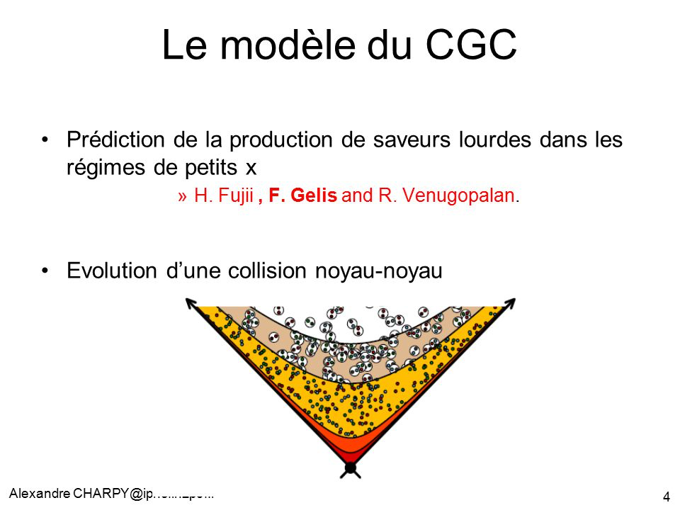
WG3: Initial state and hard probes
WG3 coordinator: Elena G. Ferreiro (USC, Spain)
35 members registered on THOR website
Physics topics:
Early processes in nuclear collisions:
  parton distribution functions in pp and AA
  shadowing and gluon saturation
Hard probes:
  jets, their quenching and energy loss.
  evolution of heavy quarks
Topics closely related to those of WG2
(dynamical evolution of the bulk part of the fireball)

Slide 50
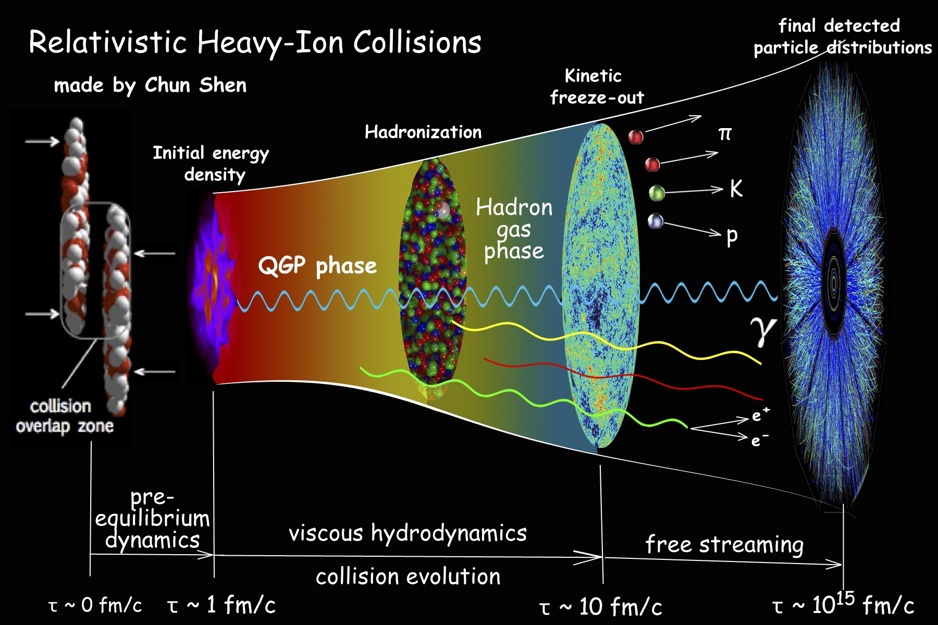
Topics closely related to those of WG2 (dynamical evolution of the bulk part of the fireball)

Slide 51
WG2&3 Meeting: THOR COST/ GDRE Heavy Quark Physics
Athens, 6-8 Sept 2017
Organisers: Joerg Aichelin, Klaus Werner
24 participants
24 talks + 2 extended discussion sessions
See https://indico.cern.ch/event/662779/overview
Programme: issues of the open and hidden charm meson produced in relativistic heavy ion collisions

Slide 52
11. Scientific planning
Scientific strategy (MoU objectives, GP Goals, WG tasks and deliverables);

Slide 54
GP1 Goals
WG/Core Group meeting, Frankfurt, 1/2017
COST Action CA15213 Training School Understanding the Origin of Matter from QCD and HIC, Poland, 2/2017

Slide 55
GP2 Goals (NOW)

Slide 56
GP2: Meeting overview

Slide 57
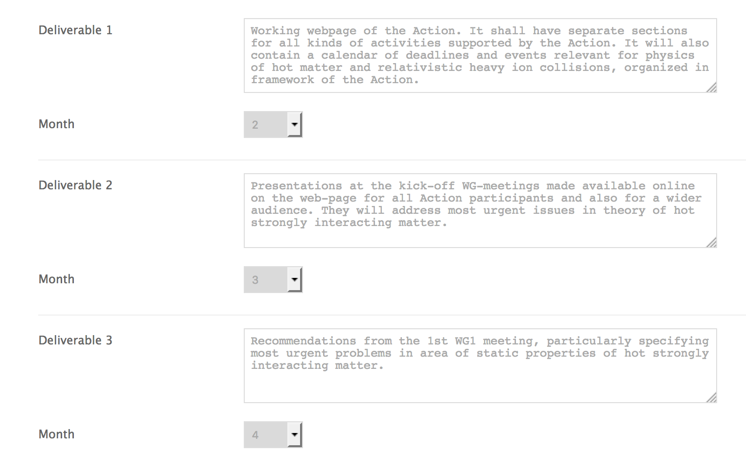
GP2: Tasks/deliverables
done
done
done

Slide 58
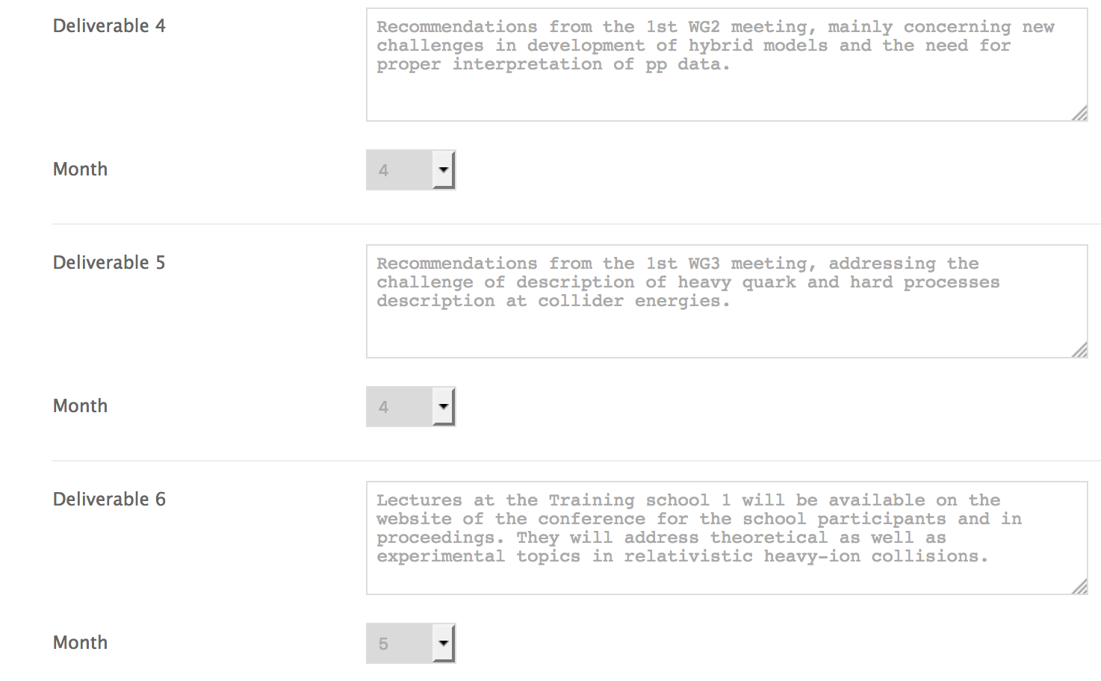
GP2: Tasks/deliverables
done
done
done (Status of proceedings?)

Slide 59
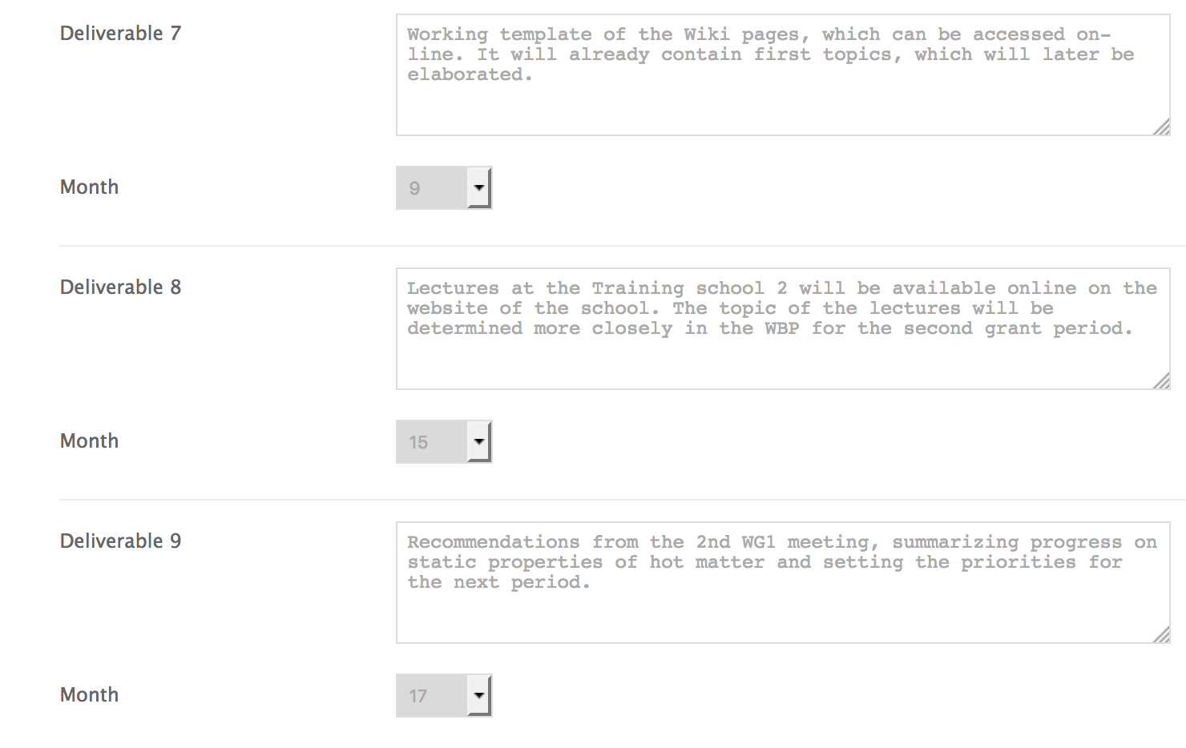
GP2: Tasks/deliverables
done
TS on 12/2017
to be done (same for WG2 and 3)

Slide 60
11. Scientific planning
Action Budget Planning;

Slide 61
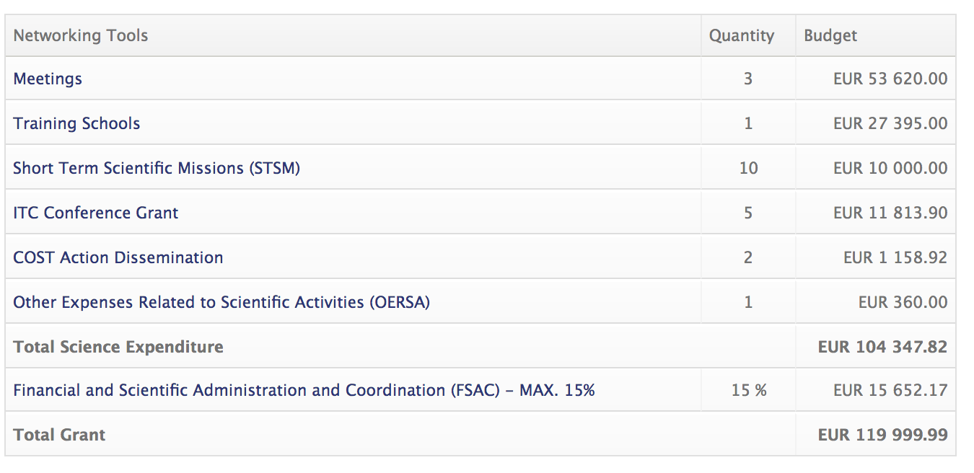
Budget planning (we will know in 2/2018)
Proposal: Continue as is... with very small changes (Combine MC and at least 2 WG meetings, move money to STSM)
3x12kE (WG)+10kE (MC)=46kE
16x1kE =16kE

Slide 62
Vote to allow Chair to adjust budget
Proposal (for this GP): Chair is allowed to adjust each budget item by up to 5kE.
Reason (funds saved in WG meeting and MC meeting, reallocate money to have more STSM)

Slide 63
11. Scientific planning
Long-term planning (including anticipated locations and dates of future activities)
(Proposals)

Slide 64
Update on next Training School

Slide 72
Proposed meetings
Maynooth, Ireland, 8/2018, WG1+WG3+MC
Lisboa, Portugal 6/2018, WG1+WG2+MC
Benasque, Spain, 8/2018, WG2+WG3+MC
Prague, Czech, 9/2018, Training School
Tuzla/Neum, Bosnia, 8/2019, Training School
Lund, Sweden, 6/2019, Training School
Discuss, make decision for 2018!
Discuss and pre-approve 2019!
(my constraints: 6/2018 ok, 1.-15.8.2018 ok.)

Slide 77
Common working group meeting
WG1 & WG2 (& GDRE* heavy quarks)
+ management board meeting
Elena Bratkovskaya, G. Aarts, J. Aichelin
11.6 - 16.6 Lisboa/Portugal (ITC)
management board meeting 13.6.
WG1: 10 Thor participants
WG2: 10 Thor participants
GDRE: 15 participants
*Groupement de Recherche Européen

Slide 78
WG1: Lattice and equilibrium physics
WG2: Transport approaches
share many interest because in high energy heavy ion
reactions a local equilibrium is obtained (and therefore
hydrodynamical eqs. are the proper tool do describe the
expansion of the Quark-Gluon-Plasma created in these
collisions .
→ Common working group meeting is useful

Slide 79
Topics of mutual interest:
Present status of the extension of the equation of state to finite μ
Common hadronization or sequential ( according to quark content)
Where are J/psi and Y stable?
How J/psi and Y are created in the transport models?
What does experiment tells us about the J/psi and Y?
How do open charm/bottom mesons interact with hadronic matter?
How to make heavy mesons at the end of the QGP phase?
simulations at nonzero chemical potential
hadronic properties from the lattice
fluctuations and resonances
Special emphasis :
Participation of female and young scientists.

Slide 81
/var/folders/fs/m431jtjn4zs2cv37x7bw2fzh0000gn/T/com.apple.Preview/com.apple.Preview.PasteboardItems/COST_Maynooth (verschoben).pdf

Slide 87
GP3 – Planning

Slide 93

Proposal for Training School 2019
Proposer: Mirza Hadzimehmedovic
Location: Tuzla (B&H)
Time: Aug 2019
Duration: 1 week
Organizers:
Mirza Hadzimehmedovic
Almedina Modric
(MC members from B&H, AM is ECI and female)
20 Trainees, 5 Trainers
Expected budget 20kE

Slide 94
Proposal for Training School 2019
Scope:
Quantum Field Theory (QCD), lat. QCD, scattering theory
→ resonance properties in vacuum and matter
Contributes to objectives:
RC1: Synergy building: Merging knowledge of loosely connected European groups in the field working on complementary topics.
RC3: Development of ab-initio approaches: Joint development of new theoretical concepts for the description of QCD matter in equilibrium and in vacuum.
CB2: To support and strengthen atomized groups from the Inclusiveness Target Countries (ITC) by supporting their collaboration with international partners.
CB3: To improve the visibility of groups and public awareness about science in ITC in general by placing events there.
CB6: To promote female scientists as role models for the young generation by giving them positions in management, as lecturers at schools, and by making them visible in outreach.

Slide 95
Summary
Maynooth, Ireland, 8/2018, WG1+WG3+MC
Lisboa, Portugal 6/2018, WG1+WG2+MC
Benasque, Spain, 8/2018, WG2+WG3+MC
Prague, Czech, 9/2018, Training School
Tuzla/Neum, Bosnia, 8/2019, Training School
Lund, Sweden, 6/2019, Training School
Discuss, make decision for 2018!
Discuss and pre-approve 2019!
(my constraints: 6/2018 ok, 1.-15.8.2018 ok.)

Slide 96
12. Requests to join the Action

Slide 97
No requests at the moment

Slide 98
13. AOB

Slide 99
Elections
Ivan Melo stepped down as outreach coordinator
Proposal: Maria Lomabardo (Italy)
(Think about forming an outreach/communication group, Axel, Maria, Jan, Marlene)
Gergely Barnaföldi (STSM coordianator) is very busy
Proposal: STMS-Coord. Axel Maas (Austria), Vice-Coord. Gergely Barnafoldi

Slide 100
14. Location and date of next meeting

Slide 101
MCM in conjunction with WG meetings!!!
Depends on the WG meetings approved before.

Slide 102
15./16. Summary of MC decisions (incl. Email votes)

Slide 103
Permission to the Core Group to decide who will receive the ITC Conference Grant and on the amount of the grant. Approved: 05.09.2017, 13:00.
New STSM committee shall then consists of: Boris Tomasik, Larissa Bravina, Gergely Barnafoldi, David Blaschke, Axel Maas, Laura Tolos, Maria Lombardo, Roman Pasechnik, Guilherme Milhano, Hannah Petersen, approved: 25.5.2017
Approval of the LOS for the MC meeting in Paris in Nov. 10, 2017, the request is to set the LOS to 340 € to cover the local costs. Approved: Sept. 21, 2017, noon.
Decision on the timing and place of the MC meeting, the decision was to hold the meeting in Paris, France on 10.11.2017, 14:00-18:00. Approved 20.6.2017.
Adjustment of stipendship rates for COST Karpacz School and other small budget adjustments, CG is allowed to adjust budget items up to 5kE. Approved 7.2.2017

Slide 104
17. Closing

