Slide 1
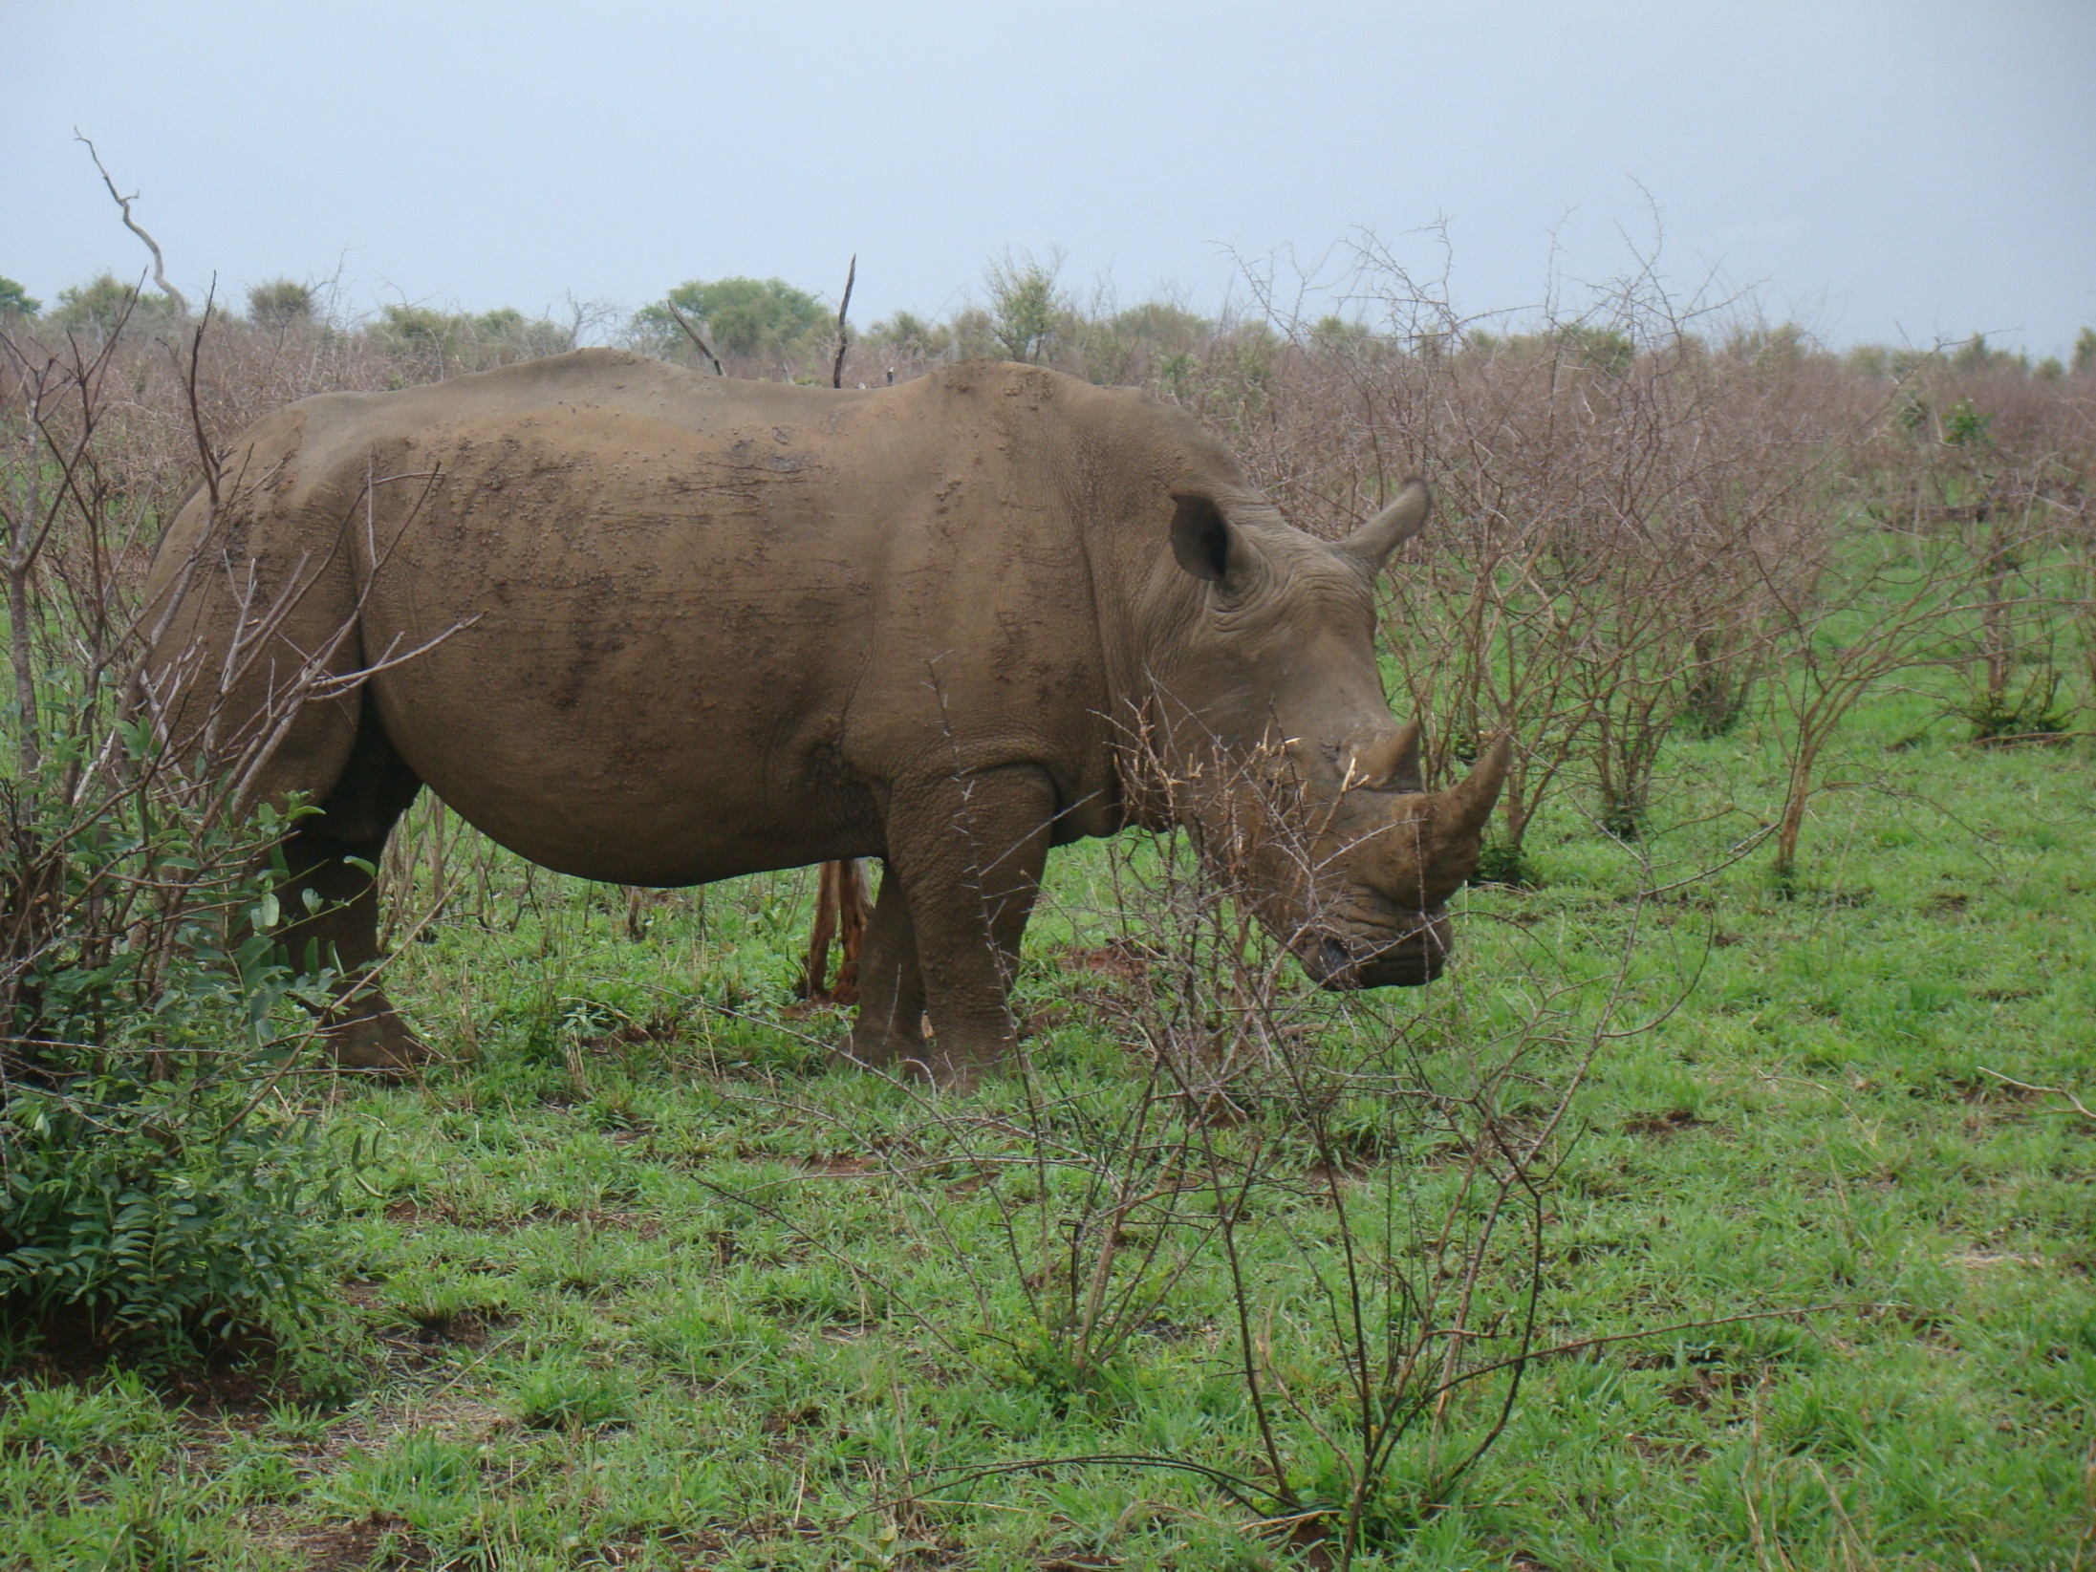
The Physics of Heavy Quarks in LHC collisions
How to detect a plasma of quarks and gluons and its degrees of freedom?
Why are heavy quarks interesting ?
Interaction of heavy quarks with the quark gluon plasma
- our model (elastic and inelastic collisions, LPM)
- comparison with LHC data
- interpretation of the results
- state of the art of the transport approaches
- what have we learned and where are the open questions
- c cbar interaction with the plasma
- Boltzmann versus Fokker Planck

Slide 2
The existence of a quark gluon plasma and the kind of transition
towards the hadronic world
has been predicted by lattice gauge calculations
has been claimed to be seen in experiments (Science)
Why this is still a topic ?
because we want to know the degrees of freedom of the plasma and their
interaction
Light hadrons: their multiplicity follows a gas of T = 158 MeV
Hadronic rescattering spoils spectra no info about plasma
Possible probes:
collective variables : ridge, elliptic flow (← hydro, only EOS)
γ, dileptons
jets no equilibrium with plasma
heavy quarks (D,B Mesons, J/psi, Y)

Slide 3
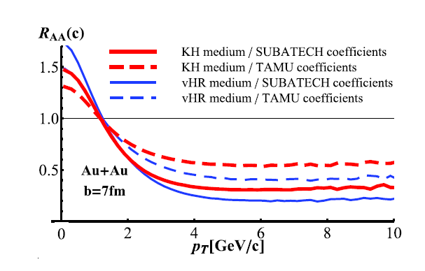
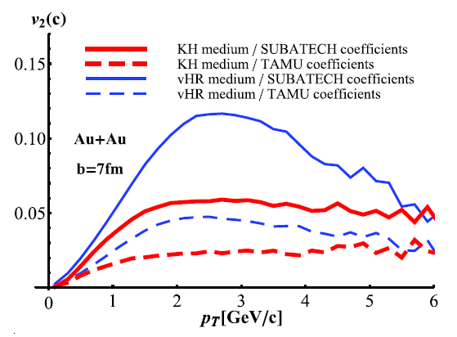
What makes heavy quarks (mesons) so interesting?
produced in hard collisions(distribution: FONLL confirmed by STAR)
high p_{T}: no equilibrium with plasma particles
not very sensitive to the hadronisation process at high p_{T}
Ideal probe to study
properties of the QGP during its expansion
Caveat: two major ingredients: expansion of the plasma AND elementary cross section (c(b)+q(g) ->c(b)+q(g)) (arXiv:1102.1114 )
Heavy quark physics not decoupled from light quark physics

Slide 4
Complicated process:
creation->propagation c ->hadronization ->propagation D
Our approach :
We assume that pQCD provides the tools to study the processes
We want to
model the reaction with a minimum of approximations:
exact Boltzmann collisions kernel, no probably unrealistic
Fokker Planck approx. (1309.7930)
take into account all the known physics with
no approximations of scattering processes (coll+ radiative)
make connection to the light quark sector (v₂ jets particle spectra)
by embedding the heavy quarks into EPOS (LHC)
This serves then as a benchmark
deviation from data points towards new physics
Problem: at the moment only two obs: R_{AA} and v₂ available

Slide 5
Nantes approach: Elastic heavy quark – q(g) collisions
Key ingradients: pQCD cross section like qQ -> qQ
pQCD cross section in a medium has 2 problems:
a) Running coupling constant
b) Infrared regulator
m_{D} regulates the long range
behaviour of the interaction
Neither g²= 4π α(t) nor κ m_{D}²= are well determined
standard: α(t) =is taken as constant or as α(2πT)
κ =1 and α =.3: large K-factors (≈ 10) are necessary to describe data

Slide 6

A) Running coupling constant
“Universality constraint” (Dokshitzer 02) helps reducing uncertainties:
Peshier
0801.0595
IR safe. The detailed form very close to Q² = 0 is not important does not contribute to the energy loss
Large values for intermediate momentum-transfer
T≈1.1 T_{c}
T≈1.5 T_{c}
V=F
KZ P.R. D71 (2005)
V=U
KZ, PoS LAT2005 (2005) 192
Lattice

Slide 7

B) Debye mass
PRC78 014904, 0901.0946
If t is small (<<T) : Born has to be replaced by a hard thermal loop (HTL) approach
For t>T Born approximation is (almost) ok
hep-ph/0607275
(Braaten and Thoma PRD44 (91) 1298,2625) for QED:
Energy loss indep. of the artificial scale t* which
separates the regimes
We do the same for QCD
(a bit more complicated)
Phys.Rev.C78:014904
Result:
much lower than the standard
value
κ ≈ 0.2

Slide 8
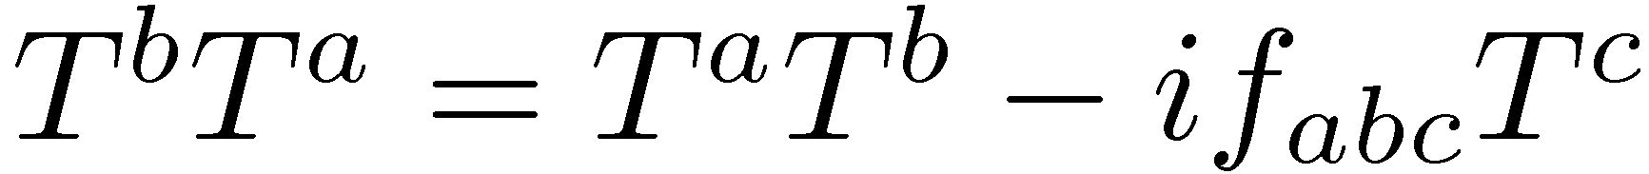
C) Inelastic Collisions
Low mass quarks : radiation dominantes energy loss
Charm and bottom: radiation of the same order as collisional
4 QED type diagrams
Commutator of the color SU(3) operators
M1-M5 : 3 gauge invariant subgroups
1 QCD diagram
M_{QCD} dominates the radiation

Slide 9
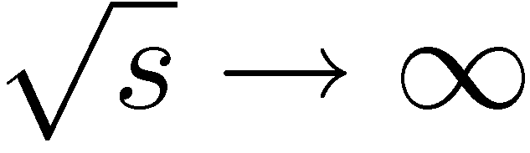
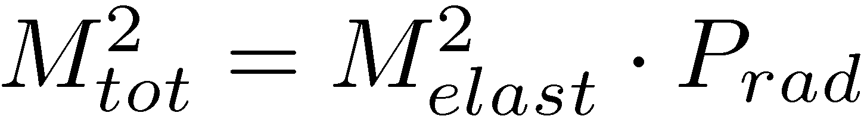
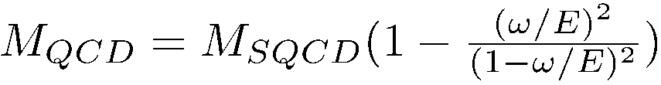
M^{SQCD} in light cone gauge
In the limit the radiation matrix elements factorize in
k_{t} , ω = transv mom/ energy of gluon E = energy of the heavy quark
Emission from heavy q
Emission from g
leading order: no emission
m=0 -> Gunion Bertsch from light q
Energy loss: heals colinear divergences
x=/E
We include Landau-Pomeranschuk Migdal effect

Slide 10
Calculations for LHC
Initialization: FONLL distribution of c and b
QGP : EPOS2
Interaction QGP-heavy quarks:
elastic collisions (collisional energy loss) (K ≈ 2)
elastic collisions + and gluon emission (radiative energy loss)
+LPM
Hadronisation:
Coalescence for low pt heavy quarks
Fragmentation for high pt heavy quarks
Hadronic rescattering is small

Slide 11
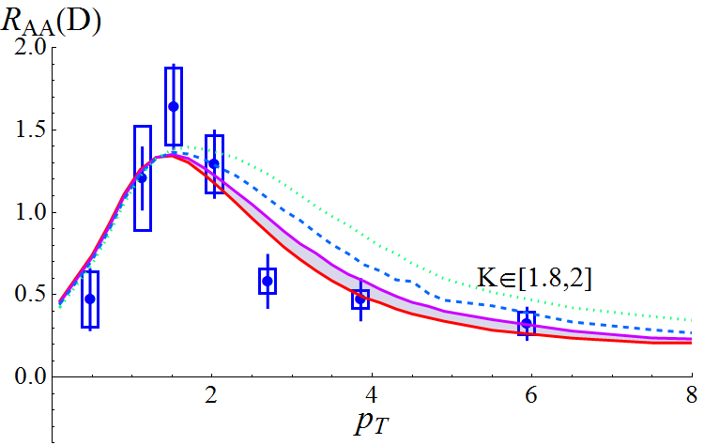
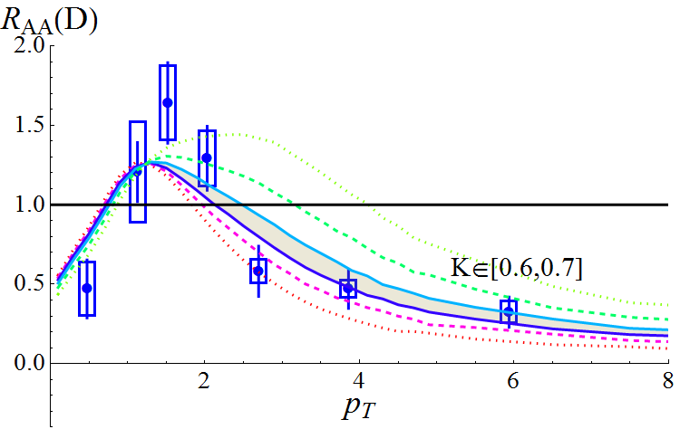
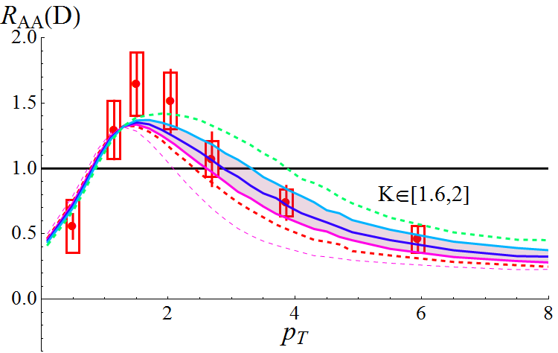
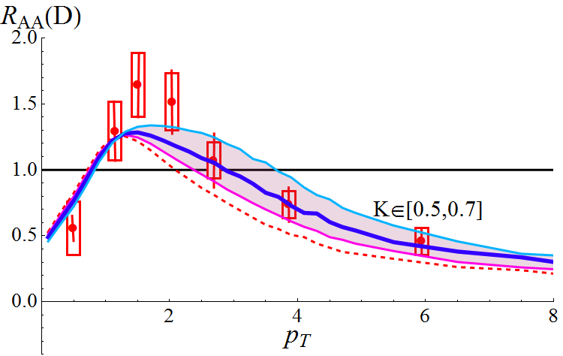
Energy loss tests the initial phase of the expansion
RHIC: D mesons
Elastic
Elastic + radiative LPM
0-10%
0-80%
No form difference between coll and coll + rad

Slide 12
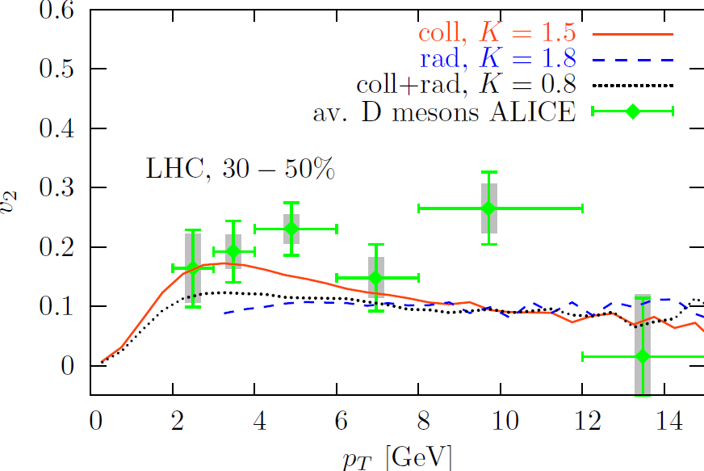
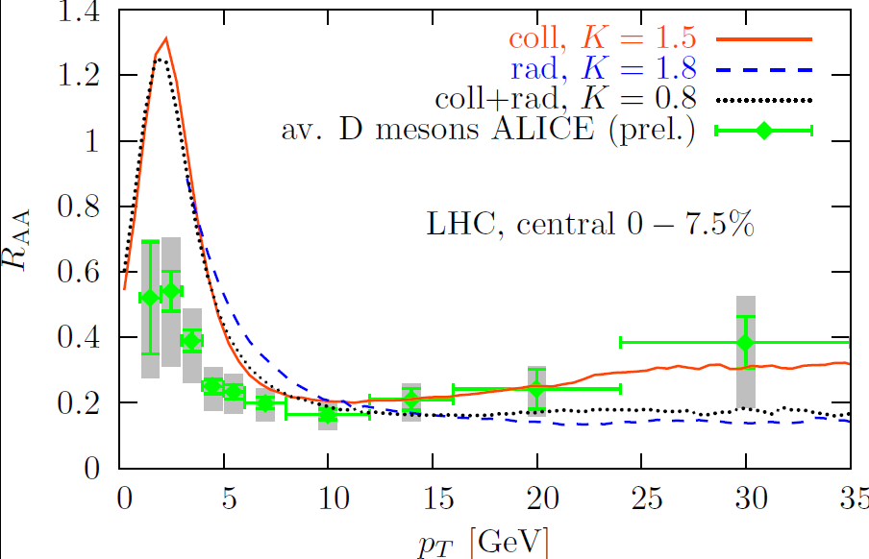
LHC : EPOS event generator
v₂ tests the late stage of the expansion
Energy loss tests the initial phase of the expansion
3 options : Collisions only K factor = 1.5
Collision and radiation K = 0.8
Radiation only K= 1.8
R_{AA} and v₂ for coll and
coll + radiative about the same
B much more suppressed

Slide 13
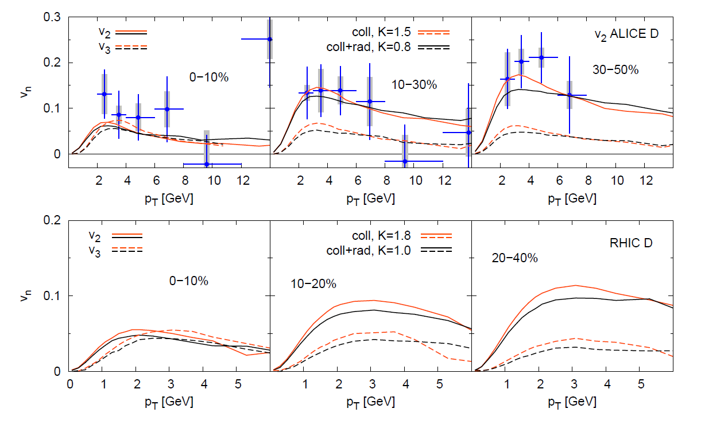
Heavy quarks show also a finite v₃ and finite higher moments
What can one learn from these results?
v₂ decreases with centrality -> understandable with the decrease of ϵ₂
v₃ independent of centrality -> fluctuations

Slide 14
Analysis of the results

Slide 15
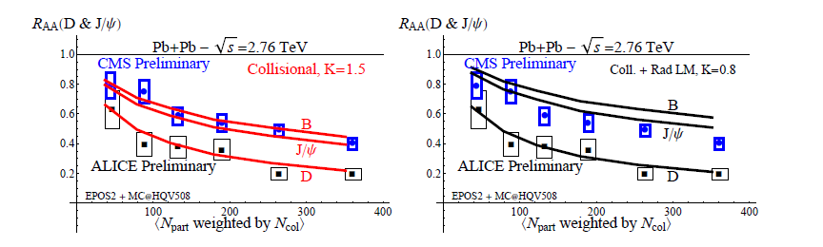
The different R_{AA} of D and B mesons seem to be verified experimentally
(by comparing two different experiments)

Slide 16
Where do the finite v_{i} come from?
z
In the ideal world the plasma
Should have only v₂
Plasma to be
studied
Reaction plane
y
x
In the real world (EPOS) the
plasma has all kinds of moments v_{i}
the v_{i} impair are fluctuations
v₃ corresponds to a Mercedes Star

Slide 17
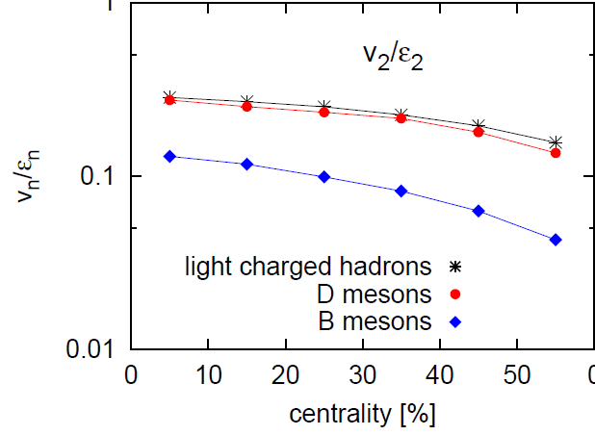
Very surprising : v₂ /ϵ₂ : same for light hadrons and D mesons
Light quarks: hydro-dynamical pressure caused by spatial eccentricity
v₂ /ϵ₂ const for ideal hydro, centrality dependent for viscous hydro
Heavy quarks: No initial v₂ (hard process)
v₂ only due to interaction with q and g
v₂ of heavy quarks is created later, measures the interaction time
Bottom quarks are too heavy to follow

Slide 18
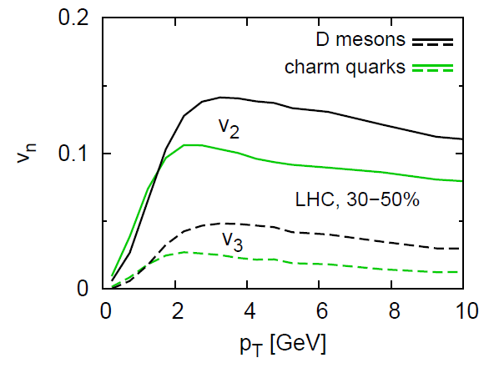
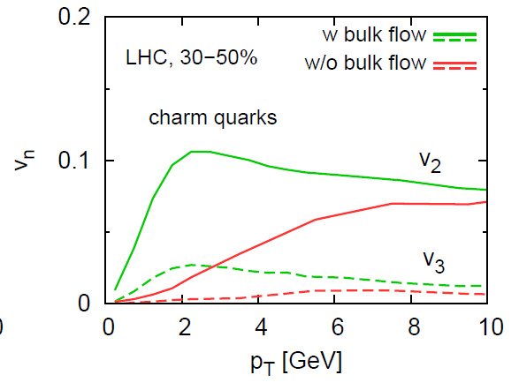
More detailed analysis of the flow
20% of v₂ due to the hadronisation
uncertainty
fragmentation or coalescence
Verification that collective flow creates v₂
Artificial elimination of the collective flow
High momentum: different path length
in and out of plane

Slide 19
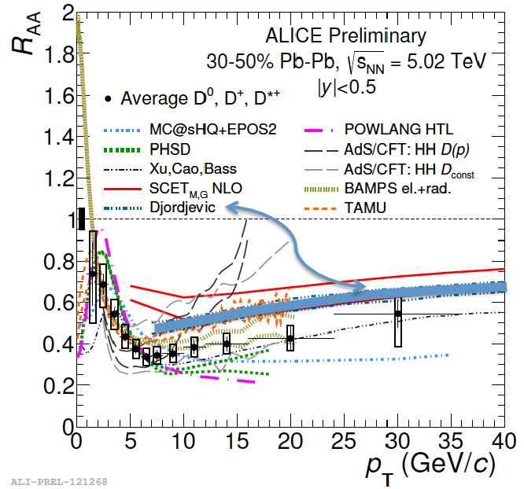
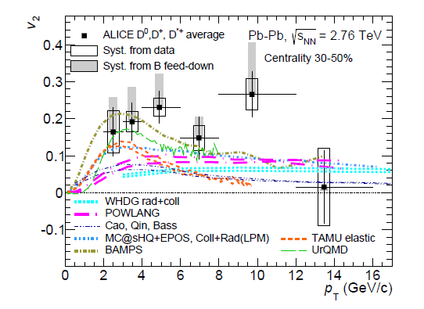
State of the Art of the Field
Evidently there are many approaches which describe
the two key observables R_{AA} and v_{2.}
despite of quite different physics input

Slide 20
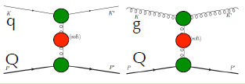
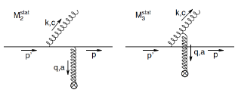
Models studying R_{AA} and v₂ simultaneously
assume that the passage through QPG medium can be
modeled by independent collisions (besides LPM)
Born type cross sections and FONLL initial distribution of heavy quarks
but
- different cross section (collisional, radiative or both, b and c)
different coupling constants α(Q² ), α(T), α= const
different masses in the propagators (form of the propagators)
different masses in exit and entrance channel m₀ , m(T)
different initial QGP
different expansion scenarios (viscous, ideal hydro, gas of q,g)
different hadronization ( coalescence, fragmentation)
R_{AA} and v₂ are not sufficient to nail down all these model parameters
collisional
radiative

Slide 21

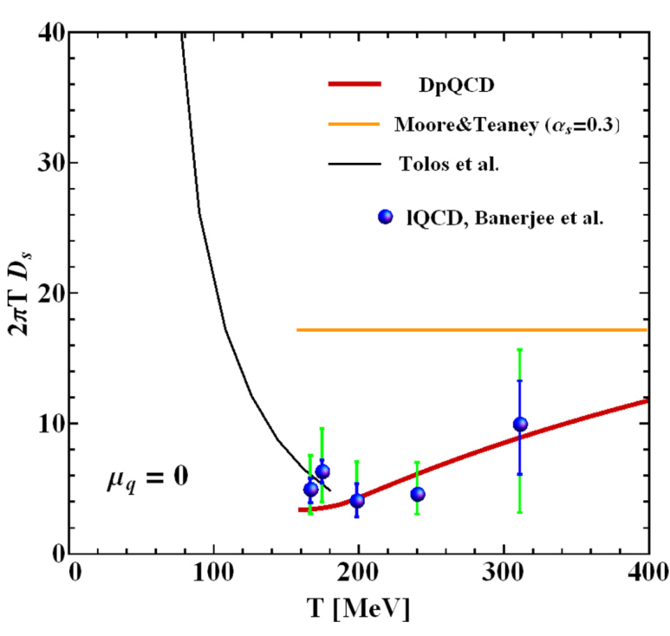

All agree on:
FONLL is the proper initial condition (shadowing??)
pQCD cross sections (α=0.3 , m=m₀ ) are too small to explain data
Confirmed by lattice calculations : Spatial diffusion coefficient
PRC90, 051901
A= drift coefficient
PRC90,064906

Slide 22
How to compare different approaches
and what
is the result?
Sequence of meetings:
Berkeley I and II
EMMi/ GSI
Leiden

Slide 23
Different numerical approaches
Fokker-Planck
Langevin
Brownian Motion
Advantage:
- very general approach
- Whole kinematics of HQ is reduced to (mom. dep.) drag and diffusion coefficient
related by the Einstein relation
Drawback:
- Physics very difficult to asses
if coeff. not determined from an underlying theory
- Need lattice data, or underlying theory
- otherwise it is a fit
Boltzmann collision integral
Advantage:
- Interaction between HQ and partons is related to the underlying Lagrangian
(Feynman diagrams) -> microscopic
interpretation possible
- Allows for the calculation of drag and
diffusion coeff. independently
Drawback:
- Assumes asympt. free states (low density)
- Presently only effective Lagrangians
Strategy:
Boltzmann type models calculate drag and diffusion coefficients
which can be compared with the Langevin approaches

Slide 24
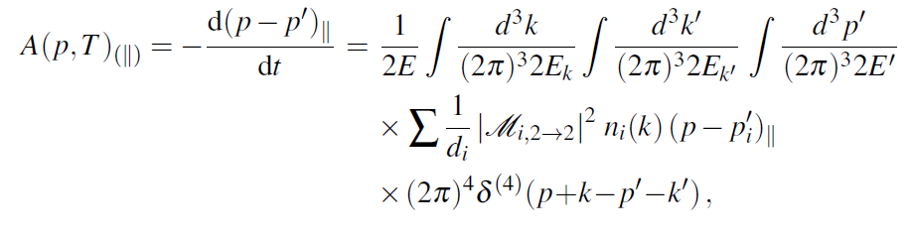
How to advance to compare very different theories?
As far as collisions are concerned: Start with transport coefficients
= Reaction of a fast particle on a thermal environment
Drag coefficient:
reduces the cross section information to a function of 2 variables: p,T
can be calculated for every cross section
-> makes cross sections comparable

Slide 25
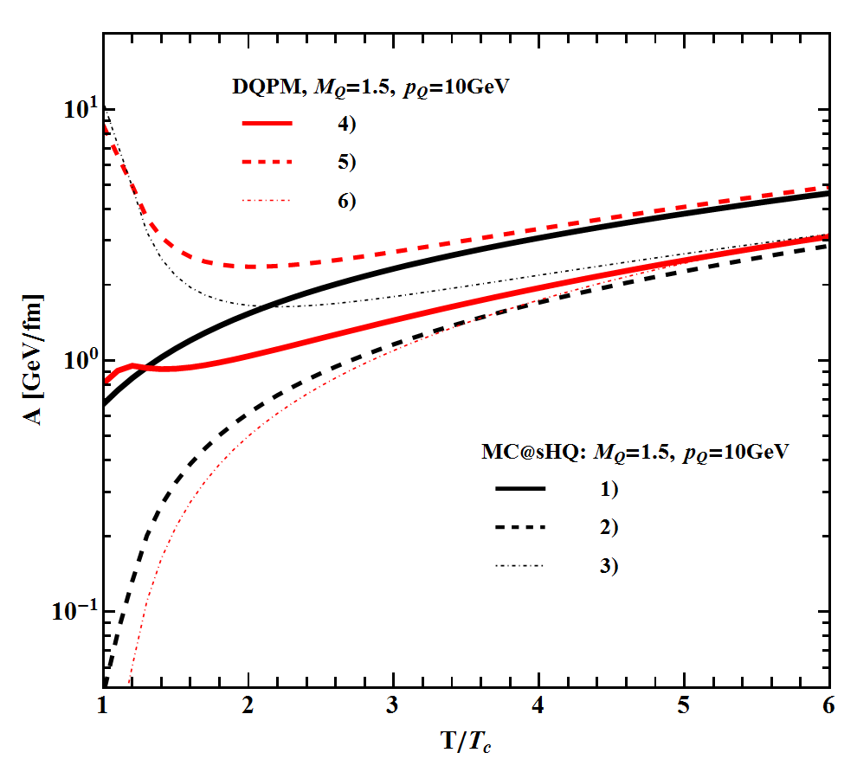
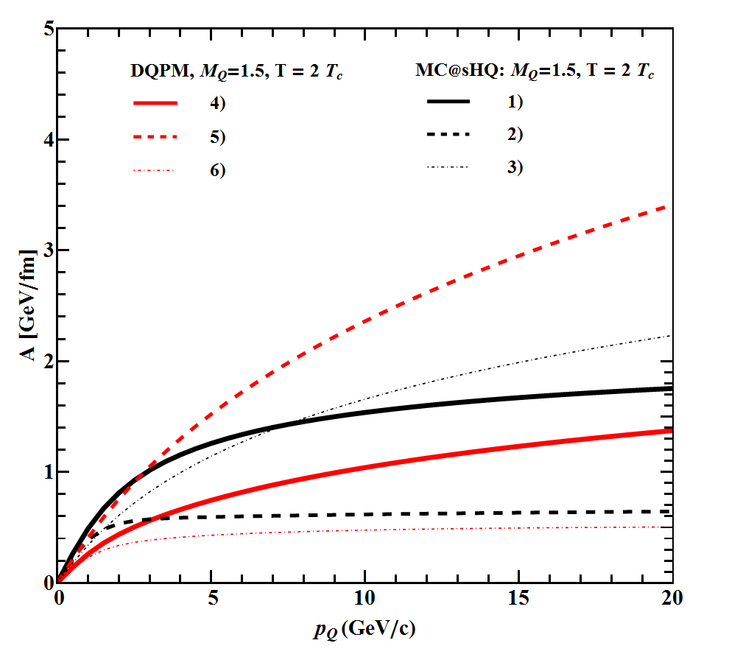
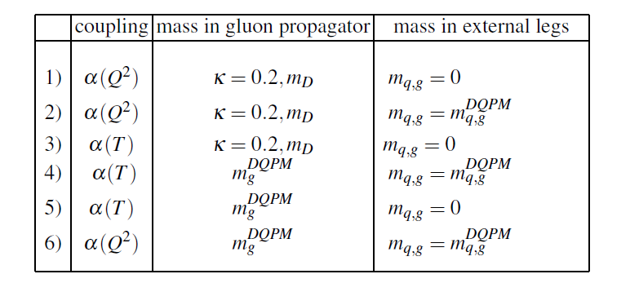
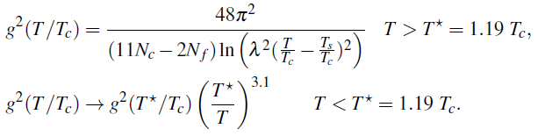
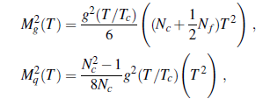

Example : EPOSHQ and PHSD
EPOSHQ
1:2 final state mass
1:3 α(T) <-> α(Q² )
3:5 propagator
DQPM/
PHSD
:
Late energy loss

Slide 26
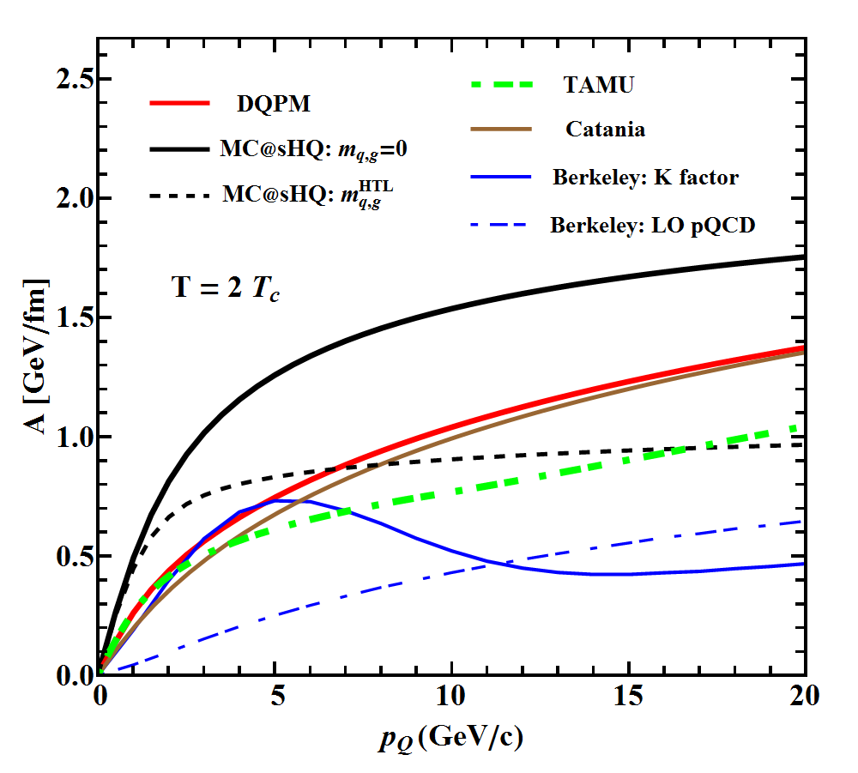
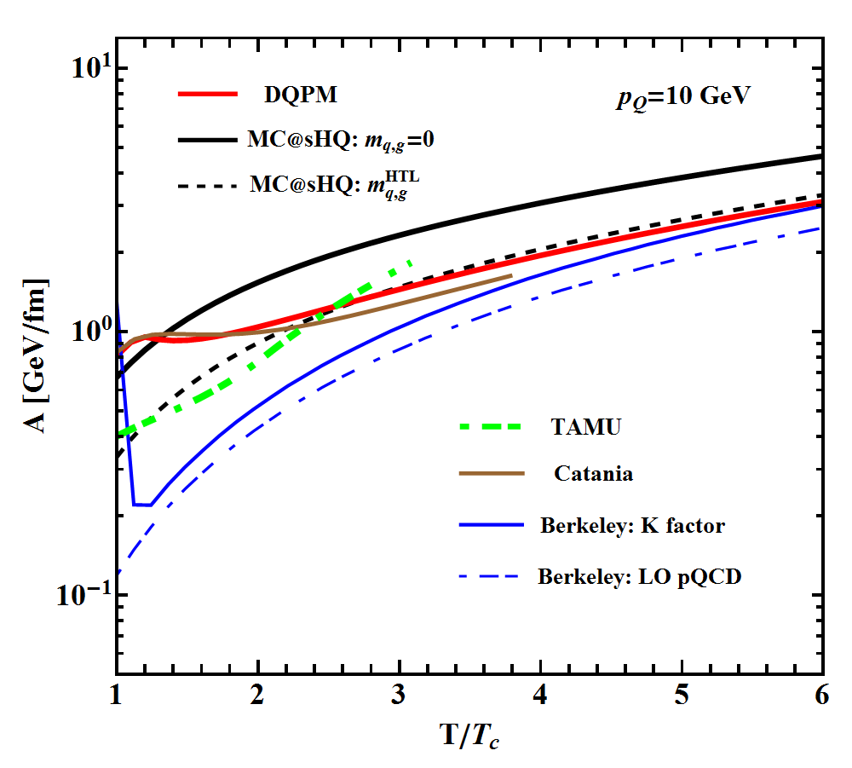
c-quarks reaction to the QGP environment rather differently in the diff. codes
large momentum loss close to T_{c} like DQPM(PHSD), Catania,Berkeley
large energy loss at T > T_{c} Nantes, pQCD like ,TAMU
Only the integral over the energy loss can be measured !!
(obviously the same because all describe data)
Elastic energy loss and c-quarks only

Slide 27
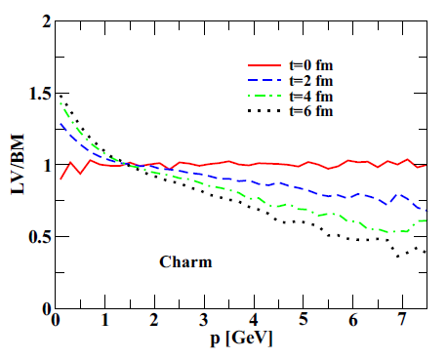
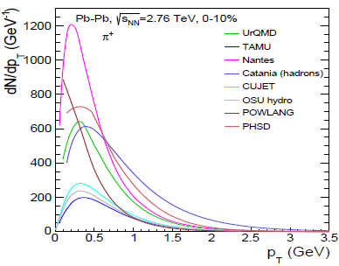
Treatment of non-pQCD features will still need a lot of discussions
among us and with the lattice community
but what we can do immediately
is to use the right (complicated) tools
for plasma expansion for the cq and cg interaction
Different models Different descriptions of the
For the QGP expansion c cbar - QGP interaction
Fokker-Planck (FP)<->Boltzmann(BM)
Catania group
PRC90(14)044901
EMMI workshop
proceedings

Slide 28
Conclusions
All experimental midrapidity RHIC and LHC data are compatible with the assumption that
pQCD describes energy loss and elliptic flow v₂ of heavy quarks. Special features running coupling constant
adjusted Debye mass
Landau Pomeranschuk Migdal
QGP expansion QGP must be controlled by light hadrons (EPOS)
Data do not allow for discriminating between different pQCD processes: radiative and collisional energy loss
First results about the physics are now possible
- b/c results
Origin of the flow (p_{T})
Effective degrees of freedom of the QGP

Slide 29
But
There are several approaches which reproduce
R_{AA} and v_{2.}
the presently only available data.
We measure only integrated energy loss in an expanding QGP
It can be obtain in many ways
lQCD EOS does not help a lot: masses are only one of the ingredients
lQCD spatial diffusion coeff -> pQCD does not work
We have to wait for new observables (identified b, Δφ of DbarD,Dh,
high precision v_{2,} D_{S}) and more input from lQCD
What transport people can do:
Using for the QGP expansion only models which reproduces
data in the light quark sector
Abandon Fokker-Planck approaches and concentrate on the
much more demanding Boltzmann collision kernel
We have to assure a kind of quality control

Slide 30
Collaborators
Nantes Vitalii Ozvenchuck
Pol Gossiaux
Thierry Gousset
Marlene Nahrgang
Luuk Vermunt
Klaus Werner
Frankfurt Hamza Berrehrah
Elena Bratkovskaya
Pierre Moreau
Taesoo Song
Giessen Wolfgang Cassing
Duke Steffen Bass
LBL Shanshan Cao
Xin-Nian Wang

Slide 31
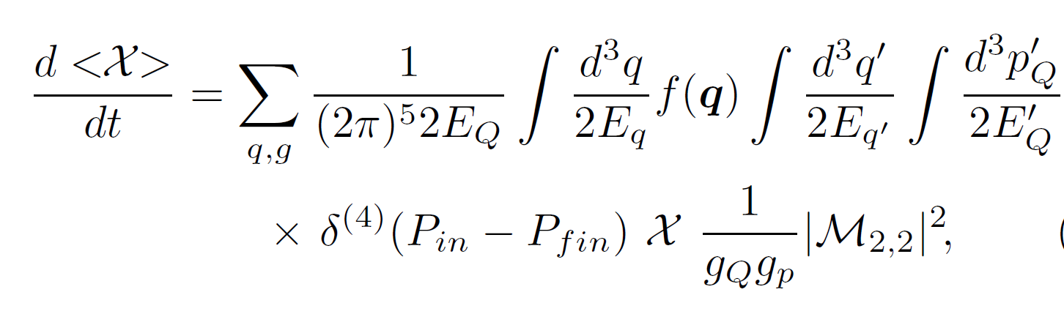
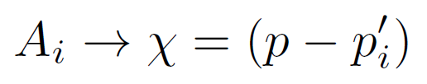
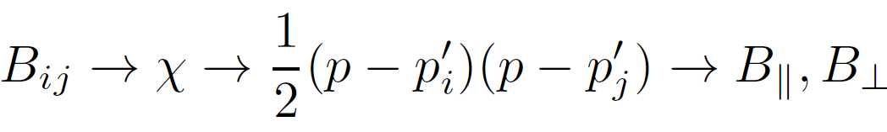
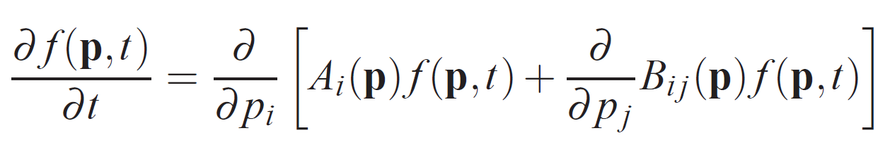
From Boltzmann to Fokker – Planck
One start with the Boltzmann collision term and forms mean values :
The drag is given by
and the diffusion by
These are the coefficients need for the Fokker-Planck equation

Slide 32


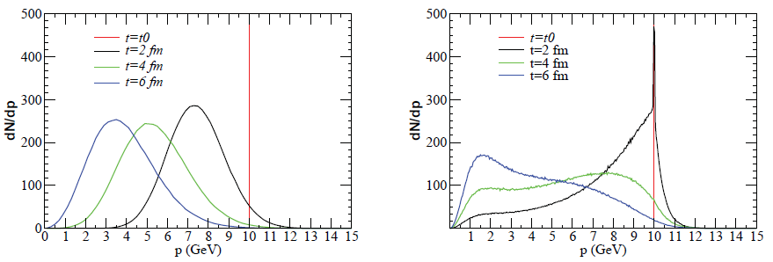
4 Observations
Whereas the Boltzmann integral brings the heavy quarks for t →∞ to a thermal
equilibrium, the Fokker Planck equation does this only if
AND A and B related by Einstein relation
This is (by far) not the case if A and B are calculated from Boltzmann collision Kernel
This leaves three options ( ) to relate Fokker Planck to Boltzmann
different choices have been made -> different results
b) Time evolution of f(p,r,t) of c with Fokker Planck is very different as compared to
Boltzmann eq. (Das et al. PRC90(14)044901) (here B is used to determine drag)
m_{D} ≈
m_{D}^{latt}
FP
Boltzmann
FP

Slide 33
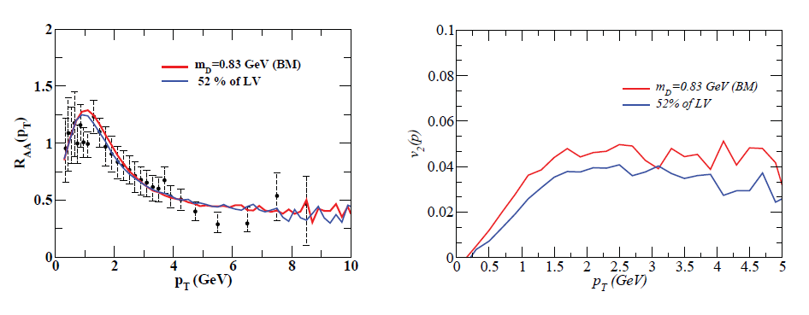
For realistic Debye masses (Kaczmarek et al.
(1206.19912))
to reproduce data:
we need by a factor of 2
different drag and diffusion coefficient
Depending on whether we apply
FP or Boltzmann.
LV: diffusion coeff 52%
of that of Boltzmann

Slide 34
