Slide 1





Forward-backward multiplicity correlations in pp collisions at LHC within the QGSM
L. Bravina
Notes:
1

Slide 2
Outline
Forward-backward multiplicity correlations in hadronic interactions
Quark-gluon string model (QGSM)
FB correlations at intermediate energies
Origin of FB correlations at LHC energies; comparison with data
Conclusions
Notes:
PANIC 2008 November
2

Slide 3
I. Forward-backward multiplicity correlations in hadronic interactions
Notes:
PANIC 2008 November
3

Slide 4
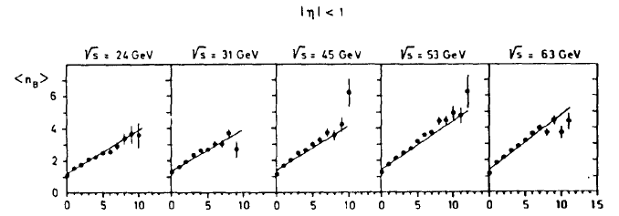
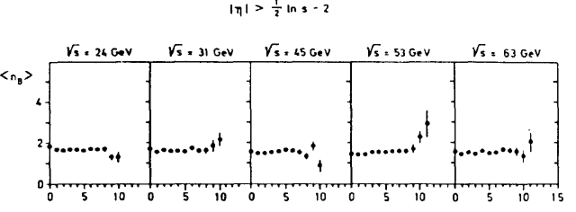
Observation of strong correlations (ISR)
S. Uhlig et al., NPB 132 (1978) 15
central region
fragmentation region
Notes:
4

Slide 5


Main results
The FB multiplicity correlations are positive
Correlations are stronger for anti-pp collisions compared to pp ones (at energies below 100 GeV)
No sizeable FB correlations were found in e⁺e⁻ annihilation up to 93 GeV
Correlations are due to central region |x_{F}| < 0.1
Notes:
5

Slide 6
(some) references
theory/models
Experiment
A.~Capella, A.~Krzywicki, PRD 18 (1978) 4120.
A.~Capella, J.Tran Thanh Van,
ZPhC 18 (1983) 85.
J.~Dias~de~Deus, PLB 100 (1981) 177.
T.T.~Chou, C.N.~Yang, PLB 135 (1984) 175.
B.~Carazza, Nuovo Cim. 99 (1988) 731.
S.~Barshay, PLB 199 (1987) 121.
L.K.~Chen, D.~Kiang, C.K.~Chew,
PLB 408 (1997) 422.
N.~Armesto, M.A.~Braun, E.G.~Ferreiro, C.~Pajares, NPA 661 (1999) 325c.
M.A.~Braun, C.~Pajares, V.V.~Vechernin,
PLB 493 (2000) 54.
V.V.~Vechernin, NPA 939 (2015) 21.
A.~Capella et al.,Phys. Rep. 236 (1994) 225.
N.S.~Amelin et al., PRL 73 (1994) 2813.
Y.-L.~Yan et al., NPA 834 (2010) 320c.
K.~Wraight, P.~Skands, EPJC 71 (2011) 1628.
V.~Kovalenko, V.~Vechernin, arXiv:1410.3884 [hep-ph].
K.~Alpgaard et al., UA5 Collab.,
Phys. Lett. B 123 (1983) 361.
G.G.~Alner et al., UA5 Collab.,
Phys. Rep. 154 (1987) 247.
R.E.~Ansorge et al., UA5 Collab.,
Z. Phys. C 37 (1988) 191.
S.~Uhlig, et al.,
Nucl. Phys. B 132 (1978) 15.
L.V.~Bravina et al., Mirabelle Collab.,
Sov. J. Nucl. Phys. 50 (1989) 245.
V.V.~Aivazyan et al., NA22 Collab.,
Z. Phys. C 42 (1989) 533.
T.~Alexopoulos et al., E735 Collab.,
Phys. Lett. B 353 (1995) 155.
J.~Adam et al., ALICE Collab.,
J. High Energy Phys. JHEP05 (2015) 097.
W.~Braunschweig et al., TASSO Collab.,
Z. Phys. C 45 (1989) 193.
R.~Akers, et al., OPAL Collaboration,
Phys. Lett. B 320(1994) 417.
Notes:
6

Slide 7
II. Quark-Gluon String Model (QGSM)
Notes:
PANIC 2008 November
7

Slide 8
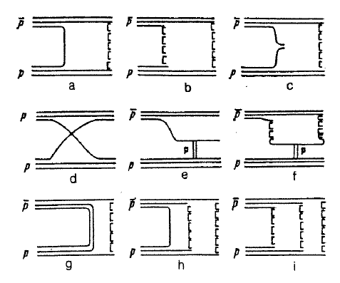
Diagrams at intermediate energies
(a) -- planar
(b) -- cylindrical
(c) – undeveloped cylinder
(d) – quark rearrangement
(e) – single diffraction of small mass
(f) – single diffraction of large mass
(g)-(i) – annihilation diagrams
+ double diffraction diagrams similar to (e),(f)
Because of the different sets of diagrams for pp and anti-pp collisions
(particularly, annihilation) there should be a difference in FB multiplicity
correlations for these two reactions.
Notes:
8

Slide 9
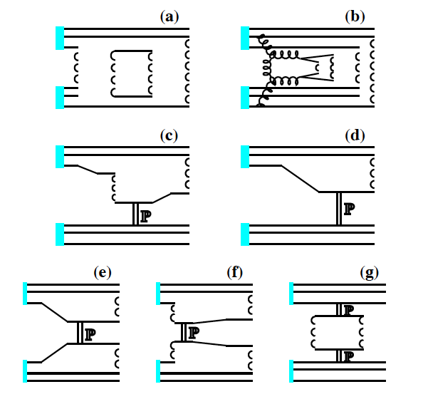
Diagrams at ultrarelativistic energies
(a) -- multi-cylinder
(b) – semihard
(+ soft) Pomeron
(c) – single diffraction of large mass
(d) – single diffraction of small mass
(e) – double diffraction of small mass
(f) – double diffraction of large mass
(g) – central diffraction
At ultrarelativistic energies only few diagrams are left, whereas cross
sections of annihilation and pre-asymptotic processes quickly drop
=> No difference between pp and anti-pp collisions
Notes:
9

Slide 10
III. FB multiplicity correlations at intermediate energies
Notes:
PANIC 2008 November
10

Slide 11
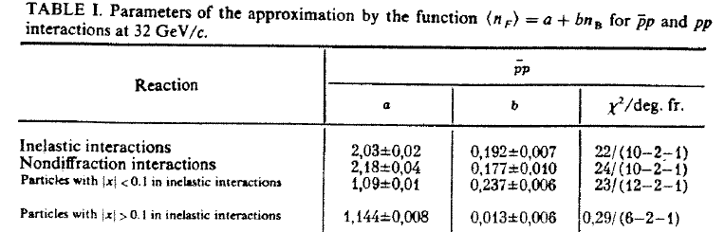
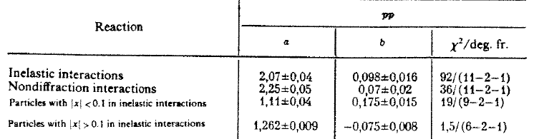
(anti)pp @ 32 GeV/c (data)
L.B. et al., Sov. J. Nucl. Phys. 50 (1989) 245
No long-range correlations between the fragmentation regions
Notes:
11

Slide 12
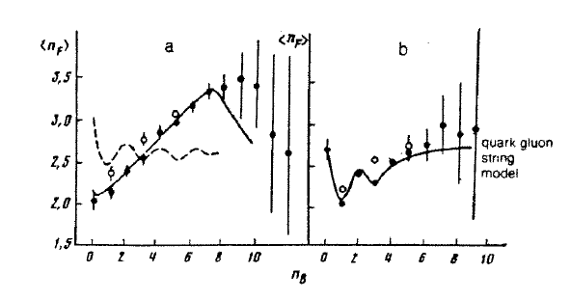
(anti)pp @ 32 GeV/c vs. QGSM
antiproton-proton proton-proton
L.B. et al., Sov. J. Nucl. Phys. 50 (1989) 245
Closed points: inelastic collisions
Open points: non-diffractive collisions
Solid curves: QGSM
Dashed curve: Lund
Notes:
12

Slide 13
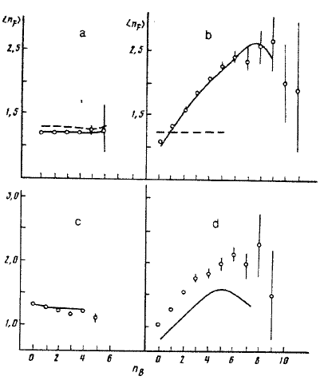
(anti)pp @ 32 GeV/c vs. QGSM
antiproton-proton
Open points: inelastic collisions
Solid curves: QGSM
Dashed curves: Lund
|x| > 0.1
|x| < 0.1
L.B. et al., Sov. J. Nucl. Phys. 50 (1989) 245
proton-proton
No long-range correlations
Positive FB correlations
come from the region
|x| < 0.1 corresponding
to |y| < 1, i.e. midrapidity region
Notes:
13

Slide 14
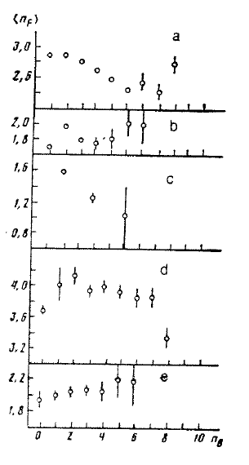
FB correlations within the subprocesses
– cylindrical diagrams
(b) – undeveloped cylinder
(c) – diffraction diagrams
(d) – annihilation diagrams
(e) – planar diagrams
L.B. et al., Sov. J. Nucl. Phys. 50 (1989) 245
No correlations
No correlations in individual processes, however,
addition of all these processes with different <n_{F}> leads to appearance of positive correlations <n_{F}>(n_{B})
Notes:
14

Slide 15
IV. Origin of FB multiplicity correlations in QGSM at LHC energies
Notes:
PANIC 2008 November
15

Slide 16
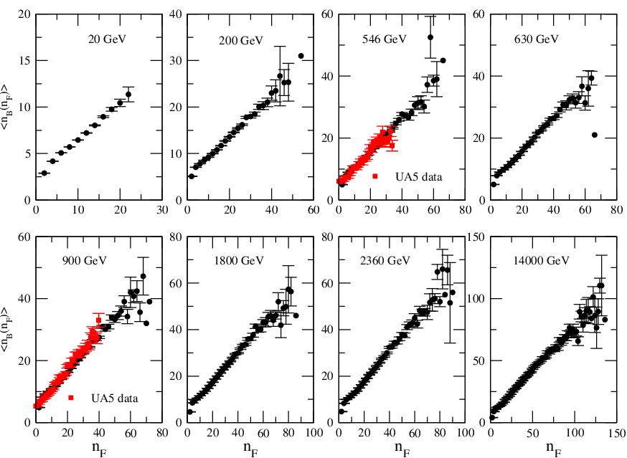
pp @ 20 GeV to 14 TeV in QGSM
The slope is almost linear; (2) no difference between pp and anti-pp at high
energies; (3) slope parameter b increases with rising energy; (4) saturation of
the increase at high multiplicities. Why?
Notes:
16

Slide 17
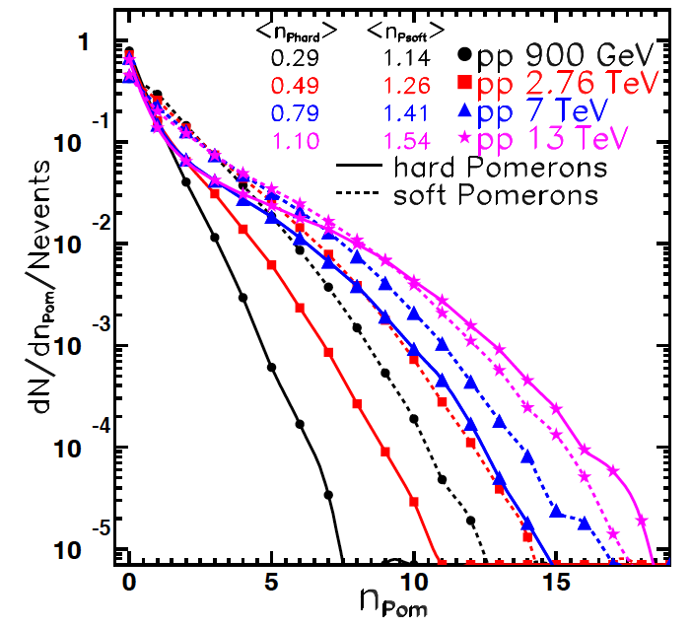
Rel. weight of soft and hard Pomerons
The ratio hard/soft increases from 0.29 : 1.14 (900 GeV)
to 1.10 : 1.54 (13 TeV)
Notes:
17

Slide 18
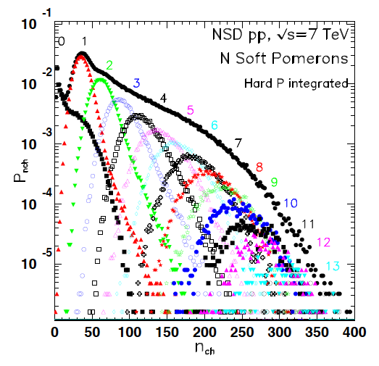
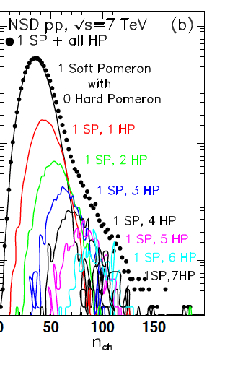
Contribution of soft and hard Pomerons
Soft Pomerons
Hard Pomerons
Notes:
18

Slide 19
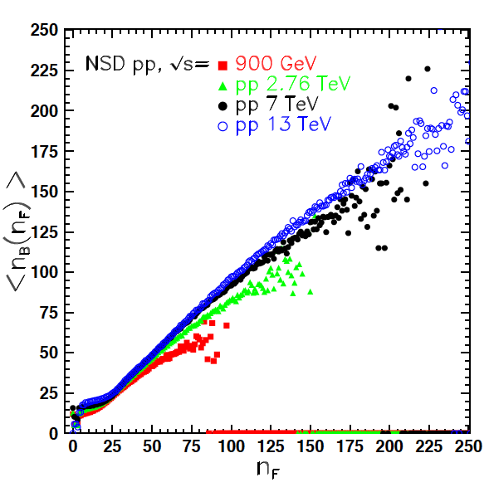
Change of the slope with energy
The slope increases. Also, the distributions are more horizontal at very small and very high multiplicities. Why?
Notes:
19

Slide 20
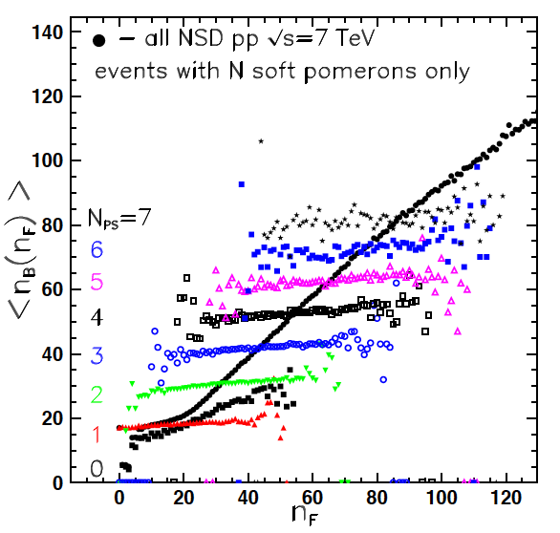
Contributions of n-Pomeron processes
If we select processes
going via
1,2,…N Pomerons,
then the distributions
are remarkably flat
(no FB correlations).
However, average
multiplicities are
different.
This leads to positive
correlations when one
adds all processes
together. The same
is true for the diffraction,
but the slope is not so
steep, therefore
b_{NSD} > b_{inel}
Notes:
20

Slide 21
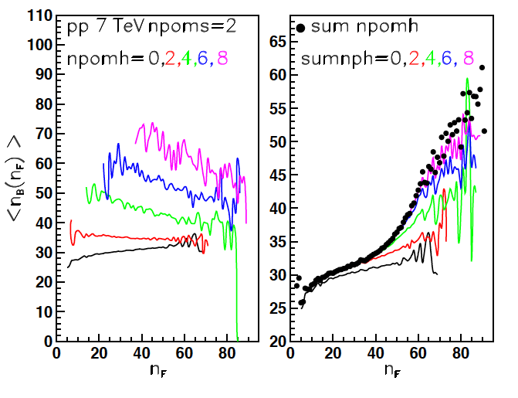
FB correlations for hard Pomerons
Positive FB correlations arise when we add events
with different amount of hard Pomerons
Notes:
21

Slide 22
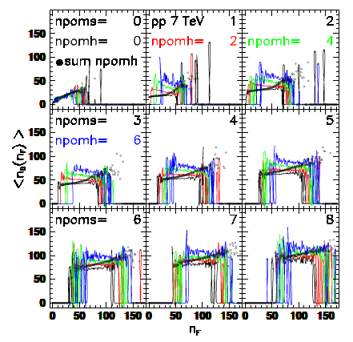
more details …
Notes:
22

Slide 23
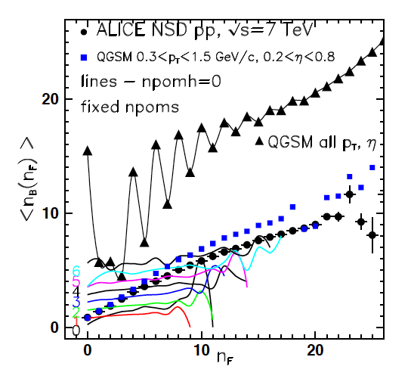
Comparison with LHC data
ALICE Collaboration,
JHEP05 (2015) 097
Agreement is good, however, in addition to SD we drop DD events as well. Solid curve displays results for NSD events in the full phase space. The oscillations are due to DD events.
This effect would be interesting to measure.
Notes:
23

Slide 24
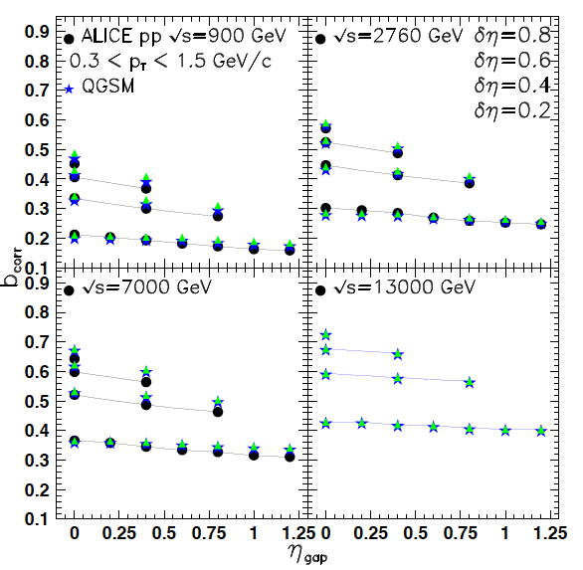
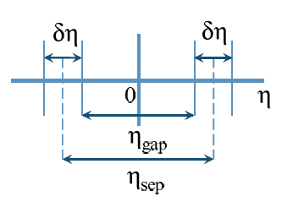
Comparison with LHC data
Dependence of b_{corr} on δη and η_{gap} is close to experiment
Notes:
24

Slide 25
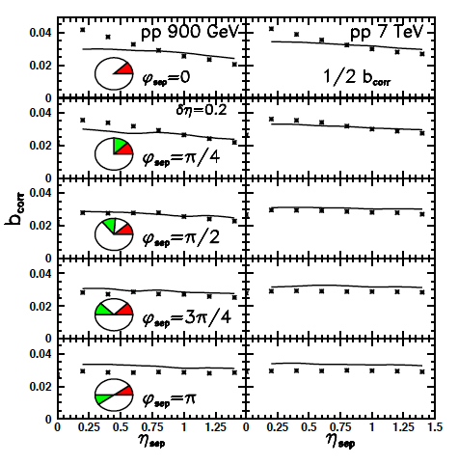
Comparison with LHC data
ALICE Collaboration,
JHEP05 (2015) 097
FB multiplicity correlations are studied in azimuthal sectors. Except of the absolute strength of the correlations, there is a very weak difference between the distributions at 900 GeV and 7 TeV.
Notes:
25

Slide 26
Conclusions
In pp and pp collisions positive forward-backward correlations
of the multiplicity of particles are observed in QGSM in a broad
energy range from 8 GeV to 14 TeV
At energies below 100 GeV the correlations are higher for
pp interactions
The observed dependences are due to hadrons coming from
the central area |x_{F}| < 0.1
No correlations are observed for events corresponding to the
same mechanism of particle production
At lowest and highest multiplicities the distributions are more
flat
The analysis shows that these correlations are not “true”
correlations due to the mechanism of particle production but
arise as a consequence of the addition of events corresponding
to different production mechanisms with different average
multiplicities of secondary hadrons. This is in line with the
observations of other models.
−
−

