Slide 1

Initial state & Λ polarization
Current status of QCD from
nuclear reactions to the high energy frontier -
COST-THOR meeting – FIAS, Frankfurt am Main, Jan 19-20, 2017

Slide 2
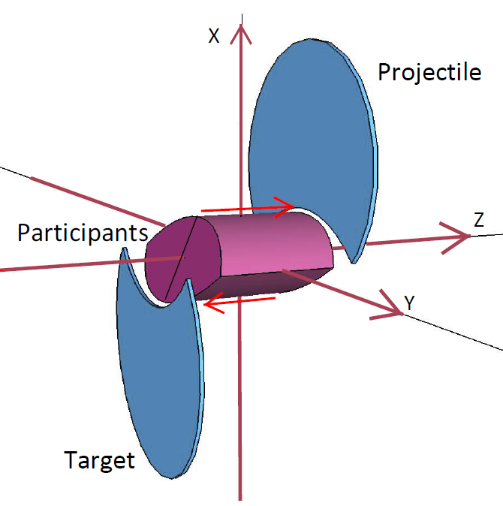
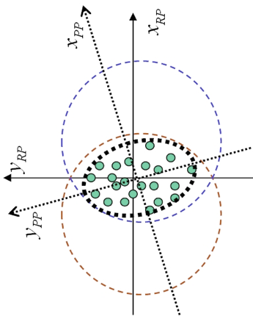
Peripheral Collisions (A+A) ➔ v₂ flow

Slide 3
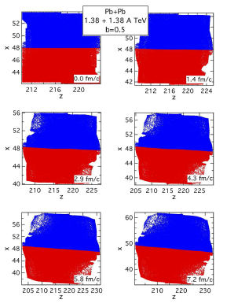
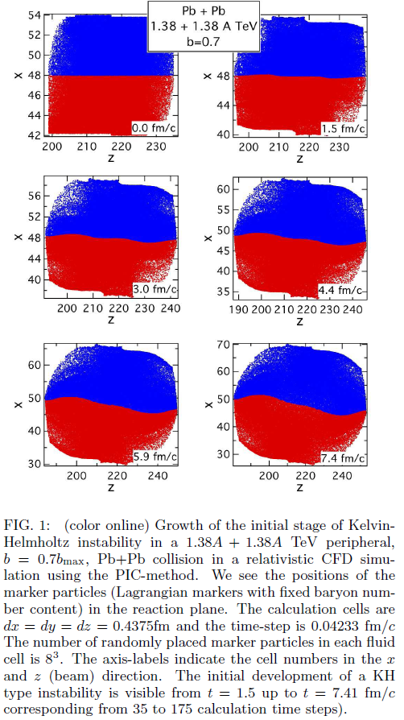
PICR: Shear & Turbulence → KHI
ROTATION – high η
KHI– low η
KHI
2.4 fm

Slide 4
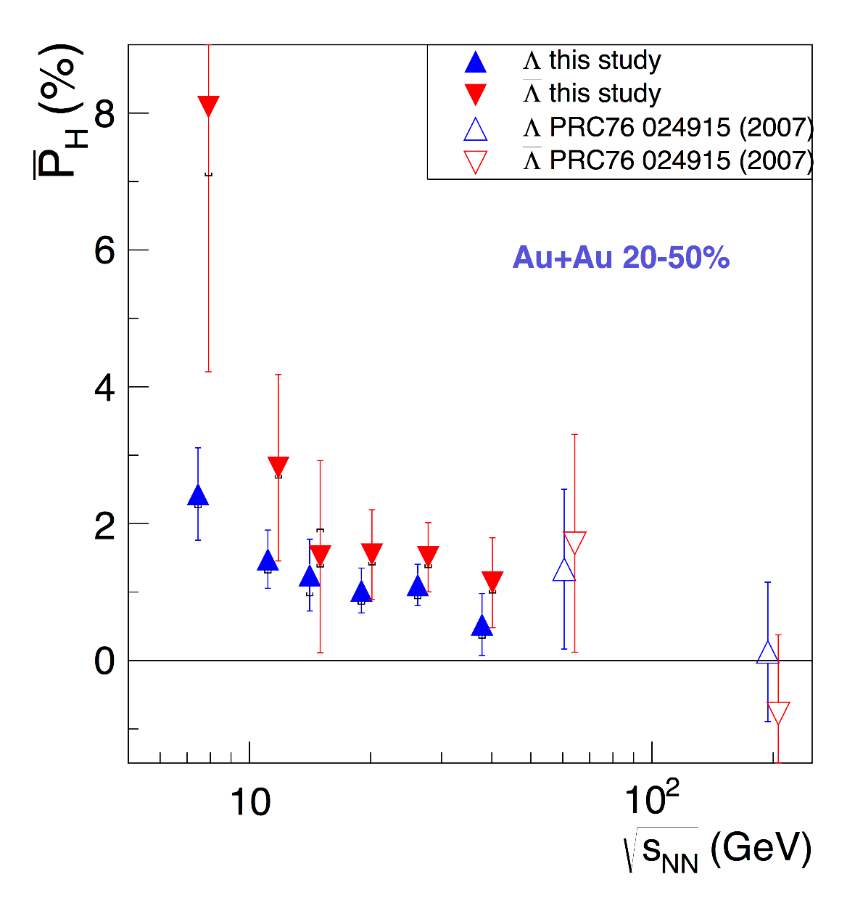
Rotation and Turbulence - (2015-16)
● STAR results
[M.A. Lisa, et al. (STAR Collaboration), Invited talk, QCD Chirality Workshop - UCLA,
February 23-26, 2016, Los Angeles, USA.]

Slide 5
Observable consequences
Mike Lisa & STAR
Λ & anti- Λ
polarization

Slide 6
Initial State – Peripheral reactions
Magas, Csernai, Strottman (2001), (2002)
Yang-Mills flux tube model for longitudinal streaks
String tension is decreasing at the periphery
Initial shear & vorticity is present

Slide 7
Present parton kinetic models
- HIJING, AMPT, PACIAE
Different space-time configurations
[Long-Gang Pang, Hannah Petersen, Guang-You Qin, Victor Roy and Xin-Nian Wang, 27 September - 3 October
2015, Kobe, Japan; and Long-Gang Pang, Hannah Petersen, Guang-You Qin, Victor Roy, Xin-Nian Wang, arXiv: 1511.04131 ]
[Wei-Tian Deng, and Xu-Guang Huang, arXiv: 1609.01801]

Slide 8
Present parton kinetic models
- HIJING, AMPT, PATHIA
Different space-time configurations
[Wei-Tian Deng, and Xu-Guang Huang, arXiv: 1609.01801]

Slide 9

Initiative: new I.S. in τ, η coordinates
Separately for each longitudinal streak
String tension is not decreasing at the periphery
Initial shear & vorticity is present !
Conservation laws:

Slide 10

Initiative: new I.S. in τ, η coordinates
For the i-th streak (t,z) and (τ, η)
coordinates are connected as
For the central streak:
and

Slide 11


Initiative: new I.S. in τ, η coordinates
For the i-th streak:
➔ The origin, t_{0i}, z_{0i}, will be
different for each streak.

Slide 12
Initiative: new I.S. in τ, η coordinates
Thus for each streak, i, we can get the origin of the τ=τ₀ hyperbola,
from:

Slide 13
Matching I.S. to hydro
PHYSICAL REVIEW C 81, 064910 (2010)
Matching stages of heavy-ion collision models, Yun Cheng, L. P. Csernai, V. K. Magas, B. R. Schlei, and D. Strottman
There are hydro options: Cartesian / Bjorken coordinates
Transition surface, τ = const. , t = const., curved h.s.
In all cases I.S. T ^{μ ν} → Conservation laws due to EoS.

Slide 14
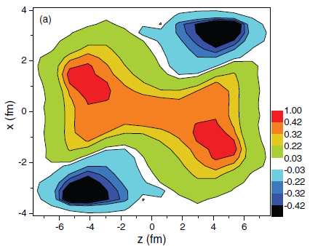
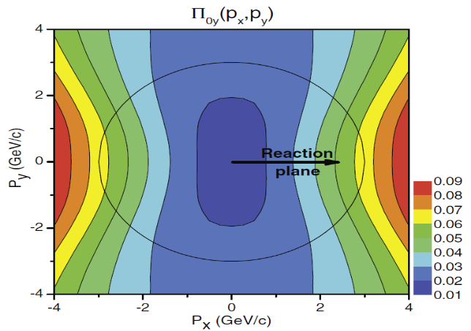
Consequences:
Will be similar to the 2001-2 I.S. in (t,z) coordinates
More compact → vorticity may survive better
The earlier results will remain qualitatively similar:
Fig. 3 The vorticity calculated in the reaction (xz) plane at t = 0.17 fm/c after the start of fluid dynamical evolution.
Fig. 4. The dominant y component of the observable polarization, Π₀(p) in the Λ’s rest frame.
The initial rotation can lead to observable vorticity (Fig. 3),
and polarization (Fig. 4): Leading vorticity term.
The initial angular momentum can be transferred to the polarization at final state, via spin-orbit coupling or equipartition.
[L. P. Csernai, et al, PRC 87, 034906 (2013)]
[F. Becattini, et al. PRC 88, 034905 (2013)]

Slide 15
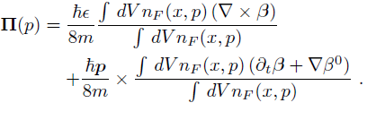


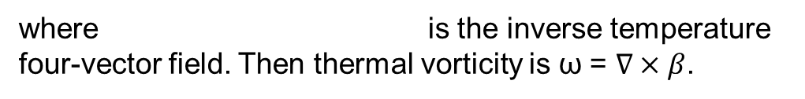
Consequences:
Based on Ref. [Becattini, 2013], Λ polarization can be calculated as:
Vorticity, 1st
Expansion, 2nd
where is the inverse temperature four-vector field. Then thermal vorticity is ω = $∇×β$.
The polarization 3-vector in the rest frame of particle can be found by Lorentz-boosting the above four-vector:
[F. Becattini, L.P. Csernai, and D.J. Wang, Phys. Rev. C 88, 034905 (2013)]

Slide 16
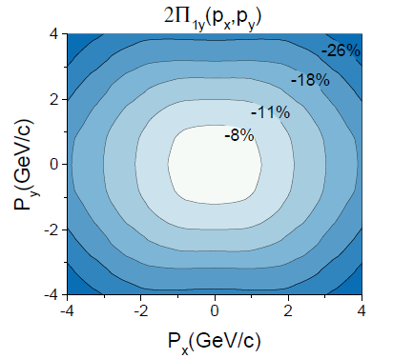
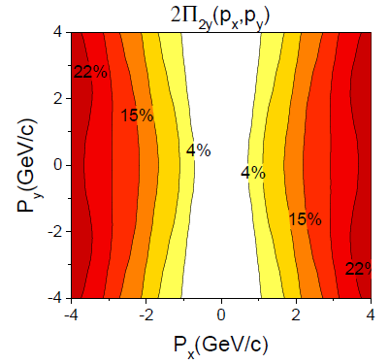
Consequences:
Fig. 6 The first (left) and second (right) term of the dominant y component of the Λ polarization for momentum vectors in the transverse plane at p_{z} = 0,for the FAIR U+U reaction at 8.0 GeV
The y component is dominant, is up to ~20%, as we can compare it with x and z components later.
1st & 2nd terms are opposite direction. Result into a relatively smaller value of global polarization.

Slide 17
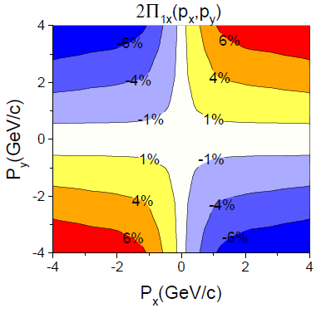
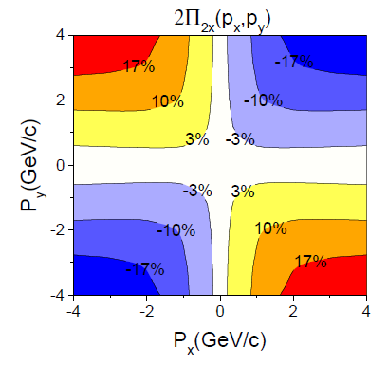
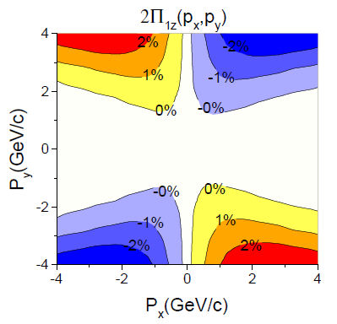
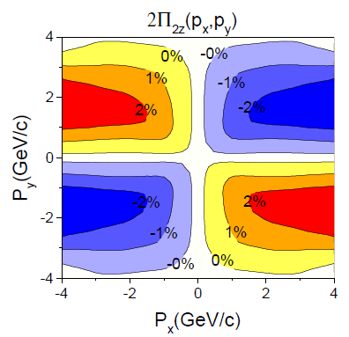
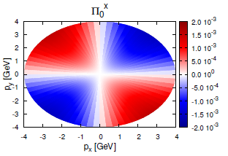
Consequences / c.m. !
Anti-symmetry
2. Trivial.
Fig. 7 The first (left) and second (right) terms of the x(up) and y(down) components of the Λ polarization for momentum vectors in the transverse plane at pz = 0,for the FAIR U+U reaction at 8.0 GeV
[Becattini, et al., Eur. Phys. J. C 75, 406 (2015).] →

Slide 18
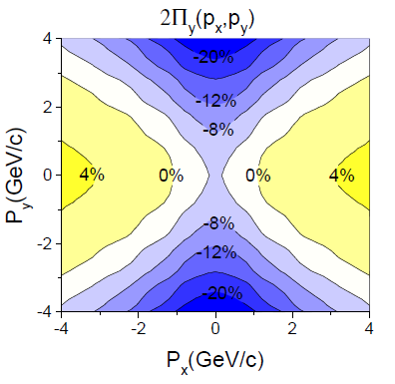
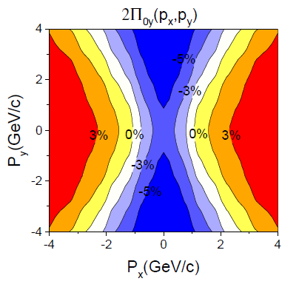
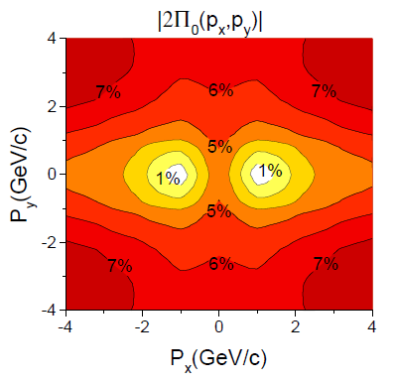
Consequences FAIR
The modulus of polarization is very similar with the y component of polarization, both in magnitude and the structure. I. e. the other x and z components do not contribute to the polarization, which is in line with previous observations in this work and other papers.
Fig. 8 The y component (left) of polarization vector in center of mass frame and Λ’s rest frame. The right sub-figure are the modulus of the polarization in Λ’s rest frame. At FAIR, 8.0 GeV at time 2.5+4.75 fm/c.

Slide 19
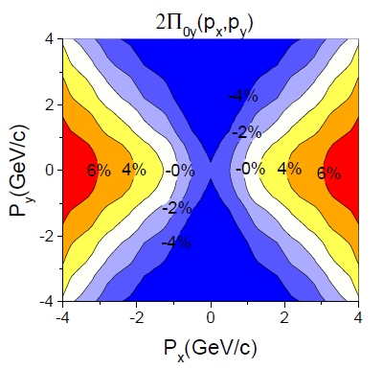
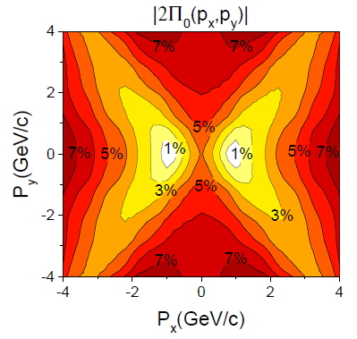
Consequences NICA
Fig. 9 The y component (left) and the modulus (right) of the polarization for momentum vectors in the transverse plane at pz = 0, for the NICA Au+Au reaction at 9.3 GeV. The figure is in the Λ’s rest frame.
Similarity between y component and modulus of Polarization, in magnitude and structure.
Similarity between NICA and FAIR’s polarization results.
The net polarization is still negative, which means the first term is larger than the second term, at this time.

Slide 20
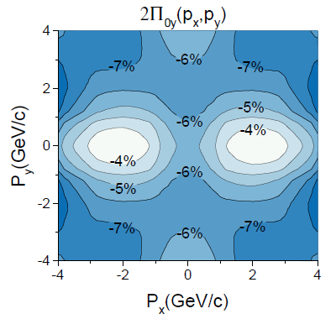
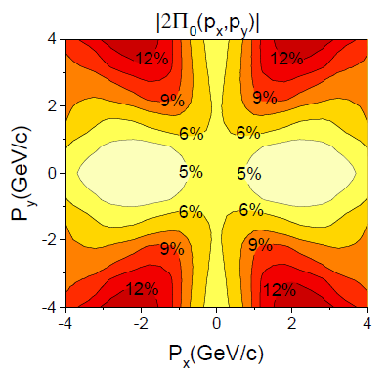
Consequences FAIR
Fig. 9 The y component (left) and the modulus (right) of the polarization for momentum vectors in the transverse plane at pz = 0, for the FAIR U+U reaction at 8.0 GeV, but at an earlier time t= 2.5+1.7 fm/c. The figure is in the Λ’s rest frame.
Initially, the first term is very dominant

Slide 21
Conclusions
Peripheral reactions show shear, vorticity (turbulence)
I.S. can be implemented in (t, z) and ( τ, η) hydro codes
Different components, -y, x, z, and momentum dependence do show the weight of different dynamical flow patterns.

