Slide 1

Tests of Relativity
In the τ Sector
Brett Altschul
University of South Carolina
September 27, 2021

Slide 2
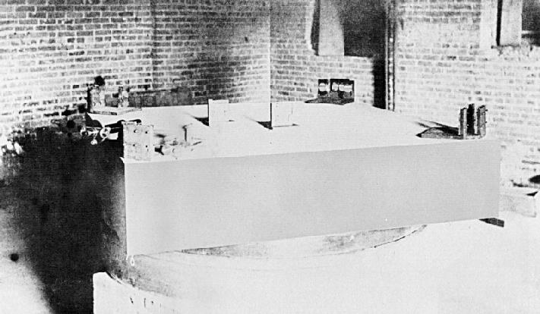
We have been testing relativity experimentally for a long time.
The first good test was done in 1887, before special relativity was even understood.
Michelson & Morley, 1887
And even 134 years later, Lorentz tests are still an active area of experimentation.

Slide 3
Introduction
In the last twenty-five years, there has been growing interest in the possibility that Lorentz and CPT symmetries may not be exact.
There are two broad reasons for this interest:
Reason One: Many theories that have been put forward as candidates to explain quantum gravity involve LV in some regime.
(For example, string theory, non-commutative geometry, loop quantum gravity…)

Slide 4
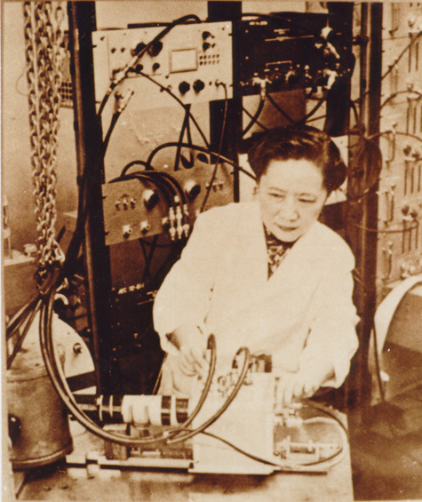
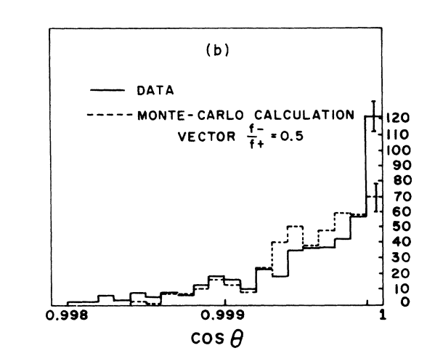
Reason Two: Lorentz symmetry is a basic building block of both quantum field theory and the General Theory of Relativity, which together describe all observed phenomena.
Anything this fundamental
should be tested. Much
of the story of modern
particle physics is how
important symmetries do
not hold exactly.

Slide 5
Ultimately, we don’t know where Lorentz violation might come from. However, any theory with CPT violation must also be Lorentz-violating.
[Greenberg, PRL 89, 231602 (2002)]
Without evidence for LV, it makes sense to have a systematic framework for searching for it.
This framework is the SME, an effective field theory.

Slide 6
Standard Model Extension (SME)
Idea: Look for all operators that can contribute to Lorentz violation.
[Kostelecký and Colladay, PRD 58, 116002 (1998)]
Then one usually adds restrictions:
locality
superficial renormalizability
gauge invariance
etc...
Many other formalisms turn out to be special cases of the SME.
$$SU(3)_{C}×SU(2)_{L}×U(1)_{Y}$$

Slide 7
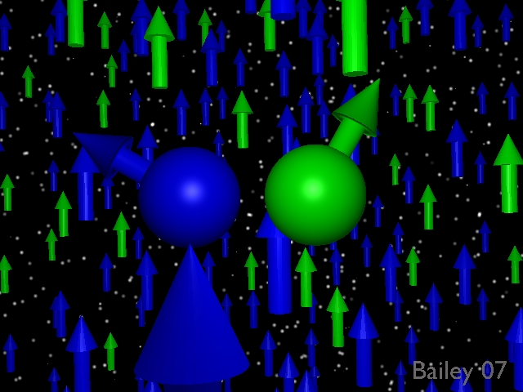
Lorentz violating operators have objects built up from standard model fields, contracted with constant background tensors.
Earth-based laboratories will see slightly different local physics as the planet rotates and revolves.

Slide 8
The Lagrange density for a Lorentz-violating free Fermion theory is:
L $=\bar{ψ}\left(iΓ^{μ}∂_{μ}−M\right)ψ$
$$M=m+\overset{̸}{a}−\overset{̸}{b}γ_{5}+\frac{1}{2}H^{μν}σ_{μν} \\ Γ^{μ}=γ^{μ}+c^{νμ}γ_{ν}−d^{νμ}γ_{ν}γ_{5}+e^{μ}+if^{μ}γ_{5}+\frac{1}{2}g^{λνμ}σ_{λν}$$
a, b, e, and g also violate CPT.
A separate set of coefficients will exist for every elementary particle in the theory, like the τ.

Slide 9
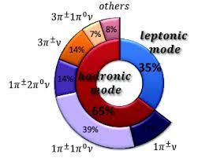
Experimental Bounds
For short-lived particles, practically the only way to place bounds is by looking at modified kinematics in high-energy reactions.
So we would want to
look at τ production
and decay, right?

Slide 10
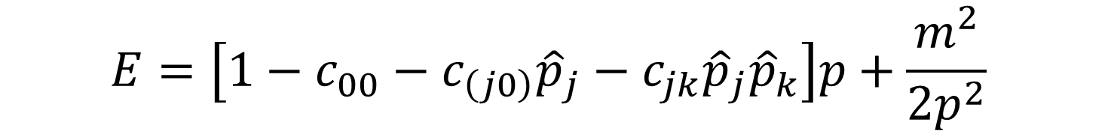
Actually, it turns out that there are no published bounds based on experiments in which actual τ leptons appear!
The few bounds are based on the absence of forbidden τ processes that could become allowed with Lorentz violation.
How? Well, with c coefficients, the behavior of the energy for ultrarelativistic fermions is
$$E=\left[1−c_{00}−c_{\left(j0\right)}{\hat{p}}_{j}−c_{jk}{\hat{p}}_{j}{\hat{p}}_{k}\right]p+\frac{m^{2}}{2p^{2}}$$

Slide 11
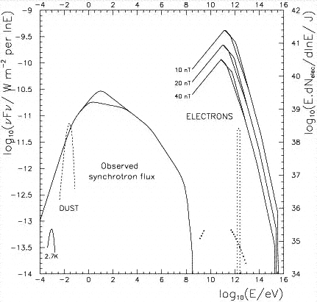
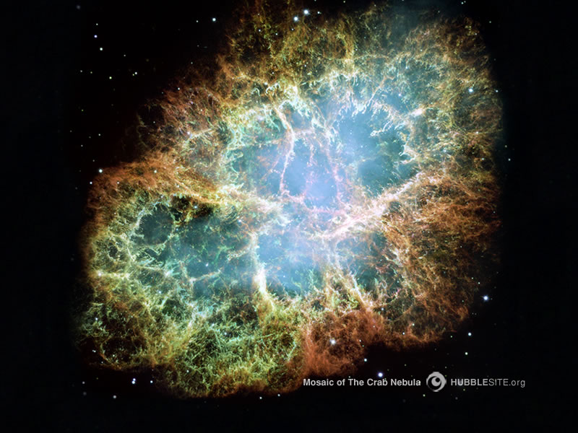
Even for electrons, the best bounds on boost violations come from looking at blazing hot sources. The radiation they emit tells us about the energy-momentum relations for photons and other particles.

Slide 12
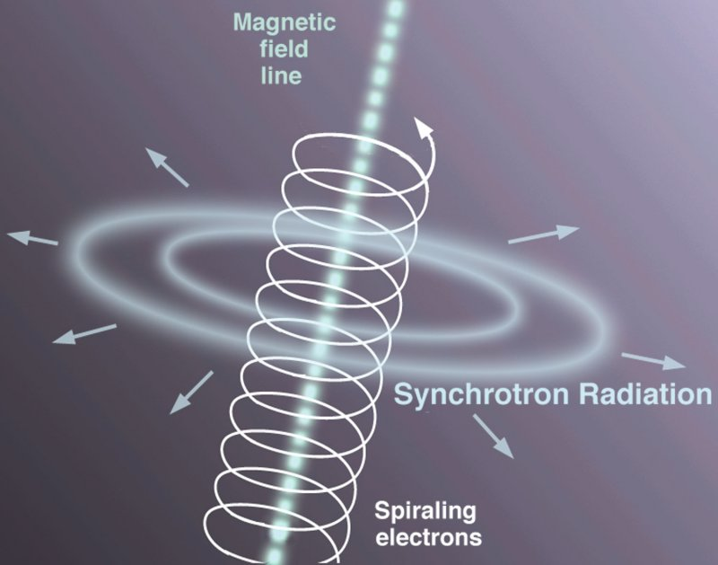
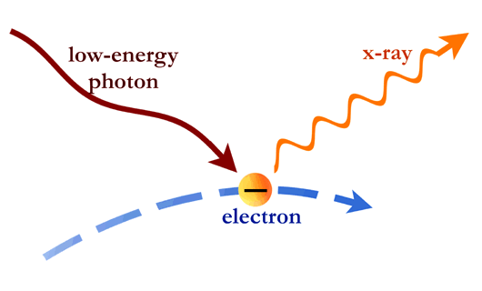
We can draw inferences from the Crab spectrum, since we see evidence of PeV electrons emitting synchrotron and inverse Compton radiation.
That these are possible tell us a lot about the electrons. The electron c and d are bounded at the ${\left(m_{e}/E_{γ}\right)}^{2}$level.
This can be ~ 10^{–20} !

Slide 13
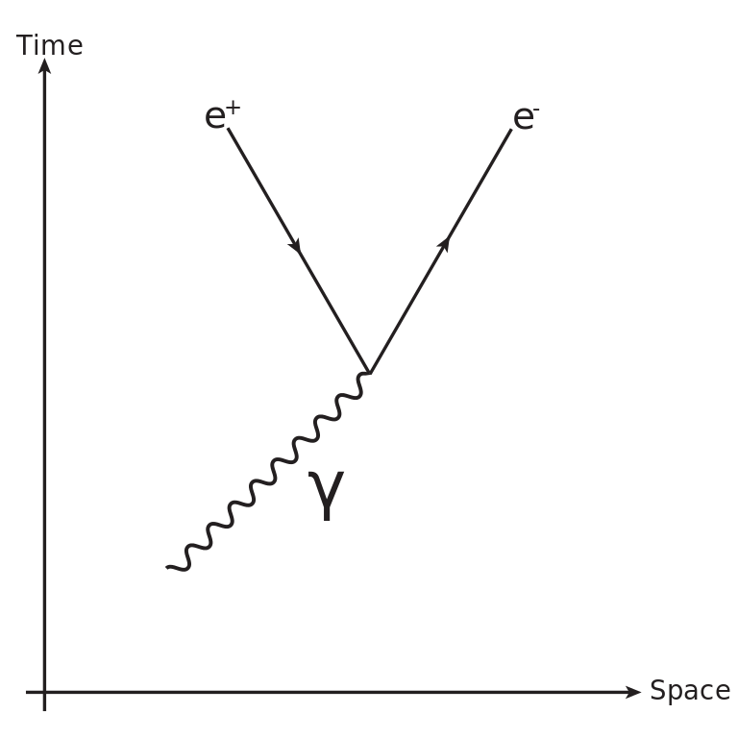
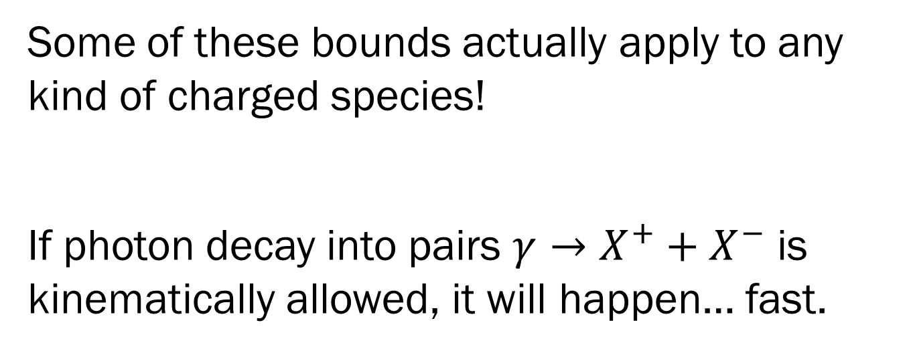
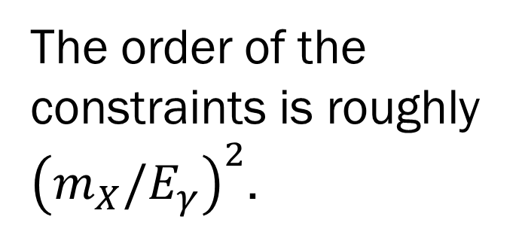
Some of these bounds actually apply to any kind of charged species!
If photon decay into pairs $γ→X^{+}+X^{−}$ is kinematically allowed, it will happen… fast.
The order of the constraints is roughly ${\left(m_{X}/E_{γ}\right)}^{2}$.

Slide 14
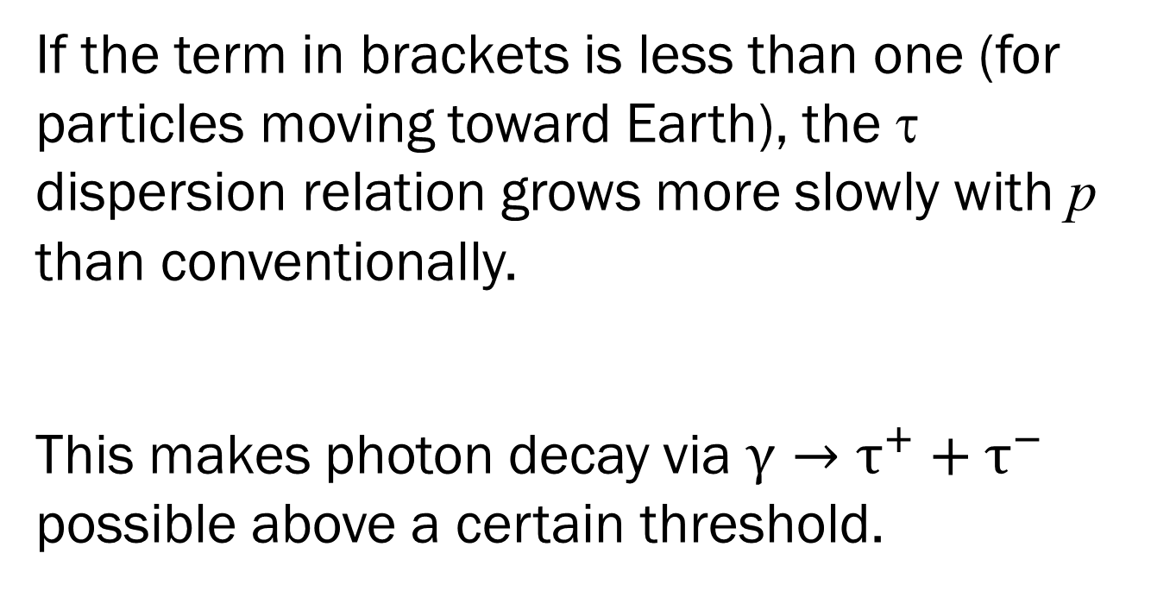
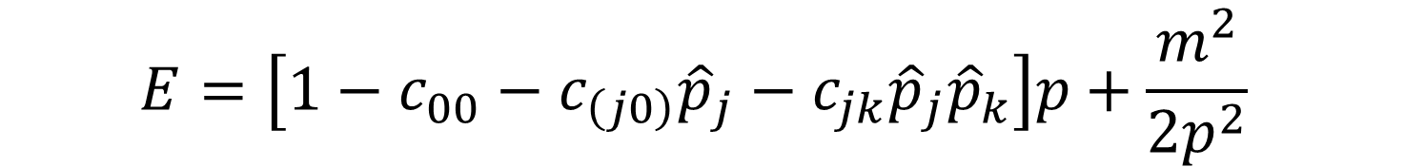
$$E=\left[1−c_{00}−c_{\left(j0\right)}{\hat{p}}_{j}−c_{jk}{\hat{p}}_{j}{\hat{p}}_{k}\right]p+\frac{m^{2}}{2p^{2}}$$
If the term in brackets is less than one (for particles moving toward Earth), the τ dispersion relation grows more slowly with p than conventionally.
This makes photon decay via $γ→τ^{+}+τ^{−}$ possible above a certain threshold.

Slide 15
For the c coefficients, the resulting bounds are at the ~ 10^{–8} –10^{–13} levels for various linear combinations.
[BA, Astropart. Phys. 28, 380 (2007)]
A similar analysis for the b coefficients yields bounds at the 10^{–11} GeV level for the b coefficients.
[Escobar, Noordmans, Potting, PRD 97, 115030 (2018)]
Lots of parameter space remains unexplored.

Slide 16
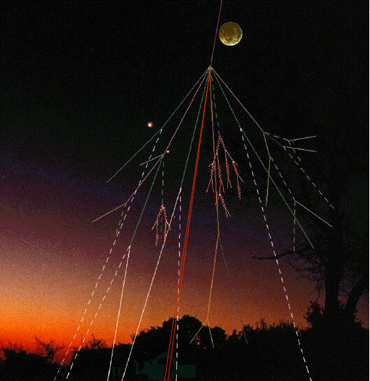
Summary
Testing Lorentz and CPT symmetries is an active area of research in fundamental physics.
However, in the τ sector,
essentially all the bounds
come from the absence
of certain τ-related processes
in cosmic-ray physics.

Slide 17
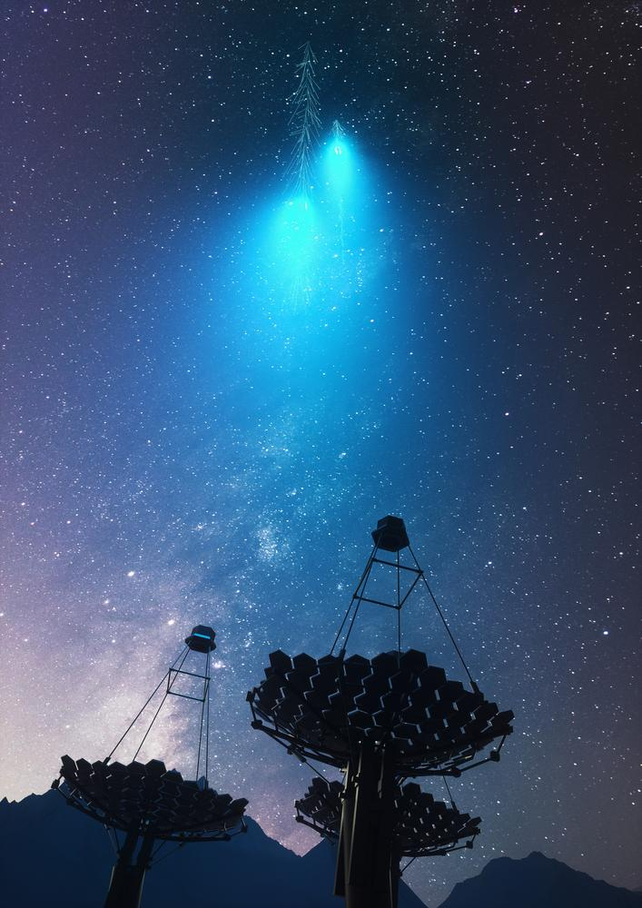

Thanks to Q. G. Bailey, V. A. Kostelecký, and M. Schindler.
That’s all, folks!

