Slide 1

Associate Laboratory Director’s Review
STAR Forward Upgrade
Project Overview:
  What we hope to learn
  How we plan to do it
Scott Wissink
Indiana University
November 19, 2018

Slide 2

Motivation: Fitting into the Bigger Picture
Exciting times ahead in High-Energy Nuclear Physics / “Cold” QCD!
Over the last decade, have made enormous strides in understanding nucleon structure, driven largely by programs at RHIC:
Compelling evidence that gluons contribute to the proton spin, at about the same level as the quarks
New insights into the nature and origin of the quark-antiquark ‘sea,’ through studies of weak boson production
Clear signatures of transverse polarization effects, seen in correlations between pairs of outgoing hadrons, or hadrons w.r.t . jets
But our interpretation of these results – and what we need to learn in preparation for design and construction of an EIC – would benefit greatly from new measurements

Slide 3
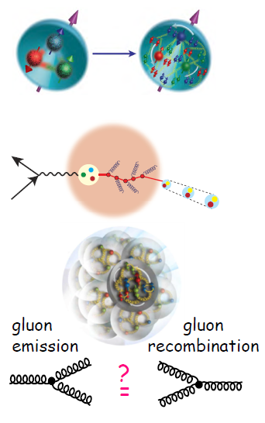
Motivation: STAR in 2021+
STAR is well positioned to address some of the deepest open questions in Cold QCD
Emergent properties of hadrons
  How are quarks, gluons, and their spins distributed in space and momentum inside the nucleon?
  Does orbital motion contribute to the proton spin?
Probing the nuclear medium
  How do colored quarks and gluons, and colorless jet fragments, interact with the nuclear medium?
  Does the nuclear environment itself modify the distributions of bound quarks and gluons? Do the abundant low-x gluons remain confined in nucleons?
Gluon saturation
  What happens to the gluon density at high energy or low momentum? Is there a saturated gluon state that is universal among all nuclei? What would be its experimental signatures?

Slide 4
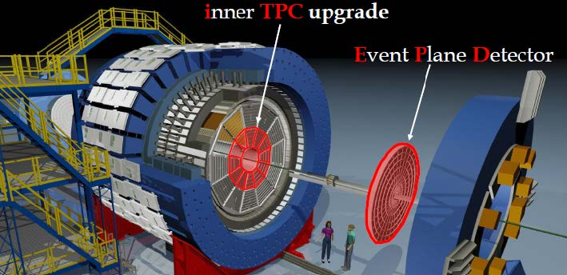
STAR in 2021+: Meeting the Challenge
By the end of the BES-II program, STAR will have an excellent set of ‘tools’ for studies at mid- and intermediate pseudorapidity
iTPC: extends tracking to higher η, improves dE/dx, accesses lower p_{T} hadrons
EPD: improves event plane reconstruction, reduces some forms of trigger bias
Endcap TOF: allows for improved PID over range -0.9 < η < -1.5
These will allow precision measurements of quark and gluon behavior, but with limited sensitivity outside the partonic momentum fraction range 0.05 < x < 0.2.
For the envisioned cold QCD program, it is essential that one probe this physics at both the higher-x valence region, and at low x where glue and the sea abound
These extreme regions are accessed most directly in highly asymmetric partonic collisions (x₁ >> x₂), which lead to outgoing particles boosted to high η regime
→ Need improved tracking and calorimetry at forward angles!

Slide 5
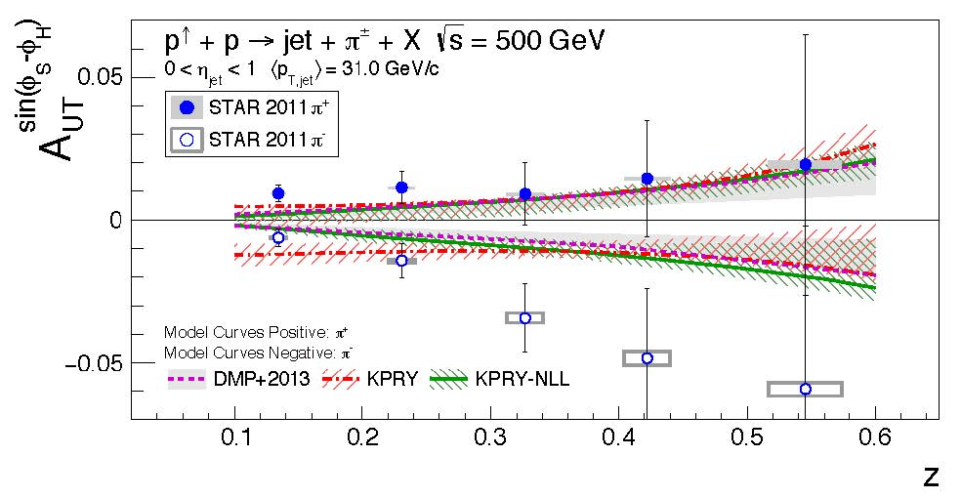
Detector Requirements I: Collins Asymmetries in pp
Physics goal: search for spin dependence in fragmentation of a transversely polarized q
Method: reconstruct full jet, measure yield of charged h^{+/-} as function of azimuthal w.r.t. jet
Impact: tests factorization and universality via comparisons with SIDIS and e⁺e⁻ studies
S_{q}
Technical challenges:
Need accurate reconstruction of jet (~ parton) thrust axis – good e.m. and hadronic cal., tracks from ‘right’ vertex
Charge-sign discrimination!
Minimize / quantify bias due to hadrons missing detector

Slide 6
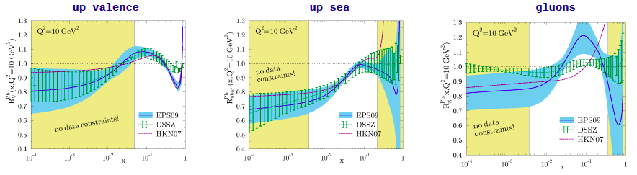
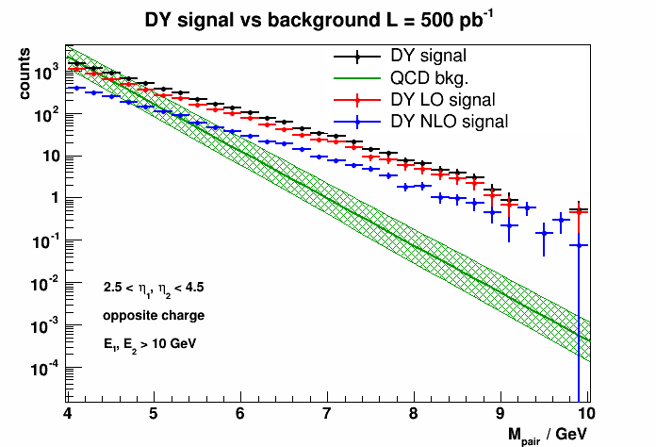
Detector Requirements II: Drell-Yan Studies in pA
Physics goal: compare x distributions of sea quarks in nuclei to those in nucleons
Method: measure forward (w.r.t. p beam) e⁺e⁻ pairs, created via annihilation of high-x q from proton with low-x q in nucleus
Impact: probes a critical feature of nuclear initial state – is the ‘sea’ modified within a nucleus – with little distortion from FSI
Technical challenges:
Need charged hadron suppression of ~10³ for each lepton
Require robust charge determination for leptons to avoid dilution of signal

Slide 7
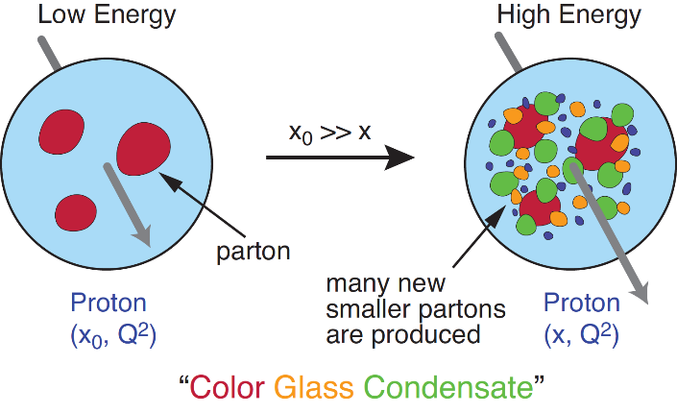
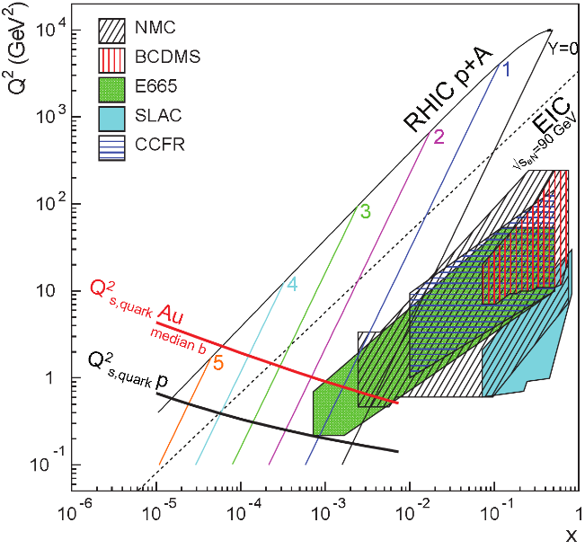
Detector Requirements III: Gluon Saturation in pA
Physics goal: determine if nature imposes an upper limit to the gluon density that is attained in a strongly-interacting system
Method: study angular dependence of two-particle correlations: di-hadrons (easy to measure, hard to interpret) to γ-jet (opp) look for suppression of back-to-back corr.
Impact: saturation scale Q_{s} provides an infrared cutoff in QCD, putting perturbative calc’s and low-x evolution on solid footing
Technical challenges:
For photon-jet events, must discriminate between rare prompt photons and abundant ones due primarily to neutral meson decay

Slide 8
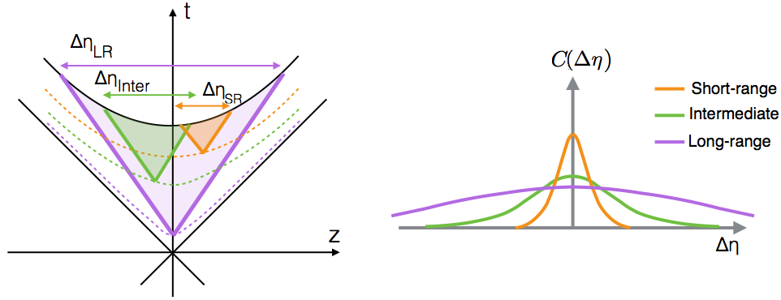
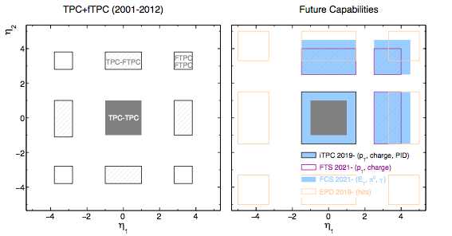
Detector Requirements IV: Initial States in AA
Physics goal: explore dynamics at early stages of QGP development, longitudinal structure of nuclear initial state
Method: construct momentum-dependent correlation function C(Δη,Δϕ), with focus on very long-range (large Δη) events
Impact: early spatial correlations → long- range p correlations via fluid dynamics, providing insight into transport properties
Technical challenges:
Expect high occupancy at most forward angles for high centrality AA collisions

Slide 9
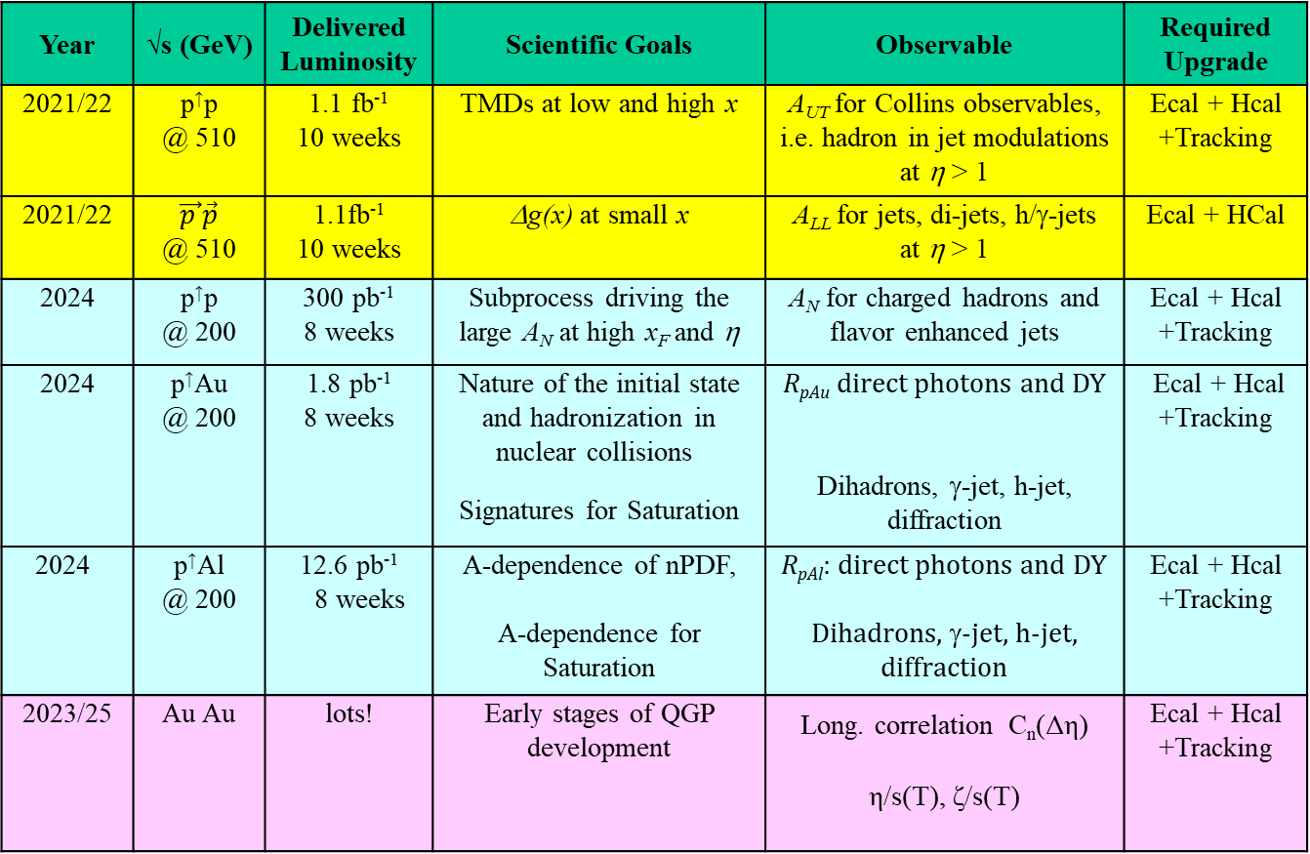
Scientific Goals, Observables, Detector Needs
Year | √s (GeV) | Delivered Luminosity | Scientific Goals | Observable | Required Upgrade
2021/22 | p↑p @ 510 | 1.1 fb⁻¹ 10 weeks | TMDs at low and high x | A_{UT} for Collins observables, i.e. hadron in jet modulations at η > 1 | Ecal + Hcal +Tracking
2021/22 | $\vec{p }\vec{p}$ @ 510 | 1.1fb⁻¹ 10 weeks | Δg(x) at small x | A_{LL} for jets, di-jets, h/γ-jets at η > 1 | Ecal + HCal
2024 | p↑p @ 200 | 300 pb⁻¹ 8 weeks | Subprocess driving the large A_{N} at high x_{F} and η | A_{N} for charged hadrons and flavor enhanced jets | Ecal + Hcal +Tracking
2024 | p↑Au @ 200 | 1.8 pb⁻¹ 8 weeks | Nature of the initial state and hadronization in nuclear collisions Signatures for Saturation | R_{pAu} direct photons and DY Dihadrons, γ-jet, h-jet, diffraction | Ecal + Hcal +Tracking
2024 | p↑Al @ 200 | 12.6 pb⁻¹ 8 weeks | A-dependence of nPDF, A-dependence for Saturation | R_{pAl}: direct photons and DY Dihadrons, γ-jet, h-jet, diffraction | Ecal + Hcal +Tracking
2023/25 | Au Au | lots! | Early stages of QGP development | Long. correlation C_{n}(Δη) η/s(T), ζ/s(T) | Ecal + Hcal +Tracking

Slide 10
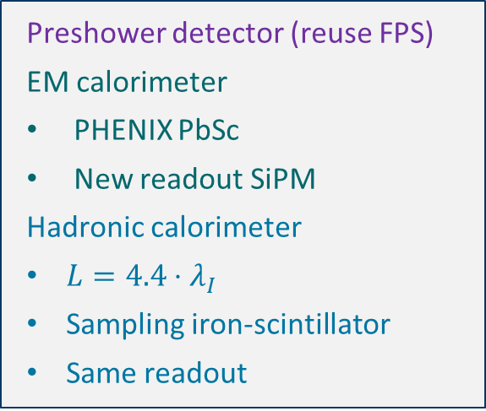
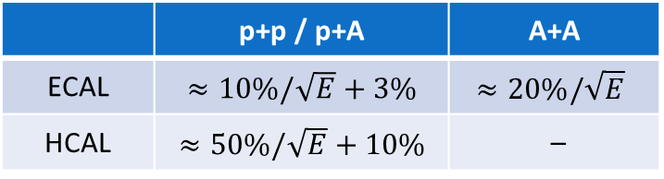
Forward Calorimeter System – Concept
 | p+p / p+A | A+A
ECAL | $≈10\%/\sqrt{E}$ + 3% | $$≈20\%/\sqrt{E}$$
HCAL | $≈50\%/\sqrt{E}$ + 10% | –
Preshower detector (reuse FPS)
EM calorimeter
PHENIX PbSc
New readout SiPM
Hadronic calorimeter
$L=4.4⋅λ_{I}$
Sampling iron-scintillator
Same readout
Significant development efforts for EMCal and HCal as part of EIC R&D
Extensive testing of prototypes at both FNAL and at STAR

Slide 11
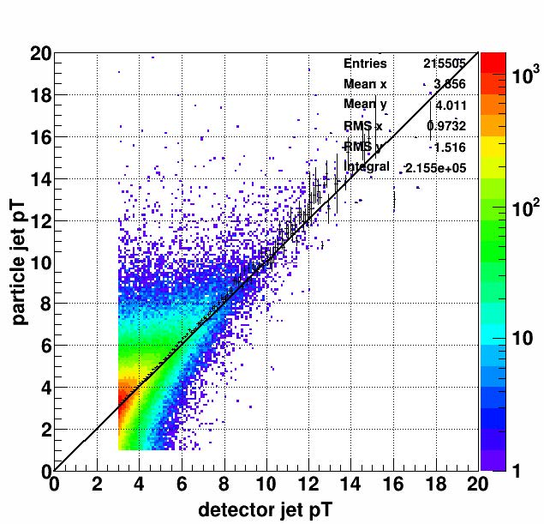
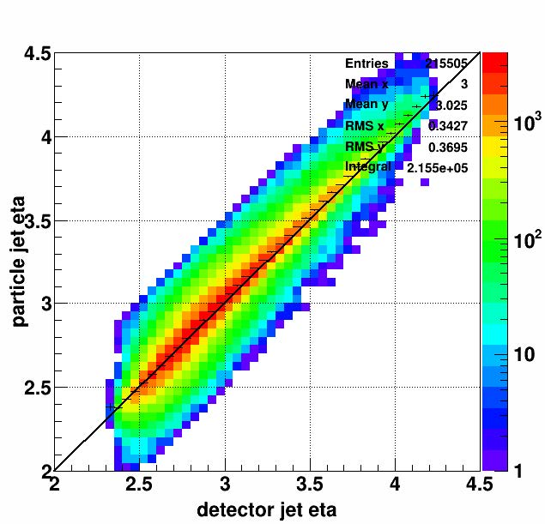
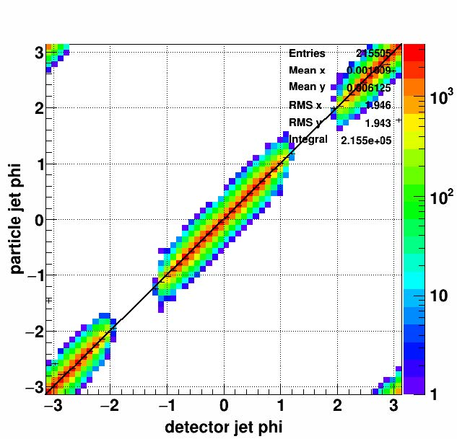
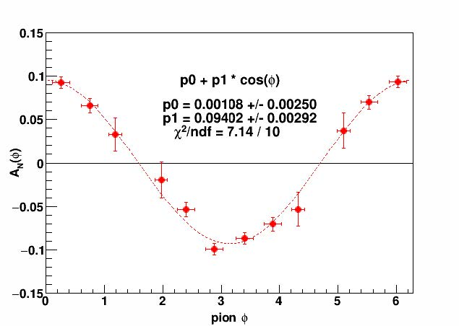
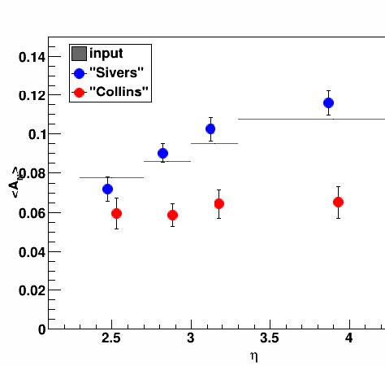
Forward Calorimeter System – Simulations
Run PYTHIA events through full GEANT simulation of FCS, compare output of jet-finder (anti-kt algo) at particle level to results at detector level for p_{T}, η, ϕ
Excellent agreement after imposing fiducial cut keeping jet > 0.2 from edge
See no significant degradation of signal or systematic bias in Sivers A_{N} due to gaps in phi coverage of FCS

Slide 12
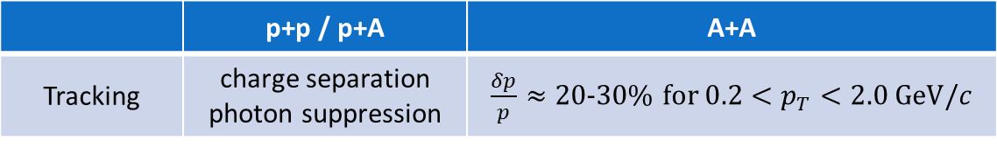
Forward Tracking System – Concept
 | p+p / p+A | A+A
Tracking | charge separation photon suppression | $\frac{δp}{p}≈$ 20-30% for $0.2<p_{T}<2.0 \text{GeV}/c$
3 layers of silicon mini-strip disk
  Positioned at z = 140, 163, 187 cm
  Builds on experience of STAR IST (Intermediate Silicon Tracker)
4 layers of small-strip Thin Gap Chambers
  z = 273, 303, 333, 363 cm
  TPX electronics from STAR TPC for readout
  Significant reduction of the project cost
Simulations indicate above requirements can be met with no significant loss in performance compared to an “all silicon” (6 disks) design

Slide 13
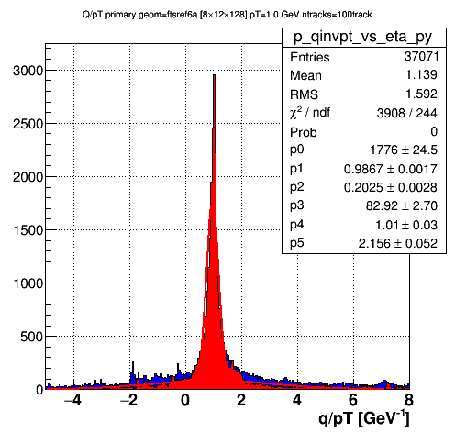
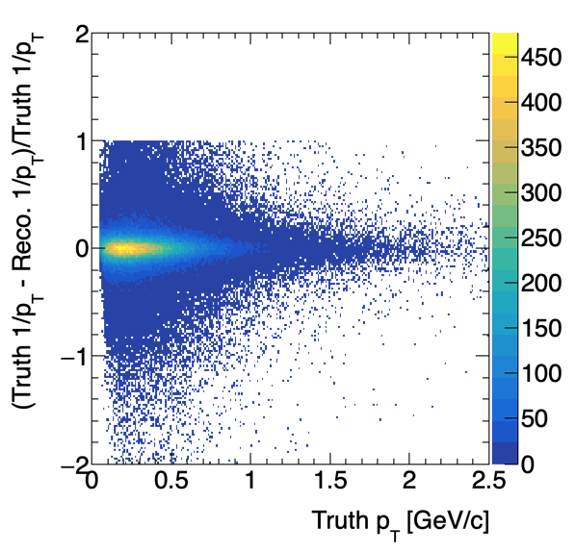
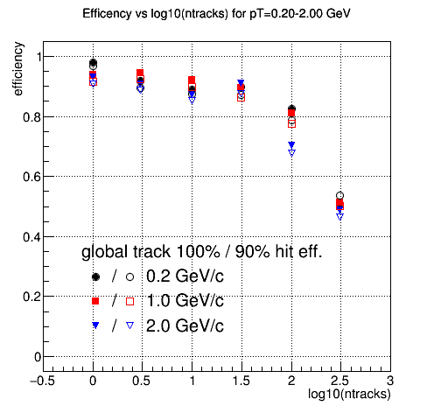
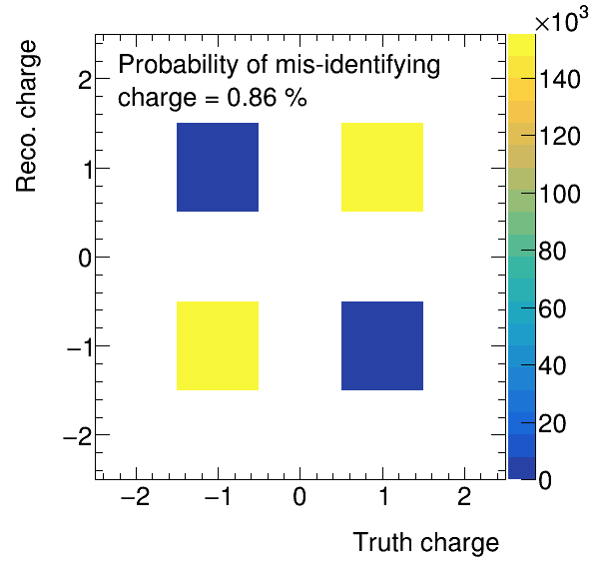
Forward Tracking System – Simulations
Track 1/p_{T} resolution for 1.0 GeV/c pions, at 100 π’s / event in 2.5 < η < 4.0. At right is fractional deviation of 1/p_{T} from the input value as a function of p_{T}, indicating < 20% resolution is attained
~1% of charged pions in PYTHIA events are reconstructed with wrong sign
Pions are found with > 80% efficiency for track densities up to ~100 / event

Slide 14
The fSTAR Project: Summary and Outlook
Unique program that will address some of the most pressing, fundamental questions in cold QCD for nucleon structure and the nuclear initial state
  Logical and essential step in fulfilling mission of the RHIC physics program
  Lays critical groundwork for the EIC, both scientifically and technically
  Strongly endorsed by BNL PAC over last few years
Project is on an aggressive timeline, but is technologically conservative
  Fully exploit STAR’s existing and planned capabilities at mid- & interm- rapidity
  fSTAR environment is familiar, explored in FTPC, FPD, FMS programs
  Reuse detector and electronic components from decommissioned systems
  Readout and triggering can follow closely schemes used successfully in STAR
  Goal is to complete upgrade, take data during possible polarized pp running at 500 GeV in late FY2021, and throughout much of the sPHENIX running period
Questions?

