Slide 1
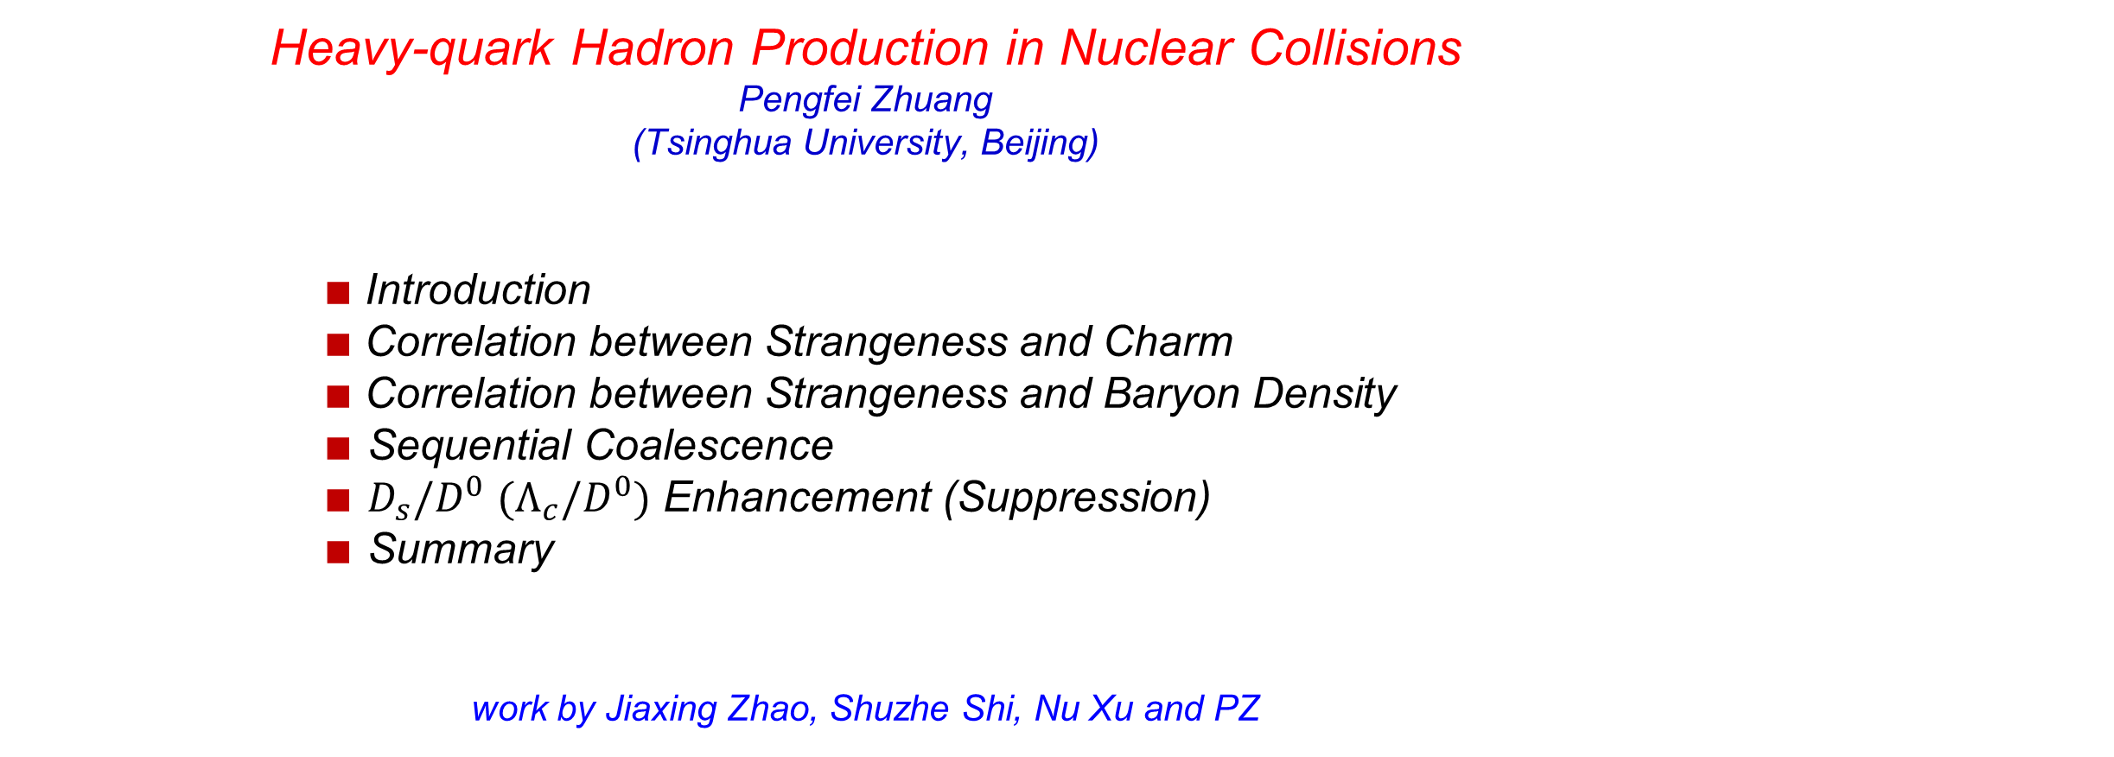
Heavy-quark Hadron Production in Nuclear Collisions
Pengfei Zhuang (Tsinghua University, Beijing)
$∎$Introduction
$∎$Correlation between Strangeness and Charm
$∎$Correlation between Strangeness and Baryon Density
$∎$ Sequential Coalescence
$∎$ $D_{s}/D^{0}$ $(Λ_{c}/D^{0})$ Enhancement (Suppression)
$∎$ Summary
work by Jiaxing Zhao, Shuzhe Shi, Nu Xu and PZ
Pengfei Zhuang, Shuryak Workshop, CCNU, 20181008-11 1

Slide 2
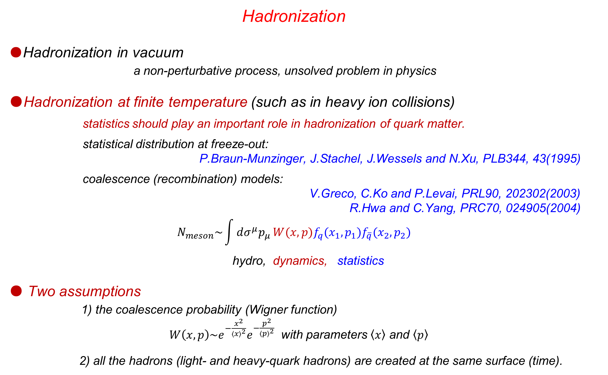
Hadronization
●Hadronization in vacuum
a non-perturbative process, unsolved problem in physics
●Hadronization at finite temperature (such as in heavy ion collisions)
statistics should play an important role in hadronization of quark matter.
statistical distribution at freeze-out:
P.Braun-Munzinger, J.Stachel, J.Wessels and N.Xu, PLB344, 43(1995)
coalescence (recombination) models:
V.Greco, C.Ko and P.Levai, PRL90, 202302(2003)
R.Hwa and C.Yang, PRC70, 024905(2004)
$$N_{meson}\sim \int{dσ^{μ}p_{μ}}W(x,p)f_{q}(x_{1},p_{1})f_{\overline{q}}(x_{2},p_{2})$$
hydro, dynamics, statistics
● Two assumptions
1) the coalescence probability (Wigner function)
$W\left(x,p\right)\sim e^{−\frac{x^{2}}{{\left\langle x\right\rangle }^{2}}}e^{−\frac{p^{2}}{{\left\langle p\right\rangle }^{2}}}$ with parameters $\left\langle x\right\rangle$ and $\left\langle p\right\rangle$
2) all the hadrons (light- and heavy-quark hadrons) are created at the same surface (time).
Pengfei Zhuang, Shuryak Workshop, CCNU, 20181008-11 2

Slide 3
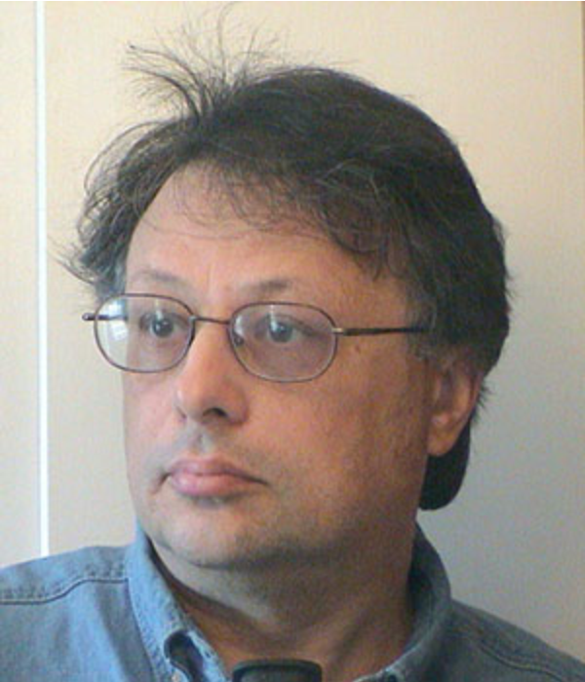
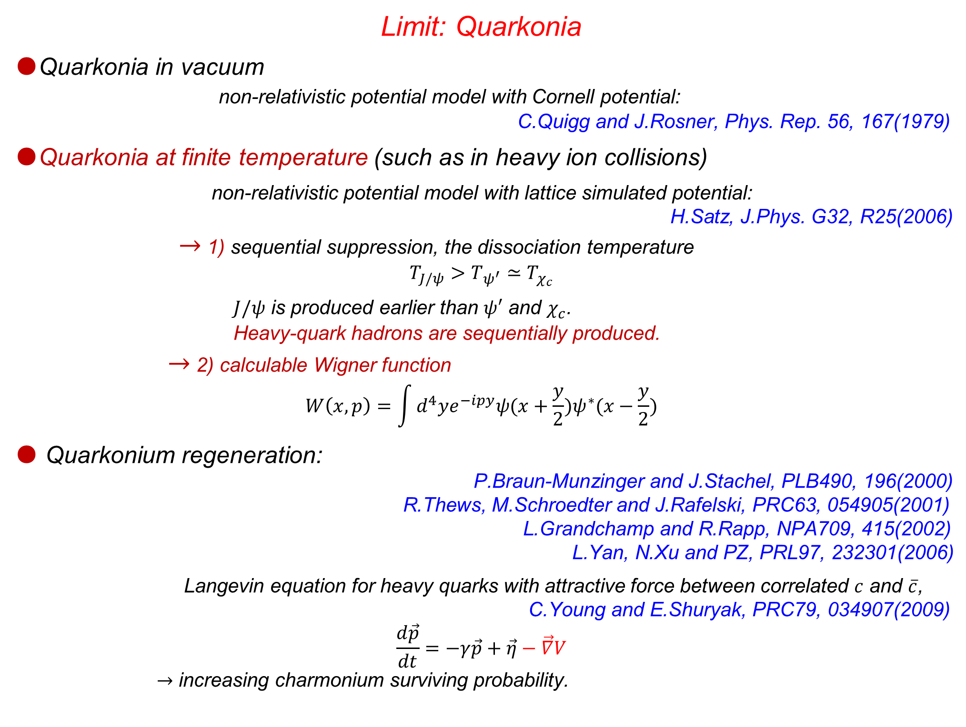
Limit: Quarkonia
●Quarkonia in vacuum
non-relativistic potential model with Cornell potential:
C.Quigg and J.Rosner, Phys. Rep. 56, 167(1979)
●Quarkonia at finite temperature (such as in heavy ion collisions)
non-relativistic potential model with lattice simulated potential:
H.Satz, J.Phys. G32, R25(2006)
$→$ 1) sequential suppression, the dissociation temperature
$$T_{J/ψ}>T_{ψ^{′}}≃T_{χ_{c}}$$
$J/ψ$ is produced earlier than $ψ′$ and $χ_{c}$.
Heavy-quark hadrons are sequentially produced.
$→$ 2) calculable Wigner function
$$W\left(x,p\right)=\int{d^{4}ye^{−ipy}ψ(x+\frac{y}{2})ψ^{∗}(x−\frac{y}{2})}$$
● Quarkonium regeneration:
P.Braun-Munzinger and J.Stachel, PLB490, 196(2000)
R.Thews, M.Schroedter and J.Rafelski, PRC63, 054905(2001)
L.Grandchamp and R.Rapp, NPA709, 415(2002)
L.Yan, N.Xu and PZ, PRL97, 232301(2006)
Langevin equation for heavy quarks with attractive force between correlated $c$ and $\overline{c}$,
C.Young and E.Shuryak, PRC79, 034907(2009)
$$\frac{d\vec{p}}{dt}=−γ\vec{p}+\vec{η}−\vec{∇}V$$
$→$ increasing charmonium surviving probability.
Pengfei Zhuang, Shuryak Workshop, CCNU, 20181008-11 3

Slide 4
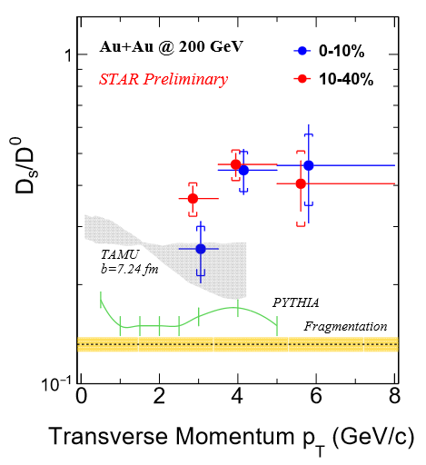
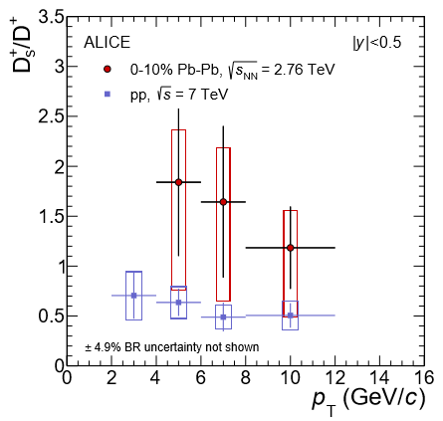

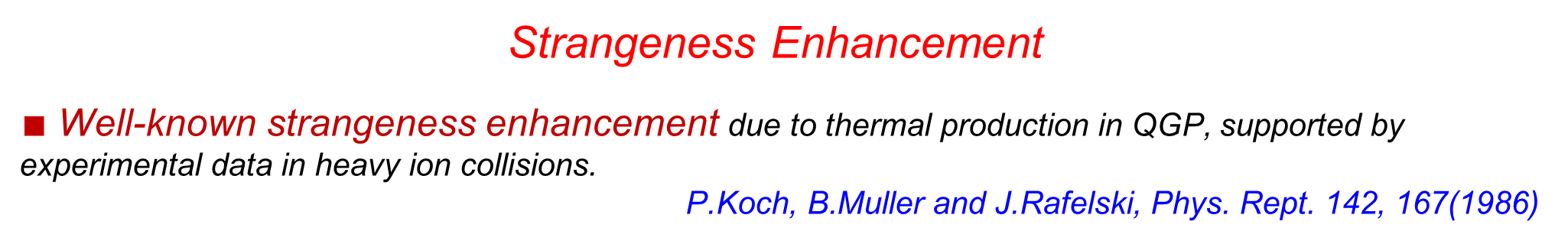
Strangeness Enhancement
$∎$Well-known strangeness enhancement due to thermal production in QGP, supported by experimental data in heavy ion collisions.
P.Koch, B.Muller and J.Rafelski, Phys. Rept. 142, 167(1986)
$∎$ Strong $D_{s}/D^{0}$ enhancement at RHIC and LHC
$∎$ $D_{s}$ enhancement via strangeness enhanement
L.Zhou [STAR], NPA967, 620(2017) J.Adam et. al. [ALICE], JHEP 1603, 082(2016)
M.He, R.Fries and R.Rapp, PRL110, 112301(2013)
there is still a sizeable difference between strangeness enhancement and data.
Pengfei Zhuang, Shuryak Workshop, CCNU, 20181008-11 4

Slide 5
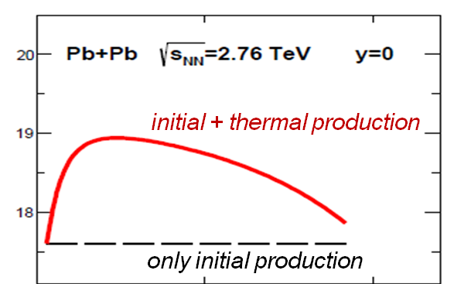

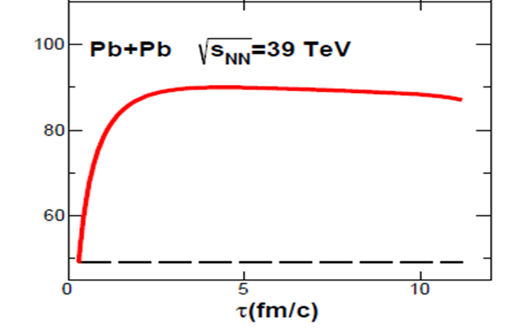
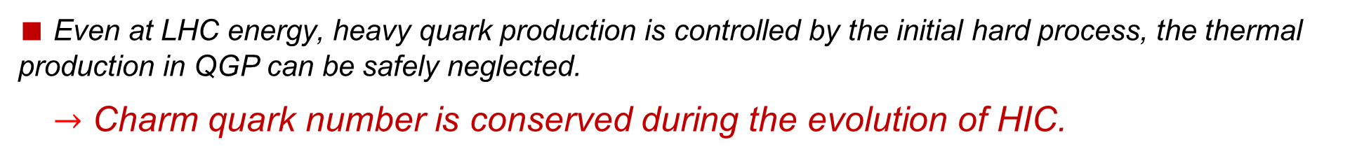
Charm Conservation
$∎$ Charm quark thermal production in QGP
K.Zhou, Z.Chen, C.Greiner and PZ,. PLB758, 434(2016)
$∎$Even at LHC energy, heavy quark production is controlled by the initial hard process, the thermal production in QGP can be safely neglected.
$→$ Charm quark number is conserved during the evolution of HIC.
Pengfei Zhuang, Shuryak Workshop, CCNU, 20181008-11 5

Slide 6
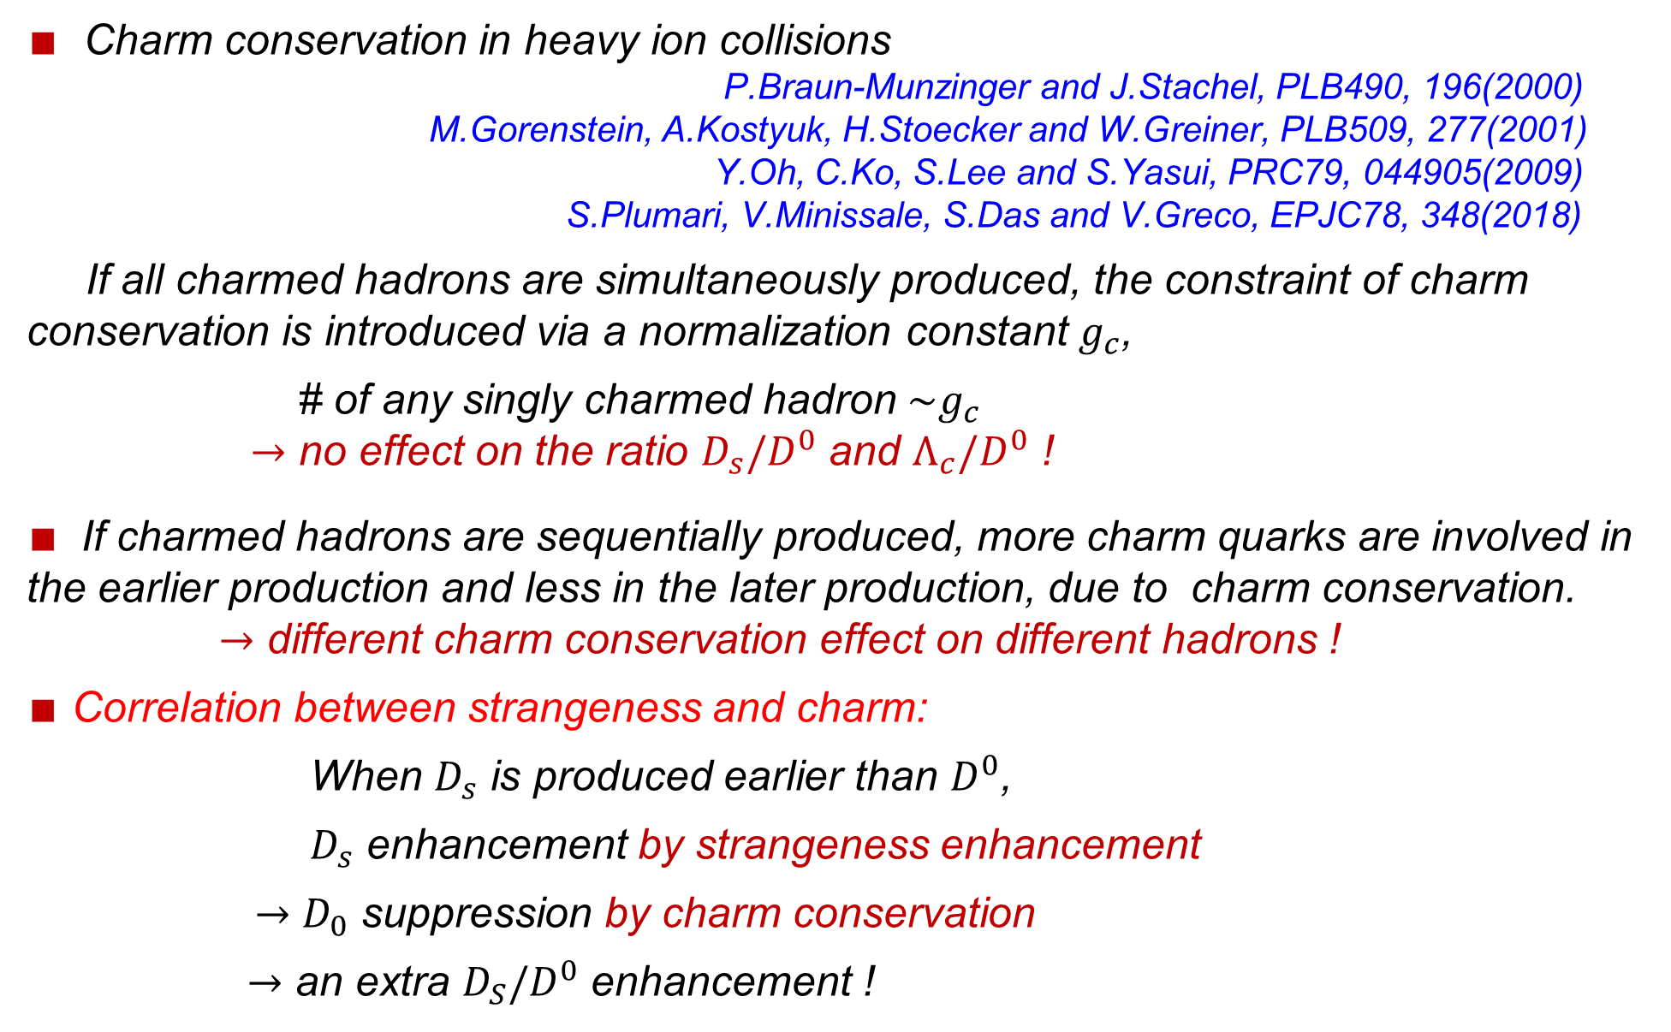
Correlation between Strangeness and Charm
$∎$ Charm conservation in heavy ion collisions
P.Braun-Munzinger and J.Stachel, PLB490, 196(2000)
M.Gorenstein, A.Kostyuk, H.Stoecker and W.Greiner, PLB509, 277(2001)
Y.Oh, C.Ko, S.Lee and S.Yasui, PRC79, 044905(2009)
S.Plumari, V.Minissale, S.Das and V.Greco, EPJC78, 348(2018)
If all charmed hadrons are simultaneously produced, the constraint of charm conservation is introduced via a normalization constant $g_{c}$,
# of any singly charmed hadron $\sim g_{c}$
$→$ no effect on the ratio $D_{s}/D^{0}$ and $Λ_{c}/D^{0}$ !
$∎$ If charmed hadrons are sequentially produced, more charm quarks are involved in the earlier production and less in the later production, due to charm conservation.
$→$ different charm conservation effect on different hadrons !
$∎$ Correlation between strangeness and charm:
When $D_{s}$ is produced earlier than $D^{0}$,
$D_{s}$ enhancement by strangeness enhancement
$→$ $D_{0}$ suppression by charm conservation
$→$ an extra $D_{S}/D^{0}$ enhancement !
Pengfei Zhuang, Shuryak Workshop, CCNU, 20181008-11 6

Slide 7
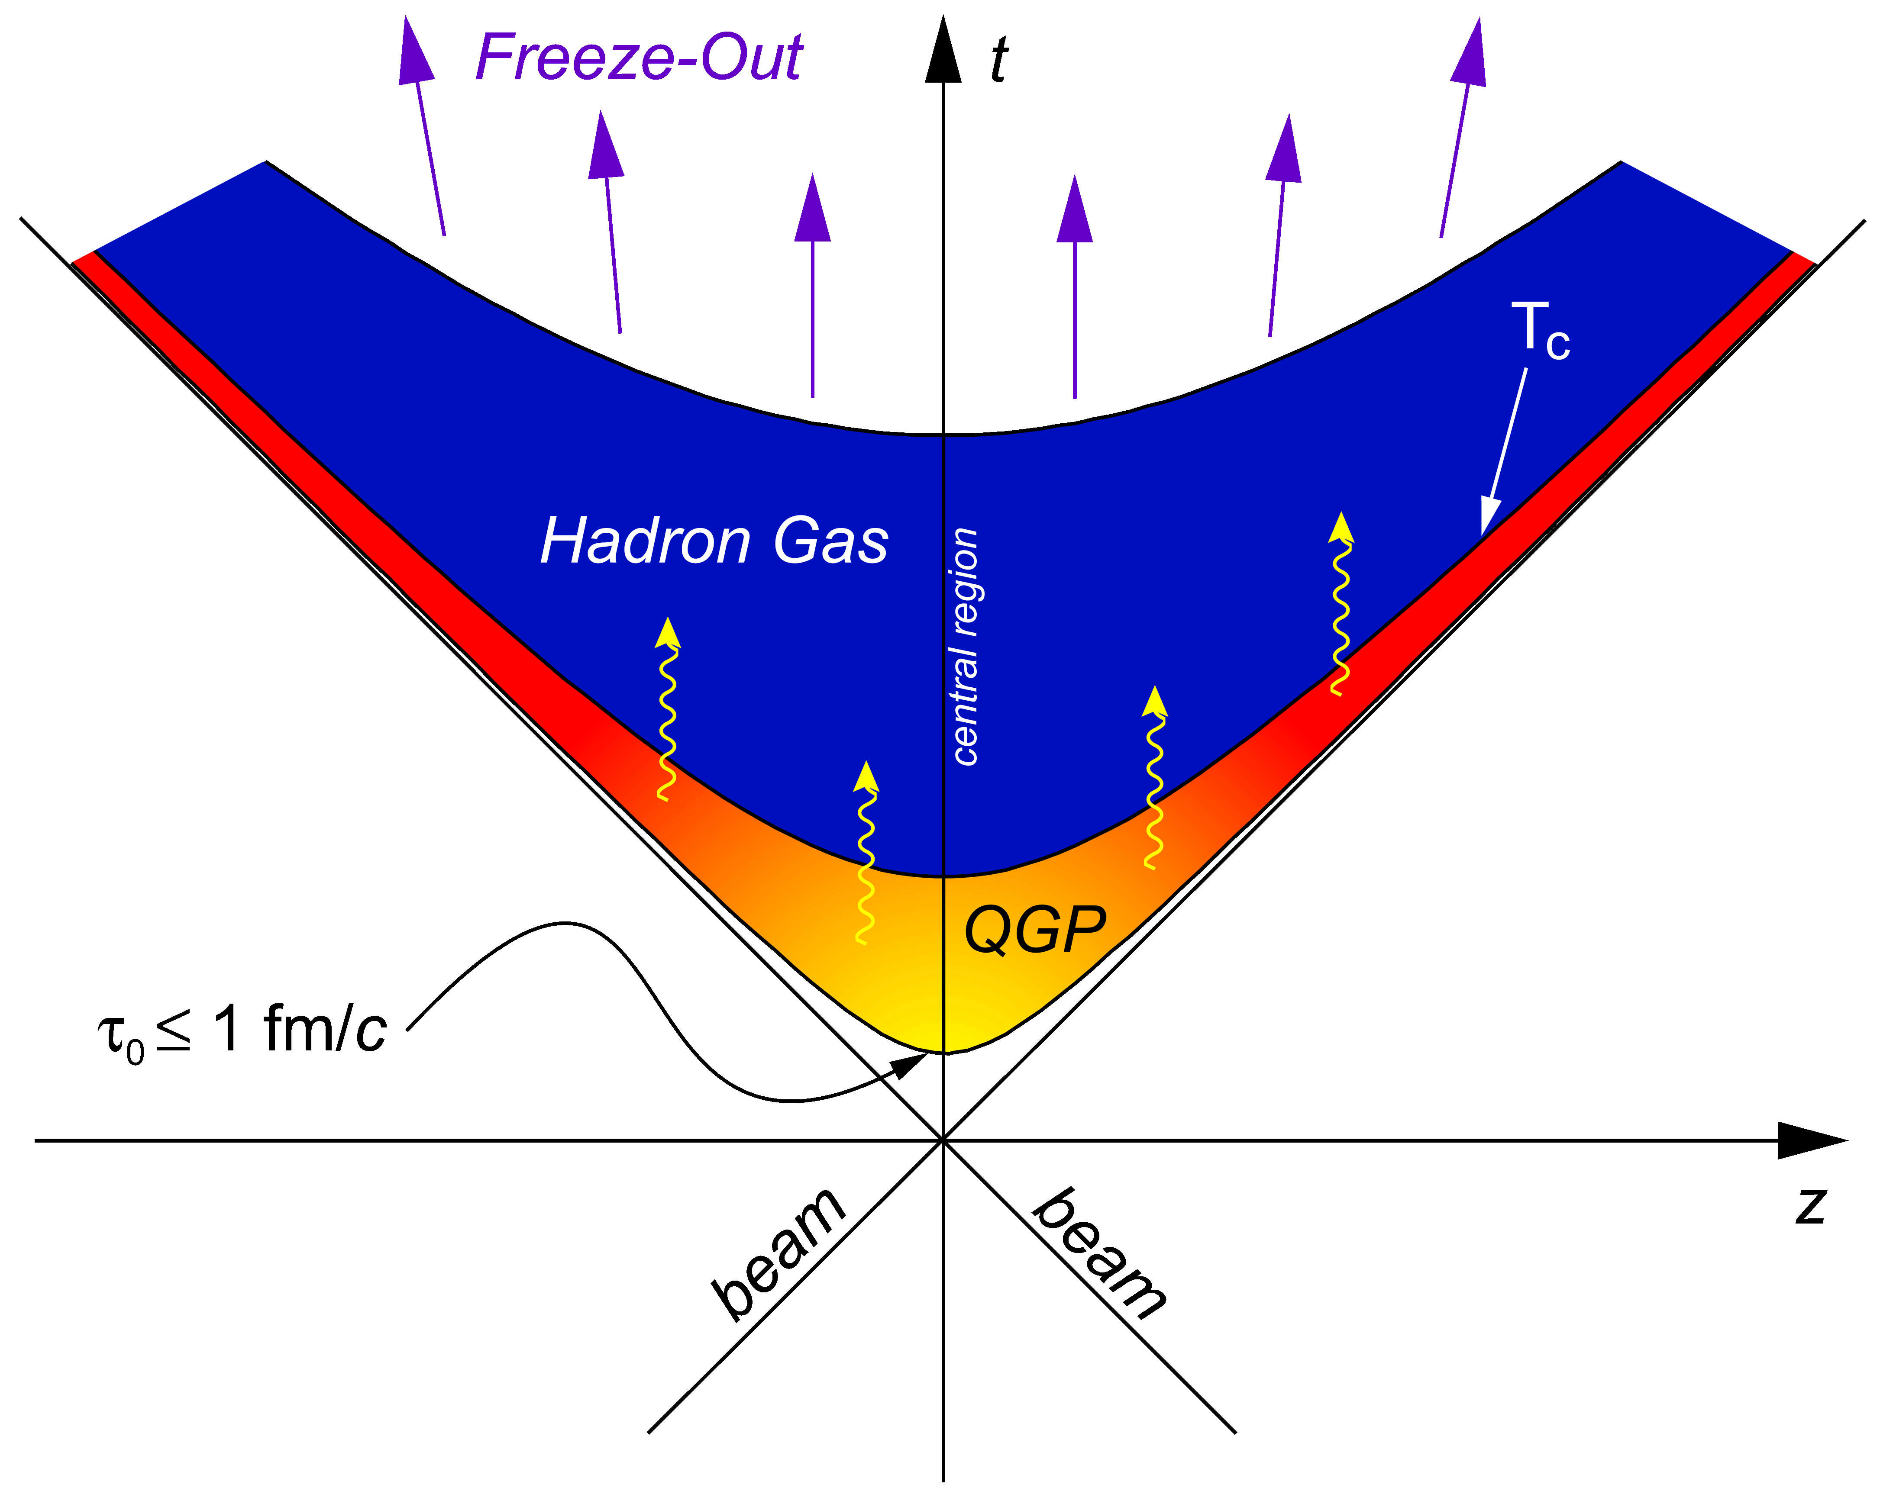
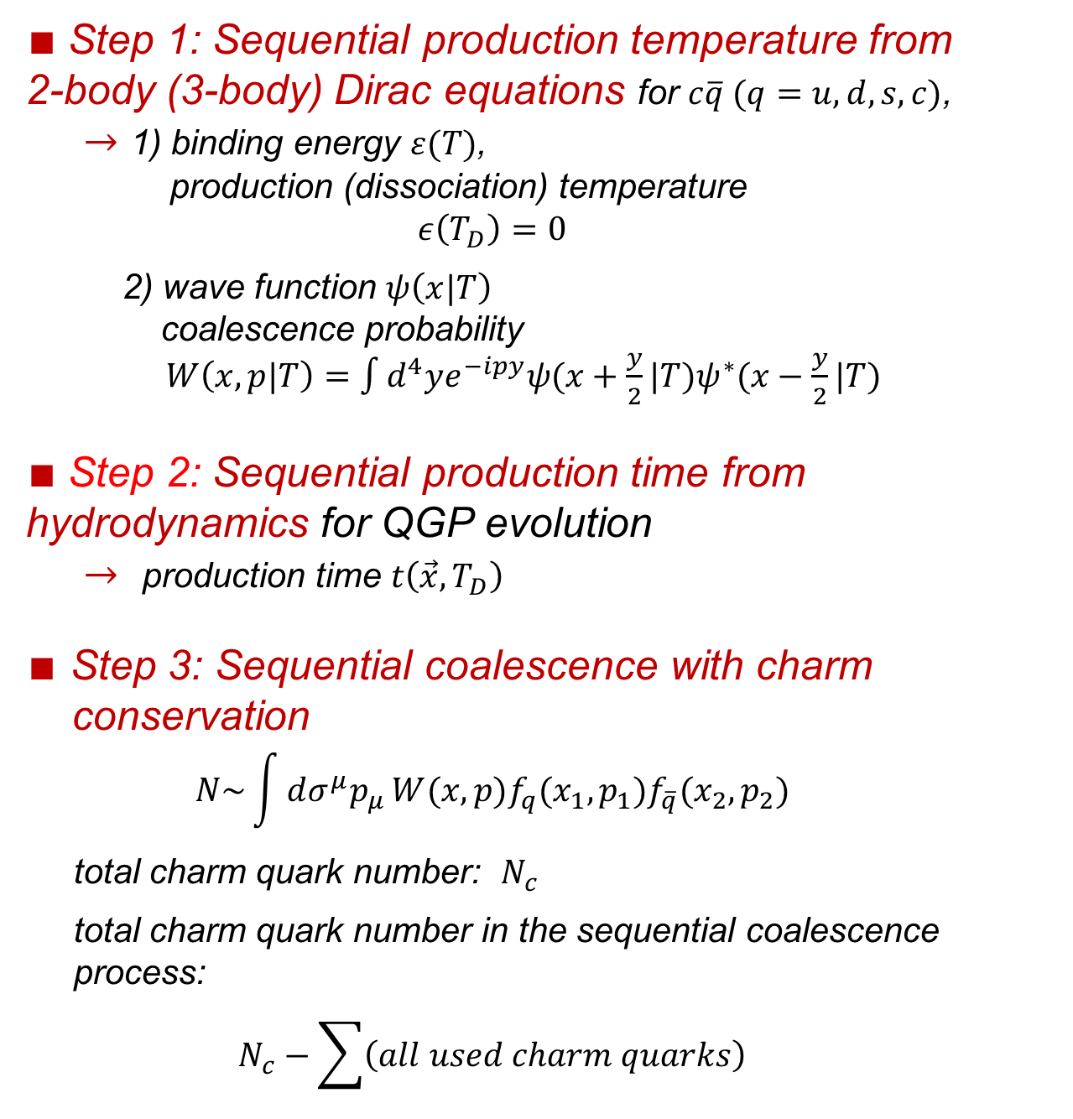

Sequential Coalescence Model
J.Zhao, S.Shi, N.Xu and PZ, arXiv: 1805.10858
$∎$Step 1: Sequential production temperature from 2-body (3-body) Dirac equations for $c\overline{q} (q=u,d,s,c)$,
$→$ 1) binding energy $ε(T)$,
production (dissociation) temperature
$$ε\left(T_{D}\right)=0$$
2) wave function $ψ\left(x|T\right)$
coalescence probability
$W\left(x,p|T\right)=\int{d^{4}ye^{−ipy}ψ(x+\frac{y}{2}|T)ψ^{∗}(x−\frac{y}{2}|T)}$
$∎$Step 2: Sequential production time from hydrodynamics for QGP evolution
$→$ production time $t\left(\vec{x},T_{D}\right)$
$∎$ Step 3: Sequential coalescence with charm
conservation
$$N\sim \int{dσ^{μ}p_{μ}}W(x,p)f_{q}(x_{1},p_{1})f_{\overline{q}}(x_{2},p_{2})$$
total charm quark number: $N_{c}$
total charm quark number in the sequential coalescence
process:
$$N_{c}−\sum{\left(all used charm quarks\right)}$$
J/Ψ
$$D^{0}$$
Pengfei Zhuang, Shuryak Workshop, CCNU, 20181008-11 7

Slide 8
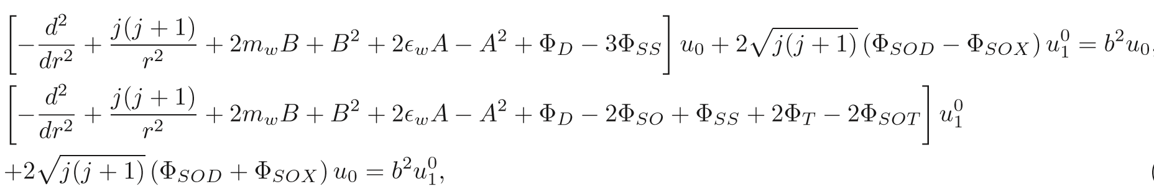
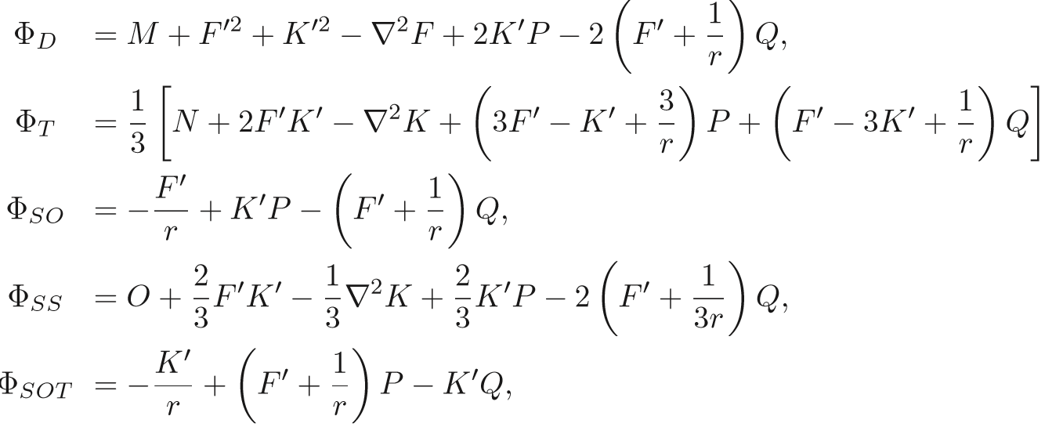
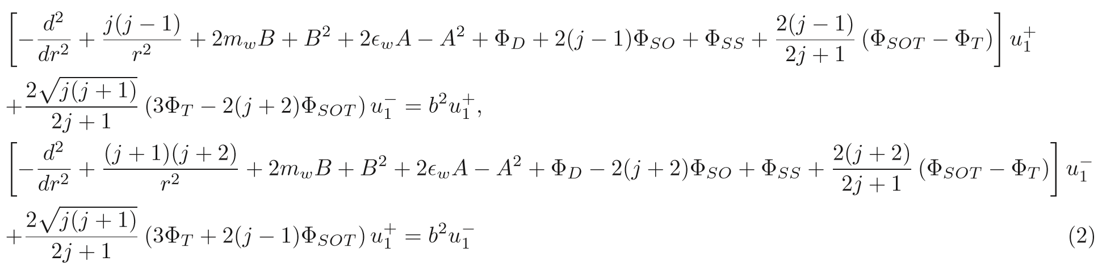
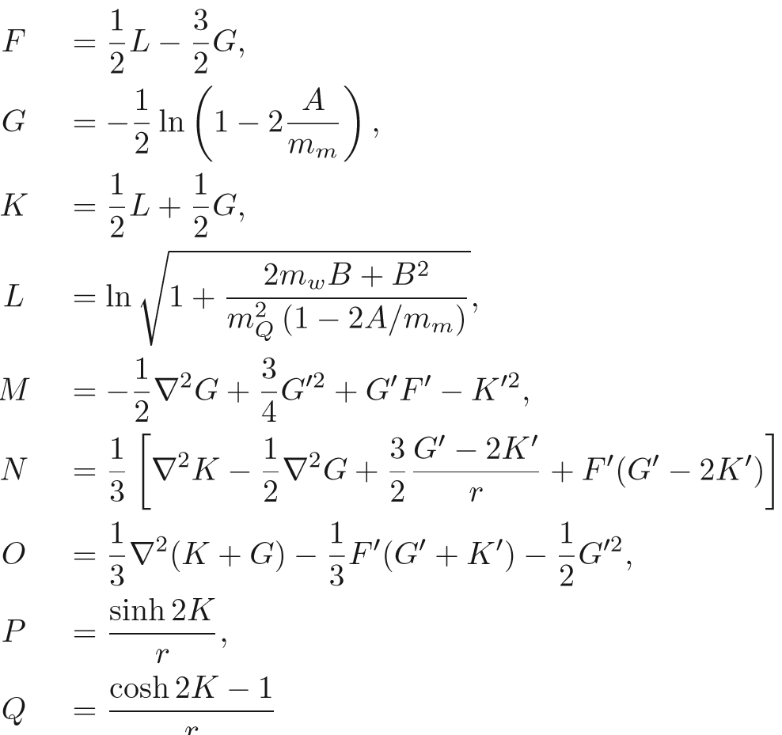
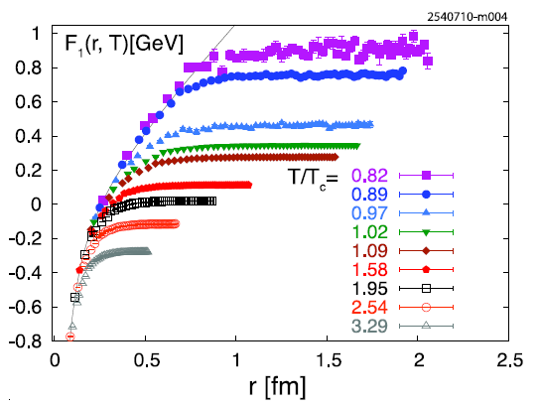
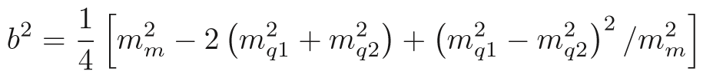
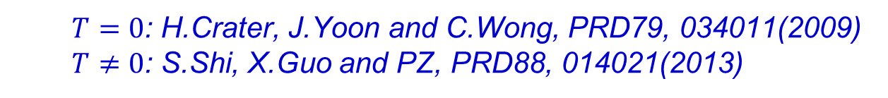
Step 1: Sequential Production Temperature from 2-body Dirac Equations
$T=0$: H.Crater, J.Yoon and C.Wong, PRD79, 034011(2009)
$T≠0$: S.Shi, X.Guo and PZ, PRD88, 014021(2013)
O.Kaczmarek, EPJC 61, 811(2009)
Pengfei Zhuang, Shuryak Workshop, CCNU, 20181008-11 8

Slide 9
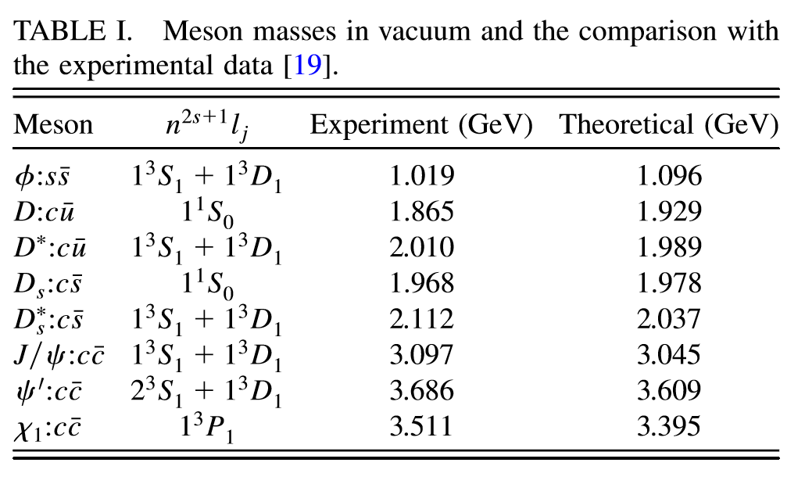



Step 2: Sequential Production Time from Hydrodynamic Equations
$∎$Sequential production temperature
$∎$Sequential production time
ideal hydrodynamics: $∂^{μ}T_{μν}=0 + ∂^{μ}n_{μ}=0 → τ(\vec{x}|T_{D})$
$$V=F$$
$$T_{D}/T_{c}≃\left\{\begin{aligned}1.20 D_{s} \\ 1.15 D^{0} \\ 1 Λ_{c}\end{aligned}\right.$$
Pengfei Zhuang, Shuryak Workshop, CCNU, 20181008-11 9

Slide 10
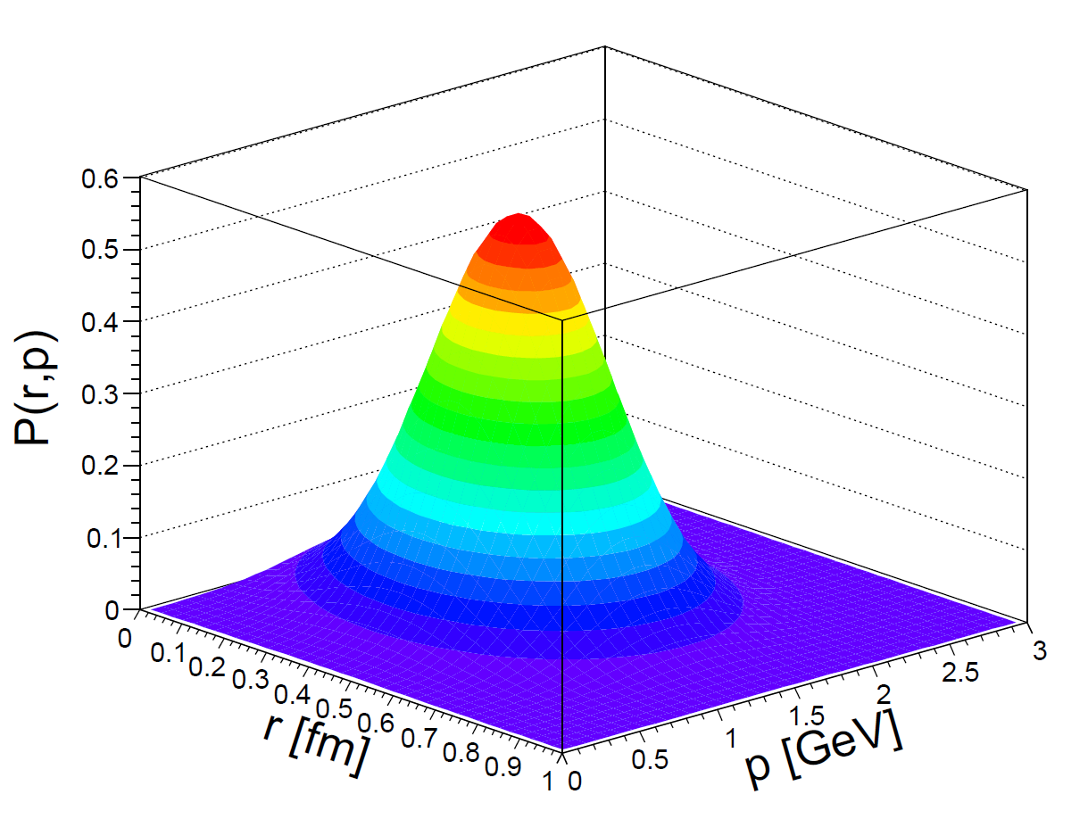
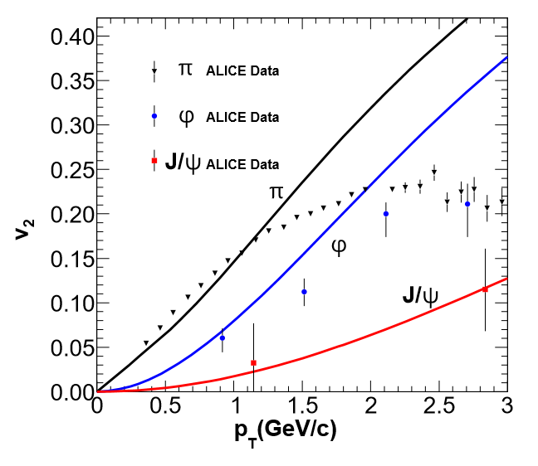
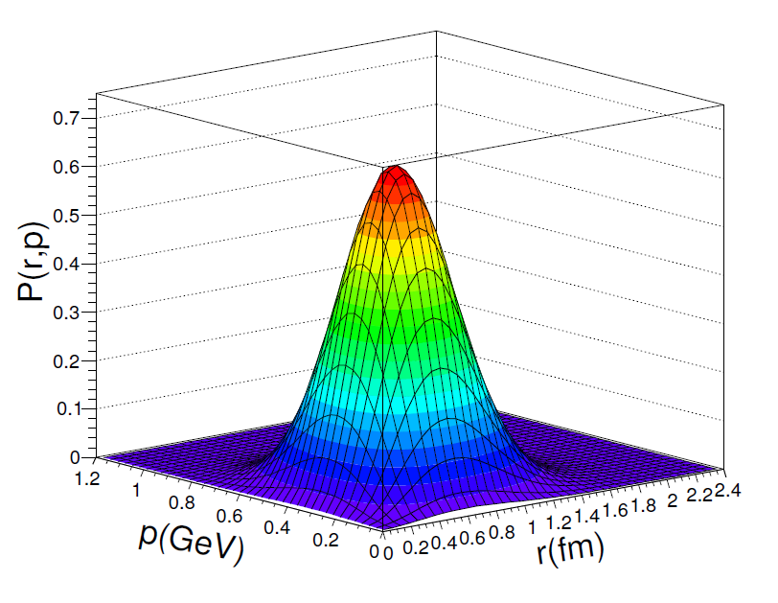



Step 3: Sequential Coalescence
$\frac{dN}{d^{2}P_{T}dη}=C\int{\frac{P^{μ}dσ_{μν}\left(R\right)}{{\left(2π\right)}^{3}}}\frac{d^{4}rd^{4}p}{{\left(2π\right)}^{3}}f_{c}{\left(r_{1},p_{1}\right)f}_{\overline{q}}\left(r_{2},p_{2}\right)W\left(r,p\right)$
J.Zhao, H.He and PZ, PLB771, 349(2017)
$$Ξ_{cc}^{+}$$
$$D^{0}$$
$$D^{0}$$
S.Shi, X.Guo and PZ, PRD88, 014021(2013)
Pengfei Zhuang, Shuryak Workshop, CCNU, 20181008-11 10

Slide 11
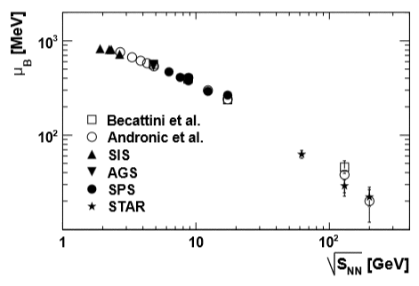
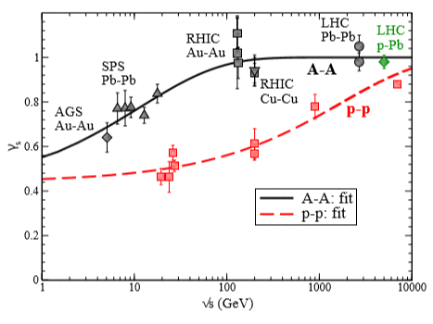
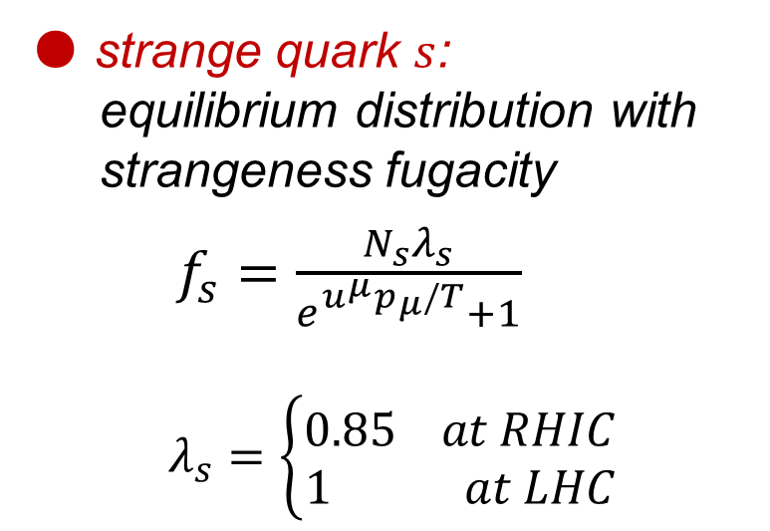
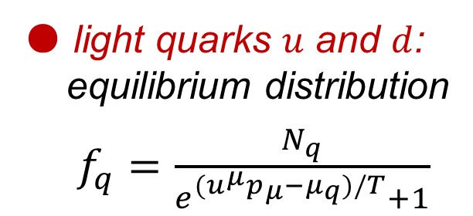
Light & Strange Quark Distributions
STAR Collaboration. Phys. Rev. C79,034909(2009)
● light quarks $u$ and $d$:
equilibrium distribution
$f_{q}=\frac{N_{q}}{e^{{(u}^{μ}p_{μ}−μ_{q})/T}+1}$
● strange quark $s$:
equilibrium distribution with
strangeness fugacity
$f_{s}=\frac{N_{s}λ_{s}}{e^{u^{μ}p_{μ}/T}+1}$
$$λ_{s}=\left\{\begin{aligned}0.85 at RHIC \\ 1 at LHC\end{aligned}\right.$$
H. Satz et al. Int. J. Mod. Phys. E26, 1750081(2017)
Pengfei Zhuang, Shuryak Workshop, CCNU, 20181008-11 11

Slide 12
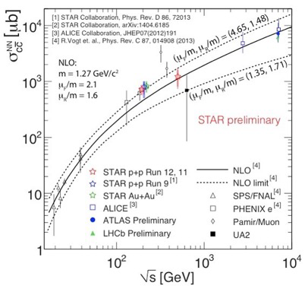
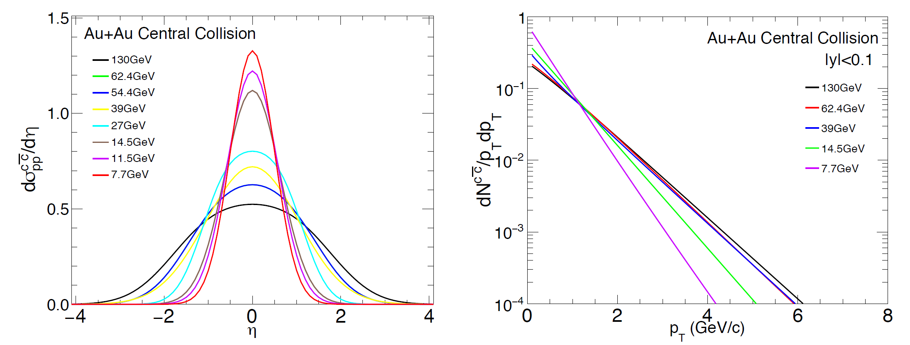
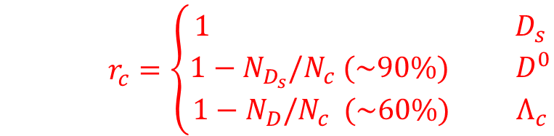

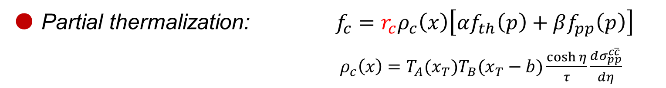
Charm Quark Distribution
● Partial thermalization: $f_{c}=r_{c}ρ_{c}\left(x\right)\left[αf_{th}\left(p\right)+βf_{pp}\left(p\right)\right]$
$ρ_{c}\left(x\right)=T_{A}(x_{T})T_{B}(x_{T}−b)\frac{\cosh{η}}{τ}\frac{dσ_{pp}^{c\overline{c}}}{dη}$
● Sequential thermalization:
$\left(α,β\right)=\left\{\begin{aligned}\left(0.4, 0.6\right) D_{s} \\ \left(0.5, 0.5\right) D^{0} \\ \left(0.6, 0.4\right) { Λ}_{c}\end{aligned}\right.$
● Charm conservation:
$r_{c}=\left\{\begin{aligned}1 D_{s} \\ 1−N_{D_{s}}/N_{c} (\sim 90\%) D^{0} \\ 1−N_{D}/N_{c} (\sim 60\%) Λ_{c}\end{aligned}\right.$
Normalized rapidity and transverse momentum distributions with PYTHIA8
Pengfei Zhuang, Shuryak Workshop, CCNU, 20181008-11 12

Slide 13
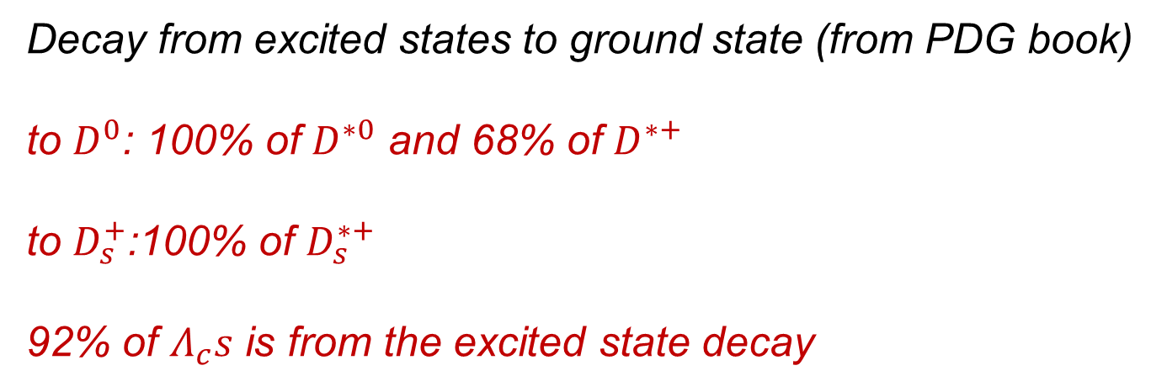
Hadron Decay after Coalescence
Decay from excited states to ground state (from PDG book)
to $D^{0}$: 100% of $D^{∗0}$ and 68% of $D^{∗+}$
to $D_{s}^{+}$:100% of $D_{s}^{∗+}$
92% of $Λ_{c}s$ is from the excited state decay
Pengfei Zhuang, Shuryak Workshop, CCNU, 20181008-11 13

Slide 14
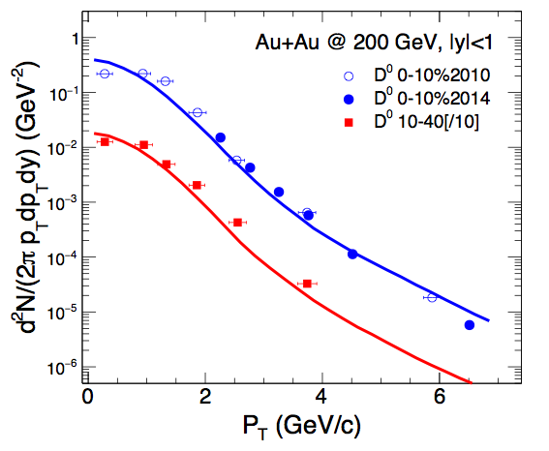
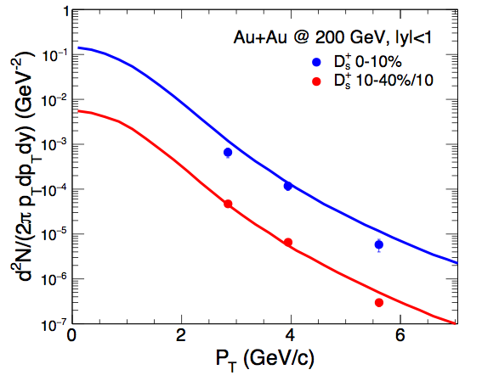
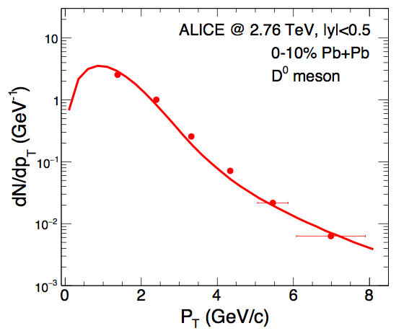
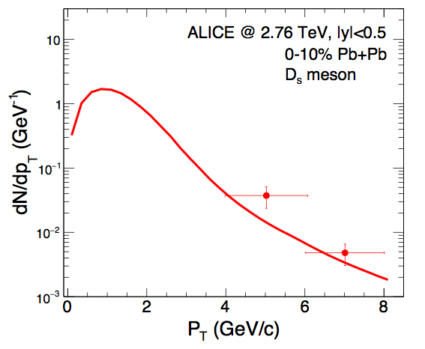


Charmed Hadron $P_{T}$ Distribution
J.Zhao, S.Shi, N.Xu and PZ, arXiv: 1805.10858
$$D^{0}$$
$$D_{s}$$
RHIC
LHC
$$the shape is controlled by charm quark thermalization, namely the value of α.$$
Pengfei Zhuang, Shuryak Workshop, CCNU, 20181008-11 14

Slide 15
Yield Ratios
J.Zhao, S.Shi, N.Xu and PZ, arXiv: 1805.10858
RHIC LHC
Solid lines: with charm conservation
Dashed lines: without charm conservation
Charm conservation increases the ratio $D_{s}/D^{0}$,
but sequential thermalization decreases the ratio at low $p_{T}$ and increases the ratio at high $p_{T}$.
Pengfei Zhuang, Shuryak Workshop, CCNU, 20181008-11 15

Slide 16


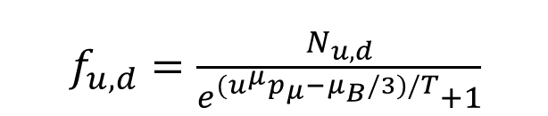



Correlation between Strangeness and Baryon Density
$∎$Baryon density effect
At high baryon density, more $u$ and $d$ quarks, less $\overline{u}$ and $\overline{d}$ quarks, and probably $n_{\overline{u}}<n_{\overline{s}}$ !
$∎$ Strangeness enhancement at high baryon density!
$D_{s}(c\overline{s})$ enhancement in comparison with $D^{0}(c\overline{u})$!
$f_{u,d}=\frac{N_{u,d}}{e^{{(u}^{μ}p_{μ}−μ_{B}/3)/T}+1}$
$$f_{s}=\frac{N_{s}λ_{s}}{e^{u^{μ}p_{μ}/T}+1}$$
Quark number density at $\vec{r}=0:$
$$D_{s}/D^{0}$$
pp limit
$$\sqrt{s}$$
Pengfei Zhuang, Shuryak Workshop, CCNU, 20181008-11 16

Slide 17
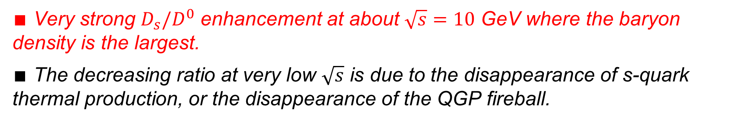
$$D_{s}/D^{0}\left(\sqrt{s}\right)$$
$∎$ Very strong $D_{s}/D^{0}$ enhancement at about $\sqrt{s}=10$ GeV where the baryon density is the largest.
$∎$ The decreasing ratio at very low $\sqrt{s}$ is due to the disappearance of s-quark thermal production, or the disappearance of the QGP fireball.
Pengfei Zhuang, Shuryak Workshop, CCNU, 20181008-11 17

Slide 18
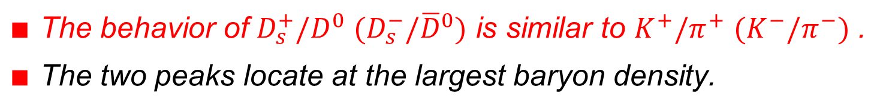
Comparison with $K/π$
$∎$ The behavior of $D_{s}^{+}/D^{0}$ ${(D}_{s}^{−}/{\overline{D}}^{0})$ is similar to $K^{+}/π^{+}$ $(K^{−}/π^{−})$ .
$∎$ The two peaks locate at the largest baryon density.
Pengfei Zhuang, Shuryak Workshop, CCNU, 20181008-11 18

Slide 19
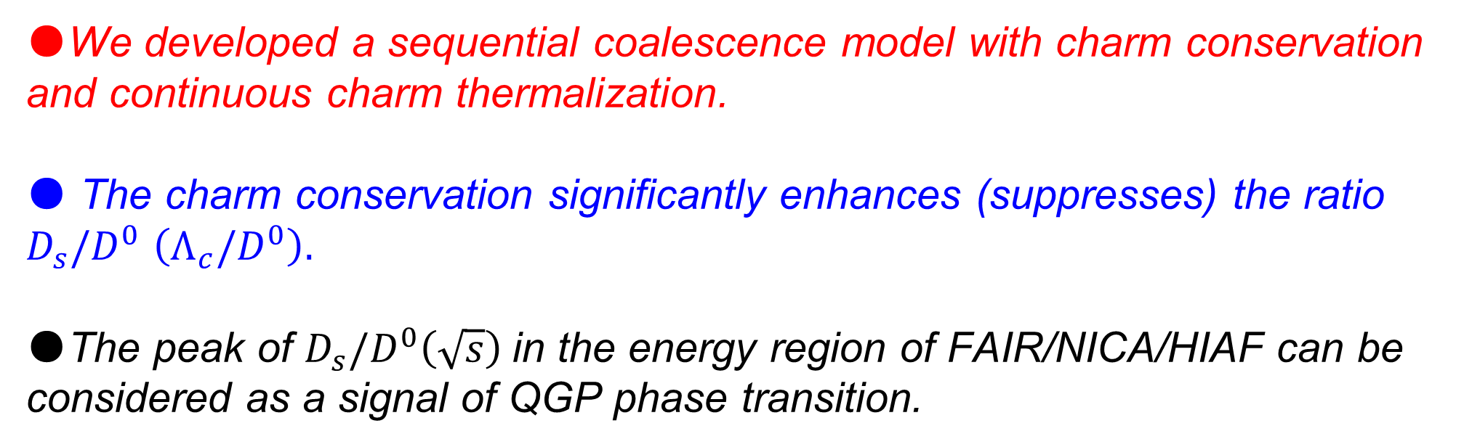
Summary
●We developed a sequential coalescence model with charm conservation and continuous charm thermalization.
● The charm conservation significantly enhances (suppresses) the ratio $D_{s}/D^{0}$ $\left(Λ_{c}/D^{0}\right).$
●The peak of $D_{s}/D^{0}\left(\sqrt{s}\right)$in the energy region of FAIR/NICA/HIAF can be
considered as a signal of QGP phase transition.
Pengfei Zhuang, Shuryak Workshop, CCNU, 20181008-11 19

Slide 20
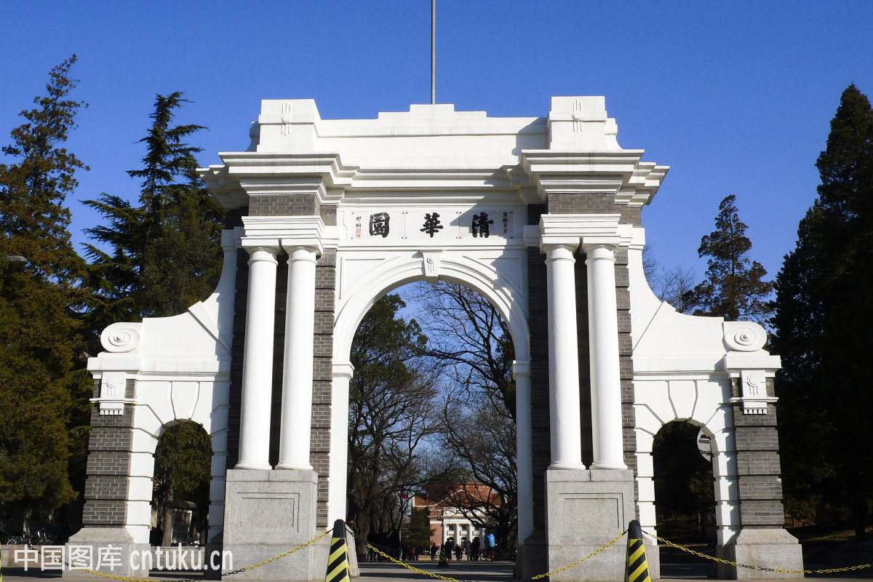
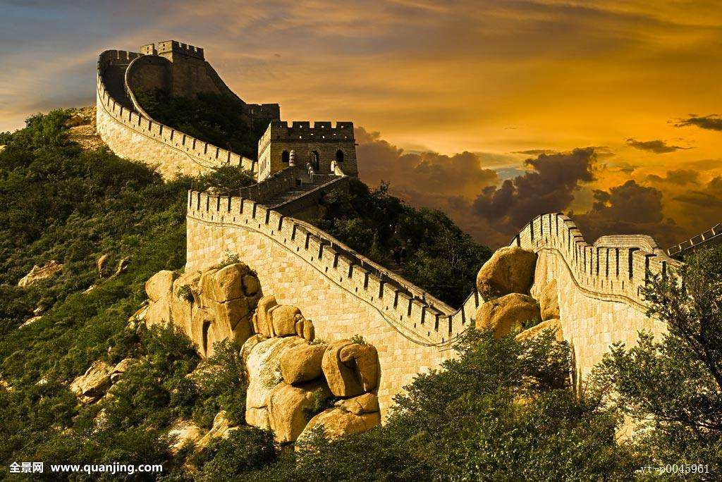
Chirality Workshop 2019
The 5th Workshop on Chirality, Vorticity and Magnetic Field in Heavy Ion Collisions
The 1st (2015), 2nd(2016), and 3rd (2017) workshops at UCLA
The 4th workshop at Florence
● Place: Tsinghua University, Beijing
● Date: April 8-12, 2019
这里：清华二校门和北京长城的图片
You are welcome to join the workshop!
Pengfei Zhuang, Shuryak Workshop, CCNU, 20181008-11 20

