Slide 1


What can we learn from and about free-response assessment questions in physics?
Ashutosh Kumar Pathak
Supervisors: Prof Sally Jordan, Dr Jonathan Nylk

Slide 2
Concept Inventory
In the simplest terms, a concept inventory is an outline of core knowledge and concepts for a given field.
Concept inventories are collection of multiple-choice questions that are designed to probe students’ understanding of fundamental concepts.
The questions are designed to assess students' qualitative understanding of concepts, rather than their ability to solve quantitative problems.

Slide 3
To inform changes in instruction from year to year
To assess student learning during a course, module or activity
Concept Inventory
To identify key misconceptions students hold about an evolutionary topic.
Pre/Post assesment
Identify demographic variables (e.g. ethnicity, gender, etc.)
For measuring student knowledge in a topic before a course or module
Furrow, R.E. and Hsu, J.L. (2019). Concept inventories as a resource for teaching evolution. Evolution: Education and Outreach, 12(1).

Slide 4
The Force Concept Inventory
The Force Concept Inventory (FCI) is an instrument designed to probe students’ misconceptions about force and motion.
The FCI consists of 30 multiple-choice questions.
Major common-sense categories covered in the FCI are as followed
1. Kinematics | 2. Impetus
3. Active Forces | 4. Action-reaction pair
5. Concatenation of influences | 6. Other influences of motion
Hestenes, D., Wells, M. and Swackhamer, G. (1992). Force concept inventory. The Physics Teacher, 30(3), pp.141–158. doi:https://doi.org/10.1119/1.2343497.

Slide 5
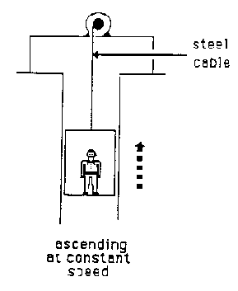
Example…
An elevator, as illustrated, is being lifted up an elevator shaft by a steel cable. When the elevator is moving up the shaft at a constant velocity;
the upward force on the elevator by the cable is greater than the downward force of gravity.
(B) the amount of upward force on the elevator by the cable is equal to that of the downward force of gravity.
(C) the upward force on the elevator by the cable is less than the downward force of gravity.
(D) it goes up because the cable is being shortened, not because of the force being exerted on the elevator by the cable.
(E) the upward force on the elevator by the cable is greater than the downward force due to the combined effects of air pressure and the force of gravity.
Option B

Slide 6
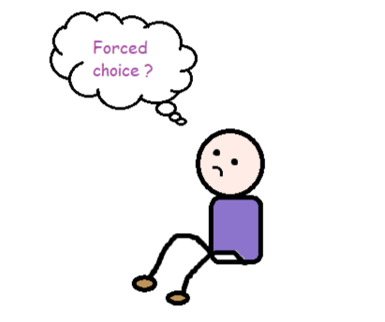
Hestenes et al. claim that the FCI overall is a very good Newtonian thinking detector and that errors (false positive or false negative) on the inventory are more insightful than the correct selections.
In a good multiple-choice question (MCQ), all choices should be well defined and mutually exclusive, with each choice representing a plausible response. However, it has been found that the most of the FCI questions are not in agreement with the definition.
Well, is there any alternative of MCQ based Force concept inventory?

Slide 7
Free-response Version of the Elevator Problem
Q. An elevator, as illustrated, is being lifted up an elevator shaft by a steel cable. When the elevator is moving up the shaft at a constant velocity;
the upward force on the elevator by the cable is greater than the downward force of gravity.
(B) the amount of upward force on the elevator by the cable is equal to that of the downward force of gravity.
(C) the upward force on the elevator by the cable is less than the downward force of gravity.
(D) it goes up because the cable is being shortened, not because of the force being exerted on the elevator by the cable.
(E) the upward force on the elevator by the cable is greater than the downward force due to the combined effects of air pressure and the force of gravity.
In the diagram below, an elevator is being hauled up by a shaft at a constant speed by a steel cable. All frictional effects are negligible. Identify the forces acting on the elevator.
Recall that the lift is going up in the shaft at a constant speed. What does it tell you about the forces acting on the lift?

Slide 8
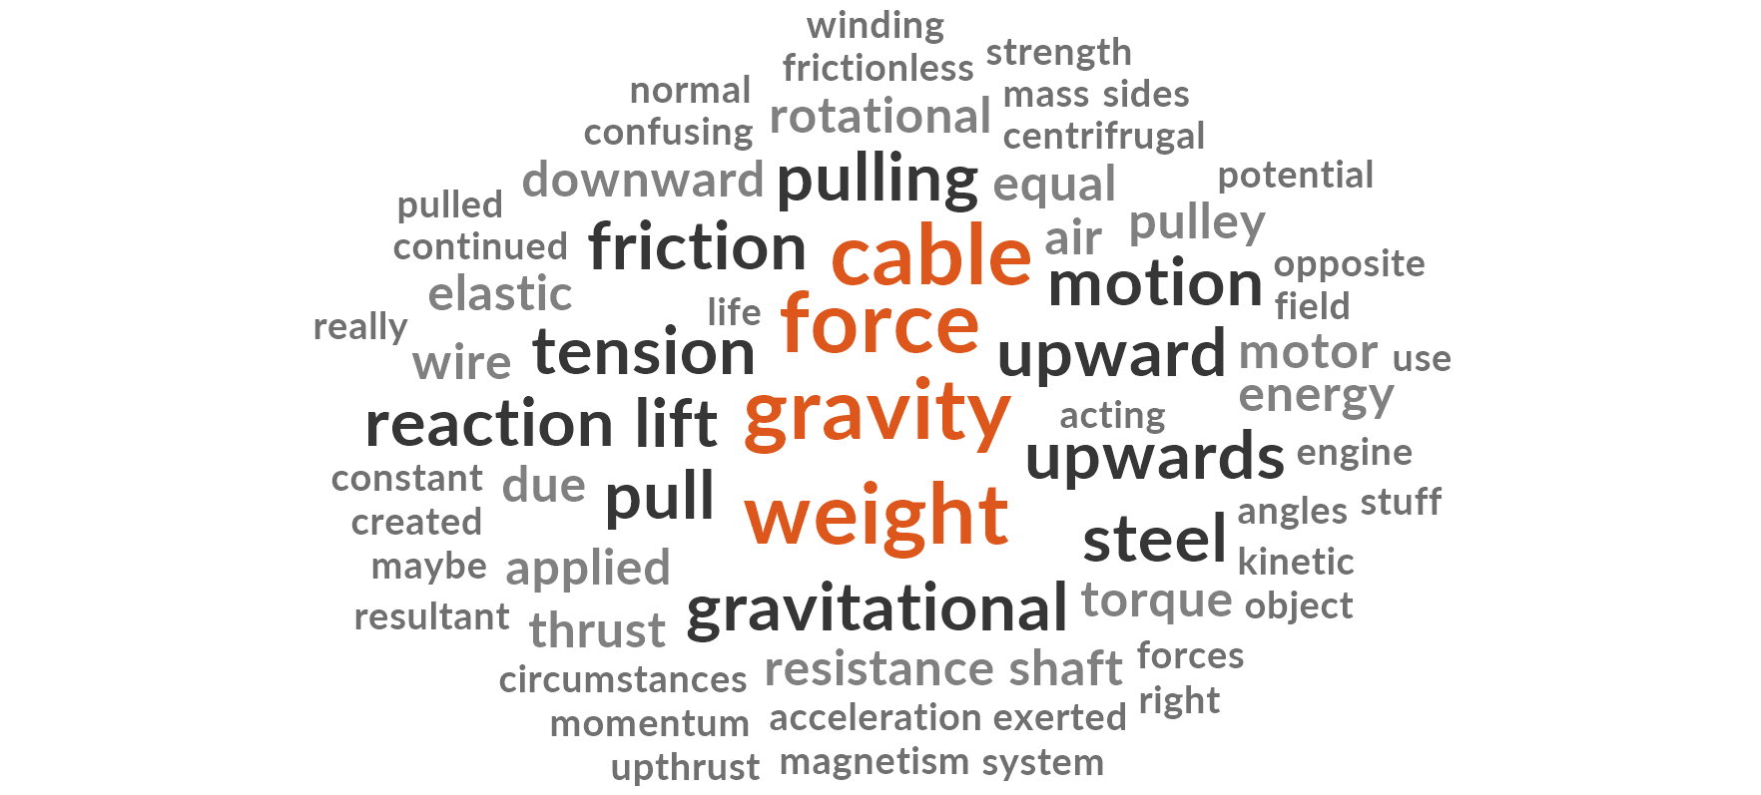
Keywords-in-Context Analysis
In the diagram below, an elevator is being hauled up by a shaft at a constant speed by a steel cable. All frictional effects are negligible. Identify the forces acting on the elevator.
Some of the answers are as follows;
1. downward weight upward: upward force
2. DOWNWARD GRAVITY
3. reaction force weight friction
4. Gravitational potential energy Gravity Kinetic energy
5. Gravity friction air resistance

Slide 9
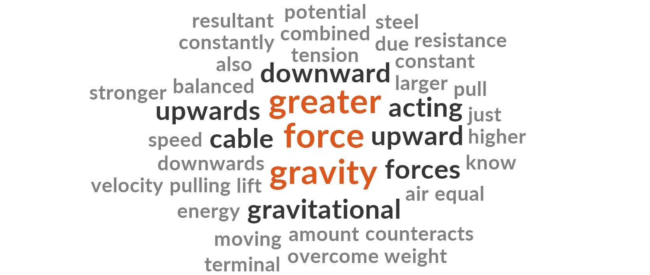
Keywords-in-Context Analysis
2. Recall that the lift is going up in the shaft at a constant speed. What does it tell you about the forces acting on the lift?
Some of the answers are as follows;
Gravitational potential energy is greater than that from the force of gravity
steel cable force greater than gravity
the upward force by the cable is greater than the downward force of gravity.
the force of the cable is greater then the gravitational force and also moving at a constant spee
Total 275 responses were collected across the sections in 2019
Pattern-match question type – MoodleDocs
https://lumivero.com/products/nvivo/
22 wrote that one of the two forces was more than another.

Slide 10
Free-text Sub-questions
Free-response version of the Force Concept Inventory are very effective when it comes to probe misconceptions in Newtonian mechanics.
However, it has been observed that Free-response questions don’t eliminate the possibility of guess-work.
By posing carefully designed sub-questions, we can eliminate the guess work and understand the expertise level of students.
Rebello and Zollman, D.A. (2004). AJP, 72(1), pp.116–125.

Slide 11
1. Design and write sequential free-text sub-questions
2. Ethical approval
Interviews with graduate students, subject matter experts and researchers
Pattern-match coding for the questions when finalised
Set of questions solved by targeted students
Following to be performed once the responses are received;
Reliability and validity of the assessment tool (The FCI)
Check for possible gender biasing
Possible modification in pattern-match coding based on the responses
Factor analysis across the sub-questions
Thematic and keyword analysis to be done using NVIVO software
Hestenes, D. and Halloun, I. (1995). TPT, 33(8), pp.502–502
Dietz, R.D., Pearson, R.H., Semak, M.R. and Willis, C.W. (2012). Nucleation and Atmospheric Aerosols
Murshed, M.B. (2020). International Journal of Psychosocial Rehabilitation, 24(5), pp.143–151.

Slide 12
Thank you

