Slide 1



Searches for Physics Beyond
the SM at the Large Hadron Collider
Albert De Roeck
CERN, Geneva, Switzerland
Antwerp University Belgium
UC-Davis California USA
NTU, Singapore
10th July 2019

Slide 2
Lecture Plan
Overview of the 3 lectures in the next days
Lecture 1: Introduction to Experimental Techniques at the LHC & Measurements and test of the Standard Model
Lecture 2: The Higgs boson and Standard Searches beyond the Standard Model,
Lecture 3: New Searches, New Experiments and an outlook to the Future at the LHC

Slide 3
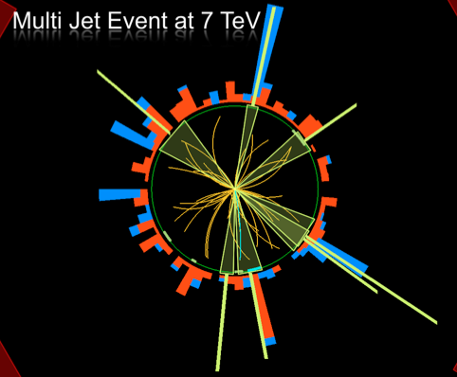
Outline Lecture I
The Higgs: new physics or
Standard Model?
Searching for Supersymmetry
Searching for Dark Matter
Exotica Searches
Summary
Disclaimer:
ATLAS & CMS have very
similar results
Typically one chosen
for illustration

Slide 4
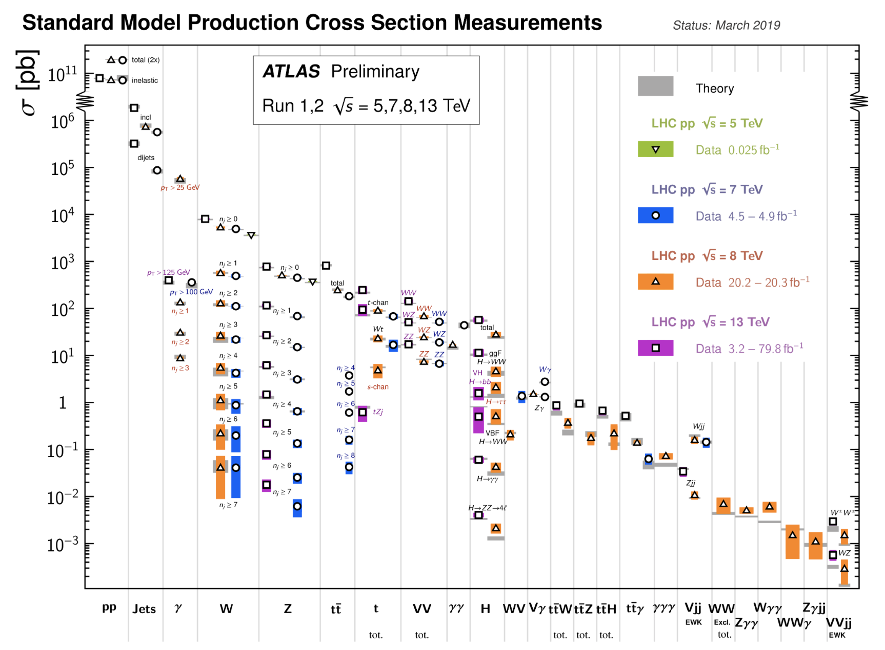
Summary: Cross Sections 7/8/13 TeV
All measurements in good agreement with the Standard Model predictions!!

Slide 5
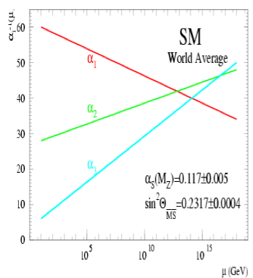
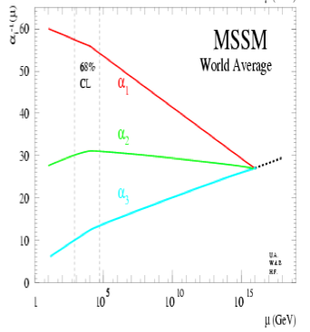
Physics case for new High Energy Machines
Understand the mechanism Electroweak Symmetry Breaking
Discover physics beyond the Standard Model
Reminder: The Standard Model
- tells us how but not why
3 flavour families? Mass spectra? Hierarchy? 19 parameters!
- needs fine tuning of parameters to level of 10⁻³⁰ !
- has no connection with gravity
- no unification of the forces at high energy
- Supersymmetry
- Extra space dimensions
Many other ideas: More symmetry and gauge bosons, composite
Higgs models, L-R symmetry, quark & lepton substructure,
Little Higgs models, Technicolor, Hidden Valleys, 4th generation…
Most popular extensions since 2000
Higgsless models “disfavoured” these days

Slide 6

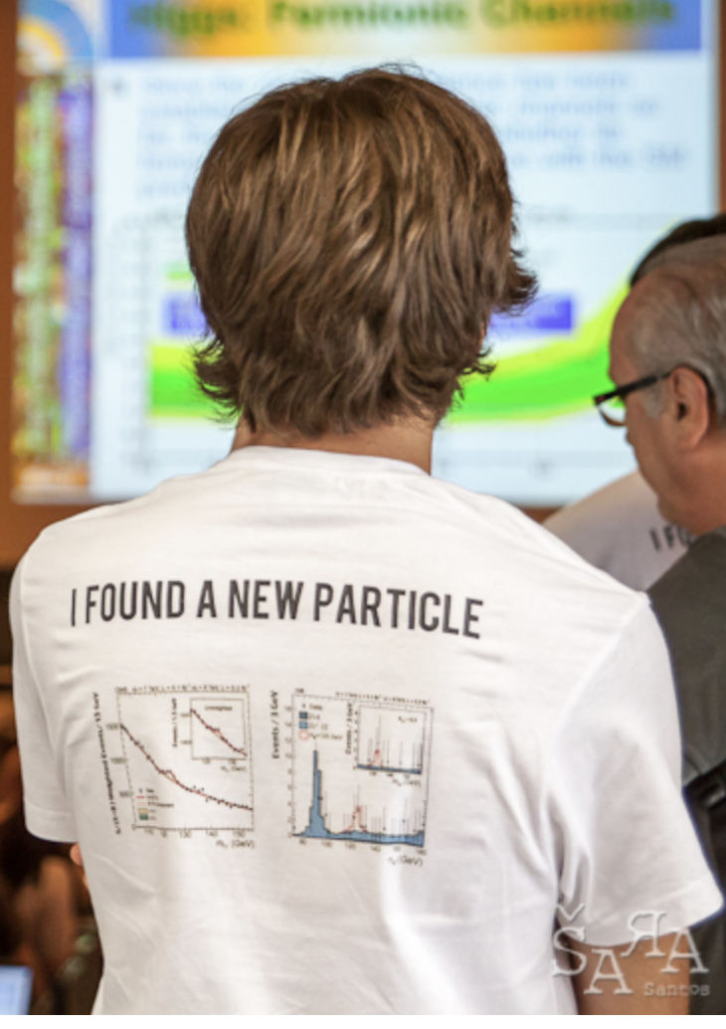

Higgs
The party 7 years ago

Slide 7

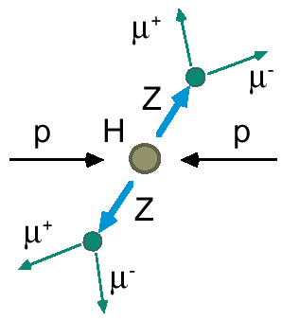
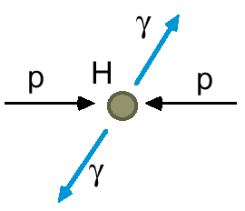
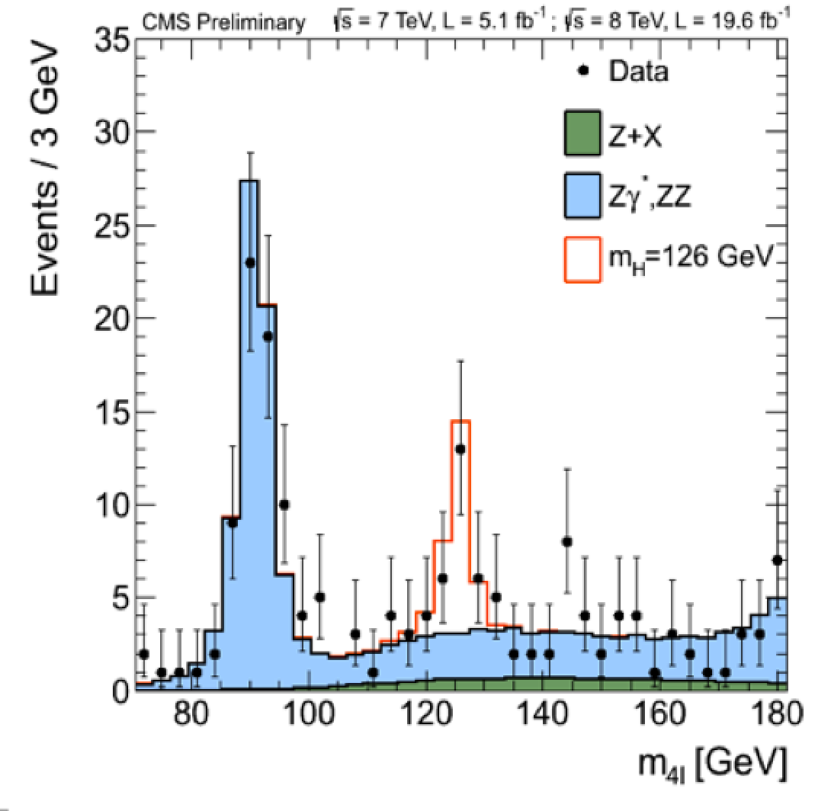
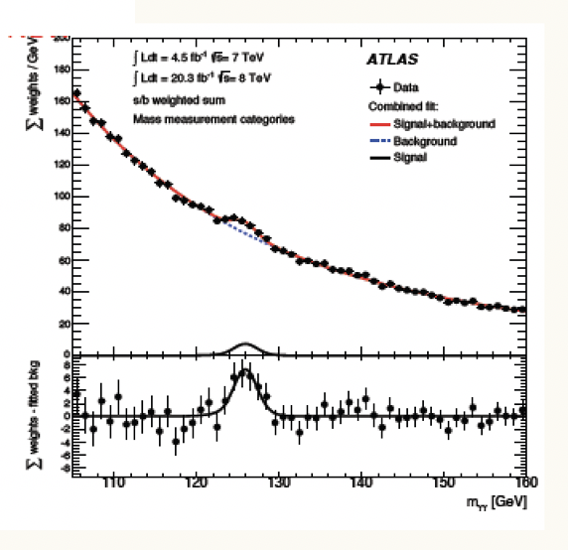

2012: A Milestone in Particle Physics
Observation of a Higgs Particle at the LHC, after about 40 years
of experimental searches to find it
proton
proton
The mass of the Higgs particle is
following the Run-1 ATLAS+CMS combination arXiv:1503.07589

Slide 8
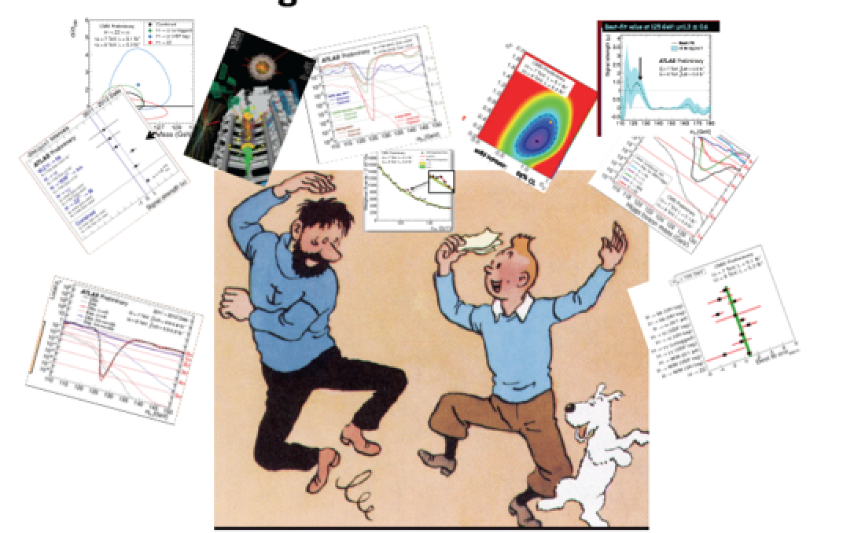

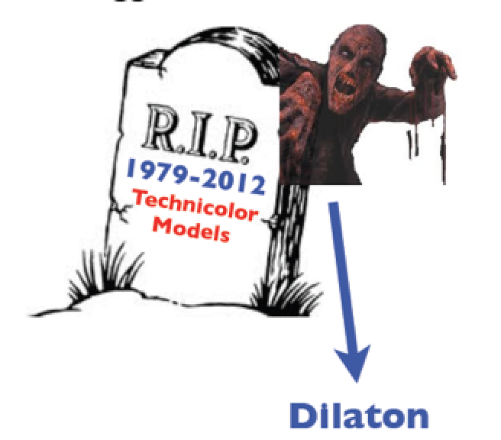
The Theorist and Experimentalists
The party in 2012!
Not everybody at the party
eg higgsless models…
A. Pomarol ICHEP2012
But careful about resurrections, Higgs imposters…

Slide 9


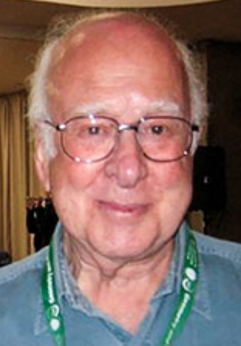

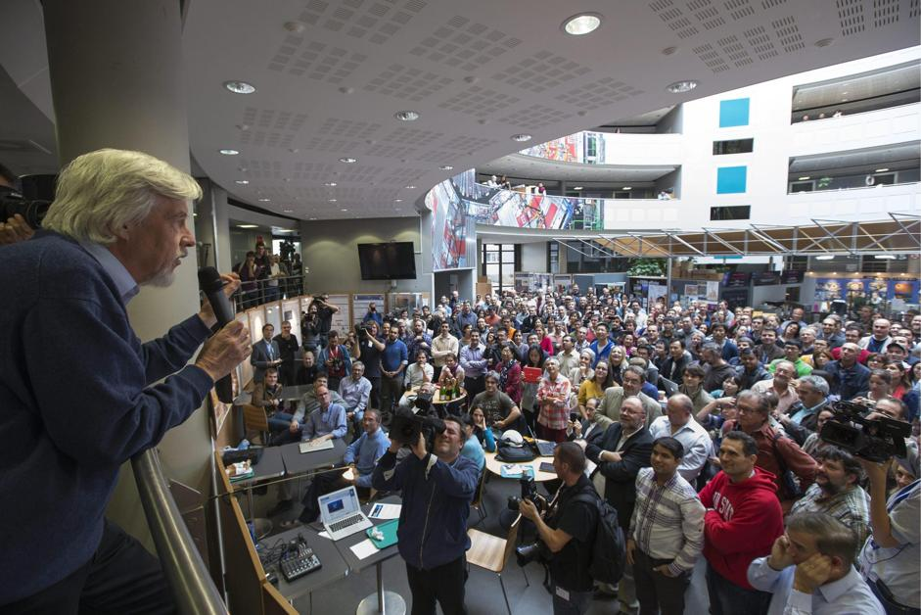


Tuesday 8 October 2013
Francois Englert
Peter Higgs
Congratulations!!!!

Slide 10
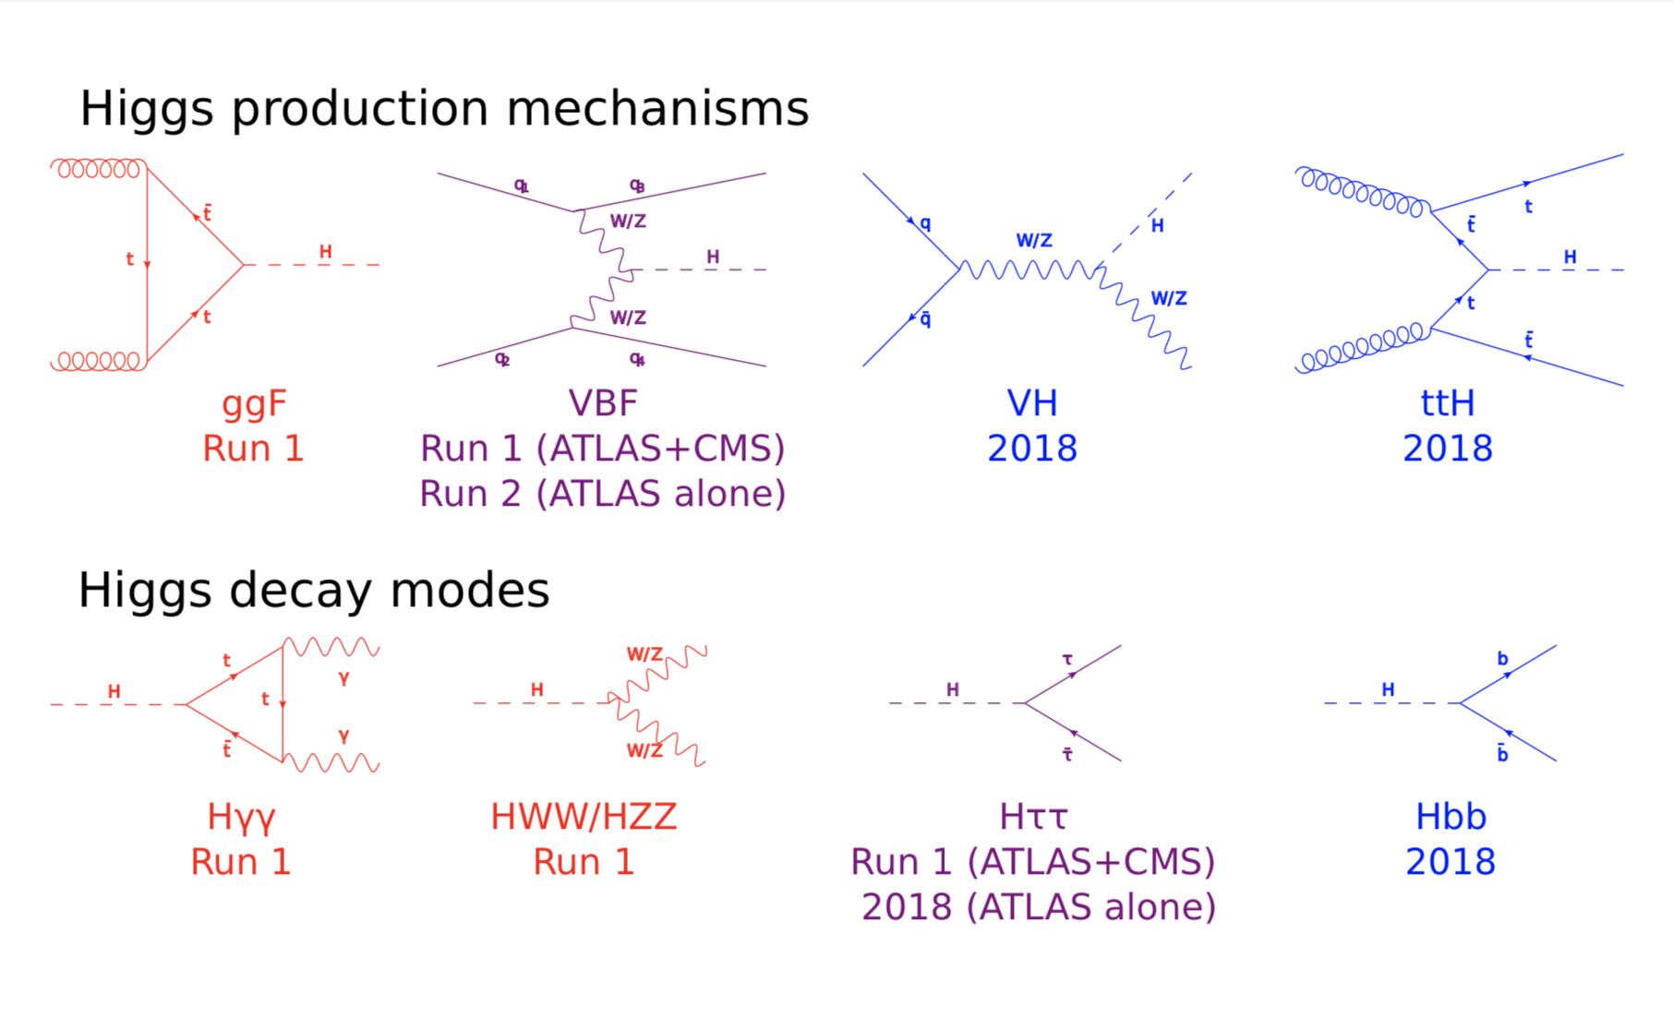
Higgs Production and Decay
Not observed in run-1

Slide 11
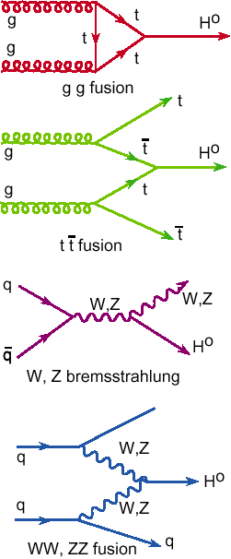
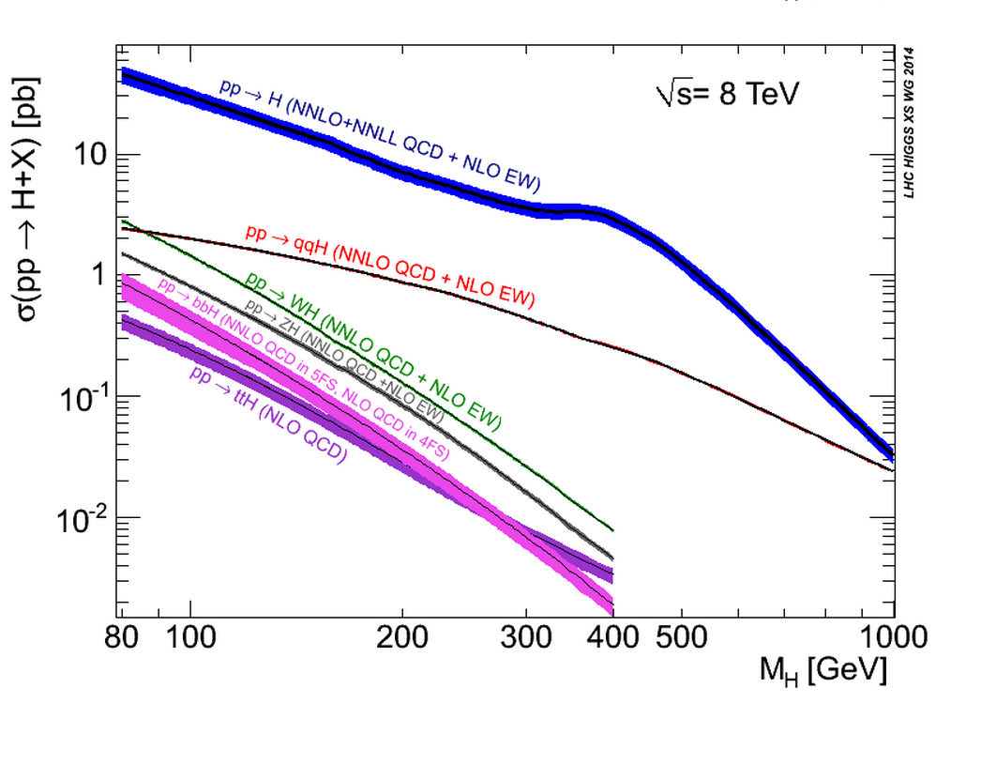
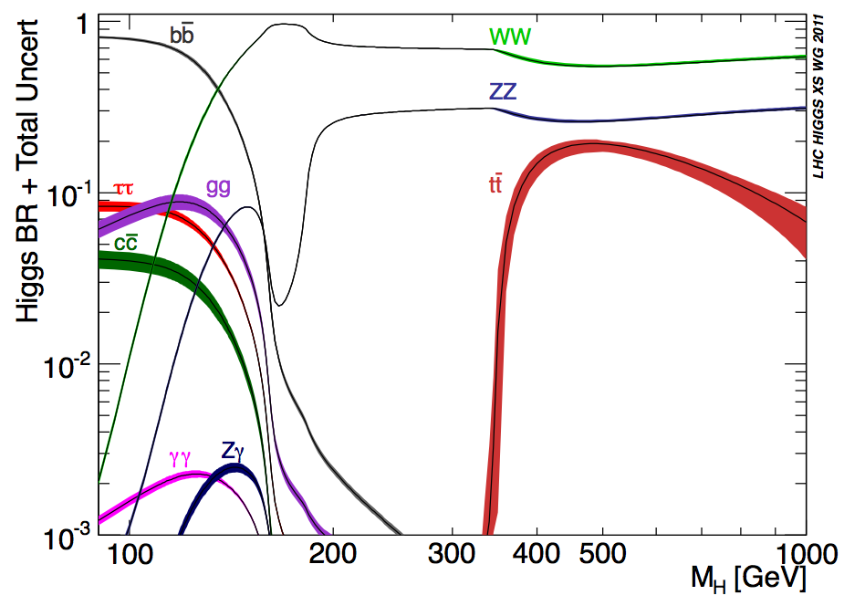
Higgs Production & Decay
Processes
•Gluon fusion
•Vector Boson Fusion
•W/Z associated prod.
•Top associated prod
•B-quark associated prod?
Numbers taken from the
LHC Higgs Cross Section WG
See CERN yellow reports:
YR1: Inclusive cross sections
YR2: Differential cross sections
YR3: Properties
YR4: Deciphering the nature of the
Higgs sector

Slide 12
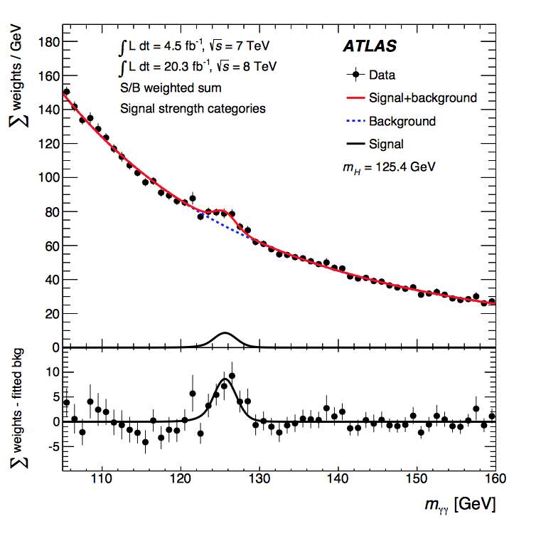
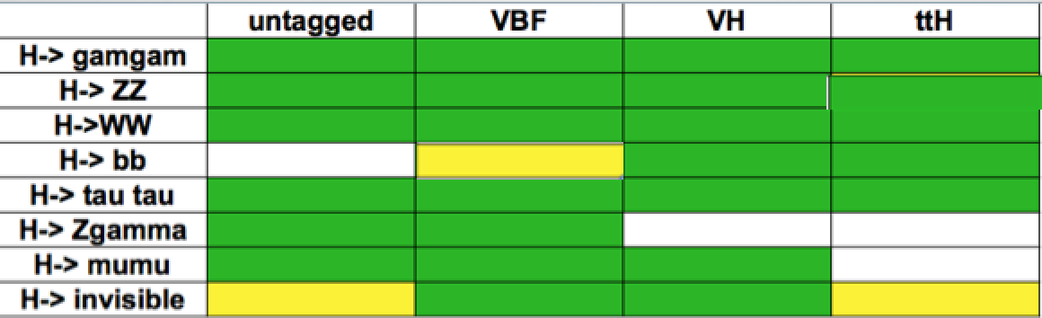



2012: A Milestone in Particle Physics
Observation of a Higgs Particle at the LHC, after
about 40 years of experimental searches to find it
2014: Higgs Boson
well established.
Most accessible
channels studied
Observation in WW,
ZZ and γγ channels
⋅tau tau at the limit
bb and ttH not
observed in Run-1
ggF
2018

Slide 13
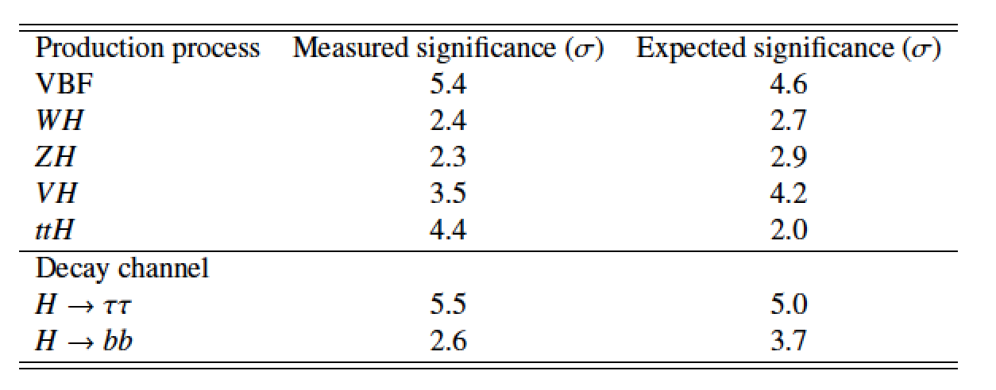
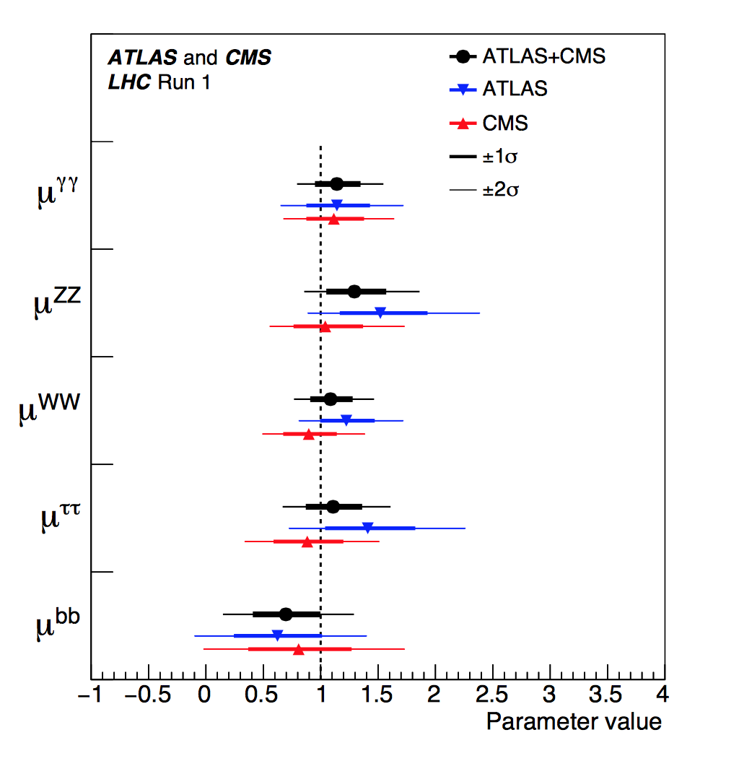
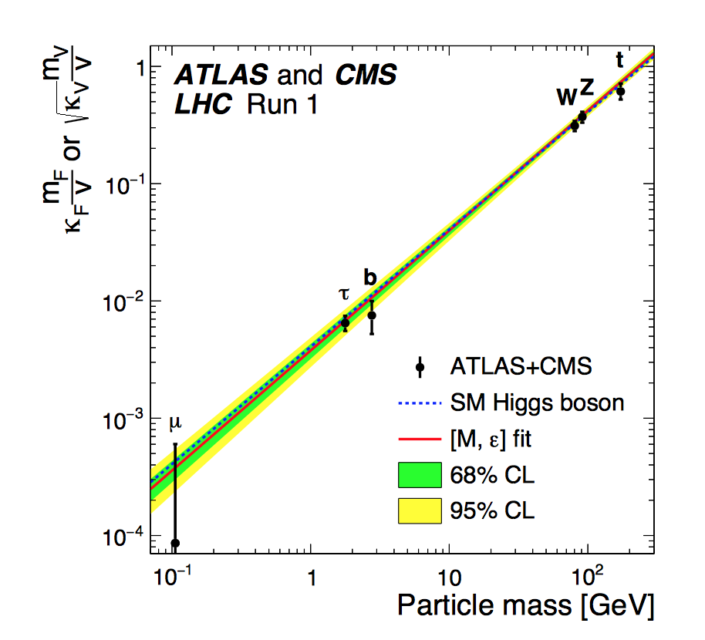
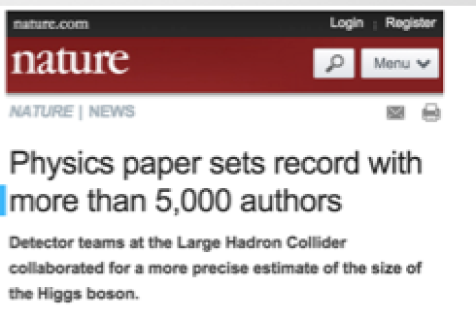
Higgs: ATLAS+CMS Combination
The Run-1 Higgs Legacy!
arXiv:1606.02266 /
JHEP 1608 (2016) 045
5153 authors!!
The newly found boson has
properties as expected for
a Standard Model Higgs
Signal strength/SM:

Slide 14
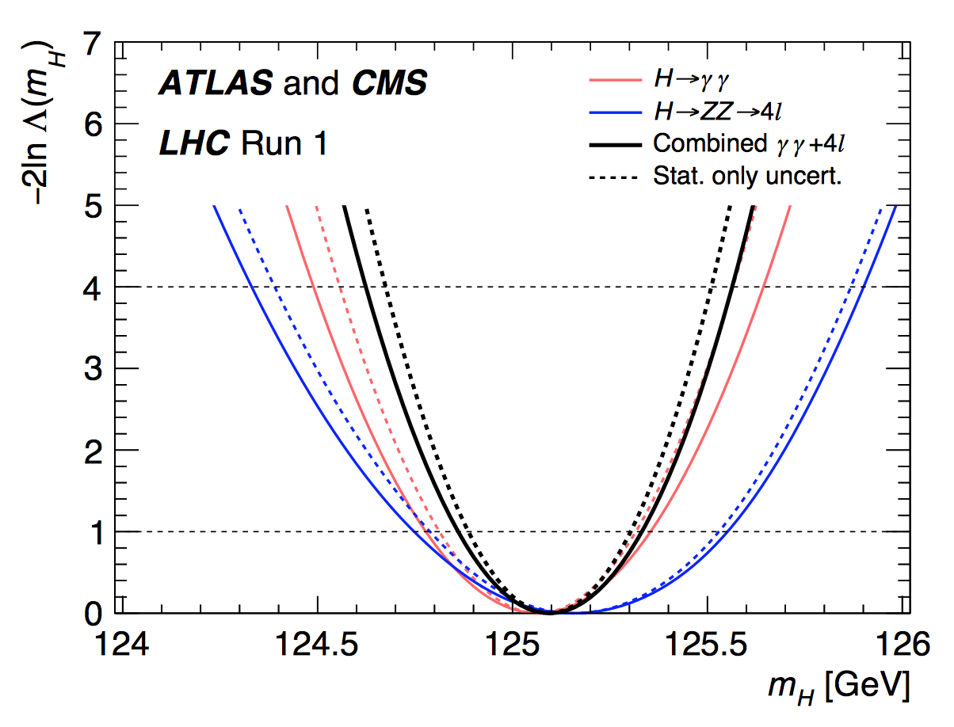
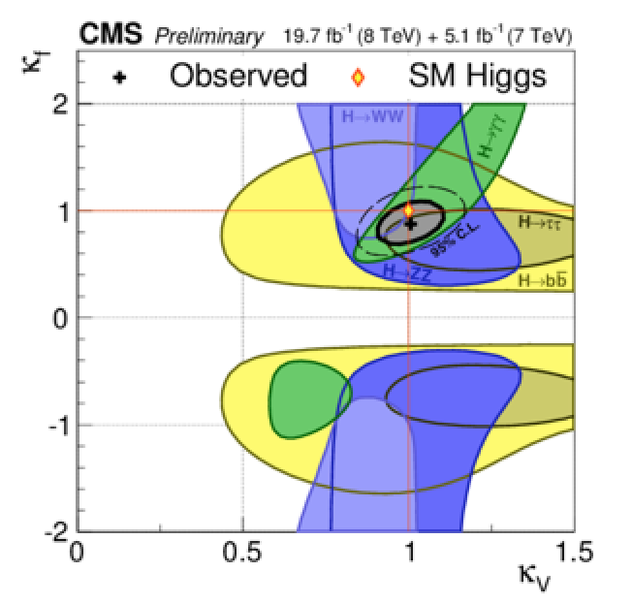
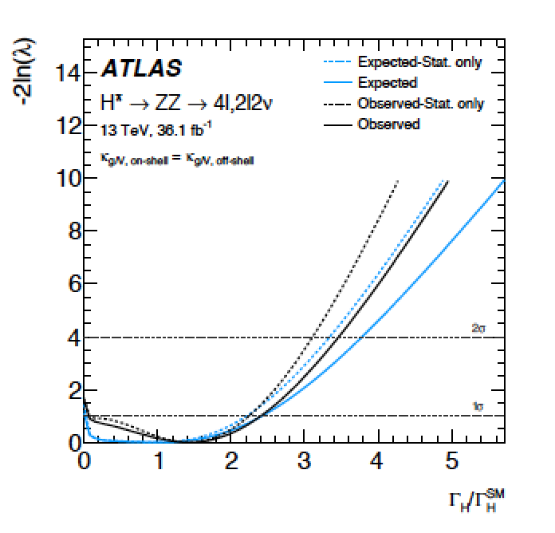
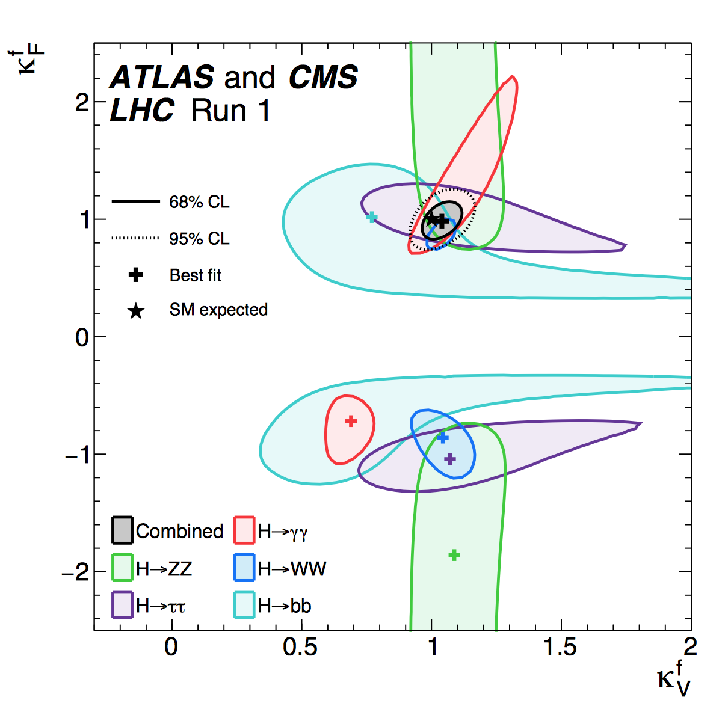
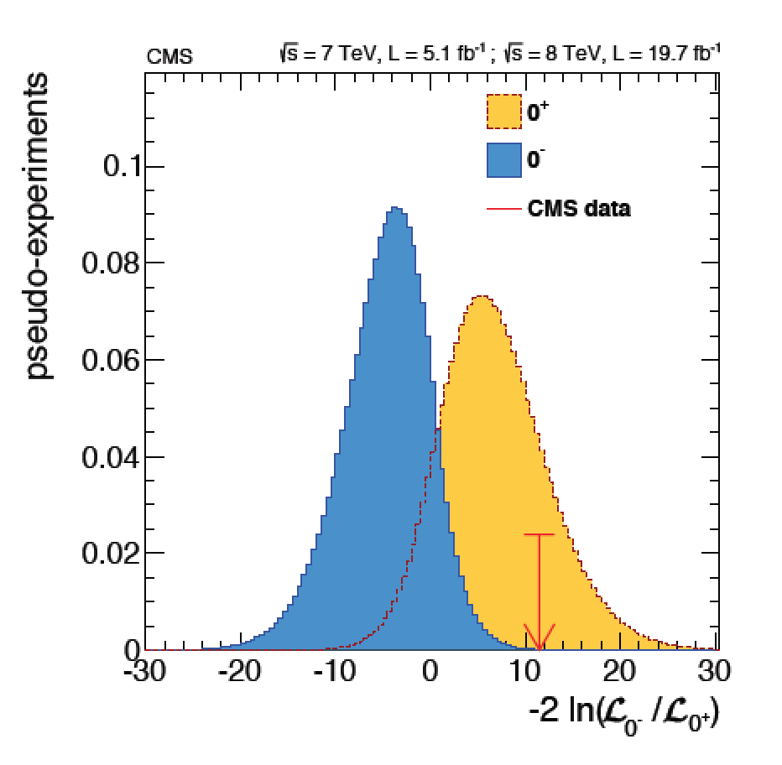

Brief Higgs Summary from Run 1
We know already a lot on this brand New Higgs particle!!
Mass = CMS+ATLAS
125.09 ±0.21(stat)
±0.11(syst) GeV
Width
< 14 MeV
(95%CL)
Couplings are
within ~10-20%
of the SM values
Spin =
0⁺⁽⁺⁾ preferred
over 0⁻,1,2
We continue to look for anomalies, i.e. unexpected decay modes or couplings,
multi-Higgs production, heavier Higgses, charged Higgses…

Slide 15
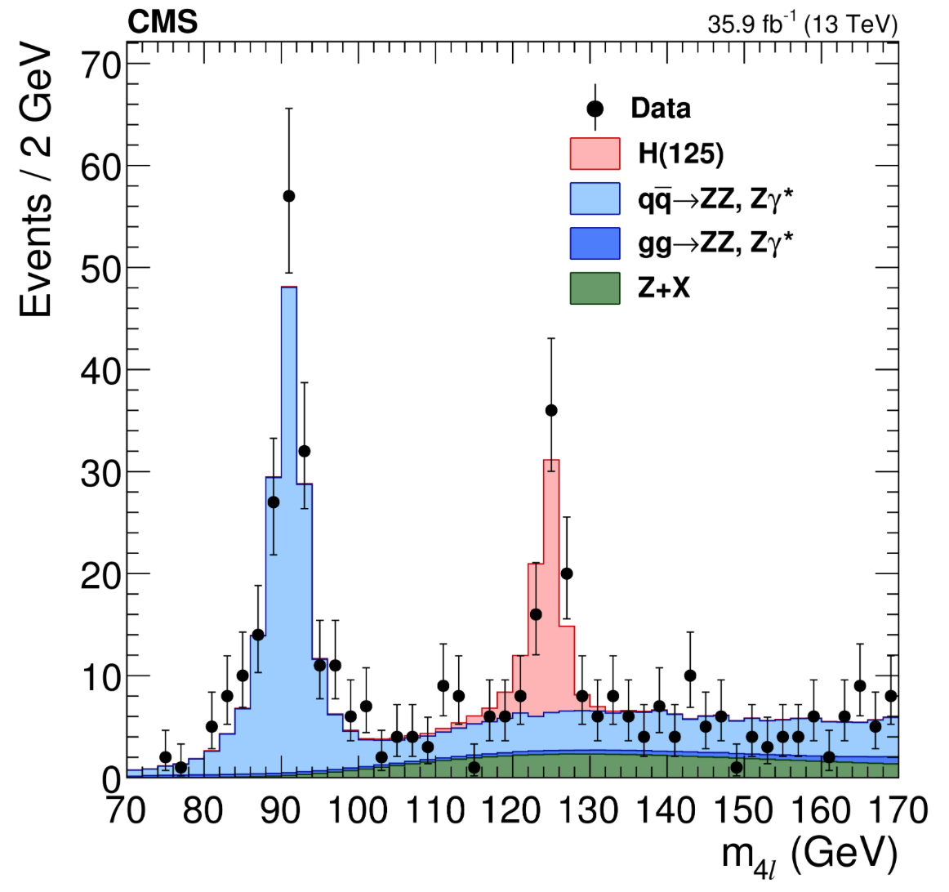
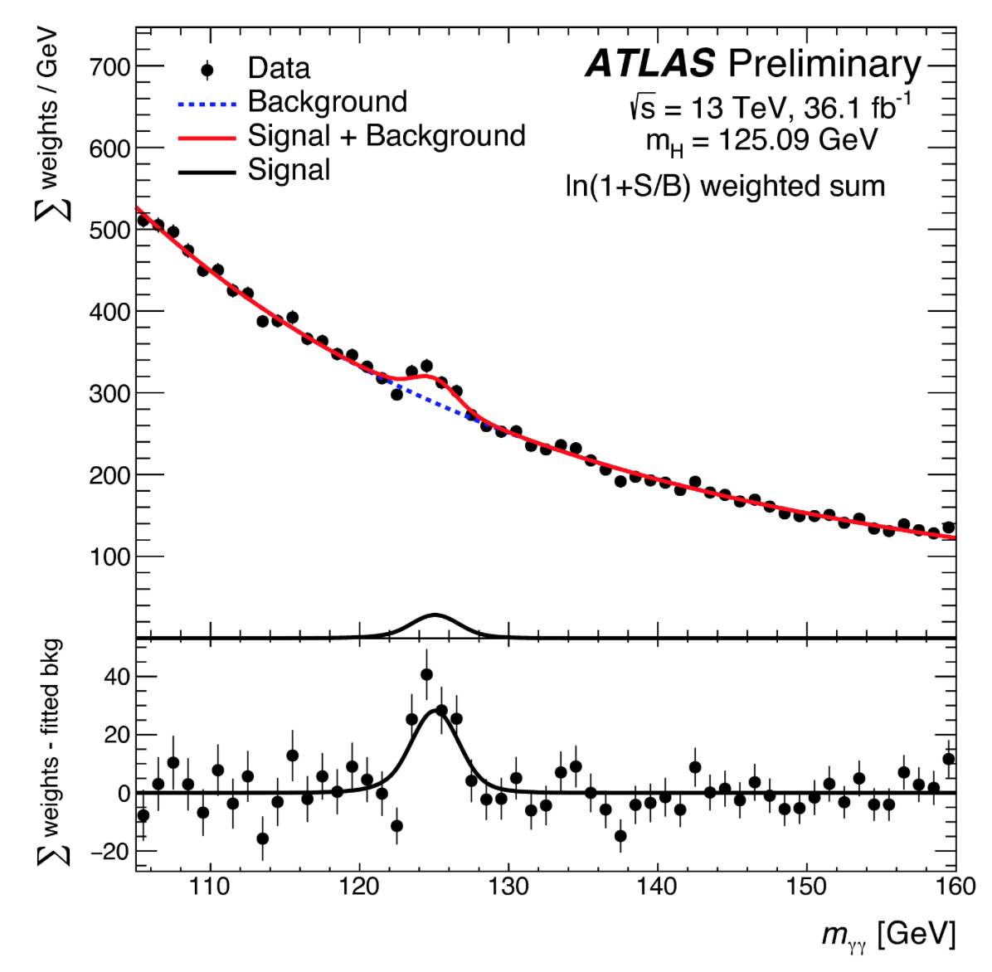
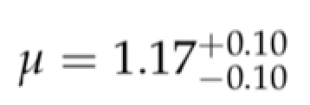
Higgs @ 13 TeV in Run 2
Higgs particle is still there ! ☺
The mild deviations seen in Run-1 seem to be gone ☹
Observation of H→bb in the associated production channel
Direct observation of ttH production
No deviations from Standard Model Higgs expectations yet!!
H→ ZZ
H→ γγ
The Higgs Boson is still very
much Standard Model-like!

Slide 16
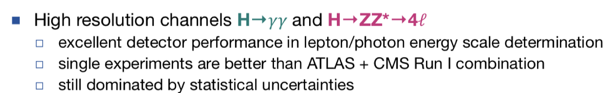
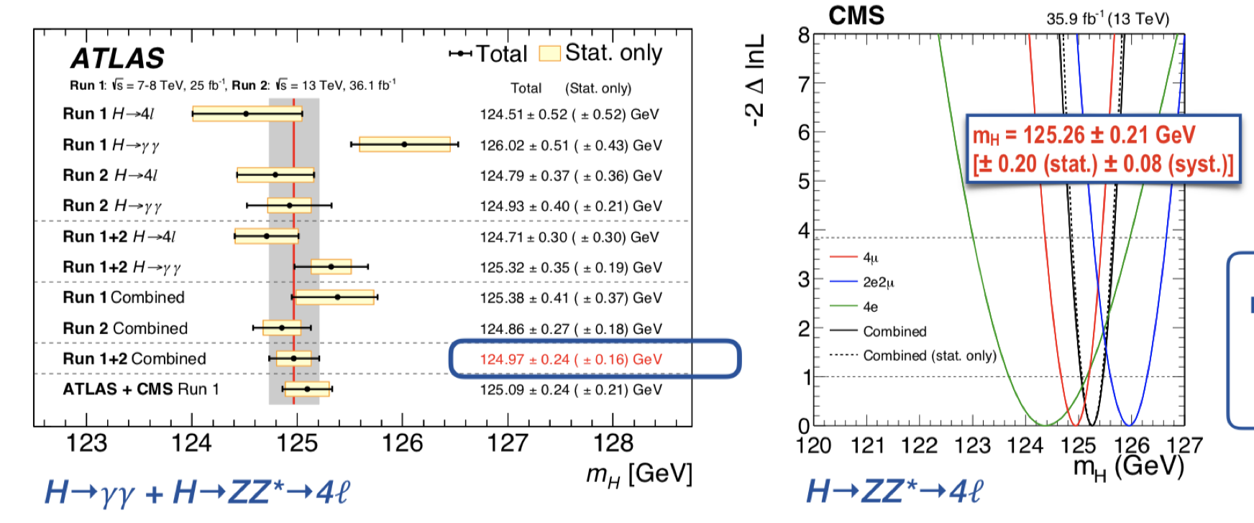
Higgs Mass
M_{H} is known to a precision of 2 per mille

Slide 17
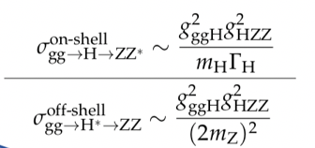
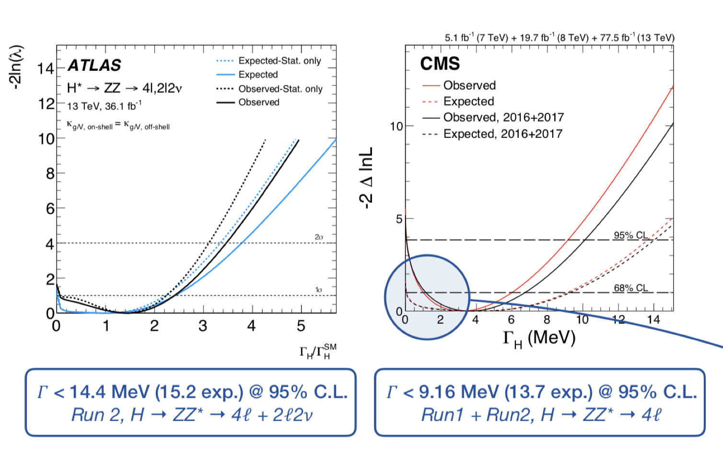
Higgs Width
Technique: on-shell to off-shell cross section
SM Higgs
width =4 MeV
We start to get
a lower bound
on the Higgs
width!

Slide 18
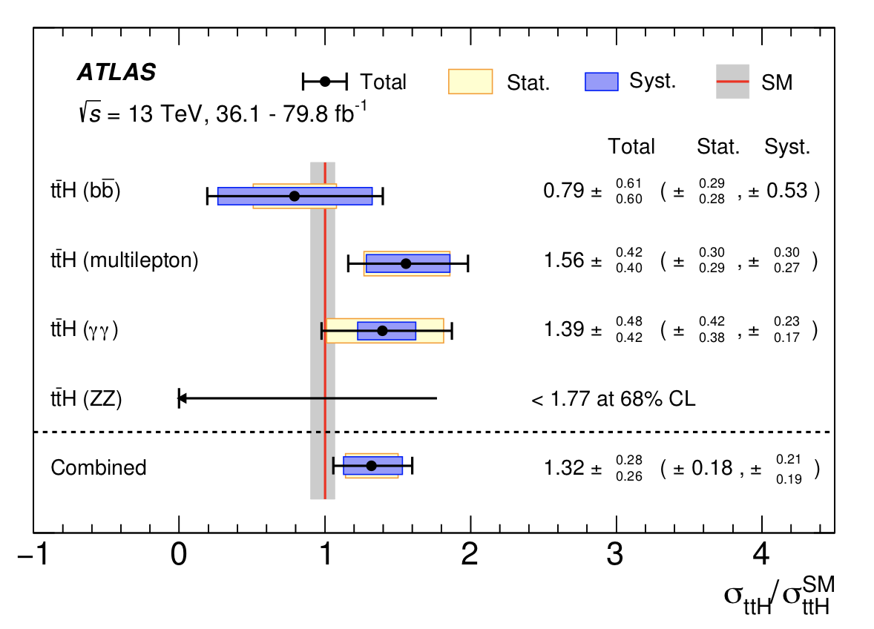
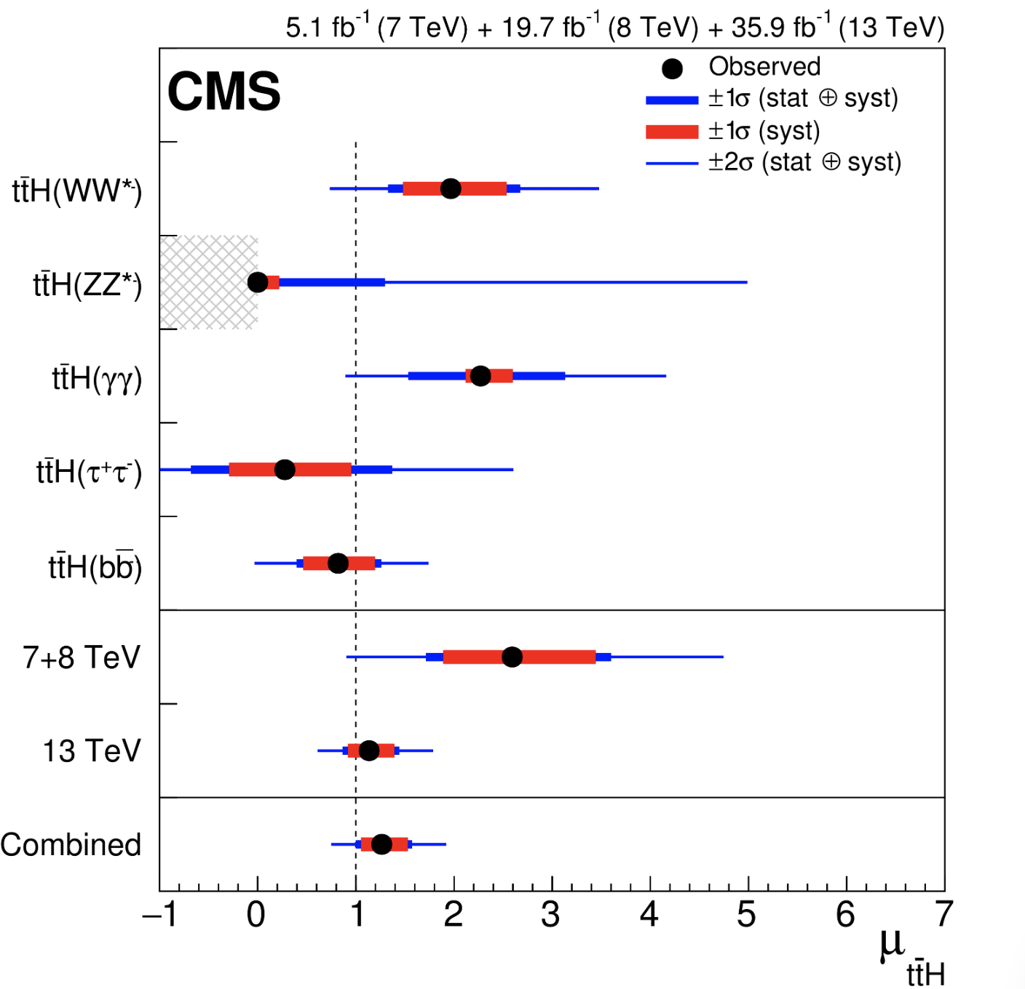
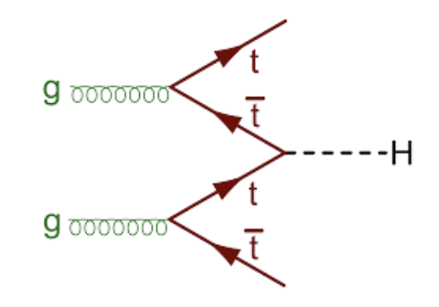
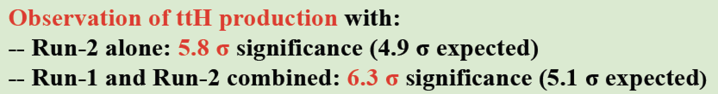

Higgs ttH Production
ttH production: Combination of all Higgs decay channels
and combination with the 7/8 TeV data of Run-1
arXiv:1804.02610
arXiv:1806.0425
7+8+13 TeV data
Observation of ttH!
Results in agreement with the Standard Model
Significance = 5.9σ (exp 4.2σ )

Slide 19
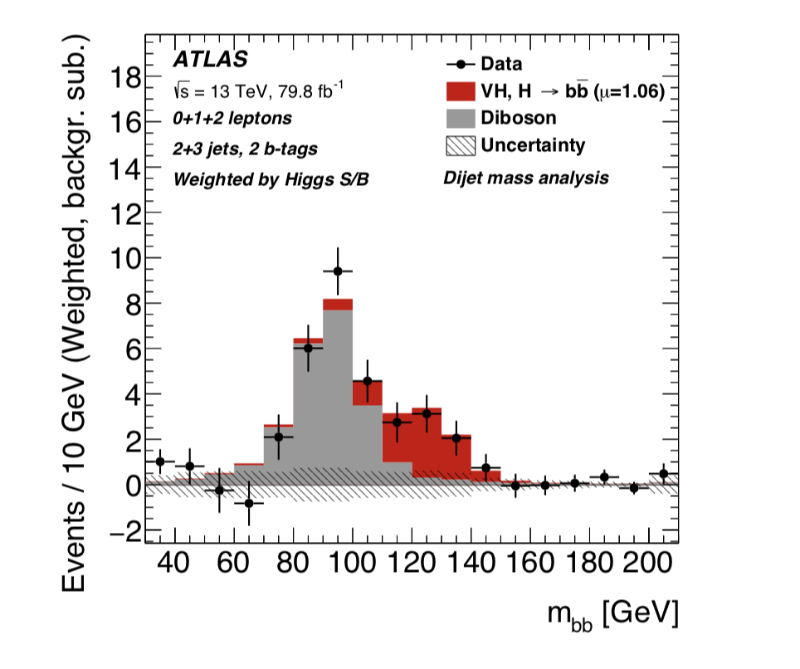
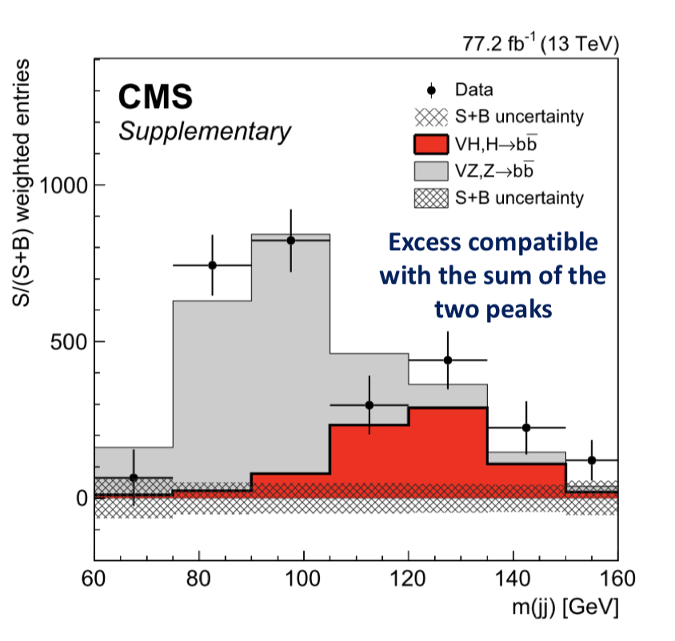
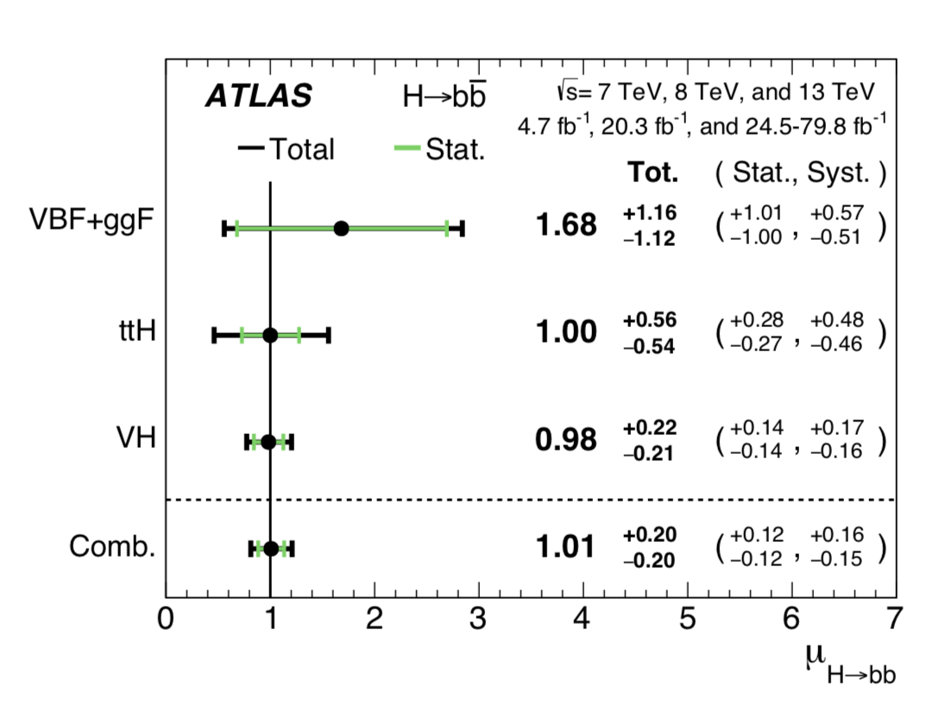
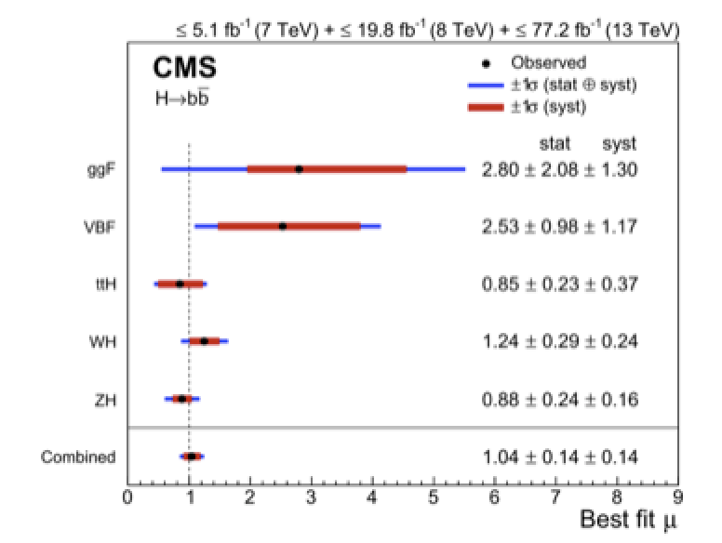
Higgs to bb Decay
H->bb decay: Combination of all Higgs decay channels
and combination with the 7/8 TeV data of Run-1
H->bb observed
with more than
5σ in both
experiments
arXiv:1808.08238
arXiv:1808.08242

Slide 20
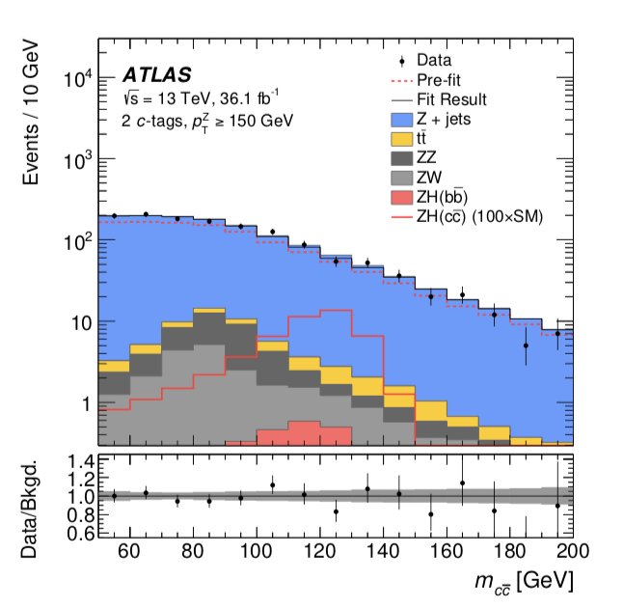
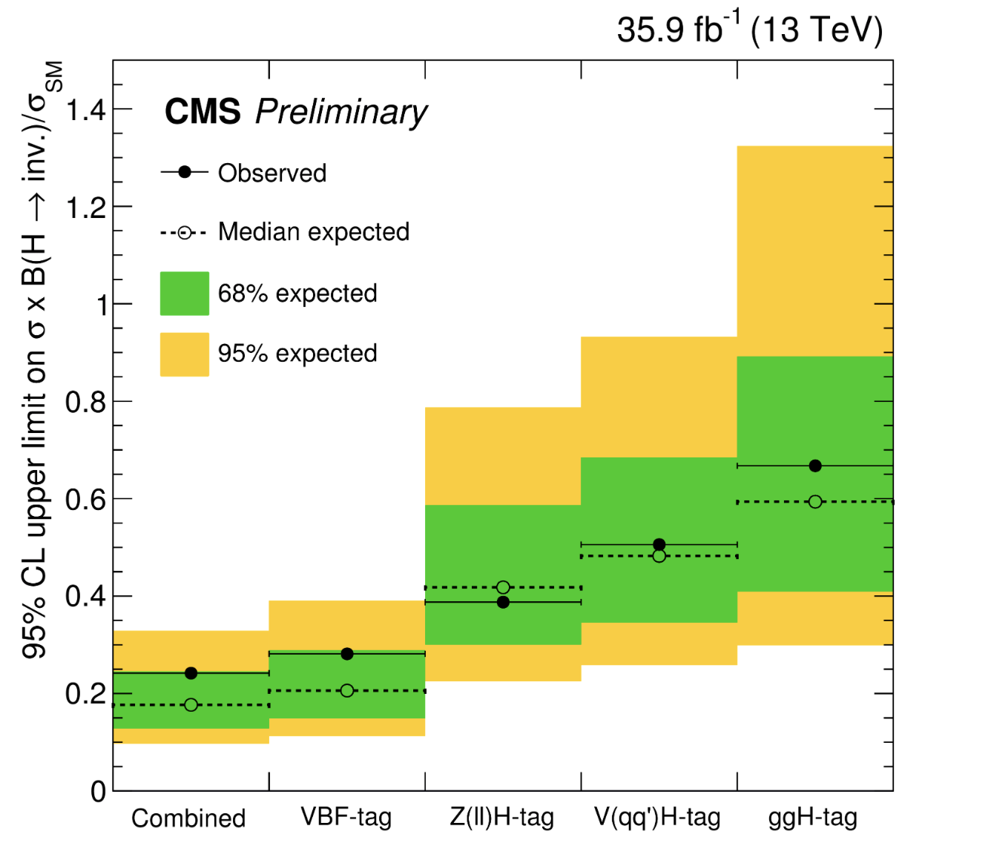
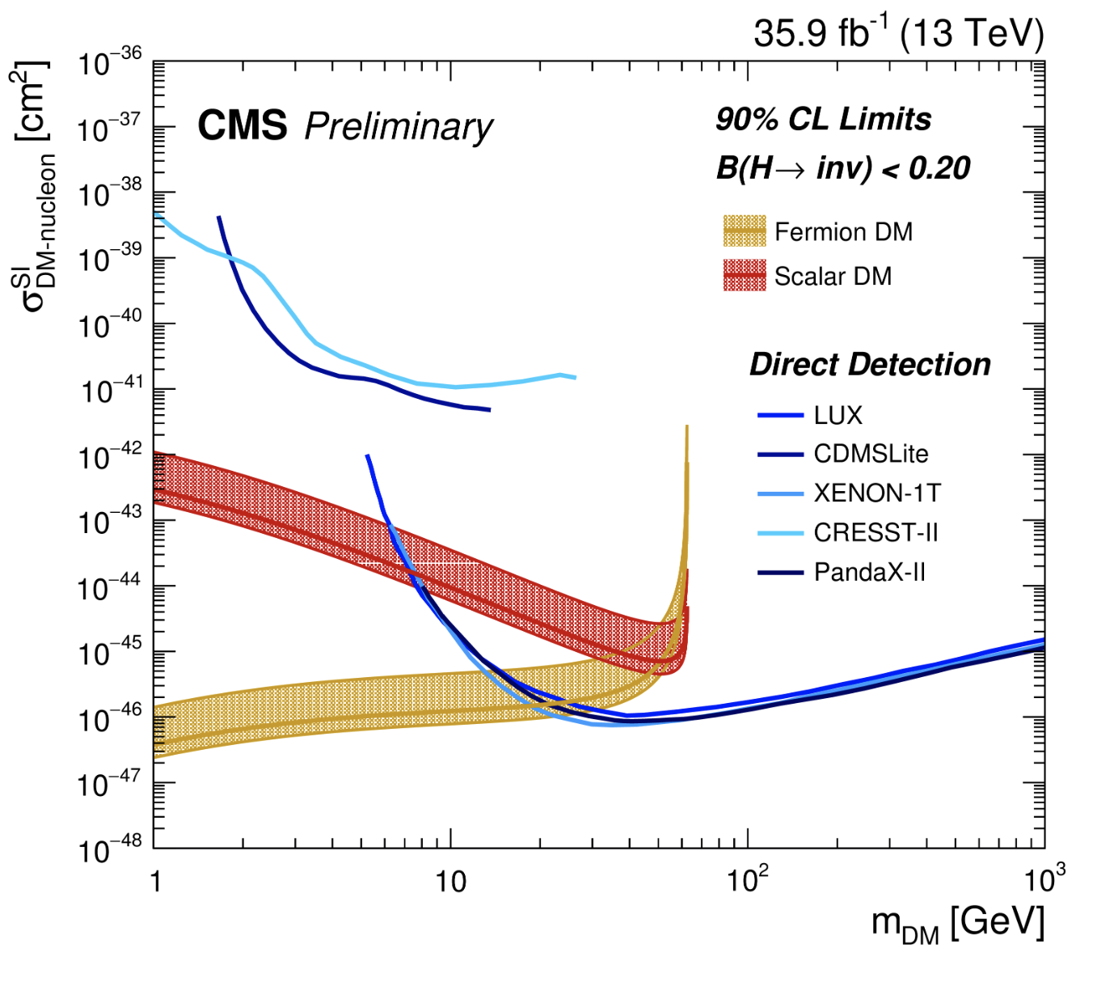
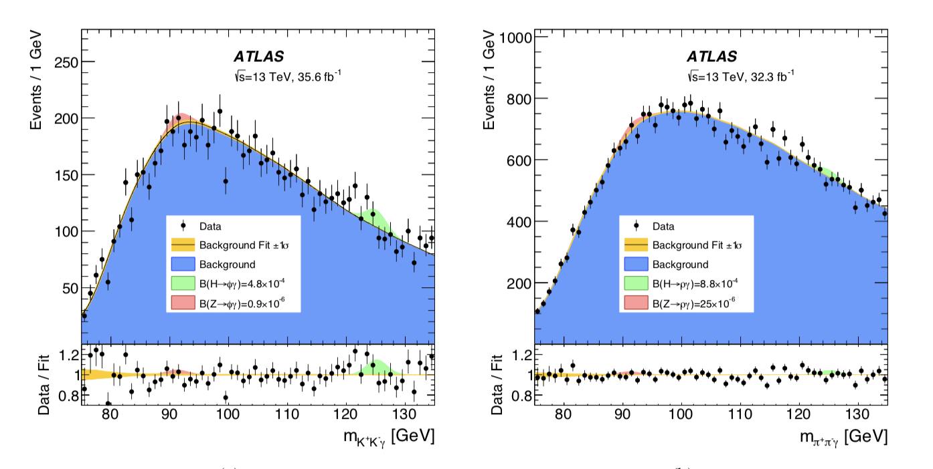
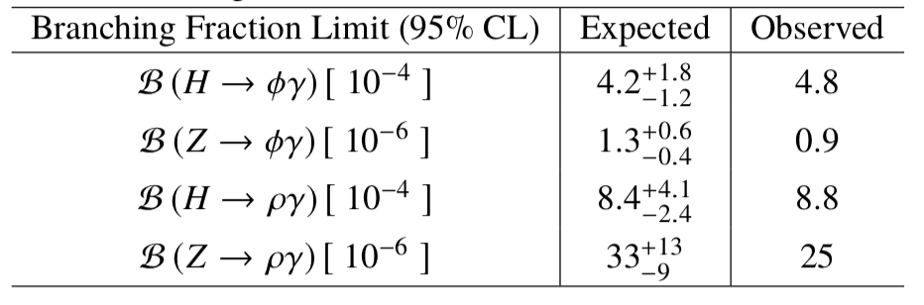
More Higgs Studies…
arXiv:1802.04329
Higgs decay to invisible
Higgs decay to charm search
HIG-17-023
95% upper limit
Higgs decay to ργ and φγ search
arXiv:1712.02758

Slide 21
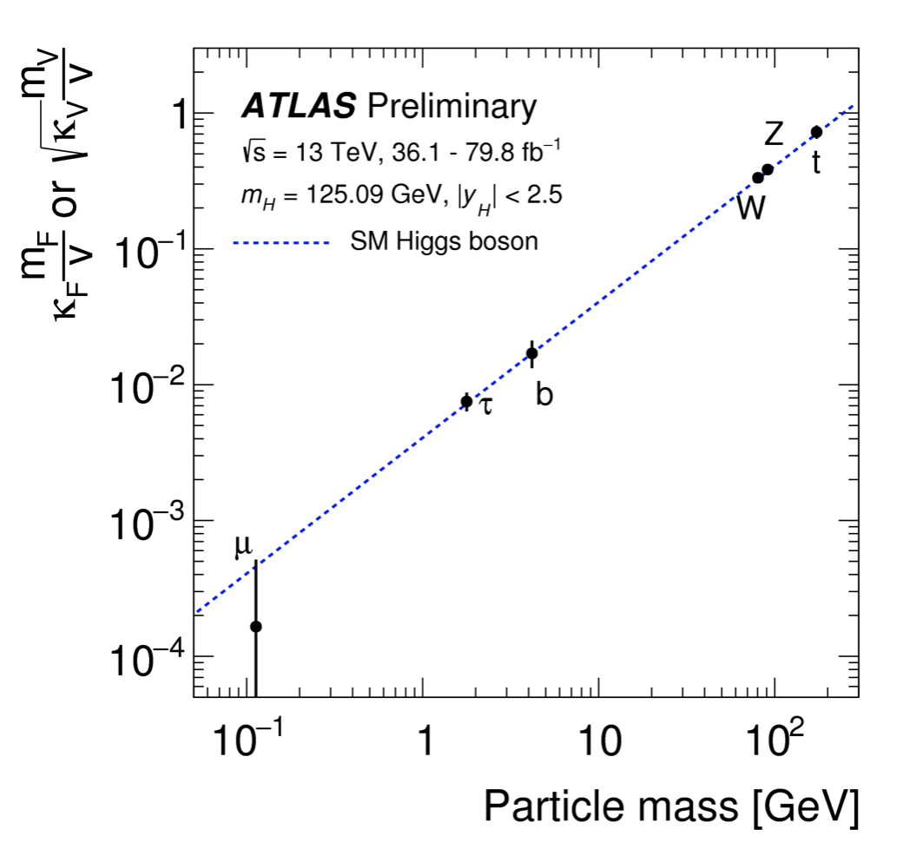
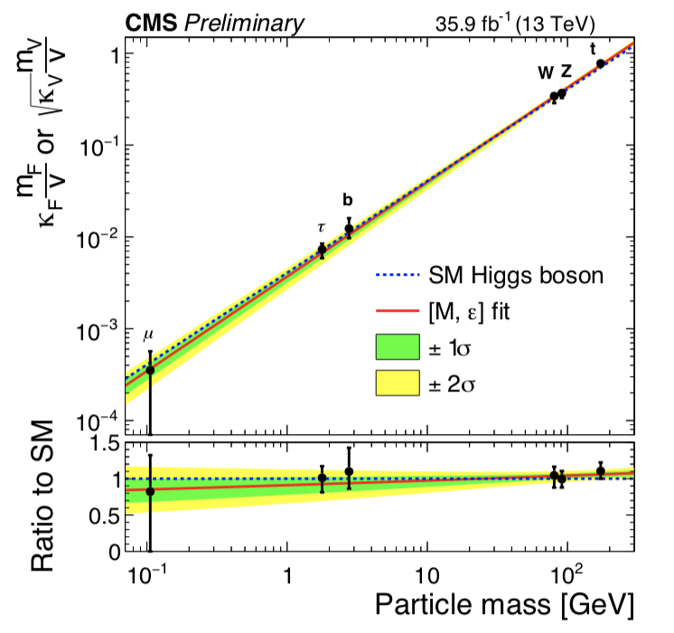

Brief Higgs Summary (so far)
Combination of all Higgs production/decay channels at 13 TeV
Check overall consistency of the couplings
ATLAS-CONF-2018-031
CMS: arXiv:1809.10733
Results in agreement with
the Standard Model

Slide 22



Searches for Exotic Higgses…
No exotic or extra Higgses found so far…
H,A Higgs search
in MSSM SUSY
scenario
Invisible Higgs
searches
BR (H-> invisible)
is less than 20%
Charged Higgs search

Slide 23


The Future: Studying the Higgs…
•More LHC Data 2021-2023
•LHC upgrade ! 2026-2036
•Experiment upgrades!!
•Other/new machines?
Many questions are still unanswered:
•What explain a Higgs mass ~ 125 GeV?
•What explains the particle mass pattern?
•Connection with Dark Matter?
•Where is the antimatter in the Universe?
•What is the origin of neutrino masses?
•…

Slide 24






Physics Beyond the Standard Model?
A Higgs at 125 GeV
Precise measurements of the top quark and the Higgs mass
arXiv:1403.6535
We also know that:
New Physics inevitable?
But at which scale/energy?
fermion
Searches!!
boson
N. Arkani-Hamed

Slide 25








New Physics?
New Gauge Bosons?
Supersymmetry
ZZ/WW resonances?
Technicolor?
Little Higgs?
Extra Dimensions?
Hidden Valleys?
Black Holes???
What stabelizes the Higgs Mass? Many ideas, not all viable any more
A large variety of possible signals. We have to be ready for that
Notes:
24

Slide 26



New Physics Hunters @ the LHC
The ATLAS experiment
The CMS experiment
…And also LHCb and MoEDAL

Slide 27

Searches for BSM Physics

Slide 28



Beyond the Higgs Boson
Supersymmetry: a new symmetry in Nature?
Candidate particles for Dark Matter
⇒ Produce Dark Matter in the lab
SUSY particle production at the LHC
Picture from Marusa Bradac

Slide 29


Detecting Supersymmetric Particles
simulation
Energy produced in the detector
θ
φ
Supersymmetric particles decay and produce a cascade of jets, leptons and missing transverse energy (MET) due to escaping ‘dark matter’ particle candidates
Very prominent signatures in CMS and ATLAS

Slide 30

Why SUSY is good for you!!

Slide 31


Slide 32






Supersymmetry: Gluinos
Interpretation in simplified models (SMS)
No significant signal to date
Within the context of the SMS:
Exclude with gluino masses ~ 2200 GeV for neutralino masses up to 800 GeV

Slide 33



Supersymmetry: Quarks
B-squarks and light
squarks
No significant signal to date
Within the context of the SMS: Exclude with squark masses ~ 1500 GeV

Slide 34

Supersymmetry: Electroweakinos

Slide 35

Supersymmetry: Electroweakinos

Slide 36

What is really needed from SUSY?
End 2011: Revision!
N. Arkani-Ahmed
CERN Nov 2011
Papucci, Ruderman,
Weiler arXiv:1110.6926
LHC data end 2011
Stops > 200-300 GeV
Gluino > 600-800 GeV
Moving away from
constrained SUSY models
to ‘natural’ models
Natural SUSY survived
LHC so far, but we
are getting close to
push it to its limits!

Slide 37



Top Squark Search Summaries
Partner of the top quark – the stop– plays
a prominent role in Natural Models
Within the context of the SMS:
Exclude with masses up to 1100 GeV for neutralino masses up to 500 GeV
Is this getting critical for Natural Models??

Slide 38





Phenomenological MSSM analysis
SMS don’t always fully cover signatures…
-> the 19 parameter phenomenological MSSM (pMSSM) analyses
arXiv:1606.03577
gluinos
squarks
stop
Based on
8 TeV data
limits
10⁸ points sampled: Leads to softer limits on the sparticles masses
Gluinos > 500 GeV, stops > 300 GeV => there is still low mass phase space left!

Slide 39


The SUSY SEARCH Chart So Far…
Limits from individual
analyses
Excluded squark and
gluino mass region
excluded

Slide 40


SUSY (as seen from outside HEP…)
But not giving
up as yet!!!
So far 2016
data analysed
Keep the party
ready..
2017+2018 (4x
more data) is
coming !!
November ‘16 reported by The Economist (!?!):
http://www.economist.com/news/science-and-technology/21709946-supersymmetry-beautiful-idea-there-still-no-evidence-support-it

Slide 41

J. Ellis

Slide 42



Vector-Like Quarks
✱
VLQs to tame the
quantum corrections
VLQs: Lower limits
presently in the
800-1000 GeV range
✱ Composite Higgs
CMS

Slide 43






Dark Matter Searches at the LHC
•Identifying Dark Matter is one of the most important questions in physics today!
•It is likely a new as yet undetected particle
•Can it be produced
at the LHC?
Is Dark Matter
a new weakly
interacting particle?

Slide 44

A High p_{T} Mono-jet event

Slide 45


Mono-object Searches in CMS
Mono-jets: Generally the most powerful
Mono-photons: First used for dark matter Searches
Mono-Ws: Distinguish dark matter couplings to u- and d-type of quarks
Mono-Zs: Clean signature
Mono-Tops: Couplings to tops
Mono-Higgs: Higgs-portals
Higgs Decays?
Are Dark Matter weakly interacting
massive particles (WIMPs?)
Example Monojets
Dark Matter?

Slide 46



Comparison with Direct Detection
No signal seen in any of the “mono”-signals so far
Extend limits by search for the mediator
Axial-vector mediator and
Spin-dependent direct limits
Vector mediator and
Spin-independent direct limits
90% CL limits
Mono-jet/V & Dijet searches are typically the most sensitive ones

Slide 47




Extra Space Dimensions
Problem:
arXiv:1712.02345
Search for monojets
No signal found yet
New Planck scale is
larger than 6-10 TeV
The Gravitational force can become strong!

Slide 48




Search for Micro Black Holes
Extra Dimensions!
2015: 12 jet event with S_{T}=5.4 TeV
Planck scale
a few TeV?
arXiv:1805.06013
Look for the decay producs
of an evaporating black hole
-Define S_{T} to be the scalar
sum of all high p_{T} objects
found in the event
-Look for deviations
at high S_{T}
Black hole mass excluded up to ~10 TeV depending on model assumptions

Slide 49

Dijet Resonance Searches @13TeV

Slide 50



Search for Di-jet Resonances
ATLAS-CONF-2019-007
Search for high mass dijet
resonances based on the full run2 data sample
Masses of excited quarks or generic Gaussian
shaped signals excluded in the 6-7 TeV region
More Luminosity -> test smaller couplings

Slide 51


Search for Di-jet Resonances
Access LOWER dijet invariant
masses via initial state radiation
for the trigger: eg a high p_{T} photon
photon

Slide 52



Are Quarks Elementary Particles?
Rutherford experiment:
Unexpected backscattering
of α-particles:
Evidence for the structure
of atoms !! (1911)

Slide 53





Are Quarks Elementary Particles?
CONF-2016-069
Measurement of the production angle
of the jet with respect to the beam
-> High Energy Rutherford Experiment
Quarks remain elementary particles after these measurements

Slide 54



E.g. Di-lepton Resonance
Example
pp→μμ +X
Plot the di-lepton
invariant mass
A peak!!
A new particle!!
A discovery!!
G ?
μ
μ
If we are lucky:
a signal could be
seen very early on

Slide 55





Lepton+MET & Dilepton Searches
Search for dilepton resonances (Z’…) or lepton+MET (W’…) searches
arXiv:1903.06248
e
e
arXiv:1906.05609
Analyses that include
all run 2 data!
W’ in context of sequential SM excluded
up to 6 TeV with 139 fb⁻¹
Z’ excluded up to about 5 TeV

Slide 56

Summary
Measurements of Standard Model processes show good agreement with predictions. Precise measurements require precise calculations.
New Higgs measurements at 13 TeV. So far the Higgs is very consistent with Standard Model expectations. All main decay and production channels now observed
No sign of new physics in the 13 TeV data so far… This starts to cut into the ‘preferred regions’ for a large number of models, like SUSY. Naturalness? …There are a few 3-sigma effects…
Many other directions (models) have been tested. Several of these tests include already the full run 2 data sample
We continue the searches and explore new directions such as long lived particles

