Slide 1










What NExT?
The dangers of microdiscriminations
Professor Averil Macdonald OBE

Slide 2
SEPnet PGR Destination Data 2016-7
46% in industry (2014-5 = 57%)
Increase in PhDs entering business
technology (from 22% to 35%)
More into data science
Decrease in education/scicomm
(from 16% to 2%)

Slide 3
PhD | Job Role | Organisation
Astrophysics | Data Scientist | Argos
Quantum Light and Matter | Laser Systems Engineer | Coherent
Condensed Matter | Production Test Engineer | Gatan
Nuclear Physics | Technical Assistant | Mathys & Squire LLP
Solid State | GIS and LIDAR Analyst | Network Mapping
Particle Physics | Junior IT Consultant | Sopra Banking Software
Experimental Nuclear Physics | Insertion Device Physicist | Diamond Light source
Theoretical Physics | Data Scientist | HSBC
Nuclear Engineering | Nuclear Strategy Lead | NPL
Solid State | Curator, Petrology | Natural History Museum
Quantum Light and Matter | Optoelectronic Development Engineer | Oxsensis
Radiation and Medical Physics | Senior Radiosurgery Physicist | Medical Physics Ltd
Astronomy | Physicist | Cambridge Consultants
Quantum Light and Matter | Consultant | The Technology Partnership
Particle Physics | Data Analytics | British Gas
Quantum Light and Matter | Senior Scientist | DSTL

Slide 4
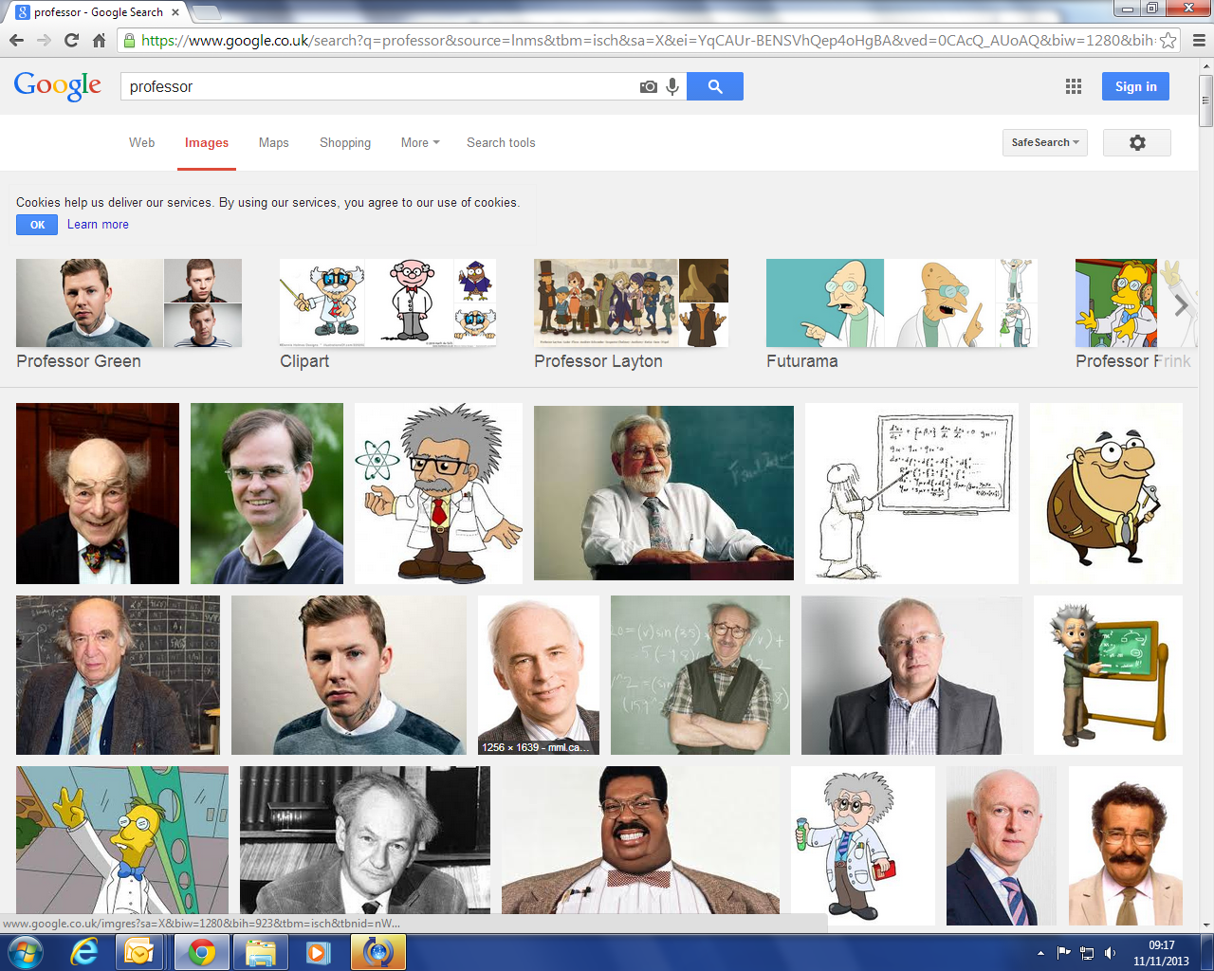
Who are professors?

Slide 5
Microdiscriminations in hiring
Moss-Racusin, CA, Dovidio, JF, Brescoll, VL, Graham, M & Handelsman, J (2012)
‘Science faculty’s subtle gender biases favor male applicants’. Proceedings of the National Academy of Sciences for the United States of America 109(41): 16474–16479
Uhlmann, EL and Cohen, GL (2005)
‘Constructed criteria redefining merit to justify discrimination’.
American Psychological Society 16(6): 474–480.

Slide 6
Where might microdiscriminations have an impact?
Bias in shortlisting CVs based on name/ school/background (eg Steinpreis et al 1999)
Bias in shortlisting applicants based on foreign qualifications (Carlsson and Rooth 2000)
Bias in friendliness of body language
(eg McConnell and Leibold 2001)
Bias in type of drugs prescribed by doctors to different patients (Green et al 2007)

Slide 7
Risks in recruitment
how suitable we think an applicant is for a particular course – do they look/sound right
Recruitment/selection tests – leads to risk of disadvantaging minority groups
  minority group should be 30% min (tutorials)
Stereotype threat – individuals underperforming if told people like them do badly in certain tasks

Slide 8
Risks in teaching/assessment
Bias in assessment of students’ aptitude for science (Spear, M. (1987).
The biasing influence of pupil sex in a science marking exercise. In A. Kelly (Ed.), Science for Girls? (pp. 46-51). Milton Keynes: Open University Press)

Slide 9
Risk in student satisfaction surveys
Female lecturers performing the same lecture are graded more harshly:
Amy Bug; Physics World Volume 23, No. 8, August 2010, p16, 'Swimming against the unseen tide'.
N.B. no evidence of correlation between student satisfaction survey data and quality of teaching or learning

Slide 10
Which characteristics might elicit an unconscious response?

Slide 11
Which characteristics might elicit an unconscious response?
Gender
Ethnicity
Religion/belief
Perceived sexual
orientation
Attractiveness
Age
Disability
School
Accent
Clothing
Haircut
Piercings/tattoos
Body language
Personality
Friends/family

Slide 12
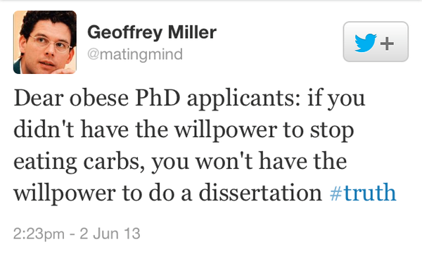
Appearance

Slide 13
Under-attainment in BME students
  “Despite controlling for other factors which impact on attainment, we find that ethnicity is still statistically significant in explaining attainment in HE: all students from minority ethnic communities … are found to be less likely to achieve a better degree relative to White UK & Irish students – and this result holds at all levels of attainment.”
  (Broecke and Nicholls, DfES 2007)

Slide 14
Table 1: Attainment across JACS1 subject areas split by ethnicity
JACS1 Subject Areas | Proportion of graduates in each subject |  | Good Degree Attainment |  |  | First Degree Attainment
 | Non-White | White | Non-White | White | Diff. White Non-white | Non-White | White | Diff. White Non-whit
Subjects allied to medicine | 35.9% | 64.1% | 67.5% | 75.7% | 8.2% | 15.1% | 26.1% | 11.0%
Computer science | 25.8% | 74.2% | 56.4% | 71.4% | 15.0% | 35.9% | 38.4% | 2.5%
Engineering & technology | 23.0% | 77.0% | 66.1% | 79.4% | 13.3% | 21.1% | 30.4% | 9.3%
Law | 22.9% | 77.1% | 79.8% | 88.3% | 8.5% | 8.7% | 16.8% | 8.2%
Social studies | 22.0% | 78.0% | 71.4% | 81.8% | 10.3% | 15.1% | 15.2% | 0.1%
Mathematical sciences | 20.5% | 79.5% | 62.2% | 66.3% | 4.1% | 23.5% | 31.6% | 8.1%
Business & administrative studies | 19.7% | 80.3% | 81.9% | 82.4% | 0.5% | 13.1% | 9.7% | -3.5%
Combined JACS1 subjects | 19.3% | 80.7% | 69.8% | 83.0% | 13.2% | 9.0% | 14.8% | 5.8%
Biological sciences | 15.9% | 84.1% | 68.8% | 84.9% | 16.1% | 10.2% | 22.2% | 12.0%
Architecture, building & planning | 15.6% | 84.4% | 72.0% | 77.8% | 5.8% | N/A | 14.8% | N/A
Physical sciences | 12.1% | 87.9% | 58.5% | 66.7% | 8.1% | 14.6% | 29.8% | 15.2%
Languages | 10.3% | 89.7% | 70.0% | 79.8% | 9.8% | 8.5% | 10.9% | 2.5%
Geographical Studies | 7.3% | 92.7% | 62.2% | 74.1% | 11.9% | 16.2% | 13.7% | -2.5%
Historical & philosophical studies | 7.3% | 92.7% | 73.2% | 84.6% | 11.4% | 12.7% | 14.2% | 1.5%
Education | 7.1% | 92.9% | N/A | 61.5% | N/A | N/A | 0.0% | N/A
Creative arts & design | 5.3% | 94.7% | 92.9% | 94.0% | 1.2% | 21.4% | 27.8% | 6.3%
Grand Total | 17.7% | 82.3% | 69.7% | 80.2% | 10.6% | 13.9% | 18.6% | 4.7%
N/A – Less than 10 students within cohort
Professor
Aneez Esmail.
Manchester University

Slide 15
BME under attainment in Physical Sciences
In the Physical Sciences 12% of students were UK BME and there was an 8% attainment gap.
Physical Sciences had the largest gap when it came to attaining Firsts (15%)
(The three subject areas with the highest proportions of BME students had good degree attainment levels below the
average (78.4%) and within these subjects white UK students outperformed BME UK students.)

Slide 16
Microdiscriminations:
- Psychological explanation
Unconscious bias refers to a bias that we are unaware of, and which happens outside of our control. It is a bias that happens automatically and is triggered by our brain making quick judgments and assessments of people and situations, influenced by our background, cultural environment and personal experiences
(ECU: 2013 Unconscious bias in higher education)

Slide 17
Microdiscriminations:
- explanation from evolution
The 100 µs judgement:
Friend or foe
Level of attractiveness
Dominant or not
A matter of survival…..
200,000 unconscious thoughts – 1 conscious

Slide 18
Explanation for 21st Century
Fast thinking people – favour gut reaction
System 1 brain
Slow thinking people – favour logical analysis
System 2 brain
implication for giving presentations eg Public Engagement
– we’re not all slow thinkers

Slide 19
So what do you want to do?
How do you find the job you were born to do?

Slide 20
Break

Slide 21
Barriers to you getting your dream job
The world’s barriers
Your barriers

Slide 22
The experiment:
Cheerful Committed Communal Connected Considerate Cooperative Dependable Empathic Honest Interpersonal Interdependent Interpersonal Kind Loyal Modest Nurturing People-focused Pleasant Polite Quiet Responsible Sensitive Supporting Sympathetic Trustworthy Understanding Warm

Slide 23
The experiment:
Active Adventurous Ambitious Analytical Assertive Connected Autonomous Challenging Competent Confident Courageous Decisive Determined Dominant Forceful Implusive Independent Individual Intellectual Leader Logical Merit Objective Opinionated Outspoken Persistent Principled Superior Self-confident Self-sufficient Self-reliant

Slide 24
The evidence:
Masculine language
Active Adventurous Ambitious Analytical Assertive Connected Autonomous Challenging Competent Confident Courageous Decisive Determined Dominant Forceful Implusive Independent Individual Intellectual Leader Logical Merit Objective Opinionated Outspoken Persistent Principled Superior Self-confident Self-sufficient Self-reliant

Slide 25
The evidence:
Feminine language
Cheerful Committed Communal Compassionate Connected Considerate Cooperative Dependable Empathic Honest Interpersonal Interdependent Interpersonal Kind Loyal Modest Nurturing People-focused Pleasant Polite Quiet Responsible Sensitive Supporting Sympathetic Together Trustworthy Understanding Warm

Slide 26
The research:
“Evidence That Gendered Wording in Job Advertisements Exists and Sustains Gender Inequality”.
Danielle Gaucher and Justin Friesen.
University of Waterloo, Canada.
Aaron C. Kay. Duke University, Canada.
Journal of Personality and Social Psychology, 2011,
Vol. 101, No. 1, 109–128.
American Psychological Association

Slide 27
Outcomes:
Masculine wording in job advertisements leads women to identify
  lower sense of ‘belongingness’
  jobs as less appealing
  less interest in applying for the job.
Gendered wording did not affect people’s appraisals of their personal ability to carry out a job.

Slide 28
Interestingly
In post-experiment debriefings no participant suggested that:
his/her responses were influenced by the wording of the advertisements
advertisements included words that conformed to gender stereotypes

Slide 29
Graduates reaction to job adverts
Arrogance vs humility
Overview vs job detail
Wishful thinking vs realistic expectations
Individualism vs supportive environment
Salary negotiable vs stated salary range
“Analysis of job adverts and barriers to application”.
Sandyha Patel and Tanya Lynden, University of Reading.
http://www.hestem.ac.uk/activity/analysis-job-adverts-and-students-reading-job-adverts-identify-barriers-students-applying-j

Slide 30
A good selection process……
The Royal Academy of Engineering:
“Diverse teams produce better results where different experiences and ways of thinking often lead to innovative outcomes.”
http://www.raeng.org.uk/policy/diversity-in-engineering/resources#General

Slide 31
A poor selection process
The danger words
Competent (feisty)
Merit
Potential
Gravitas

Slide 32
Risky References
http://www.nature.com/news/women-postdocs-less-likely-then-men-to-get-a-glowing-reference-1.20715
Dutt, K. et al. Nature Geosci (2016)
…….regardless of gender of referee

Slide 33
Risky References
“highly intelligent”
“very productive”
“outstanding”
“scientific leader”
“hard working”
“brilliant scientist”
“trailblazer”

Slide 34
Risky References
Beware referees who:
use gendered words – as above!
emphasise male 'potential’
emphasise female 'diligence’
N.B. teamplayer means different things!

Slide 35
The rules of the promotion game
It’s not just about working hard

Slide 36
The rules of the promotion game
In universities – and in business….
It’s not just about working hard
- hard work
- visibility
- image

Slide 37
The rules of the promotion game
It’s not just about working hard
- hard work - 12%
- visibility - 65%
- image - 23%

Slide 38
The rules of the promotion game
It’s not just about working hard
  The value of being on committees/boards
  – build your visibility
  The value of networking
  Volunteer – show willing
  Provide solutions not problems

Slide 39
Overcoming your barriers:
Creating your portfolio
  Fill the gaps
Use positive words to sell yourself
  Practise applying for jobs
  NB the careers Snakes & Ladders
  BUT don’t forget there are things outside of your control….

Slide 40
CV’s
Use positive adjectives:
Ambitious Analytical Assertive Connected Autonomous Competent Confident Courageous Decisive Determined Independent Individual Intellectual Leader Logical Merit Objective Persistent Principled Self-sufficient Self-reliant
Use significant words:
Initiated Designed Managed Drove Led Inspired Completed Success(ful) Impact(ful) Strategic

Slide 41
Make Yourself Visible
Be seen – join / attend things
Relationships – nothing works without them
Dress for the job you want not the job you have

Slide 42
Never Say No
Don’t assume things will remain as they are
Keep your eyes open
Create your own opportunities.
Moving on to something different isn’t a failure!

Slide 43
Over to you……

