Slide 1

What is the mass scale of the 2nd Higgs boson?
Kei Yagyu
Based on
S. Kanemura, K. Tsumura, KY, H. Yokoya, PRD90, 075001 (2014)
S. Moretti, and KY, PRD91, 055022 (2015)
29th, April, 2015
University College of London

Slide 2
LHC Run-I Tells Us
1. There exits one CP-even scalar boson
→ At least 4 d.o.f. of scalar state (3 NGBs and h)
Its mass is about 125 GeV.
→ Consistent w/ EW precision tests
It was observed from ZZ, γγ, WW and τ⁺τ⁻.
→ hVV/hff couplings
4. The combined signal strength is consistent w/ the SM Higgs.
This suggests that there is at least one isospin
doublet scalar field.
The SM Higgs sector is the minimal realization.

Slide 3
Questions for the Higgs Sector
What is the structure of the Higgs sector?
- the number of multiplets, representations, symmetries, …
What is the relation to the BSM phenomena?
- Neutrino mass, dark matter, baryon number asymmetry, …
What is the mass scale of the 2nd Higgs boson?
- TeV scale or higher
Etc…
Property of the Higgs sector can strongly depends on
new physics scenarios.
→ Higgs is a probe of New Physics!!
2

Slide 4
Higgs as a Probe of New Physics
New Physics Beyond the SM
B-L models
MSSM
Type-II seesaw
Rad. ν-mass models
CPV
LR sym. models
Bottom Up Approach!!
Singlets
Doublets
Triplets
+ Doublet ∋ h(125)
Non-minimal Higgs sectors

Slide 5
How can We Determine?
Mass²
Additional multiplets: S, D, T, …
H, A, H±, H±±, …
H
λ’v² + M²
λv² =
(125 GeV)²
h(125)
Higgs sector
h
hVV
hff
Gauge bosons
Quarks & Leptons
Notes:
This slide schematically shows the structure of models with a non-minimal Higgs sector.

Slide 6
How can We Determine?
Mass²
TeV²
Additional multiplets: S, D, T, …
H, A, H±, H±±, …
H
λ’v² + M²
Direct
search
λv² =
(125 GeV)²
h(125)
Higgs sector
h
hVV
hff
Gauge bosons
Quarks & Leptons

Slide 7
How can We Determine?
Mass²
TeV²
Additional multiplets: S, D, T, …
H, A, H±, H±±, …
H
λ’v² + M²
Direct
search
Mixing
λv² =
(125 GeV)²
h(125)
Higgs sector
h
Indirect
search
hVV
hff
Deviation
Gauge bosons
Quarks & Leptons

Slide 8
How can We Determine?
Mass²
TeV²
Additional multiplets: S, D, T, …
H, A, H±, H±±, …
H
λ’v² + M²
Direct
search
Mixing
λv² + δM² (~ M²×θ)
=(125 GeV)²
h(125)
Higgs sector
h
Indirect
search
hVV
hff
When M² ≫ v² and θ≠0 ⇒ |λ| ≫ 1
⇒ This must break perturbativity of the theory.
Gauge bosons
Quarks & Leptons

Slide 9
Implication of non-zero mixing
Non-zero mixing between h and extra Higgs bosons
Higgs coupling deviations
and
Upper limit on the 2nd Higgs mass!
In this talk, I discuss S-matrix unitarity to give the upper bound.

Slide 10
Contents
Introduction
- Relationship between Higgs coupling deviations & Higgs mass bound
S matrix Unitarity and its application to Higgs mass bounds
- SM, 2HDM, 3HDM
Deviations in the SM-like Higgs boson couplings
Summary

Slide 11


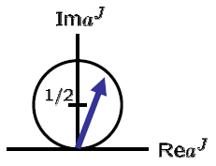


S matrix Unitarity
S matrix unitarity:
Using the partial wave expansion:
-1/2
+1/2
we obtain
at the tree level.
for 2→２ elastic scatterings.

Slide 12
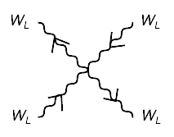
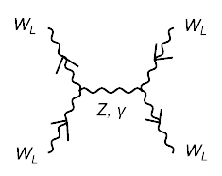
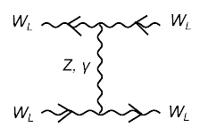
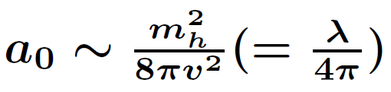
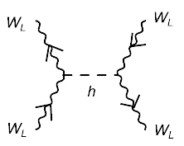
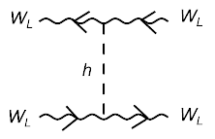
W_{L}⁺W_{L}⁻ → W_{L}⁺W_{L}⁻ scattering in SM
Lee, Quigg, Thacker (1977)
a₀ ~ a E² + O(E⁰)
+ O(g²)
From |a₀| < 1/2 , we get
mh < 870 GeV
a₀ ~ -a E² + O(E⁰)

Slide 13
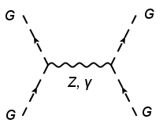
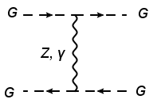
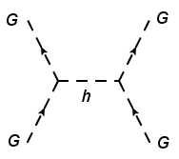
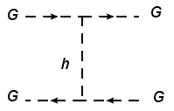
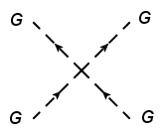
Equivalence Theorem
Cornwall, Levin, Tiktopoulos (1974)
In the high energy limit, we can replace W_{L}±, Z_{L}⁰ by G±, G⁰ .

Slide 14
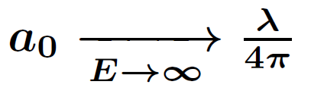
Equivalence Theorem
Cornwall, Levin, Tiktopoulos (1974)
In the high energy limit, we can replace W_{L}±, Z_{L}⁰ by G±, G⁰ .

Slide 15
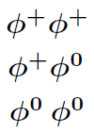
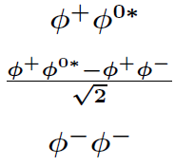

Diagonalization of the S-wave matrix
There are not only W_{L}⁺W_{L}⁻ state, but also Z_{L}Z_{L}, hh, Z_{L}h (neutral),
W_{L}±Z_{L}, W_{L}±h (singly-charged) and W_{L}±W_{L}± (doubly-charged) states.
In the E→∞ limit, we can classify all the orthogonal 2 body states by T, T₃ and Y.
Ginzburg, Ivanov (2003)
Φ ⊗ Φ (Y=1)
Φ ⊗ Φ^{c} (Y=0)
(T₃=1)
(T₃=1)
T=1
(T₃=0)
a₀=λ/8π
(T₃=0)
a₀= λ/8π
(T₃=-1)
(T₃=-1)
T=0
Absent
a₀= 3λ/8π
From |a₀^{i}| < 1/2 → mh < 712 GeV

Slide 16



Application to the 2HDM
Let us consider the application of the unitarity bound to the 2HDM
w/ a softly-broken Z₂ symmetry (Φ₁ → + Φ₁, Φ₂ → -Φ₂).
Higgs doublets
, (i =1, 2)
Mass eigenstates

Slide 17

Higgs potential in the 2HDM
The Higgs potential under the softly-broken Z₂ sym. and CP-invariance
We have 8 parameters in the potential. They can be interpreted by
v (=246 GeV), m_{h} (=125 GeV),
m_{H}, m_{A}, m_{H+}, sin(β-α), tanβ, and M²
Mass formulae with sin(β-α) ~1
m_{h}² ~ λv², m_{Φ}² ~ M² + λ’v²
Φ = H±, A, H

Slide 18
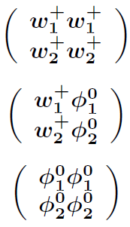




S-wave amp. in 2HDM
Maalampi, Sirkka, Vilja (1991);
Kanemura, Kubota, Takasugi (1993);
Akeroyd, Arhrib, Naimi (2000);
Ginzburg, Ivanov (2005)
There are 14 neutral, 8 singly-charged and 3 doubly-charged states.
The 2 body scalar states are classified
in terms of Z₂ charge in addition to T, T₃ and Y.
Φ₁ ⊗ Φ₁ (Y=1, Z₂ even)
Φ₁ ⊗ Φ₂ (Y=1, Z₂ odd)
(T₃=1)
(T₃=1)
T=1
(T₃=0)
T=1
(T₃=0)
(T₃=-1)
(T₃=-1)
T = 0
Absent
T = 0
In addition, there are (Y=0, Z₂ even) and (Y=0, Z₂ odd) states.

Slide 19
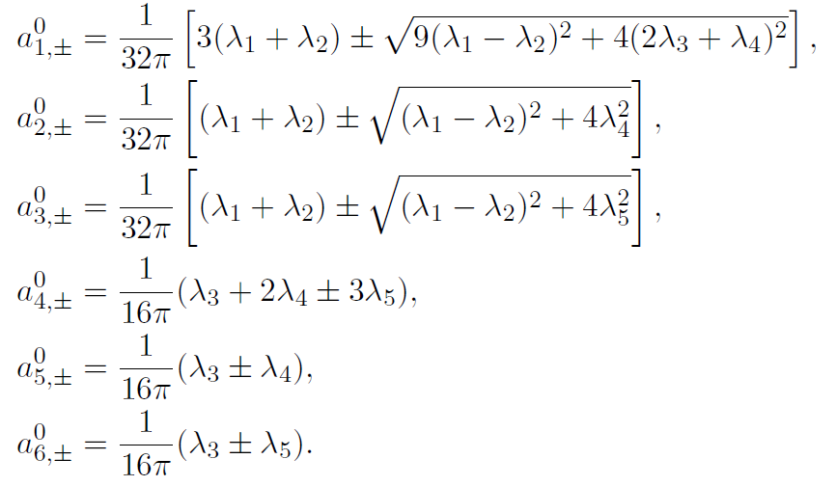
All the independent eigenvalues
Kanemura, Kubota, Takasugi (1993) [Diagonalized all the neutral channels]
Akeroyd, Arhrib, Naimi (2000) [Diagonalized all the singly-charged channels]
Ginzburg, Ivanov (2003) [Extended to the CPV 2HDM]

Slide 20
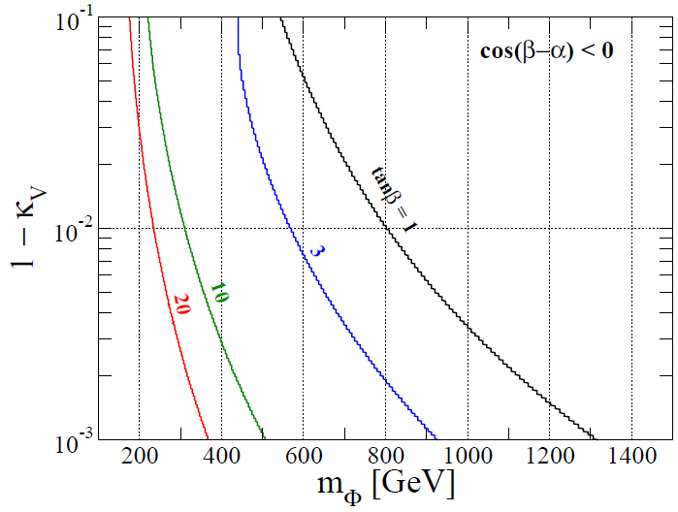
Upper lim. of the 2nd Higgs mass
10% dev.
Excluded
by unitarity and vacuum stab.
(κ_{V} = sin(β-α) = g_{hVV}^{2HDM}/g_{hVV}SM )
1% dev.
0.1% dev.
(m_{Φ} =m_{H+} = m_{A} = m_{H})
Notes:
Small 1-kv,

Slide 21
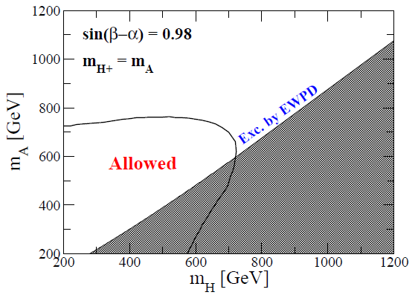
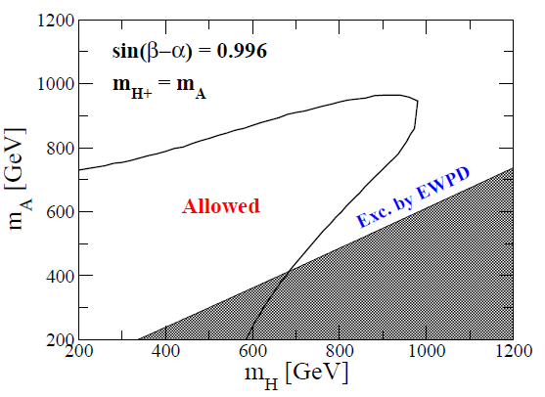
Constraint on the m_{A} vs m_{H} plane
Moretti, KY, PRD91 (2015)
Bound on mH and mA is correlated .
Stronger constraint is obtained in the case with larger 1-sin(β-α).
Notes:
Small 1-kv,

Slide 22
Application to the 3HDM
Keus, King, Moretti, PRD91 (2015)
There are several versions of 3HDM
depending on a symmetry of the potential
Grzadkowski, Ogreid, Osland, PRD80 (2009)
3HDM with Z₂ (exact, unbroken)× Z’₂ (softly-broken)
Φ₁ , Φ₂ (Z₂-even)
Φ₃ (Z₂-odd)
Interaction
Non-0 VEVs (Active)
No VEV (Inert)
H±, A, H, h (SM-like)
H₃±, H₃⁰, A₃⁰
No tree FCNC by Z₂’
Lightest one = DM
Via the interaction term, inert particles affect on the active sector.

Slide 23
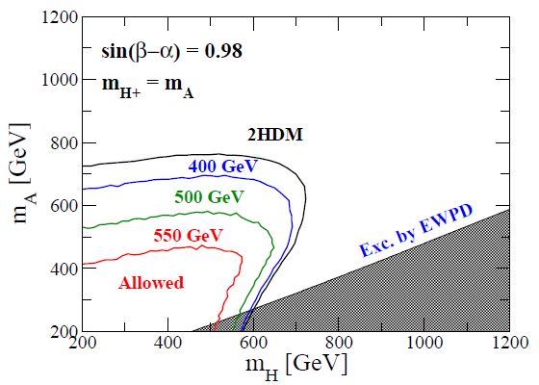
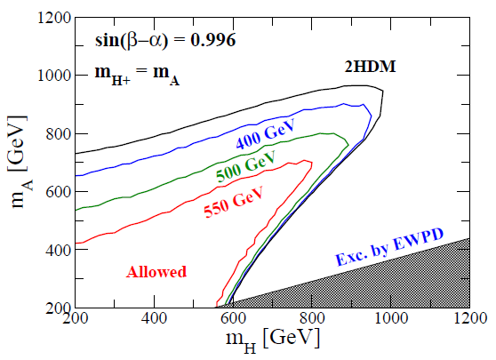
Results
Moretti, KY, PRD91 (2015)
We take m(H₃)= mh/2 and
m(A₃) = m(H₃±)=400, 500 and 550 GeV .

Slide 24
Contents
Introduction
- Relationship between Higgs coupling deviations & Higgs mass bound
S matrix Unitarity and its application to Higgs mass bounds
- SM, 2HDM, 3HDM
Deviations in the SM-like Higgs boson couplings
Summary

Slide 25
Yukawa Interactions
Under the Z₂ symmetry, the Yukawa interactions are given by
Four independent types are allowed as follows
Barger, Hewett, Phillips, PRD41 (1990); Grossman, NPB426 (1994).
Type-I
Type-II (MSSM)
Type-X
(Leptophilic)
Type-Y
(Flipped)
Φ_{２}
Φ_{２}
Φ_{１}
Φ_{２}
Φ_{１}
Φ_{２}
Φ_{１}
u
u
d
e
u
u
d
e
d
e
d
e

Slide 26
Higgs Boson Couplings
V
 | ξ_{u} | ξ_{d} | ξ_{e}
Type-I | cotβ | cotβ | cotβ
Type-II | cotβ | -tanβ | -tanβ
Type-X | cotβ | cotβ | -tanβ
Type-Y | cotβ | -tanβ | cotβ
h
= (SM) × sin(β-α)
V
f
= (SM) ×
[sin(β-α)+ξ_{f} cos(β-α)]
h
f
When sin(β-α) ≠ 1 , both hVV and hff couplings
deviate from the SM predictions.

Slide 27
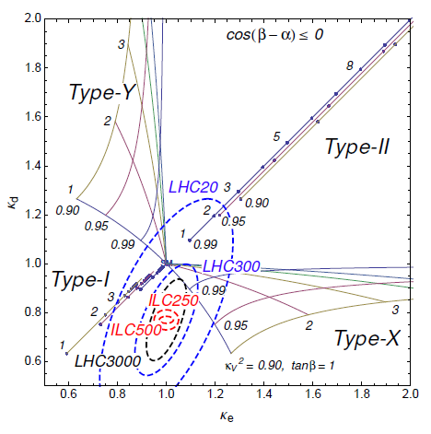

κ_{e} VS κ_{d}
Kanemura, Tsumura, KY, Yokoya, PRD90 (2014)
 | ξ_{d} | ξ_{e}
Type-I | cotβ | cotβ
Type-II | -tanβ | -tanβ
Type-X | cotβ | -tanβ
Type-Y | -tanβ | cotβ
The structure of the Higgs sector can be determined from the measurements of hVV and hff couplings!

Slide 28
Summary
1. Bottom up approach
By the reconstruction of the Higgs sector, the direction of new physics can be clarified.
2. Non-zero mixing between h and extra Higgs bosons
Non-zero mixing between SM-like Higgs and extra Higgs bosons gives
an upper limit on masses of extra Higgs bosons and deviations in h couplings.
3. Unitarity bound
In the high-energy limit, only scalar quartic terms are related to the unitarity bound.
Larger deviations in hVV give stronger bounds on masses of extra Higgs bosons.
4. Fingerprinting the Higgs sector
From deviations in Yukawa couplings, we can discriminate the model type.

Slide 29
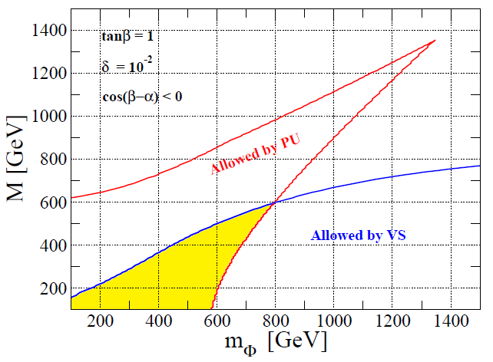
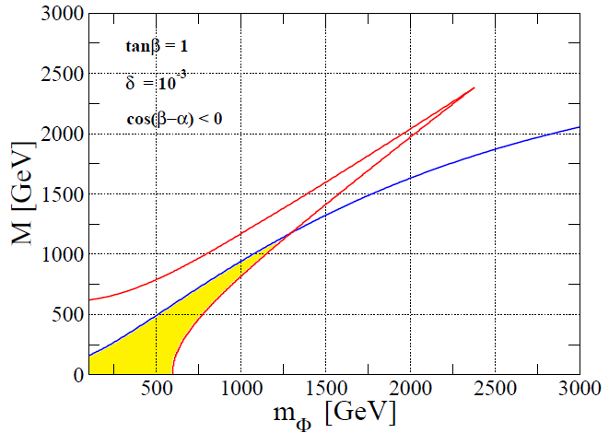
Unitarity & Vacuum stability bounds

Slide 30

h Coupling Measurements (Current)
Scaling factors: κ_{X}= g_{hXX}^{exp}/g_{hXX}SM
Heinemeyer, Mariotti, Passarino, Tanaka,
arXiv:1307.1347 [hep-ph]
2 parameter fit (κ_{V} = κ_{Z} = κ_{W,} κ_{F} = κ_{t} = κ_{b} = κ_{τ})
ATLAS Collaboration, ATLAS-CONF-2014-009
CMS Collaboration, arXiv: 1412.8662 [hep-ex]

Slide 31
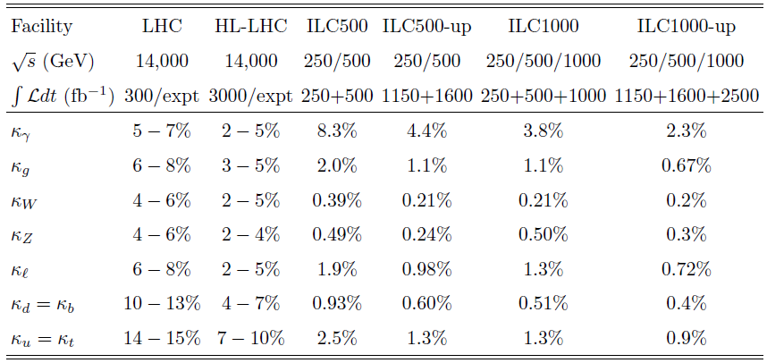
h Coupling Measurements (Future)
Snowmass Higgs Working Group Report, arXiv: 1310.8361 [hep-ex]
The Higgs boson couplings can be measured with the accuracy of
a few% at HL-LHC and O(1)% or better than 1% at ILC500 !

Slide 32
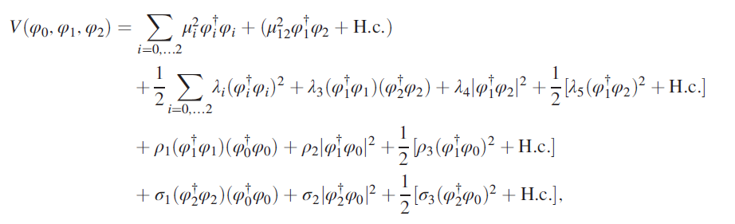
Higgs Potential in the 3HDM
Moretti, KY, PRD91 (2015)
Under Z₂ × Z₂’, the most general Higgs potential is given by
・There are totally 16 independent parameters.
・8 of them correspond to 2HDM parameters.
・3 of them correspond to the masses of inert scalar bosons.
・Remaining 5 are fixed as σ_{i} = ρ_{i} (i=1,2,3), λ₀ = 0, ρ₁ > 2|ρ₂| .

Slide 33
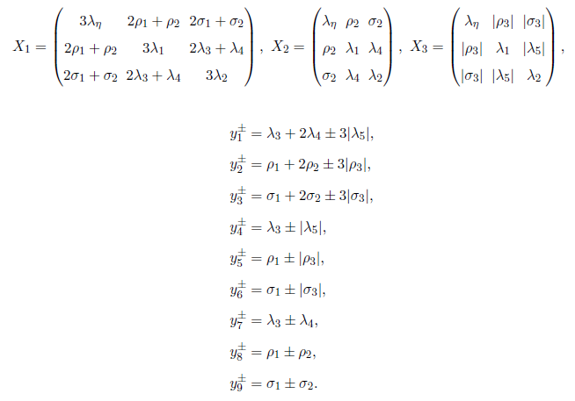
All the independent eigenvalues
Moretti, KY, PRD91 (2015)
There are totally 27 independent eigenvalues.

Slide 34
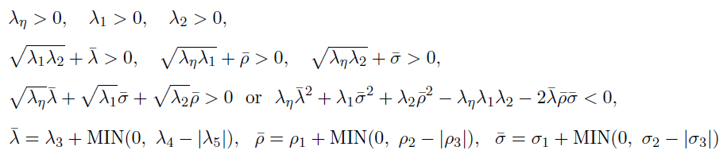
Vacuum Stability
Grzadkowski, Ogreid, Osland, PRD80 (2009)

Slide 35
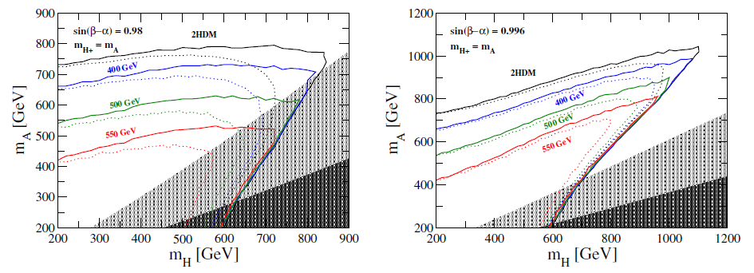
Tanβ Scanned Case

Slide 36
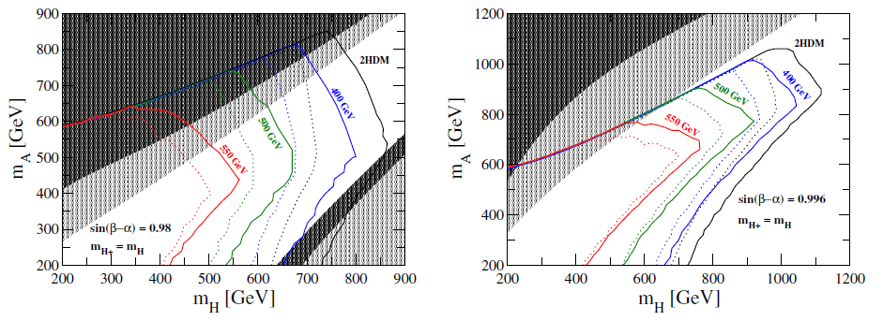
The case with mH± = mH

Slide 37

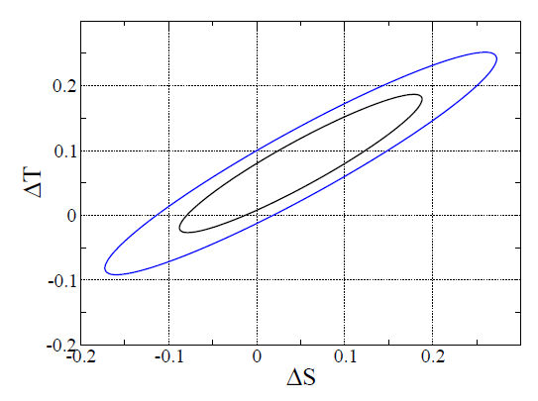
Electroweak S and T parameters
Under mH± = mA and mH₃± = mA₃, we have
68% CL
95% CL
★
SM

