Slide 1
Quantum Computing Initiative
EU-T0 EB/CB meeting
Federico Carminati
Septembre 20th, 2018

Slide 2
Outline
Where?
Why?
What?
Who?
When?
Conclusions

Slide 3
Where?

Slide 4
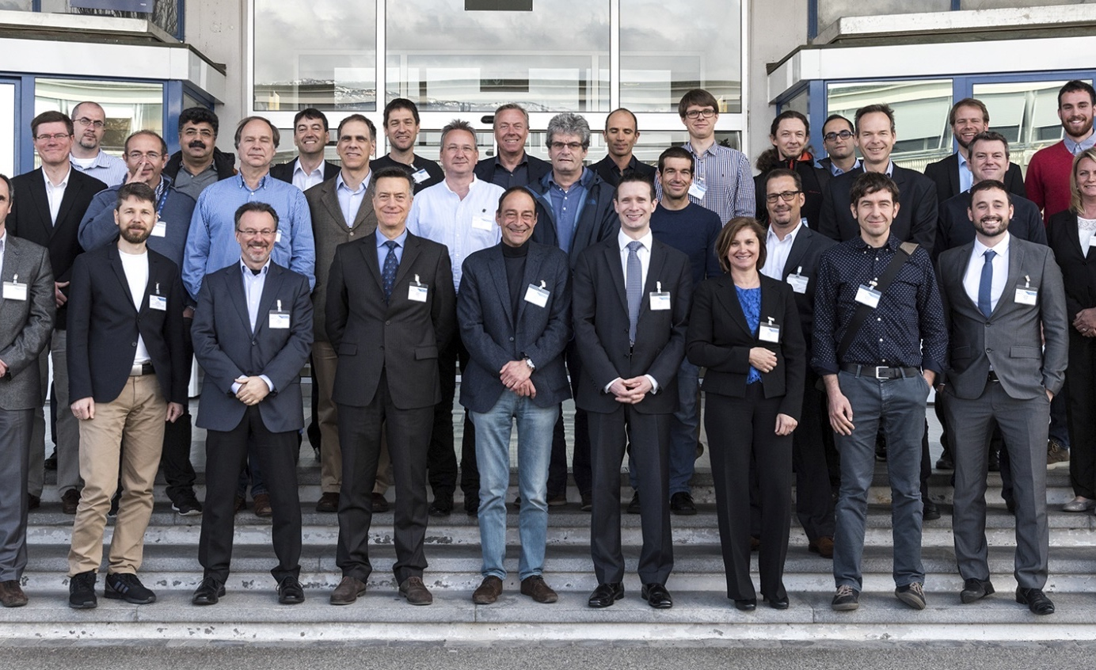
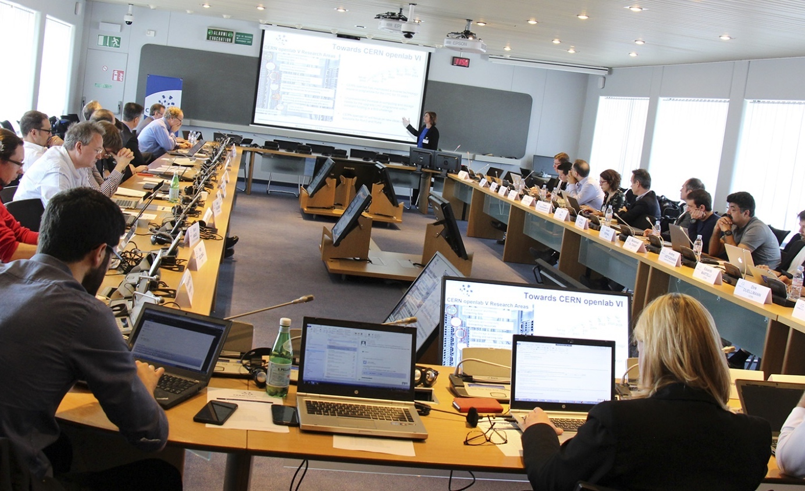
DRIVING INNOVATION SINCE 2001
Entering our sixth three-year phase
CERN openlab Collaboration Board 2017

Slide 5
CERN OPENLAB’S MISSION
Evaluate and test state-of-the-art technologies in a challenging environment and improve them in collaboration with industry.
Collaborate and exchange ideas with other communities to create knowledge and innovation.
Communicate results, demonstrate impact, and reach new audiences.
Train the next generation of engineers/researchers, promote education and cultural exchanges.

Slide 6














Joint R&D Projects
High-bandwidth fabrics, accelerated platforms
Data Acquisition (LHCb, IT-CF)
Code modernization (EP-SFT, IT-CF)
Cloud infra (IT-CM)
Data Storage (IT-ST, IT-DB)
Data Analytics, Machine Learning (many)
Networks (IT-CS)
Control Systems
(BE-ICS)
Data quality monitoring, anomaly detection, physics data reduction, benchmarking/scalability, systems biology and large-scale multi-disciplinary platforms
You make it we break it
Simulation, HPC on the Cloud,
benchmarking
Predictive/proactive maintenance and operations
Cloud federations, containers, scalability
Software Defined Networks, Security
Storage architectures, scalability, monitoring

Slide 7
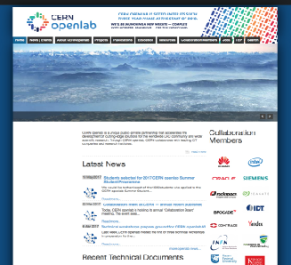
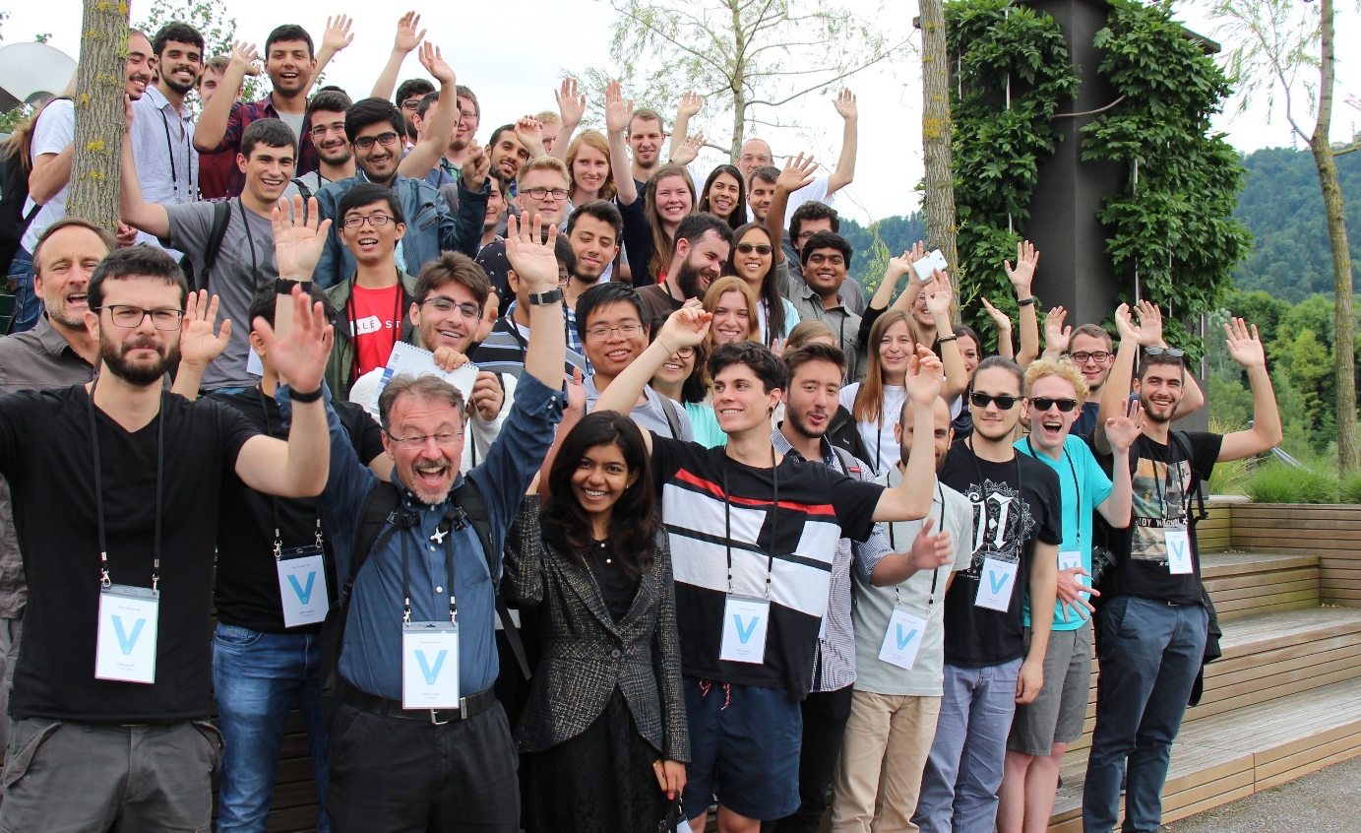
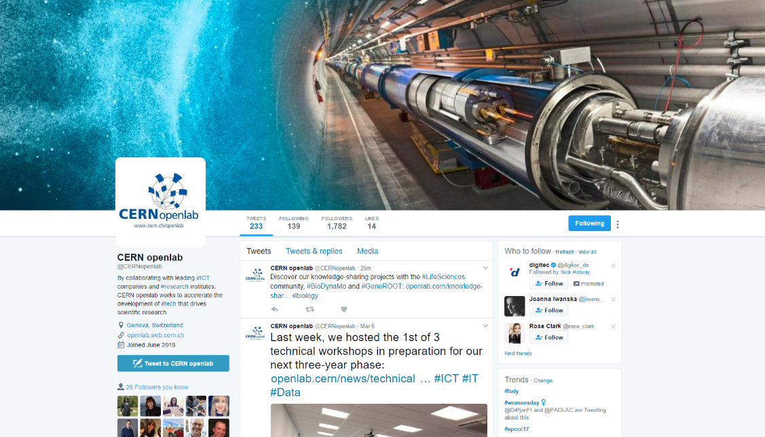

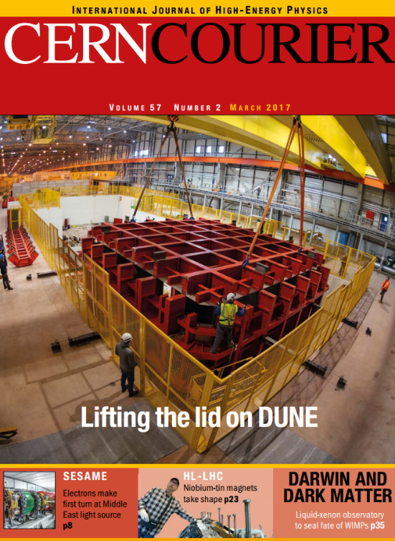
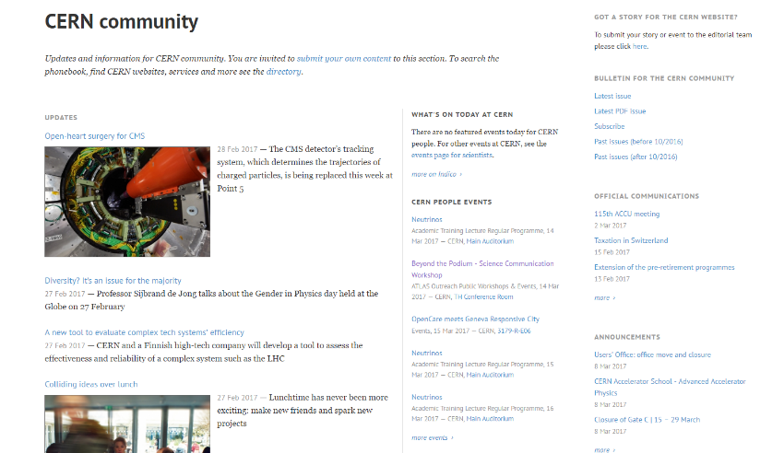
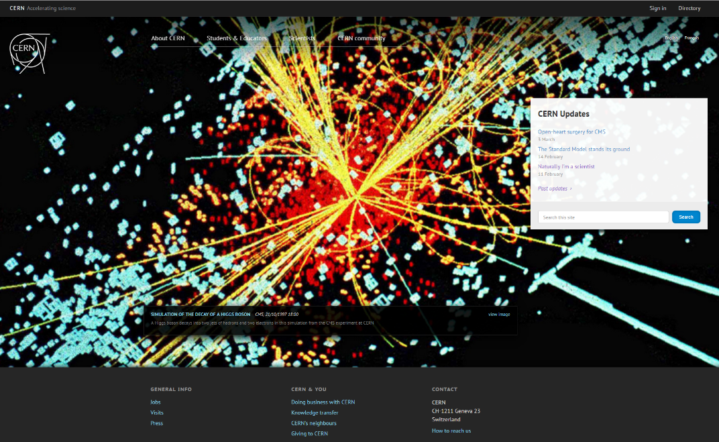
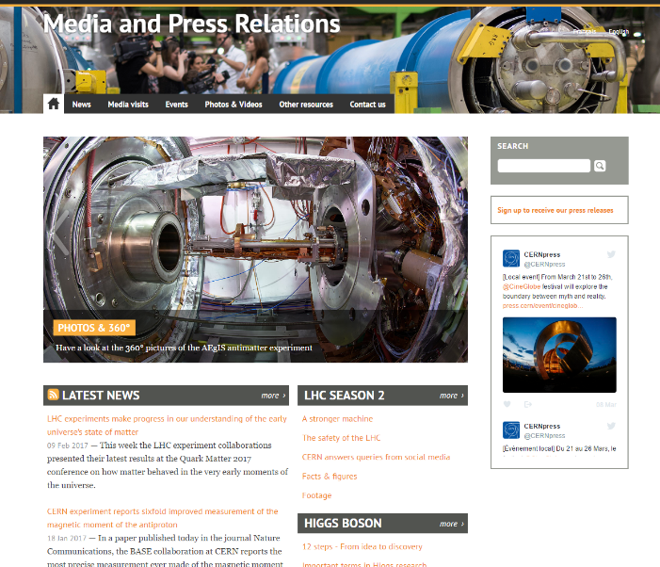
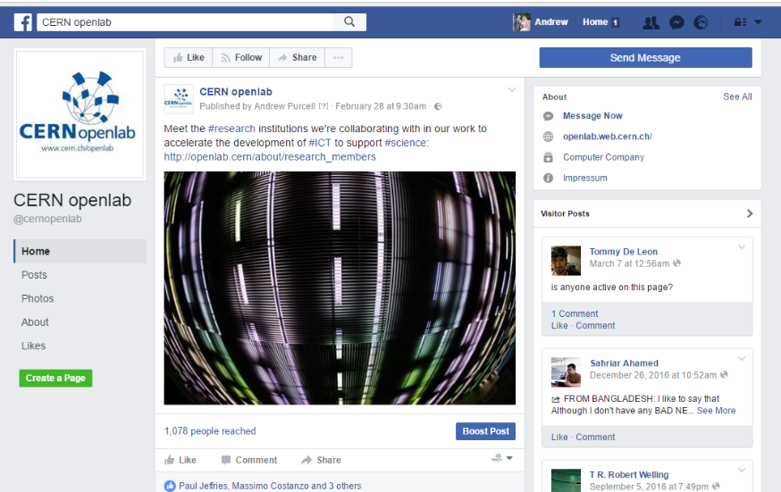

Measuring Impact
Communication and Outreach
CERN openlab runs a highly competitive summer-student programme
Most dedicated CERN openlab personnel are young, talented ‘fellows’.
Our website: http://openlab.cern/
~150k unique visitors/year (+100%)
Articles in other CERN and external
channels
~900 press cuts (+300%)
~ 40 students selected from around 1500 applicants
Receive hands-on experience with cutting-edge technologies
Facebook: http://cern.ch/go/p7pF
3.5k people reached / 100k single posts
Workshops, training courses, and other initiatives run with our collaborators.
Experts from industry and research give lectures.
Facebook group: http://cern.ch/go/n6xD
Twitter: http://cern.ch/go/7vvk
Workplace: http://cern.ch/go/6MTQ
Competitions, challenges, online training, hackathons.
Participate in events both inside and outside CERN.
LinkedIn: http://cern.ch/go/NK9k
Join the alumni: https://alumni.cern/

Slide 8
Why?

Slide 9
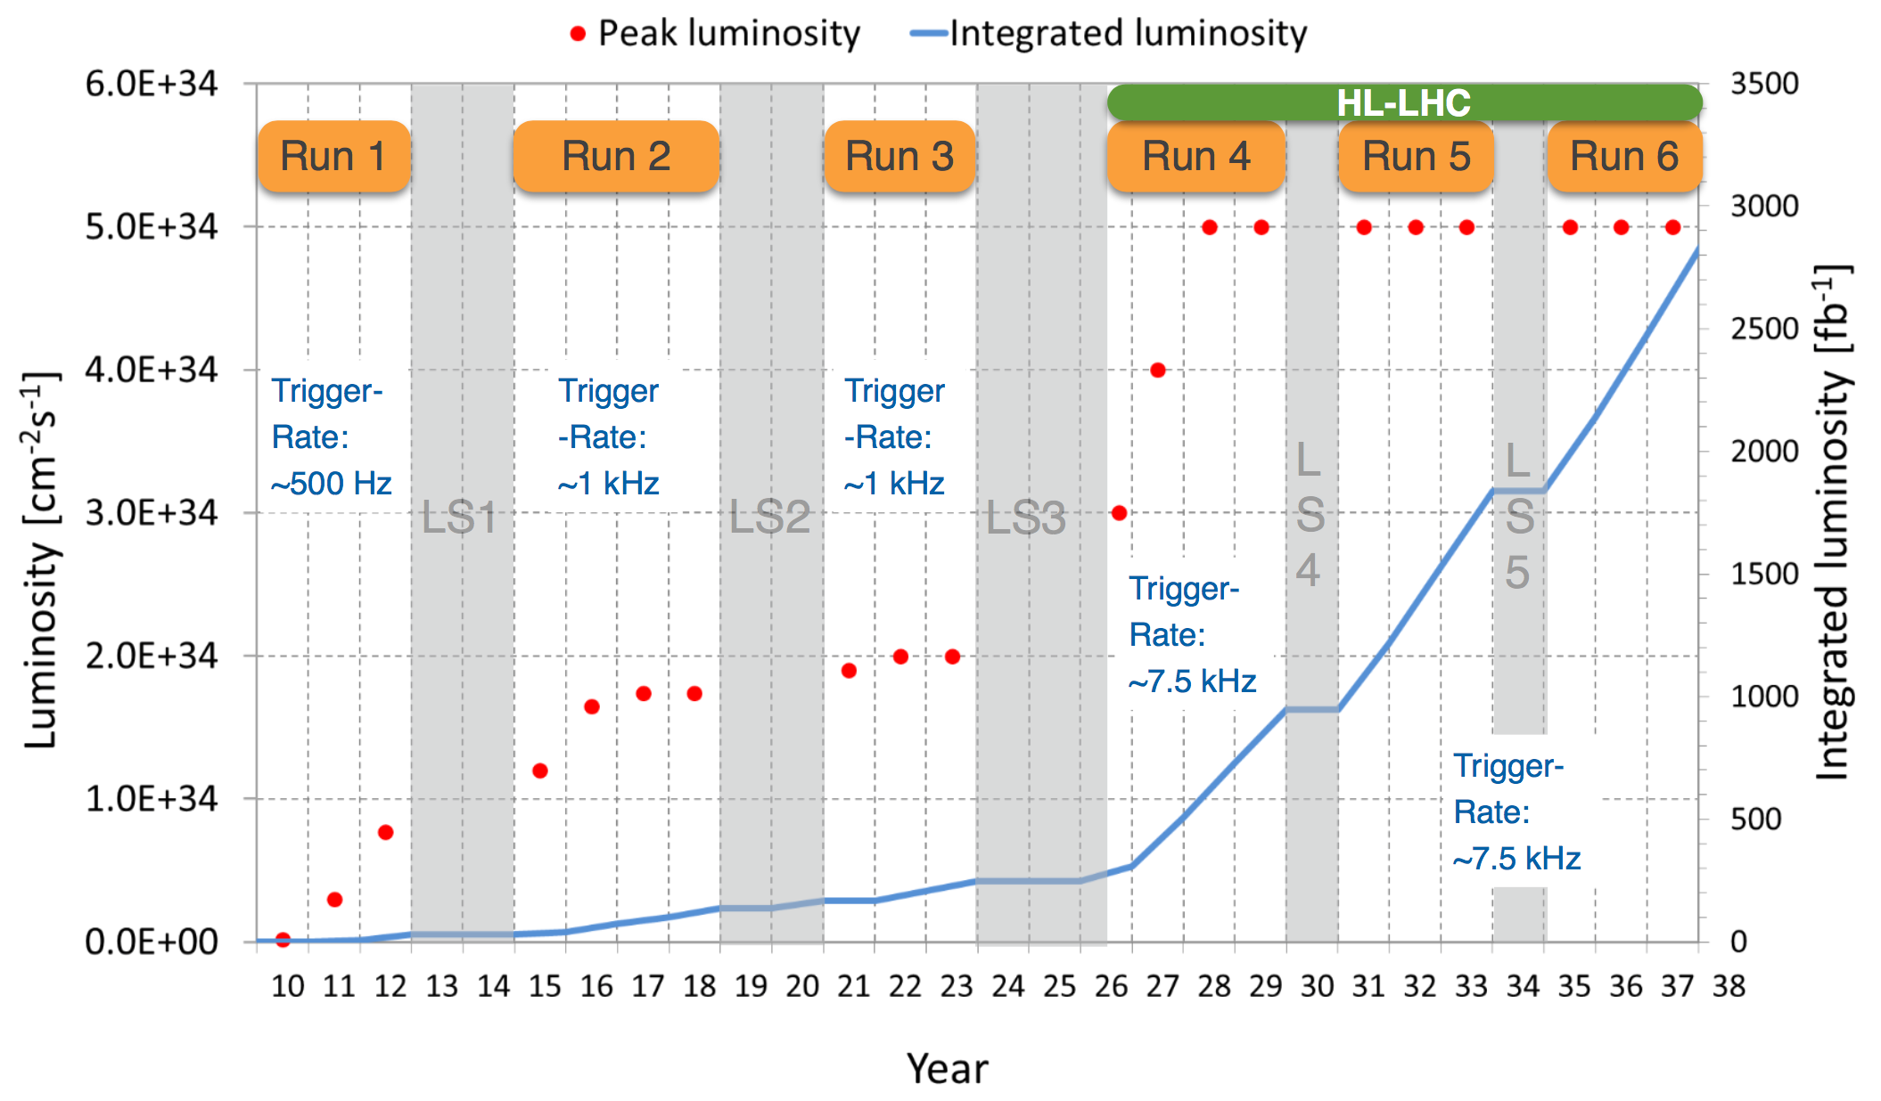
HL-LHC
Detectors development must be matched by software innovation
M. Pierini, openlab meeting, July 2018
“This is when the R&D has to happen”

Slide 10
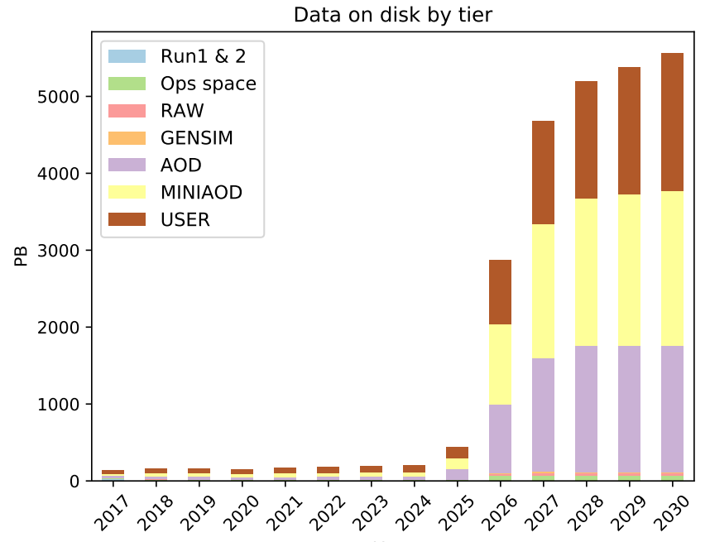
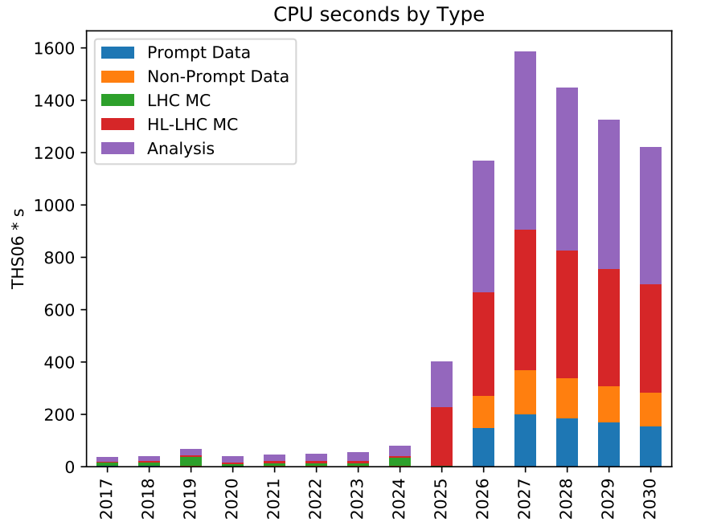
HL-LHC: data volume
CMS
Flat budget
Flat budget
https://arxiv.org/pdf/1712.06982.pdf
Raw data volume increases exponentially
  Processing and analysis load
Technology at ~20%/year will bring x6-10 in ~10 years
  Estimates of resource needs x10 above what is realistic to expect

Slide 11
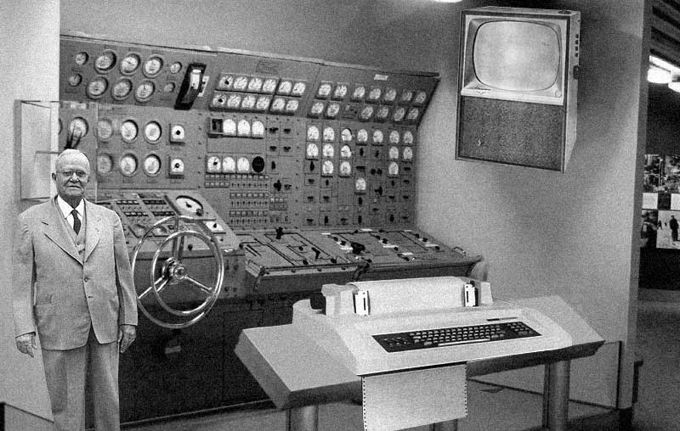
History – LEP
The estimation of the computing power needed by LEP contained in the Muscle report (1988) sent a shock wave through HEP
It was simply unthinkable to satisfy these requirements with mainframes
… and then …
miracle!
Here comes the “Killer Micro”
Gordon Bell, 2006

Slide 12

History – LHC
The LHC computing requirements, when finally spelled out in 2000-2001 (the “Hoffman report”) were so formidable that the committee was accused of “sabotaging the whole project”
Putting this amount of computing at CERN, even if available, would have created unsurmountable problems
Working with a distributed system was beyond Science Fiction
… and then …
miracle!
Here comes the Grid

Slide 13
History – conclusions
Moral of the story
HEP has regularly faced “computer requirement walls” and the associated scaremongering
  It reminds me a bit of the Y2K story… if you are old enough to remember it
We have been very good to “seize the opportunity” and turn emerging technologies into production facilities
This has allowed us to survive (indeed very well) at a reasonable cost
This has also provided a productive dialogue with the ICT community
One essential element of the success is that we had people already investigating the field within HEP, i.e. the “seeds” were already there
The only question (!) is what will be the next “savior(s)”

Slide 14
What?

Slide 15
Quantum Computing?
"Nature is quantum, goddamn it! So if we want to simulate it, we need a quantum computer.”
R.Feynman, 1981, Endicott House, MIT
Use qubits instead of bits… e.g. bits that exhibit quantum behavior
`Bloch’s sphere

Slide 16
Qubits are great!
n normal bits can be in one of 2^{n} states at a time
n qbits can be in 2^{n} states at the same time: any quantum operation is in fact 2^{n} operations in parallel
  79 qubits can represent a number of Avogadro of states
  263 qubits can represent as many concurrent states as there are protons in the universe
  400 entangled qubits would contain the whole information of our universe.
…and the icing on the cake is entanglement of the qubits: any operation on one part of the set has implications on the other

Slide 17
But qubits are also nasty…
Extremely difficult to realize in practice
You can only retrieve one quantum state at a time
States cannot be copied exactly
You can only use reversible (Unitary) logic gates, limiting the algorithms you can apply
Quantum decoherence is always present
Errors are more difficult to correct
  you have to correct the phase too!
  Current 2-qbit error rate > 10⁻³

Slide 18
Quantum Computing in perspective
The three frontiers
  Short distance -> High Energy Physics
  Long distance -> Cosmology
  Entanglement (i.e. complexity) -> Quantum Information Technology
Since Turing it was believed that the “hardness” of a problem (whether it could be solved in polynomial or greater time), was independent of the physi­cal apparatus trying to solve it
Quantum Computing is now challenging this

Slide 19
Quantum supremacy
…or is the gain worth the pain?
Can we control complex quantum systems and if we can, so what?
(J.Preskill, 2012)
Can quantum computers outperform classical computers on all algorithms?
Can quantum computers do things that cannot be done by classical computers (quantum supremacy)?
The golden apple is “superpolynomial speedup”
  Reducing to polynomial time what in classic computing is exponential or more
  Theoretically achieved with some algorithms
But polynomial speedup can be very appealing
  Particularly for large problems
For the moment it is debatable whether
Quantum Supremacy has been demonstrated
or not
Time
Problem size

Slide 20
Powerful
… but not omnipotent…
Some problems can be solved exponentially
faster by Quantum Computers.
  Factoring is the best known example.
Sampling the probability distribution of measurement outcomes for n-qubits is out–of-reach classically
  We believe it can be efficiently implemented on Quantum Computers
Quantum Computers cannot be efficiently simulated classically
At the moment we do not believe we can efficiently solve worst-case NP-hard optimization problems
  But we can find sub-optimal solutions much faster!

Slide 21
Quantum Hardware state of the art
IBM Quantum Experience in the cloud: now 16 qubits (superconducting circuit). 20 qubits soon, 50-qubit device “built and measured.”
Google 22-qubit device (superconducting circuit), 49 and 72 qubits built.
ionQ: 32-qubit processor planned (trapped ions), with all-to-all connectivity.
Microsoft: is 2018 the year of the Majorana qubit?
Harvard 51-qubit quantum simulator (Rydberg atoms in optical tweezers). Dynamical phase transition in Ising-like systems; puzzles in defect (domain wall) density.
UMd 53-qubit quantum simulator (trapped ions). Dynamical phase transition in Ising-like systems; high efficiency single-shot readout of many-body correlators.
D-Wave quantum annealer with 2000 qubits
And many other... spin qubits, defects in diamond (and other materials), photonic systems, ...

Slide 22
The “seeds” are already there
Most of the work we do is based on optimisation / fitting / minimisation that features superpolynomial speedup
  https://www.nature.com/news/quantum-machine-goes-in-search-of-the-higgs-boson-1.22860
Training of Deep Learning is revealing to be a bottleneck, quantum computing can speed it up
  https://www.datasciencecentral.com/profiles/blogs/quantum-computing-deep-learning-and-artificial-intelligence
Combinatorial searches can be speeded up
  e.g. track reconstruction
We can simulate basic interactions with QC
  https://www.nature.com/news/quantum-computer-makes-first-high-energy-physics-simulation-1.20136
  https://mappingignorance.org/2017/01/27/simulating-particle-physics-quantum-computer/
Lattice QCD calculations
  https://mappingignorance.org/2017/01/27/simulating-particle-physics-quantum-computer/
Very fast random number generators can be built
  https://www.osapublishing.org/viewmedia.cfm?r=1&uri=ICQI-2007-JWC49&seq=0
Quantum Detectors combined with Quantum Computing for online

Slide 23
More caveats…
A universal Quantum Computing machine would probably be less impossible than unpractical
If Quantum Computing really turns out to be a winning strategy, our computer models will have to be substantially updated
Quantum Computers will not speed-up existing algorithms, but will speed up time-to-solution with different algorithms
  Which we will have to discover!

Slide 24
… and money is flowing in…
EU Quantum Flagship – large-scale initiative
  funded at the 1b € level on a 10 years timescale.
US-DoE Quantum Information Science Enabled Discovery (QuantISED) for High Energy Physics
  Up to $13M total of awards in FY 2018 (FOA+LAB)
US-DoE Quantum Information Science in FY 2019 HEP
  President’s Budget Request: $27.5M

Slide 25
Just for the skeptical
I think there can be a world market for maybe five computers. (Thomas Watson, CEO of IBM, 1943)
There is no reason for an individual to have a computer at home . (Ken Olsen , president, director and founder of Digital Equipment Corp., 1977)
I think that this thing that Tim (Berners-Lee) has shown me has no future (F.Carminati, 1989)

Slide 26
ML/DL for Simulation
… but there are also other avenues …
GAN generated electron shower
Simulation is a very big part of the HEP data analysis process. Traditionally done with Monte Carlo methods.
Also in this case serious concerns about the scalability of MC in the HL-LHC era
Currently investigating the use of GAN methods to speed up simulation
Inference has already been demonstrated to be at least x10³ faster, training still an issue
Images courtesy of Sofia Vallecorsa, CERN openlab

Slide 27
Who?

Slide 28
CERN openlab role
CERN openlab will continue its ”broker” or seeding role
Plan advanced research project with major providers
Engage the research community
Open a dialog with existing initiatives
Spread the knowledge of the results obtained in the community

Slide 29
Research paths in QC
Get access to emulators and simulators to start assessing development tools and methodology, develop proof-of-concept algorithms for HEP workloads
Get access to real devices, benchmark, compare results
Investigate and collaborate in the development of APIs and user interfaces to access QC systems
Discuss collaboration on engineering aspects of QC installation, primarily cryogenics
Understand the role that CERN can play as part of broader QC development initiatives

Slide 30
When?

Slide 31
Quantum Computing Initiative Kick-Off meeting
Save the date!
CERN openlab is organizing a kick-off event of its Quantum Computing initiative on November 5th-6th
  https://indico.cern.ch/event/719844/
Currently ~240 registered participants from the HEP physics community, companies and worldwide research laboratories and beyond
Objectives:
  understand the level of interests of the HEP and other scientific communities
  assess the state-of-the-art of research and industry, and make them aware of our needs and capabilities
  bring different ideas and proposals together
  plan ahead for joint research projects between science and industry within the CERN openlab Framework

Slide 32
Conclusions
Quantum computing seems to be behind the curve
Potentially it could provide substantial benefits to our field
It is the right time for HEP to get involved and liaise the different initiatives already underway
CERN openlab has a long and successful experience of engaging with industry to bring new technologies to HEP
See you in November!

