Slide 1
Transport phenomena
in strong magnetic fields
Koichi Hattori
Fudan University
Phases of Quantum Chromodynamics (QCD) and Beam Energy Scan Program
with Heavy Ion Collisions @ Fudan Univ., Aug. 15-18, 2017

Slide 2
Dynamics in the lowest Landau level (LLL)
(1+1)-D dispersion relations
Macroscopic consequences
Anomalous transport phenomena.
Chiral magnetic/separation effect
in a number of literatures.
Any consequence in usual (dissipative)
transport phenomena?
Not fully addressed yet.
???

Slide 3
Outline
1-1. Heavy Quark Diffusion Dynamics in QGP
K. Fukushima (Tokyo), KH, H.-U. Yee (UIC), Yi Yin (MIT),
PRD. [arXiv:1512.03689 [hep-ph]]
Cf.) KH and Xu-Guang Huang (Fudan), arXiv:1609.00747 [nucl-th]
1-2. Electrical conductivity of QGP
KH, S. Li (UIC), D. Satow (Frankfurt), Ho-Ung Yee, PRD. arXiv:1610.06839 [hep-ph]
KH and D. Satow, PRD. [arXiv:1610.06818 [hep-ph]]
1-3. Bulk viscosity of QGP
KH, X.-G. Huang (Fudan), D. Rischke (Frankfurt), D. Satow, arXiv:1708.00515 [hep-ph] .
2. Anomalous magnetohydrodynamics
and new instabilities with CME current
KH, Y. Hirono (BNL), H.-U. Yee, and Y. Yin, In preparation.

Slide 4
1-1. Heavy quark diffusion in magnetic fields
K. Fukushima (Tokyo), KH, H.-U. Yee (UIC), Yi Yin (BNL→MIT),
Phys. Rev. D 93 (2016) 074028. [arXiv:1512.03689 [hep-ph]]

Slide 5
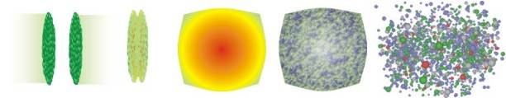
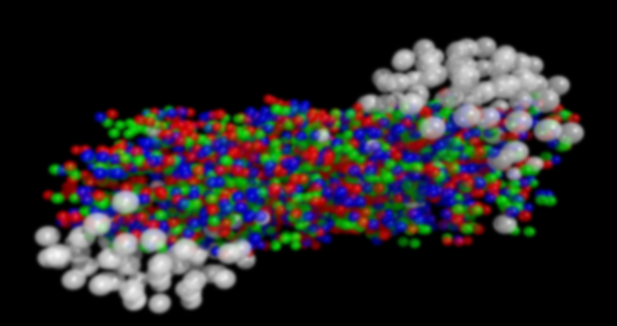
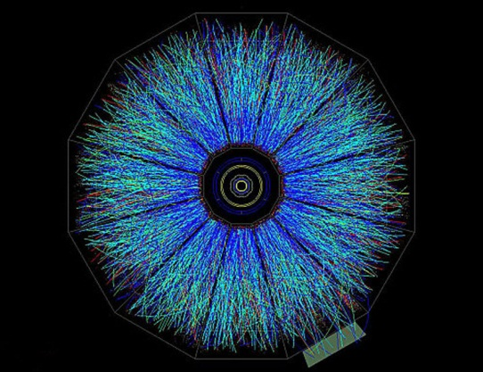
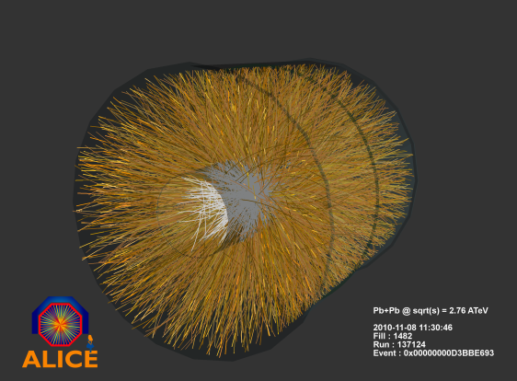
Heavy quarks as a probe of QGP
g
g
B
Thermal Quark-Gluon Plasma (QGP)
Hadrons
RHIC
Non-thermal heavy-quark production in hard scatterings
Momentum distribution of HQs in log scale
Initial distribution (τ = 0)
from pQCD
LHC
Thermal (τ = ∞)
Relaxation time is controlled by transport coefficients (Drag force, diffusion constant)

Slide 6
Heavy quark (HQ) dynamics in the QPG
-- In soft regime
Langevin equation
Random kick (white noise)
Einstein relation
Drag force coefficient: η_{D}
Diffusion constant: κ
Perturbative calculation by finite-T field theory (Hard Thermal Loop resummation)
LO and NLO without B are known (Moore & Teaney, Caron-Huot & Moore).

Slide 7



Perturbative computation of momentum diffusion constant
Momentum transfer rate in the LO Coulomb scatterings
2
2
2
2
+
+
HQ
HQ
HQ
Thermal quarks
HQ
Thermal gluons
Thermal quarks
Thermal gluons
c.f.) LO and NLO without B (Moore & Teaney, Caron-Huot & Moore)
Effects of a strong magnetic field (eB >> T^2)
1. Modification of the dispersion relation of thermal quarks
2. Modification of the Debye screening mass

Slide 8

1. Prohibition of the longitudinal momentum transfer
Linear dispersion relation
From the chirality conservation
Energy and momentum transfers in the direction of B
In the static limit (or HQ limit)
HQ
Light quark

Slide 9
2. Screening effect in a strong B
Gluon self-energy
Schwinger model
Strong B
+ There is no T or μ correction in massless Schwinger model
+ Mass correction is small ~ m/T

Slide 10
Anisotropic momentum diffusion constant
Longitudinal
Perpendicular
Quarks
Gluons
Remember the density of states in B-field,
In the strong B limit,

Slide 11
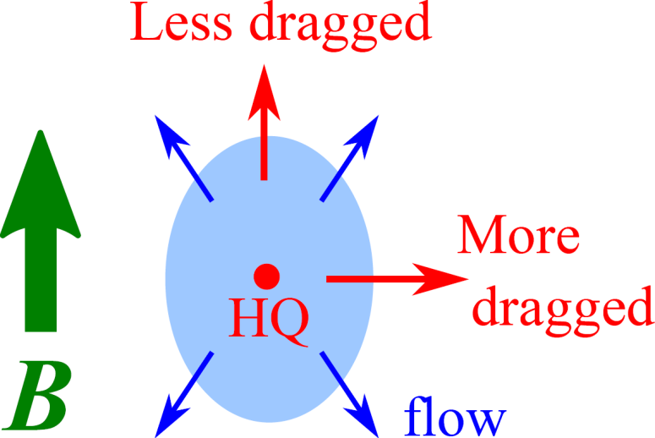
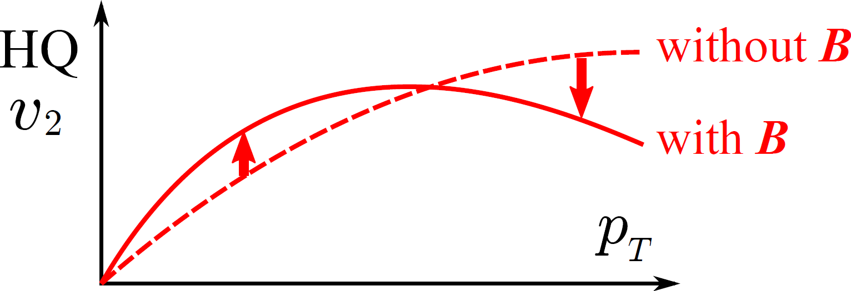
Implication for v2 of heavy flavors
Magnetic anisotropy gives rise to v2 of HQs
even without the v2 of medium.
→ Possible to generate v2 of HQs in the early QGP stage.

Slide 12
1-2. Electrical conductivity in strong magnetic field
KH, Shiyong Li, Daisuke Satow, and Ho-Ung Yee, arXiv:1610.06839 [hep-ph].
KH and Daisuke Satow, arXiv:1610.06818 [hep-ph].
Ideal
Dissipation
V
Quarks live in (1+1) D
Gluons live in (3+1) D
Strong B

Slide 13
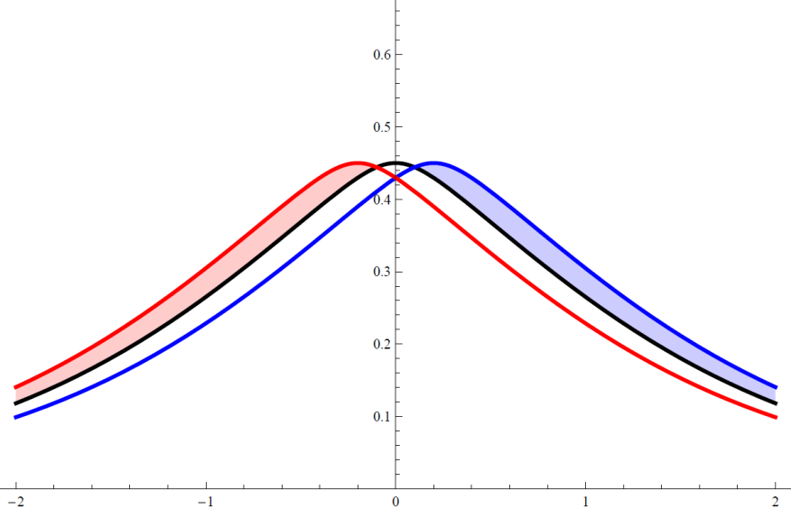
“Longitudinal conductivity” in the strong B
Current only in z direction
(1+1)-D effective Boltzmann eq.
Total current integrated over p_{z}

Slide 14
How linearized Boltzmann eq. works
Stationary and homogeneous limit
External driving force v.s. Relaxation
E field
Collision term: e.g., relaxation time approximation
Solution of linearized Boltzmann eq.

Slide 15
Quark-damping mechanism in magnetic fields
This work
AMY without B
Finite B opens 1-2 processes

Slide 16
Chirality selection in the massless limit
Chirality conservation at the vertex
“Gluon mass”
Right handed
The quark damping rate is
i) order g^2
ii) proportional to the small mass.
Right handed
Gluon emission in a collinear configuration
Transverse polarizations

Slide 17
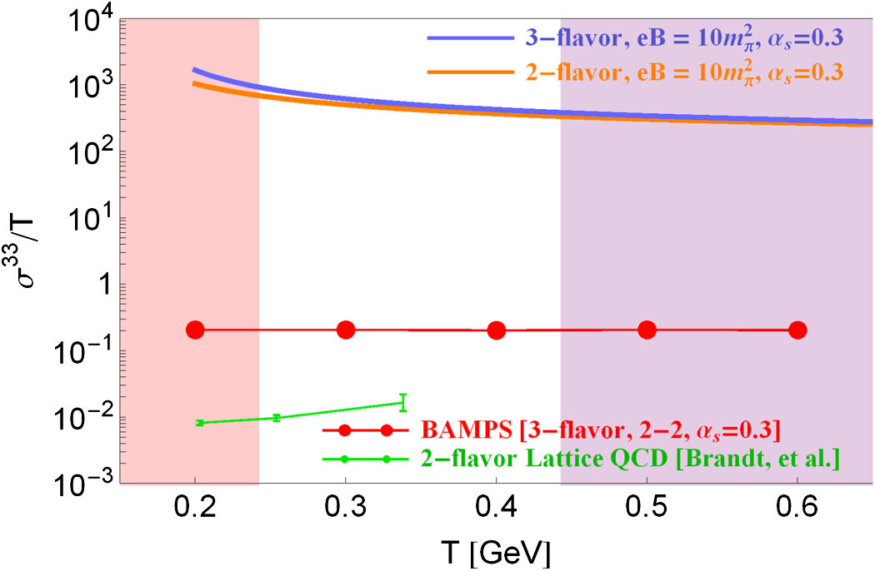
Results
+ Chirality conservation
in 1-2 (2-1) processes
+ IR cutoff M²～α_{s}*eB
AMY (Arnold, Moore, Yaffe)
See KH and Satow for a consistent
result from diagrammatic calculation
Transition from strong B (LLL)
to weak B (hLL).

Slide 18
1-3. Bulk viscosity in a strong magnetic field
KH, X.-G. Huang, D. Rischke, D. Satow, arXiv:1708.00515 [hep-ph] .

Slide 19
Bulk viscosity of the QGP
Adiabatic expansion
in an equilibrium
Rapid expansion
in (slightly) off equilibrium
Scale inv. in the massless & classical limits:
A finite bulk viscosity demands conformal-symmetry breakings.
Arnold, Dogan, Moore (2006)

Slide 20
Pressure evolution
in the presence of an expansion

Slide 21
Subtraction of the equilibrium component

Slide 22
Boltzmann eq. in an expanding system
Conformal symmetry
Damping from C[f]
Chirality selection rule

Slide 23
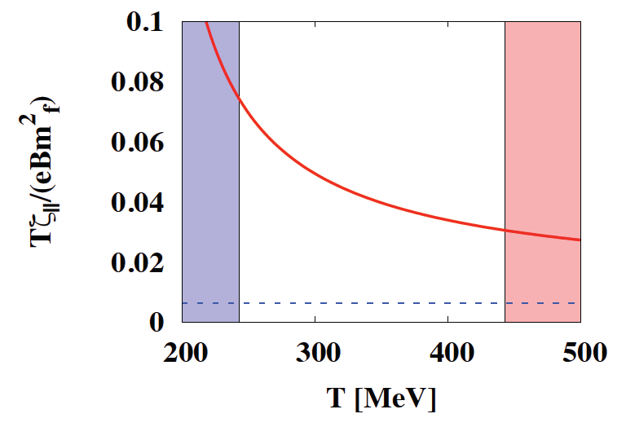
Results
Arnold, Dogan, Moore (2006)
With B
Without B
Consistent result can be obtained from diagrammatic calculation with Kubo formula.

Slide 24
2. Anomalous magnetohydrodynamics
and new instabilities with CME current
KH, Yuji Hirono, Ho-Ung Yee, and Yi Yin, In preparation.

Slide 25
Anomalous hydrodynamics
in STRONG & DYNAMICAL magnetic fields
-- Anomalous hydrodynamics
Son & Surowka
-- Anomalous magnetohydrodynamics (MHD)
This work.
+ CME current is reproduced from the entropy argument
in the MHD counting.
+ Hydrodynamic waves in anomalous MHD
→ New hydrodynamic instabilities!

Slide 26
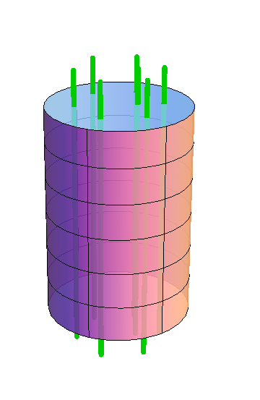
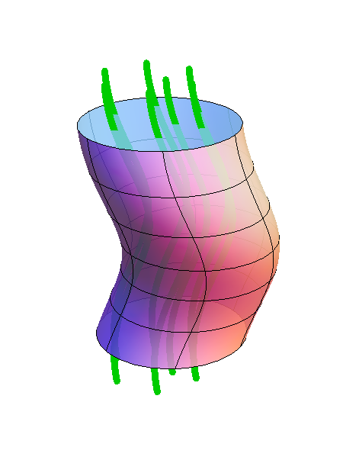
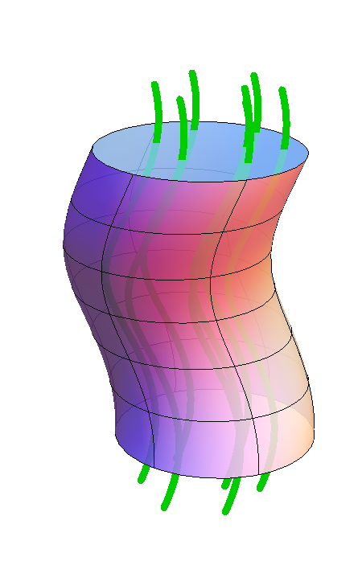
Collective excitations in MHD without anomaly
Alfven’s theorem = “Frozen-in” condition:
Magnetic flux is frozen in a fluid volume
and moves together with the fluid.
* Magnetic lines move together with the fluid volume.
Navier-Stokes + Maxwell eqs.
Oscillation
Transverse Alfven wave
Tension of B-field = Restoring force
Fluid energy density = Inertia

Slide 27
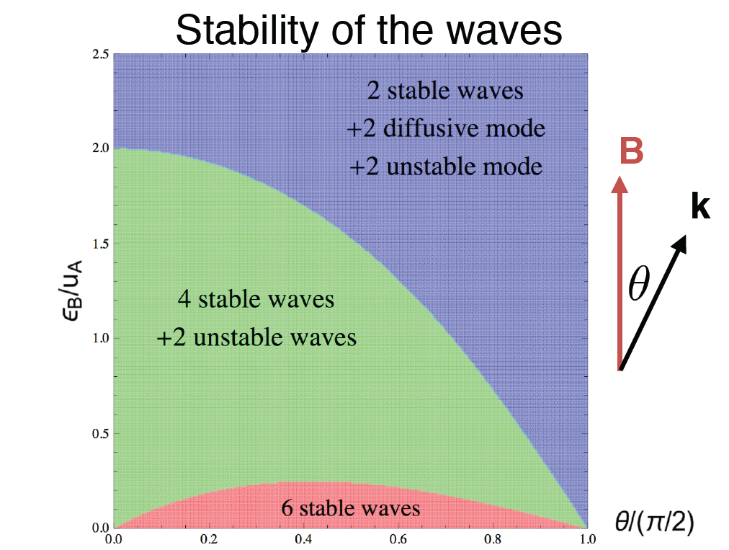
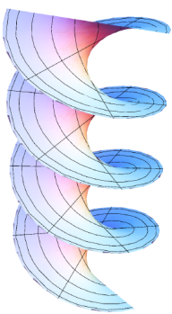
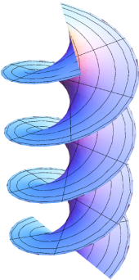
Excitations in anomalous MHD
-- Emergence of new instabilities
A finite CME current without CVE:
Linearlized EoM → Wave equation as a cubic eq. of ω² (6 solutions)
Stability of the waves from classification of solutions
Helicity decomposition
(Circular R/L polarizations)

Slide 28




Helicity conversions
Akamatsu, Yamamoto
Hirono, Kharzeev, Yin
Xia, Qin, Wang
Chiral imbalance
btw R and L fermions
Chiral Plasma Instability (CPI)
Magnetic helicity
Hirono
Fluid helicity (structures of vortex strings)
Dynamical & beyond-linear analysis demanded.

Slide 29
Summary 1
The chirality selection plays crucial roles in
the non-anomalous transports
as well as in the anomalous transports.
Consequences of the chirality selection rule
HQ diffusion:
Electrical conductivity:
Bulk viscosity:

Slide 30
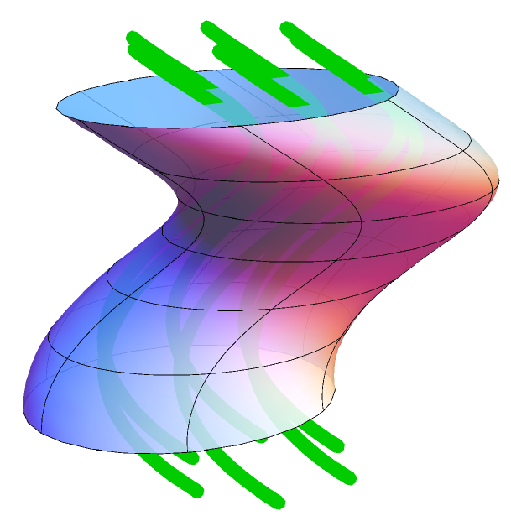
Summary 2
We observed an onset of instabilities in the mixture of
B and fluid velocity (v) fields in the anomalous MHD,
in the presence of a CME current.
Amplitudes of both B and v grow exponentially in time.
Stay tuned for more results & discussions in publication.

Slide 31
Backup slides

Slide 32
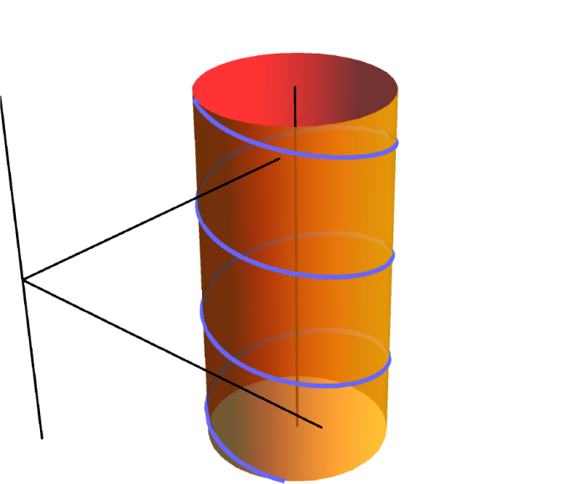
Landau level discretization due to the cyclotron motion
B
“Harmonic oscillator” in the transverse plane
Nonrelativistic:
Cyclotron frequency
Relativistic:
In addition, there is the Zeeman effect.

Slide 33
Transverse diffusion constant in massless limit
Distribution of the quark scatterers
Screened Coulomb scattering amplitude (squared)
Spectral density

Slide 34
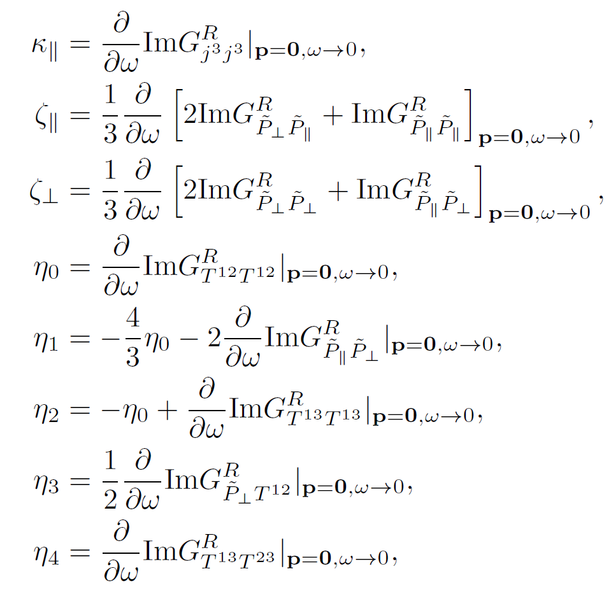
Kubo formulas
Huang, Rischke, Sedrakian (2011)
Hernandez and Kovtun (2017)

Slide 35
Energy-momentum tensor in the LLL
In the Landau gauge,
When q → 0,

Slide 36
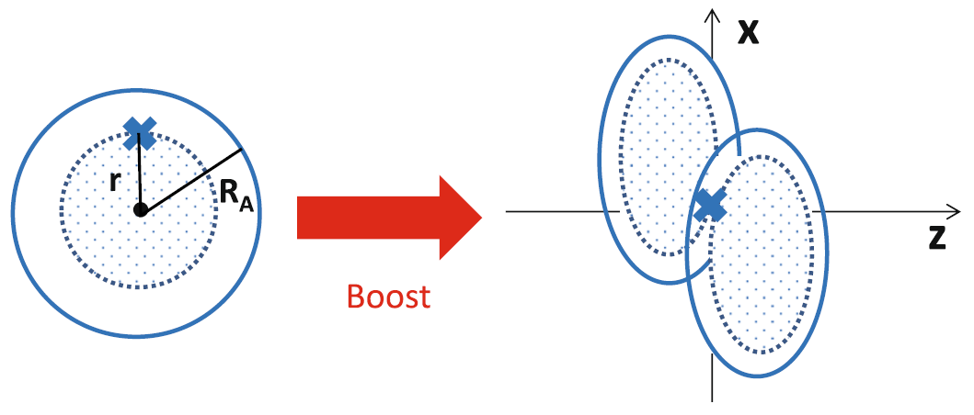
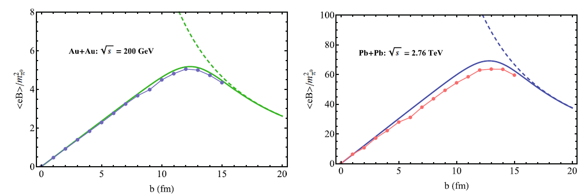
Analytic estimate of the strong B
-- Impact parameter dependences
B
W.-T. Deng & X.-G. Huang, KH and X.-G. Huang

Slide 37
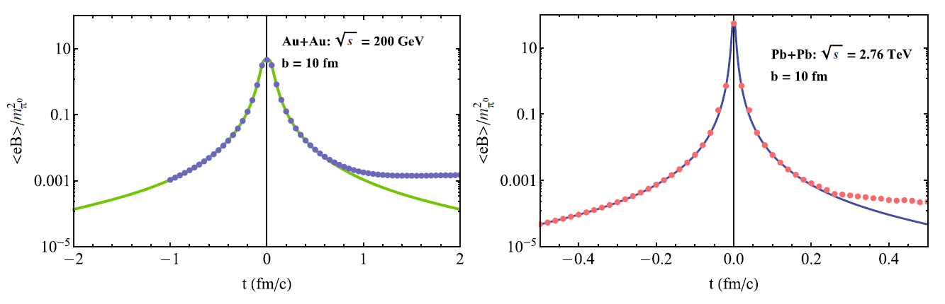
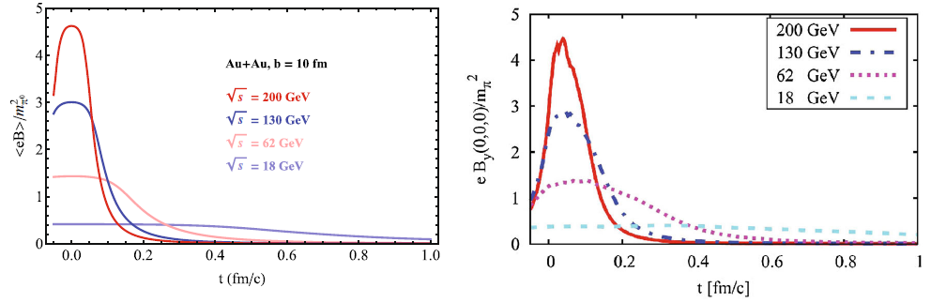
Time dependences
Collision-energy dependences
V. Voronyuk, et al. (2011)

Slide 38
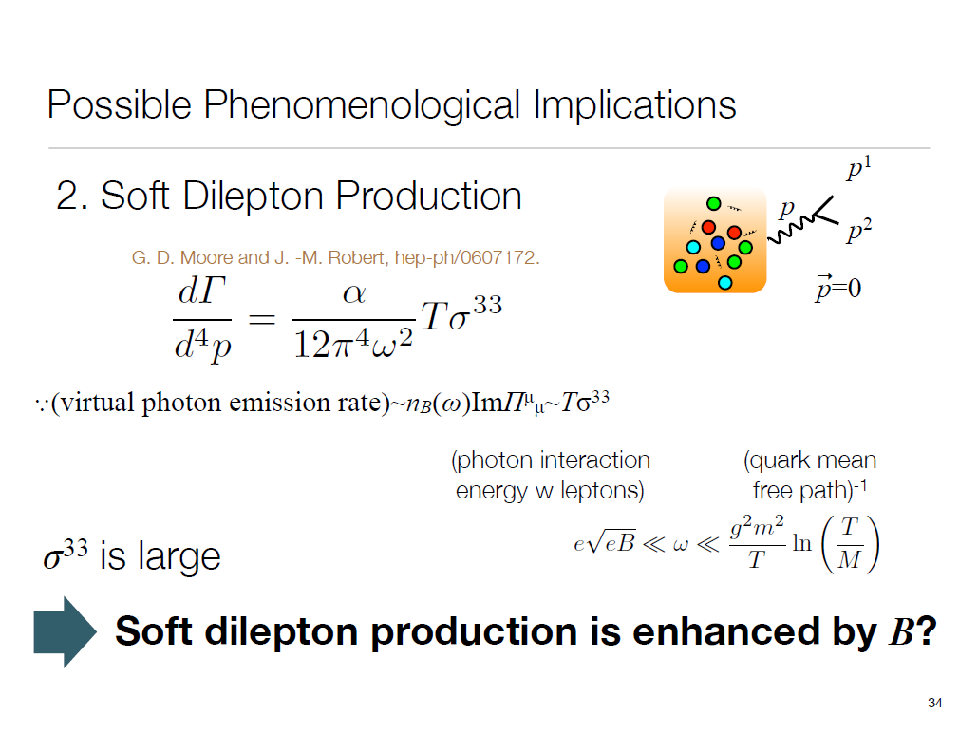
From Daisuke Satow’s slides

Slide 39
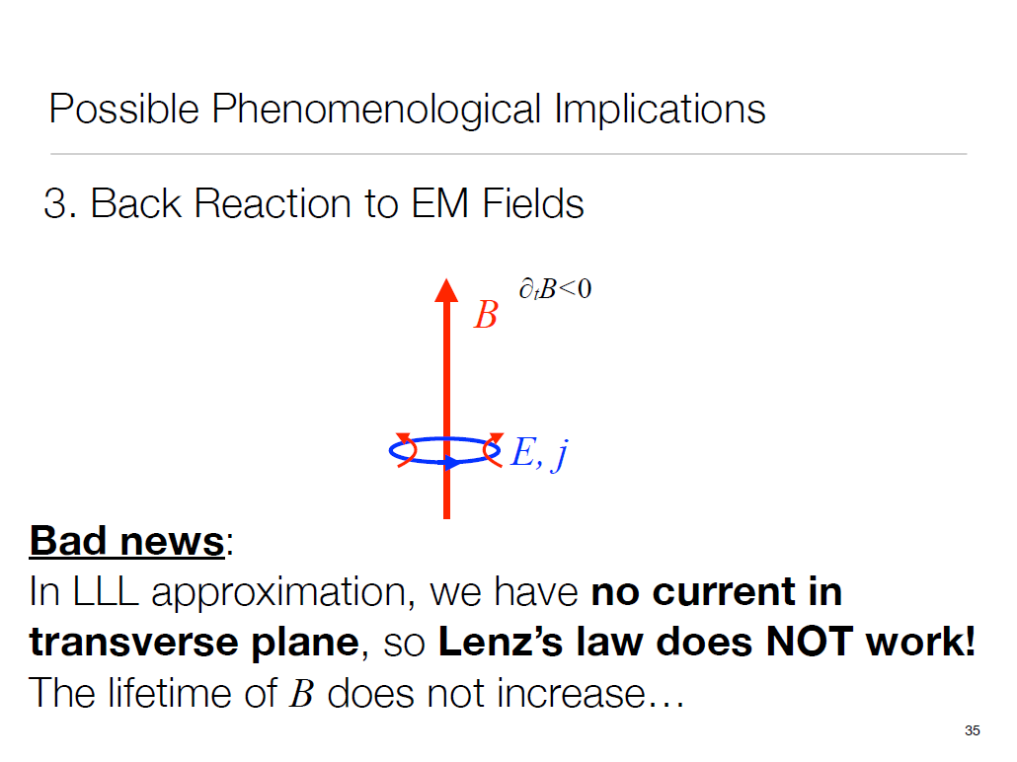
From Daisuke Satow’s slides

Slide 40
Consistent result from diagrammatic calculation
KH, D. Satow
Response function
Kubo formula
Divergence in free theory
Regularized by quark damping rate
No need to resum the pinch singularities in the present case
+
+
+ ・・・

Slide 41
3. Anomalous transports
from magneto-vorticity coupling
KH and Yi Yin, Phys. Rev. Lett. 117 (2016) 15. [arXiv:1607.01513 [hep-th]]

Slide 42
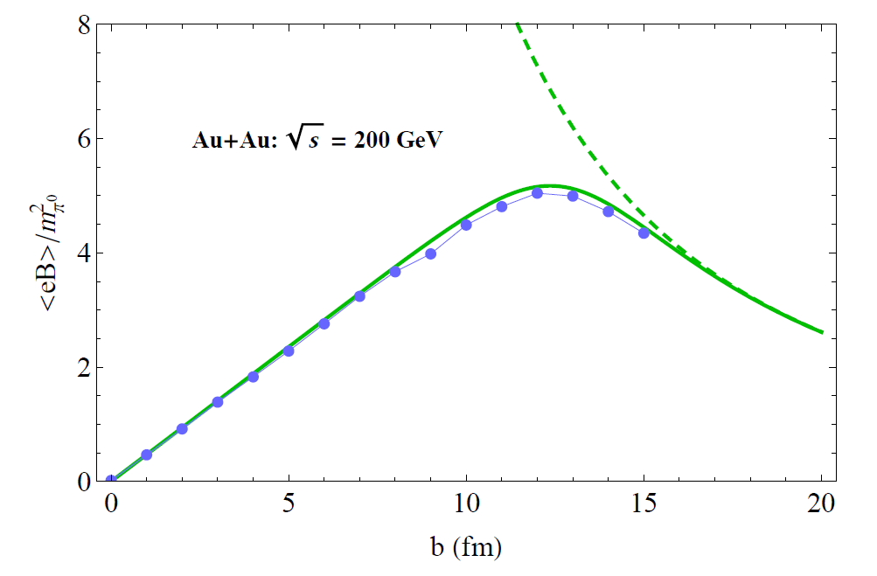
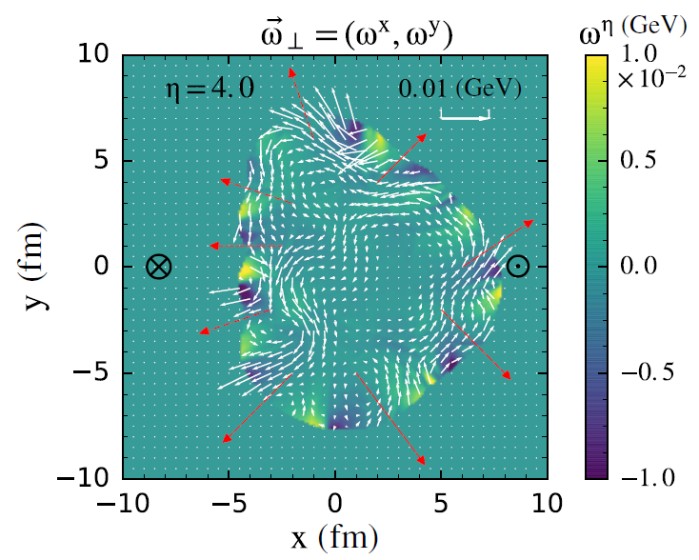
Strong magnetic field & vorticity/angular momentum
induced by heavy-ion collisions
B
ω =∇×v_{fluid}
Super-strong B
Vorticity in HIC
Impact parameter
Deng & Huang (2012), KH & Huang (2016)
Skokov et al. (2009), Voronyuk et al. (2011),
Bzdak, Skokov (2012) McLerran, Skokov (2014)
Pang, Petersen, Wang, Wang (2016)
Becattini et al., Csernai et al., Huang, Huovinen, Wang
Jiang, Lin, Liao(2016) Deng, Huang (2016)

Slide 43
Anomaly-induced transports
in a magnetic OR vortex field
Chiral magnetic effect:
Chiral vortical effect:
Coefficients are time-reversal even.
Non-dissipative transport phenomena is
due to topology in quantum anomaly and is nonrenormalizable.
Anomaly relation:

Slide 44
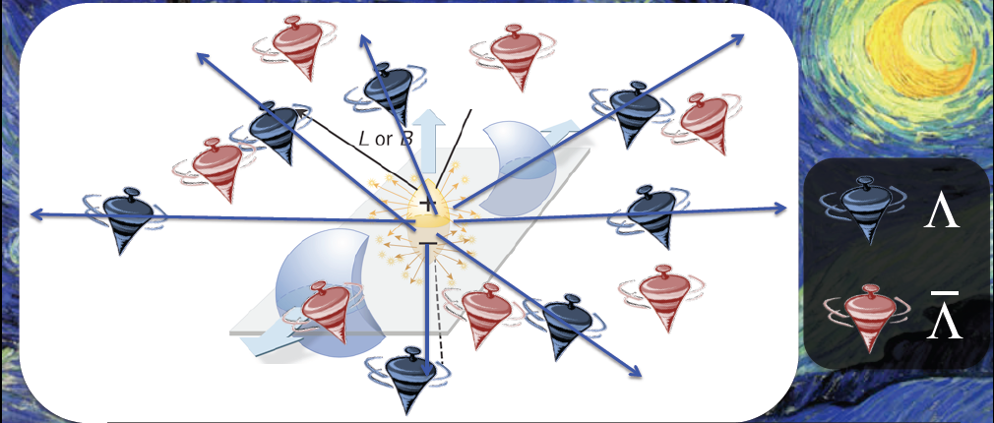
Spin polarizations from spin-rotation coupling
Λ polarization
Slide by M. Lisa
See talks by Becattini, Niida, Konyushikhin, Li
Becattini et al., Glastad & Csernai, Gyulassy & Torrieri, Xie,,,,

Slide 45
An interplay B ⊗ ω
For dimensional reason, one would get
Cf., In CVE, it was
#
Could the magneto-vorticity coupling be important ??
QFT with Kubo formula
Anomalous hydrodynamics due to Son and Surowka
Anomalous transports
Chiral kinetic theory
→ Yes, it is important when B is so strong that B >> O(∂¹).
Q1. Is the coefficient related to any quantum anomaly?
Q2. How is T and/or μ dependence?

Slide 46
Consequences of a magneto-vorticity coupling

Slide 47
Shift of thermal distribution functions
by the spin-vorticity coupling
Spin-vorticity coupling
Landau & Lifshitz, Becattini et al.
In the LLL, the spin direction is aligned along the magnetic field .
- for particle
+ for antiparticle
Number density
At the LO in the energy shift Δε

Slide 48
The shift is independent of the chirality, and depends only on the spin direction.
In the V-A basis,
½ from the size
of the spin
Spatial components of the current
The shift depends on the chirality through the velocity.
In the V-A basis,

Slide 49
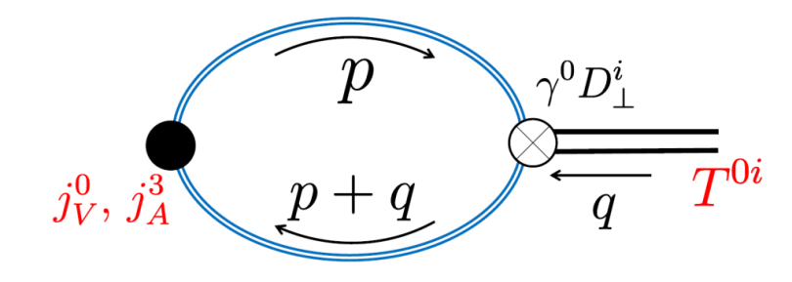
Field-theoretical computation by Kubo formula
Perturbative ω in a strong B
LLL fermions
Similar to the Kubo formula used to get the T² term in CVE (Landsteiner, Megias, Pena-Benitez)
We confirm
the previous results obtained from the shift of distributions.
a relation of <n_{V} T⁰²> to the chiral anomaly diagram in the (1+1) dim.
There is no T or μ correction in the massless limit,
since it is related to the chiral anomaly!

Slide 50
Summary 2
A magneto-vorticity coupling B ⊗ ω induces
charge redistributions without μ_{A}.
Related to the chiral anomaly in the (1+1) dimensions.
No T or μ correction.
R
+
R
-
R
R
+
-
+
L
+
L
L
-
B
L
-
Coupling between the CME and fluid velocity induces a new
instability in MHD. Take by Y. Hiron. KH, Hirono, Yee, Yin, In preparation.

Slide 51
Alfven wave from a linear analysis
Navier-Stokes + Maxwell eqs.
Stationary solutions
Transverse perturbations
as functions of z.
Linearlized eqs in an ideal hydro.
Wave equation
Transverse wave
propagating along background B₀
Alfven wave velocity
Same wave equation for δv
→ Fluctuations of B and v propagate together.

Slide 53
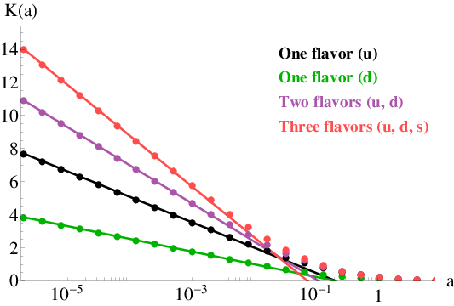

Slide 54

Field-theoretical computation by Kubo formula
There is no T or μ correction in the massless limit!
→ Consistent with the previous observation from the shift of distributions.

Slide 55
Causality problem:
A rigid rotation of an infinite-size system breaks
causality in the peripheral region.
One must have a finite-size system with an exterior boundary
or a local vortex field.
L
R
Local shift of the charge density
→ Redistribution of charge in the system

