Slide 1
Some theoretical issues of Chiral anomalous transports
Defu Hou
Central China Normal University, Wuhan
phases of QCD &BES @ Fudan Uni. Aug15-18 , 2017

Slide 2
III. Subtlety of the Wigner function used for CME
IV CME on lattice and Higher order correction
Outline
I. Introduction to anomalous transport
II. CME with non-constant Axial & B
V. Conclusion and outlook

Slide 3
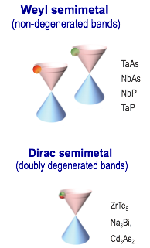

I. Introduction : Anomalous Transports
(Fukushima-Kharzeev-Warringa, Son-Zhitnitsky, Vilenkin
Micro-quantum anomaly + B/ Ω → macro-transport (CME/CVE)
Micro
Search in HIC
B
Ω
Nature Phys.12（2016）
Macro
Phys. Rev. X.5（2015）
Science350（2015）413
Astrophysics, cosmology
X.Huang , Rep.prog. Phys. (2016)
Kharzeev,Liao,Voloshin,Wang: Prog.Part.Nucl.Phys.2016

Slide 4
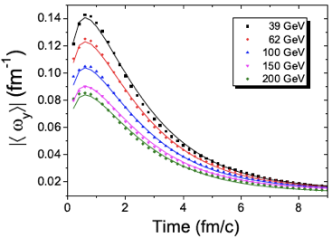
Strong EM Field/Rotation/polarization produced in HIC
Deng, Huang, 2015
Li, Sheng, Wang 2016
Jiang,Lin,Liao, 2016

Slide 5


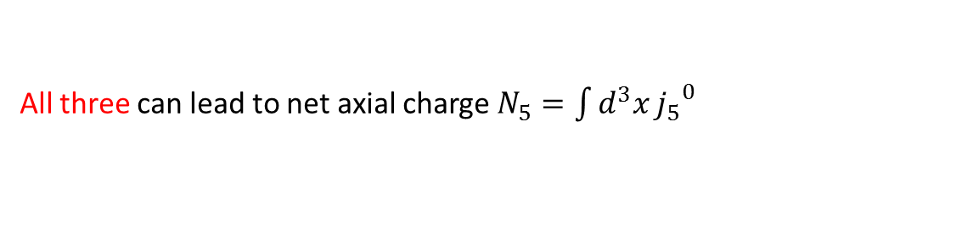


Net axial charge generated
$$∂_{μ}{j_{5}}_{}^{μ}=−\frac{q^{2}N_{c}}{16π^{2}}F\tilde{F}−\frac{g^{2}N_{f}}{8π^{2}}trG\tilde{G}+2im\overline{ψ}γ^{5}ψ$$
$$F\tilde{F}$$
Parallel electric and magnetic fields
condensed matter
$$trG\tilde{G}$$
Topological field configurations(instanton, sphaleron)
Parallel chromo electric and magnetic fields
HIC
$$2im\overline{ψ}γ^{5}ψ$$
Explicit breaking by quark mass
HIC
All three can lead to net axial charge $N_{5}=\int{d^{3}x}{j_{5}}^{0}$
(See S. Lin’s talk on Friday)

Slide 6
• Experimental situation in HIC (See H.Z.Huang’s talk)
① Off central collisions generate inhomogeneous & transient
② axial charge produced via topological fluct. plus mass effect
(See S. Lin’s talk on Friday)
③ Beyond thermal equilibrium
• Theoretical investigations:
① Field theory
② Holography
③ Hydrodynamics & Kinetic theory
K. Fukushima et. al., Phy. Rev. D. 78, 074033, 2008
Hou ， Liu ， Ren , JHEP 1105: 046, 2011
D. Kharzeev et. al., arXiv: 1312.3348
Yee. Rebhan et. al., JHEP 0911: 085, 2009
Shu Lin et. al., PRL114, 2015; PRD88. 2013
D. T. Son et. al., PRL103, 2009, PRL106, 2011; Stephanov, Yin, PRL (2012)
Gao, Liang, Pu, Q Wang, XN Wang PRL109 2012,
Anomalous Viscous Fluid Dynamics (AVFD): Jiang, Shi, Yin, JL, PLB (2015); arXiv:1611.04586.

Slide 7
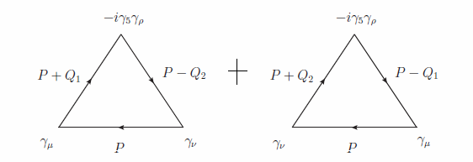
General properties and Subtleties
Axial anomaly：
Vector Ward identity：
Naive Axial Vector Ward identity
UV diverge→ impossible to maintain（1）&（2）
Gauge invariance→ vector Ward identity
Anomaly,
Universal to all orders of coupling，all temperature & chemical potential .Necessary to explain

Slide 8
Anomalous, Ward identity in an electromagnetic field
Naïve axial charge Q_5 is not conserved
Conversed axial charge
Should be used in the equilibrium thermodynamics (Rubakov)

Slide 9
II. Non-constant & B / Subtlety of Constant Limits
Hou, Ren, Liu JHEP 05(2011)046
CME in general
Constant limit:
Always gives ?
Color-flavor factor
9

Slide 10
Constant , non-constant B:
Kharzeev
& Warringar
Artifact of one-loop approximation. The ambiguity disappears
with higher order corrections. (Satow & Yee)
10

Slide 11
Constant B, non-constant
Follows from the EM gauge invariance and the non-renormalization of the axial anomaly. Valid to all orders!
with T=0 and : relativistic invariance requires
the two limit orders are equivalent:
11

Slide 12
 | IR limit |  |  | Higher order
 |  |  | 0 | none
 |  |  |  | none if IR safe
 |  |  |  | yes
 |  |  | 0 | none

Slide 13
III. Subtlety of the Wigner function used for CME
• Wigner function formulation
Vasak, Gyulassy , Elze (1987), Heinz et al ( non-abelian plasma) (96)
The Wigner function that links various hydrodynamic quantities of the system to the Green's function
Gao et al obtain CME& CVE and axial anomalies with a constant
(see S. Pu’s talk )
Gao, Liang, Pu, qWang, xnWang (2012)
,
inhomogeneous and transient ?
Wu,Hou, Ren, 2016

Slide 14
• The electric current extracted from the wigner function
For a constant
For a non-constant , it is problematic because of UV divergence with the limit

Slide 15
Considering a massless Dirac field in an external and
＊The action：
＊The Lagrangian density：
with

Slide 16
• Closed time path Green function formation
＊ A fermion propagator
time ordering
anti-time ordering
＊ The electric current

Slide 17
＊ Expansion to the linear order in and
full propagator:
free propagator
with
gauge link:

Slide 18
Problems of the Wigner function formalism
＊ The nonconserversion of the electric current
with

Slide 19
＊＊ by averaging the direction of y
The electric current is not conserved!
unless the axial potential is a pure gradient

Slide 20
＊ An incosistency
In principle, the electric current should satisfy the consistency
However, the electric current from Wigner function:
Averaging the direction of y
The consistency condition broken!

Slide 21
Applying to a general chiral case, the present form of the Wigner function formulation needs to be revised!

Slide 22
correction : the regulated Wigner function
a robust regularization scheme has to be introduced to the underlying field theory before defining the wigner function.
e.g. If the underlying field theory is regularized by PV scheme
PV regulator should be included in it
But the CME current would also be cancelled.
The Bardeen like term should be added in.

Slide 24
Wu,Hou, Ren, 2016
gives CME current :
CME current canceled at thermal equilibrium.

Slide 25
Phenomenological implications of the subtleties regarding the order of limits
Axial charge generated via toplogical fluctuations dictated by the stochastic Eq with a white noise
In Momentum sapce
Corresponding an axial potential

Slide 26
Average current vanishes, the correlation funct. is dominated by diffusion pole
If the homog. \mu_5 is a good approximation and
classic form of CME current emerges ---Noneq. Phenom.
Towards equilibrium,
Inverse limit-order prevails, and CME current disappears,

Slide 27
CME on Lattice
See Bo Feng”s talk
Yamamoto,PRL(2011)
using lattice QCD with Wilson term
Karsten and Smit (1981)

Slide 28
One-loop self-energy on lattice of size
CME vanishes at continu. limit .
At zero temperature
Feng,Hou, Liu, Ren, Wu, PRD95,(2017)

Slide 30

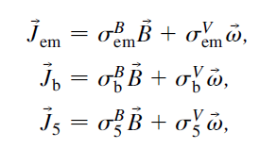





Higher order correction to CVE
Under B & vorticity
Son & Surowka
Kubo formula：
→q
q→0

Slide 31

Triangle anomaly & hydrodynamics & thermodynamics
D. T. Son & P. Surowka
Y. Neiman & Y. Oz
One-loop calculation Landsteiner et. al.
C=1/12
Kinetic theory , Stephenov, Gao et.al.
Any higher order connection to c ?
Possible relation with the gravity anomaly→ No （ Landsteiner et.al）
Coleman-Hill theorem for a field theory without gauge degrees of freedom at all→（Golkan & Son）
A field theory with gauge degrees of freedom？

Slide 32
Higher order correction to CVE

Slide 33
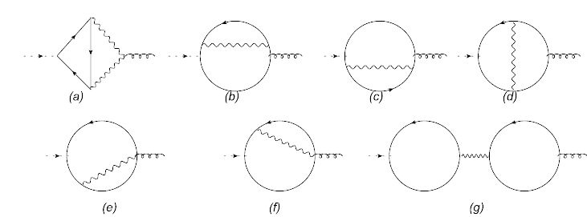



Hou,Liu,Ren, PRD86 (2012) 121703®
Are there any corrections from higher orders ?
S. Golkar and D. T. Son, arXiv:1207.5806 : No (Yes)
33

Slide 34
V. Concluding Remarks
The zero P & zero E limits of do not commute and the
difference is robust against Higer Order correction
While the CSE is expected in RHIC, its magnitude may not
reach the ideal value because of inhomogeneity
Nonrenormalization is true for most but not for all anomal.
transp. coefs . We obtained 2-loop correction to CVE coef.
Naive Wigner function can not be applicable to the case with
non-constant . The problem stems from axial anomaly .
The PV regulated WF leads consistent results
. We examine the issues raised here with lattice formulation
we obtained the same results as that in continuous case
with QFT and Wigner function method .
34

Slide 35
B.Feng, H. Liu, H-c, Ren, Y. Wu
Thank you very much for your attention!

