Slide 1
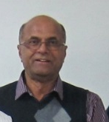
Charge separation measurements in p+Au and A(B)+A collisions; Implications for characterization of the chiral magnetic effect
Roy A. Lacey (for the STAR Collaboration)
Stony Brook University
This talk is
dedicated to the Memory of
Outline
Introduction
  Phase Diagram
  Brief Comments on the CEP (my own)
Anomalous transport & the CME
  Prior measurements & challenges
  New Measurements
    Correlator details
    Signal Identification & Quantification
Results
  p+Au, Au+Au, Cu+Au, U+U
  Future measurements
Summary
N. N. Ajitanand

Slide 2
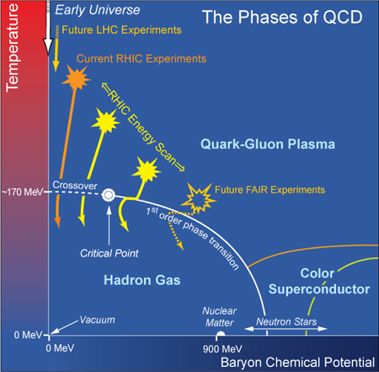
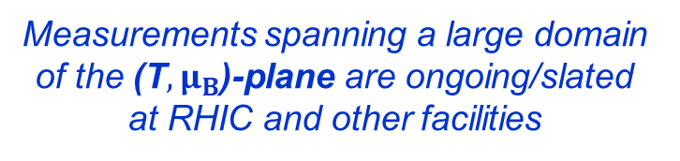
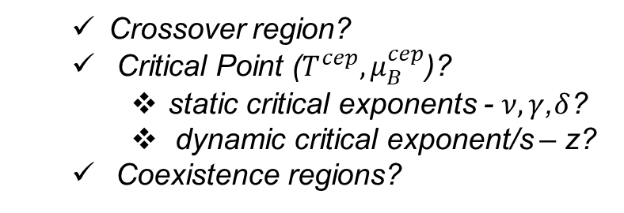
QCD Phase Diagram
Quantitative study of the QCD phase diagram is a current focus of our field
Questions of interest:
Location of the essential “landmarks”?
  Crossover region?
  Critical Point ($T^{cep}{, μ}_{B}^{cep}$)?
    static critical exponents - $ν, γ$,$δ$?
    dynamic critical exponent/s – z?
  Coexistence regions?
Properties of the respective phases?
  Thermodynamic properties?
  Topological & Chiral properties
  Transport properties?
  Anomalous chiral transport?
  etc
Measurements spanning a large domain of the (${\text{T},μ}_{B}$)-plane are ongoing/slated at RHIC and other facilities
All are required to fully chart the
phase diagram
Subject of this talk

Slide 3
Comments about the CEP
Comment - I
Meaningful discussions about the location and character of the
Critical End Point (CEP) must include Finite-size and/or Finite-time effects
Comment - II
The Generalized Finite-Size-Finite-Time Scaling form for $χ$ is well known
FSS form
FTS form
If Finite-Time Effects Dominate
If Finite-Size Effects Dominate
Utilize Finite-Size-Finite-Time Scaling of susceptibility measurements for different sizes (L)

Slide 4
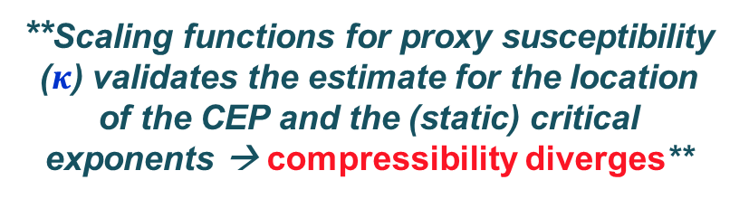
CEP estimate via finite-size scaling
RL - Phys.Rev.Lett. 114 (2015) no.14, 142301
  2nd order phase transition
  3D Ising Model (static) universality class for CEP
**The pseudocritical point (PCP) has a strong volume dependence**
**Scaling functions for proxy susceptibility ($κ$) validates the estimate for the location of the CEP and the (static) critical exponents → compressibility diverges**
Finite-Size Effects shifts $μ_{B}^{pcp}$to much lager values

Slide 5
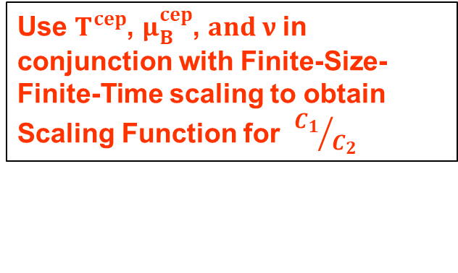
CEP estimate via Finite-Size-Finite-Time scaling
Stoki´c,et. al, Phys.Lett.B673:192-196,2009
For an isothermal change
From partition function one obtains
At the CEP the inverse compressibility → 0
Scaling properties of fluctuations data can be leveraged.
RL - arXiv:1606.08071
Use $T^{cep}$, $μ_{B}^{cep}$, $and ν$in conjunction with Finite-Size-Finite-Time scaling to obtain Scaling Function for ${C_{1}}/{C_{2}}$

Slide 6

Anomalous Transport in the QGP
Jiang et al., arXiv:1611.04586
B
Chiral Magnetic Effect
Electric
Current
Chiral Magnetic
Conductivity
Reaction
Plane $Ψ_{n}$
Chiral Chemical
potential
y
x
Non-zero
Topological charge
Kharzeev
hep-ph/0406125
The Chiral Magnetic Effect (CME) results from anomalous chiral transport of the chiral fermions in the QGP, leading to the generation of an electric current along the magnetic field generated in the collision:
→ Leads to charge separation about the event plane
Charge separation leads to a dipole term in the azimuthal distribution of the produced charged hadrons:
Objective: identify & characterize this “dipole moment”

Slide 7

Gamma correlator & its Response
Ma, Zhang
Phys.Lett. B700 (2011) 39-43
Results from AMPT
$$Ψ_{Rp}$$
Input charge separation
studied with AMPT
The Gamma Correlator’s response is similar for signal and background
  Background-driven correlations complicate CME-driven signal extraction?
switch the p_{y} values of a fraction of each set

Slide 8
Gamma correlator status quo & measurements
Local charge conservation is an especially important background
    Background-driven correlations can account for a part, or all of the observed charge separation signal?

Slide 9

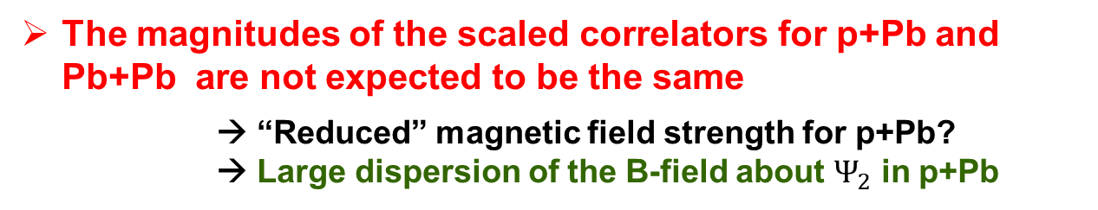


Gamma correlator status quo & measurements
Recent CMS measurements for p+Pb and Pb+Pb
at the LHC gives cause for pause!
Pb+Pb
B
$Ψ_{2}$ plane
B and $Ψ_{2}$ correlated
p+Pb
plane
B and $Ψ_{2}$ ~ uncorrelated
The magnitudes of the scaled correlators for p+Pb and Pb+Pb are not expected to be the same
      → “Reduced” magnetic field strength for p+Pb?
      → Large dispersion of the B-field about $Ψ_{2}$ in p+Pb

Slide 10
Separating signal from Background
P.Tribedy QM2017
Techniques which can reliably suppress or separate background contributions from the desired CME-driven signal
→ underway
Gamma correlator Measurements focused on ``clever” subtraction techniques
Ongoing strategy
vary the background for a fixed signal
vary the signal for fixed background
P.Tribedy QM2017
Data trend compatible with expectation from projected B-field

Slide 11
Separating signal from Background
Complimentary approach:
Focus on new measurements with an “improved” correlator which can distinguish between signal and background
A charge-sensitive in-event correlator is used to search for, and characterize CME-driven charge separation

Slide 12





“New” Correlator
A Multi-particle charge-sensitive in-event correlator is used to measure charge separation ($ΔS$) relative to the $Ψ_{2}$ plane!
N. N. Ajitanand, et al.,
Phys. Rev. C 83, 011901(R) (2011).
The Numerator is the distribution over events, of the event-by-event averaged $ΔS$
charged hadrons ($h^{∓}$)
B
n = # $h^{−}$
p = # $h^{+}$
$Ψ_{2}$ plane
→ Random shuffling of [only] the charges within an event
Numerator → carries charge separation response
Denominator → carries the “null” or charge averaged response
A second multi-particle correlator is similarly constructed for , for which contributions from CME-driven charge asymmetry vanish.
Background
Dominated
The shape and magnitude of the correlator,
is used to identify and characterize charge separation

Slide 13
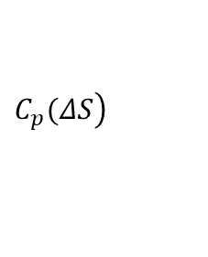




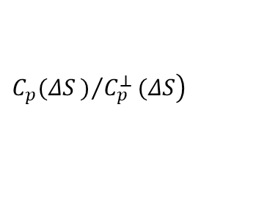
New Correlator Response
Toy model with
  Flow
  No resonance decay
  Charge separation (a₁>0)
Is “concave-shaped” for CME-driven charge separation
Is flat or “convex-shaped” for all known non-CME related backgrounds of interest
    collective flow,
    momentum conservation,
    local charge conservation
    etc.
$$\left.C_{p}(ΔS\right)$$
$$\left.C_{p}(ΔS)/{C_{p}^{⊥}}(ΔS\right)$$
$$ΔS$$
$C_{p}^{⊥}(ΔS$)
$$ΔS$$
“Concave-shaped” response for input charge separation validated
$$ΔS$$

Slide 14

New Correlator Response
AMPT model
  Flow
  Resonance decay
  Charge separation (a₁=0)
Is “concave-shaped” for CME-driven charge separation
Is flat or “convex-shaped” for all known non-CME related backgrounds of interest
Gamma correlator Results from AMPT
Non-CME background
Non-CME background
Non-CME convex-shaped background validated
  Gamma correlator’s response contrasts with that for $R(∆S)$

Slide 15

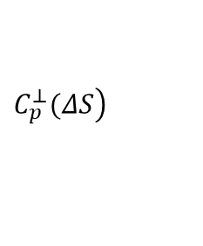

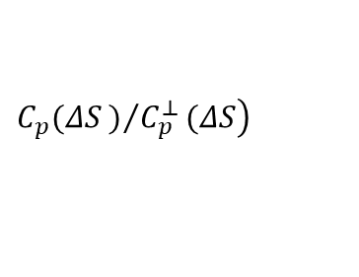
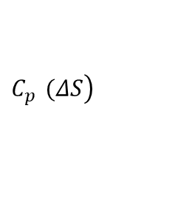

New Correlator Response
Toy model with
  Flow
  Resonance decay
  Charge separation (a₁>0)
Is “concave-shaped” for CME-driven charge separation
Is flat or “convex-shaped” for all known non-CME related backgrounds of interest
    collective flow,
    momentum conservation,
    local charge conservation
    etc.
$$\left.C_{p}^{}(ΔS\right)$$
$$\left.C_{p}(ΔS)/{C_{p}^{⊥}}(ΔS\right)$$
$$ΔS$$
$$\left.C_{p}^{⊥}(ΔS\right)$$
$$ΔS$$
“Concave-shaped” response validates charge separation input in the presence of sizeable background
$$ΔS$$

Slide 16
Signal Quantification
Data driven simulation, which takes account of the respective correlations due to anisotropic flow, resonance decays, local charge conservation, etc., can be used to quantify the magnitudes of the charge separation signals
Sampling distribution
v_{n} obtained from data
Strength of input charge separation signal
Constraints for
Relative abundance of resonances
Local charge conservation
Etc.
Anomalous Viscous Fluid Dynamics calculations
  Requisite set of constraints included
**Detailed extractions of $a_{1}^{ch}$ currently underway**

Slide 17



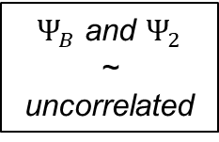

B
Signal Quantification & trends
Charge separation amplitude
$Ψ_{2,B}$ planes
Relation to Gamma Correlator
$Ψ_{B}$ and $Ψ_{2}$ correlated
System dependence
p+Au
200 GeV
plane
Chatterjee, Tribedy
PRC 92, 011902 (2015)
$Ψ_{B}$ and $Ψ_{2}$
~ uncorrelated
→ Little if any, dependence on $\sqrt{s}$
Characteristic $\sqrt{s}$, centrality and system dependence
Expected for “background-free” signal?

Slide 18
Measurements
Data sets studied:
U+U 193 GeV
Au+Au 7.7 – 200 GeV
Cu+Au 200 GeV
p+Au 200 GeV
Analysis
Charged hadrons with 0.2 < p_{T} < 2.0 GeV/c used to construct ;
Ψ_{2E} (East) for particles with 0.1 < η < 1.0
Ψ_{2W} (West) for particles with −1.0 < η < −0.1
For p+Au, Ψ₂ for the Au going side is used
for charged hadrons with 0.35 < pT < 2.0 GeV/c,
Ψ_{2W} (West) for particles in the range 0.1 < η < 1.0
Ψ_{2E} (East) for particles in the range −1.0 < η < −0.1
  Avoids auto-correlations,
  Suppress possible short-range
  non-ﬂow correlations

Slide 19



Results
System dependence - Au+Au vs. p+Au Collisions
Au+Au
B
$Ψ_{2}$ plane
$Ψ_{B}$ and $Ψ_{2}$ correlated
plane
$Ψ_{B}$ and $Ψ_{2}$ ~ uncorrelated
STAR Preliminary
A decidedly “concave-shaped” distribution for peripheral Au+Au collisions
In contrast, an essentially flat distribution for p+Au
Validates the absence of significant charge separation signal in these collisions
Indication for a CME-driven charge separation contribution in these collisions
  “reduced magnetic field strength”
  random B-field orientations

Slide 20

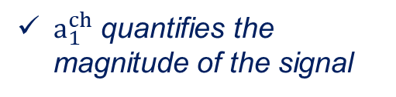

Results
$\sqrt{s_{NN}}$ dependence – Au+Au Collisions
STAR Preliminary
$a_{1}^{ch}$ quantifies the magnitude of the signal
Concave-shaped distributions validate CME-driven charge separation in Au+Au collisions at each beam energy
Chatterjee, Tribedy
PRC 92, 011902 (2015)
Signal variation consistent with expectation
Indications for weak $\sqrt{s}$ dependence of the charge separation signal!

Slide 21

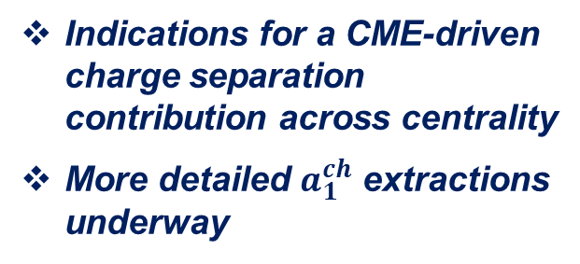
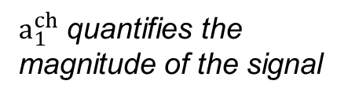
Results
Centrality dependence – Au+Au @$\sqrt{s_{NN}}$ = 39 GeV
STAR Preliminary
$a_{1}^{ch}$ quantifies the magnitude of the signal
Wei-Tian et. Al. Phys.Rev. C85 (2012) 044907
Indications for a CME-driven charge separation contribution across centrality
  More detailed $a_{1}^{ch}$ extractions underway
Chatterjee, Tribedy
PRC 92, 011902 (2015)
Centrality dependence of $a_{1}^{ch}$ expected to follow the trend of the magnetic field

Slide 22
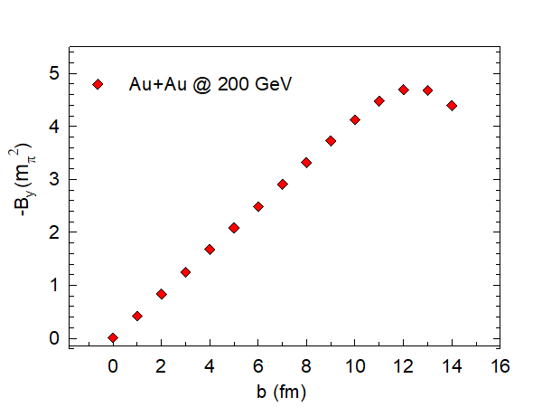

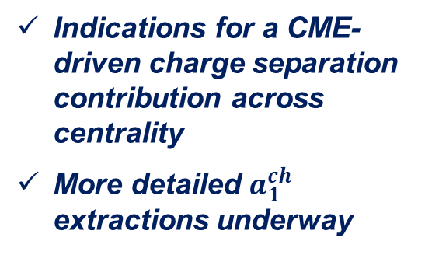
Results
Centrality dependence – Au+Au @ $\sqrt{s_{NN}}$= 200 GeV
STAR Preliminary
Indications for a CME-driven charge separation contribution across centrality
  More detailed $a_{1}^{ch}$ extractions underway
Similar centrality dependent charge separation pattern expected for $\sqrt{s}$ = 200 GeV?

Slide 23

Results
Centrality dependence – Cu+Au @ $\sqrt{s_{NN}}$=200 GeV
STAR Preliminary
Indications for a CME-driven charge separation contribution across centrality
  More detailed $a_{1}^{ch}$ extractions underway
200 GeV
Similar magnitude and centrality dependence expected for $a_{1}^{ch}$ for Cu+Au @$\sqrt{s_{NN}}$ = 200 GeV?

Slide 24

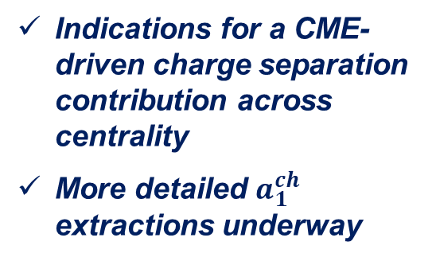
Results
Centrality dependence – U+U @ $\sqrt{s_{NN}}$ = 193 GeV
STAR Preliminary
Indications for a CME-driven charge separation contribution across centrality
  More detailed $a_{1}^{ch}$ extractions underway
Similar centrality dependence but smaller magnitudes for $a_{1}^{ch}$ for $U+U$?

Slide 25
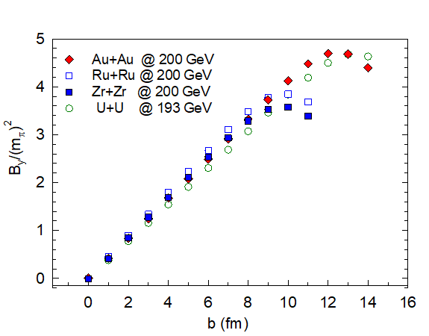

Near-term Horizon
STAR Preliminary
p+A measurements used as an important bench mark for identification of CME-driven charge separation in A(B)+A collisions → this work !!
Refined extractions of $a_{1}^{ch}$ - underway
Further leveraging of the system dependence of charge separation is planned for the near term

Slide 26
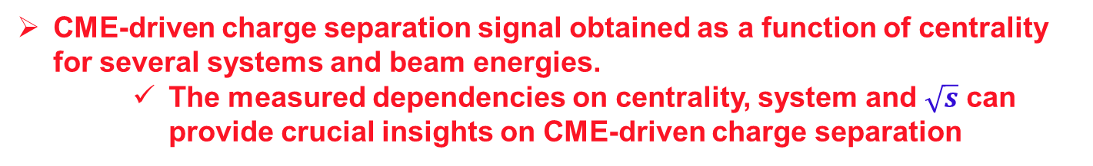
Summary
New charge-sensitive correlator used to to perform charge separation measurements for charged hadrons in p+Au and A(B)+A collisions
  This correlator gives distinct responses for CME-driven charge separation and non-CME background
  well suited for identification and characterization of CME-driven charge separation.
For A(B)+A collisions, shows a characteristic concave shape, indicative of a non-zero CME-driven charge separation signal.
  In contrast, the measurements for p+Au collisions show an approximately flat distribution consistent with the “reduced” magnetic field strength and random B-field orientations generated in these collisions.
CME-driven charge separation signal obtained as a function of centrality for several systems and beam energies.
    The measured dependencies on centrality, system and $\sqrt{s}$ can provide crucial insights on CME-driven charge separation

Slide 27
End

Slide 28
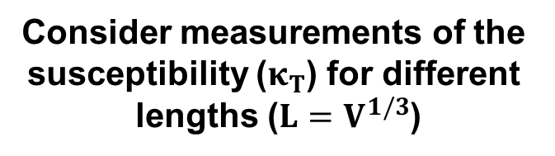
The Blessings of Finite-Size
critical exponents
Consider measurements of the
susceptibility ($κ_{T}$) for different
lengths ($L=V^{1/3}$)
M. Suzuki, Prog. Theor. Phys. 58, 1142, 1977
Finite-size effects lead to specific dependencies of the peak heights, widths & positions on L
L scales
the volume
The scaling of these dependencies give access to the CEP’s location, critical exponents and a non-singular scaling function.

Slide 29
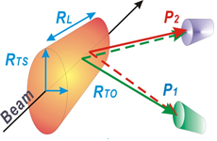
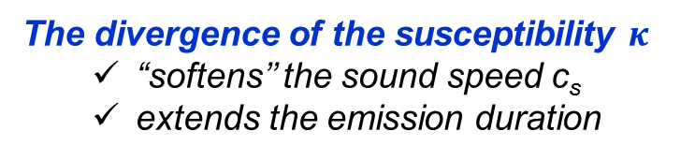

Interferometry as a susceptibility proxy
Hung, Shuryak, PRL. 75,4003 (95)
The radii of the “fireball” encode
space-time information for
the reaction dynamics
T. Csörgő. and B. Lörstad, PRC54 (1996) 1390-1403
Chapman, Scotto, Heinz, PRL.74.4400 (95)
Makhlin, Sinyukov, ZPC.39.69 (88)
emission
duration
The divergence of the susceptibility $κ_{}$
  “softens’’ the sound speed c_{s}
  extends the emission duration
(R²_{out} - R²_{side}) sensitive to the $κ_{}$
emission
lifetime
  (R_{side} - R_{init})/ R_{long} sensitive to c_{s}
Specific non-monotonic patterns expected as a function of √s_{NN}
  A maximum for (R²_{out} - R²_{side})
  A minimum for (R_{side} - R_{initial})/R_{long}

