Slide 1
RHIC Update & Future Program
Berndt Mueller (BNL)
BES Workshop
Fudan University
August 15-18, 2017

Slide 2
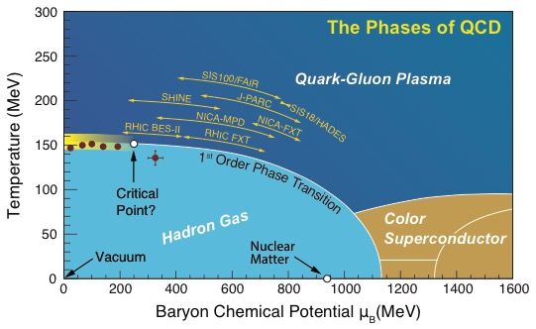
RHIC: A Unique Facility
The world’s most versatile facility for the exploration of the phases of QCD matter from high temperature to high baryon density.
The world’s first and only polarized proton collider and explores properties of the proton’s spin.
RHIC
RHIC discoveries include:
The quark-gluon plasma is a “perfect liquid”.
Jet quenching in QCD matter.
Gluons make a substantial contribution to the proton spin.

Slide 3
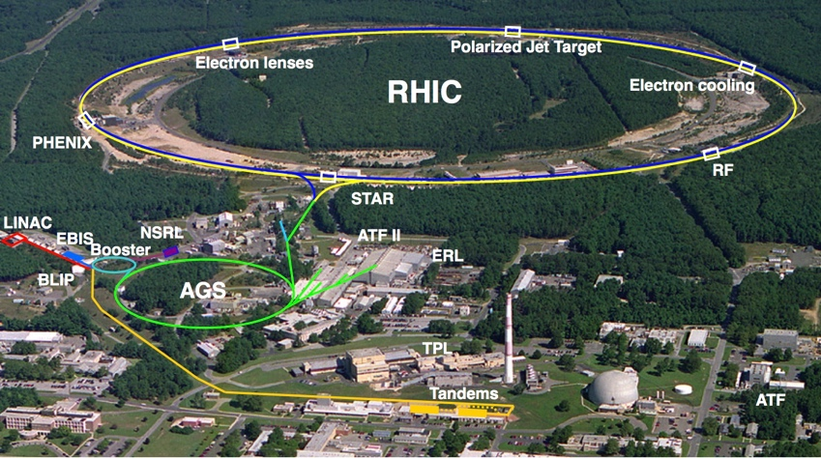
RHIC’s Physics Program is Rich
Quark Gluon Plasma
QCD Phase Diagram
Gluon Saturation
Parton Energy Loss
Parton Correlations
Transverse Spin Dynamics
Hadron Formation
Nuclear parton densities
Proton Spin
Structure
Nuclear Tomography by UPC

Slide 4
RHIC Delivers Whatever it Takes
In 2016 RHIC collided deuterons with gold ions at four different energies with setup times as low as 0.8 days between energies.

Slide 5
Record Luminosity and Aiming for More
Au+Au
@ RHIC
Average store luminosity for Au+Au has now reached 44 times the design value. In 10 minutes RHIC today produces more collisions than during the entire commissioning run in 2000.
Electron cooling for the Beam Energy Scan II (BES-II) aims for a four-fold increase at the three lowest energies of the scan.
A three-fold increase at the two highest energies is possible without cooling, and has been demonstrated in 2016.

Slide 6
RHIC Program Since 2015
Run 2015:
  Transverse and longitudinally polarized p+p at √s_{NN} = 200 GeV
  Baseline comparison runs (p+p. p+Au) for heavy flavor program
  Polarized p+Au and p+Al at √s_{NN} = 200 GeV
  Gluon helicity; transverse spin in QCD; nuclear PDFs
Run 2016:
  High statistics Au+Au at √s_{NN} = 200 GeV
  Precision measurement of heavy flavor dynamics in the QGP
  d+Au beam energy scan
  Energy dependence of collective flow in small systems
Run 2017 (ongoing):
  High luminosity transverse polarized p+p at √s_{NN} = 510 GeV
  Study of scale evolution of the transverse momentum dependent parton distributions and sign change of the Sivers function
  Au+Au at √s_{NN} = 53 GeV
  Study of longitudinal correlations in QGP initial conditions & energy dependence of jet quenching

Slide 7

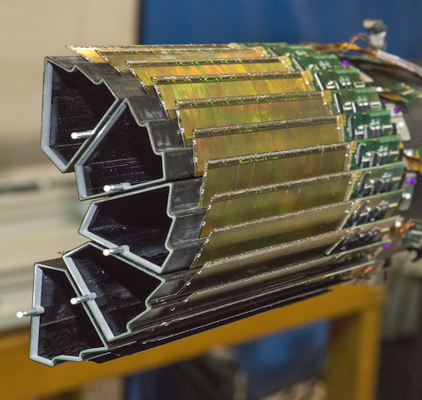
RHIC Highlight (1): Flow
Elliptic flow of D0 mesons (charm quarks)
PRL 118 (2017) 212301
Heavy Flavor Tracker: >10-year development - first use in a collider experiment
Enabling technology: High-precision low-mass Monolithic" Active Pixels
Result: Charm quarks flow just as well as lighter quarks – “Perfect liquid”

Slide 8
RHIC Highlight (2): Flow
Phys. Rev. C 95 (2017) 034910
PHENIX Preliminary
Signatures of collective flow exist even in the smallest systems and at the lowest RHIC energies
PHENIX Preliminary

Slide 9
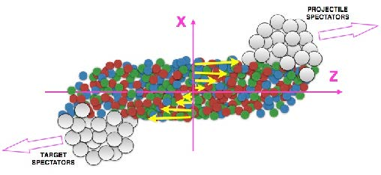
RHIC Highlight (3): The most vortical fluid
Global collision angular momentum generates QGP vorticity
accepted by Nature
Global Lambda Polarization is signal of vorticity
  Strongest signal at Beam Energy Scan (BES-II) energies
Signal is consistent with vorticity ω = (9 ± 1) x 10²¹s⁻¹, greater than previously observed in any system, including nuclei in high-spin states
  Holds potential for measurement of late time magnetic field in BES-II

Slide 10
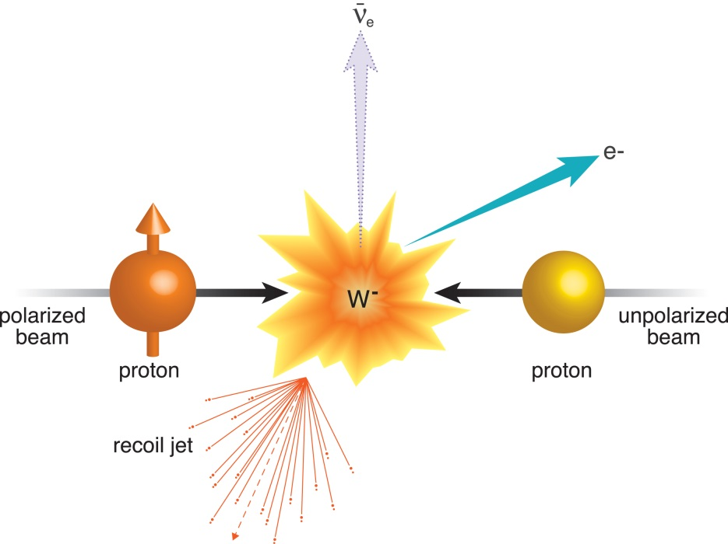
RHIC Highlight (4): Transverse spin in QCD
2011 Run established feasibility – results favor a TMD Sivers function sign change, but are not definitive (~2σ)
2017 Spin Run will yield a definitive test, including TMD evolution with scale, which is important for EIC predictions
Phys. Rev. Lett. 116 (2016) 132301
Scale evolution of the Sivers effect will be measured comparing W-production with DY e+e− pair production at 5−10 GeV

Slide 11
RHIC Future Plans
Run 2018:
  High statistics isobar system (⁹⁶Ru - ⁹⁶Zr) comparison run
  Test of signatures of Chiral Symmetry Restoration in the QGP
  27 GeV Au+Au (3 weeks) & 3 GeV Au+Au (2 days fixed target)
  Λ hyperon polarization & net proton fluctuations
Completion of the Low-Energy electron Cooling Upgrade
Installation of STAR inner TPC Upgrade
Runs 2019-20:
  High statistics Au+Au beam energy scan (√s_{NN} = 7−20 GeV)
  Search for signs of critical phenomena in event-by-event fluctuations, including search for a critical point
Completion and Installation of the sPHENIX Upgrade
Runs 2022++:
  Au+Au, polarized p+p, p+Au √s_{NN} = 200 GeV
  Precision measurements of fully resolved jets and Upsilon states using the new sPHENIX detector (received CD-0 in 2016
  Cold QCD measurements to unambiguously separate intrinsic properties of nuclei from process dependent phenomena (EIC!)

Slide 12
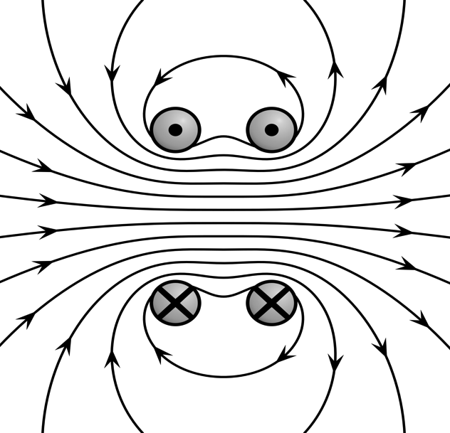
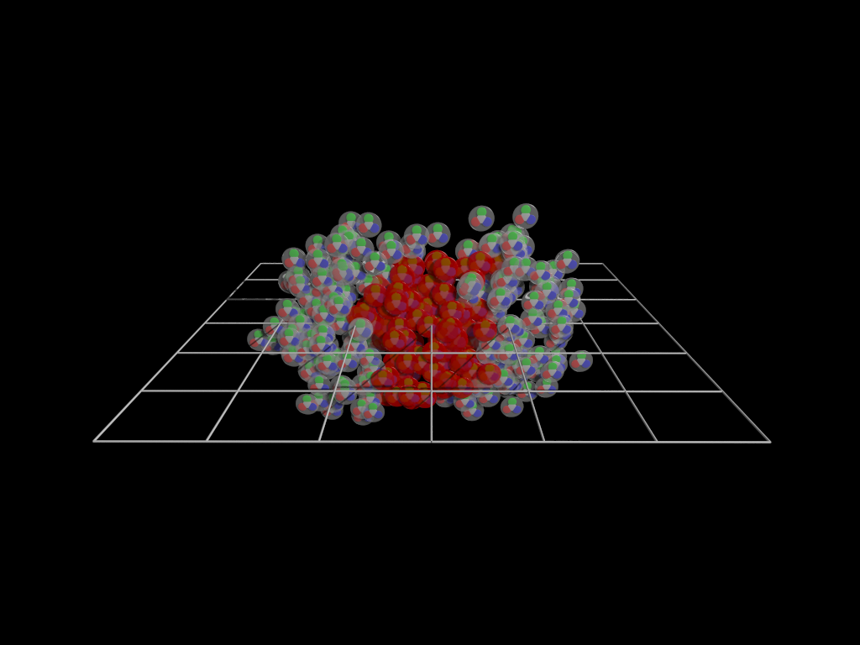
RHIC Future (1): Chiral Symmetry & Topology
Topology is a fundamental characteristic of QCD
Observation of topological field fluctuations requires
- (nearly) massless quarks = chiral symmetry
- superstrong magnetic fields
Heavy ion collisions provide both!
The chiral anomaly of QCD creates local fluctuations in the number of left and right handed quarks
+
B=10¹⁷ Gauss
-
An excess of right- or left-handed quarks will cause an electric current to flow along the magnetic field: Chiral Magnetic Effect (CME)
When clearly established experimentally, the CME provides for an unambiguous signal of chiral symmetry restoration.
4/25/17
12

Slide 13
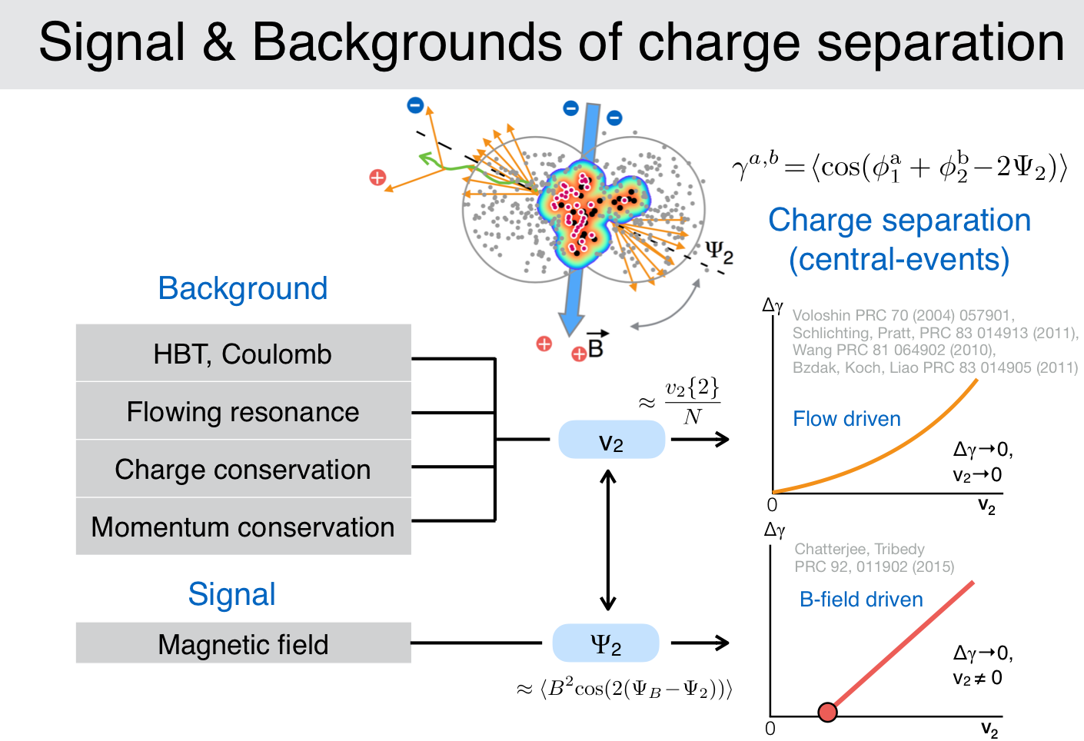
P. Tribedy, QM2017

Slide 14
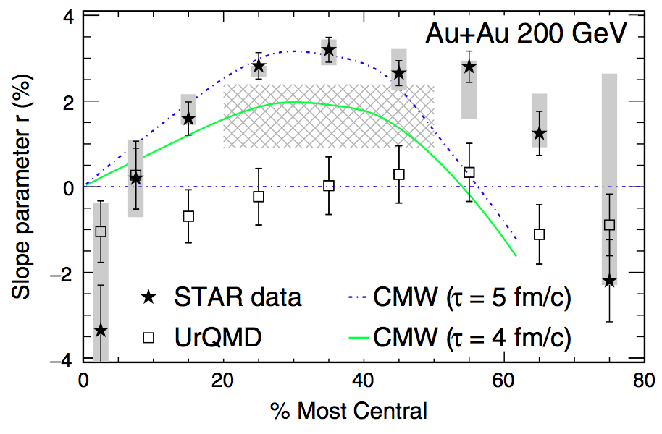
Phenomenology
Chiral Magnetic Wave?
U+U and Au+Au central data:
Intercept at non-zero v₂
Measured kaon slope is positive; was predicted to be negative in background model without CMW

Slide 15
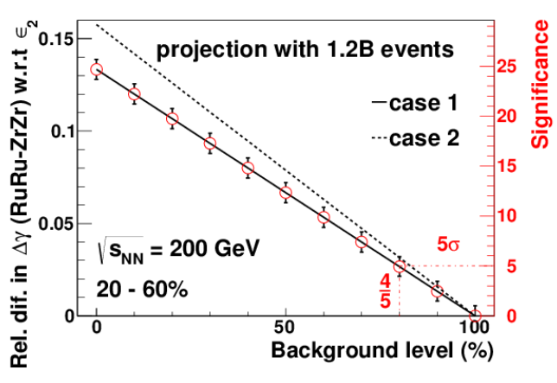
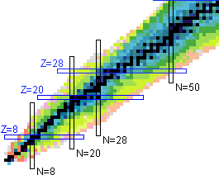
RHIC Future (1): Chiral Symmetry & Topology
Various signals of fluctuating charge separation with respect to the reaction plane have been observed, but these could be caused by background effects in correlation with elliptic flow.
The isobar comparison run in 2018 can tell us to with +/- 6% precision
what fraction of the observed charge separation is due to the CME.
4/25/17

Slide 16
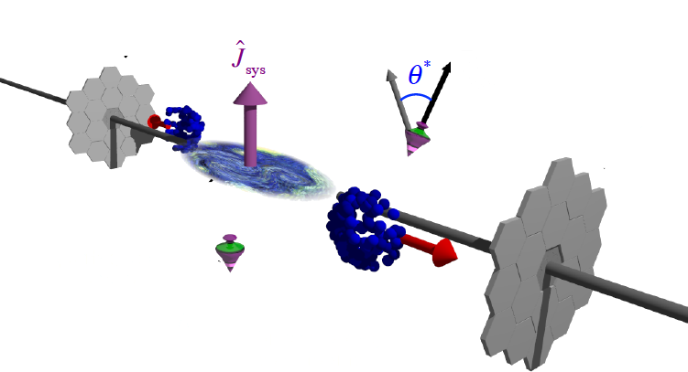
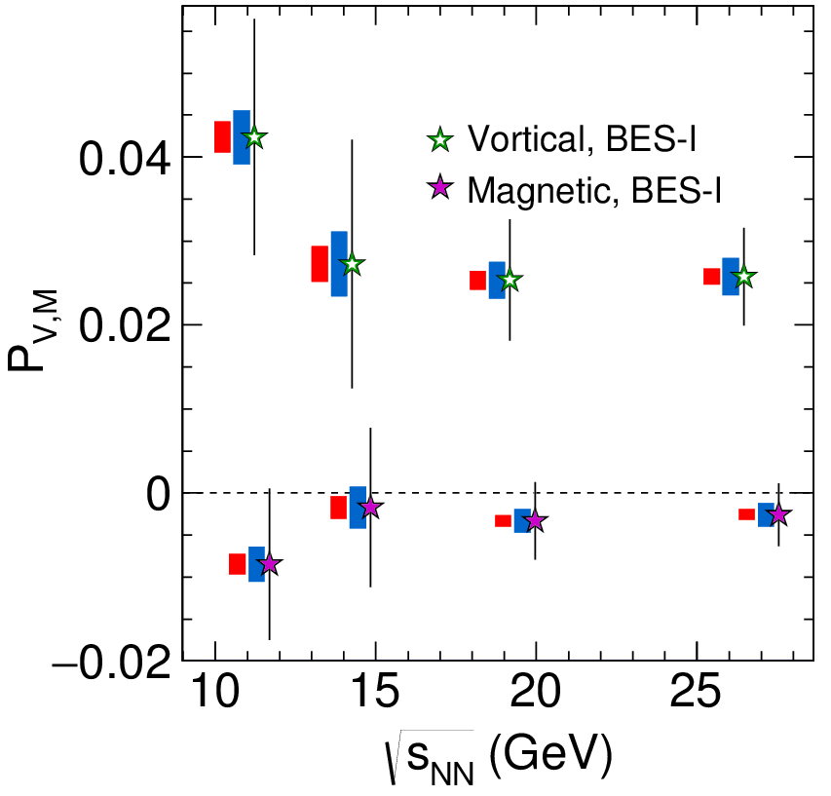
Global Λ polarization
27 GeV Au+Au run will increase statistics by factor 10 & improve reaction plane resolution
New tool to study QGP and relativistic quantum fluid vorticity
Global angular momentum
transfer to hyperon polarization
Late time magnetic field would generate difference between hyperons and antihyperons

Slide 17
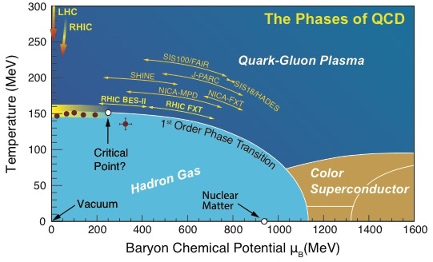
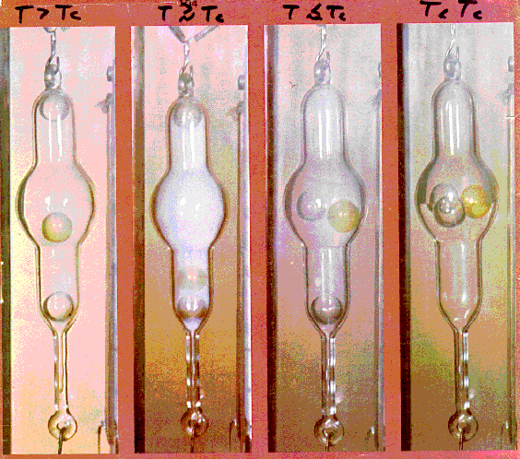
RHIC Future (2): Doping the QGP to Criticality
Critical Opalescence near a critical point is indicative of long-range fluctuations
In the QGP critical behavior is predicted to be reached by doping with net baryons (protons)
Most robust signal of criticality is a characteristic change in the non-Gaussian distribution of event-by-event net proton fluctuations
4/25/17

Slide 18
Anomalies in the Pressure?
Maximum in lifetime?
Minimum in pressure?
Region of interest √s_{NN}≲20 GeV, however, is complicated by a changing B/M ratio, baryon transport dynamics, longer nuclear crossing times, etc.
Requires concerted modeling effort: the work of the BESTheory topical collaboration is essential

Slide 19
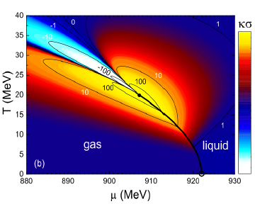
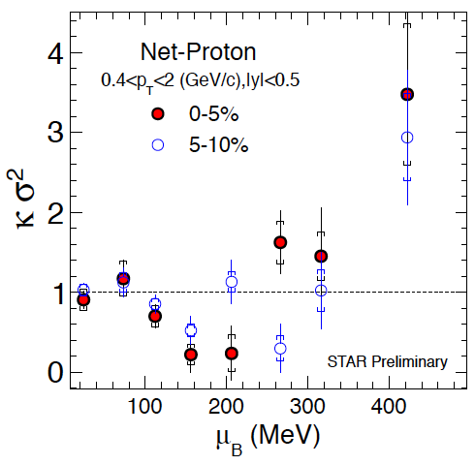
Critical behavior
The moments of the distributions of conserved charges are related to susceptibilities and are sensitive to critical fluctuations
Higher moments like kurtosis change sign at the critical point
Non-monotonic trend observed in BES-I with limited statistical precision

Slide 20
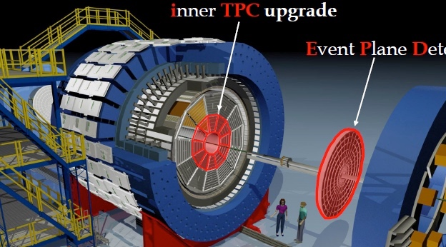
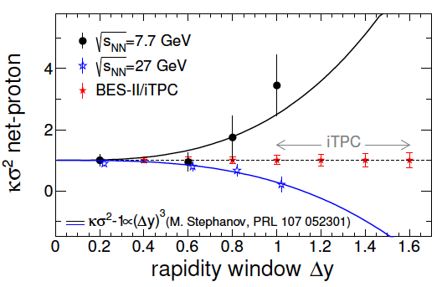
Mapping the QCD phase diagram
Higher statistics
Low energy RHIC electron cooling upgrade
Larger acceptance

Slide 21
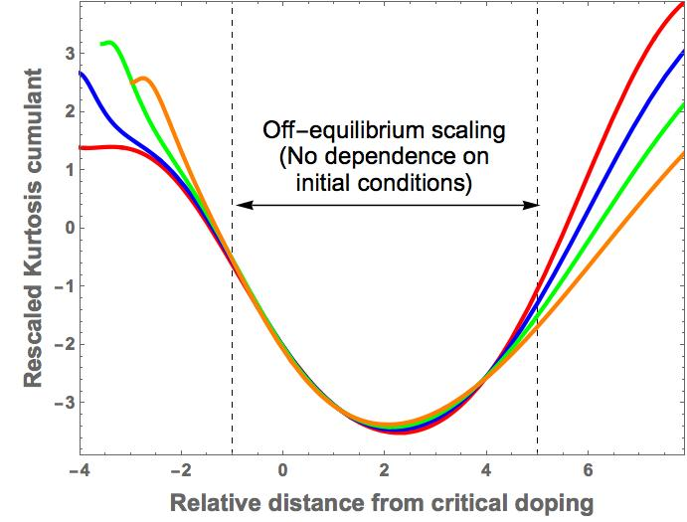
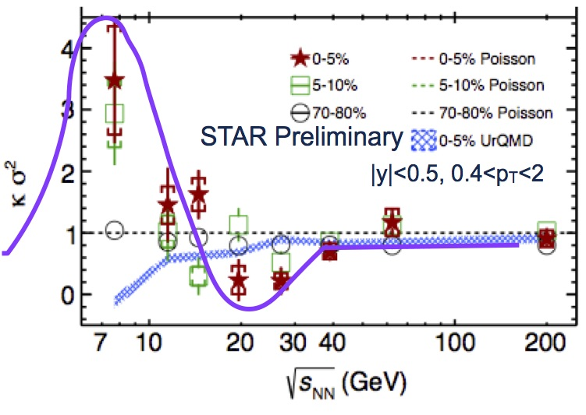
Critical signature: Net-proton kurtosis
Near a critical point, the correlation length of fluctuations diverges; kurtosis (κ−1) of the net-proton distribution changes sign
Expected behavior near critical point
Net-baryon/proton density of the QGP is controlled by the collision energy
S. Mukerjee, R. Venugopalan & Yi Yin
Relative distance from critical doping
BES I provided a tantalizing hint, but with insufficient precision

Slide 22
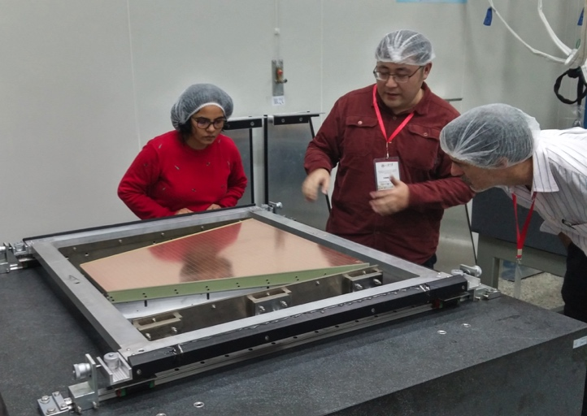
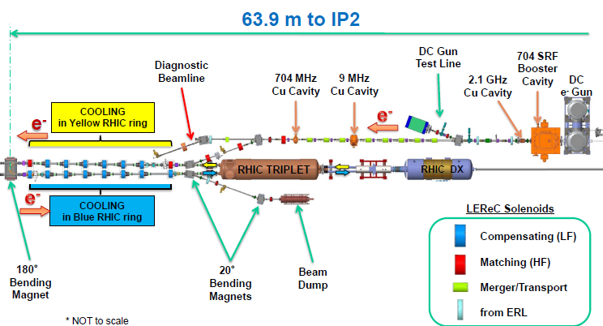
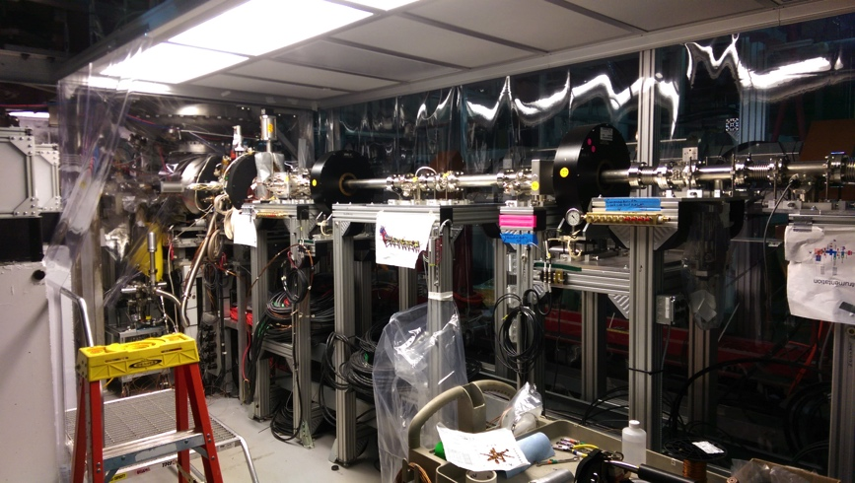
Upgrades for BES-II
Large international contributions
Enhanced detector coverage
Beam cooling for increased luminosity

Slide 23
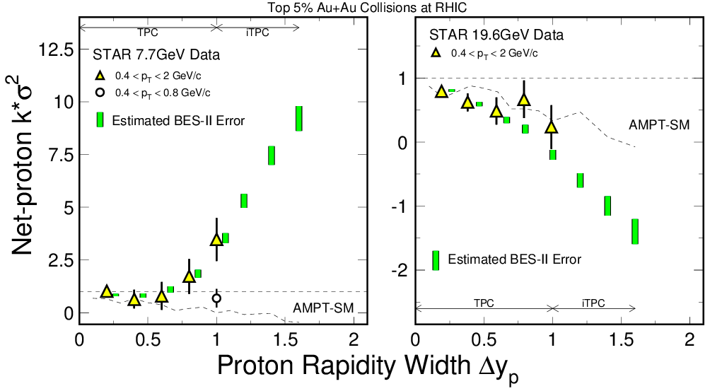
LEReC and iTPC Acceptance
BES-I
BES-I
Kurtosis (fourth-order fluctuations) signal grows like (Δy)³
Detector coverage is critical for a definitive measurement
Increased luminosity reduces error bars

Slide 24
Run 19 BUR Summary
Run 18: √s_{NN} = 3 GeV(FXT) 2 days Au+Au 100M MB
Run 20: √s_{NN} = 9.1 GeV Au+Au
√s_{NN} = 7.7 GeV Au+Au

Slide 25
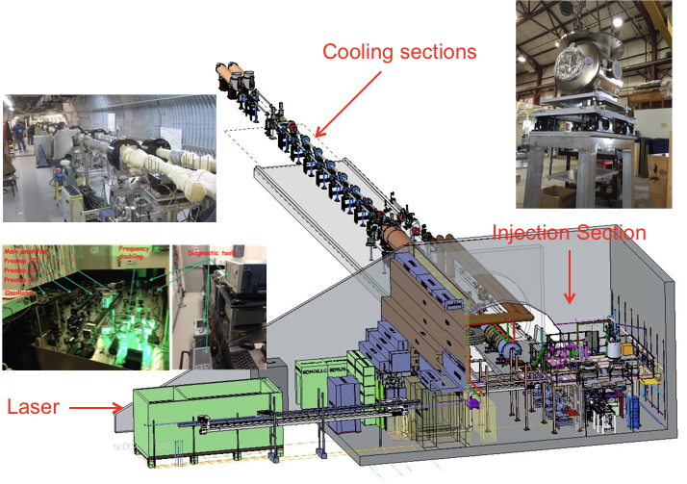
LEReC Setup

Slide 26
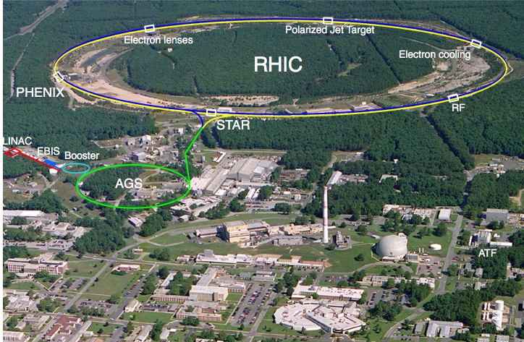
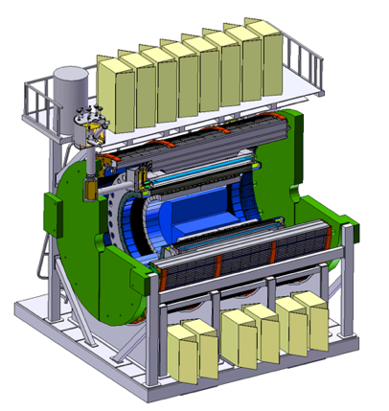
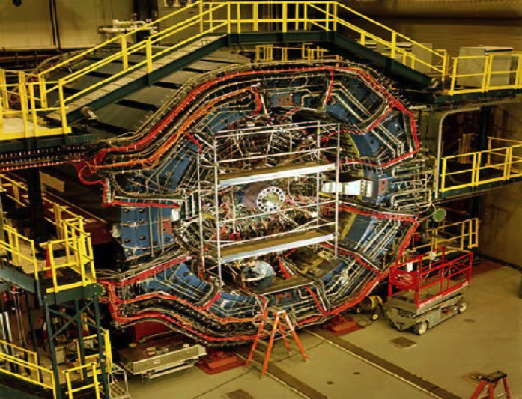
The RHIC Facility in the 2020s
s

Slide 27
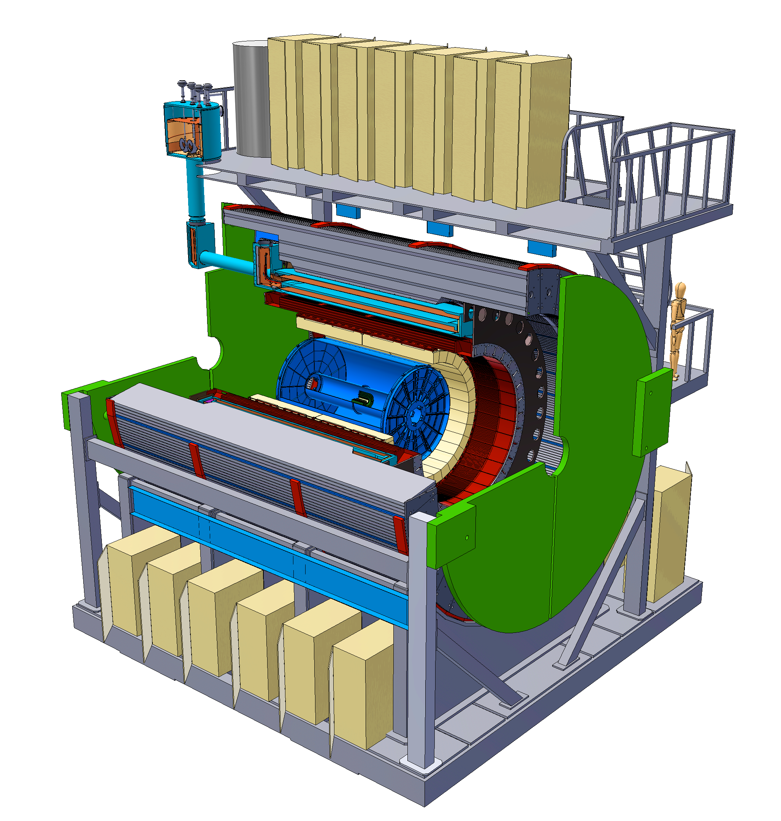
RHIC Future (3): sPHENIX
State-of-the-art jet (and Upsilon & open heavy flavor) detector
SC BaBar Solenoid 1.5 T
Coverage |η| ≤ 1.1
Inner Si Tracking
Fast TPC w/GEM Read-out
Projective Electromagnetic
Calorimeter
Hadronic Calorimeter
Capable of sampling 600 billion Au+Au interactions and recording 100 billion min bias events per year

Slide 28
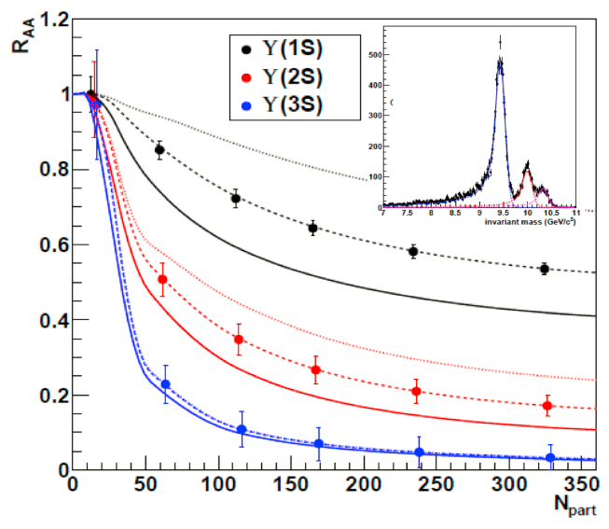
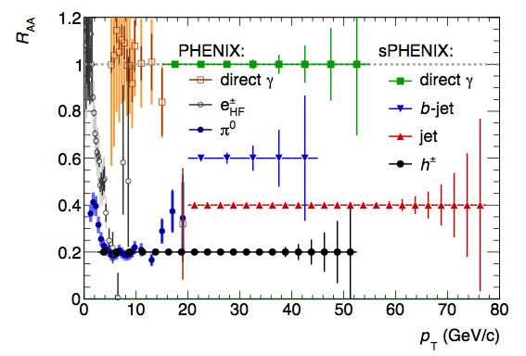
Jets & Upsilon states
sPHENIX
capabilities
Complete calorimetric
jet spectroscopy
Completely resolved
Upsilon spectroscopy

Slide 29
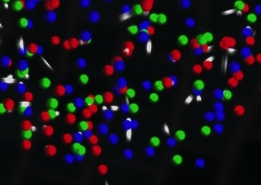
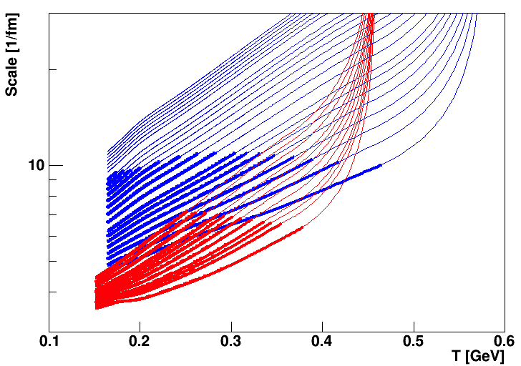
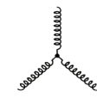



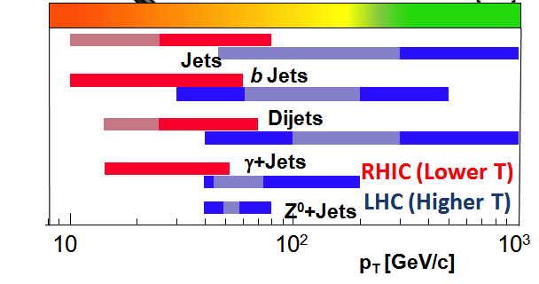
Jet Probes of QCD Structure
Bare Color Charges
Parton virtuality evolves quickly and is sensitive to the medium at the scale it probes
RHIC Jet Probes
LHC Jet Probes
QGP Influence
Thermal Mass Gluons
Structureless Fluid
Unique critical microscope resolution range at RHIC
Kinematic overlap between RHIC and LHC provides complementarity
29

Slide 30
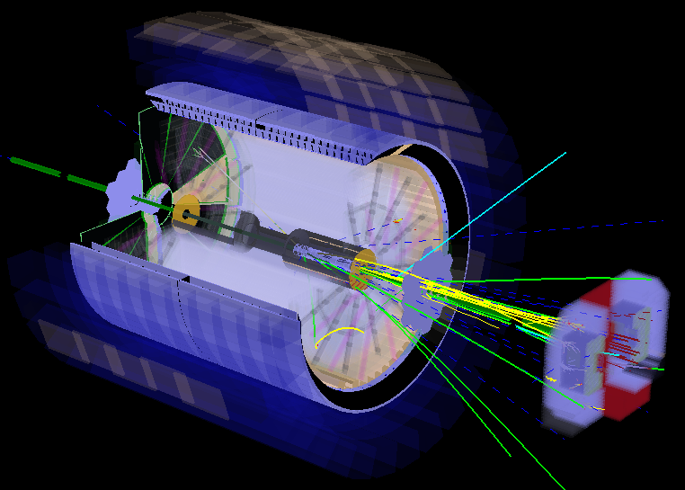
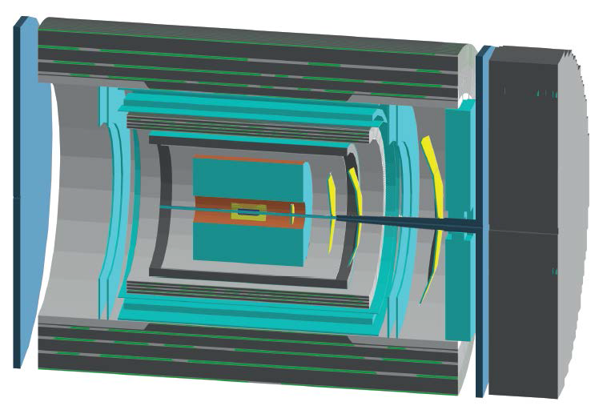
New Opportunities
Addition of forward detector components to STAR and/or sPHENIX to explore cold QCD matter effects in p+p, p+A, and A+A collisions.
Main components of forward upgrades (cost: ~$5-7M):
EM and Hadronic Calorimeters, Tracking (Si and/or sTGC/GEM).
STAR
sPHENIX

Slide 31
Forward pp,pA, AA physics
p+p: Origin of large A_{N} at high x_{F} and rapidity, universality (EIC)
p+A: Gluon saturation & universality (EIC)
A+A: Nuclear PDFs, gluon saturation, transverse parton distributions

Slide 32
“What RHIC Will Deliver”
Campaign 1 (2014-17):
  QCD equation of state at μB ≈ 0
  Precision measurement of η/s(T≈Tc)
  Measurement of heavy quark diffusion constant Dc/b
  Measurement of x-dependence of nuclear granularity
  Origin of single spin asymmetries
  ΔG, flavor dependence of spin in the quark sea
  QGP vorticity [not anticipated in 2015]
Campaign 2 (2018-20):
  Chiral symmetry restoration via CME
  QCD equation of state at μB > 0
  Discovery of the QCD critical point, if within the accessible range
Campaign 3 (>2020):
  Precision measurement of q^(T≈Tc) and e^(T≈Tc)
  Determine length scale where the QGP becomes a liquid
  Cold QCD measurements critical to EIC physics

Slide 33
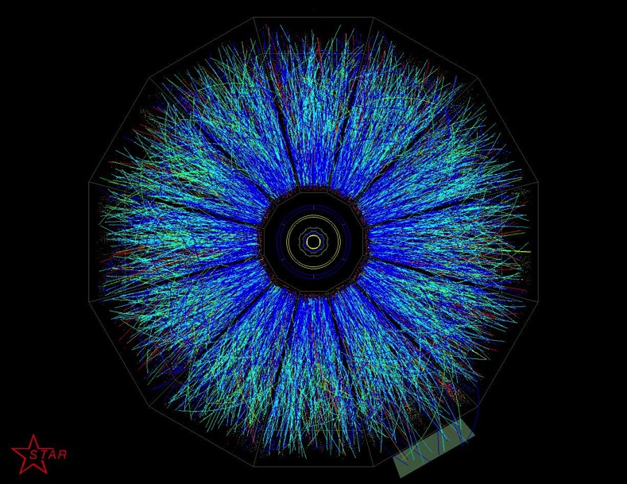
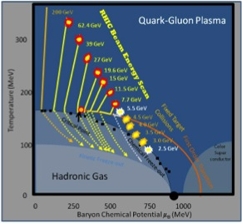

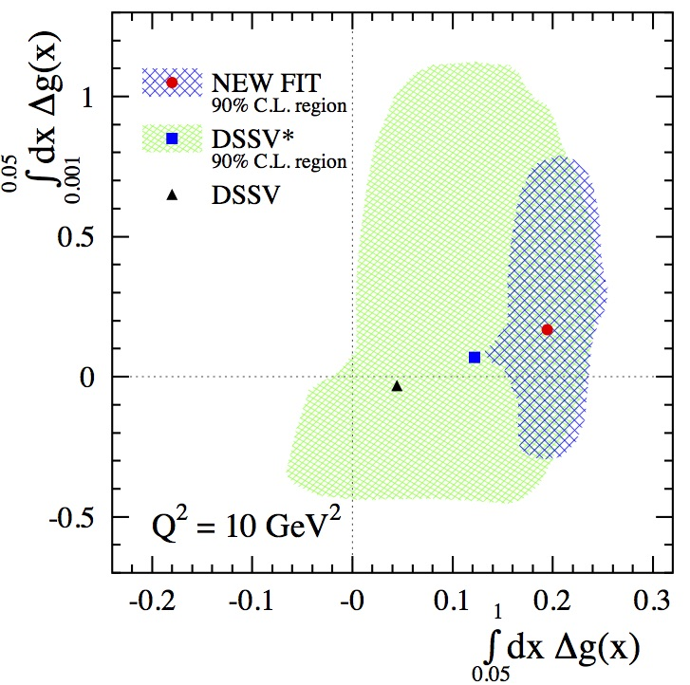
The RICH Opportunities of RHIC
STAR iTPC
BES II
RHIC
Spin
ΔG
sPHENIX

