Slide 1


Aug. 15-18, 2017, Phases of QCD and BES Program, Fudan University, Shanghai
Constraint on viscosity of QCD matter during first-order phase transition
Zhe Xu

Slide 2
Outline
Motivation
EoS
Viscous Effects
Results
Summary

Slide 3


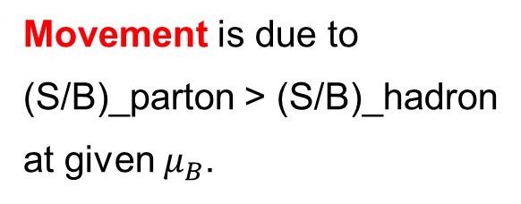
Motivation - QCD Phase Diagram
Movement is due to
(S/B)_parton > (S/B)_hadron
at given $μ_{B}$.

Slide 4
Motivation - Questions
First order phase transition: seperation and coexistence of
different phases at thermal equilibrium
How does this picture change, if the QCD matter is viscous?
How large are the viscosity allowed, in order to maintain the first-order phase transition?

Slide 5
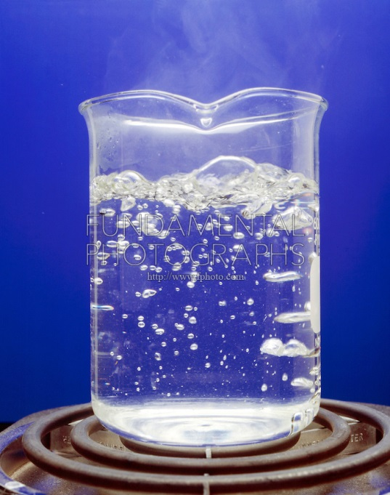


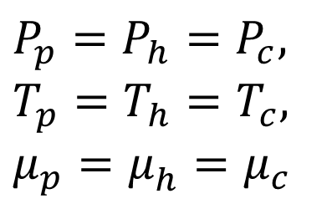
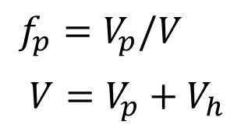
Motivation - Picture and Assumptions
Hadron bubbles
Gibbs condition
NO
YES
$$P_{p}=P_{h}=P_{c},$$
$$T_{p}^{}=T_{h}=T_{c},$$
$$μ_{p}=μ_{h}^{}=μ_{c}$$
a volume element
hadrons $V_{h}$
partonic fraction
partons $V_{p}$
$$f_{p}=V_{p}/V$$
$$V=V_{p}+V_{h}$$

Slide 6
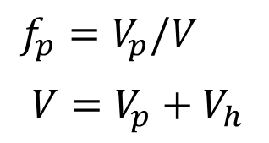
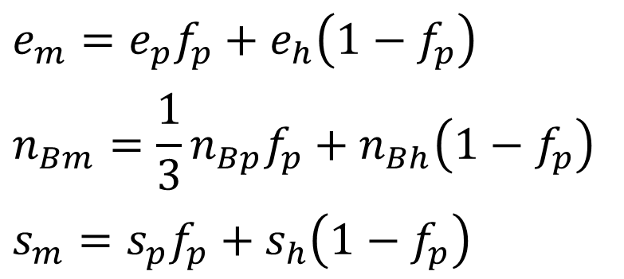


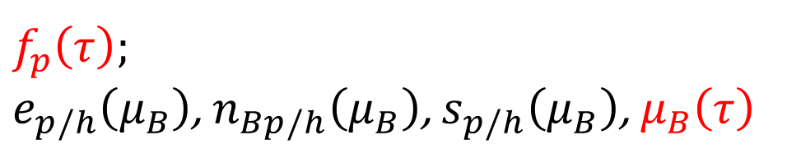
Motivation - Picture and Assumptions
a volume element
hadrons $V_{h}$
partonic fraction
partons $V_{p}$
$$f_{p}=V_{p}/V$$
$$V=V_{p}+V_{h}$$
$$e_{m}=e_{p}f_{p}+e_{h}\left(1−f_{p}\right)$$
$$n_{Bm}=\frac{1}{3}n_{Bp}f_{p}+n_{Bh}\left(1−f_{p}\right)$$
$$s_{m}=s_{p}f_{p}+s_{h}\left(1−f_{p}\right)$$
$f_{p}\left(τ\right)$;
$e_{p/h}\left(μ_{B}\right)$, $n_{Bp/h}\left(μ_{B}\right)$, $s_{p/h}\left(μ_{B}\right)$, $μ_{B}\left(τ\right)$

Slide 7
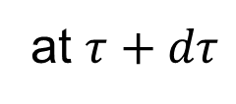
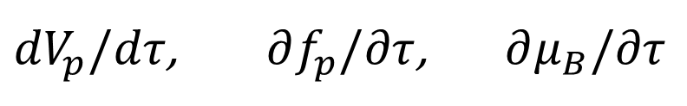
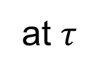
Motivation – To calculate
at $τ$
at $τ+dτ$
$$V→V+dV, V_{p}→V_{p}+dV_{p}, V_{h}→V_{h}+dV_{h}$$
to calculate
${dV}_{p}/dτ$, $∂f_{p}/∂τ$, $∂μ_{B}/∂τ$
and to look at the viscous effects.

Slide 8
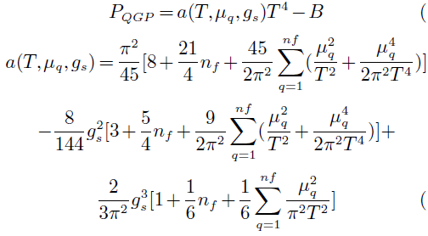
EoS - Models
partonic phase: MIT bag model
hadronic phase: resonance gas (mass < 2 GeV)
with repulsive interactions among
(anti) baryons

Slide 9
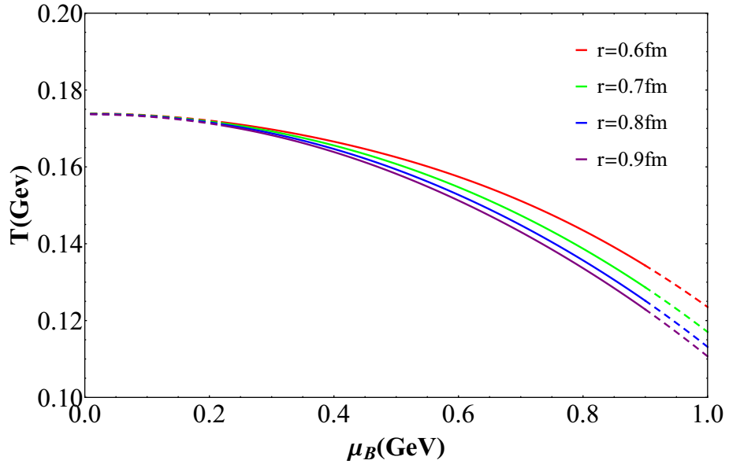
EoS – Phase Diagram
r: same hard sphere radius
for all baryons
by Bohao Feng

Slide 10
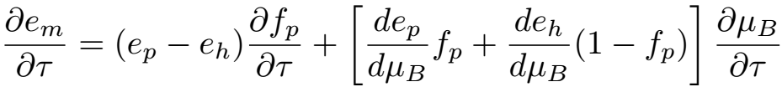
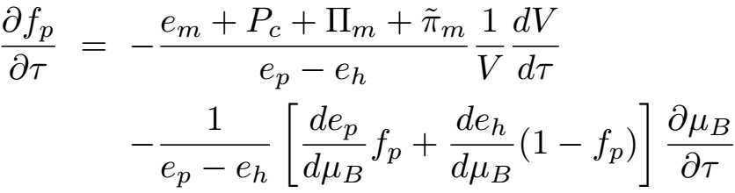
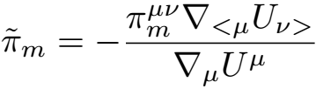

Viscous effects
from phase separation
$$e_{m}=e_{p}f_{p}+e_{h}\left(1−f_{p}\right)$$
from hydro equation
with

Slide 11

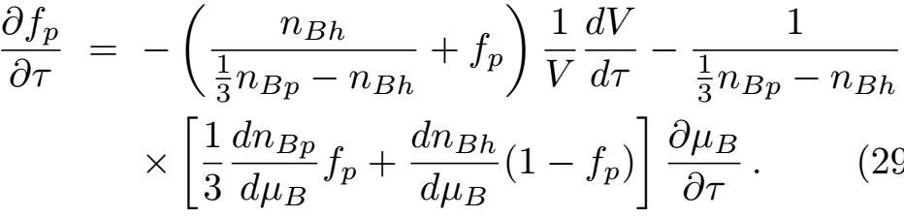
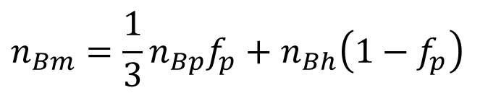
Viscous effects
$$n_{Bm}=\frac{1}{3}n_{Bp}f_{p}+n_{Bh}\left(1−f_{p}\right)$$
analogously
from hydro equation

Slide 12
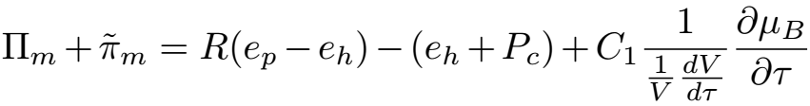
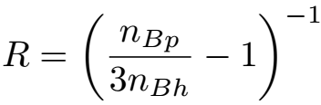
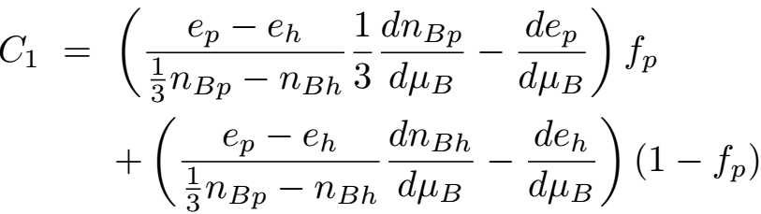
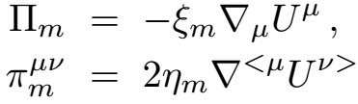
Viscous effects
We have
with
assume first-order hydro
knowing $η_{p/h}, ξ_{p/h}, U^{μ}→∂μ_{B}/∂τ→∂f_{p}/∂τ→f_{p}$

Slide 13

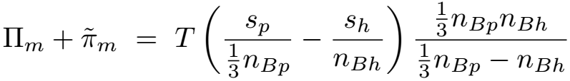
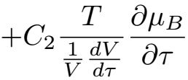
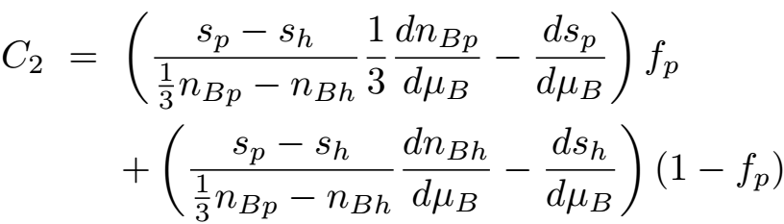
Viscous effects
remember
entropy density
with

Slide 14
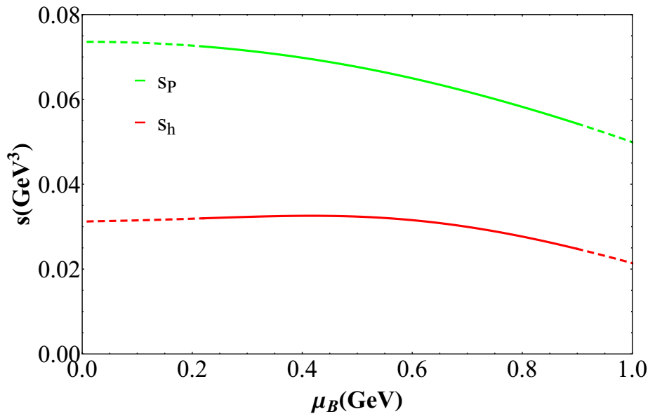
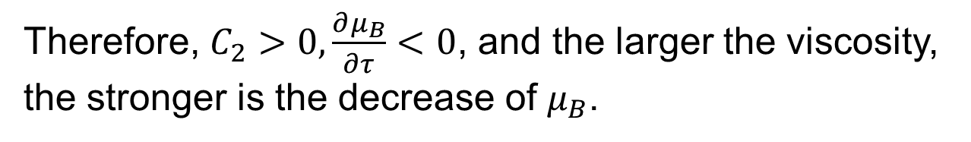
Viscous effects
by Bohao Feng
Therefore, $C_{2}>0,\frac{∂μ_{B}}{∂τ}<0$, and the larger the viscosity, the stronger is the decrease of $μ_{B}$.

Slide 15
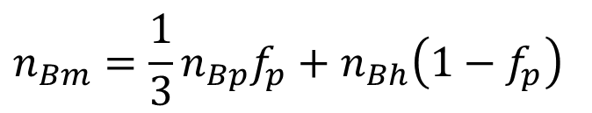
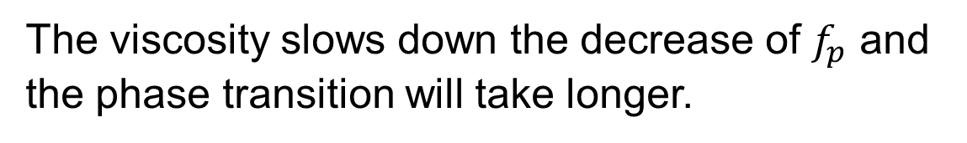
Viscous effects
$$n_{Bm}=\frac{1}{3}n_{Bp}f_{p}+n_{Bh}\left(1−f_{p}\right)$$
analogously
from hydro equation
The viscosity slows down the decrease of $f_{p}$ and the phase transition will take longer.

Slide 16
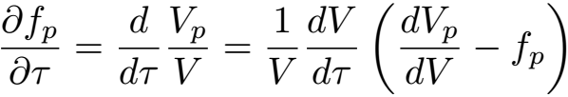
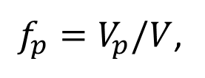
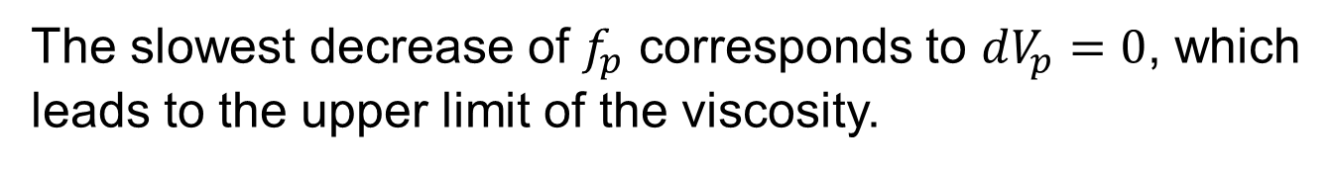
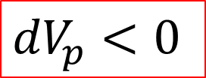
Viscous effects – upper limit of viscosity
The decrease of $f_{p}$ cannot be very slow, because
$f_{p}=V_{p}/V$,
$${dV}_{p}<0$$
The slowest decrease of $f_{p}$ corresponds to $dV_{p}=0$, which
leads to the upper limit of the viscosity.
If these maximal values are smaller than those in real experiments of heavy-ion collisions, it becomes difficult to search for signatures of the first-order phase transition and the critical point.

Slide 17
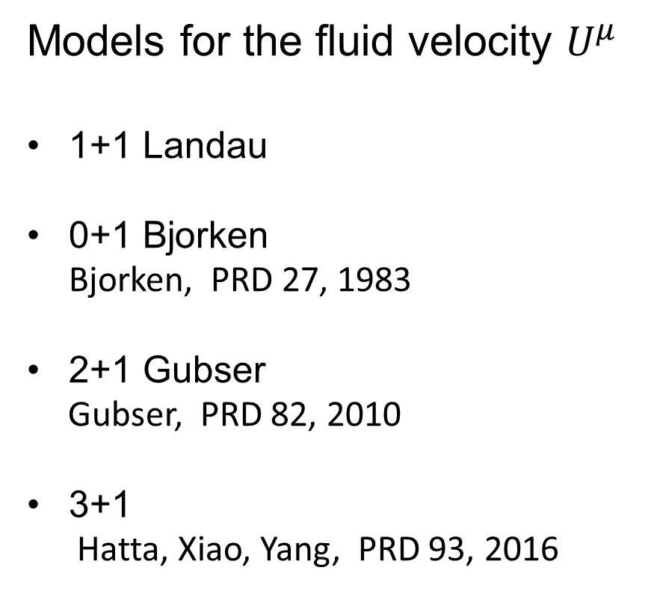
Results
Models for the fluid velocity $U^{μ}$
1+1 Landau
0+1 Bjorken
Bjorken, PRD 27, 1983
2+1 Gubser
Gubser, PRD 82, 2010
3+1
Hatta, Xiao, Yang, PRD 93, 2016

Slide 18
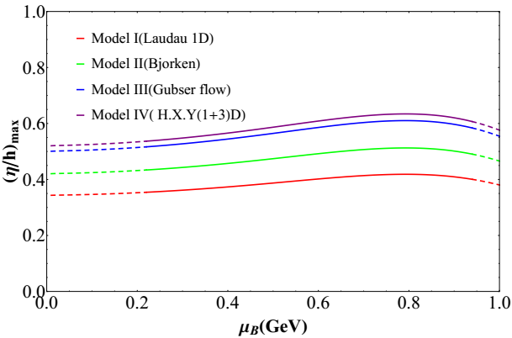
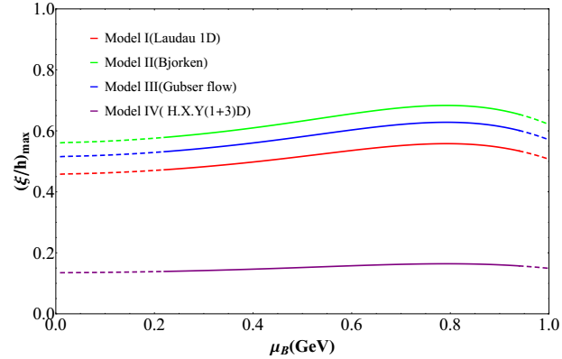
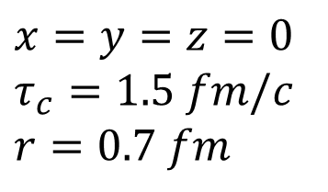
Results - Maximums
$$x=y=z=0$$
$$τ_{c}=1.5 fm/c$$
$$r=0.7 fm$$
by Bohao Feng
flat
varying between 0.3 and 0.6
flat
large variation

Slide 19
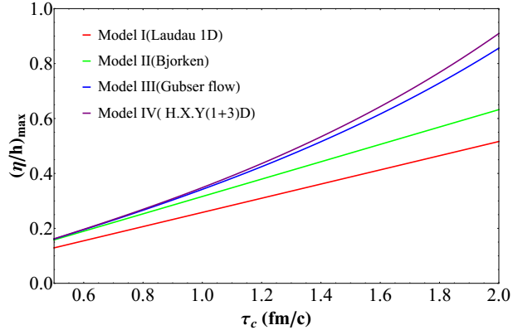
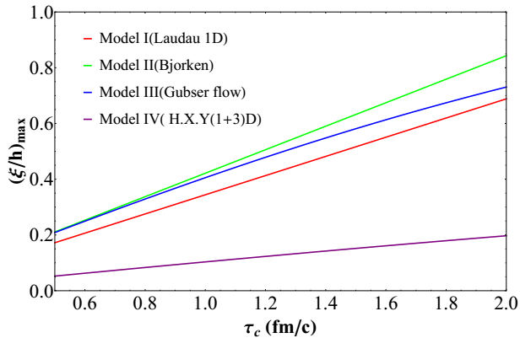

Results - τ_{c} dependence
$$μ_{B}=0.5 GeV$$
by Bohao Feng

Slide 20
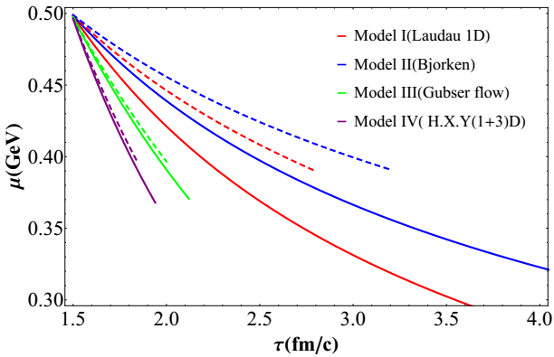
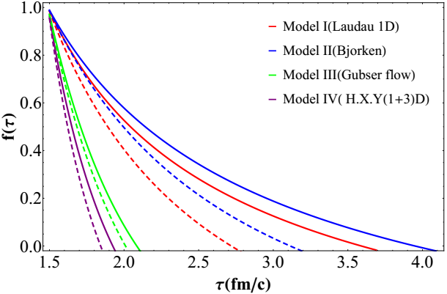
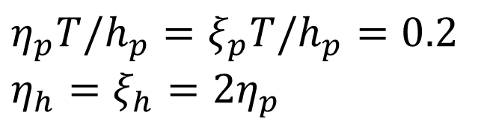
Results – time evolution of μ_{B} and f_{p}
only for demonstration
(solid curves)
$$η_{p}T/h_{p}=ξ_{p}T/h_{p}=0.2$$
$$η_{h}=ξ_{h}=2η_{p}$$
compared with ideal hydro
(dashed curves)
by Bohao Feng

Slide 21
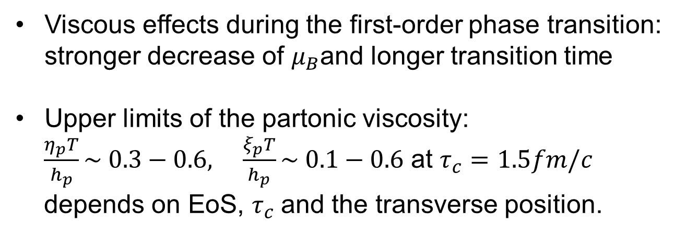
Summary
Viscous effects during the first-order phase transition: stronger decrease of $μ_{B}$and longer transition time
Upper limits of the partonic viscosity:
$\frac{η_{p}T}{h_{p}}\sim 0.3−0.6, \frac{ξ_{p}T}{h_{p}}\sim 0.1−0.6$ at $τ_{c}=1.5fm/c$
depends on EoS, $τ_{c}$and the transverse position.

Slide 22
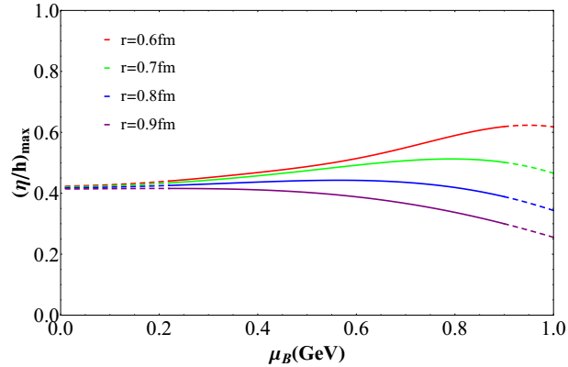
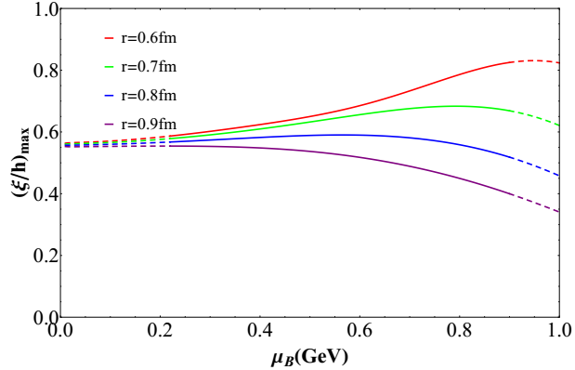
Results - r dependence
0+1 Bjorken
by Bohao Feng

