Slide 1
Dynamical initialization of QGP fluids
Phase of Quantum Chromodynamics (QCD) and
Beam Energy Scan Program with Heavy Ion Collisions
Fudan University, Shanghai, China, 8/15-18, 2017
Tetsufumi Hirano
(Sophia Univ.)
In collaboration with
Michito Okai (Sophia Univ.)
Koji Kawaguchi (Sophia Univ.)
Yasuki Tachibana (CCNU, Wuhan)
Reference:
M.Okai et al., Phys. Rev. C95, 054914 (2017).

Slide 2

Contents
Introduction
Model
  Initial parton production
  Initialization of hydrodynamic fields
  QGP fluid + jet model
Results
  Time evolution of energy density and transverse flow
  $p_{T}$ spectra, $v_{2}$ and $v_{3}$
Discussion on low energy collisions
Summary and Outlook

Slide 3








Introduction
Towards construction of a dynamical model from low to high energy heavy-ion collisions based on hydrodynamics.
When to initialize hydrodynamic fields?
$$γ\sim 100$$
$$γ≲10$$
$$t$$
$$z$$
$$A$$
$$A$$
$$A$$
$$A$$

Slide 4
Introduction (contd.)
Even in high-energy collisions, whether global hydrodynamic initial time exist??
Denser is faster?
Dynamical initialization of hydrodynamic fields in high-energy collisions (this study)
  → Application of the model to low-energy collisions (future work)

Slide 5

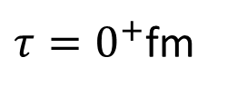


A possible picture in the (not-very) early stage
Proper time $τ$
$τ=0^{+}$fm
$$τ_{00}(∼0.1 fm)$$
$$τ_{0}(∼0.6 fm)$$
Formation of partons from decays of flux tubes
Start hydrodynamization
→ Formation of QGP fluids locally and dynamically
Start conventional QGP fluid + jet simulations
Need
Initial phase space dist. of partons
Model of dynamical hydrodynamization

Slide 6

Initial parton production
Any parton-based event generators can be used. (HIJING, EPOS, AMPT, …)
Present study: MC-Glauber + PYTHIA8 + modified Brodsky-Gunion-Kuhn (BGK) model
    Regarded as a sophisticated version of Glauber-type initial conditions in full 3D hydro
    Merit of PYTHIA: Multiplicity fluctuations and hard components naturally taken into account.
    Longitudinal structure can be considered through modified BGK model
Initial parton distributions in phase space
$ρ(τ=τ_{00}, x, y, η_{s})$

Slide 7






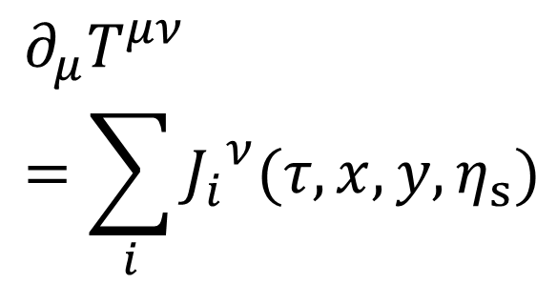
Initialization of hydrodynamic fields
Conventional hydro
Our approach
Modeling of thermodynamic
variables and flow velocity in configuration space at $τ=τ_{0}$
$$T_{fluid}^{μν}\left(τ=τ_{00},x,y,η_{s}\right)=0$$
$$∂_{μ}T^{μν}=\sum_{i}{{J_{i}}^{ν}(τ,x,y,η_{s})}$$
$$s\left(τ_{0},x,y,η_{s}\right), u^{μ}(τ_{0},x,y,η_{s})$$
$$T_{fluid}^{μν}\left(τ=τ_{0},x,t,η_{s}\right)$$
Energy and momentum are conserved as they should be!
$$T_{fluid}^{μν}\left(τ=τ_{0},x,y,η_{s}\right)$$
Modeling of source $J^{μ}$

Slide 8


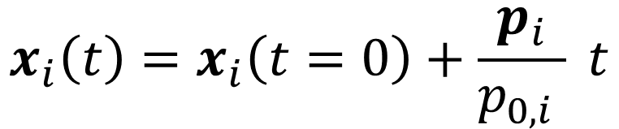
QGP fluid + jet model
Y. Tachibana and T. Hirano,
Phys. Rev. C 90, no. 2, 021902 (2014)
$$∂_{μ}T_{fluid}^{μν}=\sum_{i}{{J_{i}}^{ν}}, J_{i}^{μ}\left(x\right)=−\frac{dp_{i}^{μ}}{dt}δ^{\left(3\right)}\left(x−x_{i}\left(p_{i},t\right)\right)$$
$$x_{i}\left(t\right)=x_{i}\left(t=0\right)+\frac{p_{i}}{p_{0,i} } t$$
$T^{μν}$: Energy momentum tensor
$J^{μ}$: Four momentum density from jet partons to fluids
EOS: Wuppertal-Budapest
Assumption
Perfect fluid approximation
Instantaneous equilibration of deposited energy and momentum
Medium response to jet propagation

Slide 9
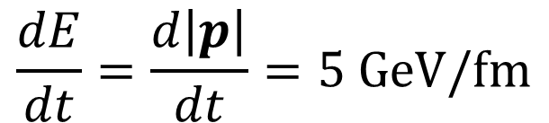
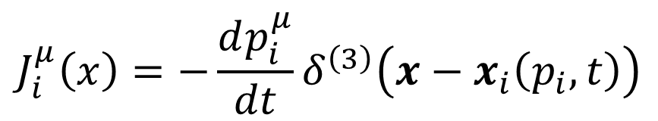
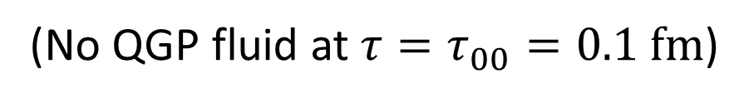


Dynamical hydrodynamization
Utilize QGP fluid + jet model to generate QGP fluids from initial partons dynamically
Initial condition
$$T_{fluid}^{μν}\left(τ=τ_{00}\right)=0$$
(No QGP fluid at $τ=τ_{00}=0.1 fm$)
“Hydrodynamization rate” of energy and momentum of the QGP fluid per parton
$$J_{i}^{μ}\left(x\right)=−\frac{dp_{i}^{μ}}{dt}δ^{\left(3\right)}\left(x−x_{i}\left(p_{i},t\right)\right)$$
$$\frac{dE}{dt}=\frac{d\left|p\right|}{dt}=5 GeV/fm$$
$$(τ_{00}<τ<τ_{0})$$
Regardless of whether matter exists or not

Slide 10
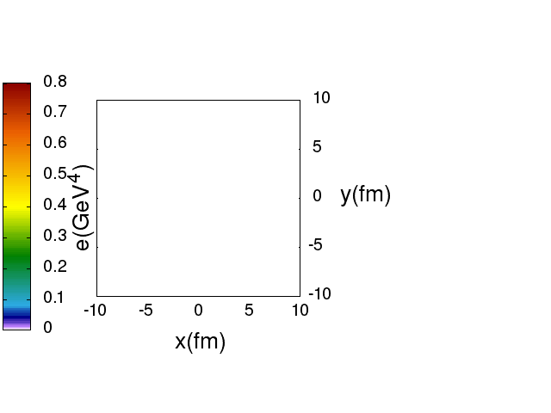
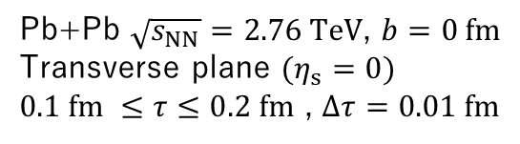

From “vacuum” to fluid: Example
Pb+Pb $\sqrt{s_{NN}}=2.76 TeV$, $b=0 fm$
Transverse plane $(η_{s}=0)$
$0.1 fm ≤τ≤0.2 fm$ , $Δτ=0.01 fm$
Energy density evolution
Interplay btw. energy deposition and expansion
$τ_{e−max}$→ Transverse position dependent

Slide 11

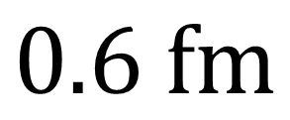
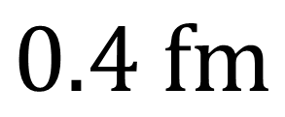
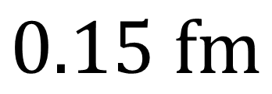

Temporal behavior of $e$ and $v_{⊥}$
$$τ$$
$$0.15 fm$$
$$0.4 fm$$
$$0.6 fm$$

Slide 12
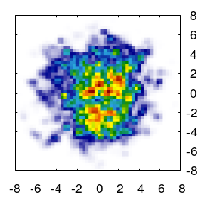
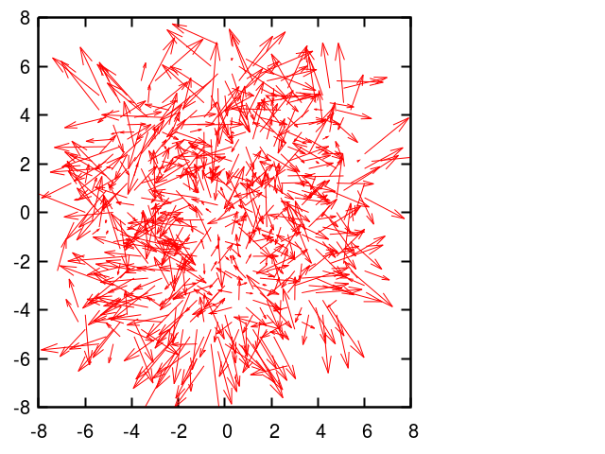


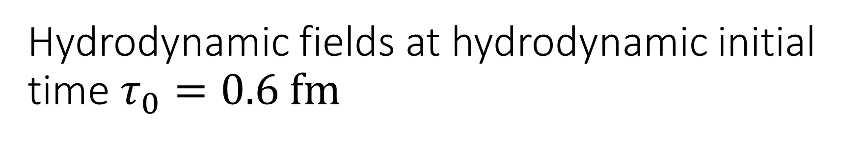


Hydrodynamic fields at hydrodynamic initial time $τ_{0}=0.6 fm$
$$y (fm)$$
$$y (fm)$$
$$x (fm)$$
$$x (fm)$$
Energy density
Transverse flow velocity
Similar to conventional e-by-e initial conditions
Random transverse flow reflects initial momentum of partons

Slide 13

A possible picture in the (not-very) early stage
Proper time $τ$
$τ=0^{+}$fm
$$τ_{00}(∼0.1 fm)$$
$$τ_{0}(∼0.6 fm)$$
Formation of partons from decays of flux tubes
Start hydrodynamization
→ Formation of QGP fluids locally and dynamically
Start conventional QGP fluid + jet simulations
Initial fluctuations of profiles
+ Random flow velocity
+ Surviving partons
MC-Glauber
+ modified BGK model
+ PYTHIA
$$∂_{μ}T^{μν}=\sum_{i}{{J_{i}}^{ν}}$$

Slide 14
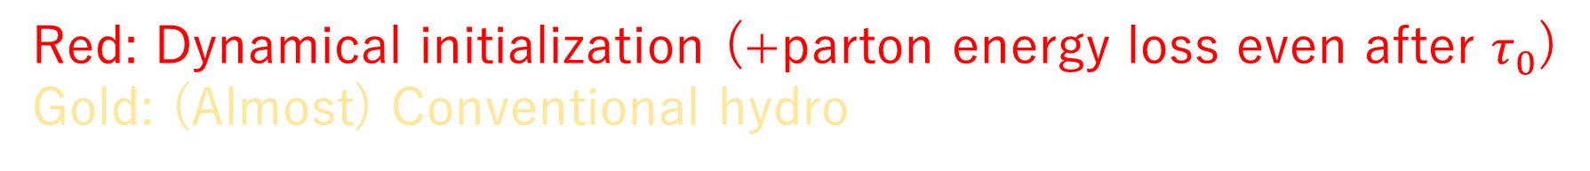
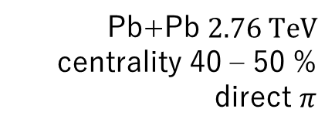
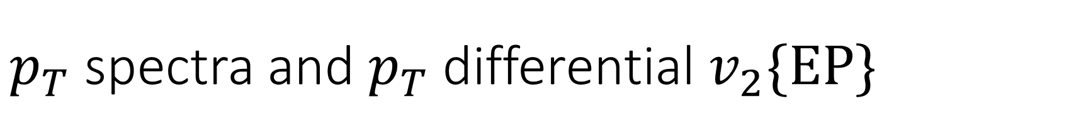
$p_{T}$ spectra and $p_{T}$ differential $v_{2}\{EP\}$
Red: Dynamical initialization (+parton energy loss even after $τ_{0}$)
Gold: (Almost) Conventional hydro
Pb+Pb $2.76 TeV$
centrality 40 – 50 %
direct $π$
Enhancement of yields and decorrelation of event plane at $p_{T}=3$-$5 GeV$
→ Initial random flow plays an important role in transverse dynamics.

Slide 15
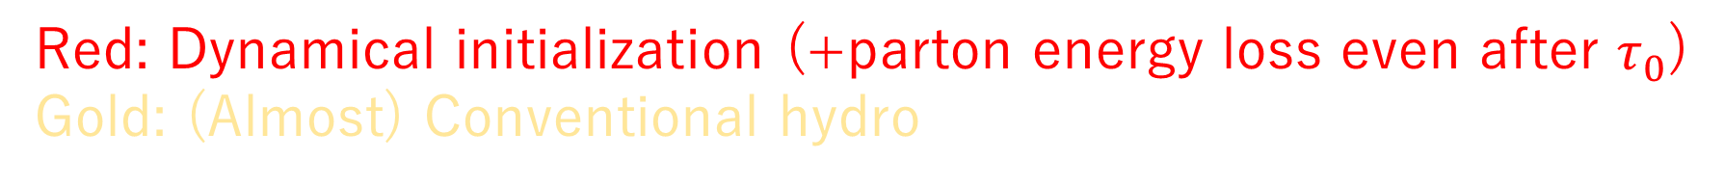

Effect of initial random transverse flow to triangular flow
Red: Dynamical initialization (+parton energy loss even after $τ_{0}$)
Gold: (Almost) Conventional hydro
Initial random transverse flow enhances triangular flow
→ $v_{2}$ mainly driven by shape, $v_{3}$ by (any) fluctuations

Slide 16
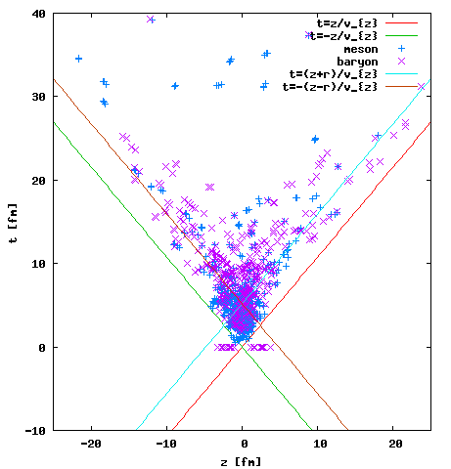

Low energy collisions
Heavy ion physics at J-PARC
System: $Au+Au$
Energy in CMS:$\sqrt{s_{NN}}=5 GeV$
Impact parameter: $b=2 fm$
Radius of Au: $R=6.4 fm$
Mode in JAM: B-B (on), B-M (off), M-M (off)
Overlapping time ~ a few fm
No global hydrodynamic initial time?
Initialization through source terms
Distribution of last interaction points
when meson interactions are switched off

Slide 17
Similar approach
C.Shen et al. proceedings of QM2017
3D Glauber-Lexus model
String formation time depends on proper time
Dynamical initialization of fluids in low-energy collisions

Slide 18

Summary
Dynamical initialization of hydrodynamic fields by utilizing QGP fluid + jet model.
Initial conditions from MC-Glauber, PYTHIA8 and modified BGK model.
Momentum conservation between initial partons and fluids → Initial random transverse flow.
Initial random transverse flow plays an important role in transverse dynamics
  → Smearing event plane angle direction in the intermediate $p_{T}$ region

Slide 19

Outlook
Detailed analysis of transverse dynamics
  De-correlation in $p_{T}$ and in $η$
  $ε_{n}$ at $τ_{0}$
More sophisticated model for source terms $J^{μ}$
Parameter tuning from $R_{AA}$
Fragmentation from finally surviving mini-jets
Hadronic afterburner, viscous effects
Modeling in low energy collisions

Slide 20
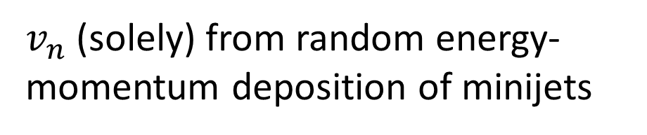
Previous work by Schulc and Tomasik
Figure taken from M.Schulc and B.Tomasik, arXiv:1611.08577
Full (3+1)-D ideal hydro + mini-jets
Initial cond. for bulk → Optical Glauber → Smooth dist.
Initial cond. for mini-jets → Binary collision dist.
0-2.5%
centrality
$v_{n}$ (solely) from random energy-momentum deposition of minijets

Slide 21
Questions
How do we divide initial partons into soft and hard?
Why do soft components form a smooth matter profile, while hard partons (mini-jets) go randomly?
Can we distinguish effects of random mini-jet propagation from those of conventional initial fluctuations of profiles?
Does the result in the previous slide overestimate effects of fluctuations? (Or, in other words, how much do the effects of mini-jet propagation survive when initial profile fluctuates?)
→ Need a unified model to treat initial conditions of fluids and mini-jets systematically

Slide 22
A possible picture in the (not-very) early stage
Proper time $τ$
Formation time
of partons
Dynamical generation of QGP fluid
QGP fluid + mini-jet propagation
An ensemble of
initial partons
No fluids
Mini-jet induces collective flow

Slide 23
A possible picture in the (not-very) early stage
Proper time $τ$
$τ=0^{+}$fm
$$τ_{00}(∼0.1 fm)$$
$$τ_{0}(∼0.6 fm)$$
Formation of partons from decays of flux tubes
Start hydrodynamization
→ Formation of QGP fluids locally and dynamically
Start conventional QGP fluid + jet simulations
Transverse: MC-Glauber
Longitudinal: (Modified) BGK model
Momentum dist. in pp: PYTHIA8

Slide 24
Initial parton production
Any parton-based event generators can be used. (HIJING, EPOS, AMPT, …)
Present study: MC-Glauber + PYTHIA8 + modified Brodsky-Gunion-Kuhn (BGK) model
    Regarded as a sophisticated version of Glauber-type initial conditions in full 3D hydro
    Merit of PYTHIA: Multiplicity fluctuations and hard components naturally taken into account.
    Longitudinal structure can be considered through modified BGK model (see the following slides)
    Caveats: No energy conservation, nPDF nor isospin effects

Slide 25








Rapidity triangle/trapezoid in asymmetric system
$$\frac{N_{A} +N_{B} }{2}$$
$$N_{A}$$
$$N_{B}$$
$$Y$$
$${−Y}_{beam}$$
$$0$$
$$Y_{beam}$$
Au-going side
A.Adil and M.Gyulassy, Phys. Rev. C 72, 034907 (2005).
Multiplicity
$∝N_{part, A}$ at $Y=−Y_{beam}$,
$∝N_{part, B}$ at $Y=Y_{beam}$,
$∝{ N}_{part}/2$ at $Y=0$
d-going side

Slide 26







Partons in configuration space
Longitudinal space
From PYTHIA
$$η_{s}^{i}=Y^{i}$$
From MC-Glauber
Transverse plane
$$y$$
Nucleon A
$$x_{⊥}^{0}=\frac{Y_{beam}+Y^{i}}{2Y_{beam}}x_{⊥,A}+\frac{Y_{beam}−Y^{i}}{2Y_{beam}}x_{⊥,B}$$
$$x_{⊥,A}$$
Linear interpolation btw. $x_{⊥,A}$ and $x_{⊥,B}$ according to rapidity of partons
→ Randomly distributed inside cross section of color flux tube
$$x_{⊥,B}$$
Nucleon B
$$x$$

Slide 27

Workflow for initial parton phase space density
MC-Glauber
  Fix impact parameter and positions of colliding nucleons
  Estimate $N_{part, A}$, $N_{part, B}$ and $N_{coll}$ and tag which nucleon collides with which.
PYTHIA8
  Run PYTHIA for each inelastic pp collision
  Repeat $N_{coll}$ times
  Rejection sampling for generated partons according to modified BGK model (see the following slides)
Estimation of phase space distribution of partons in each event
  Momentum from PYTHIA output
  Transverse position from MC-Glauber and PYTHIA

Slide 28

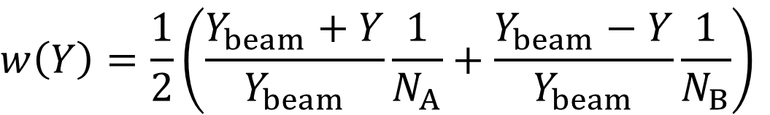
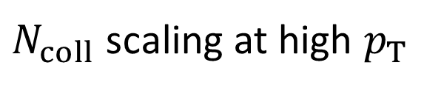

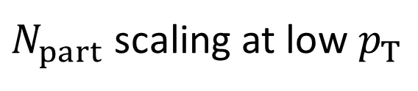
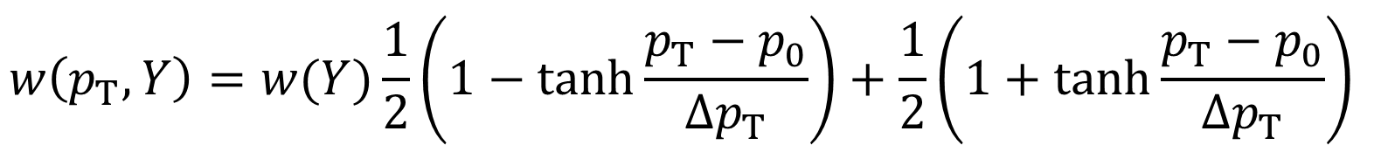
Rejection sampling for $N_{part}$ scaling
If one modeled a heavy-ion event by incoherent sum of PYTHIA inelastic pp events, multiplicity would scales with $N_{coll}$ and total energy would exceed the actual collision energy.
Need to discard some produced particles
Rejection sampling for a generated parton with $(p_{T}, Y)$
Acceptance function ($w=1$ means no rejection and $N_{coll}$ scaling.)
$$w\left(Y\right)=\frac{1}{2}\left(\frac{Y_{beam}+Y}{Y_{beam}}\frac{1}{N_{A}}+\frac{Y_{beam}−Y}{Y_{beam}}\frac{1}{N_{B}}\right)$$
→ Rapidity triangle/trapezoid
$$w\left(p_{T}, Y\right)=w(Y)\frac{1}{2}\left(1−tanh\frac{p_{T}−p_{0}}{∆p_{T}}\right)+\frac{1}{2}\left(1+\tanh{\frac{p_{T}−p_{0}}{∆p_{T}}}\right)$$
$N_{part}$ scaling at low $p_{T}$
$N_{coll}$ scaling at high $p_{T}$

Slide 29
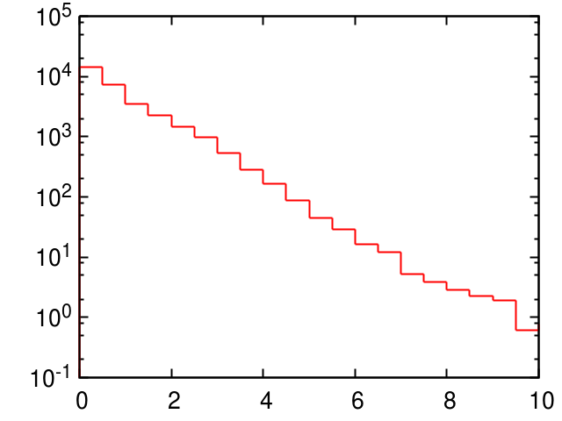

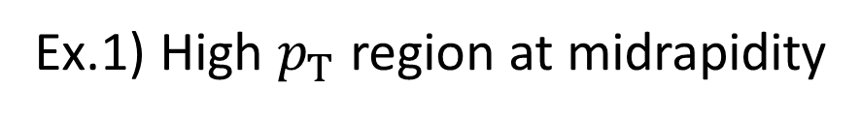

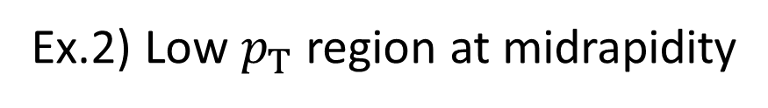
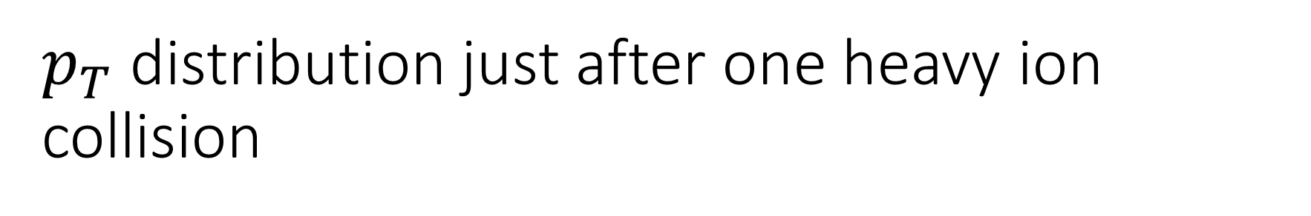
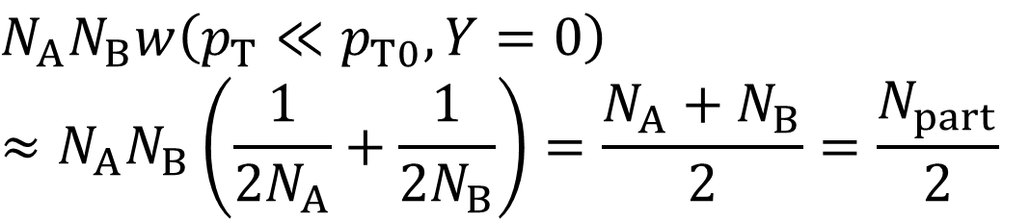

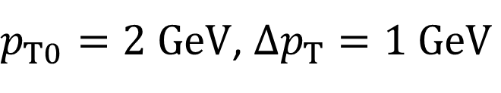


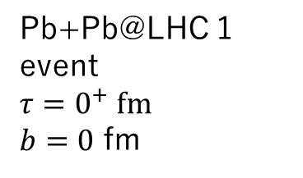

$p_{T}$ distribution just after one heavy ion collision
Ex.1) High $p_{T}$ region at midrapidity
Pb+Pb@LHC 1 event
$τ=0^{+} fm$
$b=0$ fm
$$\sim 1$$
$$\frac{dN}{p_{T}dp_{T}} ({GeV}^{−2})$$
$$N_{part}/2$$
$$N_{A}N_{B}w\left(p_{T}≫p_{T0}, Y=0\right)≈N_{A}N_{B}=N_{coll}$$
$$N_{coll}$$
Run PYTHIA $N_{A}×N_{B}$ times
Ex.2) Low $p_{T}$ region at midrapidity
$$N_{A}N_{B}w\left(p_{T}≪p_{T0}, Y=0\right)$$
$$≈N_{A}N_{B}\left(\frac{1}{2N_{A}}+\frac{1}{2N_{B}}\right)=\frac{N_{A}+N_{B}}{2}=\frac{N_{part}}{2}$$
$p_{T} (GeV)$
$p_{T0}=2 GeV$, $Δp_{T}=1 GeV$

Slide 30
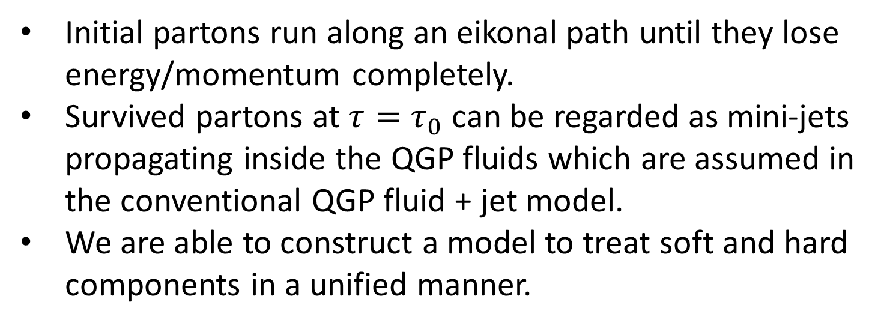
Some remarks
Initial partons run along an eikonal path until they lose energy/momentum completely.
Survived partons at $τ=τ_{0}$ can be regarded as mini-jets propagating inside the QGP fluids which are assumed in the conventional QGP fluid + jet model.
We are able to construct a model to treat soft and hard components in a unified manner.

Slide 31

Some remarks (contd.)
All the unknown thermalization/hydrodynamization processes are hidden in source terms $J^{μ}$.
In our very first trial, we just assume it is propotional to four momentum of initial partons $J^{μ}∝p^{μ}$. (Need Lorentz covariance)
  All initial energies and momenta of produced partons can be taken into account. (Energy-momentum conservation)
  Initial flow velocity is dynamically generated.
  ← In some of conventional Glauber type initial models, one just counts the number of partons and assumes it is proportional to entropy density. Initial flow velocity should be also parametrized. (One often consider fluctuations of matter profile in conventional hydro. Why not flow velocity?)

Slide 32
Some remarks (contd.)
Matching energy-momentum tensor at some initial time could be ok if one had a framework to describe thermalization/hydrodynamization processes reliably.
If the system is still far from local equilibrium state at hydrodynamic initial time in some model, dissipative corrections to ideal part of energy momentum tensor should be too large.
However,
  QGP fluids may be formed locally since “higher local density, earlier hydrodynamization time” is expected
  Hydrodynamic initial time can depend on positions.

Slide 33
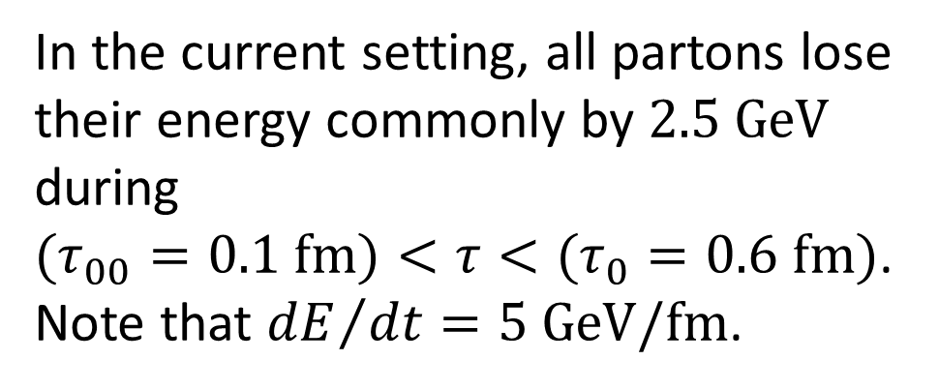
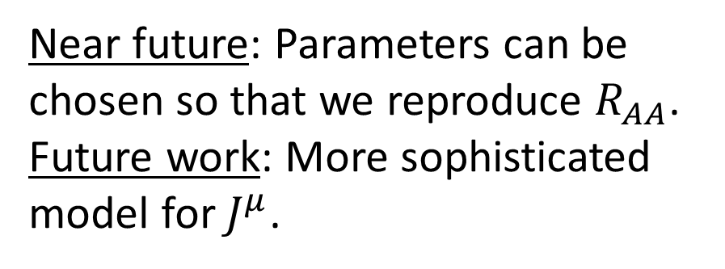
“Surviving” partons
In the current setting, all partons lose their energy commonly by $2.5 GeV$ during
$(τ_{00}=0.1 fm)<τ<(τ_{0}=0.6 fm)$.
Note that ${dE}/{dt}=5 GeV/fm$.
Near future: Parameters can be chosen so that we reproduce $R_{AA}$.
Future work: More sophisticated model for $J^{μ}$.

Slide 34

Contribution from fragmentation of surviving partons
Surviving partons
String formation btw. mini-jet
and medium parton
Decay of hadronic strings
High $p_{T}$ hadrons
$$y (fm)$$
$$x (fm)$$

