Slide 1
The XDC project
Daniele Cesini
daniele.cesini<at>extreme-datacloud.eu

Slide 2
XDC Objectives
The eXtreme DataCloud is a software development and integration project
Develops scalable technologies for federating storage resources and managing data in highly distributed computing environments
  Focus efficient, policy driven and Quality of Service based DM
The targeted platforms are the current and next generation e-Infrastructures deployed in Europe
  European Open Science Cloud (EOSC)
  The e-infrastructures used by the represented communities

Slide 3
The Einfra-21-2017 Call
(a) Support to Public Procurement of innovative HPC systems, PPI
(b) Research and Innovation Actions for e-Infrastructure prototypes
  1 - Universal discoverability of data objects and provenance
  2 – Computing e-infrastructure with extreme large datasets
Service prototypes should follow common interfaces to access and analyse underlying data collected/stored in different platforms, formats, locations and e-infrastructures […] tested against requirements of very large or highly heterogeneous research data sets.
Funds development of service prototypes at TRL6+
  Bring to TRL8 and include in a unified service catalogue in 2018+
Budget per proposal: 2.5-3M€

Slide 4
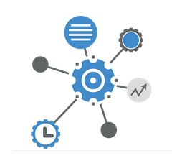
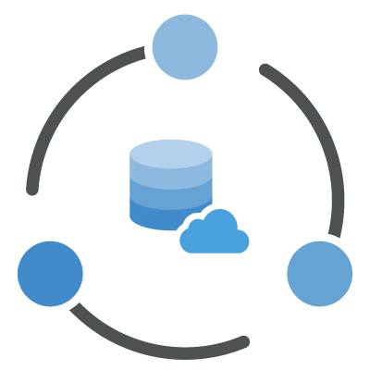

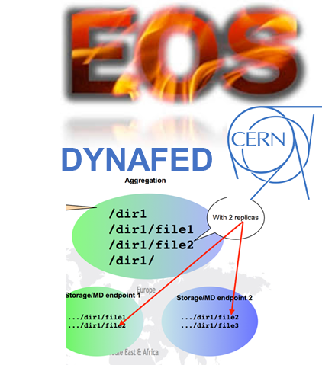

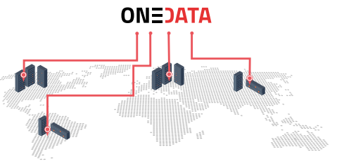





XDC Foundations
XDC take the move from
  the INDIGO Data management activity
  the experience of the project partners on data-management
Improve already existing, production quality, Federated Data Management services
  By adding missing functionalities requested by research communities
  Must be coherently harmonized in the European e-Infrastructures
FTS
INDIGO PaaS Orchestrator
INDIGO CDMI Server

Slide 5

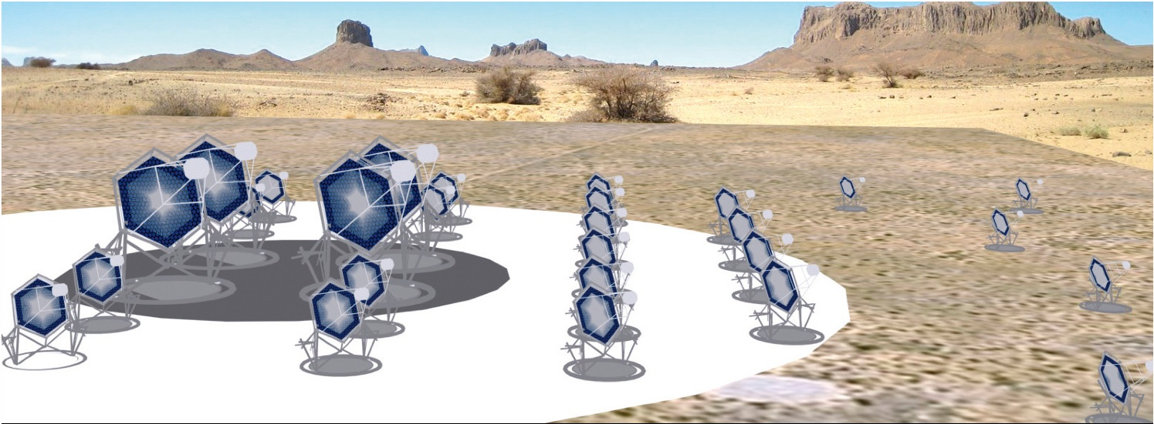
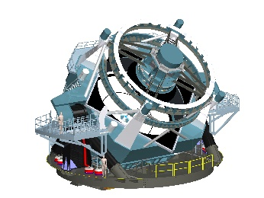
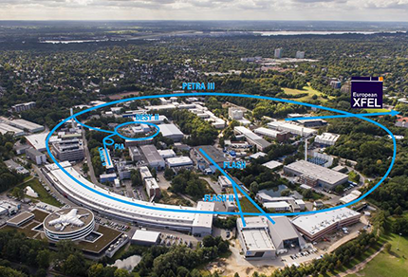



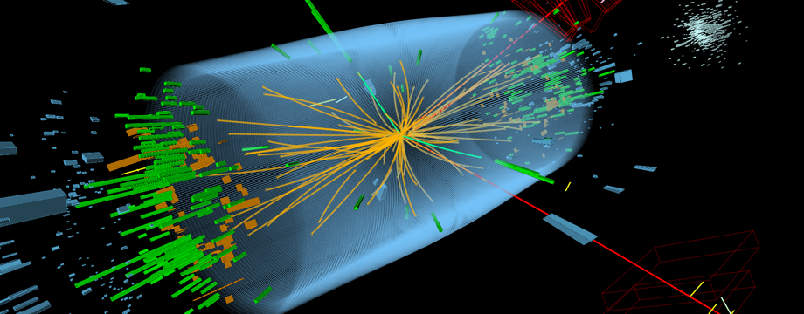




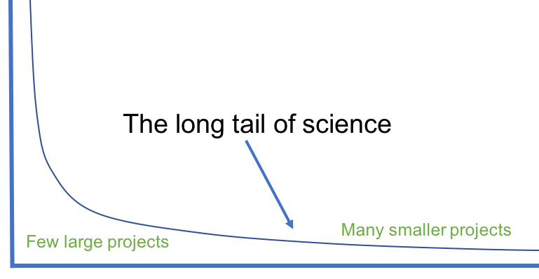
Represented research communities

Slide 6
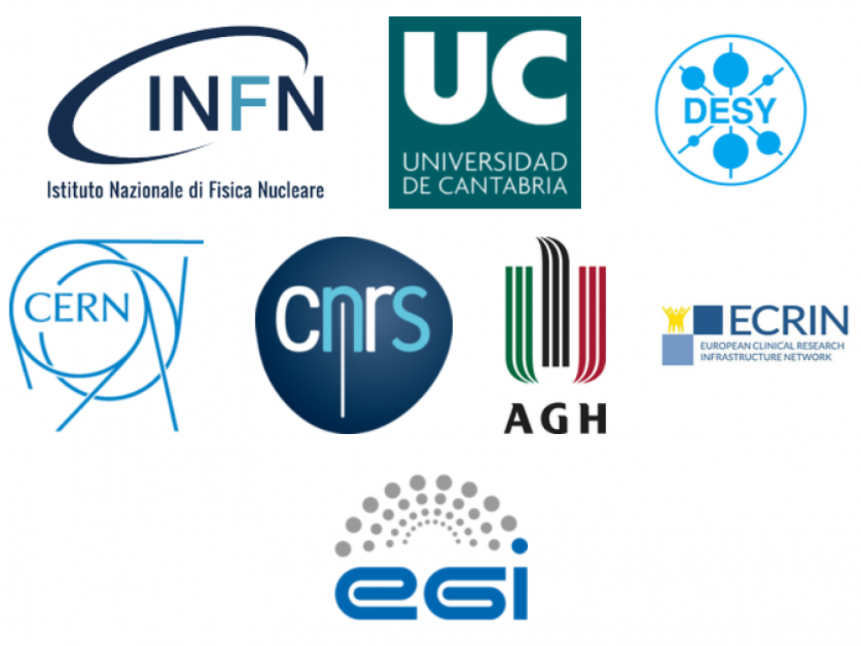
XDC Consortium
ID | Partner | Country | Represented Community | Tools and system
1 | INFN (Lead) | IT | HEP/WLCG | INDIGO-Orchestrator, INDIGO-CDMI(*)
2 | DESY | DE | Research with Photons (XFEL) | dCache
3 | CERN | CH | HEP/WLCG | EOS, DYNAFED, FTS
4 | AGH | PL |  | ONEDATA
5 | ECRIN | [ERIC] | Medical data
6 | UC | ES | Lifewatch
7 | CNRS | FR | Astro [CTA and LSST]
8 | EGI.eu | NL | EGI communities
8 partners, 7 countries
7 research communities represented + EGI
XDC Total Budget: 3.07Meuros
XDC started on Nov 1st – will run for 27 months
From the EU reviewers of the proposal: ”Consortium as a whole is well formed, bringing together the world-class expertise, experience and infrastructure to enable the successful achievement of the proposal’s objectives.”

Slide 7
The New Functionalities
Intelligent & Automated Dataset Distribution
  Orchestration to realize a policy-driven data management
  Data distribution policies based on Quality of Service (i.e. disks vs tape vs SSD) supporting geographical distributed resources (cross-sites)
  Software lifecycle management
Data pre-processing during ingestion
Data management based on access patterns
  Move to ‘glacier-like’ storage unused data, move to fast storage “hot” data
    at infrastructure level
Smart caching
  Transparent access to remote data without the need of a-priori copy
Metadata management
Sensitive data handling
  secure storage and encryption

Slide 8
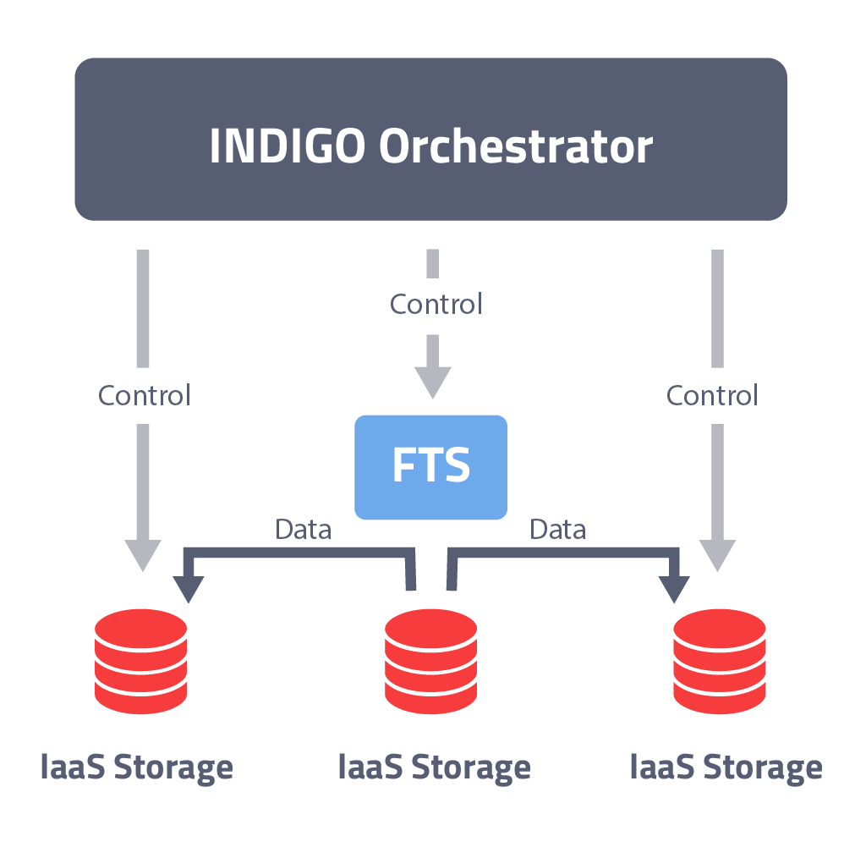
Policy driven Data Management
Intelligent & Automated Dataset Distribution
  A typical workflow
    Initially the data will be stored on low latency devices for fast access
    To ensure data safety, the data will be replicated to a second storage device and will be migrated to custodial systems, which might be tape or S3 appliances
    Eligible users will get permission to restore archived data if necessary
    After a grace period, Access Control will be changed from “private” to “open access”
  Data management based on access pattern

Slide 9
Data pre-processing
Data pre-processing during ingestion
  Automatically run user defined applications and workflows when data are uploaded
    i.e. for Skimming, indexing, metadata extraction, consistency checks
  Implement a solution to discover new data at specific locations
  Create the functions to request the INDIGO PaaS Orchestrator to execute specific applications on the computing resources on the Infrastructure
  Implement a high-level workflow engine, that will execute applications defined by the users
  Implement the data mover to store the elaborated data in the final destination

Slide 10
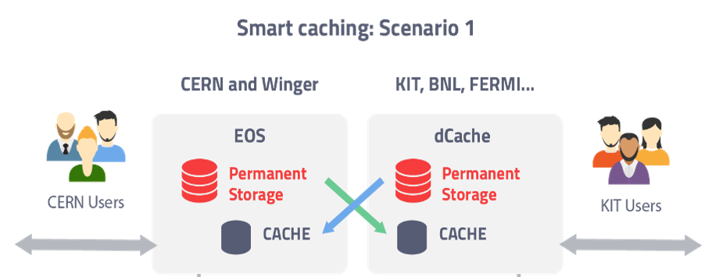
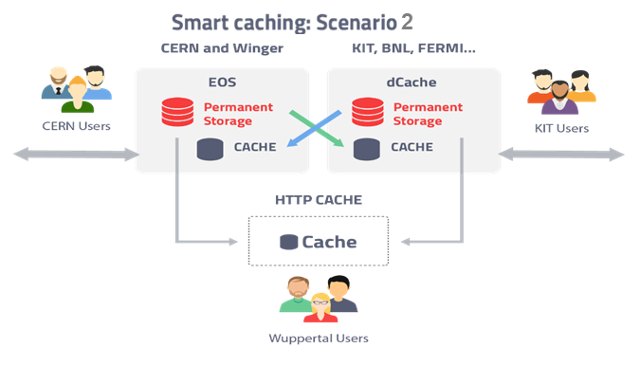
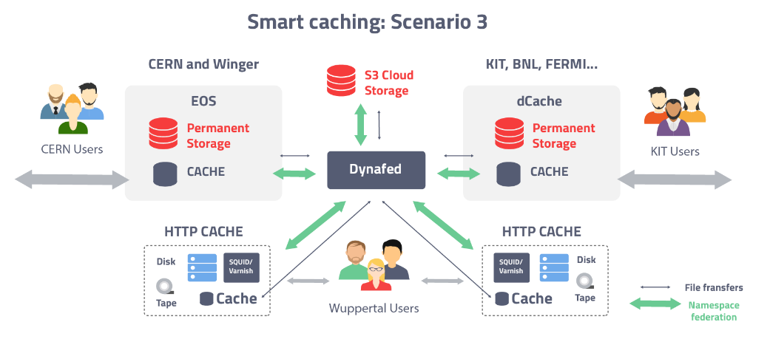
Smart caching
Smart caching
  Develop a global caching infrastructure supporting the following building blocks:
    dynamic integration of satellite sites by existing data centres
    creation of standalone caches modelled on existing web solutions
    federation of the above to create a large scale caching infrastructure

Slide 11
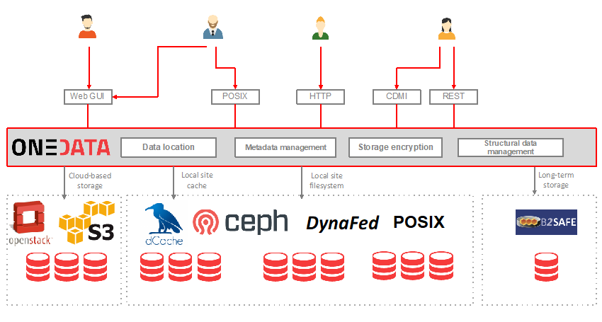
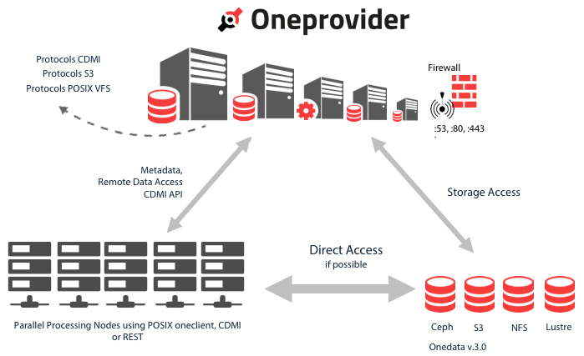
Onedata developments
Unified data access platform at a PaaS level at the Exascale
Multi-region support in Onedata
Advanced metadata management with no pre-defined schema
Encryption Services and Secure Storage
Sensitive data management and key storage within Onedata

Slide 12
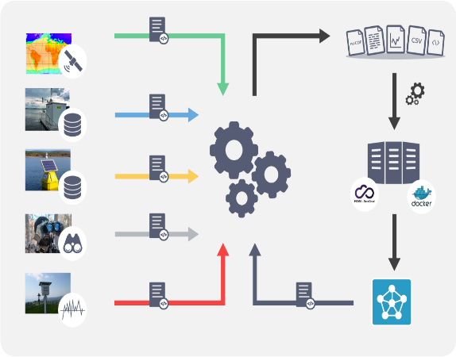
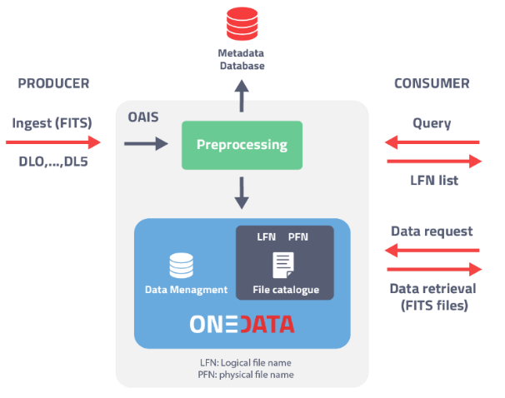
Metadata handling use cases
LIFEWATCH
CTA
ECRIN
Metadata management to handle heterogeneous and large datasets
  Different data types, formats, source and ways to access
  e.g. Copernicus data: ~16PB per year
Used as input for water quality forecasting systems
Use of standards like EML (Ecological Metadata Language) and adopting best practices like FAIR+R principles
The CTA distributed archive lies on the « Open Archival Information System » (OAIS) ISO standard. Event data are in files (FITS format) containing all metadata.
Metadata are extracted from the ingested files, with an automatic filling of the metadata database.
Metadata will be used for the further query of archive.
The system should be able to manage replicas, tapes, disks, etc, with data from low-level to high-level.
Clinical trial data objects available for sharing with others
  a variety of access mechanisms
  wide variety of different locations
      growing number of general and specialised data repositories
      trial registries
      Publications
      the original researchers’ institutions
  ‘discoverability’ will become much worse in the future as more and more materials is made available for sharing

Slide 13
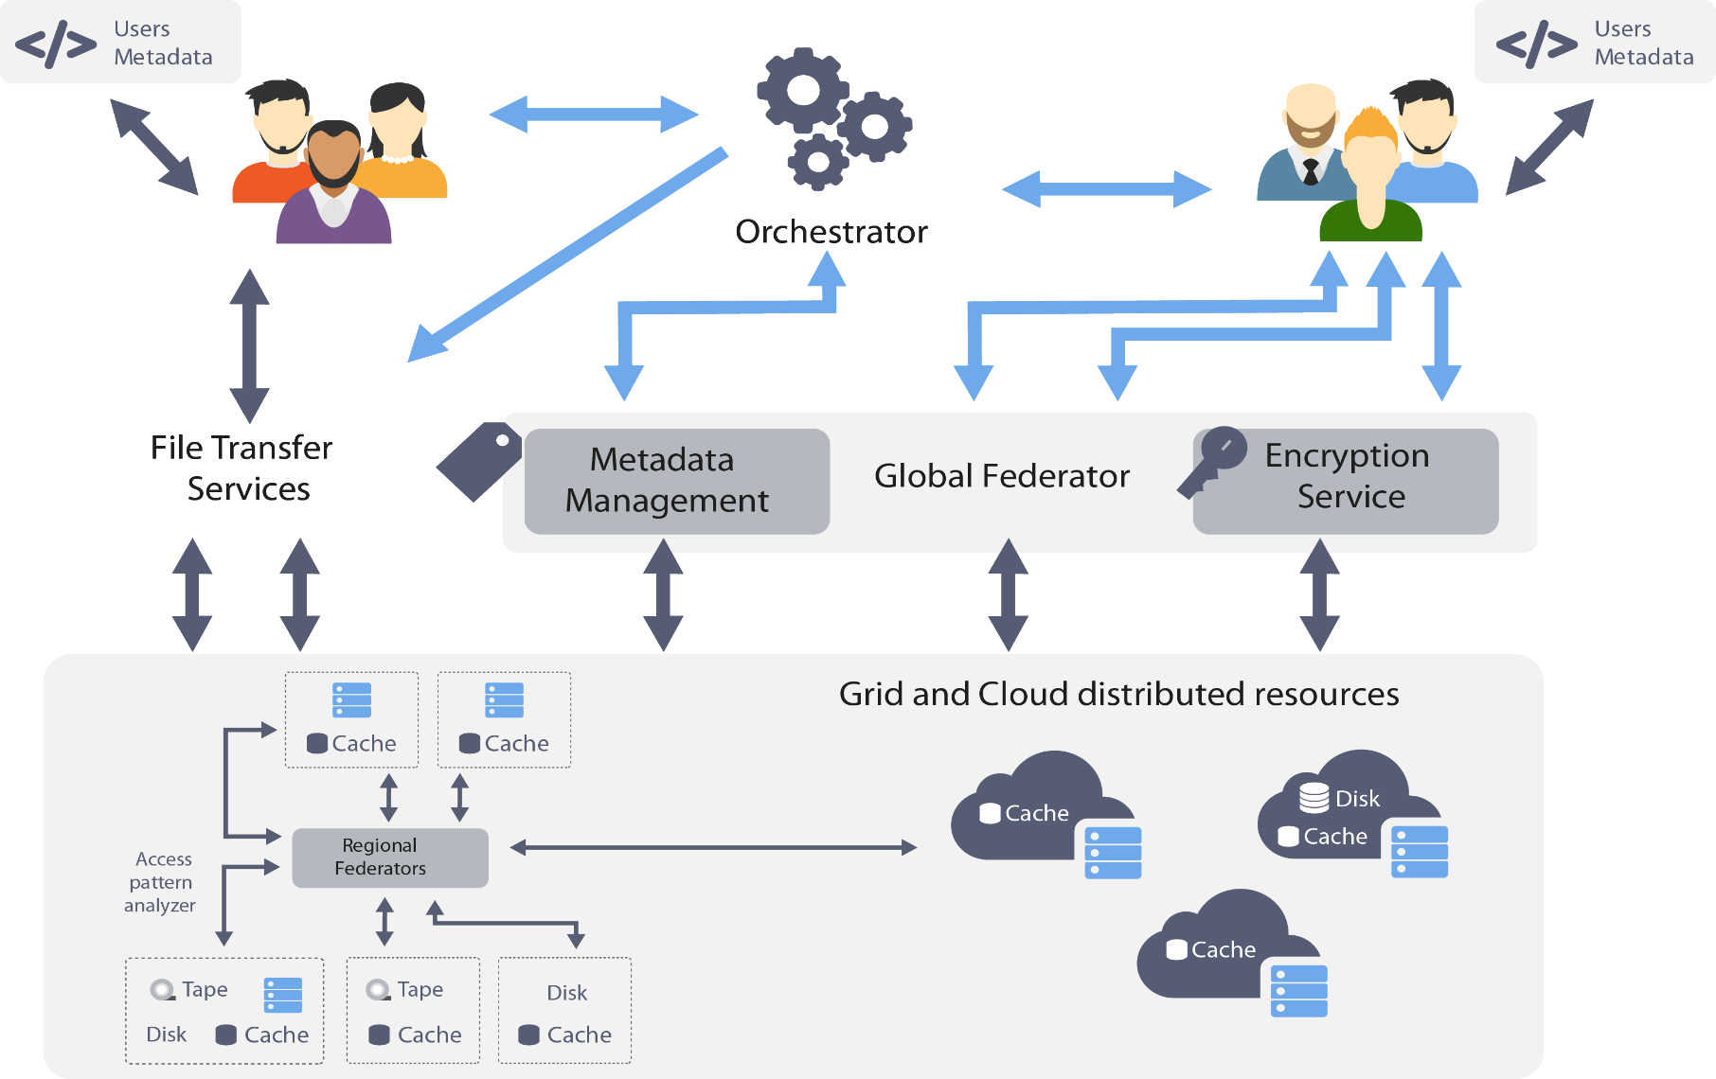
XDC high level architecture

Slide 14
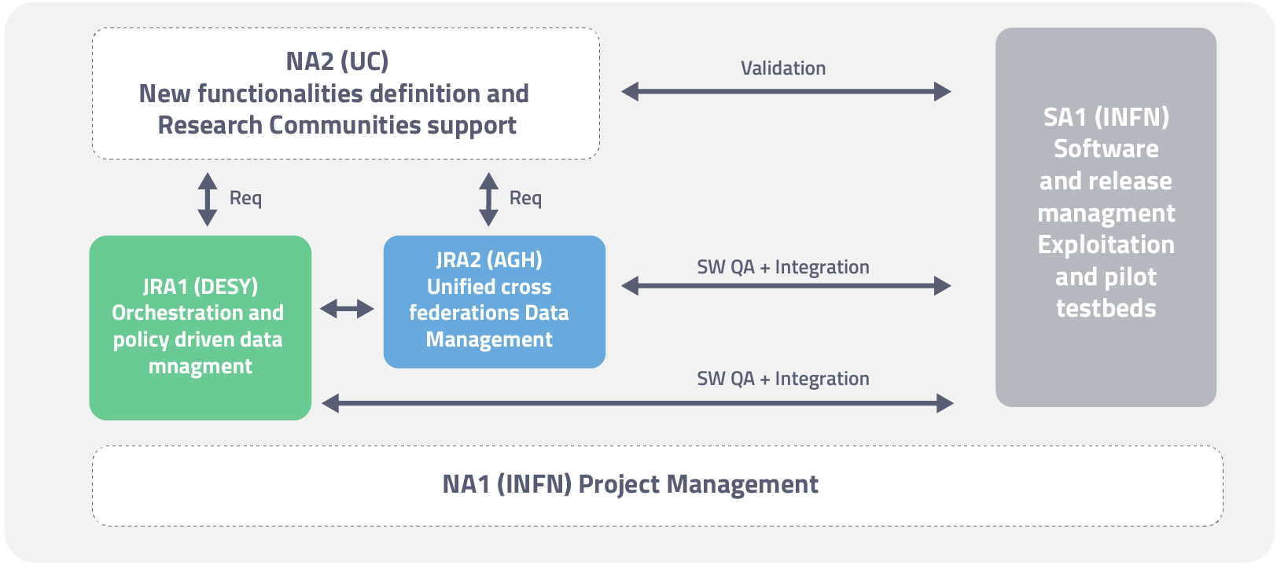
Project Structure
WP1 - Project Management (NA1)
WP2: New functionalities definition and Research Communities support (NA2)
WP3: Software Lifecycle Management, Pilot Infrastructures & Exploitation (SA1)
WP4: Orchestration and policy driven data management (JRA1)
WP5: Unified cross federations data management (JRA2)

Slide 15
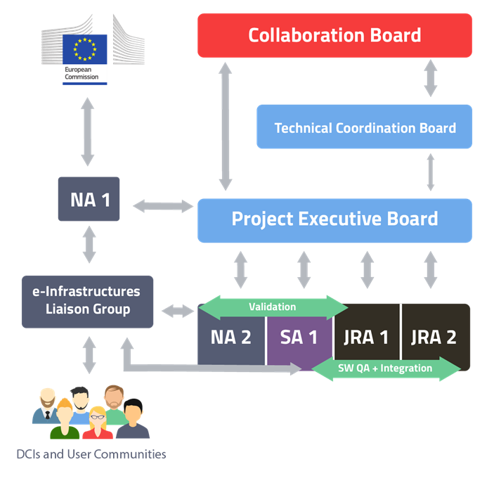
Management bodies
ELG is responsible for maintaining active relationships with the infrastructure and technology providers, discussing synergies, strategies, roadmaps and requirements workflow for the software released by the project.

Slide 16
The plan for the next couple of years
Main Milestones
  Research communities requirements for new functionalities collected
  Research communities requirements analysis performed
  Project architecture detailed
  Development schedule defined
  Event with User Communities
  XDC reference releases – 1
  XDC reference releases – 2
  Functionalities and scalability demonstrated
PM3
PM6
PM9 - Joint with DEEP in Santander
PM12
PM24
PM27

Slide 17
Conclusion
XDC has an ambitious development plan for data management services
  We want to support very diverse use cases and requirements
  We need really a modular and flexible approach in building our platform
We will support as much as possible standards protocols to make the solutions as general as possible
Sustainability of the products:
  Provide upstream to the original project all the changes developed by XDC
  Involving the user communities in exploiting the XDC outputs in their production environments
  Pushing XDC developments in the EOSC Service Catalogue

Slide 18
XDC Contacts
Website: www.extreme-datacloud.eu
@XtremeDataCloud on Twitter
Mailing list: info<at>extreme-datacloud.eu

