Slide 1

Composite matter/antimatter hadron structure indicated in petawatt laser experiments
FLASY 2024 Workshop
June 23-28
Irvine, California
Mark Pickrell
President, Albireo Scientific Corp.

Slide 2
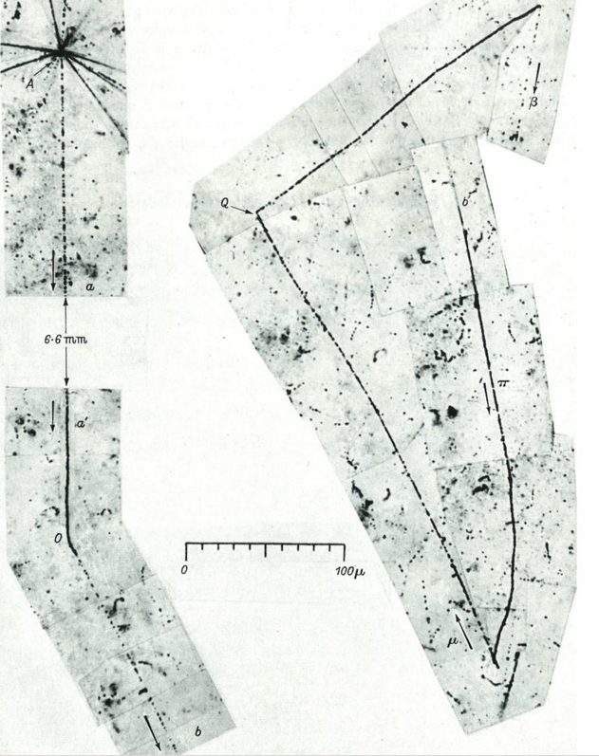
Theoretical and Experimental Background --
Matter & Antimatter
In 1928, Paul Dirac’s relativistic version of the Schrodinger wave equation recognizes solutions involving an antielectron; in 1930, Robert Oppenheimer proposed the existence of a “positively charged electron with the same mass”
In 1932, Carl Anderson discovers positrons in cosmic rays; in 1936, describes electron/positron annihilation into 2 ½ meV gamma rays, crediting Joliot’s and Thibaud’s 1934 work on radioactive decay
In 1930, Dirac anticipates existence of positrons and electrons in the “Dirac sea”; in 1934, Bethe & Heitler anticipate virtual electrons and positrons arising from the “quantum vacuum”
In 1947, Cecil Powell, et al., discover pion, ultimately understood as a combination of a quark and antiquark, in particle collider
In 1955, Owen Chamberlain and Emilio Segrè discover the antiproton at Berkeley Radiation Laboratory’s Bevatron
In 1956, Bruce Cork, et al., discovered the antineutron at BRL
In 1964, Murray Gell-Mann and George Zweig theorize existence of quarks (as denominated by Gell-Mann)
In 1964, James Cronin, Val Fitch, et al., discover CP violation for K meson decays
Positron
K meson to ∏⁺

Slide 3
In 2008, Hui Chen and others at Lawrence Livermore National Laboratory discovered that large quantities of electron/positron pairs are generated when a high-intensity laser strikes a gold target and can be separated magnetically
Chen understood that the electron/positron pairs arise from
the Bethe-Heitler quantum vacuum

Slide 4
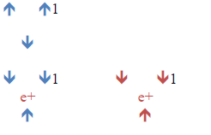
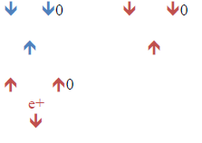
Hypothesis: Stable hadrons are composed of quarks, antiquarks, and positrons
Composite proton structures:
Composite neutron structures:
Blue indicates matter; red indicates antimatter
Arrows indicate up or down quarks or antiquarks
e⁺ = positron

Slide 5
Prediction from Composite Hadron Hypothesis:
If the positrons generated when high-energy lasers strike a gold target arise internally from the nucleus, then the target should transmutate
In 2015, Alexander Henderson observed at the Texas Petawatt Laser Facility that gold targets struck by high-intensity lasers are transmutated in the process -- Au is transmutated into Pt

Slide 6
Implications of Composite Hadron Structure
4:1 H:He ratio initial atomic structure of Universe
Proton-to-neutron conversion in proton-proton chain reactions is not caused by flavor change of quarks but, instead, positron ejection from protons
Neutrinos created as a byproduct of proton-proton chain reactions in stars cause the expansion, and the increasing rate of expansion, of the Universe
Beta decay (both B+ and B-) is likely an external, deterministic phenomenon caused by neutrinos interacting with nuclei

Slide 7
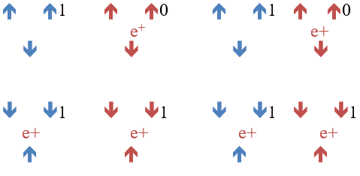
1. Initial Atomic State of the Universe
Equal numbers (in this case, six) of up quarks, down quarks, up antiquarks, down antiquarks, electrons, and positrons, reflect observed hydrogen/helium composition of stars (4:1):
= He
= 4 H
*electrons not shown

Slide 8
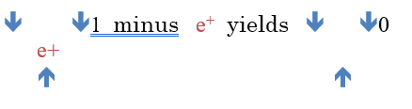
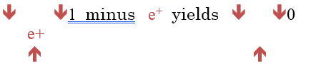






2. Proton-Proton Chain Reactions in Stars
Positrons are ejected from protons to form neutrons, which combine with protons to form deuterons, which combine to form helium nuclei
1
OR
+
=
He
2
+
+
Deuteron
Deuteron

Slide 9
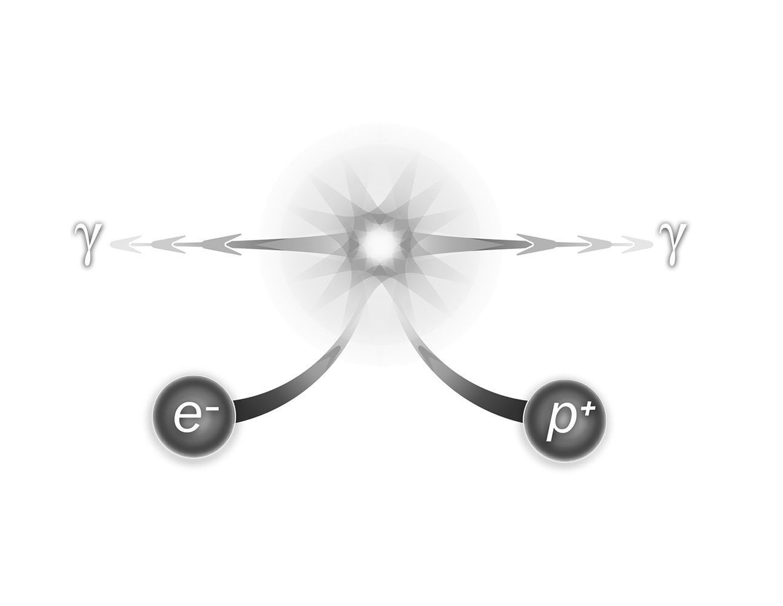
3. Expansion of the Universe
In proton-proton chain reactions in stars, positrons ejected from hydrogen nuclei encounter nearby electrons & annihilate
1. Photons (2 511-keV gamma rays) and neutrinos are generated
2. Neutrinos, which have mass, are accelerated to nearly c – expanding spacetime under the General Theory
3. If stars are increasingly active in the Universe, then the rate of expansion of the Universe will therefore increase
*p⁺ = e+

Slide 10


4a. Beta Decay (β+)
Within radioactive nuclei,
Similarly,
Likely cause: proton in nucleus struck by neutrino

Slide 11
4b. Beta Decay (β-)
Likely cause: neutrino lyses into electron & positron, depositing positron into nucleus

Slide 12
Composite Hadron Structure Is Consistent With:
Equal amounts of matter and antimatter in the Universe
Presence of pions (and their observed masses) in collider experiments
Proton-proton chain reactions in stars
Generation of positrons in petawatt laser experiments
Observed hydrogen/helium composition of stars
Expansion of Universe & increasing rate of expansion of Universe
Beta decay (β+ and β-)
Half-lives of radioactive isotopes as a 2nd-order kinetic
Observed declining half-lives of Voyager fission generator

Slide 13
Potential for Even Greater Simplicity in the Composite Hadron Structure – Pentaquarks and Tetraquarks
Tetraquarks and Pentaquarks have been discovered at the Large Hadron Collider
  LHCb Collaboration, “Observation of J/ΨP resonances consistent with pentaquark state in Λ → J/ΨK- p decays,” Phys. Rev. Lett. 115: 072001 (2015).
  LHCb Collaboration, “Observation of an exotic narrow doubly charmed tetraquark,” Nat. Phys. 18: 751-54 (2022).

Slide 14
Simplified Composite Hadron Structure
Because total positive quark/antiquark charge in initial atomic state (slide 7) is 6, and the total negative quark/antiquark charge in initial atomic state is 6 (which match the positive 6 and negative 6 charges of the electrons and positrons), it is likely that the distinction of up and down quarks & antiquarks is misplaced
May be better to think of positive quarks and negative quarks each with 1/3 of the charge of an electron or positron (equal to currently-understood down quark and down antiquark)
Stable pentaquark and tetraquark matter/antimatter structure of hadrons is likely

Slide 15
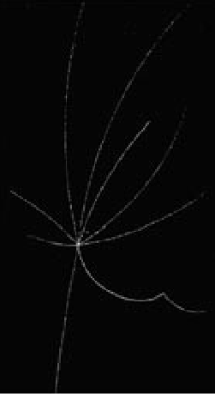
Next Steps:
Further testing/verification is called for
Implications of composite hadron structure should be evaluated:
  Revisit prior collider results (e.g., Bevatron results)
  Mathematically address presence of positrons within hadrons
  Further evaluate cosmological effect of composite hadron structure on evolution of the Universe
  Mathematically address possibility of quarks/antiquarks as simply positive & negatively charged fundamental structures (charge = +1/3 or -1/3) forming stable pentaquark and tetraquark hadrons (sometimes conjoined with a positron); i.e., currently-understood down quark and down antiquark quark are the fundamental building blocks of hadrons in the Universe
Proton/Antiproton Bevatron collision

Slide 16
Thank You!
Please address questions, comments, criticism to:
mark.pickrell@albireoscientific.net
Working paper: https://hal.science/hal-04261243/document
An updated version of this working paper is exclusively under consideration at Physics Essays, currently in post-peer-review process

Slide 17
Sources
Images
1. Positron: https://%3A%2F%2Fi.pinimg.com%2Foriginals%2F27%2Fc9%2Fd4%
2F27c9d4d46dc9f37b5ce522ea42bd61f0.jpg
2. K meson to ∏⁺: https://www.cloudylabs.fr/wp/kaoninteractions/
3. Proton/Antiproton Bevatron collision: https://indico.cern.ch/event/104466/attachments/
15569/22575/The_Bevatron.pdf

Slide 18
Sources
Select Publications
1. H. Bethe & W. Heitler On the stopping of fast particles and on the creation of positive electrons, Proc. Roy. Soc. A 146: 83 (1934).
2. O. Chamberlain, E. Segrè, C. Wiegand, and T. Ypsilantis, Observation of antiprotons, Phys. Rev. 100: 947-50 (October 24, 1955).
3. H. Chen, et al., “Relativistic positron creation using ultraintense short pulse lasers,” Phys. Rev. Lett. 102: 105001 (2009).
4. J.H. Christenson, J.W. Cronin, V.L. Fitch, and R. Trulay, Evidence for the 2Π Decay of the K₂⁰ Meson. Phys. Rev. Lett. 13(4): 138-40 (July 27, 1964).
5. LHCb Collaboration, “Observation of J/ΨP resonances consistent with pentaquark state in Λ → J/ΨK- p decays,” Phys. Rev. Lett. 115: 072001 (2015).
6. LHCb Collaboration, “Observation of an exotic narrow doubly charmed tetraquark,” Nat. Phys. 18: 751-54 (2022).
7. S. Mertens, Direct neutrino mass experiments, J. Phys. Conf. Series 718 (2): 022013 (2016)

Slide 19
Sources
Henderson
Dissertation
With Permission of Dr. Henderson
A.H. Henderson, “Monte-Carlo simulation and measurements of electrons, positrons, and gamma-rays generated by laser-solid interactions,” Rice University, Houston Texas (January 2015) (doctoral dissertation)
Henderson’s dataset: DOI//10.6084/m9.figshare.24319894
Henderson’s comparator: https://www.nndc.bnl.gov/nudat3/getdataset.jsp?nucleus=196Pt&unc=nds

