Slide 1
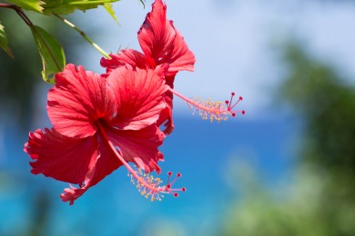
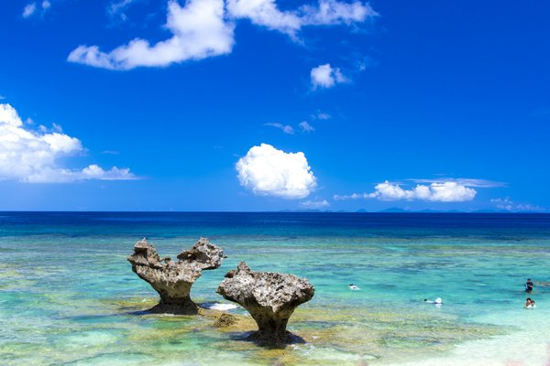

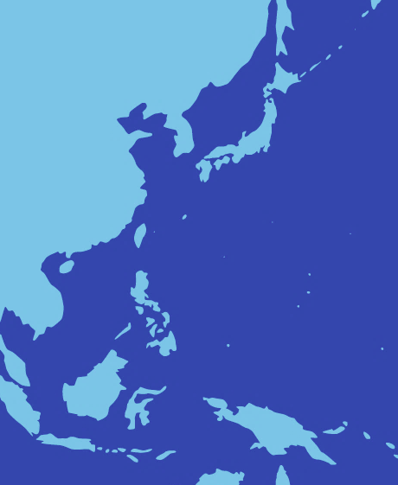
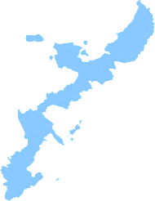
First Call for Papers
ISDEIV 2023
June 25-30, 2023
Naha, Okinawa, Japan
About ISDEIV
The International Symposium on Discharge and Electrical Insulation in Vacuum
(ISDEIV) is a non-profit, international organization whose purpose is to encourage
the advancement of the science and application of electrical insulation and discharges
in vacuum, primarily by conducting symposia for the exchange of scientific information.
The Symposia are usually held biennially. The symposia are interdisciplinary meetings for the exchange of results, presentation of progress, and discussion of ideas and challenges for the future in the field of electrical discharges and insulation in vacuum. Both fundamental and applied aspects are covered. Symposia programs consist of invited talks, invited oral contributions, and posters. Minicourses and informal discussions on relevant topics may also be offered in addition to the regular Symposium schedule.
Main Topics
A: BREAKDOWN AND FLASHOVER
A1. Vacuum breakdown and pre-breakdown phenomena
A2. Surface discharges and flashover phenomena
B: VACUUM ARCS
B1. Switching in vacuum and related phenomena
B2. Interaction of vacuum arcs with magnetic fields
B3. Vacuum arc physics
B4. Computer modeling and computer aided design
B5. Pulsed power physics and technology
C: APPLICATIONS
C1. Vacuum interrupters and their applications
C2. Surface science and modification and related technologies
C3. Electron, ion, neutron, X-ray and other beam and light sources
C4. Accelerator and fusion reactor related issues
C5. Space related technologies
C6. Vacuum microelectronics and their applications
D: OTHERS
Okinawa
City Information
The only prefecture in Japan within a subtropical region is Okinawa, which has been fostering its own culture as an independent kingdom. Domestic flights to Okinawa are frequently operated from Japanese hub-airports including Haneda, Kansai and Chubu. The domestic flight time is 2-3 hours. Many international flights are also available from Asian countries such as South Korea, China and Singapore. Explore the ruins, vast sea blue and rain-forest green nurtured in the long history of Okinawa. The sight of the magnificence gives you a feeling of the eternal flow of time.
Venue
Okinawa Jichikaikan: 15 mins by monorail from Naha Airport
Address: 116-37, Asahimachi, Naha, Okinawa 900-0029, Japan Tel: +81-98-862-8181

Slide 2
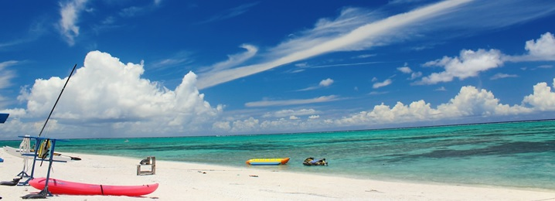
First Call for Papers: ISDEIV 2023
June 25-30, 2023
Naha, Okinawa, Japan
Important dates
- Deadline for abstract submission : September 15, 2022
- Notification of abstract acceptance : December 15, 2022
- Deadline for full paper submission : March 15, 2023
- Notification of full paper acceptance : April 24, 2023
- Conference : June 25 – 30, 2023
Contact us
E-mail : isdeiv2023@epower.ees.saitama-u.ac.jp
Website : http://isdeiv2023.w3.kanazawa-u.ac.jp
Permanent International Scientific Committee - PISC
Shenli JIA
Alexander BATRAKOV
Michael KURRAT
Matthew M. HOPKINS
René P.P. SMEETS
Raymond L. BOXMAN
Edgar DULLNI
Leslie T. FALKINGHAM
André ANDERS
P.R. China, (Chair)
Russia, (Vice Chair)
Germany, (Secretary)
USA, (Treasurer)
Netherlands (Awards Comm. Chair)
Israel
Germany
United Kingdom
USA
Eiji KANEKO
Sandeep KULKARNI
Akiko KUMADA
H. Craig MILLER
Antonio De LORENZI
Sergej SHKOL'NIK
Dirk UHRLANDT
Satoru YANABU
Jiyan ZOU
Japan
India
Japan
USA
Italy
Russia
Germany
Japan (P.R. China)
P.R. China
Local Organizing Committee - LOC
E. Kaneko, Chair (University of the Ryukyus)
A. Kumada, Vice Chair (The University of Tokyo)
Y. Yamano, Secretary (Saitama University)
H. Kojima, Editor of Proceedings (Nagoya University)
S. Harada (University of the Ryukyus)
S. Yanabu (Xi'an Jaotong University)
S. Kobayashi (Saitama University)
S. Kajita (Nagoya University)
T. Iwao (Tokyo City University)
Y. Inada (Saitama University)
K. Toyoda (Kyusyu Institute of Technology)
H. Akatsuka (Tokyo Institute of Techonology)
M. Sasaki (University of Tsukuba)
T. Fujino (University of Tsukuba)
Y. Tanaka (Kanazawa University)
Y. Nakano (Kanazawa University)
H. Iwabuchi (Shonan Institute of Technology)
Y. Niwa (Toshiba Corporation)
N. Asari (Toshiba Corporation)
H. Urai (Daido University)
H. Morita (Hitachi, Ltd.)
H.Torii (Fuji Electric CO., LTD.)
T. Donen (Mitsubishi Electric Corporation)
H. Fukuda (MEIDENSHA CORPORATION)
T. Abe (KEK)
K. Nitta (JAXA)
A. Kojima (QST)
K. Murakami (AIST)

