Slide 1

30th International Symposium
on Discharges and Electrical Insulation in Vacuum
(ISDEIV 2023)
June 25-30, 2023
Okinawa, Japan
Sep. 30, 2021

Slide 2

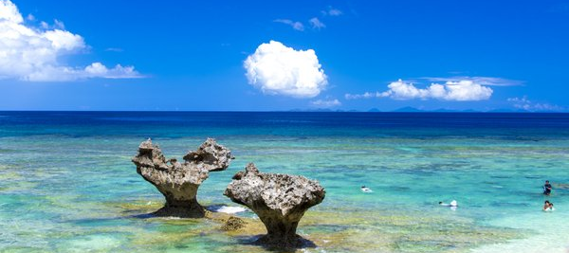
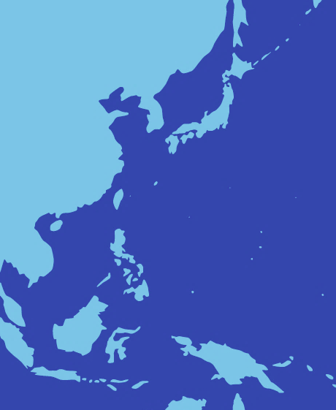
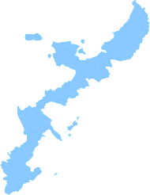
ISDEIV 2023
Next ISDEIV Location and Date
Dates
June 25-30, 2023
Location
Okinawa, Japan
Okinawa
Venue
Okinawa Jichikaikan
(Okinawa Pref. Municipal Center)

Slide 3
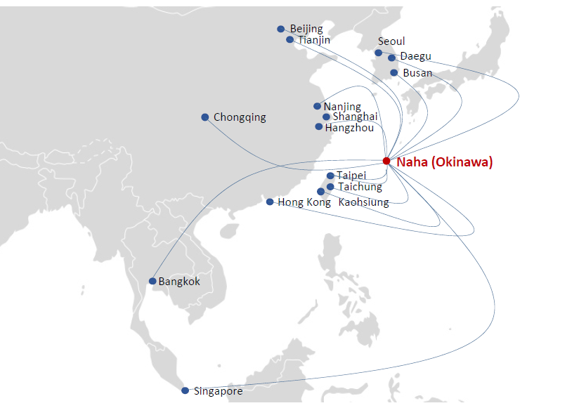
◆Good Air Accessibility
Okinawa’s Network 1
Okinawa has historically had a close relationship with Asia, and even today many international flight from Asian cities are served.

Slide 4
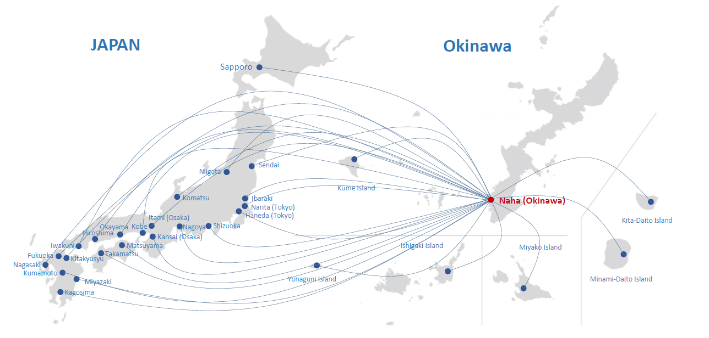
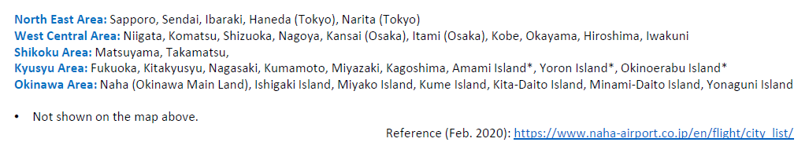
◆Good Air Accessibility
Okinawa’s Network 2

Slide 5
Next ISDEIV Venue
◆
Venue
Okinawa Jichikaikan
(Okinawa Pref. Municipal Center)

Slide 6
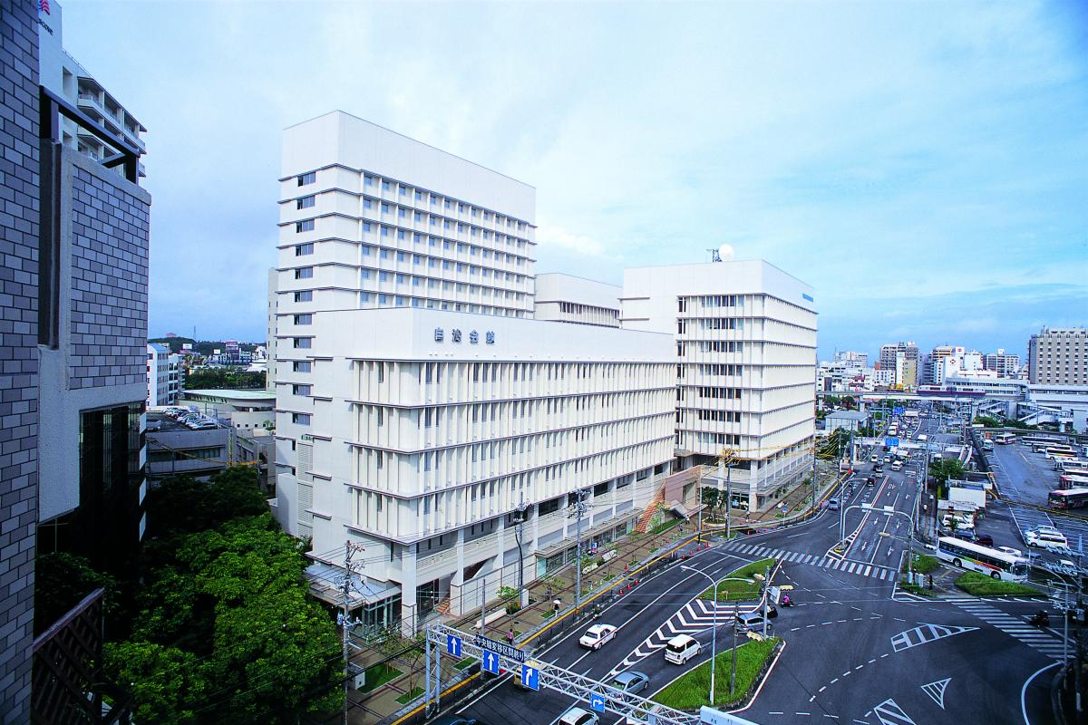
◆Event Venue
Okinawa Jichikaikan
Monorail

Slide 7
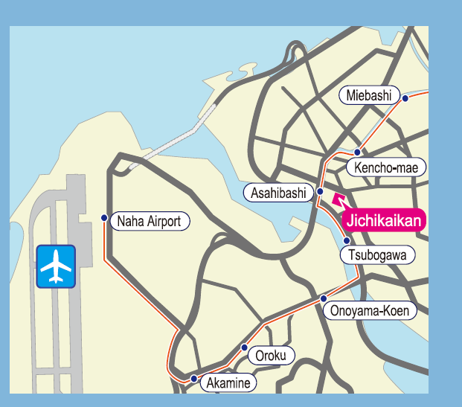
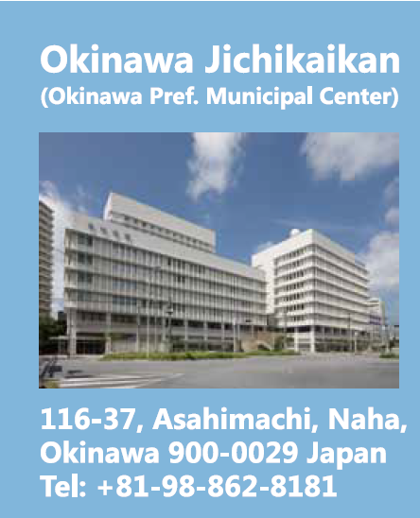
◆Event Venue
Okinawa Jichikaikan
Easy access to the venue
4.2km away from Naha airport to the venue (15min by monorail)
※Not required to operate shuttle bus.

Slide 8
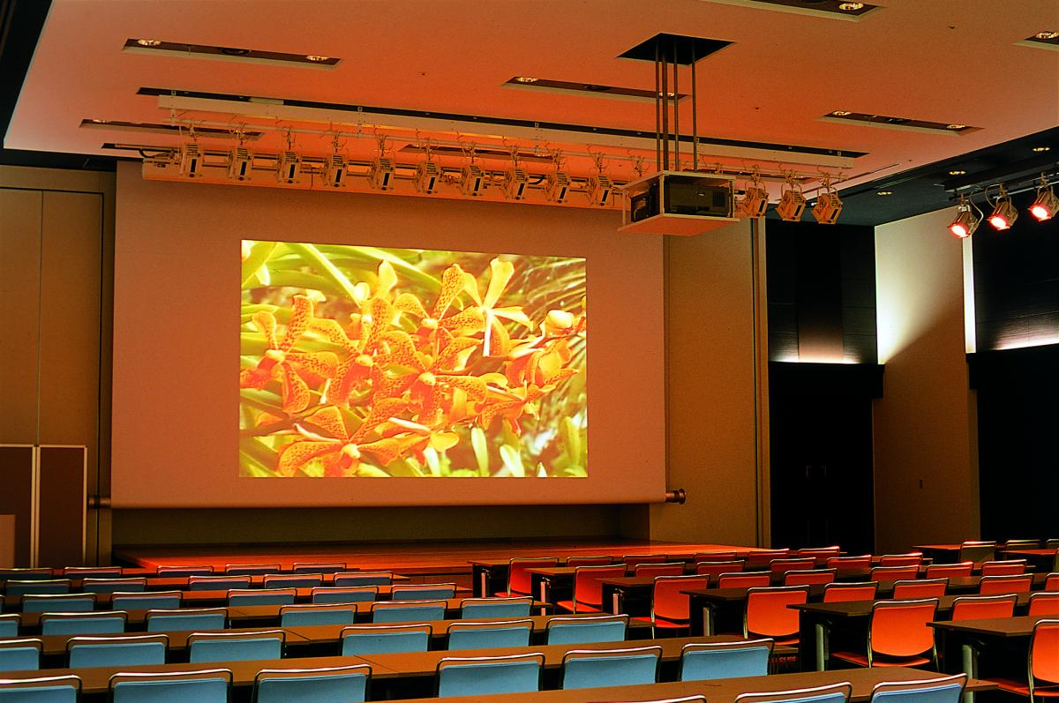
◆Event Venue
Main Hall (2F)

Slide 9
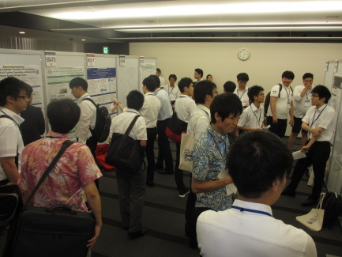
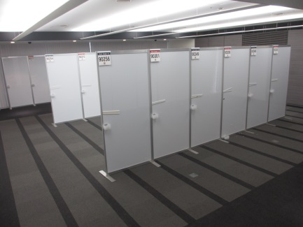
◆Event Venue
Poster session (４F)

Slide 10
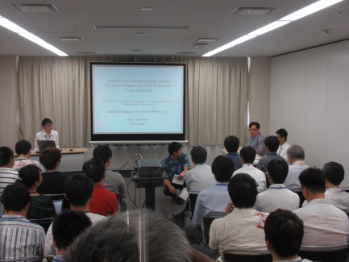

◆Event Venue
Meeting Rooms and Executive room(４F)

Slide 11
◆Accommodation
[Proposed 1] Okinawa Jichikaikan
Hotel Map
 | Hotel
① | RIHGA ROYAL GRAN OKINAWA
② | Double Tree by Hilton Hotel Naha
③ | Hotel Yuquesta Asahibashi
④ | Ryukyu Sun Royal Hotel
⑤ | GRG Hotel Naha
⑥ | OKINAWA NaHaNa HOTEL&SPA
⑦ | Daiwa Roynet Hotel OKINAWA-KENCHOMAE
⑧ | Comfort Hotel Naha Prefectural Office
⑨ | Route Inn Naha Asahibashieki Higashi
⑩ | Okinawa Harborview
⑪ | Naha Tokyu REI Hotel
International Terminal
Okinawa Jichikaikan
Naha Airport
Domestic Terminal

Slide 12
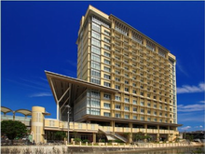
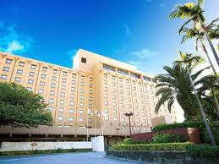
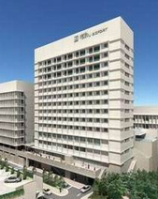
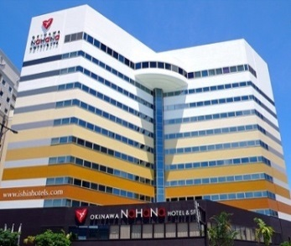
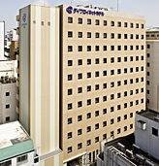
◆Accommodation
Hotel List
 | Hotel
① | RIHGA ROYAL GRAN OKINAWA
② | Double Tree by Hilton Hotel Naha
③ | Hotel Yuquesta Asahibashi
④ | Ryukyu Sun Royal Hotel
⑤ | GRG Hotel Naha
⑥ | OKINAWA NaHaNa HOTEL&SPA
⑦ | Daiwa Roynet Hotel OKINAWA-KENCHOMAE
⑧ | Comfort Hotel Naha Prefectural Office
⑨ | Route Inn Naha Asahibashieki Higashi
⑩ | ANA Crowne Plaza Okinawa Harborview
⑪ | Naha Tokyu REI Hotel
RIHGA ROYAL GRAN OKINAWA
Naha Tokyu REI Hotel
ANA Crowne Plaza Okinawa Harborview
OKINAWA NaHaNa HOTEL&SPA
Daiwa Roynet Hotel OKINAWA-KENCHOMAE

Slide 13
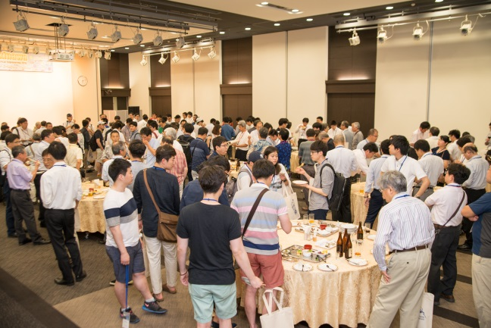
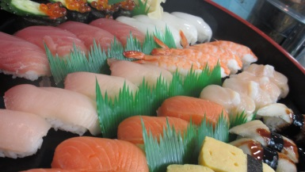
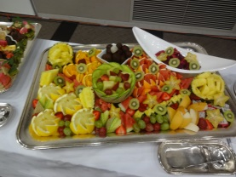
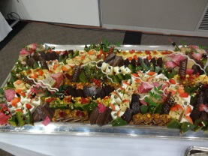

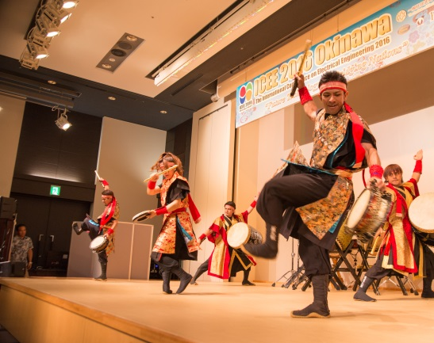

◆Event Venue
Event

Slide 14
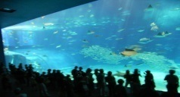
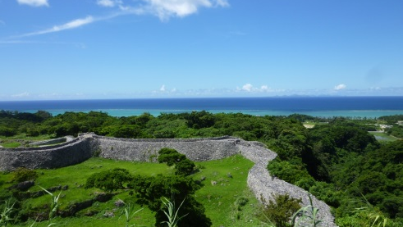
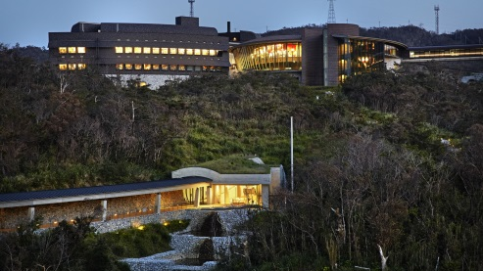
◆The Participants Service
Excursions
To enjoy and experience Okinawan great nature and history.
Ａ course: “Churaumi aquarium”
World-class Aquarium
“Churaumi Aquarium”
Hotel === Ryukyu village === Cape Manza ===
Churaumi aquarium === Hotel
Ｂ course: “Nakijin Castle Remains”
Northern Okinawa
＜ World Heritage ＞
Nakijin castle remains
Hotel === Kouri bridge === Nakijin Castle remains
=== Pineapple park === Hotel
Ｃ course: “OIST and Ryukyu village”
Okinawa Institute of Science and
Technology (OIST) and Ryukyu Village
Hotel ===Okinawa Institute of Science and Technology
=== Ryukyu village === Hotel

Slide 15
ISDEIV 2023
June 25-30, 2023 Naha, Okinawa, Japan
Dates
June 25-30, 2023
Location
Okinawa, Japan
Okinawa
Venue
Okinawa Jichikaikan
(Okinawa Pref. Municipal Center)

Slide 16
ISDEIV 2023
Important dates
- Deadline for abstract submission : September 15, 2022
- Notification of abstract acceptance : December 15, 2022
- Deadline for full paper submission : March 15, 2023
- Notification of full paper acceptance : April 24, 2023
- Conference : June 25 – 30, 2023

Slide 17
30th International Symposium
on Discharges and Electrical Insulation in Vacuum
(ISDEIV 2023)
June 25-30, 2023
We hope to see you again in Okinawa, Japan.

Slide 18

ISDEIV2023 URL & E-mail address
http://isdeiv2023.w3.kanazawa-u.ac.jp/index.html
isdeiv2023@epower.ees.saitama-u.ac.jp

Slide 19
