Slide 1
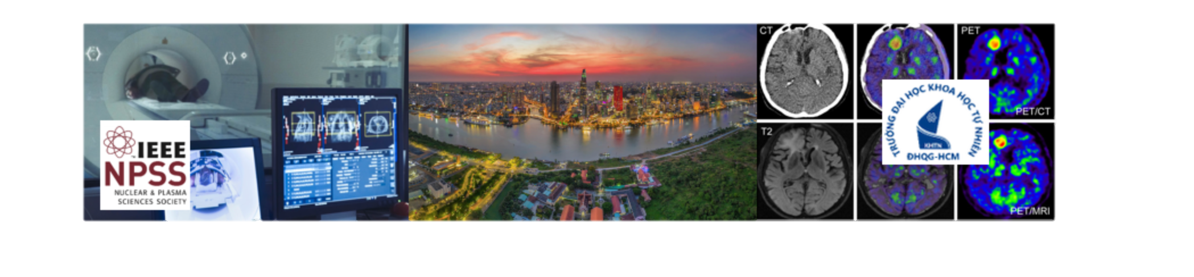


IEEE NPSS School on Advanced Topics in Molecular Imaging
– Ho Chi Minh City, 2025

Slide 2
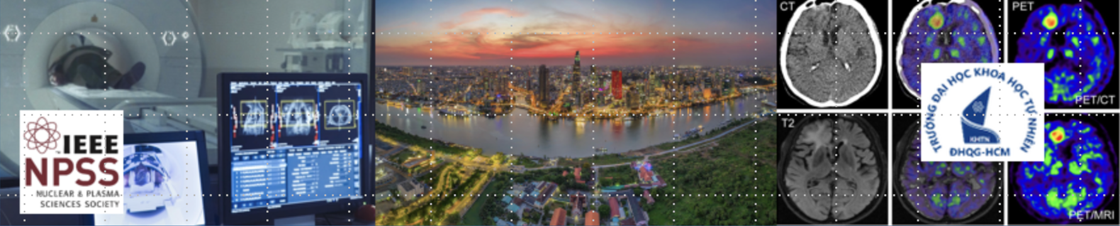
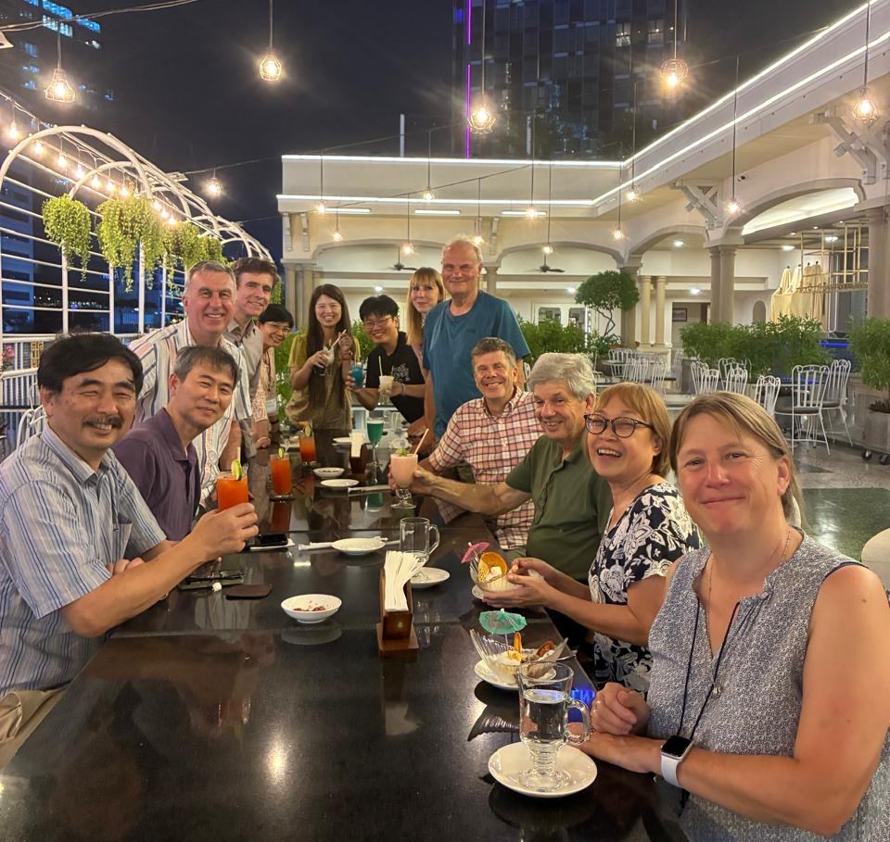
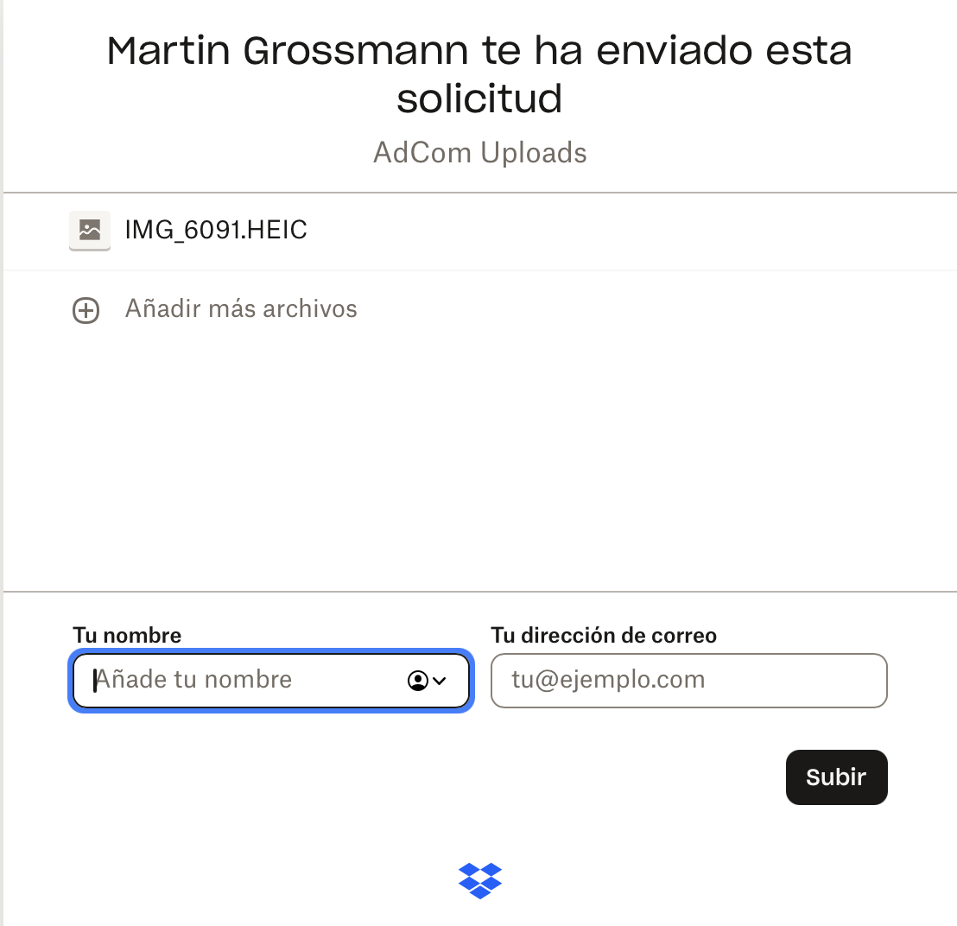
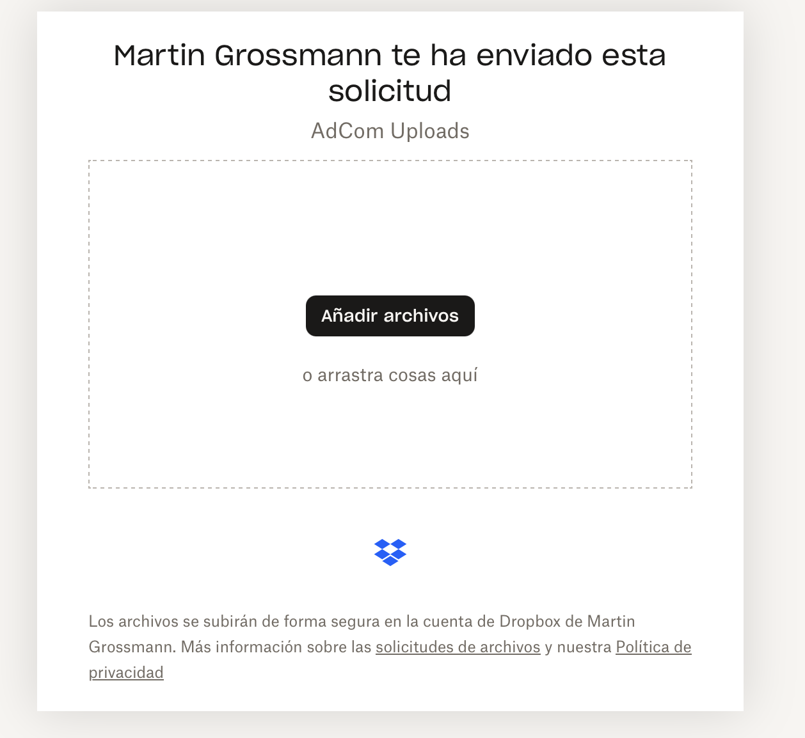

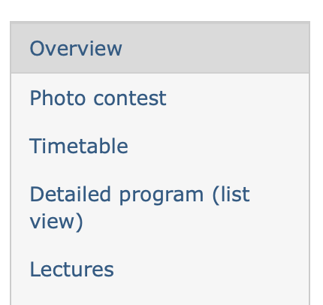
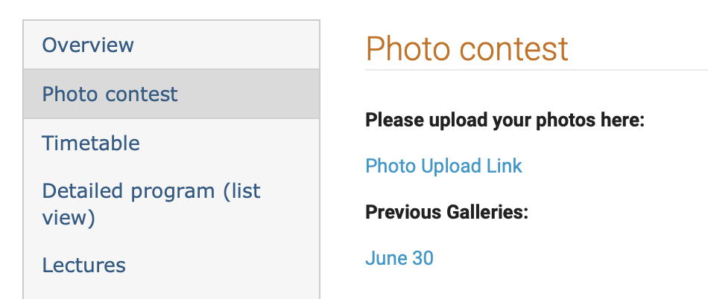
What is this?
What is this?
What is this? How this works?
  Take nice/funny/inspiring photos related to our school and your time in Prague!
  Submit the photos on Indico

Slide 3

What is this?
What is this?
We will review your uploaded photos
  One will be selected
  The winner will be rewarded with a NPSS gift!
Photo contests announcement
  → Monday 18th after the Student presentations

