Slide 1
Linear accelerator
National University of Laos
Faculty of natural science
department of physics
student: Mr. som xay xiong
Ms. Chansamone Xaiyavong

Slide 2
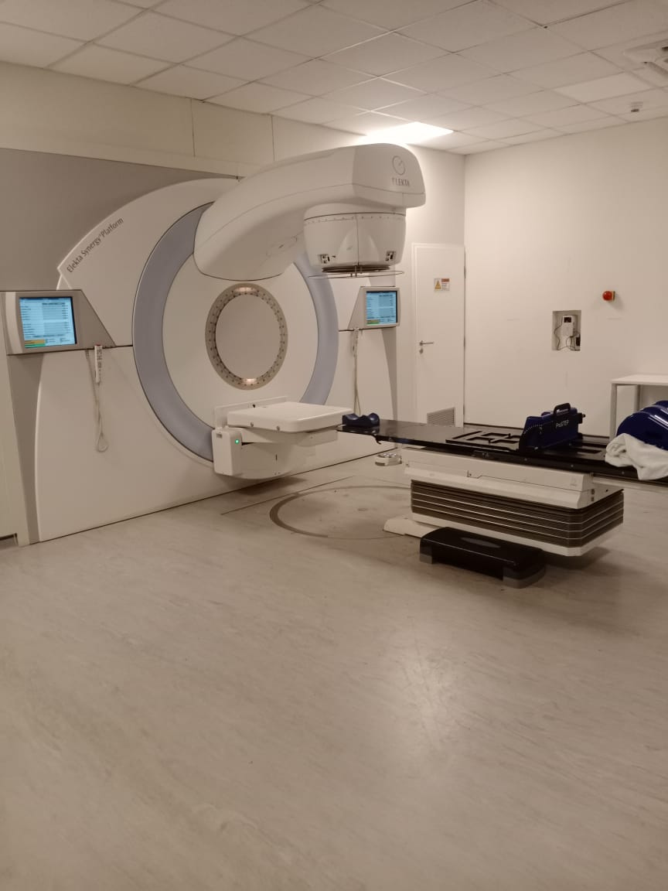
ELEKTA Application
ELEKTA is a leading company in radiation therapy equipment.
A linear accelerator (LNAC) is a machine that use X-ray (photon).
or Electron to treat cancer.
Work by accelerating electron and then directing them to produce a treatment beam
The goal kill tumor calls while protecting normal tissue.

Slide 3
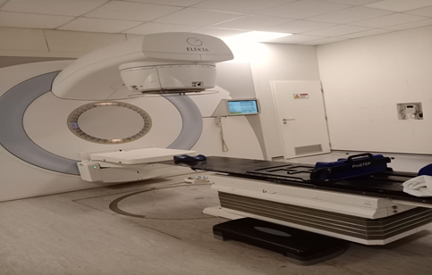
ELEKTA
it has two type of energy are X-ray(photon) and Electron
Photon beams (6MV,10MV,15MV,etc)
Electron beams (6-16Mev)
Can be used for different treatment sites (brain, lung, breast, chest, etc)
Flexible accurate and reliable machine

Slide 4
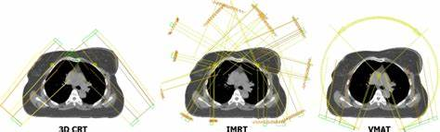
3D-CRT
Use CT images of the patient to plan treatment.
Radiation beams are shaped to match the tumor size and shape
Delivers dose precisely to match the tumor while reducing dose to nearby healthy tissue.

Slide 5
IMRT and VMAT
IMRT is an advanced radiotherapy technique that uses computer-controlled multiple collimators to vary the intensity of radiation beams. This allows us to treat irregularly shaped tumors more effectively while protecting sensitive organ.
VMAT is an advanced radiotherapy technique where the linear accelerator rotates around the patient while continuously adjusting beam shape and dose rate. It delivers highly conformal treatment in a much shorter time compared to IMRT

Slide 6
COCLUSION
ELEKTA is as modern and versatile linear accelerator
delivers treatment such as 3D-CRT,IMRT,and VMAT
Improves accuracy , safety and patient outcome

Slide 7
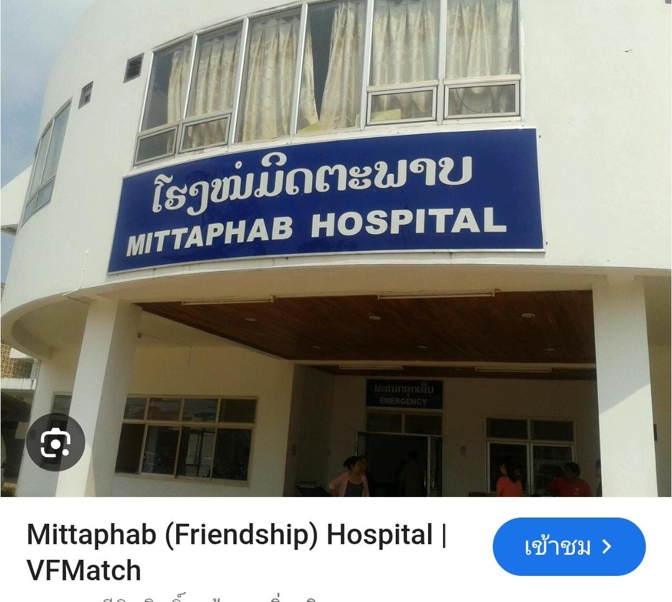
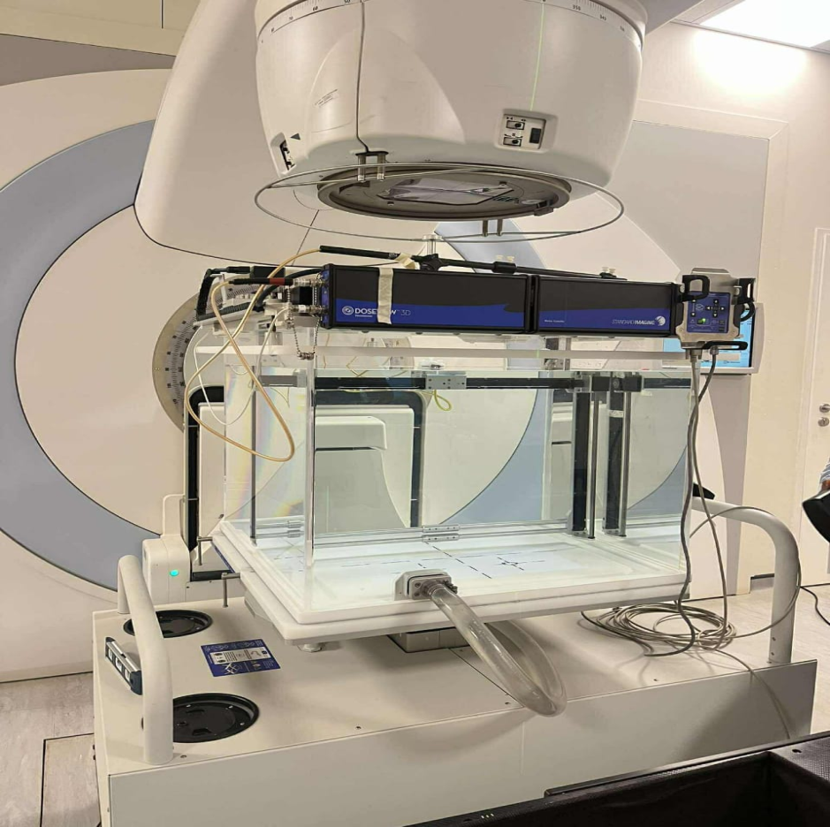
Mittaphab hospital

Slide 8
Thank you

