Slide 1
What I Learned from the School
Trần Khánh Ngân
University of Science, VNUHCM
August 18, 2025, Ho Chi Minh City

Slide 2
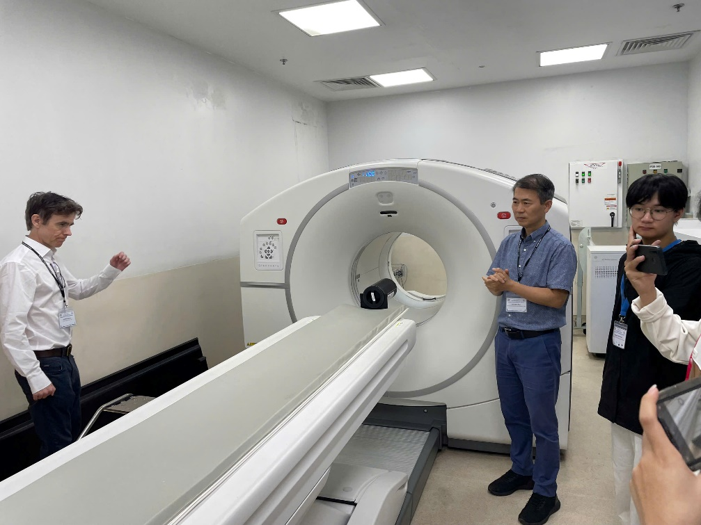
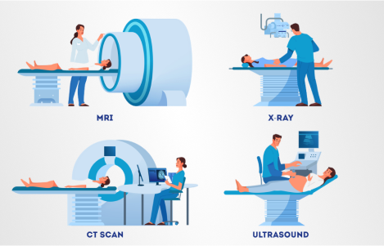
Medical Imaging Techniques
X-Ray, CT Scan, MRI, Ultrasound
PET, SPECT
Hybrid Imaging (PET/CT, SPECT/CT)
https://www.medicoverhospitals.in/articles/x-rays-mris-ct-scans-ultrasounds-improve-diagnostic-accuracy-kurnool

Slide 3
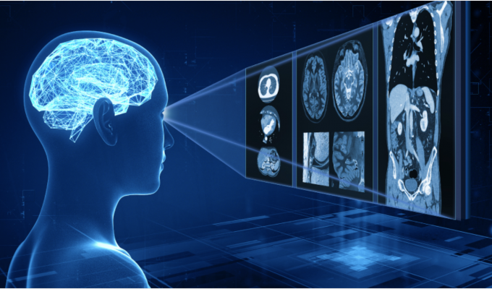
Improvements in Medical Imaging
Clearer images, less noise
Lower radiation dose, safer for patients
AI helps in image processing and diagnosis

Slide 4
Applications & Challenges of Medical Imaging
Applications:
Early disease detection (cancer, brain disorders)
Support for treatment (surgery & radiotherapy planning)
Research & innovation (neuroscience, oncology)
Challenges:
High cost & limited access
Radiation dose & safety
Complexity & training

Slide 5
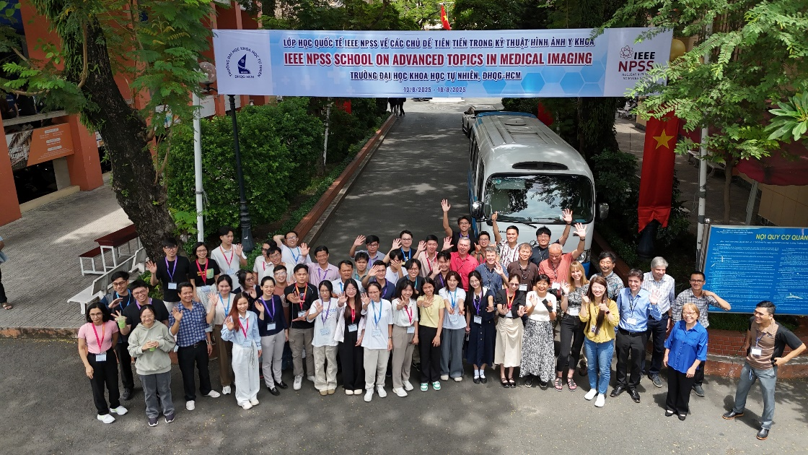
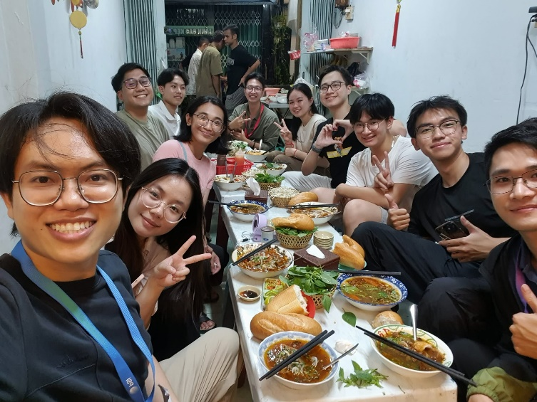

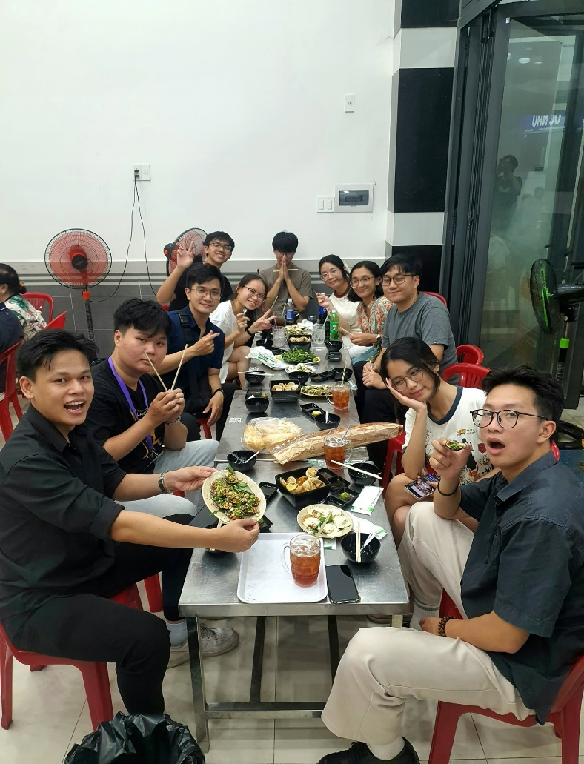
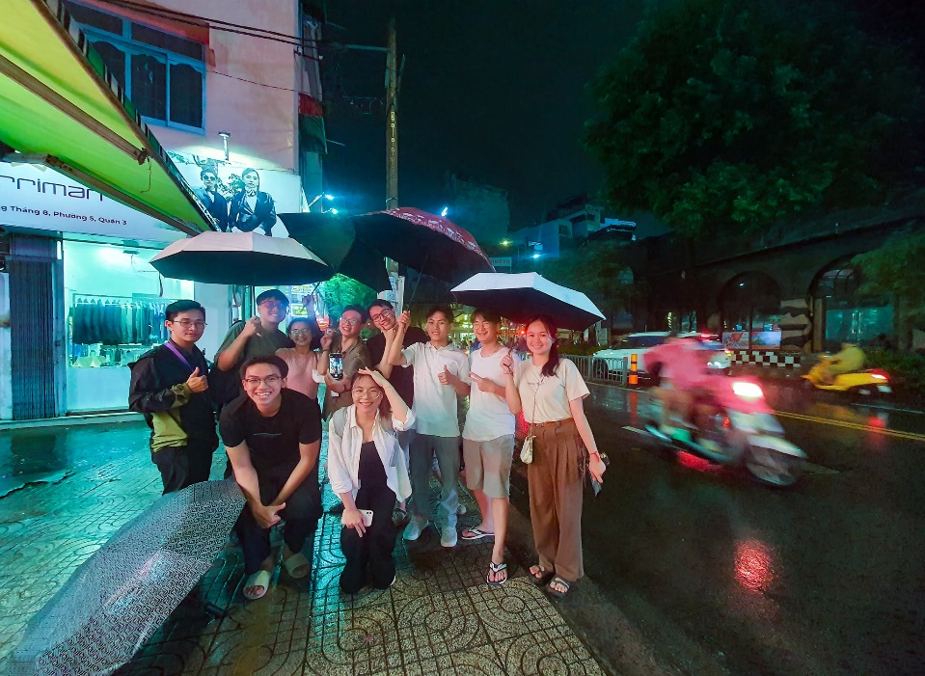
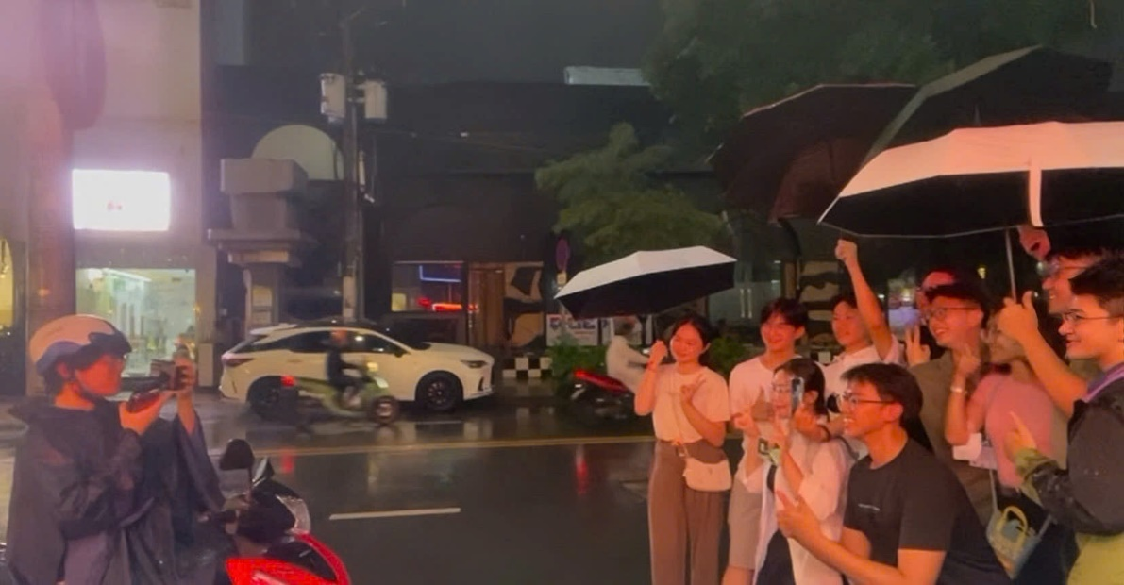
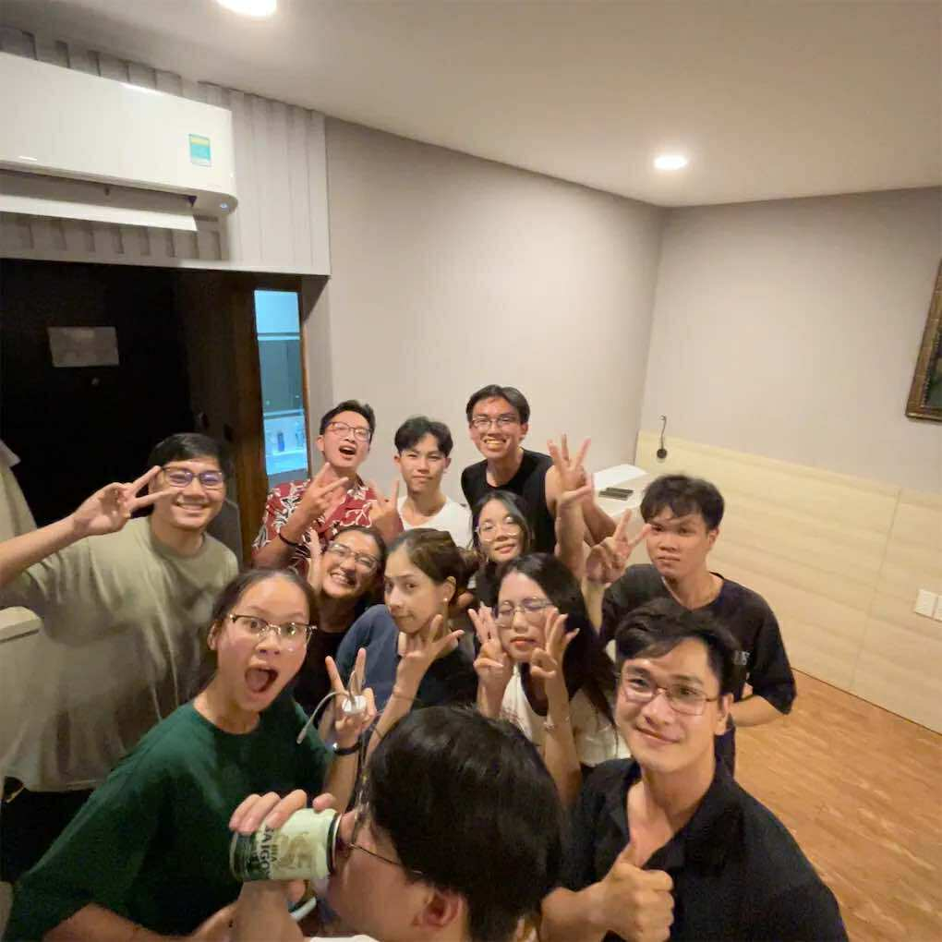
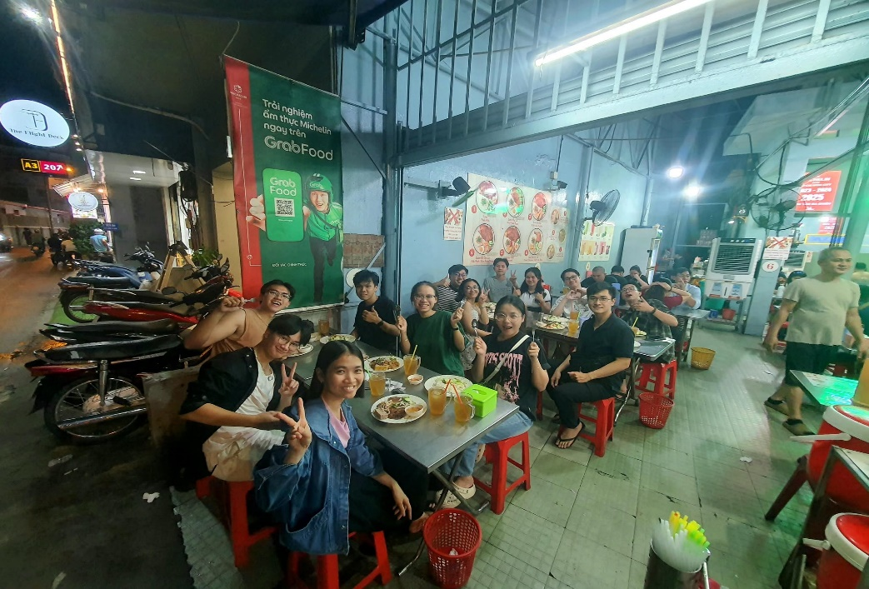


Slide 6
MANY THANKS FOR YOUR LISTENING !

