Slide 1
Evaluation Metrics for Images Generated by Generative AI Models
Vuong Uy Luc

Slide 2
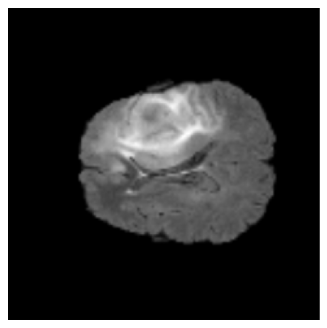
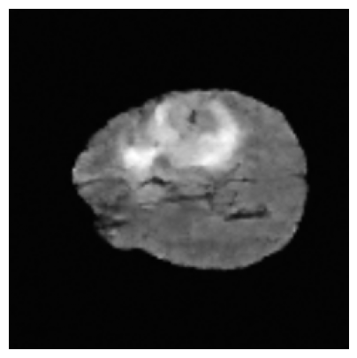
Problem in evaluated image generation
Evaluating generated images needs to be based on two main factors:
  Image quality – The generated images must be of high quality and similar to the dataset.
  Diversity – The Generator should be able to produce many different images belonging to various classes. If it only generates a few images or images from the same class repeatedly, then it’s not very meaningful.
Ground Truth
Generated image

Slide 3
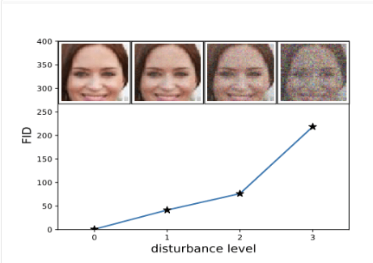
FID-Frechet Inception Distance
Compares the distribution of generated images with the distribution of a set of real images.
A lower FID indicates better-quality images (0 is perfect!).
$$d_{F}{\left(𝒩(μ,Σ),𝒩\left(μ^{′},Σ^{′}\right)\right)}^{2}={\left\|μ−μ^{′}\right\|}_{2}^{2}+tr\left(Σ+Σ^{′}−2{\left(ΣΣ^{′}\right)}^{\frac{1}{2}}\right)$$
Fig 1: Example of How Increased Distortion of an Image Correlates with High FID Score.[1]

Slide 4
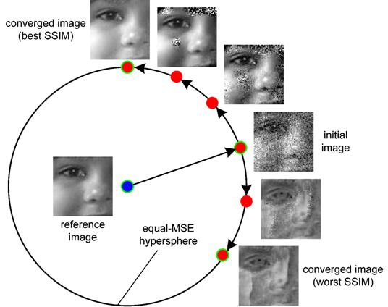

SSIM-Structural Similarity Index Measurement
Based on three parameters for comparison
  Luminance
  Contrast
  Structure
  $$SSIM(x,y)=[l(x,y)]^{α}⋅[c(x,y)]^{β}⋅[s(x,y)]^{γ}$$
SSIM ranges from -1 to 1, reaching a value of 1 when the two datasets are identical. The higher the SSIM value, the better the model’s performance.
Fig2. demonstrates the SSIM index map [2]

Slide 5
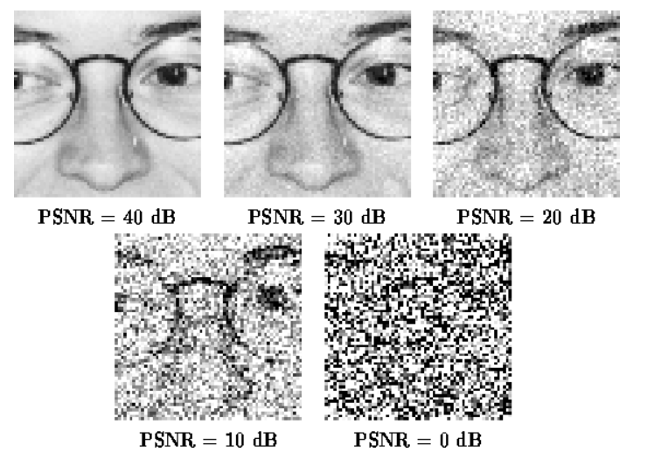
PSNR: Peak Signal-to-Noise Ratio
PSNR is used to calculate the ratio between the maximum possible signal power and the power of the distorting noise
PSNR is measured in decibels
Fig 3. Illustration of the PSNR measure[3]

Slide 6

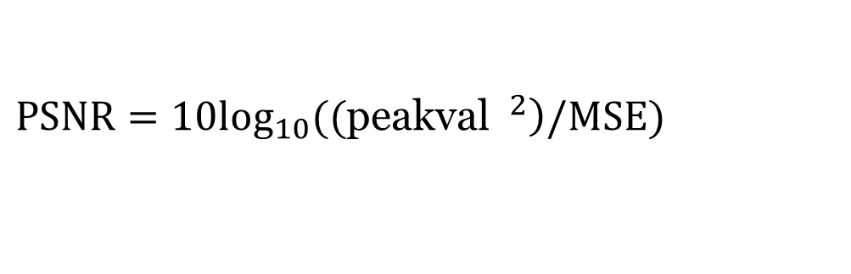
PSNR: Peak Signal-to-Noise Ratio
The PSNR is usually calculated as the logarithm term
$PSNR=10\log_{10}(($peakval $\left. ^{2}\right)/MSE)$
Here, peakval (Peak Value) is the maximum in the image data
Ex: 8-bit unsigned integer data type, the peakval is 255
Mean Squared Error (MSE) between two images such as $g(x,y)$ and $\overset{ˆ}{g}(x,y)$ is defined as:
$$\text{MSE} =\frac{1}{MN}\sum_{n=0}^{M}{ }\sum_{m=1}^{N}{ }[\overset{ˆ}{g}(n,m)−g(n,m)]^{2}$$

Slide 7
REFERENCES
[1] Heusel, M., Ramsauer, H., Unterthiner, T., Nessler, B., & Hochreiter, S. (2017). GANs Trained by a Two Time-Scale Update Rule Converge to a Local Nash Equilibrium. arXiv. https://arxiv.org/abs/1706.08500
[2] Zhou Wang, Alan C. Bovik, Hamid R. Sheikh and Eero P. Simoncelli, (2011,Feb. 11), The SSIM Index for Image Quality Assessment, https://www.cns.nyu.edu/~lcv/ssim/
[3] Todd Veldhuizen , 1998 , Measures of image quality https://homepages.inf.ed.ac.uk/rbf/CVonline/LOCAL_COPIES/VELDHUIZEN/node18.html

Slide 8

Thank you for listening

