Slide 1


Evaluation of Quality Assurance
for HyperArc Stereotactic Radiosurgery
Using the MyQA SRS System
7
Van Tung Duong, Student
University of Science, VNU-HCM
August 18th 2025, Ho Chi Minh City
1

Slide 2
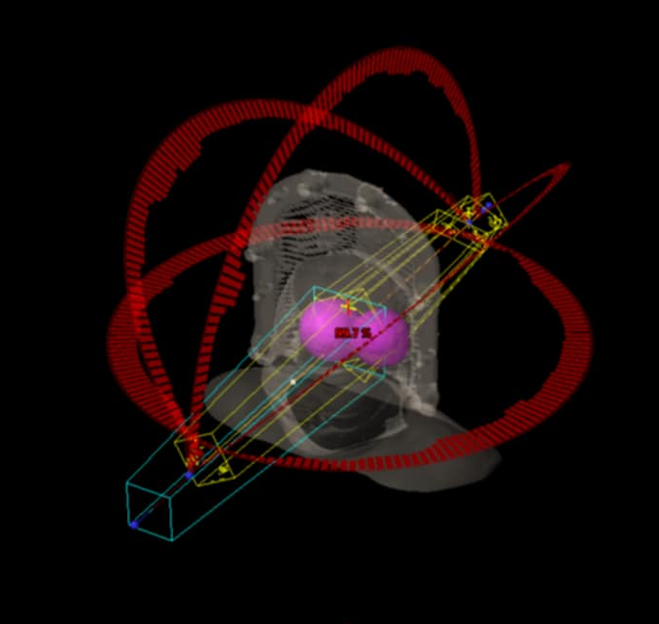
HyperArc Stereotactic Radiosurgery Technique
The HyperArc radiosurgery technique was specially developed by Varian, combining volumetric modulated arc therapy (VMAT) with non-coplanar arcs.
Enables treatment of multiple lesions simultaneously.
Delivers dose distributions with extremely steep gradients.
Optimizes treatment planning.
Figure 1. 3D simulation image of a HyperArc treatment plan.
2

Slide 3
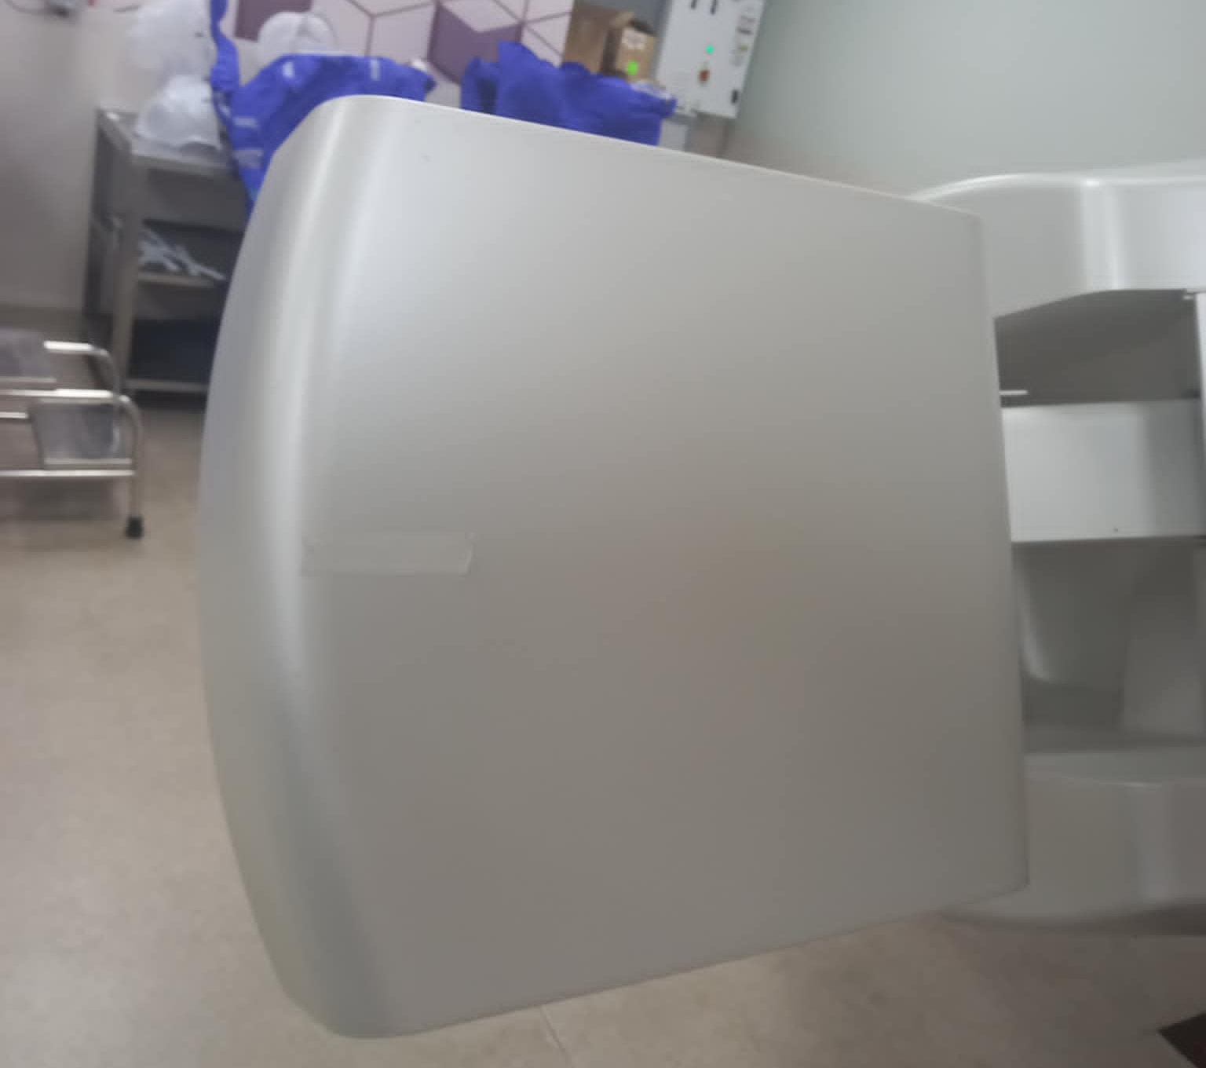
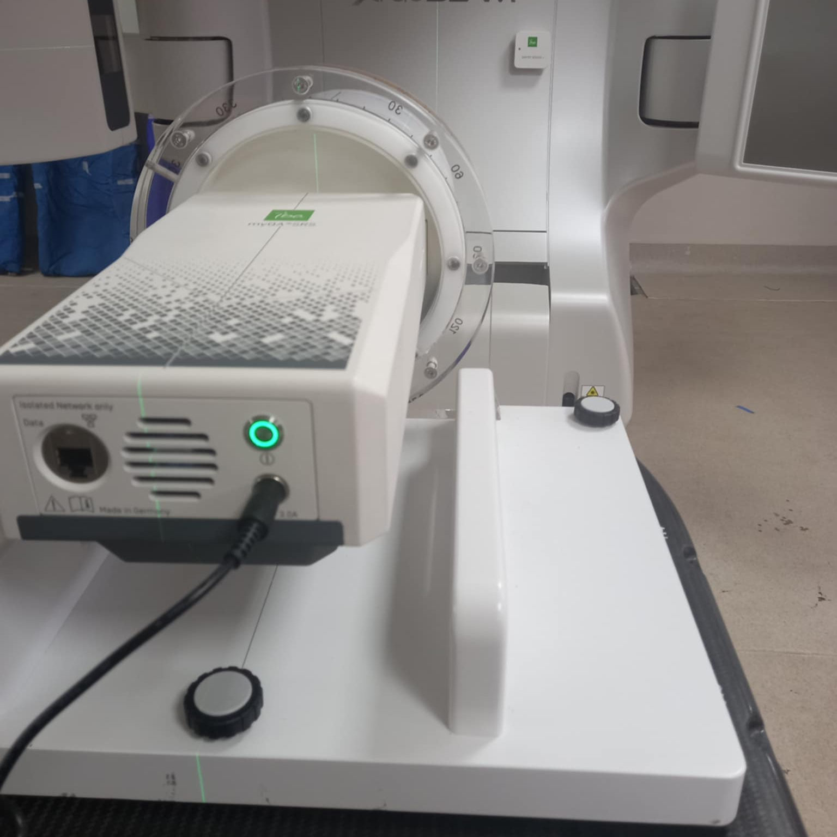
Quality Assurance for HyperArc Stereotactic Radiosurgery Treatment Plans
Figure 2. EPID
Figure 3. MyQA SRS
3

Slide 4
Subjects and Research Methods
Research Subjects
The MyQA SRS system
32 brain metastasis patients treated using the HyperArc radiosurgery technique
Research Methods
Retrospective analysis of 32 HyperArc treatment plans for brain metastasis.
Experimental setup to evaluate the effectiveness of the MyQA SRS system in QA of HyperArc treatment plans.
Comparison of QA performance between MyQA SRS and EPID in verifying HyperArc plans.
7
4

Slide 5
Procedure for Quality Assurance of HyperArc Stereotactic Radiosurgery Plans using MyQA SRS
SRS HyperArc plan
Simulation of the HyperArc plan on the myQA SRS phantom
QA plan verification and approval
CBCT
QA plan report to the linear accelerator
Reference plan extraction
Data acquisition and
Recording
Comparison
QA-verified SRS HyperArc plan
Figure 4. Procedure of QA for SRS HyperArc plans using MyQA SRS
9

Slide 6
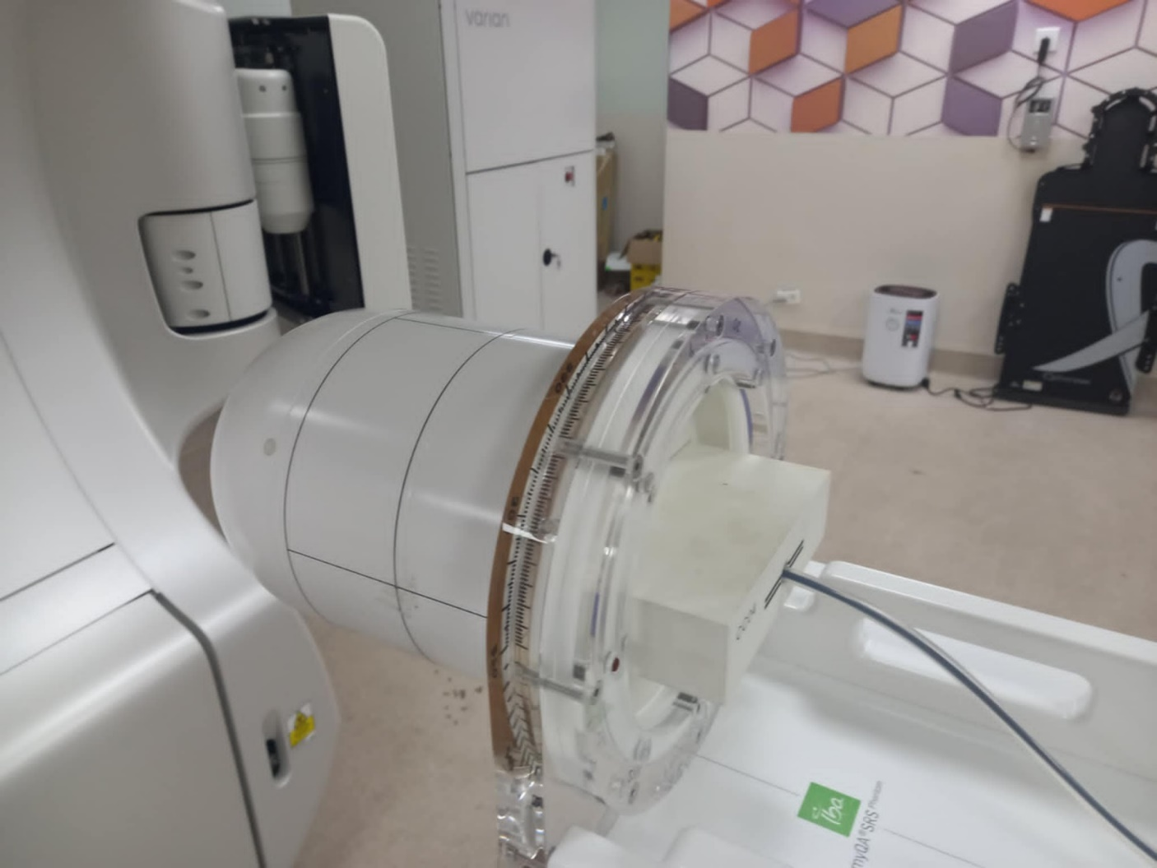
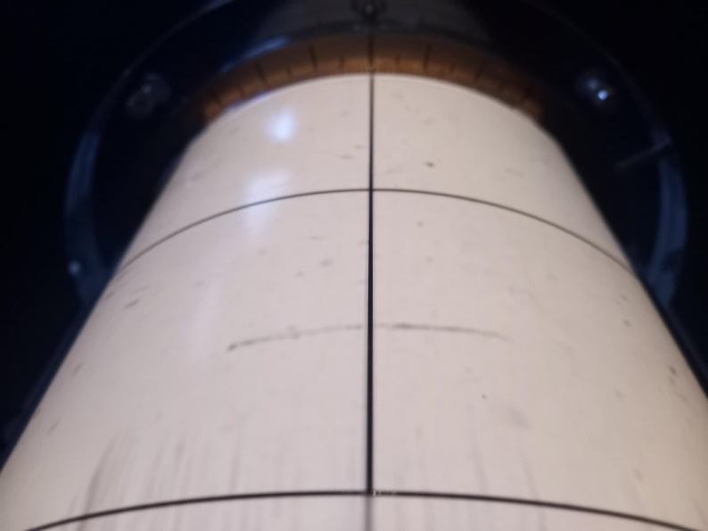

MyQA SRS System
Phantom MyQA SRS
Figure 5. Phantom MyQA SRS
Figure 6. The alignment markers on the MyQA SRS phantom
6

Slide 7
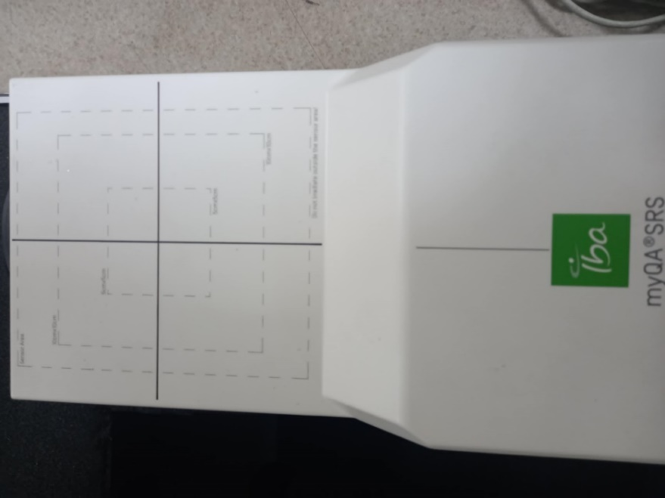
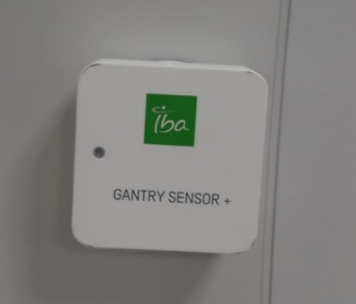
MyQA SRS System
MyQA SRS Detector
Gantry Sensor+
Figure 7. MyQA SRS Detector
Figure 8. Gantry Sensor+
7

Slide 8
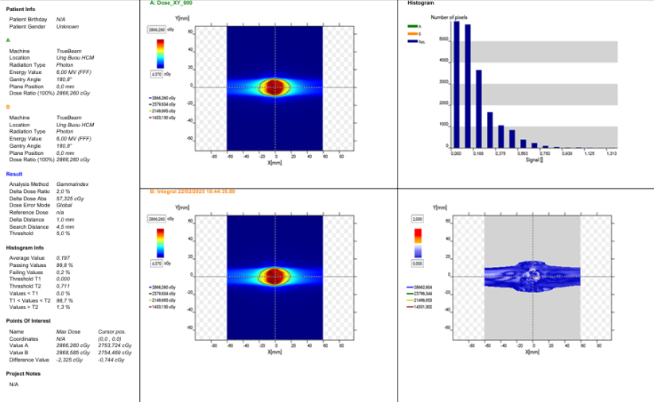
MyQA SRS System
MyQA Platform
Treatment plan analysis environment on the MyQA platform.
Supporting various techniques and compliant with TG-218, TG-135, and TG-148
Figure 9. Reporting of QA results using the MyQA SRS
8

Slide 9
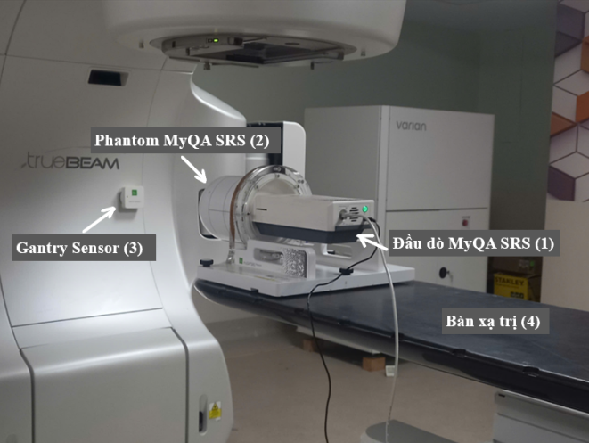
Experimental setup for QA using the MyQA SRS
Figure 10. Experimental setup for QA using the MyQA SRS
10

Slide 10
Results
Patient-specific QA was performed using a 2D method with the SRS phantom in combination with the myQA SRS detector array.
Gamma index analysis was conducted using criteria of 3%/2 mm, 2%/2 mm, 2%/1 mm, and 3%/1 mm. A gamma passing rate of ≥ 95%.
QA results were compared between measurements performed with the myQA SRS and EPID systems.
11

Slide 11
Results
Table 1a. Comparison of gamma index values according to the 3%/2 mm, 2%/2 mm,
2%/1 mm, and 3%/1 mm criteria
No. | Patient name | 3%/2mm |  | 2%/2mm |  | 2%/1mm |  | 3%/1mm
 |  | MyQA | EPID | MyQA | EPID | MyQA | EPID | MyQA | EPID
1 | LVT | 100 | 100 | 100 | 100 | 100 | 100,0 | 100 | 100
2 | NSH | 100 | 100 | 100 | 100 | 100 | 99,5 | 100 | 100
3 | VNH | 100 | 100 | 100 | 100 | 99,8 | 98,2 | 100 | 99,6
4 | NTLE | 100 | 100 | 100 | 100 | 100 | 99,5 | 100 | 99,5
5 | PTTT | 100 | 100 | 100 | 99,7 | 99,8 | 96,1 | 100 | 98,8
6 | VTTH | 100 | 99,9 | 100 | 99,9 | 99,4 | 99,1 | 99,9 | 99,9
7 | NTK | 100 | 99,9 | 99,9 | 99,9 | 99,3 | 99,2 | 100 | 99,8
8 | BHP | 100 | 100 | 100 | 98,8 | 99,8 | 94,6 | 100 | 94,7
9 | BTHV | 100 | 100 | 100 | 99,9 | 100 | 99,5 | 100 | 99,9
10 | TVH | 100 | 99,9 | 100 | 99,9 | 100 | 98,9 | 100 | 99,5
11 | TTTN | 100 | 100 | 100 | 100 | 100 | 99,5 | 100 | 99,9
12 | LTTT | 98 | 97,8 | 96,1 | 94,9 | 90,6 | 75,4 | 95,6 | 87,3
13 | NTD | 100 | 99,5 | 99,8 | 99,5 | 96,8 | 98,5 | 99,8 | 99,5
14 | TMT | 100 | 100 | 100 | 100 | 100 | 100 | 100 | 100
15 | LTL | 100 | 100 | 100 | 100 | 99,3 | 99,8 | 100 | 100
16 | LTKL | 100 | 100 | 100 | 100 | 100 | 99,8 | 100 | 100
12

Slide 12
Results
Table 1b. Comparison of gamma index values according to the 3%/2 mm, 2%/2 mm,
2%/1 mm, and 3%/1 mm criteria
No. | Patient name | 3%/2mm |  | 2%/2mm |  | 2%/1mm |  | 3%/1mm
 |  | MyQA | EPID | MyQA | EPID | MyQA | EPID | MyQA | EPID
17 | DVD | 99,9 | 99,6 | 99,7 | 99,5 | 98,5 | 98,8 | 99,7 | 99,7
18 | NTTH | 100 | 99,9 | 100 | 99,7 | 98,7 | 97,7 | 99,2 | 99,2
19 | TTA | 100 | 99,2 | 100 | 97,7 | 99,8 | 87,2 | 99,9 | 98,9
20 | NTHG | 99,1 | 98,4 | 96,9 | 96,5 | 88,7 | 88,0 | 94,60 | 96,3
21 | QTĐ | 99,7 | 94,7 | 98,9 | 89,6 | 95,2 | 70,8 | 97,8 | 82,7
22 | VVV | 100 | 99,8 | 100 | 98,6 | 95,5 | 89,1 | 98,5 | 97
23 | TTH | 100 | 98,4 | 100 | 96,6 | 97,1 | 88,9 | 99,1 | 96,7
24 | NTVD | 100 | 100 | 100 | 100 | 98,9 | 98,9 | 99,8 | 99,8
25 | TVT | 100 | 99,9 | 100 | 99,8 | 99,9 | 99,1 | 100 | 100
26 | GTHO | 100 | 100 | 100 | 100 | 100 | 99,5 | 100 | 100
27 | LTKH | 100 | 100 | 100 | 100 | 99,9 | 99,9 | 100 | 100
28 | TMVQ | 100 | 100 | 100 | 100 | 99,3 | 98,9 | 100 | 99,8
29 | CVP | 100 | 98,5 | 100 | 96,2 | 91,1 | 86,5 | 94,3 | 92,6
30 | TMQ | 100 | 100 | 100 | 99,9 | 99,9 | 98,6 | 99,9 | 99,5
31 | NMC | 97,1 | 95,1 | 96,9 | 89,8 | 95,8 | 70,6 | 97,5 | 79,8
32 | TNL | 100 | 99,7 | 100 | 98,4 | 99,2 | 83,8 | 99,8 | 92,2
13

Slide 13
Results
Table 2. Comparison of gamma index between MyQA SRS and EPID for 3%/2 mm, 2%/2 mm, 2%/1 mm, and 3%/1 mm criteria (gamma pass rate ≥ 95%)
Gamma analysis criteria | System | Mean gamma index (%) | SD (%) | Passing rate (%) | p-value
3%/2mm | MyQA | 99,806 | 0,625 | 100 | 0,1029
 | EPID | 99,381 | 1,311 | 96,875
2%/2mm | MyQA | 99,631 | 1,007 | 100 | 0,0442
 | EPID | 98,588 | 2,692 | 90,625
2%/1mm | MyQA | 98,197 | 2,998 | 90,625 | 0,0155
 | EPID | 94,184 | 8,614 | 68,75
3%/1mm | MyQA | 99,231 | 1,577 | 93,75 | 0,0423
 | EPID | 97,269 | 5,118 | 81,25
14

Slide 14
Conclusions and Recommendations
Conclusions
QA of treatment plans using the MyQA SRS demonstrated superior effectiveness compared to the use of EPID, particularly for SRS HyperArc in brain metastases cases.
In clinical practice, the myQA SRS system is recommended for patient-specific QA of SRS HyperArc plans, with the evaluation criterion of 2%/2 mm.
Recommendations
The myQA SRS system holds significant potential for further development and optimization in the future.
Optimization of QA for SRS HyperArc plans can be achieved by employing three-dimensional dose reconstruction methods
15

Slide 15
References
[1] F. Alongi et al., “First experience and clinical results using a new non-coplanar mono-isocenter technique (HyperArcTM) for Linac-based VMAT radiosurgery in brain metastases,” J. Cancer Res. Clin. Oncol., vol. 145, no. 1, pp. 193–200, Jan. 2019.
[2] O. Kamst and P. Desai, “Evaluation of HyperArcTM using film and portal dosimetry quality assurance,” Phys. Eng. Sci. Med., vol. 46, no. 1, pp. 57–66, Mar. 2023.
[3] T. Mee, N. F. Kirkby, N. N. Defourny, K. J. Kirkby, and N. G. Burnet, “The use of radiotherapy, surgery and chemotherapy in the curative treatment of cancer: results from the FORTY (Favourable Outcomes from RadioTherapY) project,” Br. J. Radiol., vol. 96, no. 1152, Nov. 2023.
[4] A. Holt et al., “Multi-institutional comparison of volumetric modulated arc therapy vs. intensity-modulated radiation therapy for head-and-neck cancer: A planning study,” Radiat. Oncol., vol. 8, no. 1, pp. 1–11, Jan. 2013.
[5] L. Nicosia et al., “Repeated stereotactic radiosurgery (SRS) using a non-coplanar mono-isocenter (HyperArcTM) technique versus upfront whole-brain radiotherapy (WBRT): a matched-pair analysis,” Clin. Exp. Metastasis, vol. 37, no. 1, pp. 77–83, Feb. 2020.
[6] G. G. Hanna et al., “UK Consensus on Normal Tissue Dose Constraints for Stereotactic Radiotherapy,” Clin. Oncol., vol. 30, no. 1, pp. 5–14, Jan. 2018, doi: 10.1016/j.clon.2017.09.007.
[7] D. I. Thwaites, B. J. Mijnheer, and J. A. Mills, “Chapter 12: Quality Assurance of External Beam Radiotherapy Set of 146 slides based on the chapter authored by of the IAEA publication: Review of Radiation Oncology Physics: A Handbook for Teachers and Students IAEA Review of Radiation Oncology Physics: A,” pp. 1–73, 2006.
[8] R. F. Krauss et al., “AAPM Medical Physics Practice Guideline 8.b: Linear accelerator performance tests,” J. Appl. Clin. Med. Phys., vol. 24, no. 11, Nov. 2023.
[9] E. E. Klein et al., “Task Group 142 report : Quality assurance of medical accelerators a …,” no. September, pp. 4197–4212, 2009.
[10] K. R. Muralidhar et al., “Clinical Application of Portal Dosimetry for Pre-treatment Dosimetric Verification Across Various Diagnoses Using Electronic Portal Imaging Integrated with Epibeam,” Am. J. Clin. Exp. Med. 2025, Vol. 13, Page 1, vol. 13, no. 1, pp. 1–7, Feb. 2025.
[11] P. Q. Uy, “Đảm bảo chất lượng kế hoạch VMAT tại bệnh viện Ung Bướu TP. Hồ Chí Minh,” Luận Văn Thạc Sĩ Vật Lý,Trường Đại Học Khoa Học Tự Nhiên, TP. Hồ Chí Minh, 2020.
[12] I. D. GmbH, “MyQA SRS - Accuracy of film QA: IBA Dosimetry.” Accessed: Jun. 13, 2025. Available: https://www.iba-dosimetry.com/product/MyQA-srs#
[13] I. Junis, Y. Yousif, R. Stensmyr, and J. Barber, “Comprehensive characterisation of the IBA MyQA SRS for SRS and SBRT patient specific quality assurance,” Phys. Eng. Sci. Med., vol. 47, no. 1, pp. 327–337, Mar. 2024.
[14] Y. Zhou et al., “Commissioning and clinical evaluation of a novel high-resolution quality assurance digital detector array for SRS and SBRT,” J. Appl. Clin. Med. Phys., vol. 25, no. 4, Apr. 2024.
[15] D. A. Low and J. F. Dempsey, “Evaluation of the gamma dose distribution comparison method,” Med. Phys., vol. 30, no. 9, pp. 2455–2464, Sep. 2003.
[16] N. Dogan et al., “AAPM Task Group Report 307: Use of EPIDs for Patient-Specific IMRT and VMAT QA,” Med. Phys., vol. 50, no. 8, pp. e865–e903, Aug. 2023.
[17] L. A. Vazquez Quino et al., “Patient specific pre-treatment QA verification using an EPID approach,” Technol. Cancer Res. Treat., vol. 13, no. 1, pp. 1–10, 2014.
[18] D. Pokhrel, J. Misa, S. McCarthy, and W. St. Clair, “Reporting Clinical Results of EPID-based Patient Specific Quality Assurance for Brain SRS/SRT: Demonstrating the Feasibility of Same Day Stereotactic Radiosurgery via HyperArc Delivery,” Adv. Radiat. Oncol., p. 101831, Jun. 2025.
16

Slide 16
Thank you
17

Slide 17
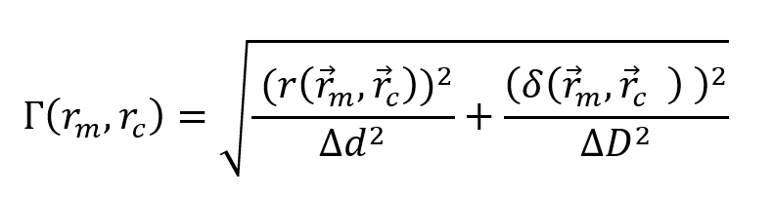
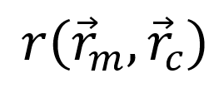
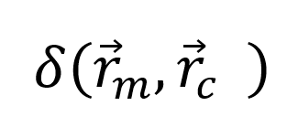
Gamma Index
(1)
In which:
The gamma value (Γ) compares a point on the measured dose distribution (m) with the corresponding point on the calculated dose distribution from the treatment plan (c).
Distance to Agreement
Dose Difference
5

