Slide 1
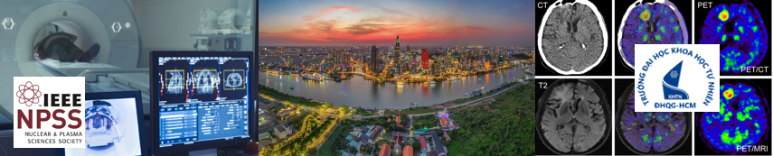
Introduction to Dual-Energy X-ray Absorptiometry (DEXA) for Bone Mineral Density Measurement
Tran Le Phu Quang, B.Sc.
Medical Physics, Faculty of Engineering Physics
Hanoi University of Science and Technology
Email: quangphu501@gmail.com
Notes:
Osteoporosis has become a growing health concern worldwide, particularly among women. For women working in science, who dedicate so much of their time and energy to advancing knowledge, taking care of their own bone health is equally essential. That is why today I will introduce Dual-Energy X-ray Absorptiometry, or DEXA, the gold standard method for Bone Mineral Density measurement.

Slide 2
Table of Contents
Overview of Bone Mineral Density (BMD) Measurement
DEXA Measurement and Formula
DEXA Equipment and Principle
Clinical Significance
Notes:
My presentation will cover four main points: an overview of BMD measurement, the principle of DEXA, its equipment, and the clinical significance, before finishing with key takeaways.

Slide 3
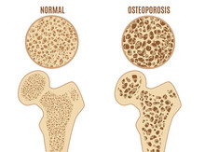
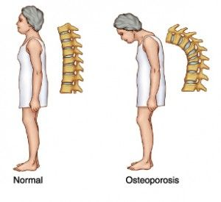
1. Overview of Bone Mineral Density Measurement
Osteoporosis is a disease characterized by reduced bone mass and deterioration of bone microarchitecture, leading to increased bone fragility and consequently a higher risk of fractures
Notes:
Osteoporosis is a disease characterized by reduced bone mass and deterioration of bone structure, which increases bone fragility and the risk of fractures. In the illustration, you can see that normal bone is denser and stronger compared to osteoporotic bone, and the lumbar spine of a healthy person is straighter than that of a patient with osteoporosis.

Slide 4
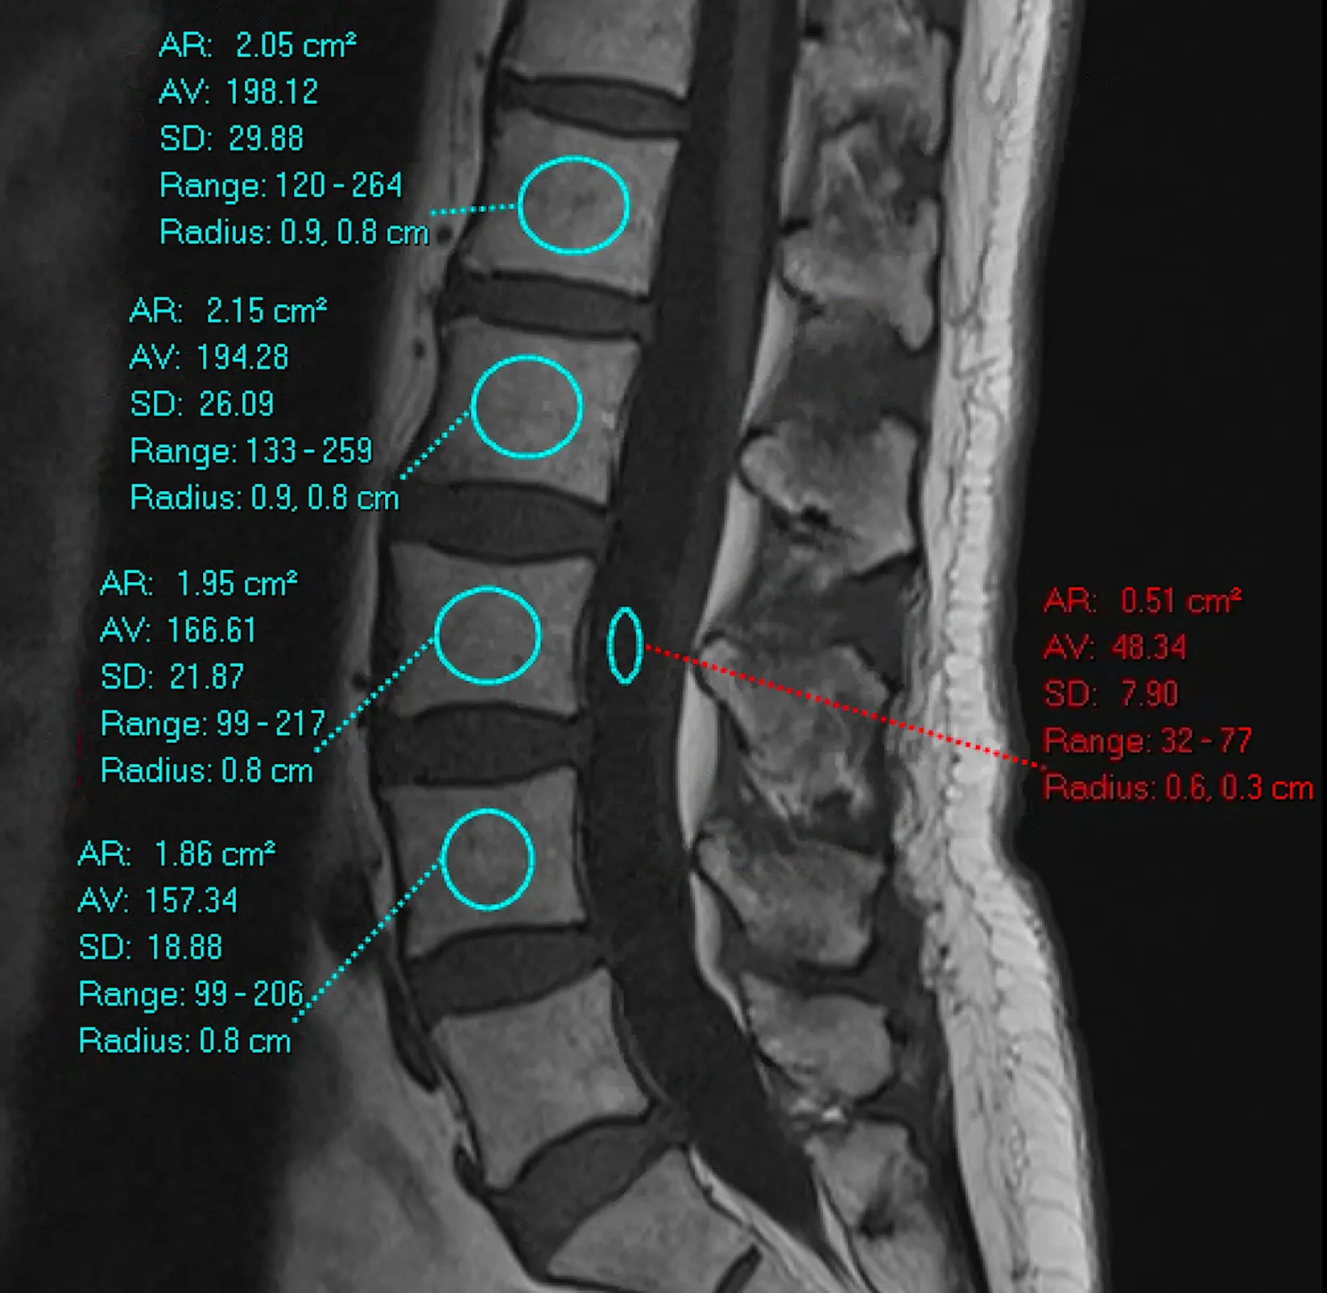
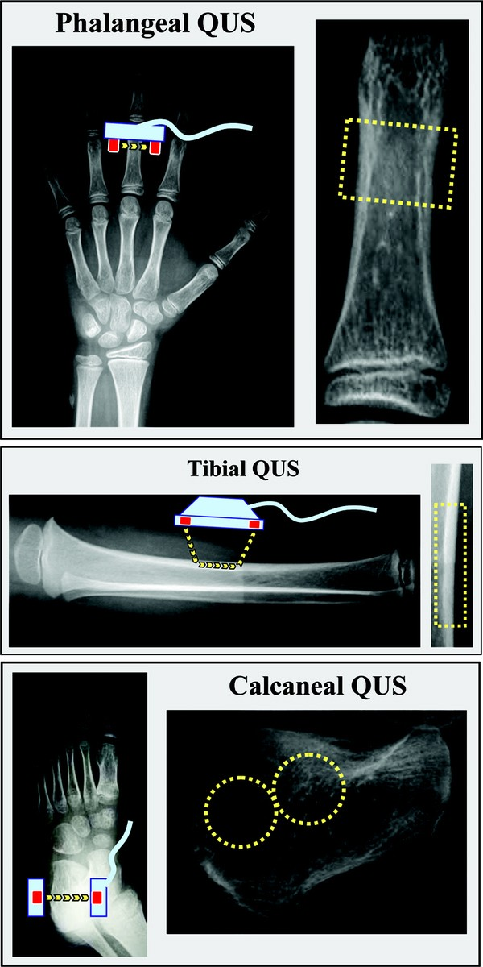
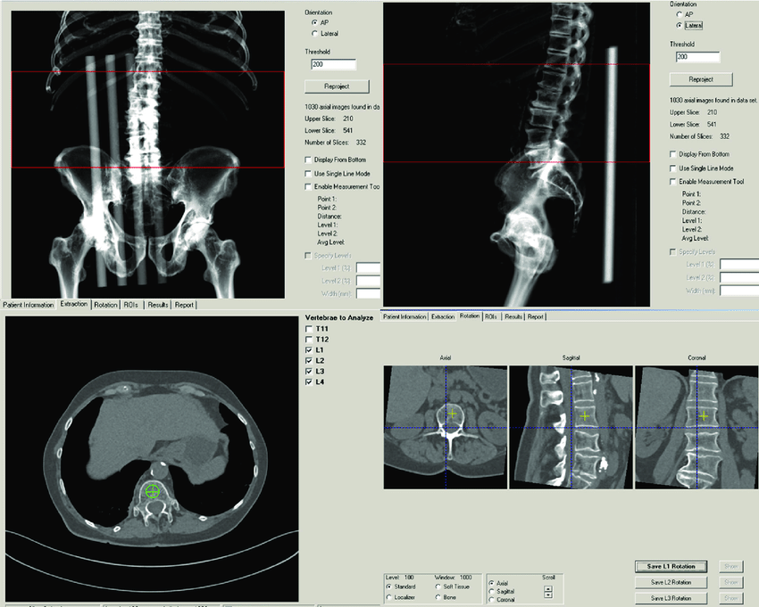
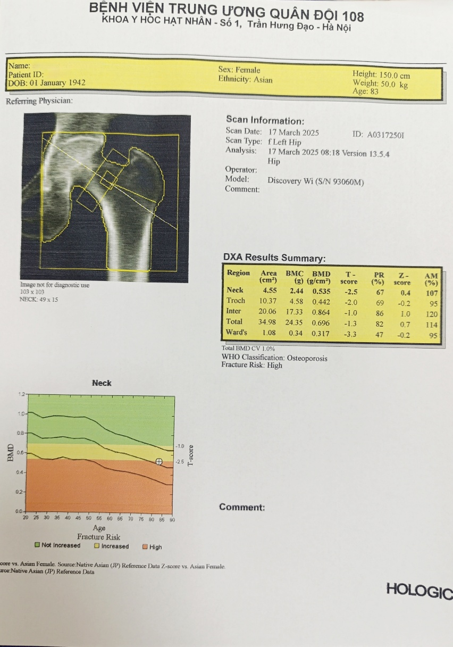
1. Overview of Bone Mineral Density Measurement
MRI
QUS
QCT
DEXA
Notes:
There are several methods for assessing bone density: MRI, quantitative ultrasound, quantitative CT, and DEXA. Each has its advantages and limitations, but DEXA is most widely used because of its low radiation dose, relatively low cost, short scan time, and standardized diagnostic criteria.
Comparison of Techniques
MRI
Hydrogen proton resonance, no ionizing radiation
Provides detailed microstructural information
High cost and long scan time
Mainly used in research for structural evaluation
QCT
Measures X-ray attenuation in CT slices
Differentiates cortical vs. trabecular bone; 3D imaging
Higher radiation dose and higher cost
Allows separate assessment of bone compartments
pQCT
Measures peripheral bone density with X-rays
Evaluates bone geometry and size
Limited to peripheral sites only
Applied in research on peripheral bone structure
QUS
Assesses sound velocity through bone
No radiation, portable devices, low cost
Lower accuracy, not suitable for treatment monitoring
Useful for initial screening and community-based studies
DEXA
Uses two X-ray energy levels for absorption measurement
High accuracy with low radiation dose
Cannot distinguish cortical vs. trabecular bone
Gold standard for diagnosis and monitoring of osteoporosis

Slide 5
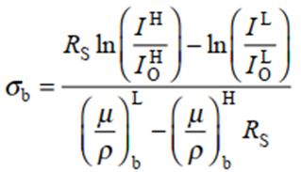
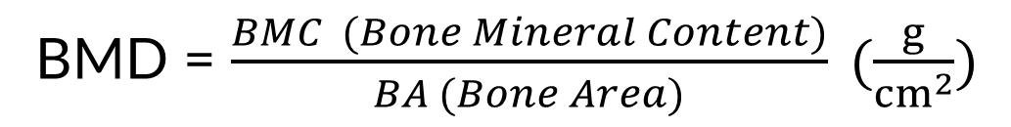
2. DEXA Measurement and Formula
Areal Mass Density of Bone:
Where 𝑅𝑠​ is the tissue proportionality constant, 𝜇/𝜌 is the mass attenuation coefficient, I0 is the initial X-ray intensity, and 𝐼 is the transmitted intensity after passing through the material..
Bone Mineral Density (BMD):
BMD = $\frac{BMC (Bone Mineral Content)}{BA (Bone Area)} (\frac{g}{{cm}^{2}})$
Notes:
Now let us define the key concept.
Areal bone mass density is defined as mineral mass over projected bone area.
Next, bone mineral density, or BMD, is calculated as the ratio of bone mineral content to bone area. BMD can be thought of as the sum of all areal bone density values across the pixels identified as bone. Both values are expressed in grams per square centimeter.
In the DEXA method, the device records X-ray intensities at two different energy levels after passing through the patient’s body. These data are combined with reference parameters to calculate the BMD.
Back in 1994, the WHO established diagnostic criteria for osteoporosis based on the T-score derived from DEXA.

Slide 6
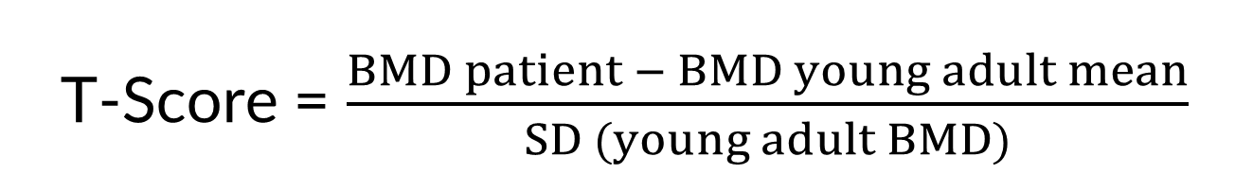
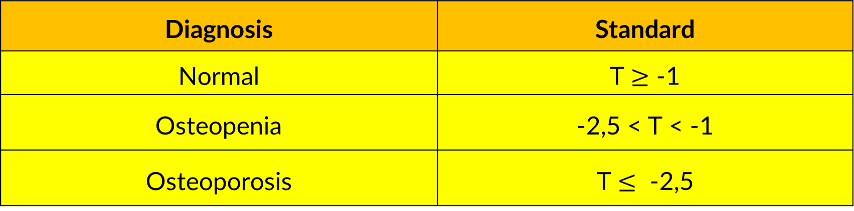
2. DEXA Measurement and Formula
In 1994, the World Health Organization (WHO) established the diagnostic criteria for bone mineral density using the T-score obtained from the DEXA method:
T-Score = $\frac{BMD patient − BMD young adult mean}{SD (young adult BMD)}$
Diagnosis | Standard
Normal | T $≥$ -1
Osteopenia | -2,5 < T < -1
Osteoporosis | T $≤$ -2,5
Notes:
In 1994, the World Health Organization established diagnostic criteria based on the T-score from DEXA. The T-score represents the number of standard deviations between the patient’s BMD and that of a healthy young adult.
According to the WHO: A T-score greater than or equal to minus one is normal. Between minus one and minus two point five is osteopenia. And less than or equal to minus two point five indicates osteoporosis.

Slide 7
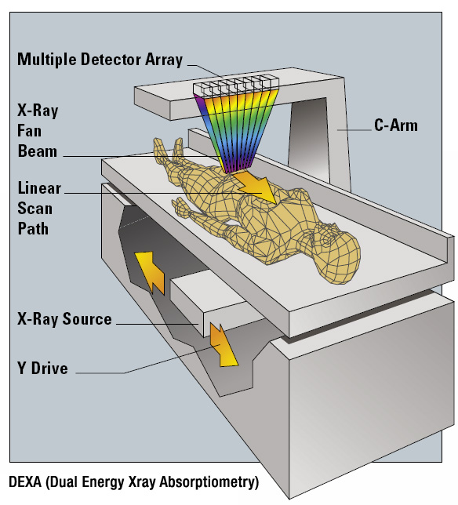

3. DEXA Equipment and Principle
Notes:
The DEXA system consists of a multi-detector array, a fan-beam X-ray source, a patient table, and a C-arm connecting the source and detectors. The C-arm moves along the patient’s body at the measurement site.
Once the patient is positioned correctly, the system scans typical sites such as the lumbar spine and femoral neck. The data are then transmitted to the computer, processed, and converted into the final results.

Slide 8
3. DEXA Equipment and Principle
Notes:
Once the scan is completed, results are displayed in three sections. First is the region of interest image, then a summary table with parameters such as BMC, BMD, and T-score, and finally a graph showing age on the X-axis and BMD or T-score on the Y-axis, which illustrates the natural decline of bone density with age.

Slide 9
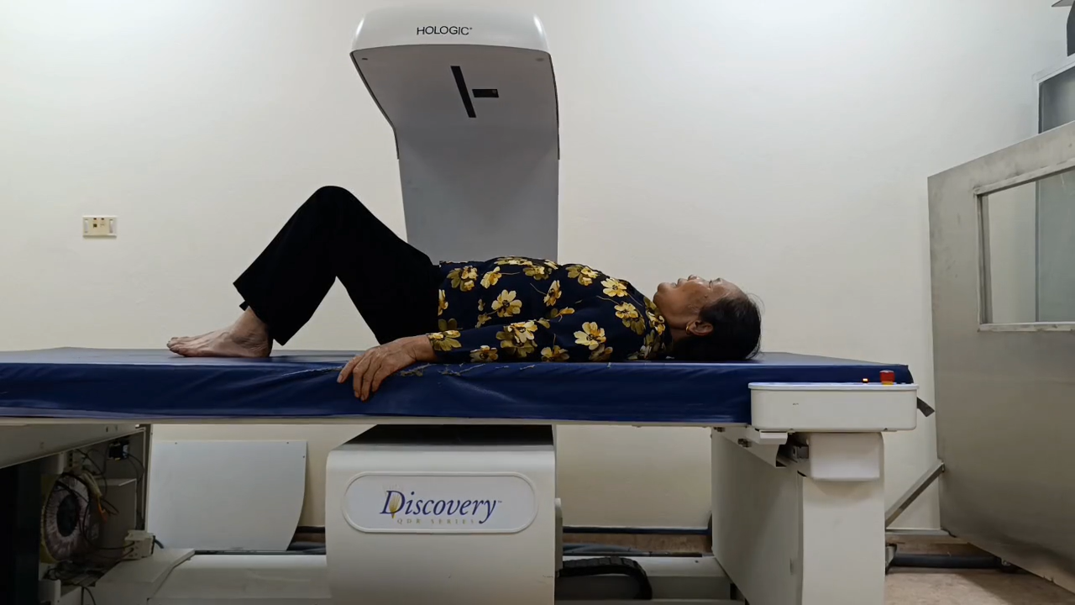
3. DEXA Equipment and Principle
Notes:
During my internship at the 108 Military Central Hospital, I recorded a video of a DEXA scan at the lumbar spine. Although I sped up the video, the entire scan of both hip and spine usually takes only about three minutes. Before scanning the hip, the technologist adjusts the patient’s position to ensure accuracy.

Slide 10
4. Clinical Significance
Diagnosis of osteoporosis and osteopenia
Assessment of fracture risk
Monitoring bone mineral density changes over time
Evaluation of treatment effectiveness
Identification of secondary causes of bone loss
Guidance for clinical decision-making in bone health management
Notes:
Now, let us consider the clinical significance. DEXA is essential for diagnosing osteoporosis and osteopenia, assessing fracture risk, monitoring bone density changes over time, and evaluating treatment effectiveness. It also helps identify secondary causes of bone loss and provides valuable guidance for clinical decision-making.

Slide 11
Conclusion
DEXA is the gold standard for diagnosing osteoporosis
BMD is calculated from X-ray intensities at two energy levels after passing through the patient’s body
DEXA helps physicians determine osteoporosis based on the T-score criteria
DEXA evaluates not only the degree of osteoporosis in the elderly but also bone loss in premenopausal women.
Notes:
To conclude: DEXA remains the gold standard for diagnosing osteoporosis. By measuring X-ray absorption at two energy levels, it calculates bone mineral density and determines the T-score. This allows physicians not only to diagnose osteoporosis in the elderly, but also to detect bone loss in younger and premenopausal women.
Thank you very much for your kind attention.

