Slide 2

GRADUATION THESIS
Topic: Evaluation of conventional and hypofractionated treatment protocols for prostate cancer using the biological indices TCP and NTCP
Student: | Trịnh Huy Vũ - 20210945
Supervisor: | Phạm Quang Trung, PhD
2
Notes:
Good morning doctors and medical physicists.
My name is Trinh Huy Vu, and today I’m honored to present my graduation thesis titled:
“Evaluation of Conventional and Hypofractionated Treatment Protocols for Prostate Cancer Using the Biological Indices TCP and NTCP.”
This research was conducted under the supervision of Dr. Pham Quang Trung.

Slide 3
I. Overview
II. Methods
III. Results
IV. Conclusion
TABLE OF CONTENTS
3
Notes:
To begin with, let me briefly introduce prostate cancer and the current situation in Vietnam.
The prostate is part of the male reproductive system. It sits just below the bladder, in front of the rectum, and surrounds the urethra.
According to GLOBOCAN 2022, prostate cancer ranks fifth in incidence among all cancers in Vietnam, accounting for around 6,000 out of 95,000 new cancer cases reported that year.
In terms of treatment, several modalities are available for prostate cancer. However, at the 108 Military Central Hospital, two radiotherapy protocols are currently applied:
- The Conventional Fractionation protocol,
- And the Hypofractionated protocol.

Slide 4
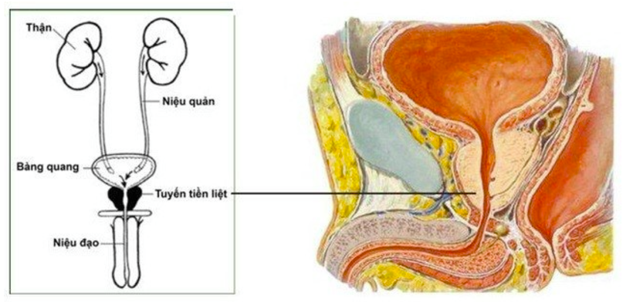
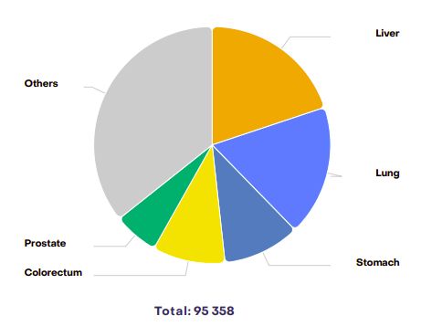
I. Overview
1.1. Current status and definition of prostate cancer
Brachytherapy
EBRT
Cancer incidence in Vietnam according to GLOBOCAN 2022.
4
Notes:
To begin with, let me briefly introduce prostate cancer and the current situation in Vietnam.
The prostate is part of the male reproductive system. It sits just below the bladder, in front of the rectum, and surrounds the urethra.
In terms of treatment, several modalities are available for prostate cancer. However, at the 108 Military Central Hospital, two radiotherapy protocols are currently applied:
- The Conventional Fractionation protocol,
- And the Hypofractionated protocol.

Slide 5
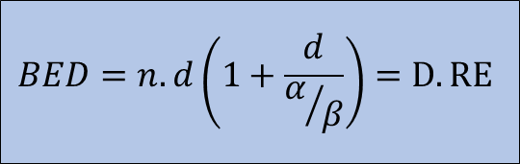
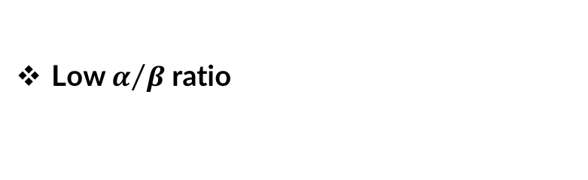
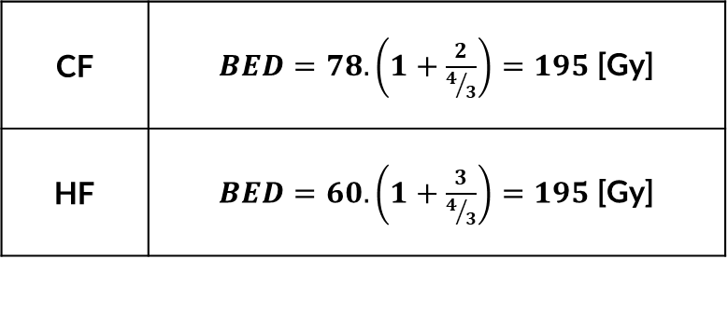
I. Overview
1.2. Protocol for prostate cancer
EBRT
Biologically Effective Dose (BED)
$$BED=n.d\left(1+\frac{d}{α/β}\right)=D.RE$$
Conventional fractionation (CF)
Total dose: 74 ~ 79.2 Gy.
Dose per fraction: small (1.8 ~ 2 Gy/Fx).
Treatment duration: 7 – 8 weeks.
Technique: IMRT or VMAT.
Using TrueBeam STx.
Hypofractionated
(HF)
Total dose: 60 ~ 65 Gy.
Dose per fraction: large (2.6 ~ 3 Gy/Fx).
Treatment duration: 4 – 5 weeks.
Technique: IMRT or VMAT.
Using TrueBeam STx.
D: Physical dose
RE: Relative Effectiveness
CF | $BED=78.\left(1+\frac{2}{4/3}\right)=195$ [Gy]
HF | $BED=60.\left(1+\frac{3}{4/3}\right)=195$ [Gy]
Low $α/β$ratio
5
Notes:
Let’s take a look at the characteristics of these two protocols.
The hypofractionated protocol delivers a lower total dose of about 60–65 Gy, but with larger dose per fraction, typically around 2.6–3 Gy/Fx.
In contrast, the conventional protocol uses a higher total dose of about 74–79.2 Gy, with smaller fractions, around 1.8–2 Gy/Fx.
As a result, the treatment duration is also shorter for the HF protocol, taking about 4 to 5 weeks, compared to 7 to 8 weeks for CF.
The reason why the hypofractionated protocol can use a lower total dose while still achieving similar treatment effectiveness is due to the calculations of Biologically Effective Dose (BED).
In addition, prostate tissue has a relatively low alpha over beta ratio, which makes it more responsive to changes in fraction size.

Slide 6
I. Overview
1.3. Problem statement
Qualitative assessment of IMRT and VMAT is imprcise
Unable to evaluate the impact of dose escalation in HF
Plan evaluation
Using DVH and distribution
Tumor Control Probability
(TCP)
Normal Tissue Complication Probability (NTCP)
Biological Indices
Integrate TCP and NTCP as a step in the treatment plan evaluation process.
6
Notes:
Now, here's the motivation behind this study
When evaluating treatment plans using techniques like IMRT and VMAT, if we just rely on qualitative assessments—looking at DVH plots or dose distributions-sometimes is imprecise
In addition, If only use dose distribution and DVH plot, we are unable to evalutate the impact of dose escalation in HF protocol.
That’s why I aimed to shift from qualitative to quantitative evaluation, by utilizing dose distribution data and DVHs to calculate Tumor Control Probability (TCP) and Normal Tissue Complication Probability (NTCP).
The ultimate goal is to gradually integrate TCP and NTCP into routine treatment plan evaluation

Slide 7
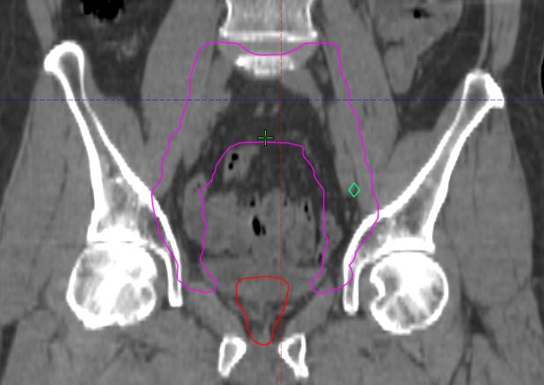
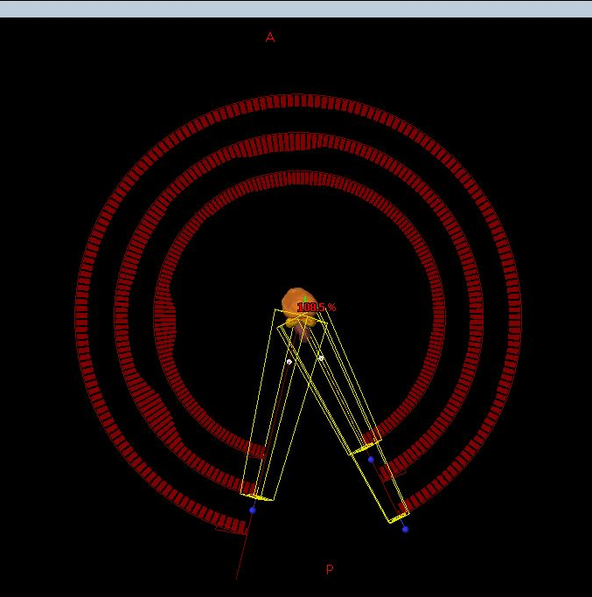
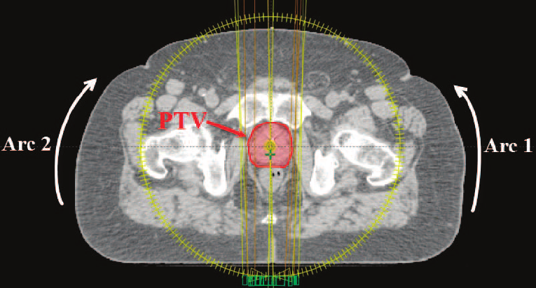
II. Method
2.1. Subjects
Table: Prescribe dose for PTVs
Figure: Anatomical position of key organs
22 prostate cancer patients.
Used VMAT technique.
PTV: 40.7 cm³ ~ 174.3 cm³.
Include patients with more than one treatment targets.
CW arc: from 200⁰ – 160⁰ , Collimator angle 30⁰.
CCW arc: from 160⁰ – 200⁰ , Collimator angle 330⁰.
Add additional arc if Mus > 400.
Additional Collimator angle: 0⁰ và 90⁰.
Dose | CF (Gy) | HF (Gy)
Prostate | 78 | 60
Seminal Vesicle | 65 | 50
Pelvic lymph nodes | 57.2 | 44
Pelvic lymph nodes
Seminal Vesicle
Prostate
Figure: Treatment arc geometry
A
CW
CCW
200⁰
160⁰
P
180⁰
7
Notes:
So, in order to address the problem I just mentioned, I used data from 22 prostate cancer patients who were prescribed a treatment dose of 60Gy in 20 fractions. Each of these patients had already undergone treatment planning with both IMRT and VMAT techniques, but for this study, I replanned all 22 patients using VMAT only, to ensure consistency.
The planning target volume (PTV) varied from around 40.7 to 174.3 cm³, and some patients had extended indications including the seminal vesicles and pelvic lymph nodes—the prescribed doses are listed in the table.
Regarding arc setup, I used clockwise arcs from 200° to 160°, and counterclockwise arcs from 160° to 200°, to avoid low-dose regions in the rectum. The collimator angles were offset by 30 degrees. Also, if the monitor units (MUs) exceeded 400, I added a third arc with a collimator angle of 0° or 90°.

Slide 8
II. Method
2.2. Workflow
Planning
Plan Evaluation
Biological Evaluation
22 patients.
VMAT technique.
Both CF and HF protocol.
Qualitative:
Dose distribution
DVH
Quantitative:
CI
HI
GI
Calculate using Rstudio and R programming language
TCP
NTCP
Calculate using Rstudio and R programming language
8
Notes:
Once the plans were created, they were first evaluated qualitatively based on dose distribution and DVH curves. Then I moved on to quantitative evaluation, using three main dosimetric indices:
- Conformity Index (CI),
- Homogeneity Index (HI),
- And Gradient Index (GI).
So, I started calculating TCP and NTCP only after the plans had passed the dosimetric checks.” All these calculations were done using the R programming language in RStudio.

Slide 9
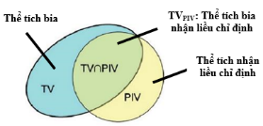
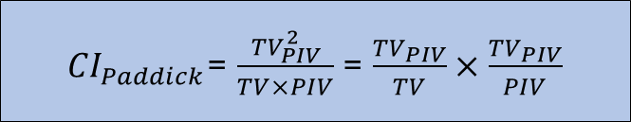
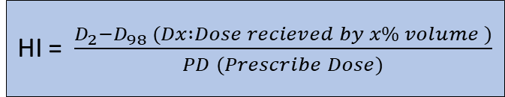
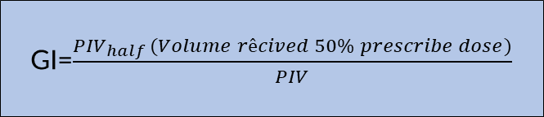
II. Method
2.3. Plan evaluation
Dose distribution and tumor evaluation indices
Dose coverage within the PTV
V100% (%) > 95% V_{PTV}
Dmax (%) < 110%
Figure: Illustration of spatial relationship among volume
Dosimetric Indices for Treatment Planning Evaluation
Homogeneity Index (HI)
Conformity Index (CI)
Wu (2000)
Paddick (2000): (CI=1)
HI = $\frac{D_{2}−D_{98} (Dx :Dose recieved by x\% volume )}{PD (Prescribe Dose)}$
${CI}_{Paddick}$= $\frac{{TV}_{PIV}^{2}}{TV×PIV}$ = $\frac{{TV}_{PIV}}{TV}×$ $\frac{{TV}_{PIV}}{PIV}$
Gradient Index(GI)
    TV_{PIV}/TV → Measures dose coverage of the tumor.
    TV_{PIV}/PIV→ Assess dos conformity to surounding tissues.
Paddick (2006): (GI=3 ÷ 5)
GI=$\frac{{PIV}_{half }(Volume rêcived 50\% prescribe dose)}{PIV}$
9
Notes:
First, let’s talk about PTV evaluation. From a qualitative perspective, the dose distribution must ensure that at least 95% of the PTV is covered by 100% of the prescribed dose, and the Dmax should not exceed 110% of the prescribed dose
For quantitative analysis, I used:
- CI based on Paddick’s 2000 definition,
- HI from Wu (2000),
- And GI, also from Paddick, published in 2006.

Slide 10
II. Method
2.3. Plan evaluation
Dose constraint for OARs
Referenced from the textbook “Practical Radiotherapy Planning” 5th edition.
Table: Dose constraint for OARs
OARs | Prescribe Dose |  | Optimum | Mandatory
 | 2Gy/Fx | 3Gy/Fx | %V or cc | %V or cc
Bladder | V50Gy | V40 Gy | <50% | _
 | V60 Gy | V48 Gy | <25% | <50%
 | V78 Gy | V56,8 Gy | <5% | _
 |  | V60 Gy | <3% | <35%
Rectum | V30 Gy | V24 Gy | <70% | <80%
 | V40 Gy | V32 Gy | <51% | <65%
 | V50 Gy | V40 Gy | <38% | <50%
 | V60 Gy | V48 Gy | <27% | <35%
 | V70 Gy | V54 Gy | <15% | <20%
 | V75 Gy | V57 Gy | <10% | <15%
 | V78 Gy | V60 Gy | <0.01%* | <3%
OARs | Prescribe Dose |  | Optimum | Mandatory
 | 2Gy/Fx | 3Gy/Fx | %V or cc | %V or cc
Femoral Heads | V50 Gy | V40 Gy | <5% | <50%
Bowel | V45 Gy | V36 Gy | <78 cc | <158 cc
 | V50 Gy | V40 Gy | <17 cc | <110 cc
 | V55 Gy | V44 Gy | <14 cc | <28 cc
 | V60 Gy | V48 Gy | <0.5 cc | <6 cc
 | V65 Gy | V52 Gy | 0 cc | <0 cc
Penile Bulb | V50 Gy | V40 Gy | <50% | _
 | V60 Gy | V48 Gy | <10% | _
Mean rectal dose | ≤45 Gy | ≤35 Gy
*: The <0.01 constraint is a very small volume and care should be taken to ensure that this optimum constraint is achieved without compromising the PTV coverage.
10
Notes:
As for the organs at risk, I applied the dose constraints for prostate cancer outlined in the 5th edition of Practical Radiotherapy Planning. The two most critical OARs in this case are the rectum and bladder.

Slide 11
II. Method
2.3. Plan evaluation
Biological Indices Evaluation
TCP and NTCP models
MODELS
NTCP
Lyman – Kutcher – Burman (LKB)
Logistic (Niemierko)
TCP
Poisson
Logistic (Niemierko)
11
Notes:
After confirming that the treatment plans were acceptable both in terms of tumor evaluation and OAR citeria, I moved on to calculate TCP and NTCP using biological models. For NTCP, I used the well-established Lyman–Kutcher–Burman (LKB) model, which is widely used today, and I cross-checked the results using Niemierko’s Logistic model. For TCP, I applied both the Poisson model and the Logistic model as well.

Slide 12
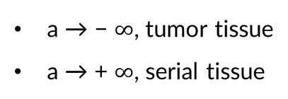
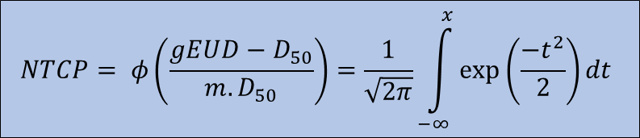
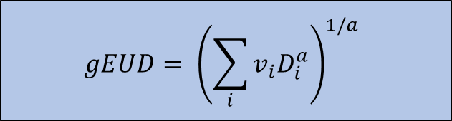

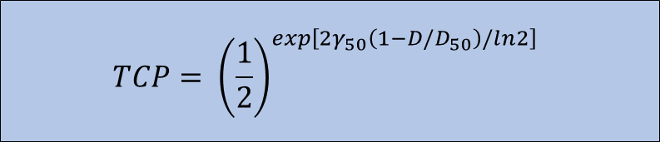

II. Method
2.3. Plan evaluation
Calculating theory of TCP và NTCP
$$gEUD= {\left(\sum_{i}{v_{i}D_{i}^{a}}\right)}^{1/a}$$
Equivalent Uniform Dose (EUD)
Convert nonuniform dose to nominal uniform dose.
“a: reflects the tissue’s properties.
a → − $∞$, tumor tissue
a → + $∞$, serial tissue
TCP và NTCP models
NTCP
TCP
Lyman – Kutcher – Burman (LKB)
Poisson
$$NTCP= φ\left(\frac{gEUD−D_{50}}{m.D_{50}}\right)=\frac{1}{\sqrt{2π}}\int_{−∞}^{x}{\exp\left(\frac{{−t}^{2}}{2}\right)}dt$$
$$TCP= {\left(\frac{1}{2}\right)}^{exp\left[2γ_{50}\left(1−D/D_{50}\right)/ln2\right]}$$
Logistic
Logistic
$$NTCP= \frac{1}{{1+\left(\frac{{TCD}_{50}}{gEUD}\right)}^{4γ_{50}}}$$
$$TCP= \frac{1}{{1+\left(\frac{{TCD}_{50}}{gEUD}\right)}^{4γ_{50}}}$$
12
Notes:
Now, all these models are based on a common principle: They convert a non-uniform dose distribution into an equivalent uniform dose (EUD). EUD reflects a uniform dose that would produce the same biological effect as the actual non-uniform distribution. So once we have the EUD, we can plug it into the formulas to compute TCP and NTCP accordingly.

Slide 13
II. Method
2.3. Plan evaluation
Parameter used for biological models
Table: Parameters for TCP calculation models
Model | Reference | a | TCD₅₀ (cGy) | γ₅₀ | α/β
Poisson | AAPM Report 166 | -10 | 4629 | 0,95 | 1,5
Logit | Ayşegül Ünal Karabey et al | -10 | 2834 | 1 | 1,2
Table: Parameters for NTCP calculation models
Model | Reference | Organ | a | TD₅₀ (cGy) | m | n | γ₅₀ | α/β
LKB | Burman et al Francis et al | Rectum | 8 | 8000 | 0,15 | 0,12 |  | 3
 |  | Bladder | 8 | 8000 | 0,11 | 0,5 |  | 3
Logit | Ayşegül Ünal Karabey et al | Rectum | 8,33 | 8000 |  |  | 4 | 3,9
 |  | Bladder | 2 | 8000 |  |  | 4 | 8
13
Notes:
Regarding the parameters used for modeling:
- For TCP, I referred to the AAPM Report No. 166 and a study by Karabey et al.
- For NTCP, I used parameter sets from Burman and Karabey as well.

Slide 14
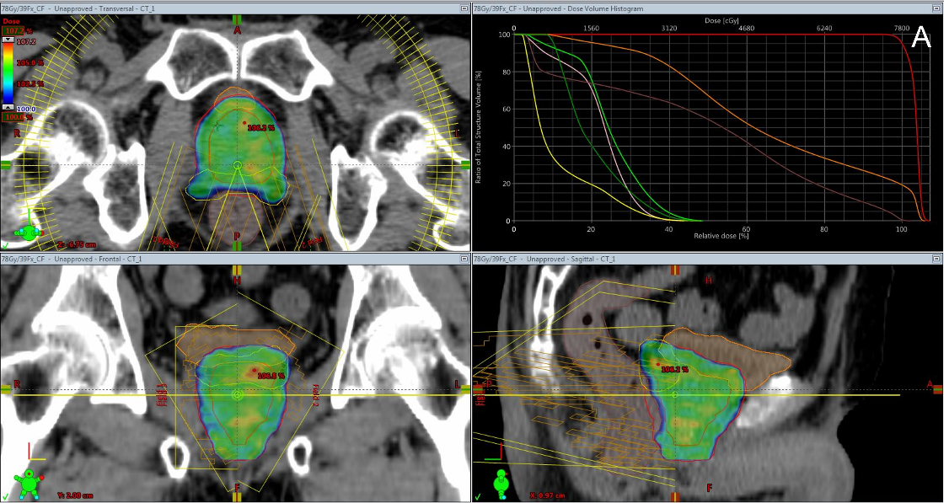
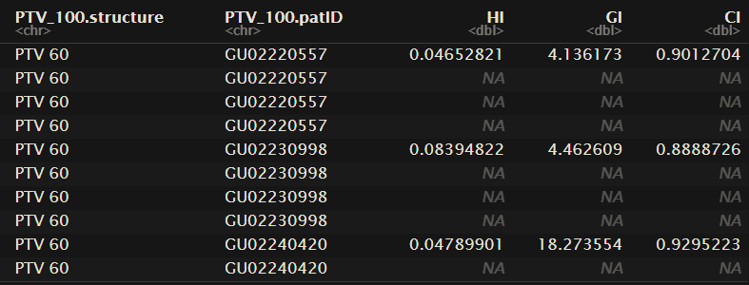
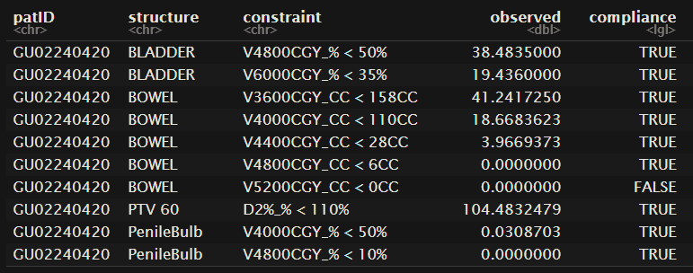
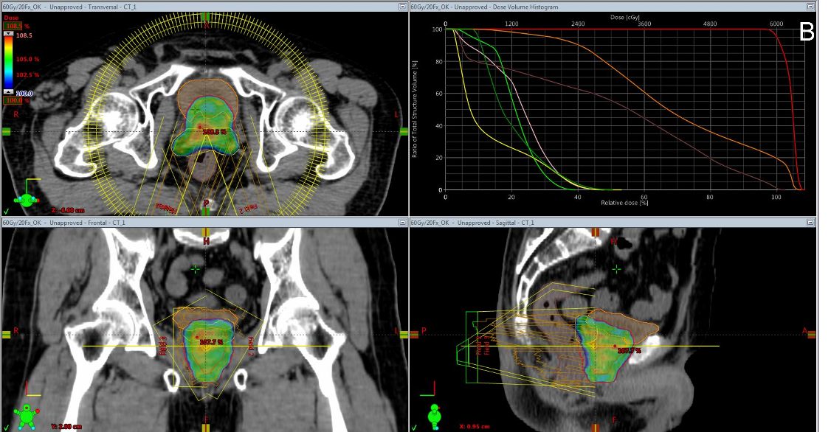
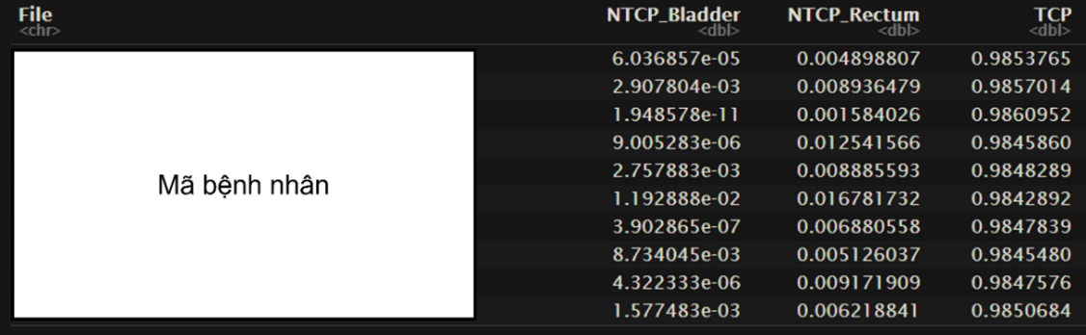
III. Result
CI, HI, GI
OARs constraint
Figure: Planning step results and calculation program.
TCP, NTCP
14
Notes:
During the study, I have replanned all 22 patients under both protocols—conventional and hypofractionated. I also developed an R-based program to automatically calculate CI, HI, GI, TCP, and NTCP, as well as check the dose constraints for OARs.

Slide 15
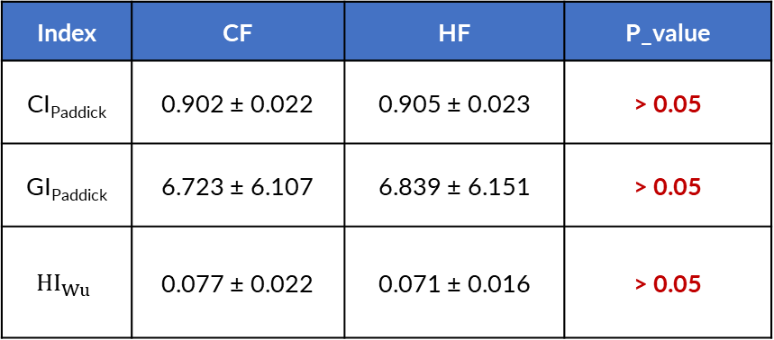
III. Result
CI, HI, GI index
Figure: CI, GI, HI on both protocols
Table: Mean values of the CI, HI, GI Indices
Index | CF | HF | P_value
CI_{Paddick} | 0.902 ± 0.022 | 0.905 ± 0.023 | > 0.05
GI_{Paddick} | 6.723 ± 6.107 | 6.839 ± 6.151 | > 0.05
$${HI}_{Wu}$$ | 0.077 ± 0.022 | 0.071 ± 0.016 | > 0.05
* p<0,05: difference is statistically significant
15
Notes:
Let’s move on to the results. For CI and HI, the values for both protocols were within the optimal range. However, GI values were noticeably higher than expected. This could be explained that some of patients are received extended indications including pelvic lymph nodes, which increased the 50% isodose volume, hence increasing the GI value.

Slide 16
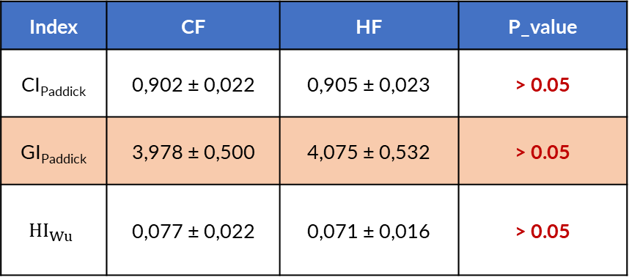
III. Result
CI, HI, GI index
Figure: CI, GI, HI on both protocols
Table: Mean values of the CI, HI, GI Indices
Index | CF | HF | P_value
CI_{Paddick} | 0,902 ± 0,022 | 0,905 ± 0,023 | > 0.05
GI_{Paddick} | 3,978 ± 0,500 | 4,075 ± 0,532 | > 0.05
$${HI}_{Wu}$$ | 0,077 ± 0,022 | 0,071 ± 0,016 | > 0.05
* p<0,05: difference is statistically significant
16
Notes:
After removing these outlier cases, the GI values for both protocols fell back within the optimal range. However, the differences in CI, HI, and GI between the two protocols were not statistically significant.

Slide 17
III. Result
NTCP_LKB, TCP_Poisson
Figure: NTCP and TCP indices for two treatment plans based on Burman parameters and TG-166 report
Table: Mean values of indices
Index | Organ | CF | HF | p_value
NTCP | Bladder | 0.036 ± 0.042 | 0.010 ± 0.013 | < 0.05
 | Rectum | 0.037 ± 0.014 | 0.017 ± 0.009 | < 0.05
TCP | PTV 60 | 0.903 ± 0.003 | 0.898 ±0.003 | < 0.05
* p<0,05 thì sự khác biệt có ý nghĩa thống kê
17
Notes:
Now let’s look at the biological outcomes. Based on the Poisson model for TCP and LKB model for NTCP, I found that the HF protocol significantly reduced NTCP, especially for the rectum and bladder. However, TCP in HF plans was around 0.5% lower than in CF plans. These differences were statistically significant.

Slide 18
III. Result
Logistic_Karabey
Figure: NTCP and TCP indices for two treatment plans based on Karabey parameters.
Table: Mean values of indices
Index | Organ | CF | HF | p_value
NTCP | Bladder | 0.0018 ± 0.031 | 0.00016 ± 0.00027 | > 0.05
 | Rectum | 0.0079 ± 0.0043 | 0.0017 ± 0.0013 | < 0.05
TCP | PTV 60 | 0.98500 ± 0.00045 | 0.97942 ± 0.00066 | < 0.05
* p<0,05 thì sự khác biệt có ý nghĩa thống kê
18
Notes:
When calculated using the Logistic model, the results were consistent. Again, NTCP values were clearly lower in the HF protocol, while TCP remained slightly lower compared to the CF protocol.

Slide 19
IV. Conclusion
Both HF and CF treatment plans met dose and physical index criteria (CI, GI, HI), indicating clinically acceptable planning quality.
CF plans yielded higher TCP values, reflecting better tumor control across both parameter sets.
HF plans significantly reduced NTCP, particularly for the rectum and bladder.
HF offers a balance between efficacy and safety, by shortening treatment time and improving patient quality of life.
Further studies with larger and more homogeneous patient cohorts are recommended to enhance statistical power and reliability of the results.
19
Notes:
So in conclusion,
- Both HF and CF treatment plans satisfied the dose and dosimetric index requirements (CI, HI, GI), meaning they are clinically acceptable.
- CF showed higher TCP, indicating slightly better tumor control.
- Meanwhile, HF significantly reduced NTCP for both the rectum and bladder.
- HF also shortens treatment time, aligning well with modern clinical trends and improving overall patient quality of life.
Of course, more studies with larger and more homogeneous patient groups will be needed to further validate these findings.

Slide 20
THANK YOU !

Slide 21
Tài liệu tham khảo
[1] Bệnh viện Trung ương quân đội 108, “Tầm soát ung thư tuyến tiền liệt,” Sep. 07, 2023. Accessed: Nov. 13, 2024. [Online]. Available: http://benhvien108.vn/tam-soat-ung-thu-tuyen-tien-liet.htm
[2] L. C. Benjamin, A. C. Tree, and D. P. Dearnaley, “The Role of Hypofractionated Radiotherapy in Prostate Cancer,” Curr Oncol Rep, vol. 19, no. 4, Apr. 2017, doi: 10.1007/S11912-017-0584-7.
[3] “Statistics at a glance, 2022 Top 5 most frequent cancers Number of new cases 180 480.”
[4] Bệnh viện Trung ương quân đội 108, “Ung thư tuyến tiền liệt: Những điều cần biết,” Feb. 13, 2023. Accessed: Nov. 19, 2024. [Online]. Available: https://www.benhvien108.vn/ung-thu-tuyen-tien-liet-nhung-dieu-can-biet.htm
[5] J. L. Bedford, “Treatment Planning for Volumetric Modulated Arc Therapy (VMAT),” 2009. [Online]. Available: www.springerlink.com
[6] F. Peng, “Optimization Methods for Volumetric Modulated Arc Therapy and Radiation Therapy Under Uncertainty,” 2013.
[7] J. F. Fowler, “21 Years of biologically effective dose,” Jul. 2010. doi: 10.1259/bjr/31372149.
[8] J. F. Fowler, “The British Journal of Radiology The linear-quadratic formula and progress in fractionated radiotherapy,” 1989.
[9] S. Morris, T. Roques, S. Ahmad, and S. Loo, “Practical Radiotherapy Planning: Fifth Edition.”
[10] S. J. McMahon, “The linear quadratic model: Usage, interpretation and challenges,” Phys Med Biol, vol. 64, no. 1, Jan. 2019, doi: 10.1088/1361-6560/aaf26a.
[11] D. J. Brenner and E. J. Hall, “PII S0360-3016(98)00438-6 BIOLOGY CONTRIBUTION FRACTIONATION AND PROTRACTION FOR RADIOTHERAPY OF PROSTATE CARCINOMA,” 1999.
[12] J. Fowler, R. Chappell, and M. Ritter, “IS / FOR PROSTATE TUMORS REALLY LOW?,” 2001.
[13] F. Clemente-Gutiérrez, C. Pérez-Vara, M. H. Clavo-Herranz, C. López-Carrizosa, J. Pérez-Regadera, and C. Ibáñez-Villoslada, “Assessment of radiobiological metrics applied to patient-specific QA process of VMAT prostate treatments,” J Appl Clin Med Phys, vol. 17, no. 2, pp. 341–367, 2016, doi: 10.1120/jacmp.v17i2.5783.
[14] H. D. Kogelnik, “Inauguration of radiotherapy as a new scientific speciality by Leopold Freund 100 years ago,” 1997.
[15] Michael Goitein, Radiation Oncology: A Physicist’s-Eye View. Scholars Portal, 2019.
[16] S. Morris, T. Roques, S. Ahmad, and S. Loo, “Practical Radiotherapy Planning: Fifth Edition.”
[17] Nguyễn Thái Hà and NXB Bách khoa-HN, “Y học hạt nhân và kỹ thuật xạ trị,” 2006.
[18] E. B. Podgorsak, “IAEA International Atomic Energy Agency Set of 170 slides based on the chapter authored by E.B. Podgorsak of the IAEA textbook (ISBN 92-0-107304-6): Radiation Oncology Physics: A Handbook for Teachers and Students Chapter 6: External Photon Beams: Physical Aspects,” 2006.
21

Slide 22
Tài liệu tham khảo
[19] J. Krishnan, S. Rao, S. Hegde, J. Shetty, and Shambhavi, “A Dosimetric Comparison of Double Arc Volumetric Modulated Arc Therapy with Large Field Intensity Modulated Radiation Therapy for Head and Neck Cancer,” Int J Med Phys Clin Eng Radiat Oncol, vol. 04, no. 04, pp. 353–363, 2015, doi: 10.4236/ijmpcero.2015.44042.
[20] E. Shaw et al., ?? “Special Feature RADIATION THERAPY ONCOLOGY GROUP: RADIOSURGERY QUALITY ASSURANCE GUIDELINES,” 1993.
[21] I. Paddick, “A simple scoring ratio to index the conformity of radiosurgical treatment plans,” J Neurosurg (Suppl 3), vol. 93, 219–222, 2000.
[22] I. Paddick and B. Lippitz, “A simple dose gradient measurement tool to complement the conformity index.,” J Neurosurg, vol. 105 Suppl, pp. 194–201, 2006, doi: 10.3171/sup.2006.105.7.194.
[23] A. Niemierko, “Reporting and analyzing dose distributions: A concept of equivalent uniform dose,” Med Phys, vol. 24, no. 1, pp. 103–110, 1997, doi: 10.1118/1.598063.
[24] AAPM Task Group 166 of the Therapy Physics Committee, The Use and QA of Biologically Related Models for Treatment Planning. 2012. doi: 10.1118/1.3685447.
[25] M. Battestini, M. Schwarz, M. Krämer, and E. Scifoni, “Including Volume Effects in Biological Treatment Plan Optimization for Carbon Ion Therapy: Generalized Equivalent Uniform Dose-Based Objective in TRiP98,” Front Oncol, vol. 12, Mar. 2022, doi: 10.3389/fonc.2022.826414.
[26] B. Warkentin, P. Stavrev, N. Stavreva, C. Field, and B. G. Fallone, “A TCP‐NTCP estimation module using DVHs and known radiobiological models and parameter sets,” J Appl Clin Med Phys, vol. 5, no. 1, pp. 50–63, Dec. 2004, doi: 10.1120/jacmp.v5i1.1970.
[27] B. Emami et al., “TOLERANCE OF NORMAL TISSUE TO THERAPEUTIC IRRADIATION,” 1991.
[28] H. A. Gay and A. Niemierko, “A free program for calculating EUD-based NTCP and TCP in external beam radiotherapy,” Physica Medica, vol. 23, no. 3–4, pp. 115–125, 2007, doi: 10.1016/j.ejmp.2007.07.001.
[29] C. Burman, G. J. Kijtcher, B. Emami, and A. M. Goitein, “FITTING OF NORMAL TISSUE TOLERANCE DATA TO AN ANALYTIC FUNCTION,” Pergamon Press plc, 1991.
[30] A. Ünal Karabey et al., “Radiobiological Models: Conventional and Ultra Hypofraction Treatments in Prostate Radiotherapy,” Turk Onkoloji Dergisi, vol. 39, no. 3, pp. 307–315, 2024, doi: 10.5505/tjo.2024.4332.
[31] F. M. (Spring) Kong, C. Pan, A. Eisbruch, and R. K. T. Haken, “Physical Models and Simpler Dosimetric Descriptors of Radiation Late Toxicity,” Semin Radiat Oncol, vol. 17, no. 2, pp. 108–120, Apr. 2007, doi: 10.1016/J.SEMRADONC.2006.11.007.
[32] B. Emami et al., “TOLERANCE OF NORMAL TISSUE TO THERAPEUTIC IRRADIATION.”
22

Slide 23
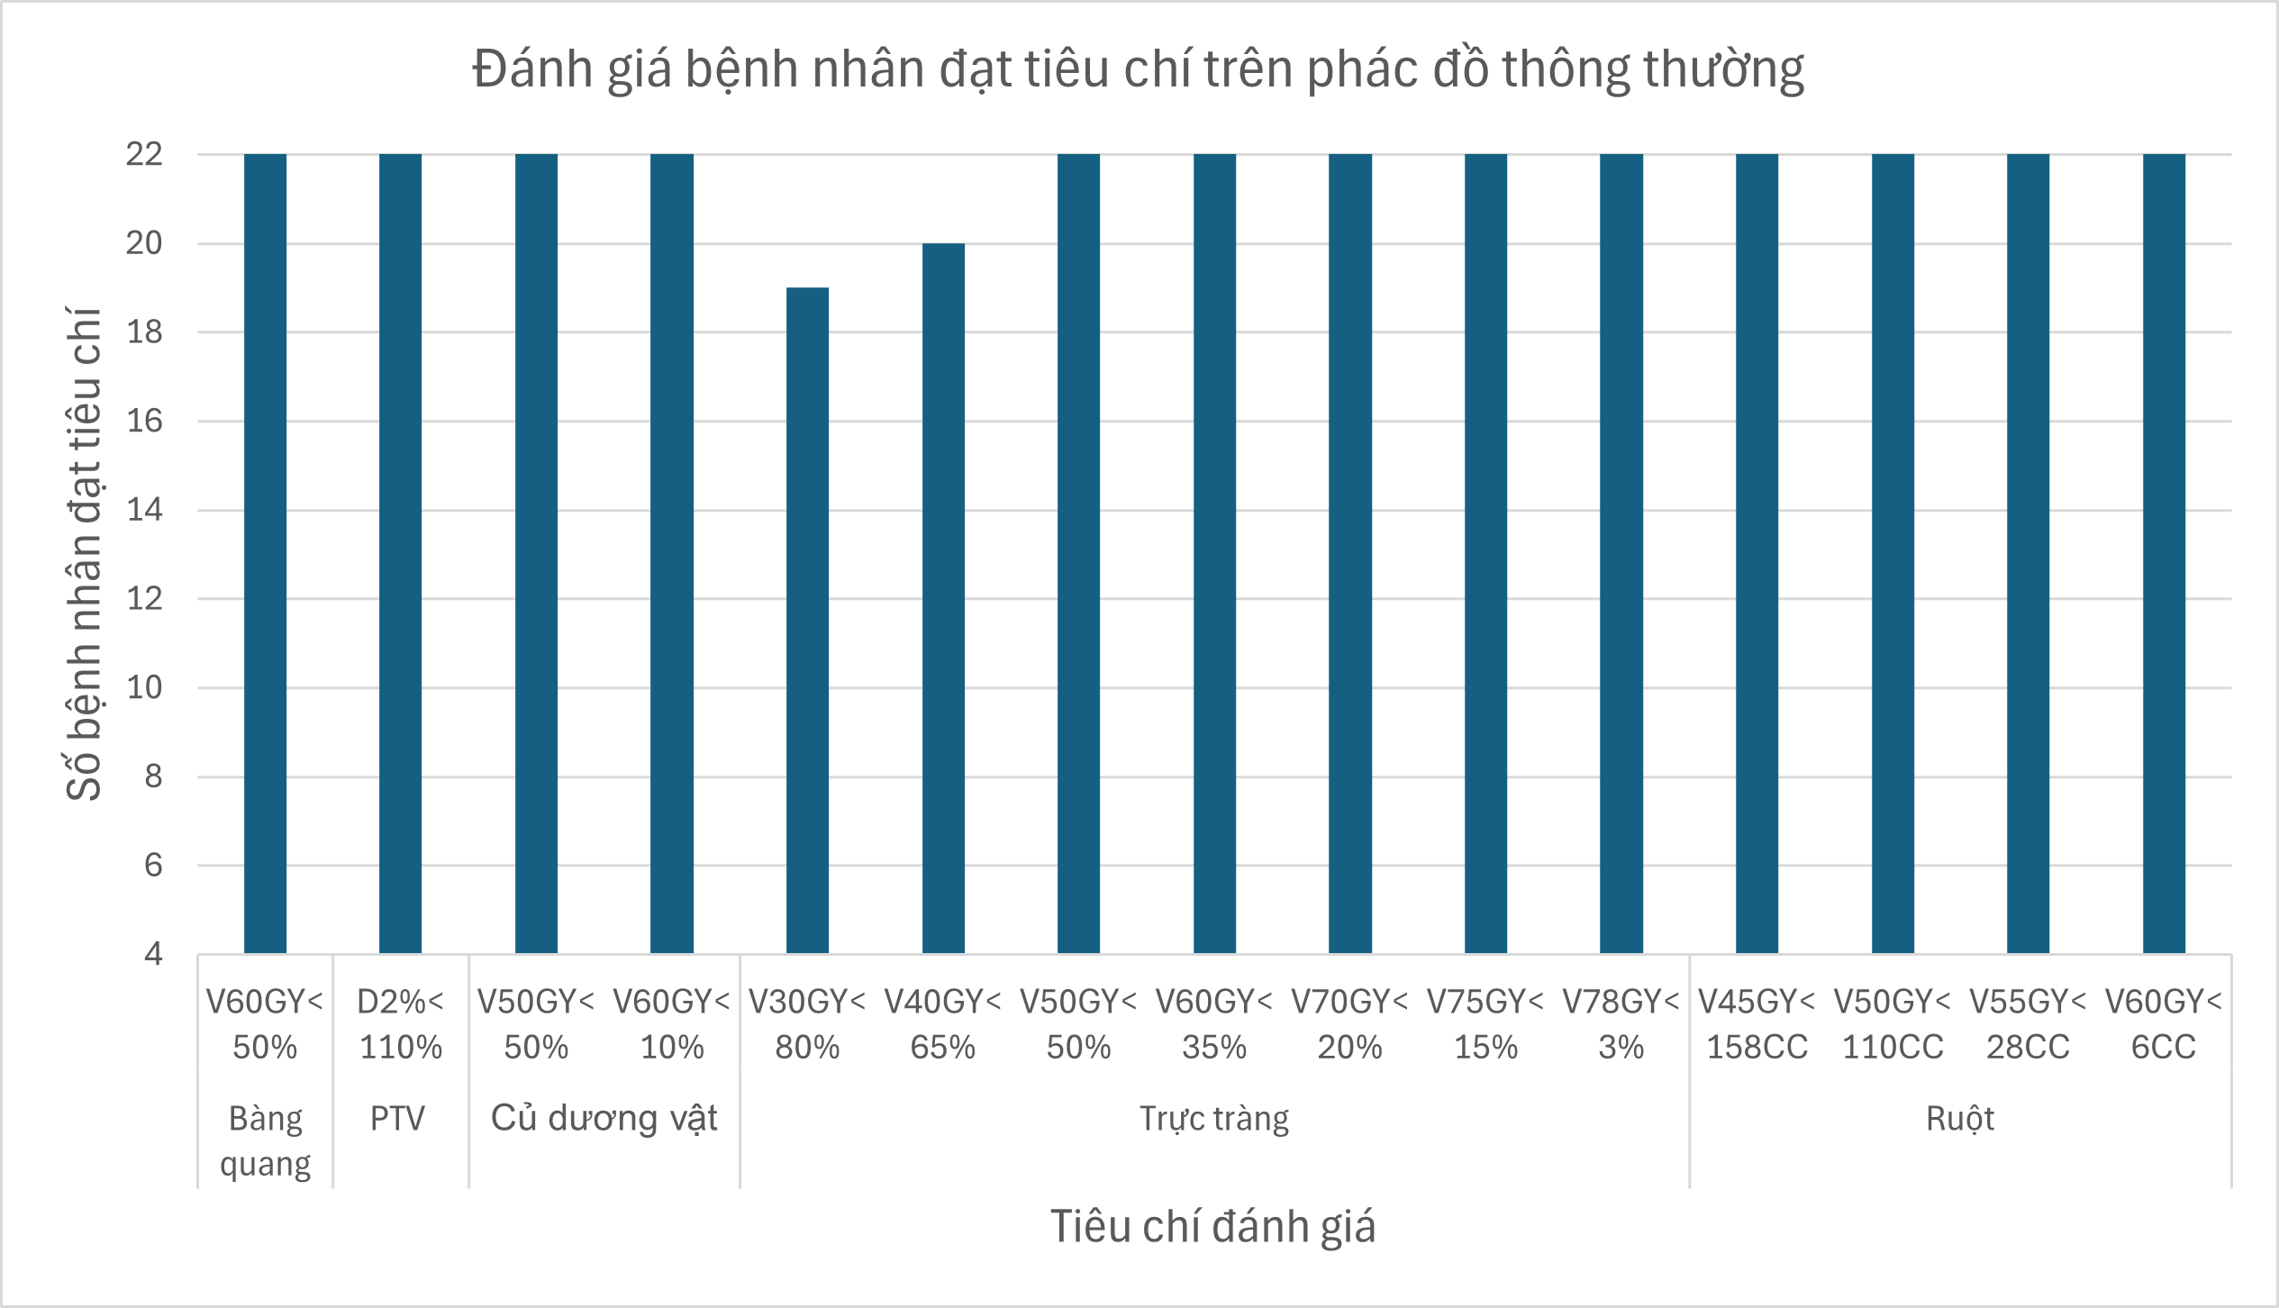
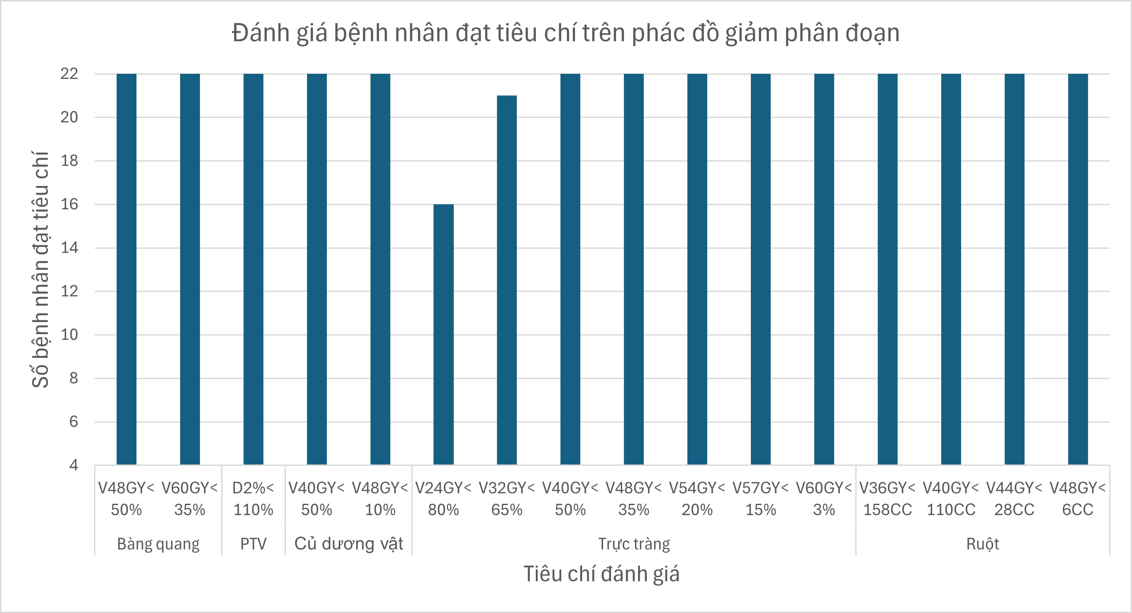
III. Result
Constraint on OARs
Figure: Number of patients meeting dose constraints for Organs at Risk
23

Slide 24
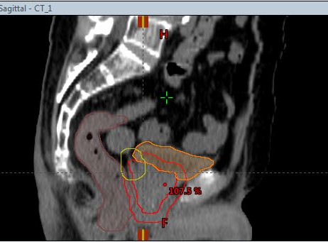
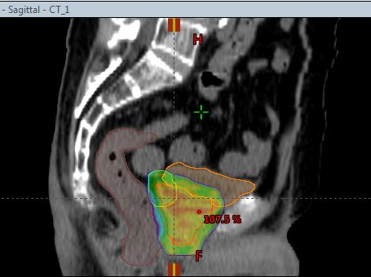
III. Result
Constraint on OARs
Figure: Anatomical structures and dose distribution to the target volume and organs at risk (OARs)
24

Slide 25
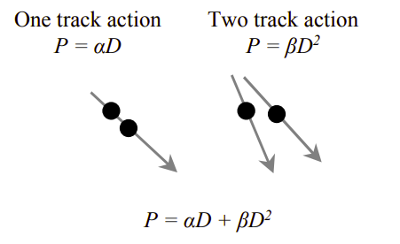
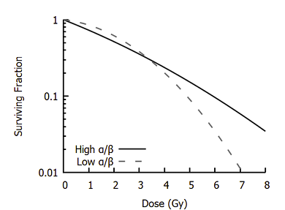
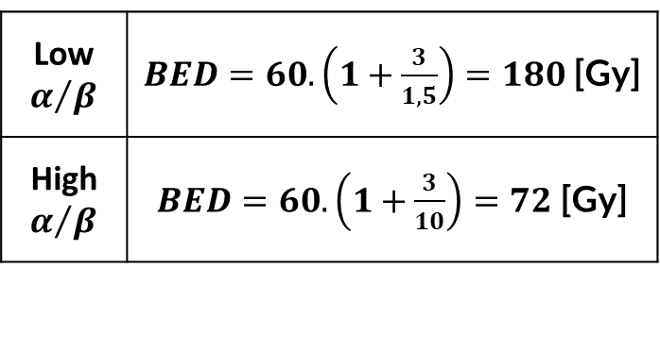
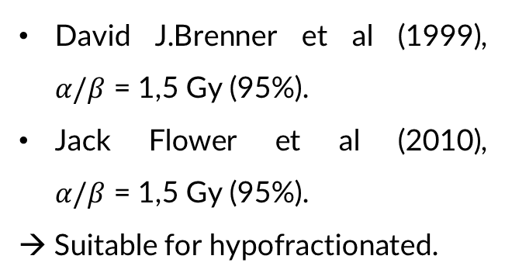
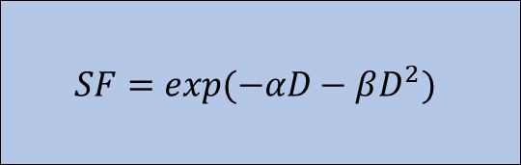
I. Overview
1.2. Protocol for prostate cancer
Figure: Relationship between dose and the α/β parameters
Impact of the α/β ratio
Low$α/β$ | $BED=60.\left(1+\frac{3}{1,5}\right)=180$ [Gy]
High$α/β$ | $BED=60.\left(1+\frac{3}{10}\right)=72$ [Gy]
Surviving fraction (SF) curve
$$SF=exp(−αD−βD^{2})$$
Reference
High α/β ratio → More resistant to dose escalation.
Low α/β ratio → More sensitive to dose escalation.
David J.Brenner et al (1999), $α/β$ = 1,5 Gy (95%).
Jack Flower et al (2010), $α/β$ = 1,5 Gy (95%).
→ Suitable for hypofractionated.
Figure: Affect of the α/β parameters on dose
25

Slide 26
I. Tổng quan
2.2. Quy trình lập kế hoạch
Contouring
Setup kế hoạch
Tối ưu hóa kế hoạch
Đánh giá kế hoạch
Vẽ các cơ quan lành
Set tâm của trường chiếu tại điểm giao các tâm chì
Chèn giường
Chọn điểm tham chiếu
Chọn tư thế nằm
Kê liều theo PTV
Chọn máy điều trị TrueBeam STx
Chọn cung và góc Collimator
Nhập các tiêu chí
Đặt trọng số ưu tiên
“Start Optimize”
Quan sát các thông số để điều chỉnh trọng số ưu tiên
Đánh giá phân bố liều trên PTV
Đánh giá trên DVH
Đánh giá tiêu chí cho cơ quan lành
26

Slide 27
II. Đối tượng và phương pháp nghiên cứu
2.2. Quy trình
Setup kế hoạch
Bảng: Các thông số đối với kế hoạch tuyến tiền liệt được lập
Các bước | Thực tế | Ghi chú | Mục đích
Chèn giường | Không chèn | Kế hoạch được lập CT đã tự chèn giường | Tính đến sự suy giảm bức xạ trong thực tế
Chọn điểm tham chiếu | PTV60 | Chọn hạch bạch huyết (nếu có) (PTV to nhất)
Chọn tư thế nằm | Ngửa đầu hướng thân máy |  | Giống lúc chụp CT mô phỏng
Chọn cung và góc Collimator | Cung CW góc 200⁰ – 160⁰ , góc Collimator 30⁰ Cung CCW góc 160⁰ – 200⁰ , góc Collimator 330⁰ | Nếu số MU >400 thì thêm arc Góc Collimator 0⁰ và 90⁰ | Không tạo full rotation để giảm liều 50% vùng trực tràng
27
Notes:
Sau khi đã lập xong kế hoạch và đánh giá định tính qua DVH và phân bố liều trên phần mềm Eclipse, dữ liệu sẽ được xuất ra dưới dạng file txt và được tải vào phần mềm R để tính toán các chỉ số đánh giá kế hoạch và chỉ số sinh học TCP và NTCP.

Slide 28
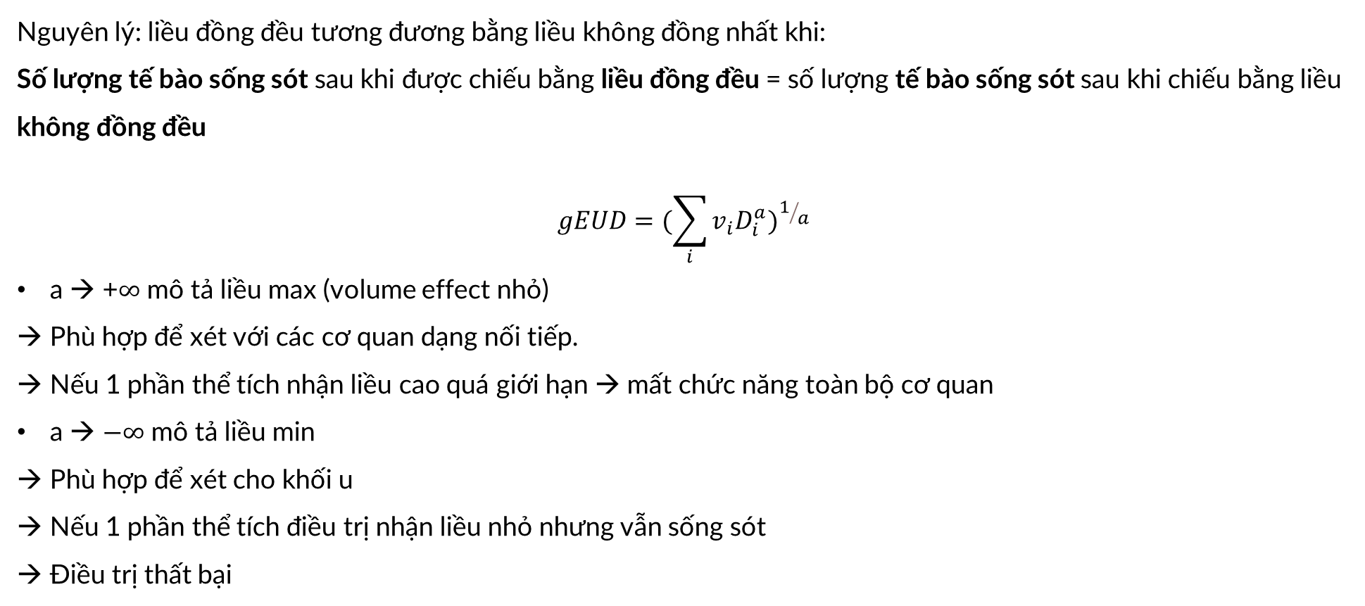
Phụ lục - gEUD
Nguyên lý: liều đồng đều tương đương bằng liều không đồng nhất khi:
Số lượng tế bào sống sót sau khi được chiếu bằng liều đồng đều = số lượng tế bào sống sót sau khi chiếu bằng liều không đồng đều
$$gEUD=(\sum_{i}{{v_{i}D_{i}^{a})}^{1/a}}$$
a → +$∞$ mô tả liều max (volume effect nhỏ)
Phù hợp để xét với các cơ quan dạng nối tiếp.
Nếu 1 phần thể tích nhận liều cao quá giới hạn → mất chức năng toàn bộ cơ quan
a → $−∞$ mô tả liều min
Phù hợp để xét cho khối u
Nếu 1 phần thể tích điều trị nhận liều nhỏ nhưng vẫn sống sót
Điều trị thất bại

Slide 29
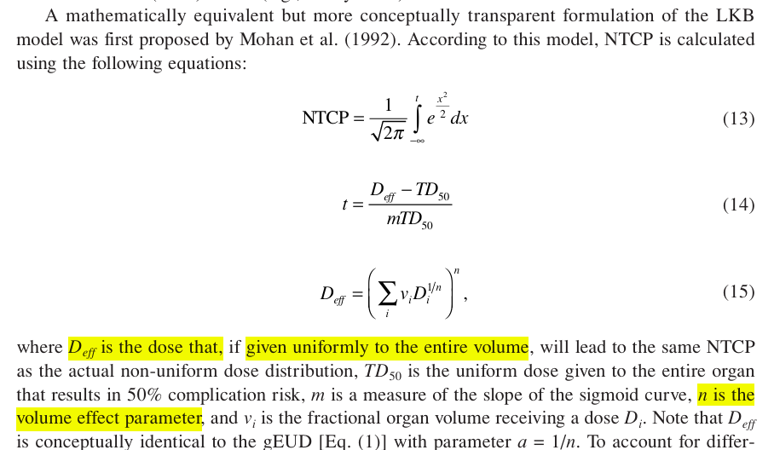
Phụ lục – Deff
AAPM REPORT NO.166

Slide 30
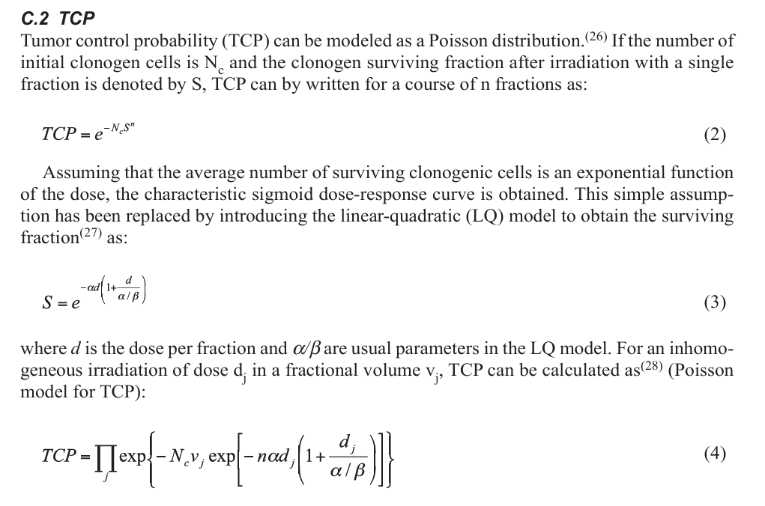
Phụ lục – TCP Poisson

Slide 31
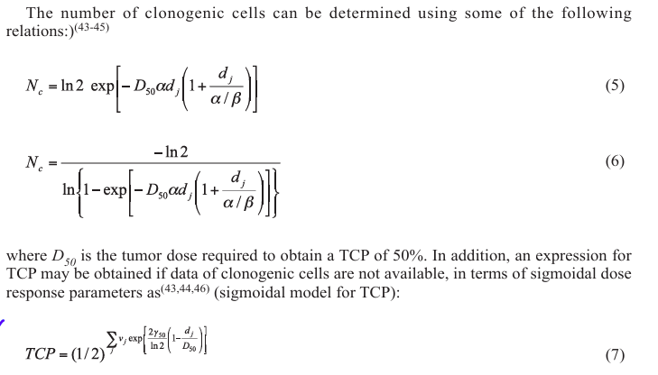
Phụ lục – TCP Poisson

Slide 32
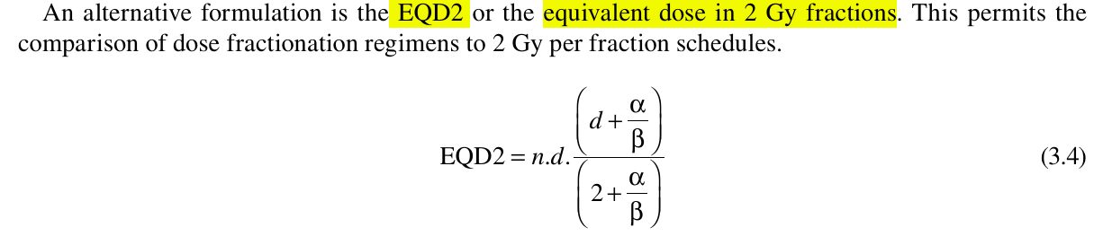
Phụ lục – EQD2

Slide 33
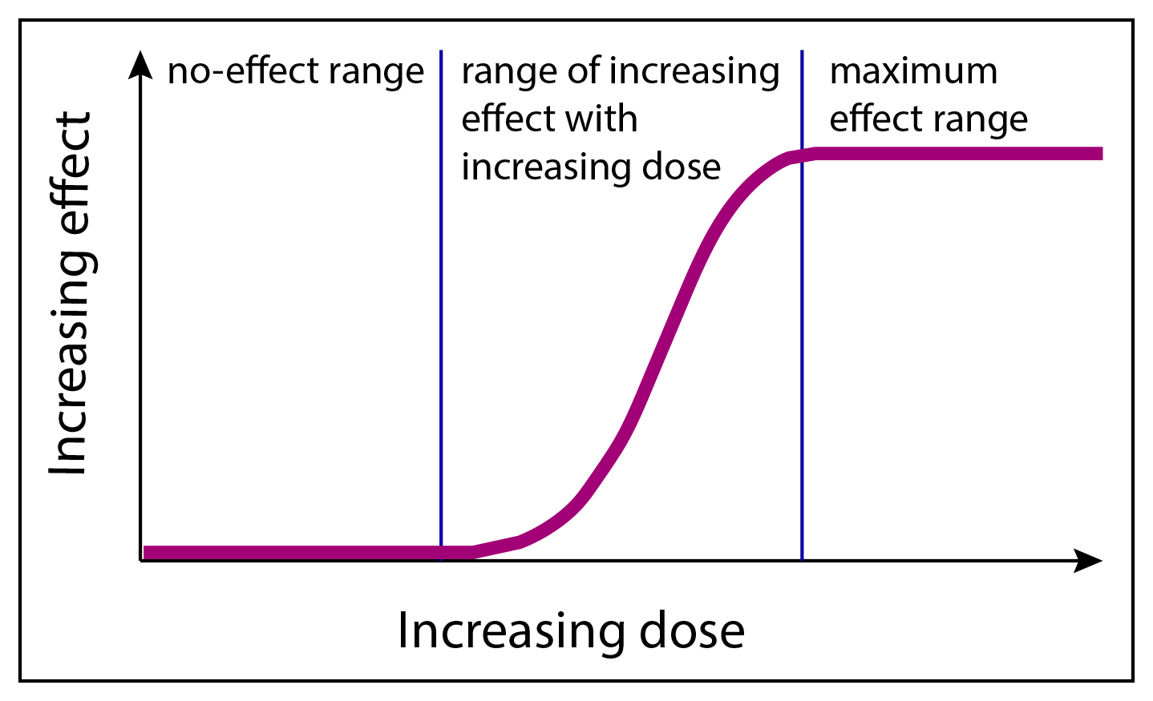
Phụ lục – Dose response curve

Slide 34
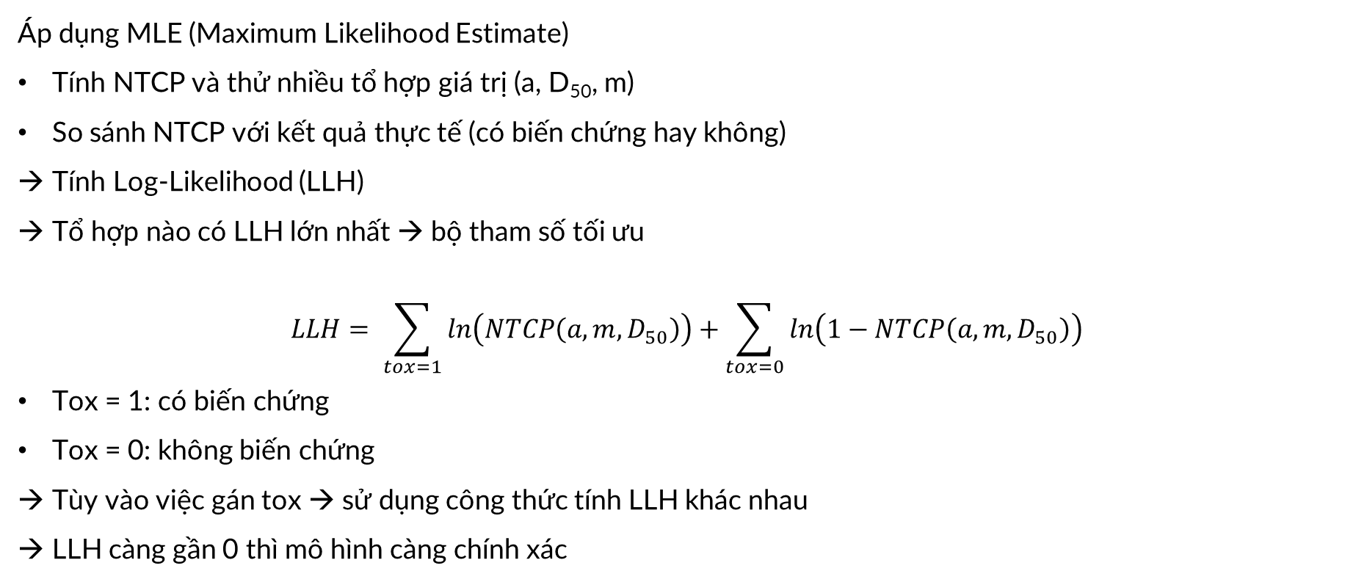
Phụ lục – Tính toán tham số tối ưu
Áp dụng MLE (Maximum Likelihood Estimate)
Tính NTCP và thử nhiều tổ hợp giá trị (a, D₅₀, m)
So sánh NTCP với kết quả thực tế (có biến chứng hay không)
Tính Log-Likelihood (LLH)
Tổ hợp nào có LLH lớn nhất → bộ tham số tối ưu
$$LLH= \sum_{tox=1}{ln\left(NTCP\left(a, m,D_{50}\right)\right)+\sum_{tox=0}{ln\left(1−NTCP\left(a, m,D_{50}\right)\right)}}$$
Tox = 1: có biến chứng
Tox = 0: không biến chứng
Tùy vào việc gán tox → sử dụng công thức tính LLH khác nhau
LLH càng gần 0 thì mô hình càng chính xác

