Slide 1


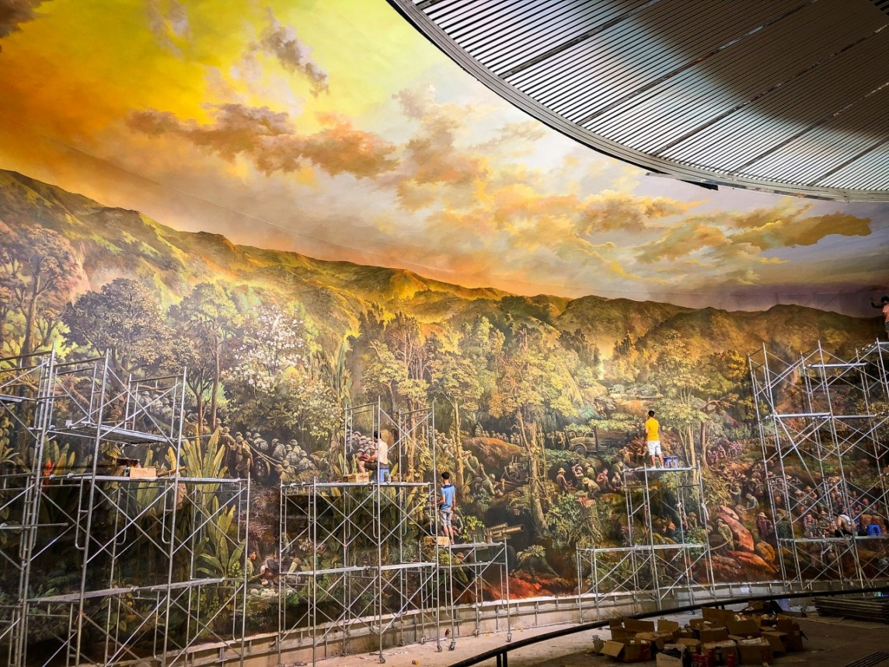
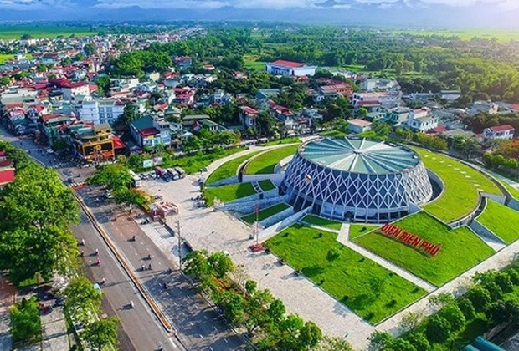

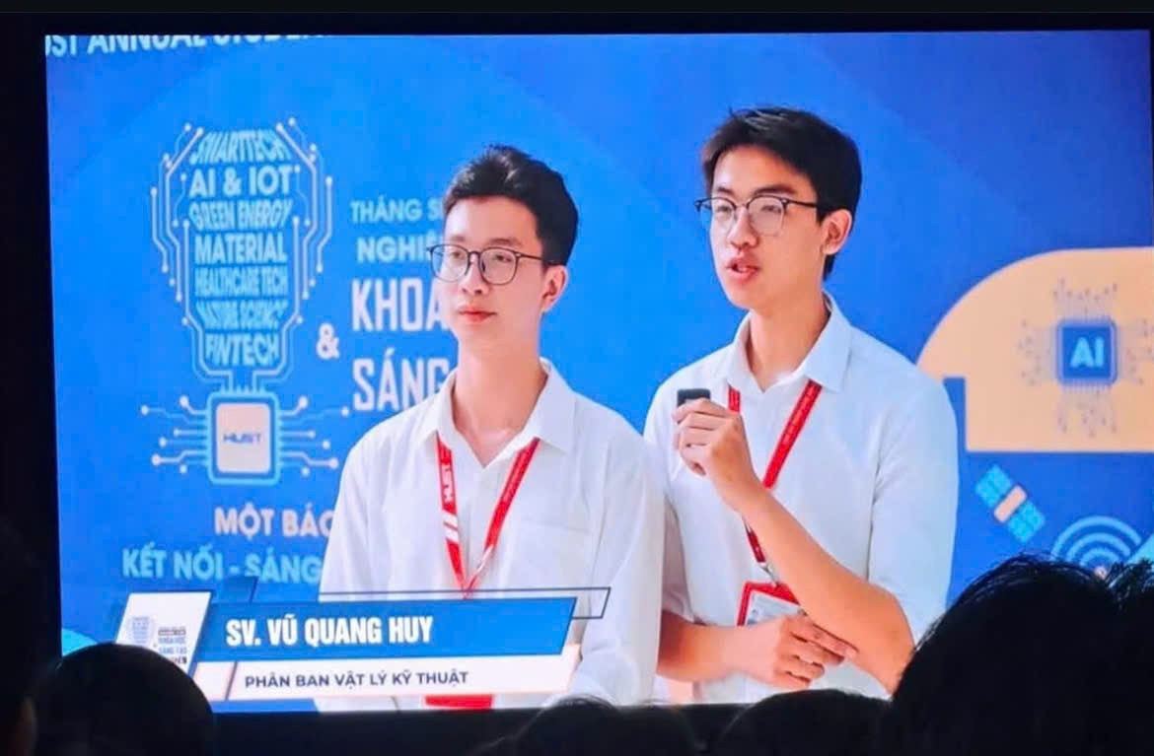
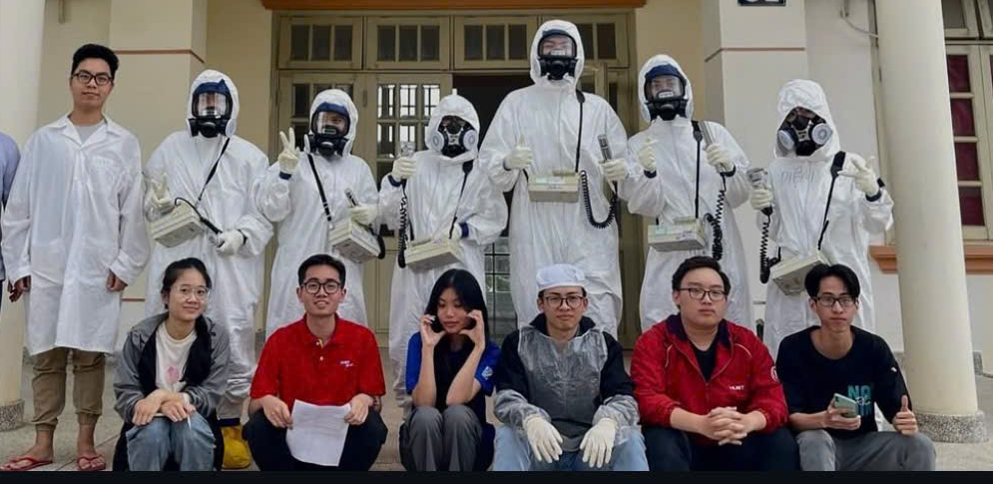

ABOUT ME
Le Quy Don High School for the Gifted, Dien Bien
Hanoi University of Science and Technology
Biology
Medical Physics
(2018-2021)
(2021-2025)
Notes:
Hello everyone, my name is Vũ Quang Huy. I am a student from Hanoi and I am very glad to join this course. I was born in Điện Biên Phủ – a historic land in the Northwest of Vietnam, which is also home to one of the world’s largest panorama paintings. If you ever have a chance, I highly recommend visiting it.
I studied Biology at Lê Quý Đôn High School for the Gifted, but later discovered a strong passion for Physics. Through national competitions, I had the opportunity to pursue Medical Physics at Hanoi University of Science and Technology. There, I was introduced to nuclear physics, medical applications, and AI in healthcare. Last month, I successfully defended my bachelor’s thesis, and today I feel very fortunate to be here to learn and connect with all of you
Dalat District Research Institute
polytechnic students, hardly compete with them, they are very good

Slide 2
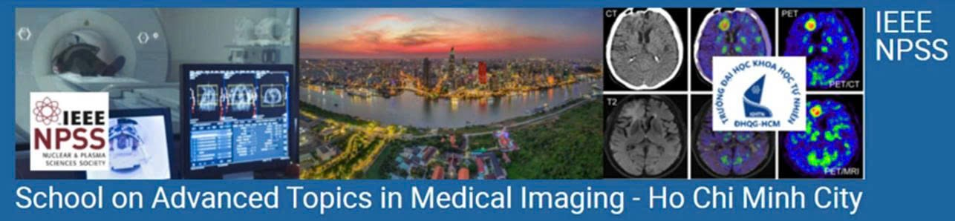
Topic: Application of Deep Learning in CT image reconstruction from MRI

Slide 3
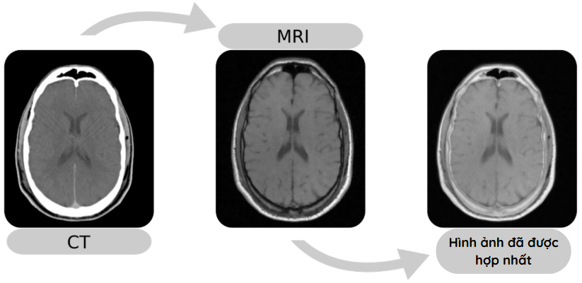
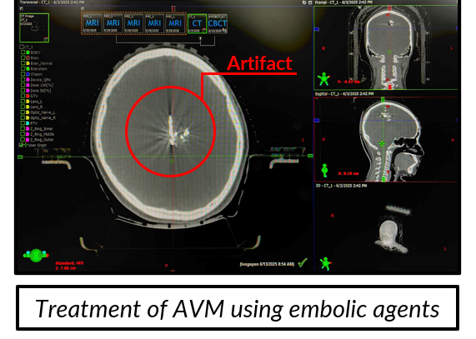
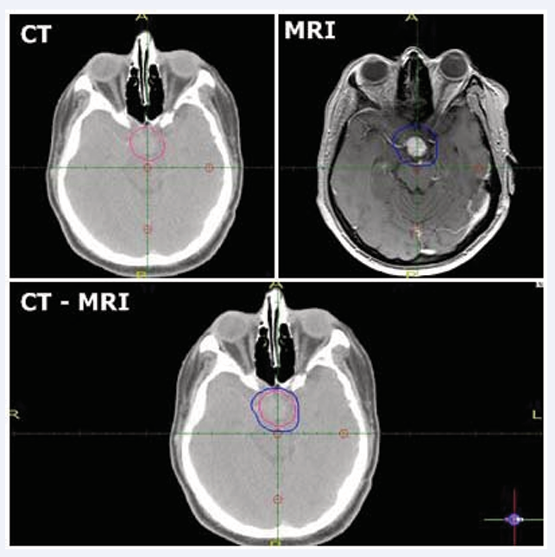

1. INTRODUCTION
Provides poor tissue contrast→ Difficult to identify tumors
Precisely localize the tumor location for planning
Fused Image
Provides good soft tissue contrast → Tumor location is determined
Prone to errors
Provides information on the distribution of X-ray attenuation coefficients, calculates electron density for dose simulation
Affects image quality
Notes:
In treatment planning, the standard workflow usually involves three main steps: acquiring CT images, acquiring MRI images, and then fusing them together. CT is essential because it provides electron density information for dose calculation, but it also delivers ionizing radiation to patients. Although the dose is small, repeated scans can be harmful, especially for pediatric patients who are more sensitive to radiation.
Moreover, CT has poor soft tissue contrast, so MRI is often added to precisely localize organs and tumors. However, CT images may suffer from artifacts, for example when embolic agents are used, which can affect fusion accuracy and dose calculation.

Slide 4
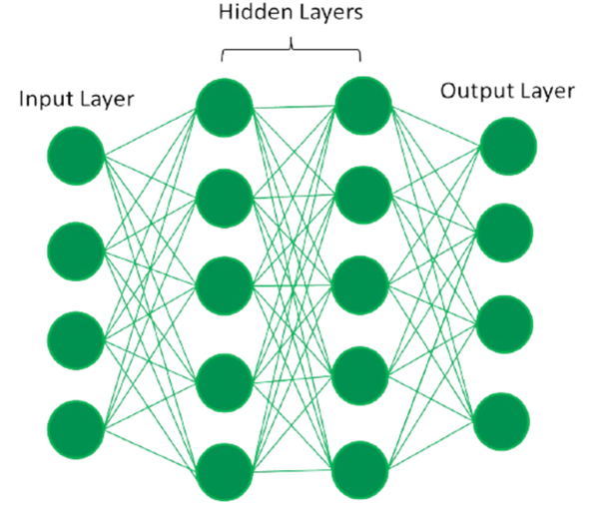
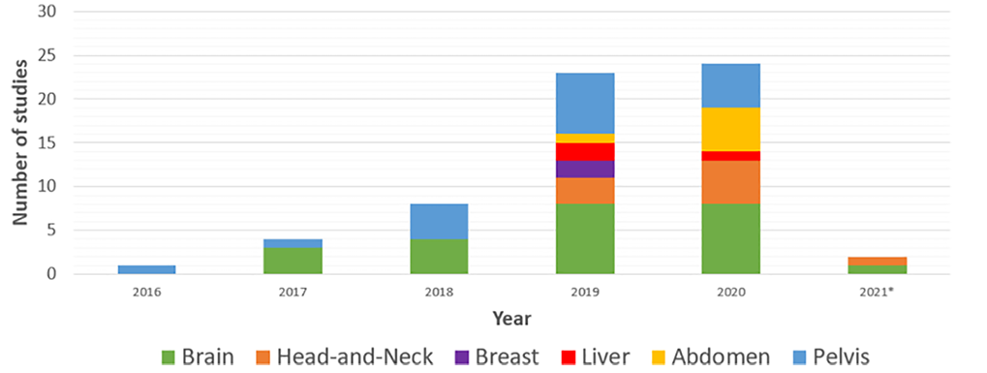
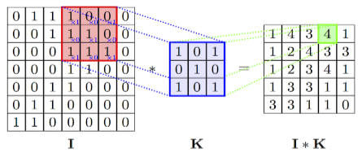
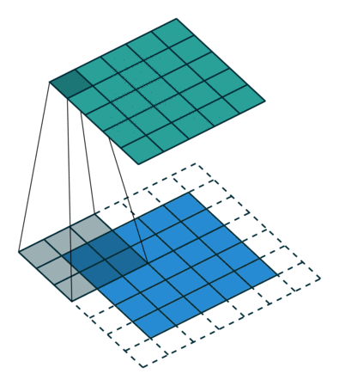
2. DEEP LEARNING IN MEDICAL IMAGING
Number of research papers on deep learning methods for generating synthetic CT from MRI in radiotherapy per year
M. Boulanger, Jean-Claude Nunes, H. Chourak, A. Largent, S. Tahri, O. Acosta, R. De Crevoisier, C. Lafond, A. Barateau, Deep learning methods to generate synthetic CT from MRI in radiotherapy: A literature review, Physica Medica, 2021.
Notes:
Because of those limitations, many recent studies have explored deep learning methods to generate synthetic CT from MRI, moving towards the concept of MRI-only treatment planning.
As you can see, the number of studies on converting MRI to CT has been steadily increasing over the years. These statistics are only collected up to 2021, and I believe that many more advanced models have been developed since then.
Here is a simple neural networks to describe about what deep learning is.
Deep learning is like a system with many layers.
The first layers learn very simple things, like edges or textures.
Higher layers combine them into larger shapes, like organs.
By training on many MRI–CT pairs, the model learns the mapping between them.
It does this by generating a CT from MRI, comparing it with the real CT, and adjusting itself step by step until the difference is minimized.
That’s why, once trained, if I give it a new MRI, it can generate a realistic synthetic CT
The model updates its parameters by minimizing a loss function. This is done using an optimizer, which controls how the parameters move in the right direction, like following a GPS towards the best solution.

Slide 5
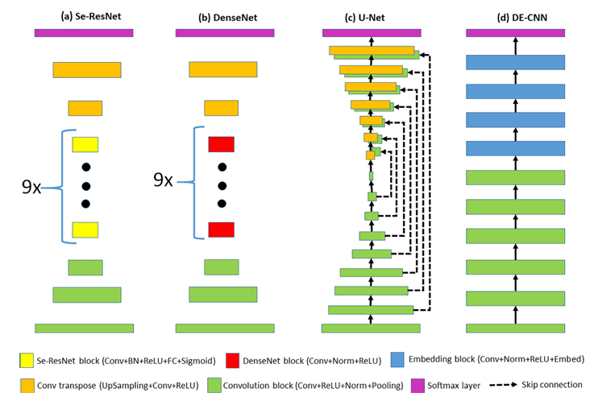
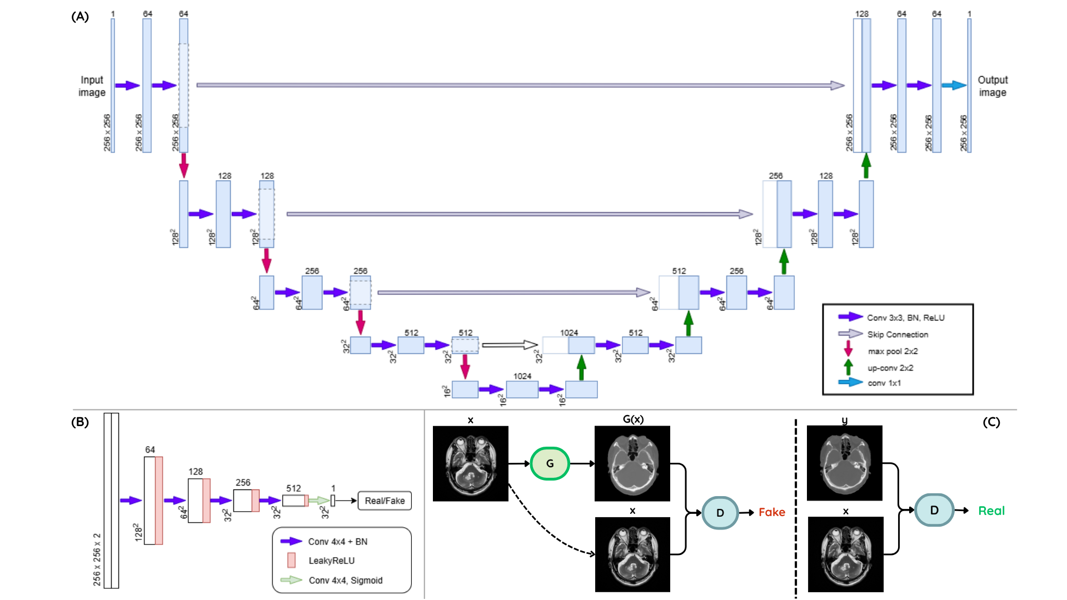

2. DEEP LEARNING IN MEDICAL IMAGING
Generator-only
Deep Learning architectures
GAN
Hybrid models
Diffusion models
cGAN
Notes:
Another model that is widely used is Generative Adversarial Networks. The image you see here illustrates one of their variants, called Conditional GAN.
This model is a bit special because it consists of two networks. The generator tries to create the most realistic image possible based on a given condition, while the discriminator attempts to distinguish between real and generated images.
Through this adversarial process, the model can produce higher-quality outputs. Of course, the final performance also depends on factors such as the chosen architecture and training parameters

Slide 6
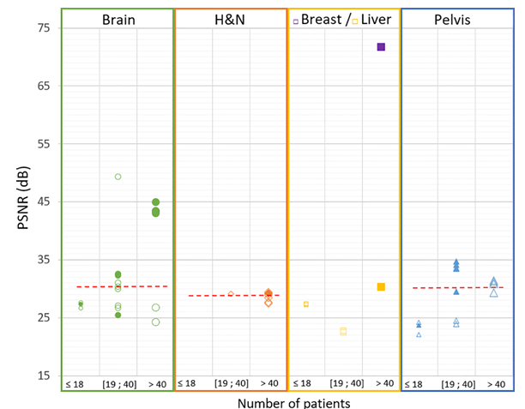
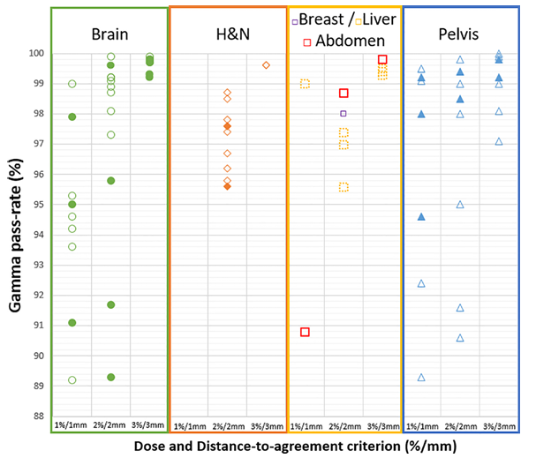
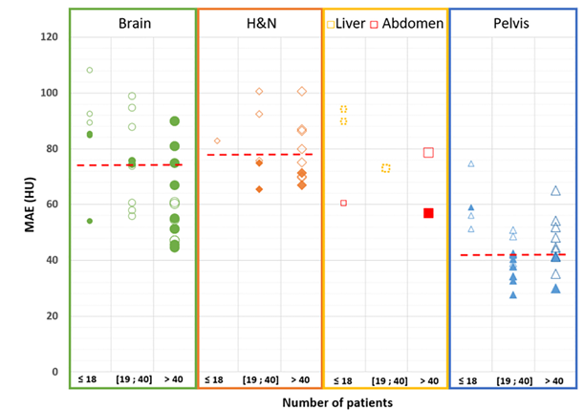
3. APPLICATION AND STUDY
Notes:
This is the result of Gamma pass rate evaluation, which compares the dose distribution calculated on the reference CT with the synthetic CT generated from MRI using Deep Learning. As we can see, in most regions such as brain, abdomen, and pelvis, the Gamma pass rate is above 95% under the 3%/3mm criterion, meaning the dose plan from synthetic CT is almost identical to that from real CT. This demonstrates that Deep Learning can generate synthetic CT with sufficient accuracy to replace CT in radiotherapy planning, especially toward an MRI-only workflow

Slide 7
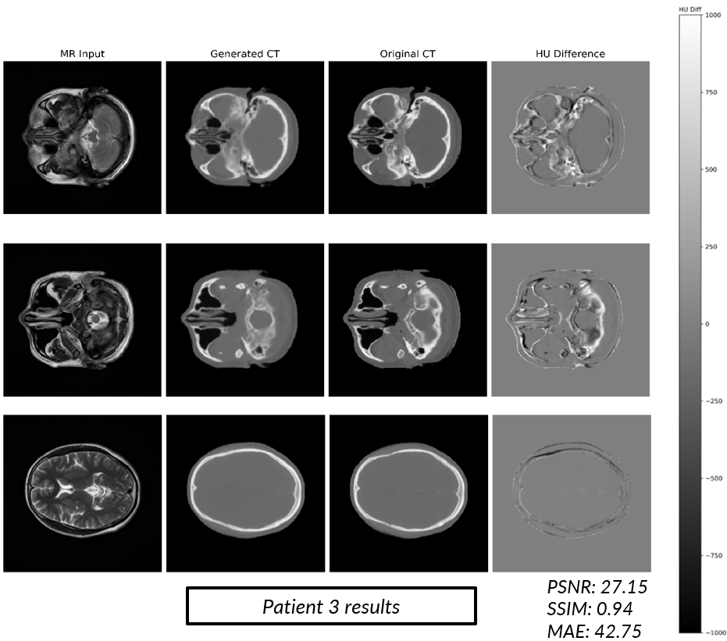
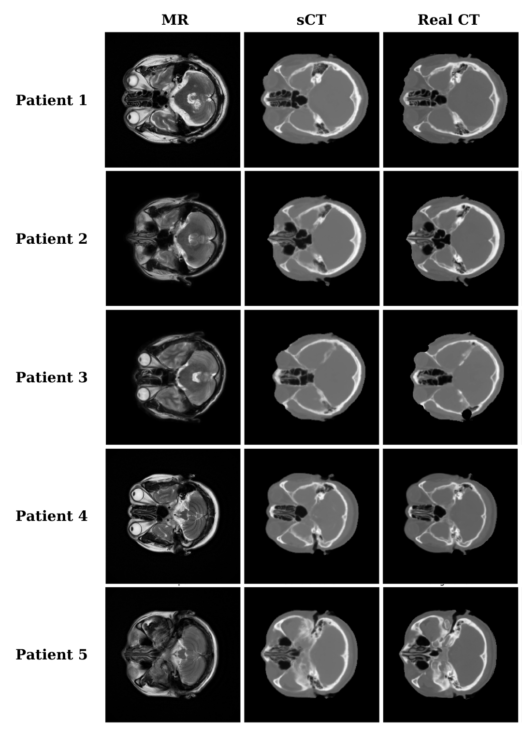
4. MY WORK

Slide 8
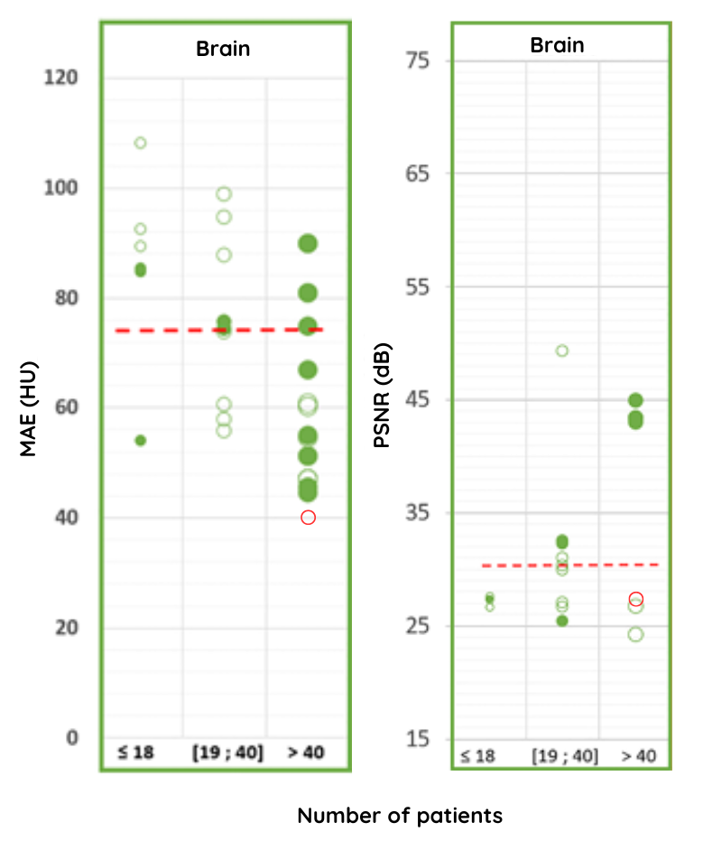
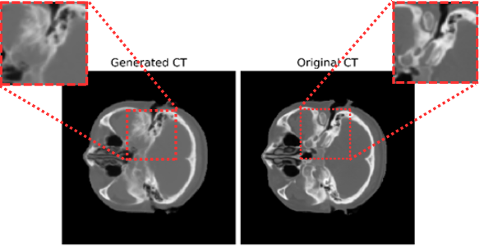
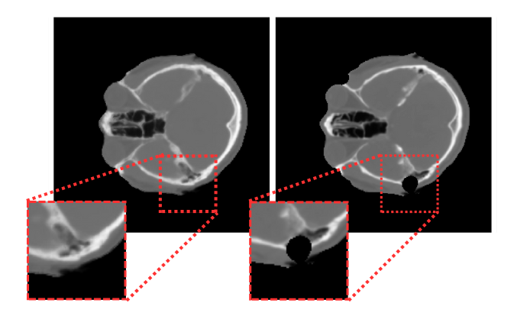
4. MY WORK
Comparison of MAE and PSNR results with previous studies
Some reasons affecting the results
Notes:
To best evaluate the effectiveness of MAE and PSNR compared to previous studies, MAE will be normalized to the HU scale. On the distribution graph on the left here, we can see that the green circles are the studies using the generative adversarial model, the solid green circles are the models using generator-only, the red circle is the result of this project. The results of this project are better than many previous studies including generator-only and GAN. However, the PSNR index is lower than the average threshold, but still better than the studies using GAN with more than 40 patients. This happens because there are some slices in the brain stem that are very poorly represented on the MRI image, almost completely dark, leading to difficulty in mapping, combined with a few slices being cut off when automatically separating the head mask. However, the model still tries to reproduce those positions well and tries to minimize the error as much as possible.

Slide 9
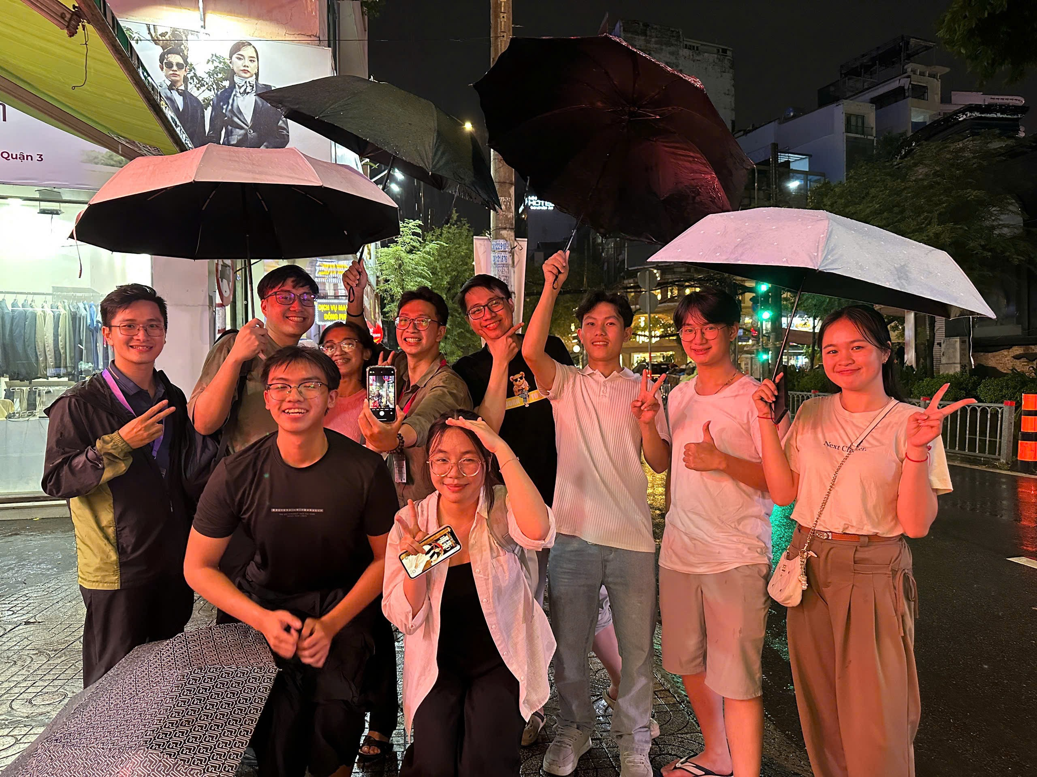
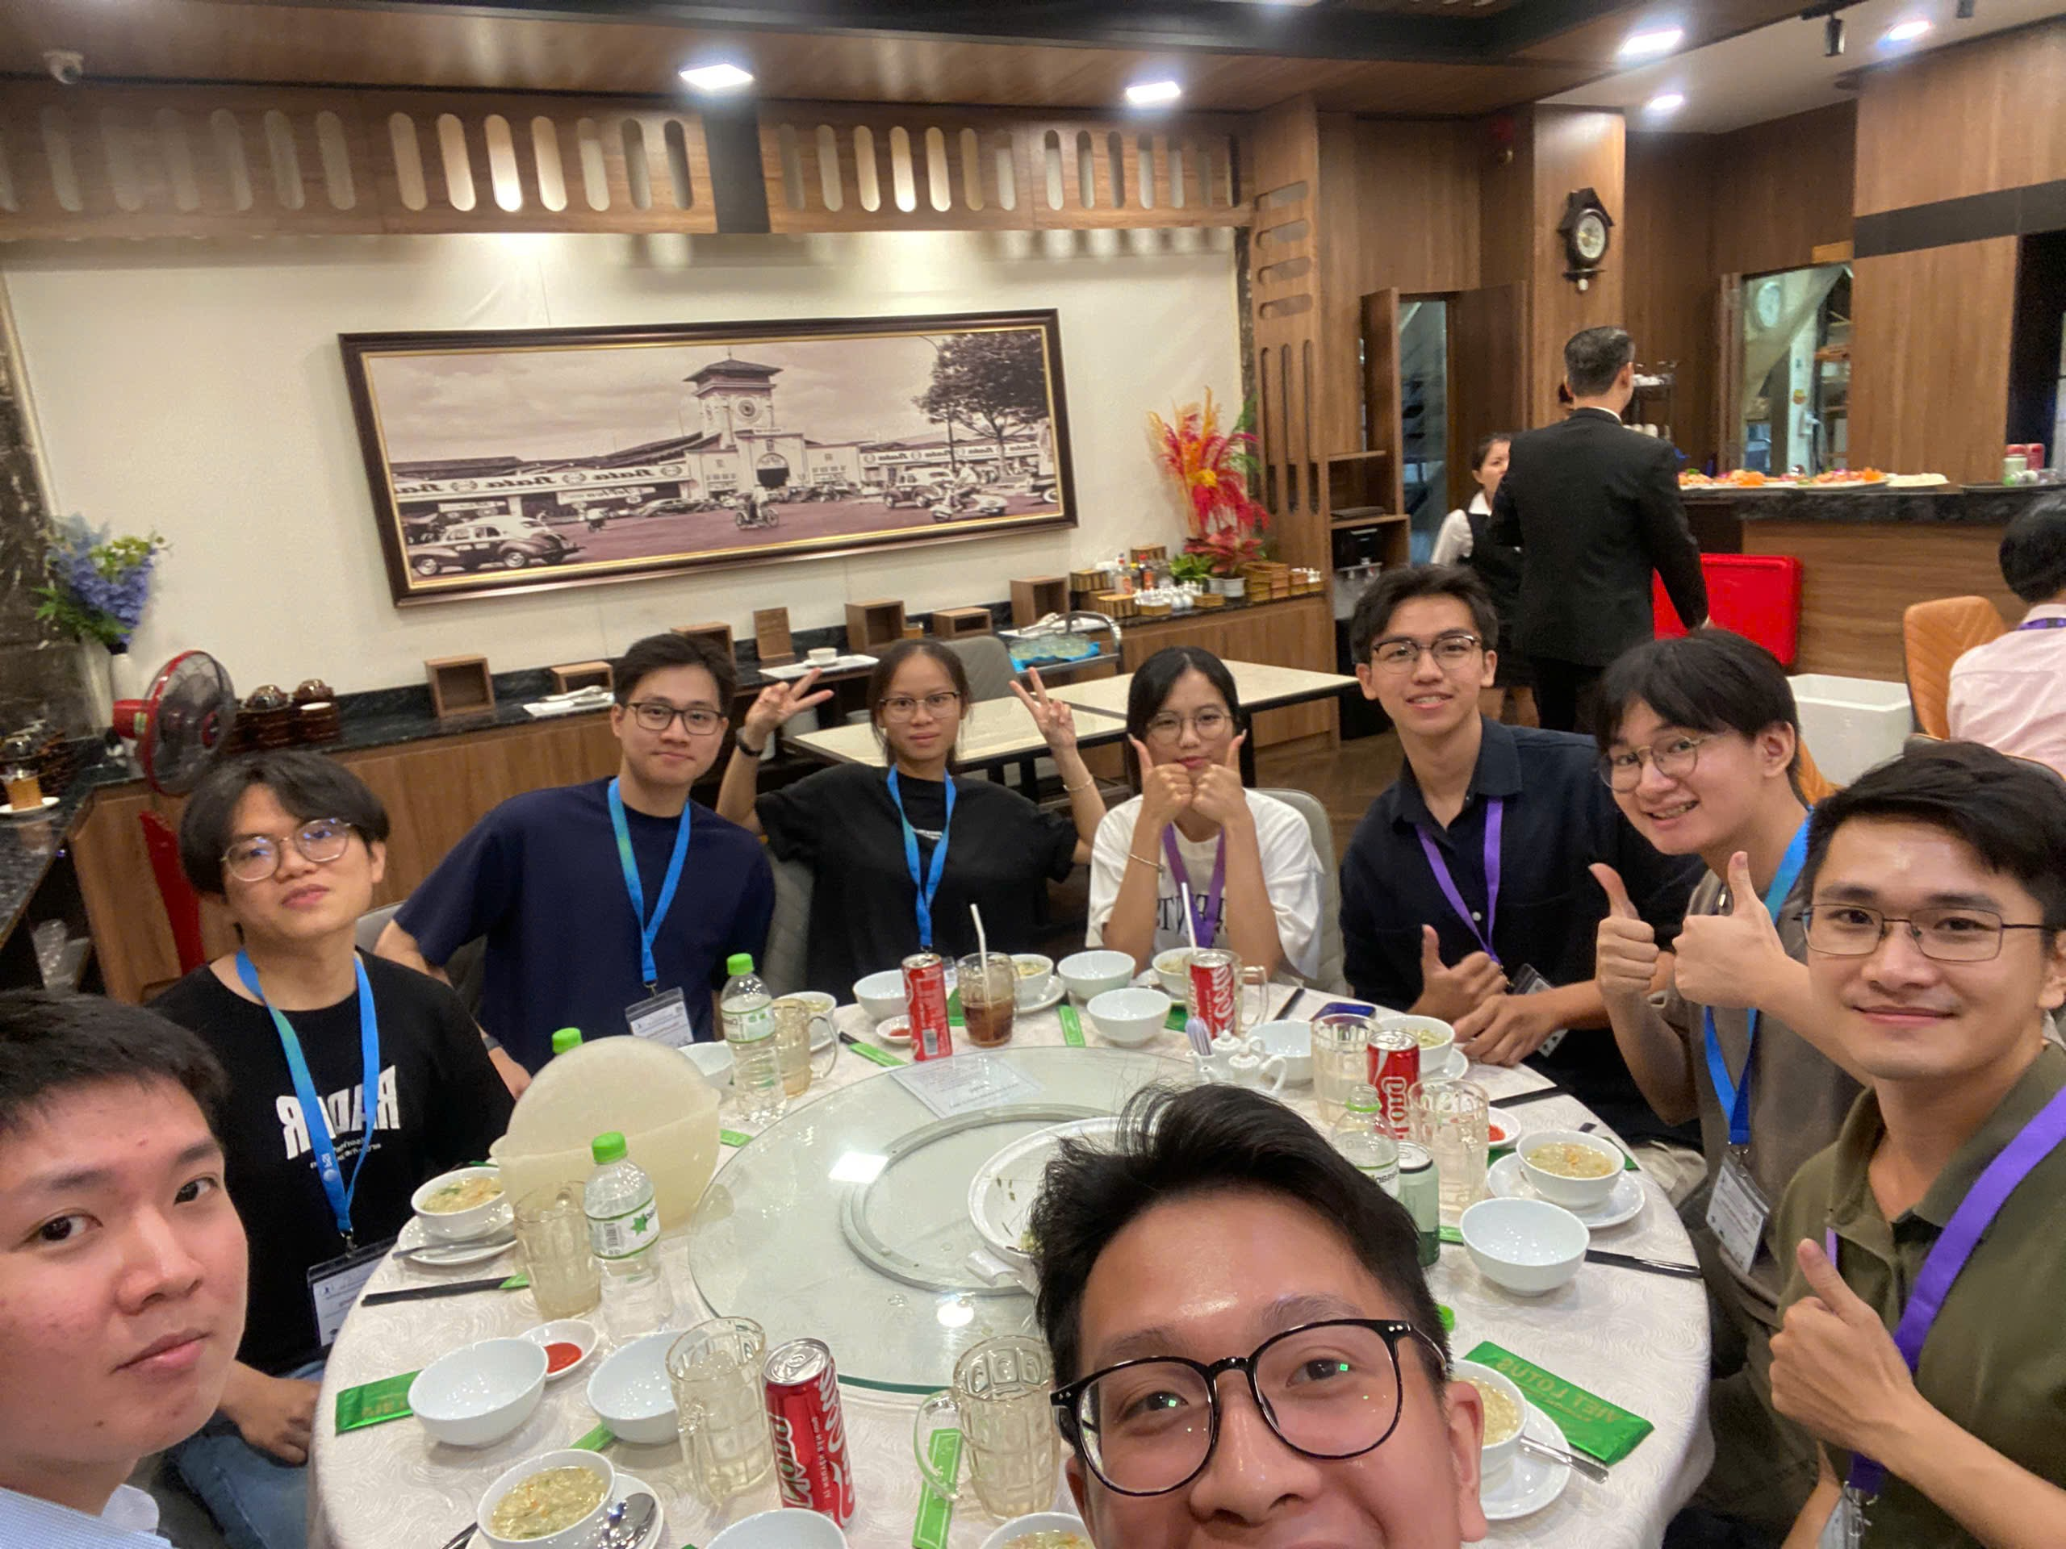
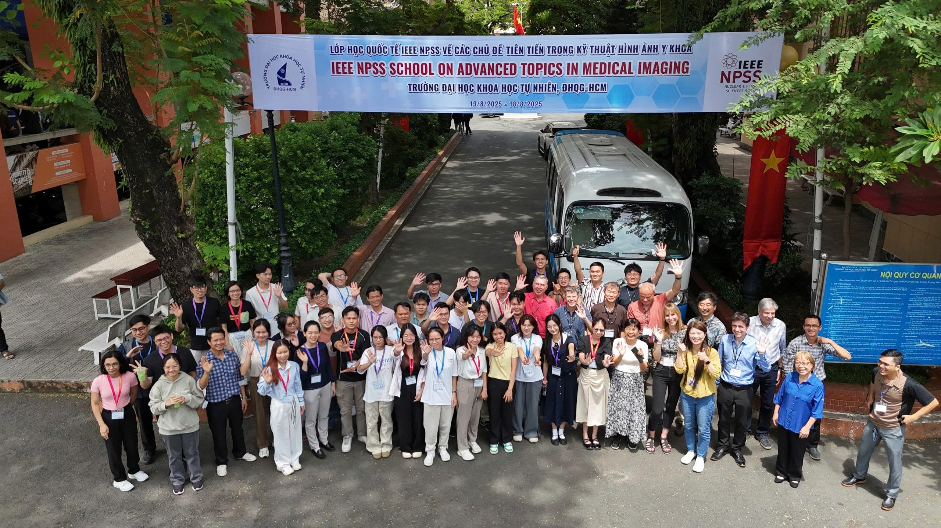
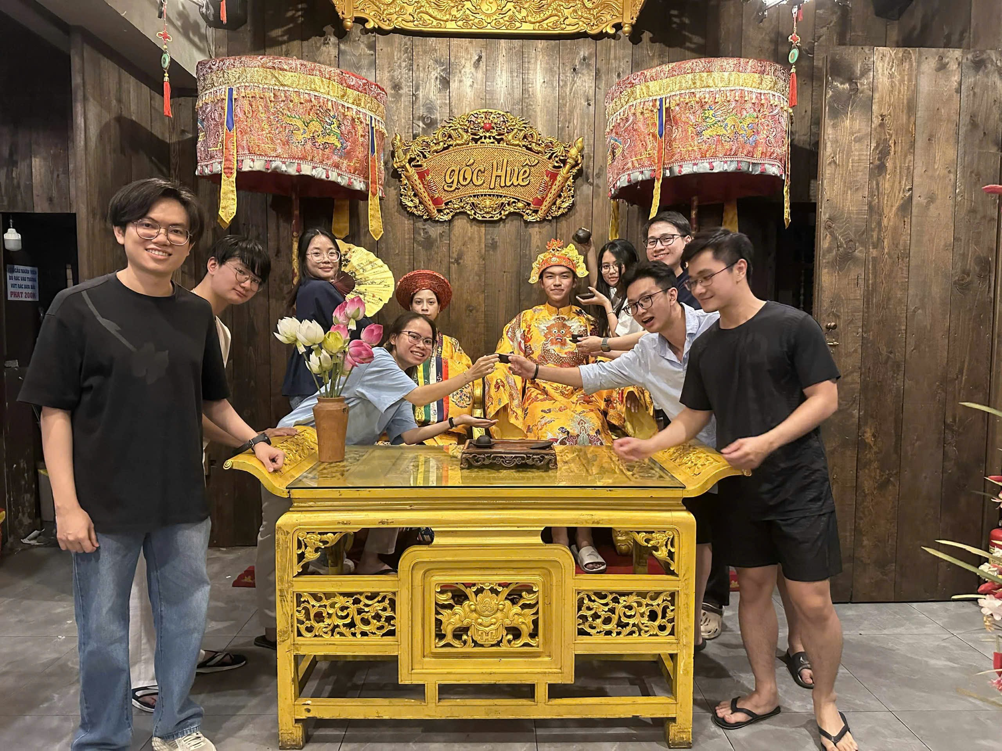
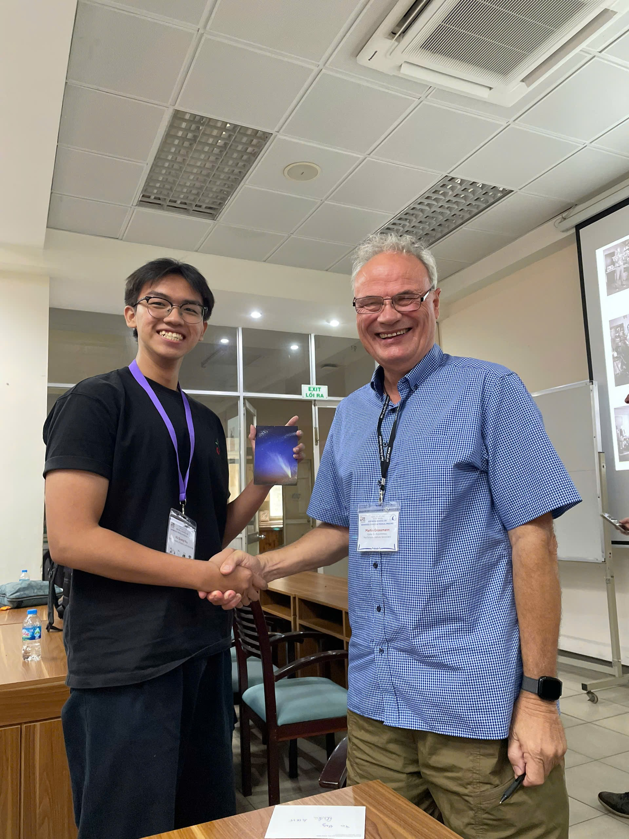
THANK YOU!
Notes:
I apologize if my presentation is not perfect, as my time and experience are still limited. I am truly grateful to the professors and fellow students for giving me the opportunity to learn and share during this course.
My special thanks go to Professor Martin for organizing the program, to Ms. Trang for her great support, and to all the professors and students who have accompanied me. I hope we will meet again at future conferences. Thank you very much

