Slide 1
IEEE NPSS School on Advanced Topics in Medical Imaging - Ho Chi Minh City
thaithimaitho_t65@hus.edu.vn
Immobilization Devices in CT Simulation
THAI THI MAI THO
VNU, Hanoi University of Science
Ho Chi Minh City, August 18, 2025

Slide 2
IEEE NPSS School on Advanced Topics in Medical Imaging - Ho Chi Minh City
Table of Contents
Introduction
Role of CT Sim in cancer radiotherapy
Immobilization devices

Slide 3
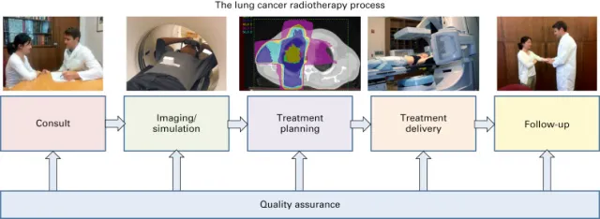
IEEE NPSS School on Advanced Topics in Medical Imaging - Ho Chi Minh City
Introduction
cancer radiotherapy process
important step

Slide 4
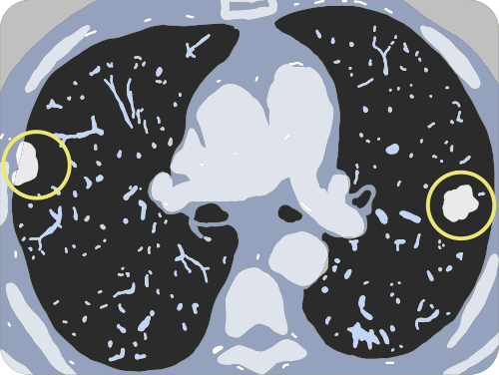
IEEE NPSS School on Advanced Topics in Medical Imaging - Ho Chi Minh City
Role of CT Sim in cancer radiotherapy
The role of CT Sim in cancer radiotherapy
  To determine the location, size, and volume of the tumor as well as the adjacent critical structures in three-dimensional (3D) space.
  To accurately identify the patient’s body contour, tumor boundaries, and tumor center.
  To define both symmetric and asymmetric margins of the target volume (tumor).

Slide 5
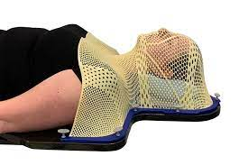
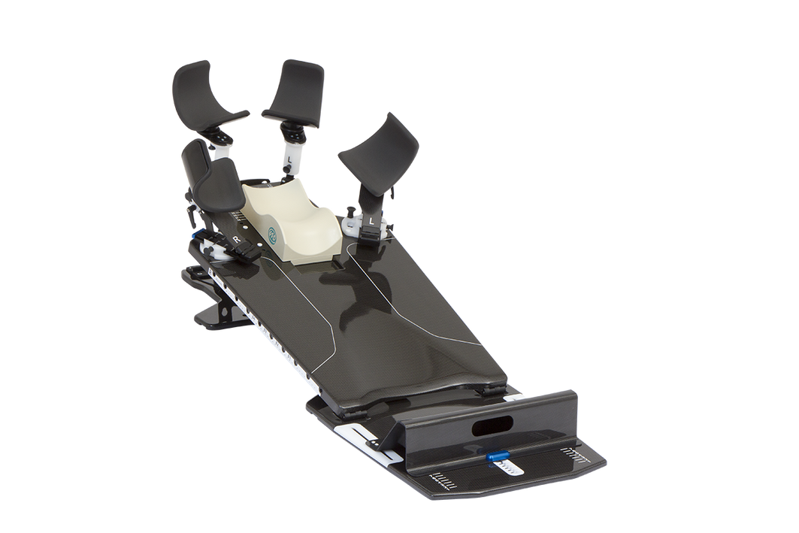
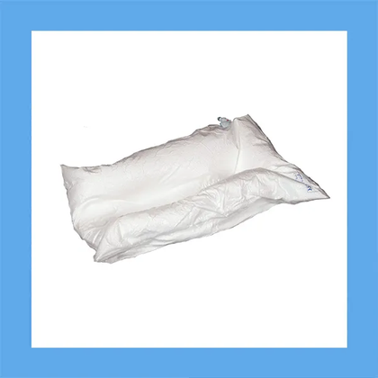
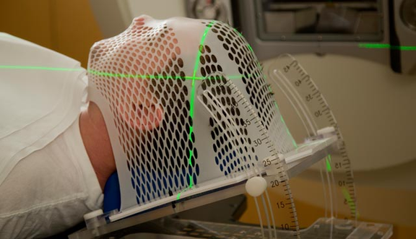

IEEE NPSS School on Advanced Topics in Medical Imaging - Ho Chi Minh City
Immobilization devices
Head and neck
Chest and breast
Three common immobilization devices in thoracic tumor treatment:
  VACLOK
  Breast Board
  2- or 4-point Thoracic Mold/Mask
brain tumors

Slide 6
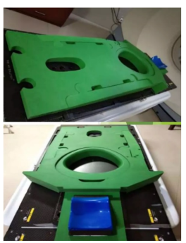
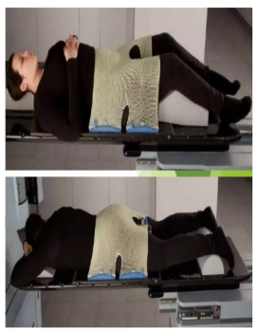
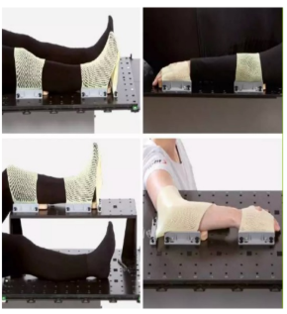
IEEE NPSS School on Advanced Topics in Medical Imaging - Ho Chi Minh City
Immobilization devices
Pelvic and abdominal immobilization.
Limbs immobilization.
abdominal
Pelvic

Slide 7

IEEE NPSS School on Advanced Topics in Medical Imaging - Ho Chi Minh City
thaithimaitho_t65@hus.edu.vn
THANK YOU!

