Slide 1
QA/QC FOR PET/CT
IEEE NPSS Summer School
Dinh Thi Kim Hue
August 18th, 2025

Slide 2
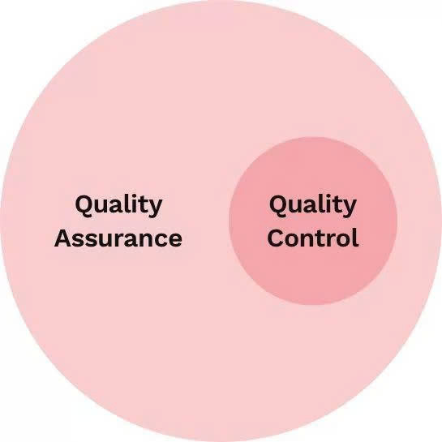
1. What is QA - QC?
- Quality Control (QC) is the process of performing measurements and comparing the technical parameters of equipment with established reference standards.
If any deviation is detected, appropriate actions such as calibration, repair, or component replacement are carried out in order to maintain or restore the technical performance of the equipment, ensuring compliance with defined quality and safety standards
- Quality Assurance (QA) is the systematic and periodic implementation of measurement procedures and dose calibration in strict accordance with technical guidelines
The QA-QC program is designed to prevent systematic errors and to minimize random errors

Slide 3
2.Why is QA- QC important?
- Patient Safety
Ensures radiation dose is as low as reasonably achievable (ALARA) while still producing diagnostic - quality images - Maintain Image Quality
Prevents patients from receiving unnecessary or excessive exposure.
- Image Quality & Diagnostic Accuracy
QA/QC ensures stability of contrast, resolution, uniformity, and noise so that clinicians can trust the images.
- Equipment Performance & Reliability
Regular QA/QC detects drift or malfunction in X-ray tubes, detectors, collimators, or software
- Quantitative Accuracy
Especially in PET/CT or SPECT/CT, quantitative values like SUV must be consistent for patient follow-up.
- Regulatory & Accreditation Compliance
International organizations (IAEA, AAPM...) and national health authorities require documented QA/QC programs.

Slide 4
3. Phantoms for CT
QC Frequency | Phantom Type | Main Purpose | Notes
Daily | - Uniform phantom (cylinder phantom filled with ⁶⁸Ge or ¹⁸F-FDG solution | - Check water HU (0 ± 4 HU) - Verify CT image uniformity - Check dose output consistency
Weekly | - Image quality phantom | - Spatial resolution - Contrast and noise (CNR, SNR) - Slice thickness
Monthly | - TDI phantom (PMMA 16 cm for head, 32 cm for body) | - Measure: CTDI100 CTDIw - Compare dose with baseline | IEC/AAPM international standard
Annual | - CTDI phantom (PMMA) - Comprehensive QA phantom | - Accurate dose calibration - Full evaluation of image quality and dose

Slide 5
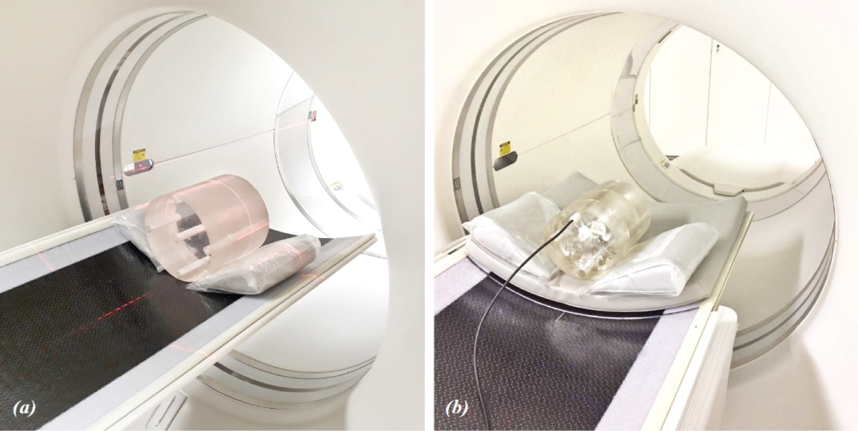
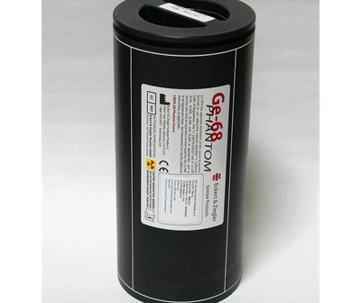
Some pictures of Phantoms
Figure 1: PMMA head phantom images: (a) Adult standard and (b) Pediatric
Figure 2: Germanium-68 annalus phantom

Slide 6
THANKS FOR LISTENING!

