Slide 1



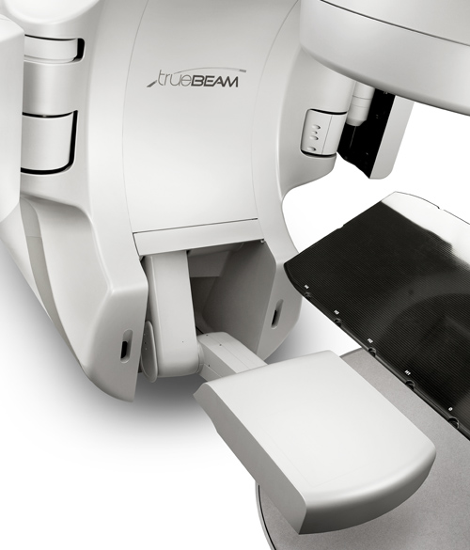
EPID IN RADIOTHERAPY: FORWARD AND BACKWARD DOSE VERIFICATION
Student: Le Tuan Anh

Slide 2
OVERVIEW
Introduction
• EPID in radiotherapy
• Role in dose verification
Main Content
• Forward approach
• Backward approach
Conclusion
• Key differences
• Importance for patient safety

Slide 3
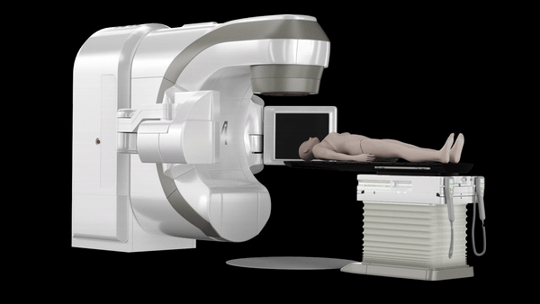
Introduction
Radiotherapy uses high-energy beams to target and destroy tumor tissue.
https://view.ceros.com/mckesson-pharma-and-specialty-health/us-oncology-network-truebeam-sales-sheet-v1-1-1-1/p/1
Notes:
Radiotherapy is a way to treat cancer.
We use high-energy beams to attack the tumor.
Because the energy is very high, we must make sure the treatment quality is good.
One device that helps us do this is the EPID – the Electronic Portal Imaging Device.

Slide 4
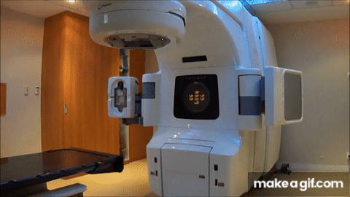
Introduction
EPID (Electronic Portal Imaging Device)
Records transmitted radiation
Functions:
Imaging → verify patient positioning (IGRT)
Dosimetry → measure transmitted dose
https://makeagif.com/gif/patient-specific-rapidarcimrt-qa-MN523I

Slide 5
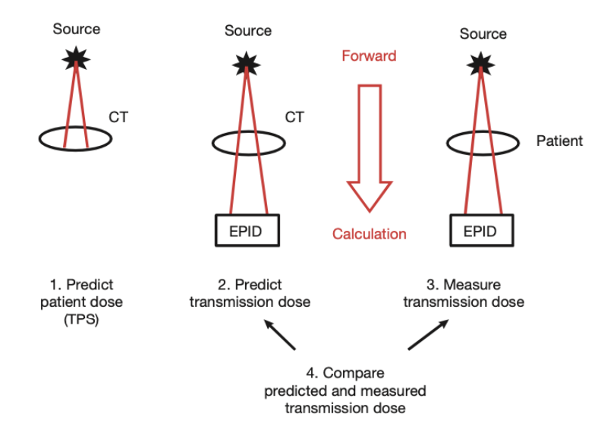
Forward approach
Notes:
After completing the treatment planning, the data are transferred to the control room, where we operate the linear accelerator.
First, from the simulation CT and the treatment planning system, we can calculate the predicted dose delivered through the patient.
Then, we use the EPID to capture the image of that predicted dose.
During beam delivery, the EPID also measures the actual transmitted dose.
Finally, we compare these two results.
If they match well, the treatment plan is considered accurate and safe for the patient.

Slide 6
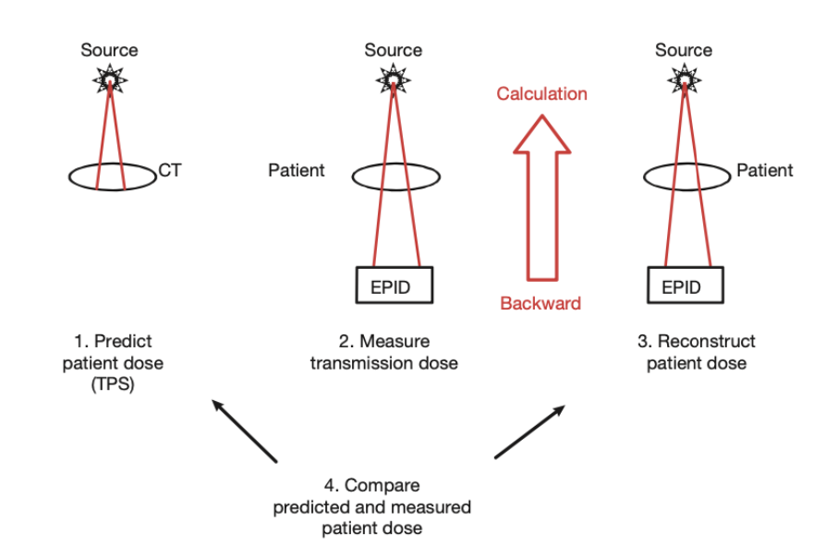
Backward approach
Notes:
Now this slide shows the backward approach.
First, during treatment, the EPID measures the transmission dose.
From this measured signal, the software reconstructs the patient dose by calculation.
Then, we can compare this reconstructed dose with the planned dose from TPS.
So, the backward approach goes from EPID back to the patient dose, unlike the forward approach that goes from TPS to EPID.

Slide 7
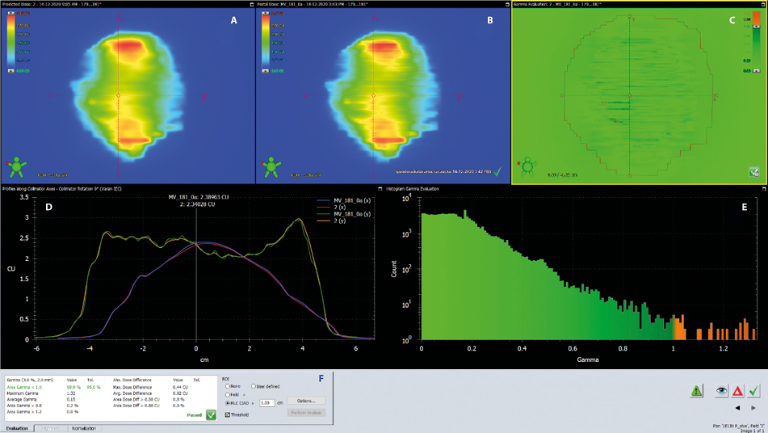
EPID Dose Verification
https://journals.viamedica.pl/nowotwory_journal_of_oncology/article/view/97697/77131
Notes:
Now we have two data: one from TPS, and one from EPID.
We don’t compare them by hand, the software does it for us.
It shows dose maps, profiles, and gamma analysis.
From gamma we get the passing rate.
And then we will know whether it can be used for treatment.”
If more than 95% pass with 3% and 3 mm, then it is accepted.
This rule comes from AAPM guidelines.

Slide 8
Conclusion
Table 1. Comparison of Forward and Backward
Forward (Prediction) | Backward (Reconstruction)
Easy, faster | More complex, needs calc.
Compare at EPID | Compare inside patient
Less clinical info | More clinically relevant
Notes:
ow we compare the two approaches.
Forward is easier, it predicts the EPID signal and compares directly.
Backward is more complex, but it reconstructs the patient dose, so it gives us more clinical meaning.
In practice, both can be used, but backward is more powerful for patient-specific QA.

Slide 9

Thank You

