Slide 1

PET image reconstruction task
Bui Hong
Code by Prof. Andrew J Reader
https://colab.research.google.com/drive/17l44lbJFk_SLpUA2Cr6c5UB_eWBzCi0P#scrollTo=R7kL3-EG4rSh

Slide 2
Task 1:
Display 2 more different slices of the FDG brain phantom
Code by Prof. Andrew Reader | Modify
# ----------------------------- IMPORT LIBRARIES AND SET DEFAULTS --------------------------- import numpy as np, matplotlib.pyplot as plt from skimage.transform import resize from tqdm import tqdm # For progress tracking in loops from skimage.transform import radon, iradon # Radon and inverse Radon transform functions from scipy.ndimage import gaussian_filter as smooth from IPython.display import display, clear_output # For animated updates plt.rcParams.update({'image.cmap':'Greys_r', 'figure.figsize': (12,4),'font.size':8,'figure.dpi': 300}) # ------ If faster code is required, reduce the number of pixels below, nxd ------ image_width_mm = 232.0 # Width of reconstructed image in mm nxd = 256 # User choice (128 -> dx=1.8125 mm, 256 -> dx=0.90625 mm pixel side length) dx = image_width_mm / nxd # pixel side length in mm (do not change, based on user's nxd) true_name = 'BrainWeb PET FDG' !pip install brainweb > /dev/null 2>&1 import brainweb as bw # Read one of the subjects, here we choose the first one [0] subject_of_interest = list(bw.LINKS.keys())[0] f_path = bw.get_file(subject_of_interest, bw.LINKS[subject_of_interest]) tissue = np.pad(bw.load_file(f_path), ((0,0), (12,12), (48,48))).astype('f4') pet = np.zeros_like(tissue) pet[(tissue == 48)] = 32 # White matter pet[(tissue == 32)] = 100 # Grey matter true = np.flipud(resize(pet[160,:,:], (nxd,nxd))) # Slice 160 true *= 1.0/np.max(true) # Standardise maximum value, will adjust later fig, axs = plt.subplots(1,3) # DISPLAY THE TRUE OBJECT axs[0].imshow(true); axs[0].set_title("True object (slice 160): %s" % true_name) | # ----------------------------- IMPORT LIBRARIES AND SET DEFAULTS --------------------------- import numpy as np, matplotlib.pyplot as plt from skimage.transform import resize from tqdm import tqdm # For progress tracking in loops from skimage.transform import radon, iradon # Radon and inverse Radon transform functions from scipy.ndimage import gaussian_filter as smooth from IPython.display import display, clear_output # For animated updates plt.rcParams.update({'image.cmap':'Greys_r', 'figure.figsize': (12,4),'font.size':8,'figure.dpi': 300}) # ------ If faster code is required, reduce the number of pixels below, nxd ------ image_width_mm = 232.0 # Width of reconstructed image in mm nxd = 256 # User choice (128 -> dx=1.8125 mm, 256 -> dx=0.90625 mm pixel side length) dx = image_width_mm / nxd # pixel side length in mm (do not change, based on user's nxd) true_name = 'BrainWeb PET FDG' !pip install brainweb > /dev/null 2>&1 import brainweb as bw # Read one of the subjects, here we choose the first one [0] subject_of_interest = list(bw.LINKS.keys())[0] f_path = bw.get_file(subject_of_interest, bw.LINKS[subject_of_interest]) tissue = np.pad(bw.load_file(f_path), ((0,0), (12,12), (48,48))).astype('f4') pet = np.zeros_like(tissue) pet[(tissue == 48)] = 32 # White matter pet[(tissue == 32)] = 100 # Grey matter true = np.flipud(resize(pet[160,:,:], (nxd,nxd))) # Slice 160 true1 = np.flipud(resize(pet[100,:,:], (nxd,nxd))) # Slice 100 true2 = np.flipud(resize(pet[220,:,:], (nxd,nxd))) # Slice 220 true *= 1.0/np.max(true) # Standardise maximum value, will adjust later fig, axs = plt.subplots(1,3) # DISPLAY THE TRUE OBJECT axs[0].imshow(true); axs[0].set_title("True object (slice 160): %s" % true_name) axs[1].imshow(true1); axs[1].set_title("True object (slice 100): %s" % true_name) axs[2].imshow(true2); axs[2].set_title("True object (slice 220): %s" % true_name)

Slide 3
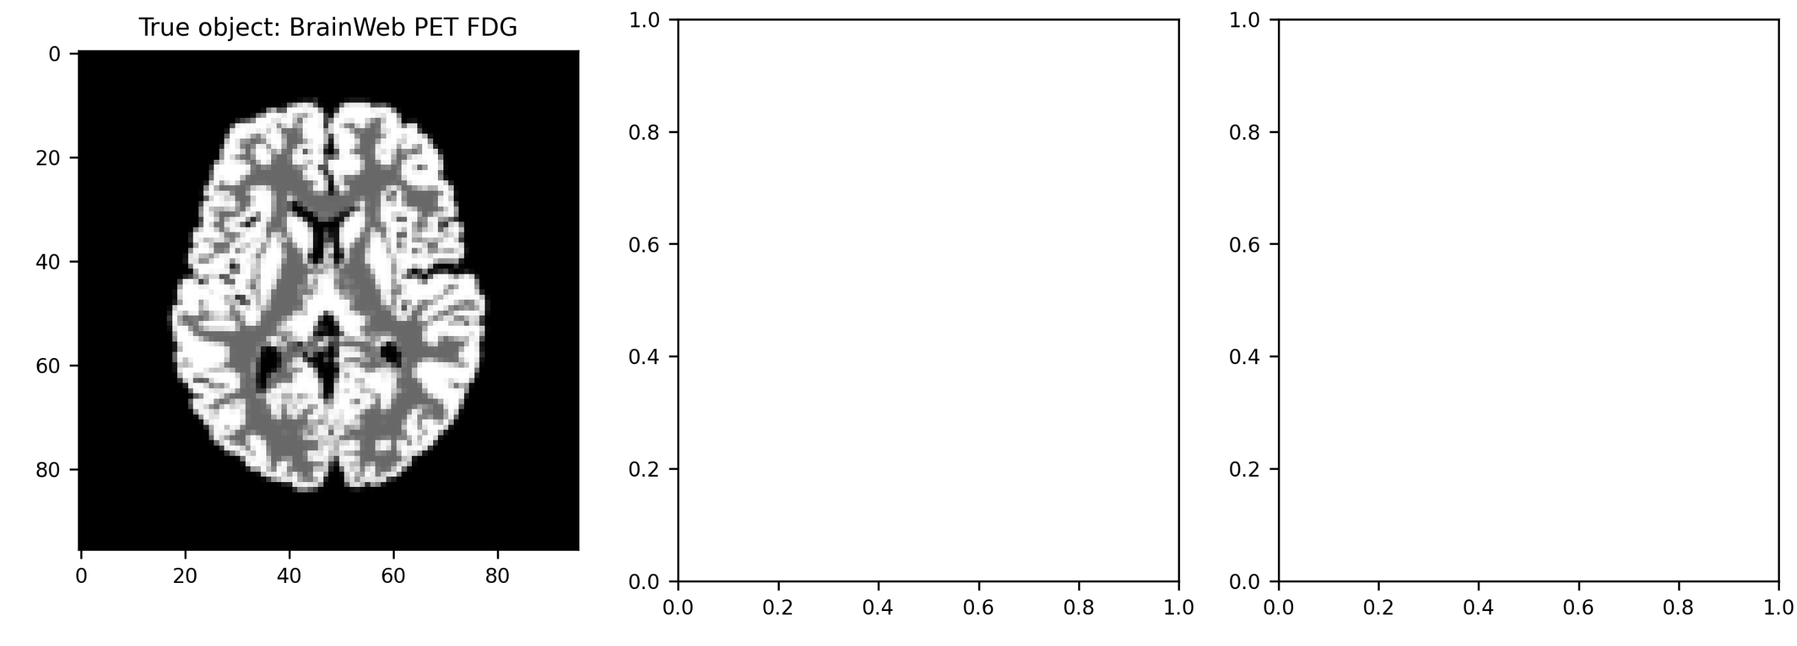
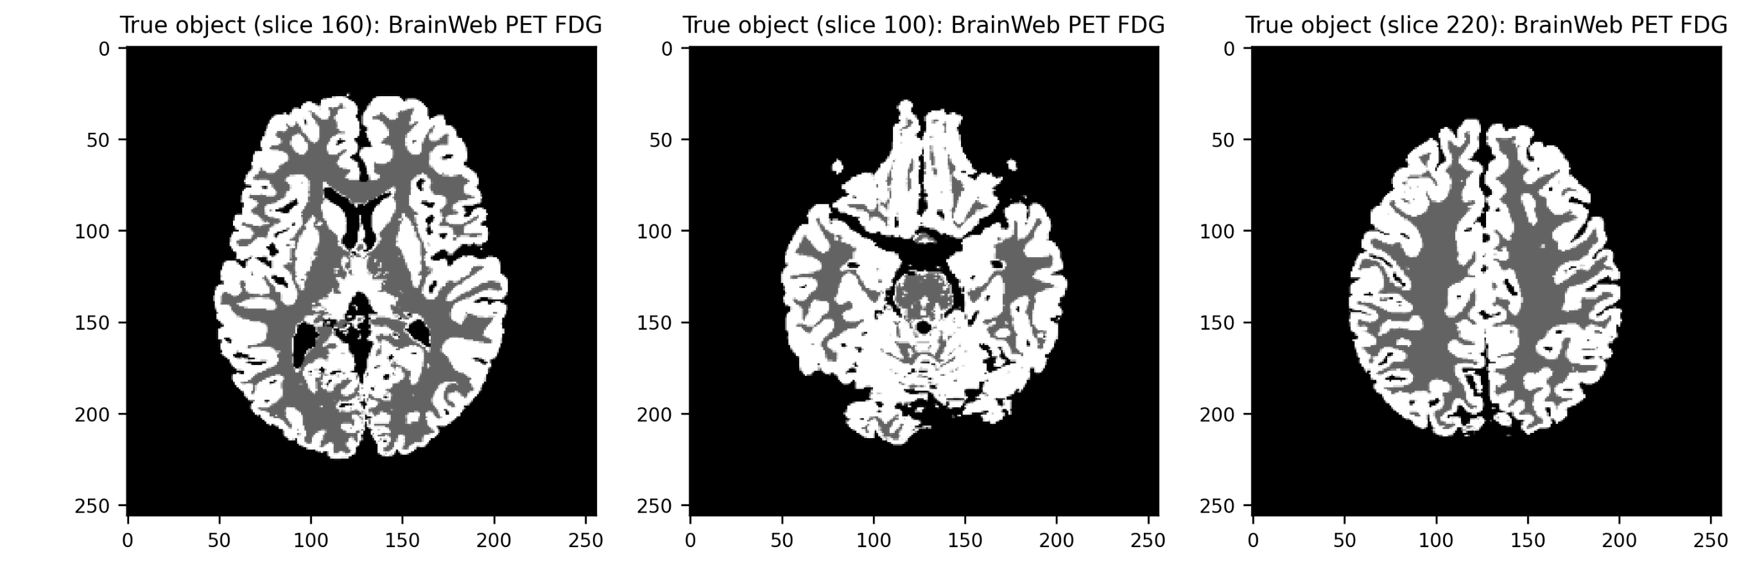
Task 1:
Display 2 more different slices of the FDG brain phantom
RESULT

Slide 4
Task 2:
Using iradon, for noise-free and noisy sinogram data: (1)Show a plain (unfiltered) backprojected image, (2) Show a filtered backprojection (FBP) reconstruction
Code by Prof. Andrew Reader | Moddify
# ------------------- GENERATE SINOGRAM DATA READY FOR RECONSTRUCTION ----------------------- fig, axs = plt.subplots(1,3) # Smaller total -> less radioactivity -> noisier data. NB: higher nxd -> noisier data. total_activity = 10000.0 true *= total_activity/np.sum(true) # Make sum of true match the total radioactivity level # A small number of angles, 48, has been chosen for speed nphid = 48 # Fixed number of scanner angles (independent of nxd, and pixel size dx) azi_angles = np.linspace(0.0,180.0, nphid, endpoint=False) # Azimuthal projection angles, phi # Do the Radon transform: forward project along parallel lines for the viewing angles # Blur true (σ = 2.0 mm) before projection, & blur sinogram (σ = 2.0 mm) after projection # to model limited resolution & avoid unrealistic perfect matches between data and models acq_sigma = 2.0 # acqusition blurring level sinogram = smooth(radon(smooth(true, acq_sigma/dx), azi_angles, False), acq_sigma/dx) nrd = sinogram.shape[0] noisy_sinogram = np.random.poisson(sinogram) axs[0].imshow(true); axs[0].set_title("True object") axs[1].imshow(sinogram.T); axs[1].set_title("Sinogram") axs[2].imshow(noisy_sinogram.T); axs[2].set_title("Noisy sinogram") | # ------------------- GENERATE SINOGRAM DATA READY FOR RECONSTRUCTION ----------------------- fig, axs = plt.subplots(1,3) # Smaller total -> less radioactivity -> noisier data. NB: higher nxd -> noisier data. total_activity = 10000.0 true *= total_activity/np.sum(true) # Make sum of true match the total radioactivity level # A small number of angles, 48, has been chosen for speed nphid = 48 # Fixed number of scanner angles (independent of nxd, and pixel size dx) azi_angles = np.linspace(0.0,180.0, nphid, endpoint=False) # Azimuthal projection angles, phi # Do the Radon transform: forward project along parallel lines for the viewing angles # Blur true (σ = 2.0 mm) before projection, & blur sinogram (σ = 2.0 mm) after projection # to model limited resolution & avoid unrealistic perfect matches between data and models acq_sigma = 2.0 # acqusition blurring level sinogram = smooth(radon(smooth(true, acq_sigma/dx), azi_angles, False), acq_sigma/dx) nrd = sinogram.shape[0] noisy_sinogram = np.random.poisson(sinogram) axs[0].imshow(true); axs[0].set_title("True object") axs[1].imshow(sinogram.T); axs[1].set_title("Sinogram") axs[2].imshow(noisy_sinogram.T); axs[2].set_title("Noisy sinogram") fig, axs = plt.subplots(1,3) bp_img = iradon(sinogram, azi_angles, filter_name=None) fbp_img = iradon(sinogram, azi_angles, filter_name='ramp') axs[0].imshow(true); axs[0].set_title("True object") axs[1].imshow(bp_img); axs[1].set_title("Unfiltered backprojection (BP)") axs[2].imshow(fbp_img); axs[2].set_title("Filtered backprojection (FBP)")

Slide 5
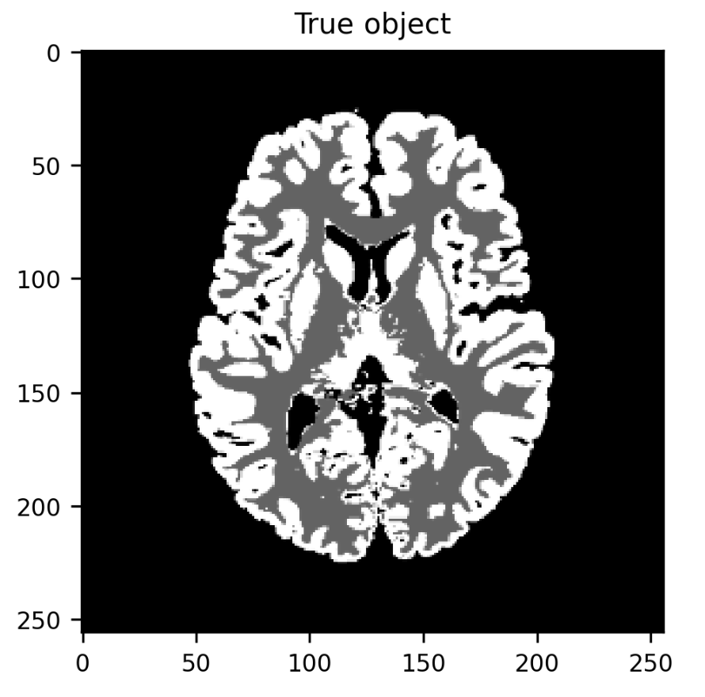
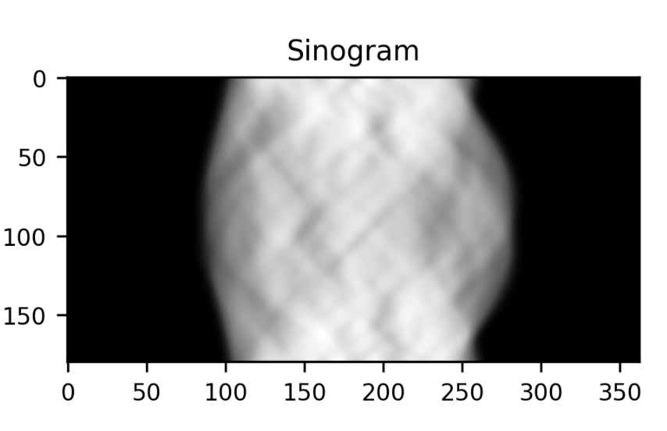
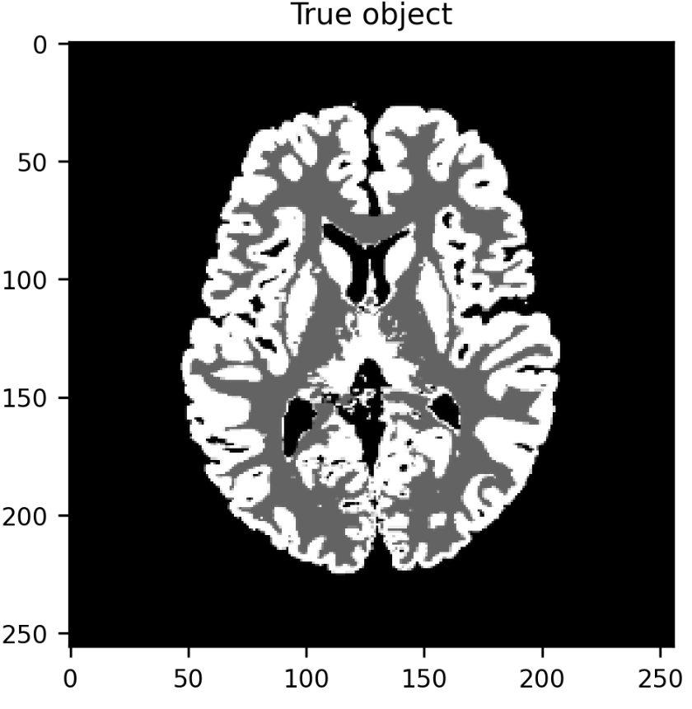
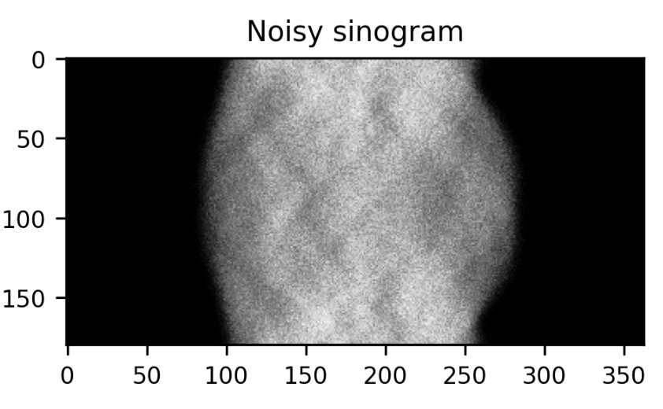
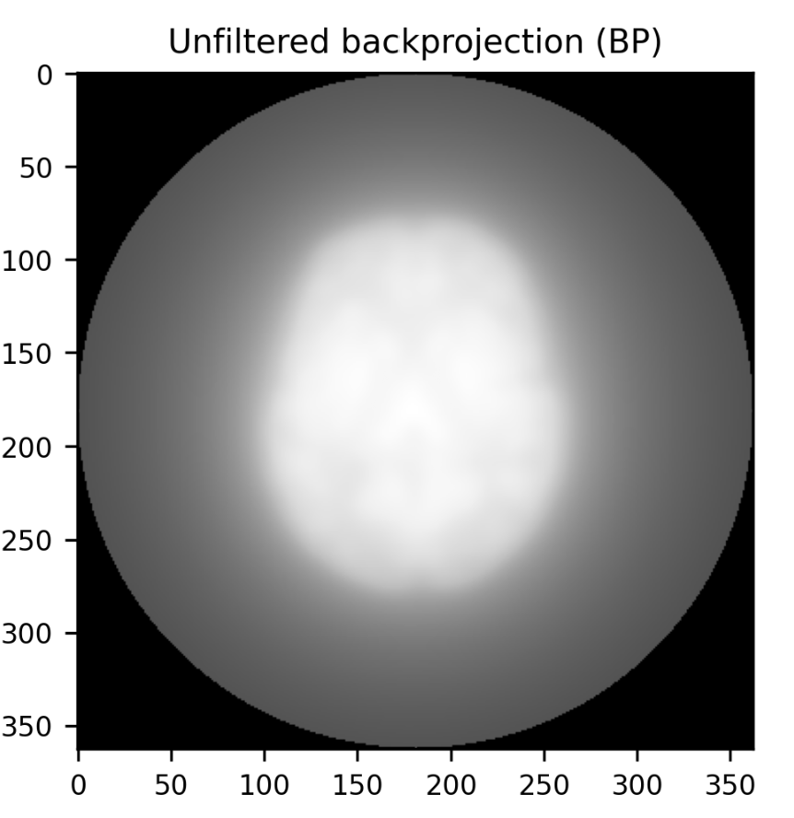
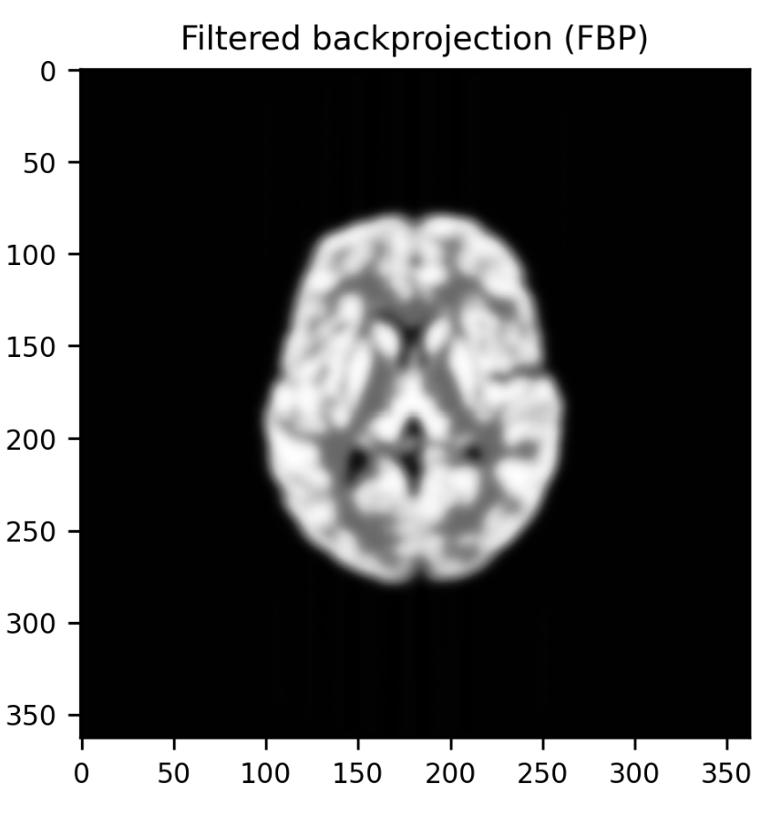
Task 2:
Using iradon, for noise-free and noisy sinogram data: (1)Show a plain (unfiltered) backprojected image, (2) Show a filtered backprojection (FBP) reconstruction
Result of Prof. Andrew | Result of task 2

Slide 6
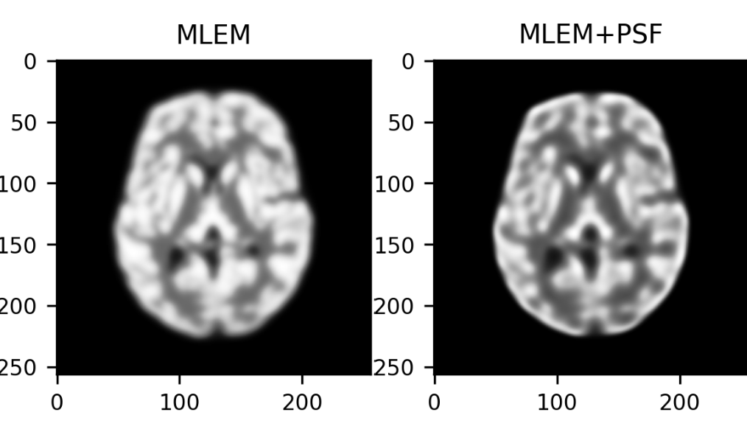
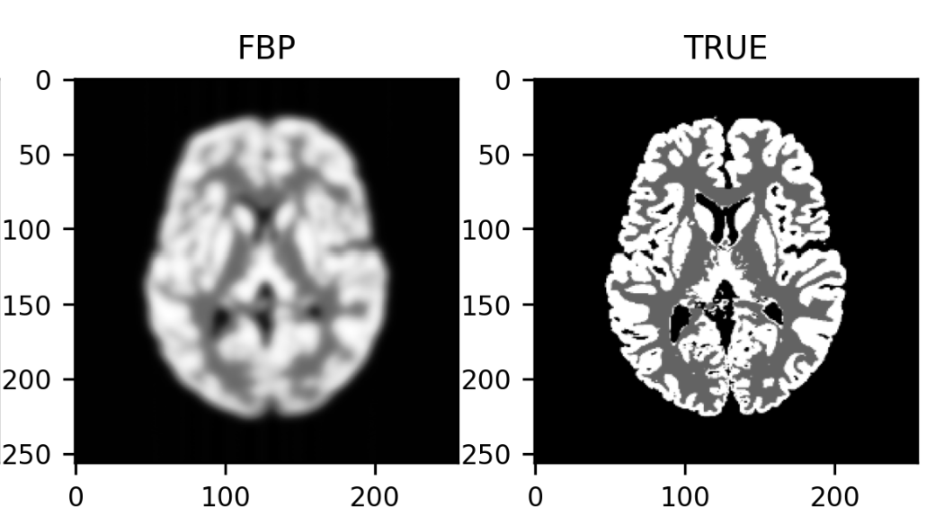
Task 3: For both noise-free and noisy data, show the PRMSE
MLEM and MLEM+PSF (noise-free) | Result
# ------------------------------------------------------------------------------------------- def prmse(im, ref): # % root mean square error mask = ref > 0.0 # defines pixels to be used diff2 = (im[mask] - ref[mask])**2 ref2 = ( ref[mask])**2 return 100.0 * (np.sqrt( np.sum(diff2) / np.sum(ref2) )) # FBP reconstruction fbp_recon = iradon(sinogram, azi_angles, circle=False) fig, axs = plt.subplots(1,4) prmse_array1 = [prmse(img, true) for img in history_nf] prmse_array2 = [prmse(img, true) for img in history_nf_PSF] prmse_fbp = prmse(fbp_recon, true) axs[0].imshow(history_nf[-1]); axs[0].set_title("MLEM") axs[1].imshow(history_nf_PSF[-1]); axs[1].set_title("MLEM+PSF") axs[2].imshow(fbp_recon); axs[2].set_title("FBP") axs[3].imshow(true); axs[3].set_title("TRUE")

Slide 7
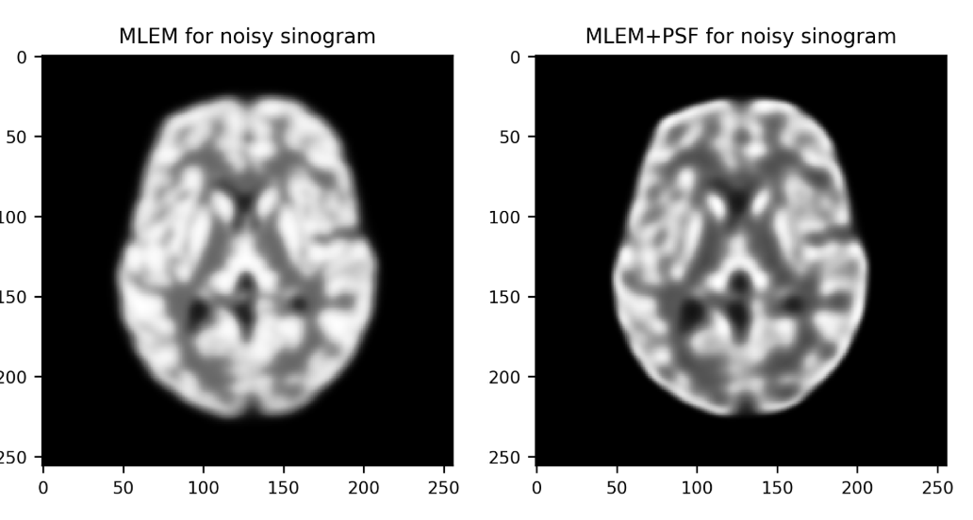
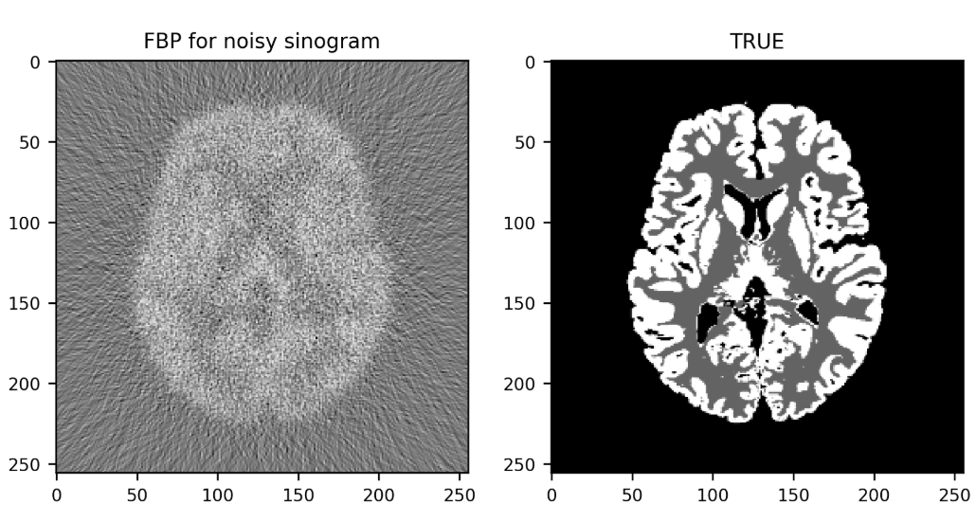
Task 3: For both noise-free and noisy data, show the PRMSE
MLEM and MLEM+PSF (noise-free) | Result
# ------------------------------------------------------------------------------------------- def prmse(im, ref): # % root mean square error mask = ref > 0.0 # defines pixels to be used diff2 = (im[mask] - ref[mask])**2 ref2 = ( ref[mask])**2 return 100.0 * (np.sqrt( np.sum(diff2) / np.sum(ref2) )) # FBP reconstruction fbp_recon_noisy = iradon(noisy_sinogram, azi_angles, circle=False) fig, axs = plt.subplots(1,4) prmse_array3 = [prmse(img, true) for img in history_noisy_S] prmse_array4 = [prmse(img, true) for img in history_noisy_S_PSF] prmse_fbp_recon_noisy = prmse(fbp_recon_noisy, true) axs[0].imshow(history_nf[-1]); axs[0].set_title("MLEM for noisy sinogram") axs[1].imshow(history_nf_PSF[-1]); axs[1].set_title("MLEM+PSF for noisy sinogram") axs[2].imshow(fbp_recon_noisy); axs[2].set_title("FBP for noisy sinogram") axs[3].imshow(true); axs[3].set_title("TRUE")

Slide 8
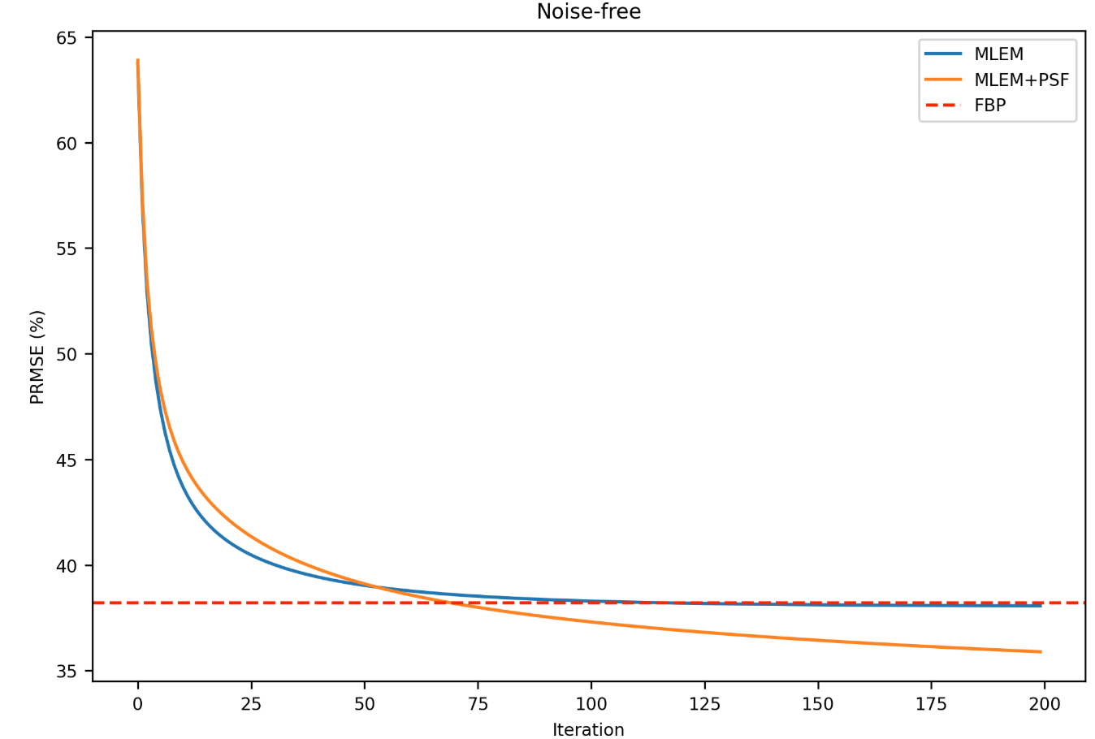
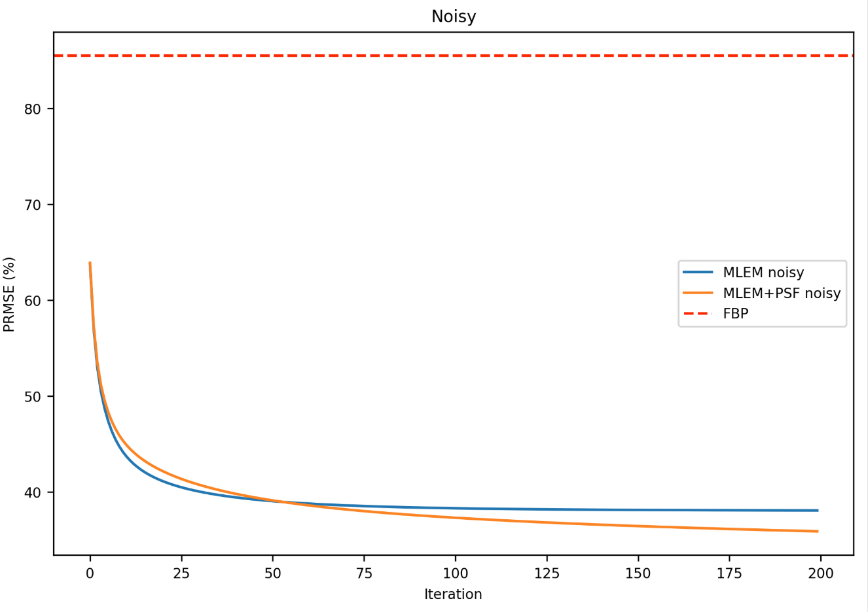
Task 3: For both noise-free and noisy data, show the PRMSE
The PRMSE for both noise-free and noisy data, show the PRMSE | Result
# 1) For both noise-free and noisy data, show the PRMSE fig, (ax1, ax2) = plt.subplots(1, 2, figsize=(14,5)) # --- Noise-free --- ax1.plot(range(len(prmse_array1)), prmse_array1, label='MLEM') ax1.plot(range(len(prmse_array2)), prmse_array2, label='MLEM+PSF') ax1.axhline(y=prmse_fbp, linestyle='--', color='red', label='FBP') ax1.set_title('Noise-free') ax1.set_xlabel('Iteration') ax1.set_ylabel('PRMSE (%)') ax1.legend() # --- Noisy --- ax2.plot(range(len(prmse_array3)), prmse_array3, label='MLEM noisy') ax2.plot(range(len(prmse_array4)), prmse_array4, label='MLEM+PSF noisy') ax2.axhline(y=prmse_fbp_recon_noisy, linestyle='--', color='red', label='FBP') ax2.set_title('Noisy') ax2.set_xlabel('Iteration') ax2.set_ylabel('PRMSE (%)') ax2.legend() plt.tight_layout() plt.show()

Slide 9
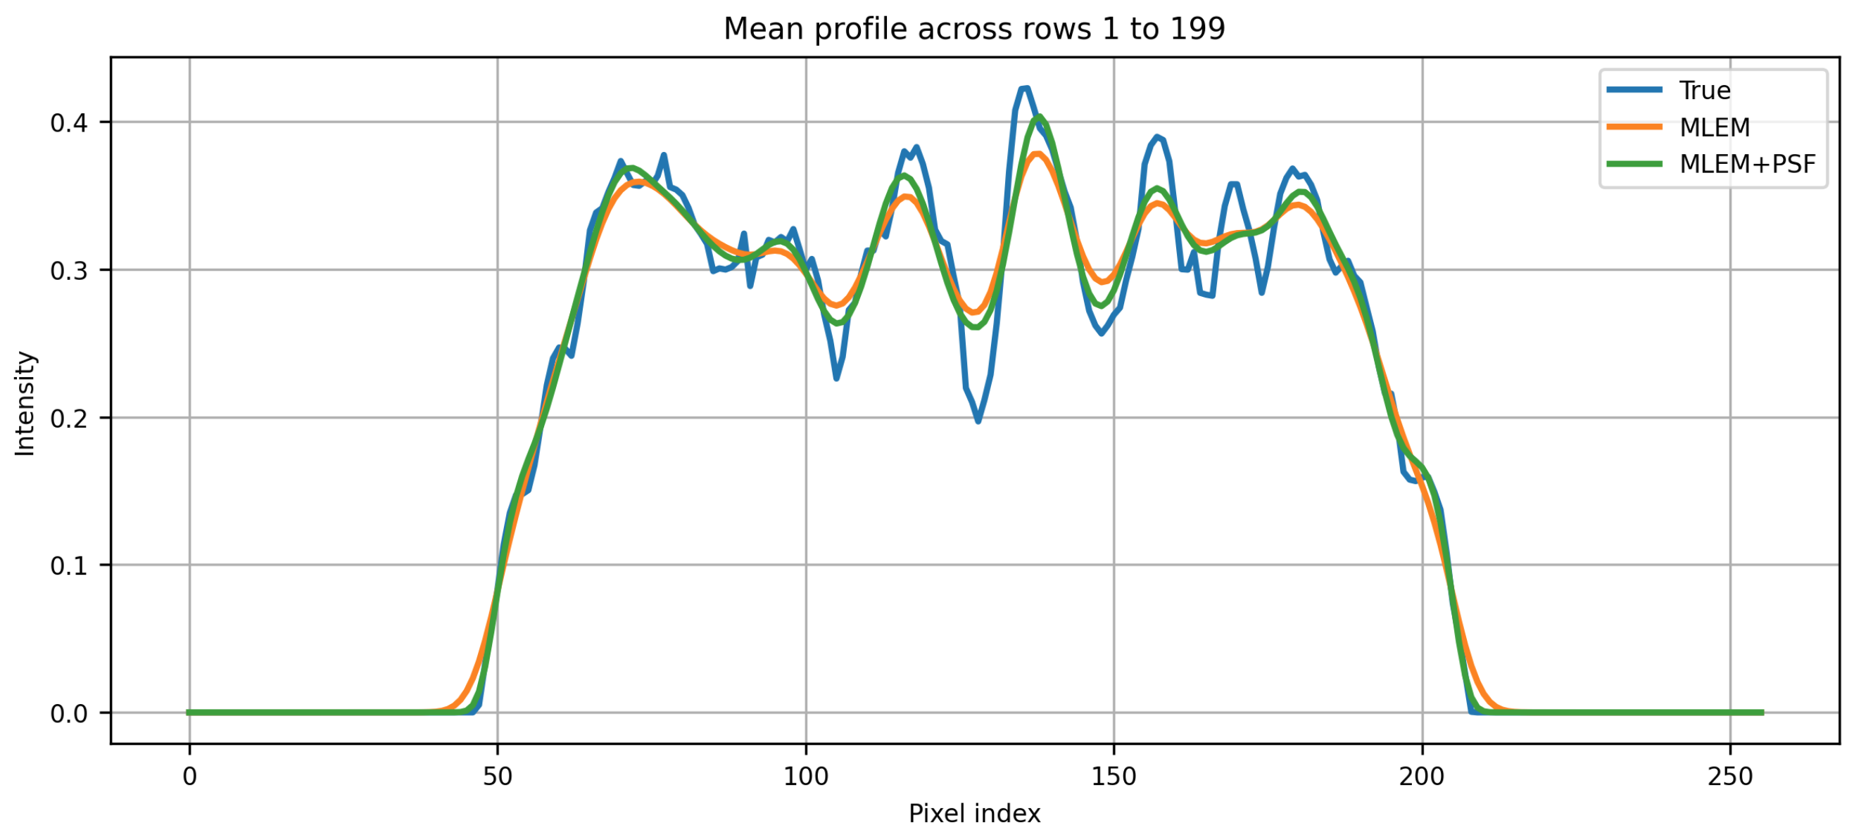
Task 3: Show profiles through all the reconstructed images, compared to the true
Show profiles through all the reconstructed images, compared to the true | Result
rows = np.arange(1, 200) def mean_profile(image, rows): return np.mean(image[rows, :], axis=0) true_profile = mean_profile(true, rows) mlem_profile = mean_profile(history_nf[-1], rows) mlem_psf_profile = mean_profile(history_nf_PSF[-1], rows) #fbp_profile = mean_profile(fbp_recon_noisy, rows) plt.figure() plt.plot(true_profile, label='True', linewidth=2) plt.plot(mlem_profile, label='MLEM', linewidth=2) plt.plot(mlem_psf_profile, label='MLEM+PSF', linewidth=2) #plt.plot(fbp_profile, label='FBP', linewidth=2) plt.xlabel('Pixel index') plt.ylabel('Intensity') plt.title(f'Mean profile across rows {rows[0]} to {rows[-1]}') plt.legend() plt.grid(True) plt.show()

