Slide 1

School on Advanced Topics in Medical Imaging - Ho Chi Minh City
Proton Boron Capture Therapy
Ly Dac Thinh
Da Nang Oncology Hospital
19.08.2025

Slide 2
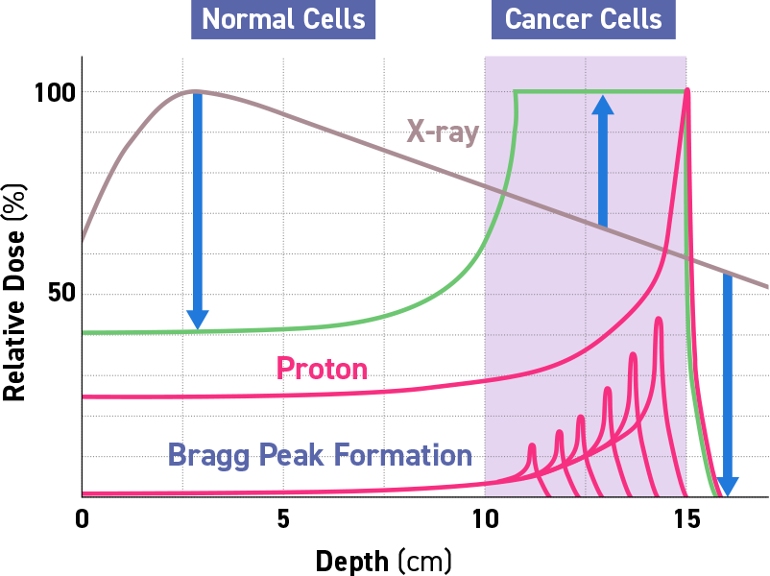
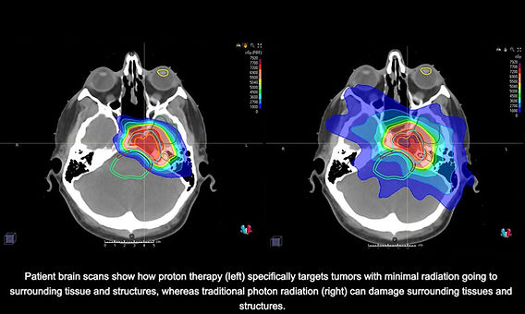
Proton Therapy
Proton therapy (PT) is a modern and extremely accurate modality of radiation therapy. Protons can reduce the radiation load on surrounding tissues up to 30-50% in comparison with gamma rays.
The main benefits of proton therapy are:
minimal damage to healthy cells located near the irradiated tumors, especially for tumors close to critical structures (for example, in the head, neck, optic nerve and other structures of the eye.).
the ability to successfully destroy deep-seated and hard-to-reach tumors;
suitability for use in pediatric cancer therapy regimens, as well as for long-term radiation treatment.

Slide 3
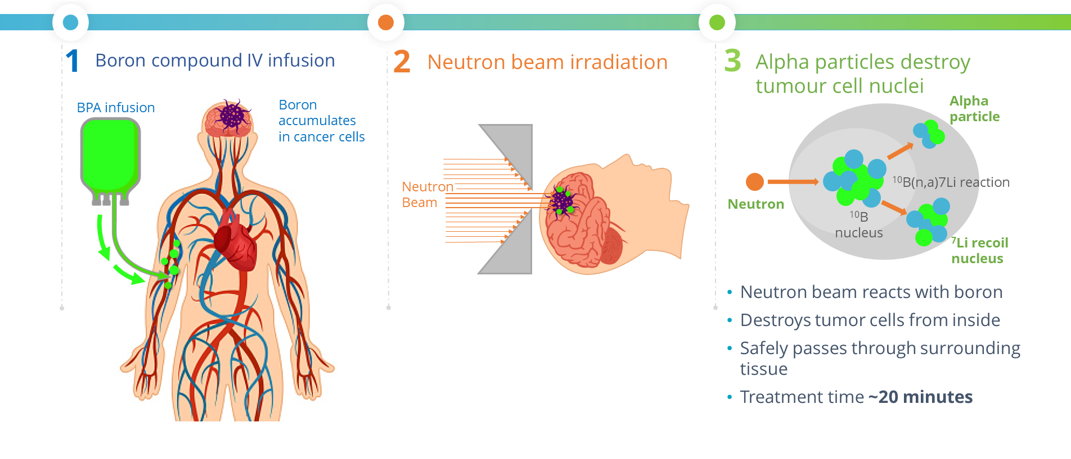
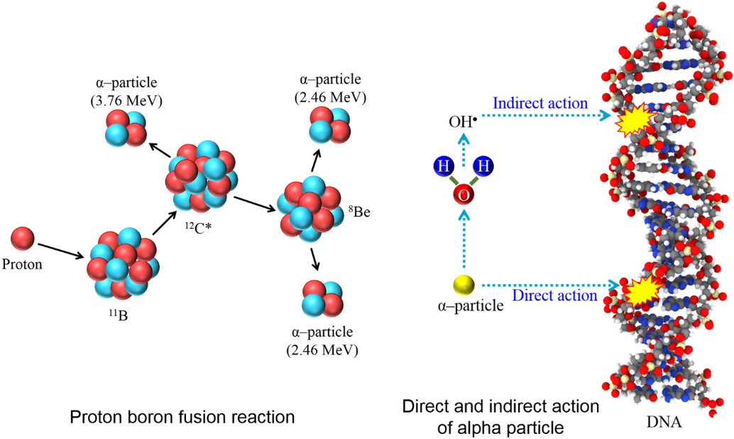
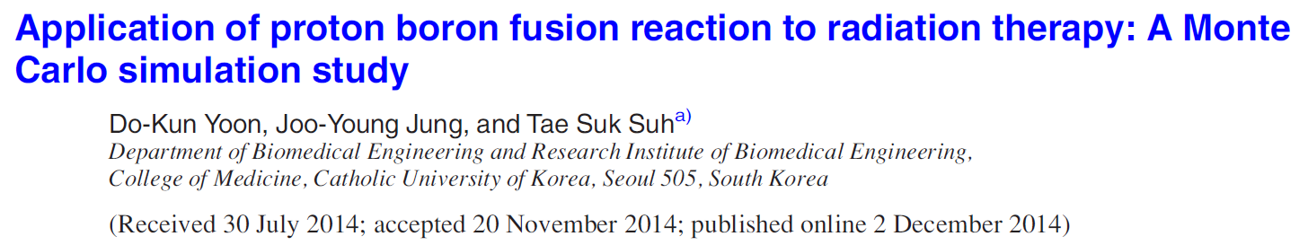
Proton boron capture therapy (PBCT)

Slide 4
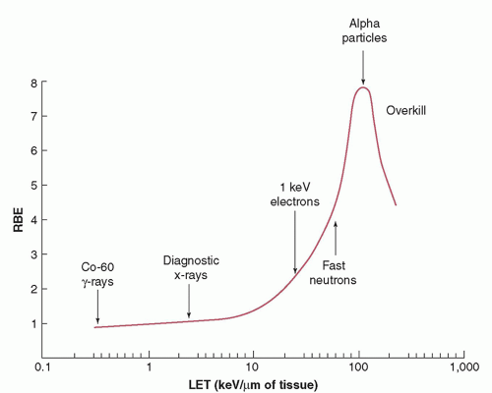
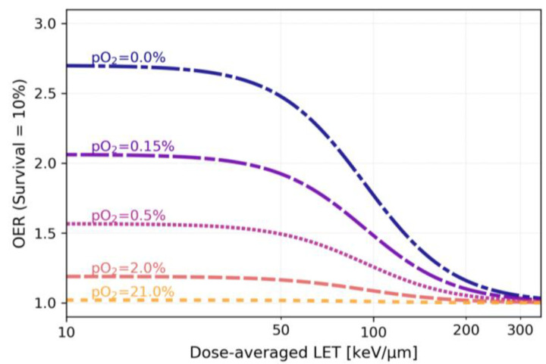
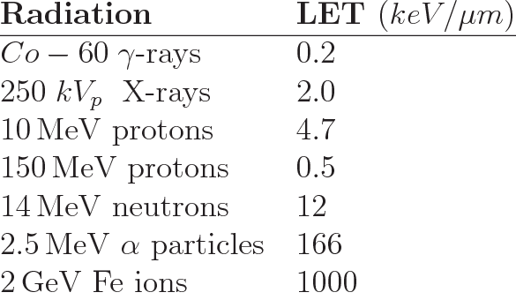
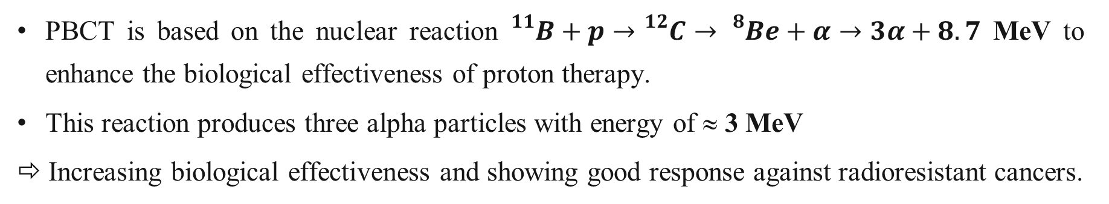
Why does Proton boron capture therapy (PBCT) have potential? (1/2)
PBCT is based on the nuclear reaction ${}_{}^{11}B+p→{}_{}^{12}C→{}_{}^{8}{Be}+α→3α+8.7$ MeV to enhance the biological effectiveness of proton therapy.
This reaction produces three alpha particles with energy of ≈ 3 MeV
⇨ Increasing biological effectiveness and showing good response against radioresistant cancers.

Slide 5

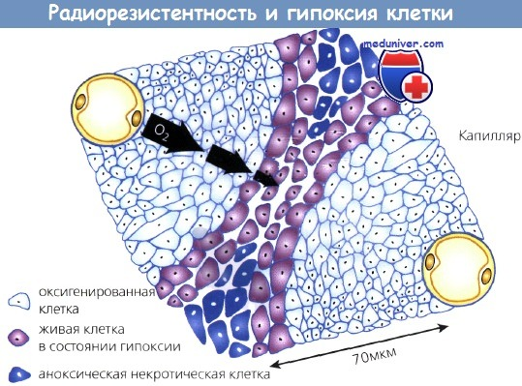
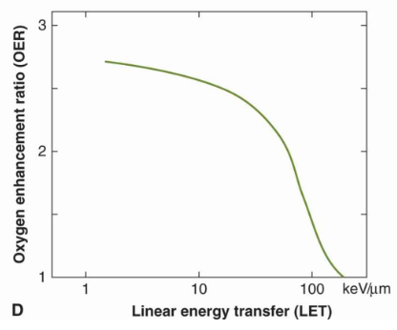
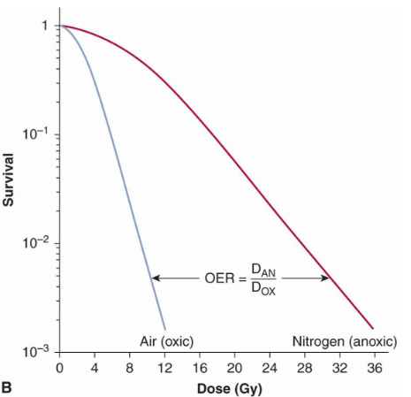
Radioresistant of tumor
The dependence of the OER on the LET of the radiation
Dependence of the cellular state on the distance to the blood vessels. Oxygen diffuses about 70 µm from the capillaries

Slide 6
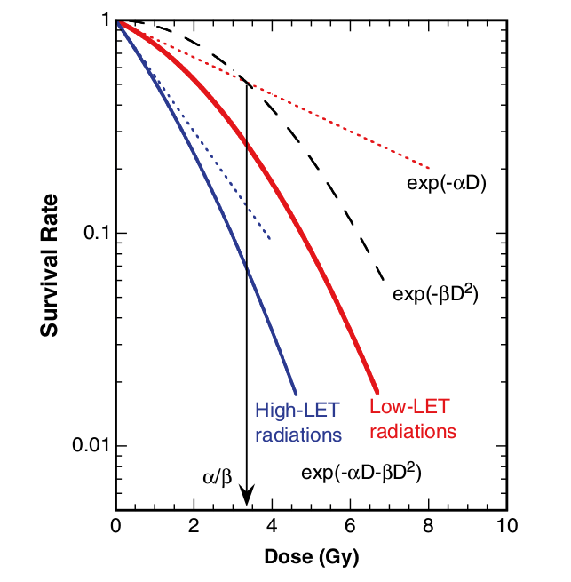
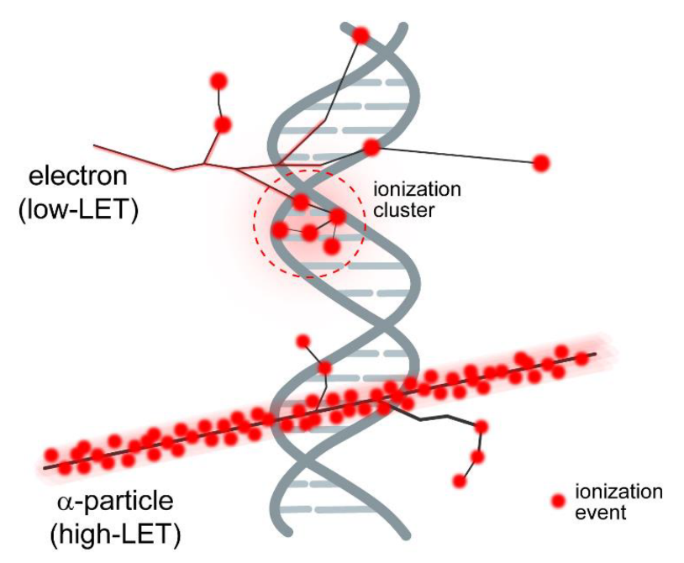
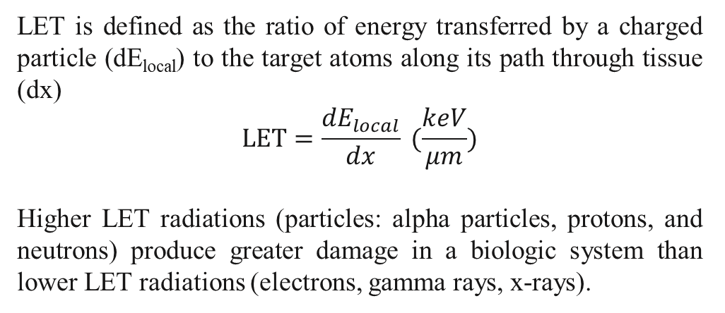
The linear energy transfer (LET)
LET is defined as the ratio of energy transferred by a charged particle (dE_{local}) to the target atoms along its path through tissue (dx)
$$LET=\frac{{dE}_{local}}{dx} (\frac{keV}{μm})$$
Higher LET radiations (particles: alpha particles, protons, and neutrons) produce greater damage in a biologic system than lower LET radiations (electrons, gamma rays, x-rays).
Typical cell survival curves for high LET (densely ionizing) radiation and low LET (sparsely ionizing) radiation

Slide 7
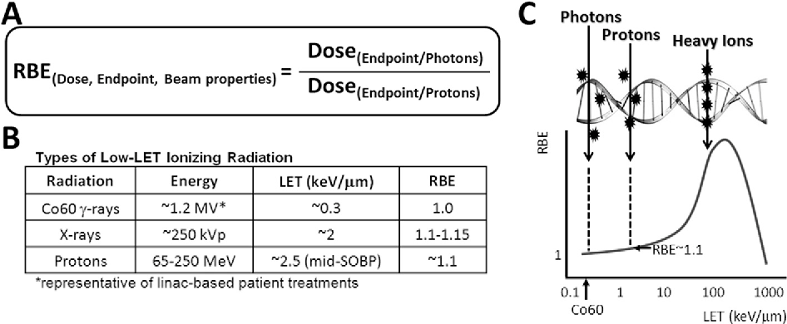
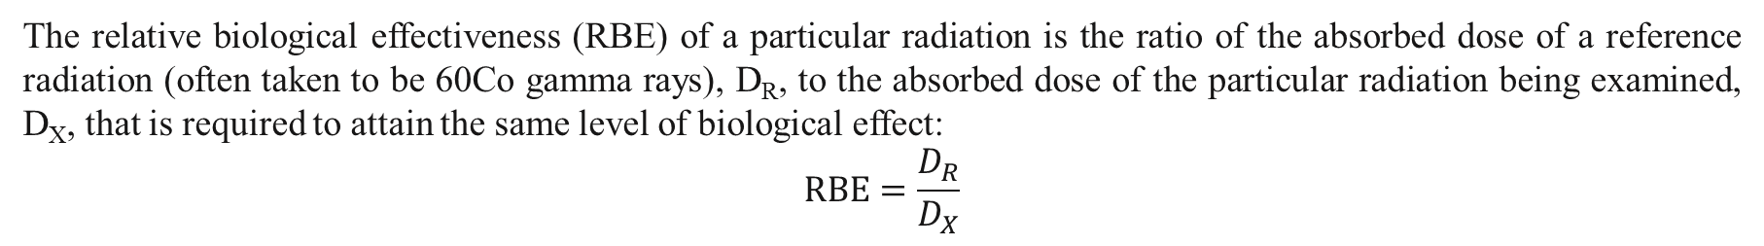
The relative biological effectiveness (RBE)
The relative biological effectiveness (RBE) of a particular radiation is the ratio of the absorbed dose of a reference radiation (often taken to be 60Co gamma rays), D_{R}, to the absorbed dose of the particular radiation being examined, D_{X}, that is required to attain the same level of biological effect:
$$RBE=\frac{D_{R}}{D_{X}}$$

Slide 8
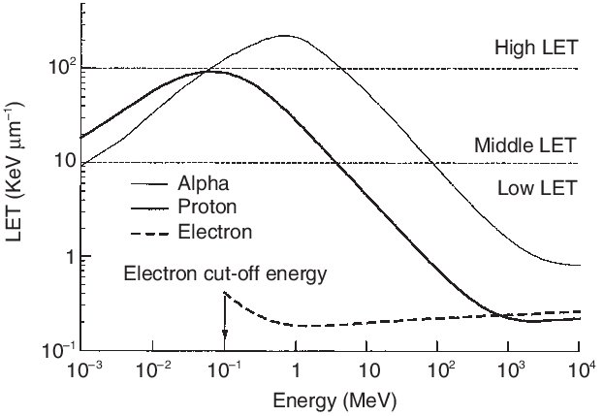
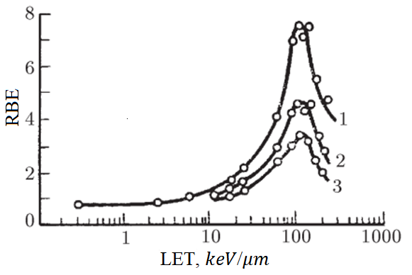
LET vs RBE
Dependence of RBE on LET according to the criteria of survival of human kidney cells in a culture medium: 1, 2, 3 - the results of irradiation with the doses at which the proportion of cell survival is 80%, 10% and 1%, respectively.
T. Sato et. Al.. Analysis of dose-LET distribution in the human body irradiated by high energy hadrons, Radiation Protection Dosimetry, 106, 2, pp. 145–153 (2003)

Slide 9
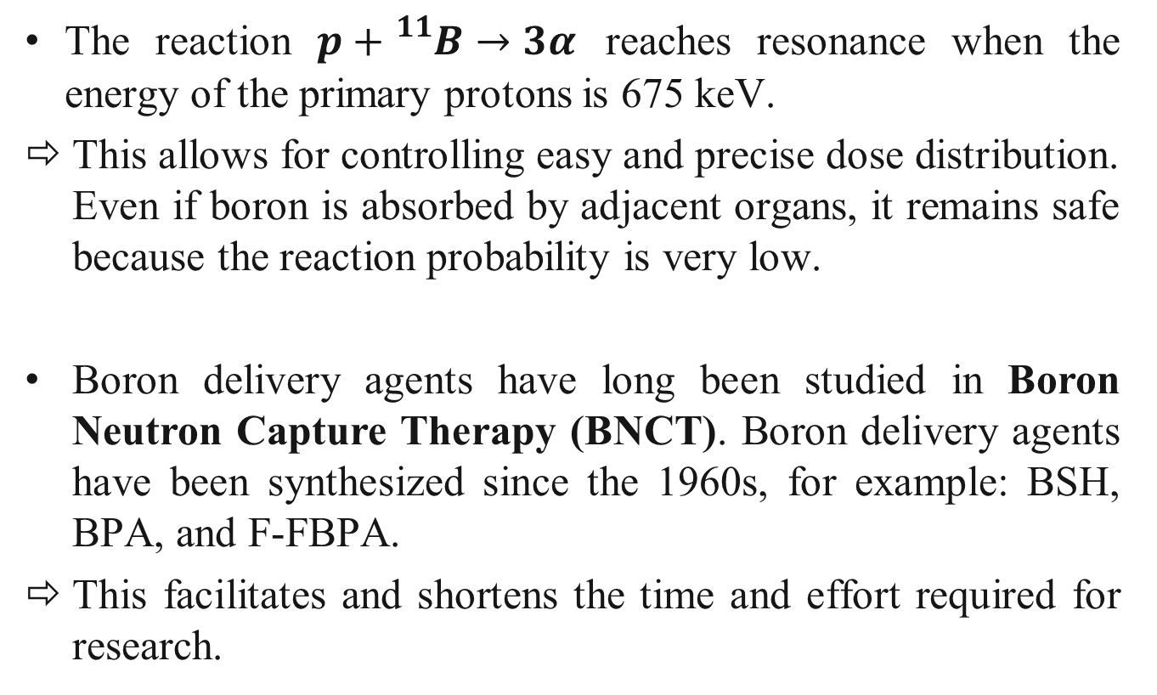
Why does Proton boron capture therapy (PBCT) have potential? (2/2)
The reaction $p+{}_{}^{11}B→3α$ reaches resonance when the energy of the primary protons is 675 keV.
This allows for controlling easy and precise dose distribution. Even if boron is absorbed by adjacent organs, it remains safe because the reaction probability is very low.
Boron delivery agents have long been studied in Boron Neutron Capture Therapy (BNCT). Boron delivery agents have been synthesized since the 1960s, for example: BSH, BPA, and F-FBPA.
This facilitates and shortens the time and effort required for research.

Slide 10
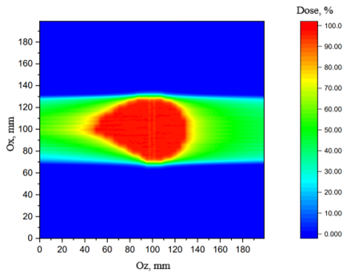
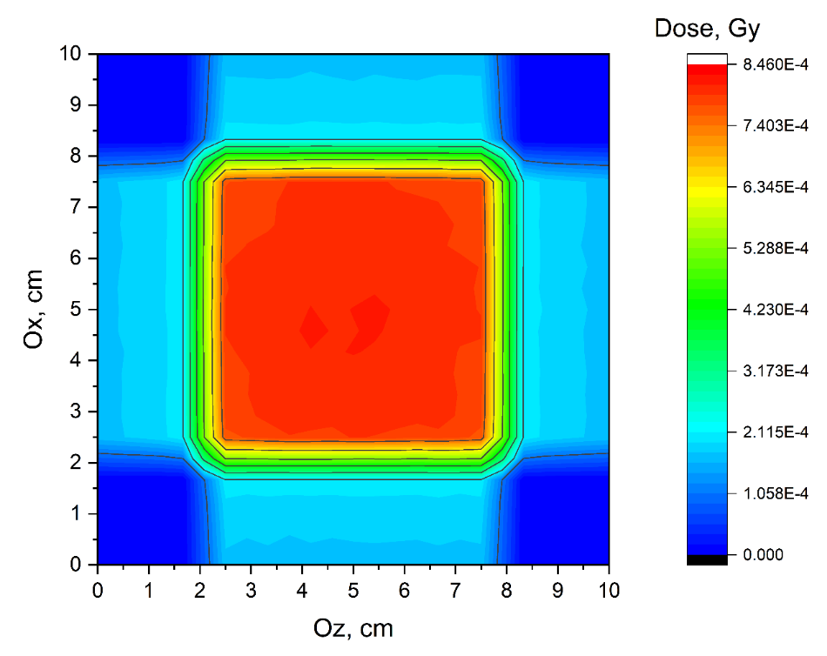
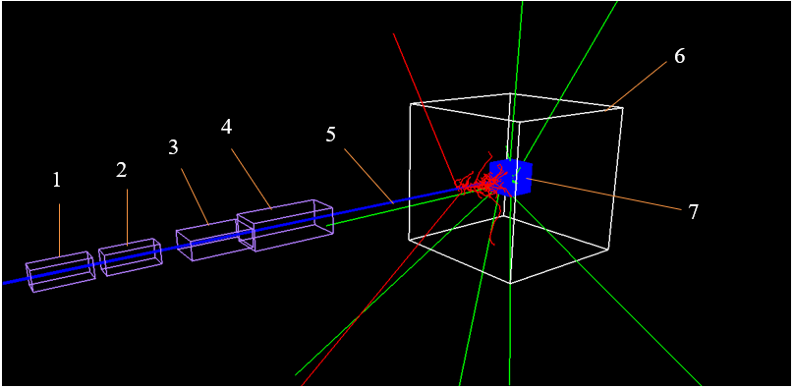
TOPAS
TOPAS wraps and extends the Geant4 Simulation Toolkit to make advanced Monte Carlo simulation of all forms of radiotherapy easier to use for medical physicists.
Example:
Structure of the pencil beam scanning system in Topas.

Slide 11
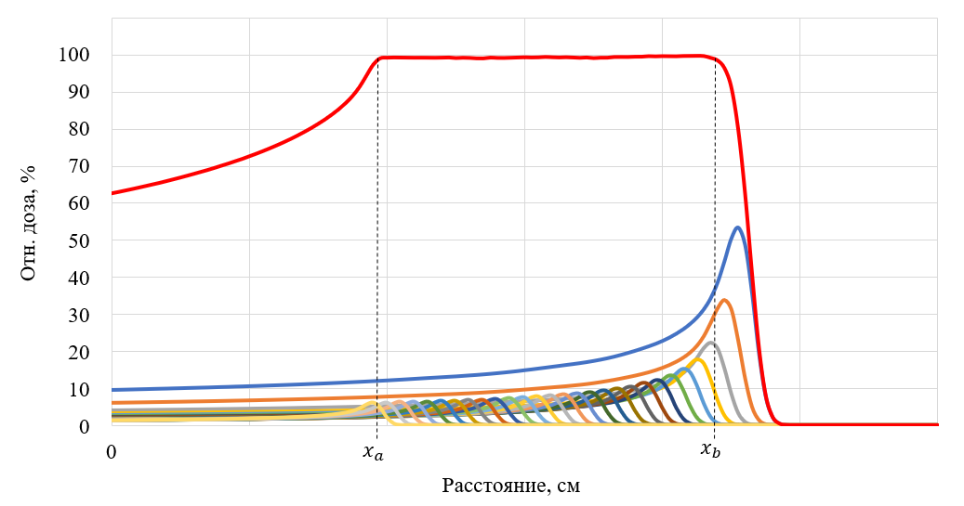
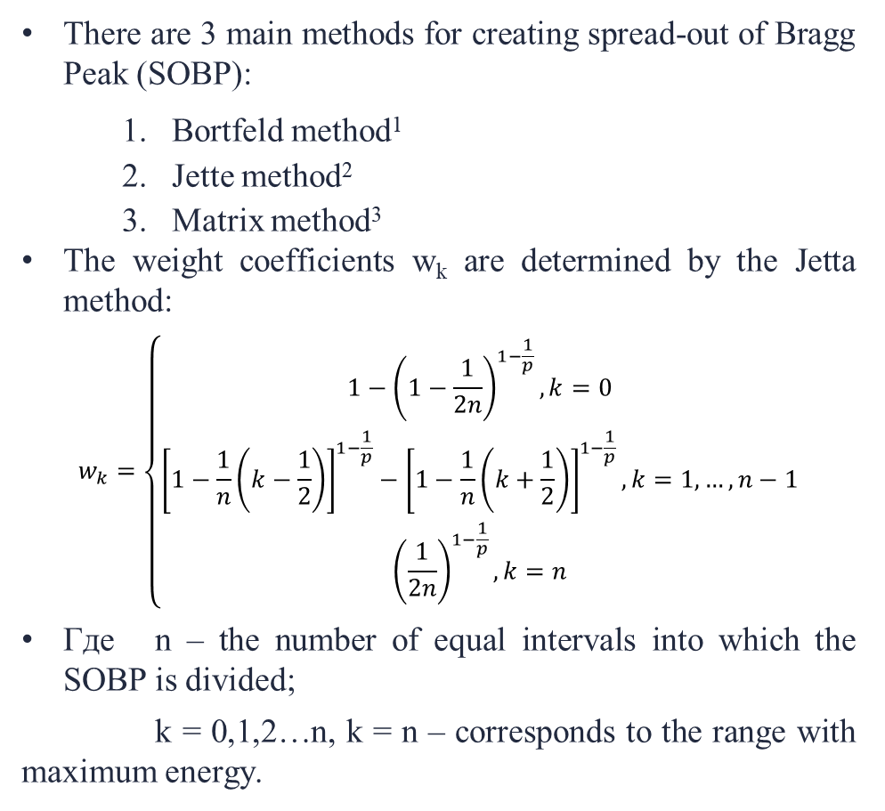
Spread-out of Bragg Peak (SOBP)
There are 3 main methods for creating spread-out of Bragg Peak (SOBP):
  Bortfeld method¹
  Jette method²
  Matrix method³
The weight coefficients w_{k} are determined by the Jetta method:
$$w_{k}=\left\{\begin{aligned}1−{\left(1−\frac{1}{2n}\right)}^{1−\frac{1}{p}}, k=0 \\ {\left[1−\frac{1}{n}\left(k−\frac{1}{2}\right)\right]}^{1−\frac{1}{p}}−{\left[1−\frac{1}{n}\left(k+\frac{1}{2}\right)\right]}^{1−\frac{1}{p}}, k=1,…, n−1 \\ {\left(\frac{1}{2n}\right)}^{1−\frac{1}{p}}, k=n\end{aligned}\right.$$
Где n – the number of equal intervals into which the SOBP is divided;
k = 0,1,2…n, k = n – corresponds to the range with maximum energy.
R, cm | 7.7 | 7.6 | 7.5 | 7.4 | 7.3 | 7.2 | 7.1 | 7.0 | …
E, MeV | 100.99 | 100.26 | 99.529 | 98.789 | 98.045 | 97.297 | 96.544 | 95.786 | …
w_{k} | 0.124812 | 0.078569 | 0.051836 | 0.041167 | 0.035024 | 0.030915 | 0.027925 | 0.025626 | ….
1. Bortfeld T., Schlegel W. An analytical approximation of depth dose distributions for therapeutic proton beams // Phys. Med. Biol. 1996, Vol. 41, pp. 1331–1339.
2. Jette D., Chen W. Creating a spread-out Bragg peak in proton beams // Phys. Med. Biol. 2011, Vol. 56, pp. 131–138.
3. Мерц С.П. Моделирование процессов распространения заряженных частиц и жесткого электромагнитного излучения с учетом сложной геометрии и гетерогенной среды // СПб: Санкт Петербургский государственный университет, 2013.
Notes:
Bệnh nhân mập, gần các cơ quan OARs. Tại sao dùng cho trẻ em?

Slide 12
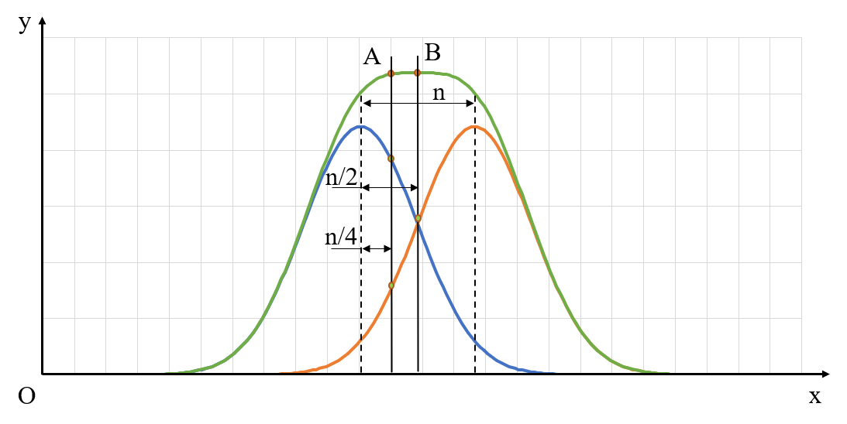
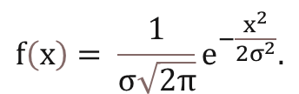
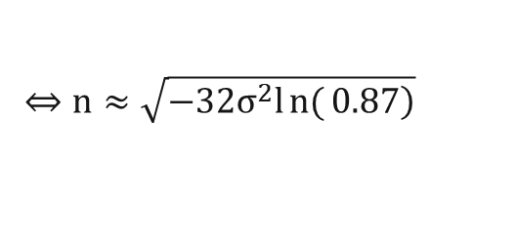
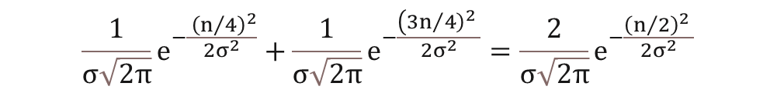
The dose profile (1/3)
Distribution of the number of protons (10⁶ particles) in a beam with a diameter of 1.7 mm (blue solid line) and the Gaussian distribution with a standard deviation σ = 0.85 mm (black dashed line).
To achieve uniformity, the values of the total number of protons at points A and B must be equal. Then we have the equation:
$$\frac{1}{σ\sqrt{2π}}e^{−\frac{ {\left(n/4\right)}^{2}}{{2σ}^{2}}}+\frac{1}{σ\sqrt{2π}}e^{−\frac{\left(3{\left.n/4\right)}^{2} \right.}{{2σ}^{2}}}=\frac{2}{σ\sqrt{2π}}e^{−\frac{{\left(n/2\right)}^{2} }{{2σ}^{2}}}$$
$$f\left(x\right)= \frac{1}{σ\sqrt{2π}}e^{−\frac{x^{2}}{{2σ}^{2}}}.$$
$$⇔n≈\sqrt{\left.−32σ^{2}ln{(}0.87\right)}$$

Slide 13
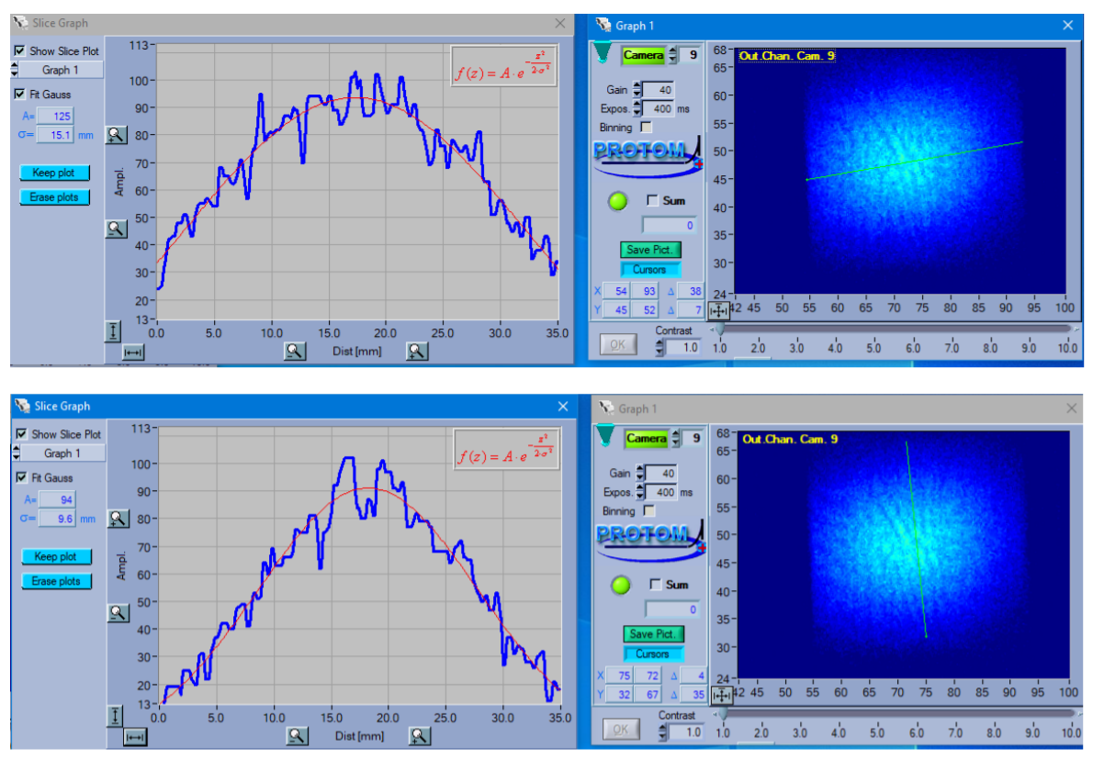
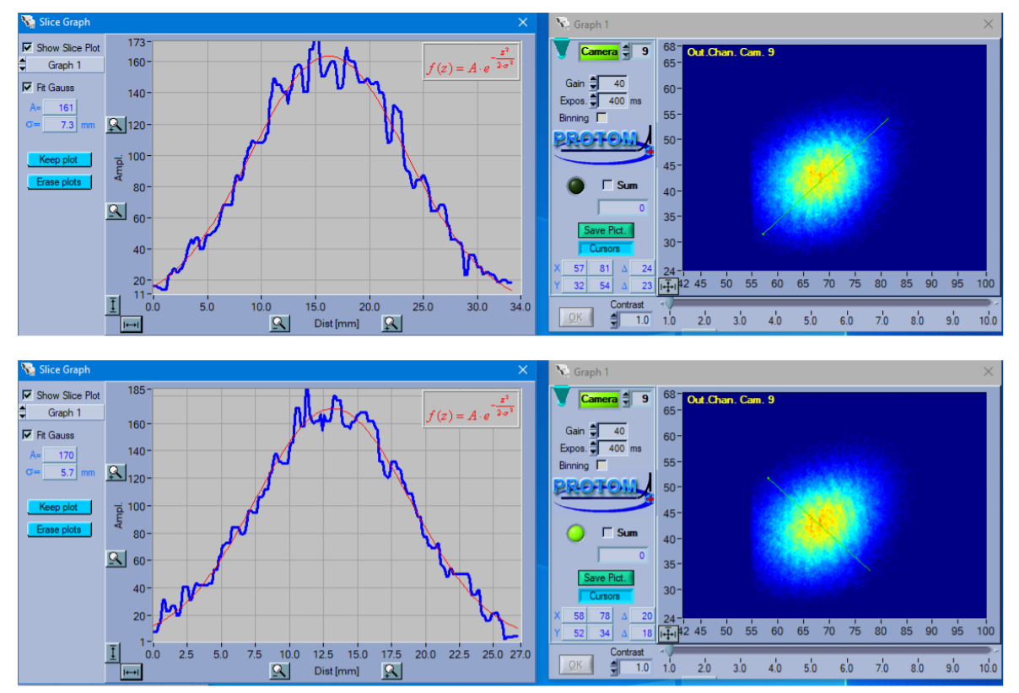
The dose profile (2/3)
a) a beam of protons with an energy of 100 MeV
b) a beam of protons with an energy of 200 MeV

Slide 14
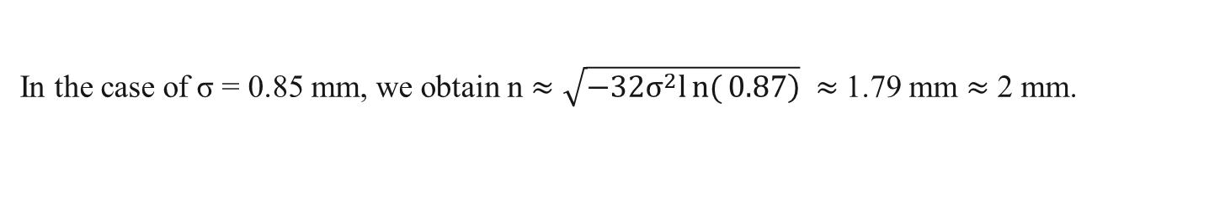
The dose profile (3/3)
In the case of σ = 0.85 mm, we obtain n $≈\sqrt{\left.−32σ^{2}ln{(}0.87\right)} ≈$1.79 mm $≈$ 2 mm.
The total dose profile (dark blue line) when the phantom is irradiated with 5 same beams located at a distance of: a) 2 mm, b) 3 mm, c) 4 mm.

Slide 15
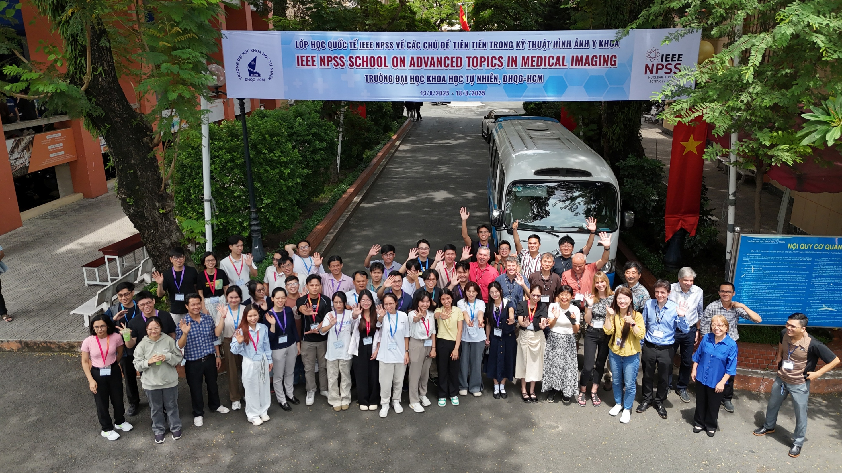
Thank for your attention!

