Slide 1


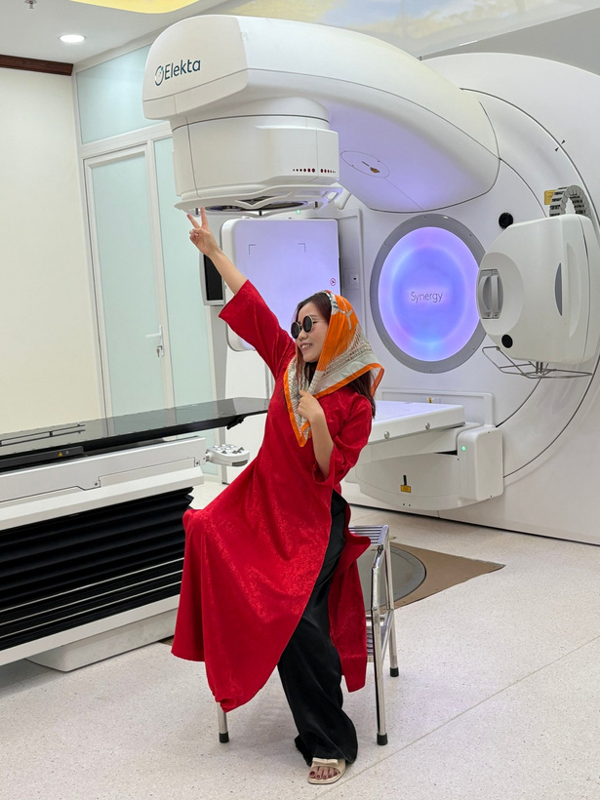
THAO
Just a few things about what I am doing - Medical Physicist
Email: thao.mt.hust@gmail.com

Slide 2
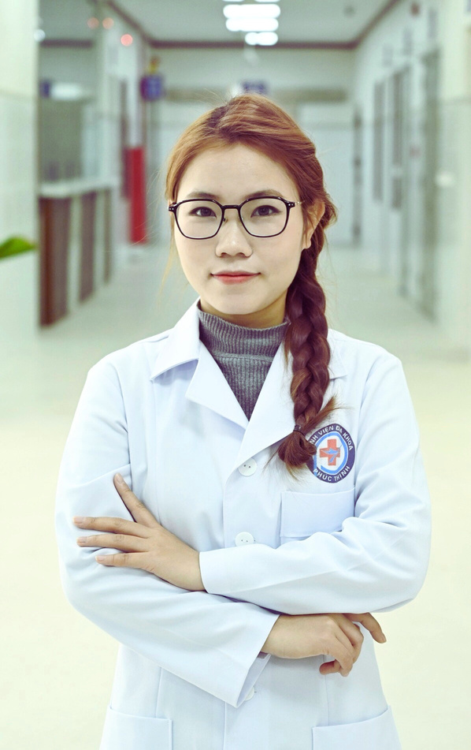

ABOUT ME
  Full Name: Mai Thị Thảo
  Graduated from HUST (Nuclear Engineering, 2019) & Chonnam National University (Biomedical Engineering, 2021)
  Currently working as a Medical Physicist at Phuc Thinh General Hospital (Thanh Hoa)

Slide 3

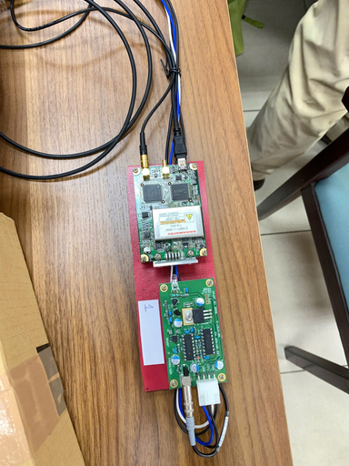
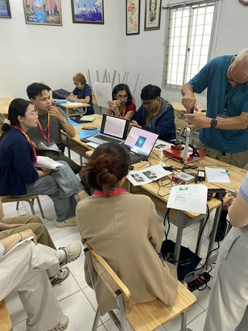
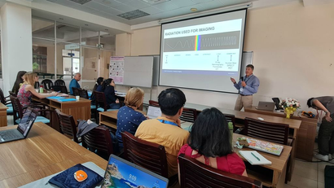
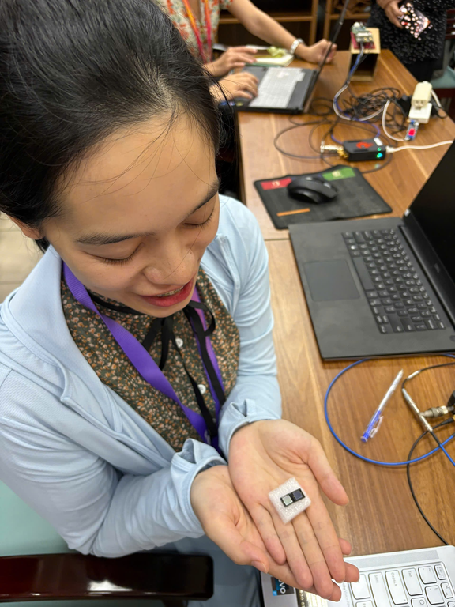
T - TECHNOLOGY
  Technology is the foundation of medical physics
  CT, PET, and SPECT → powerful imaging tools
  LINAC → key machine in radiotherapy
  Image processing → improves visualization & treatment planning
  Technology transforms patient care in diagnosis & therapy
deeper principles of imaging systems
easyPET
photon counting

Slide 4
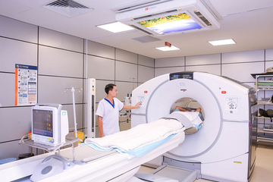
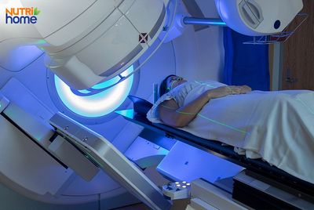
H -HEALTH & HEALING
  Core mission of Medical Physics → improving patients’ health
  Imaging → enables early & accurate diagnosis
  Radiotherapy → contributes to healing and cancer control

Slide 5
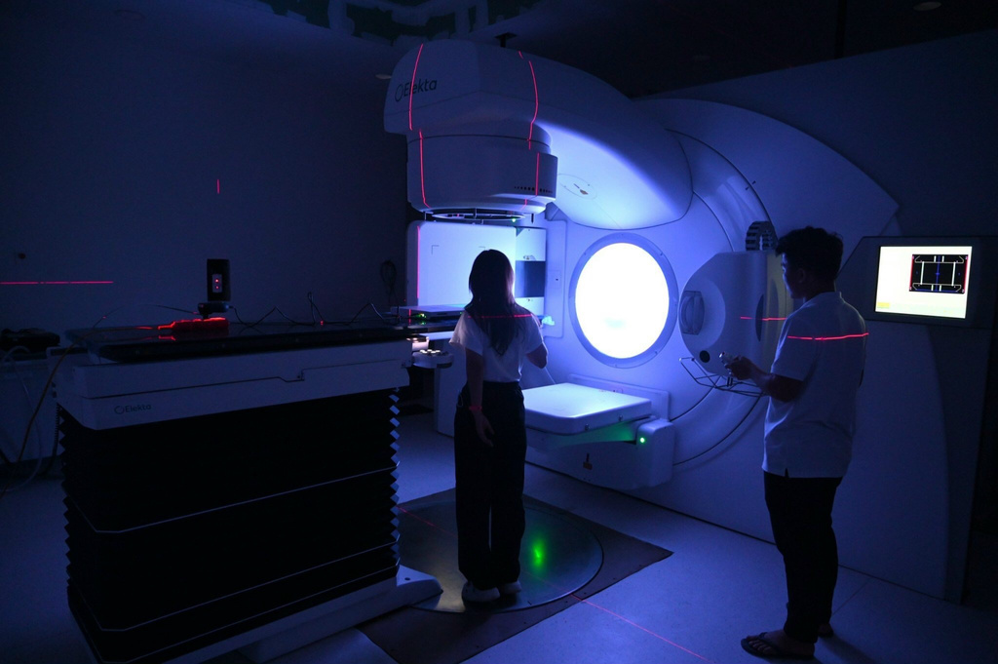
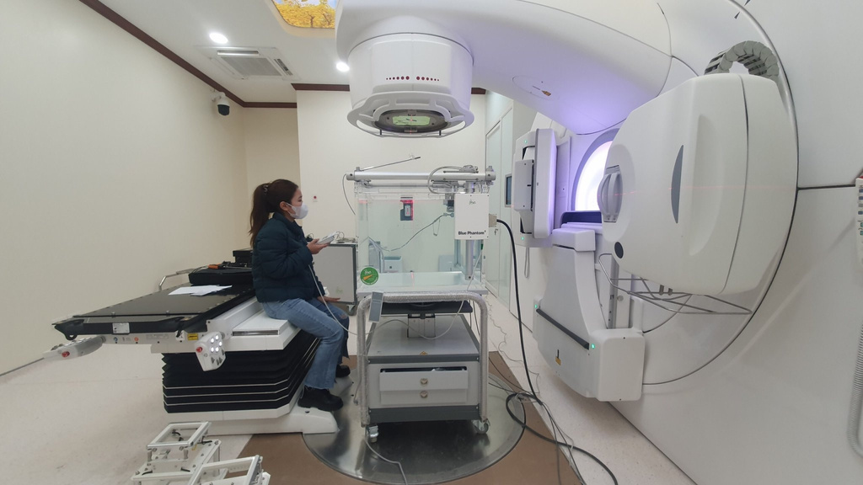
A - ACCURACY & ADVANCEMENT
  Accuracy → essential in imaging, dose calculation & treatment planning
  QA/QC of imaging & radiotherapy systems → ensures reliability & safety
  QA plans → maintain consistent treatment quality for patients
  Advancements → AI, 3D visualization, adaptive radiotherapy

Slide 6




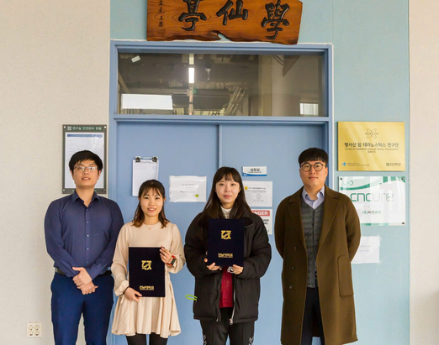
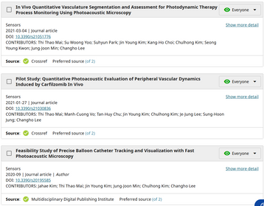
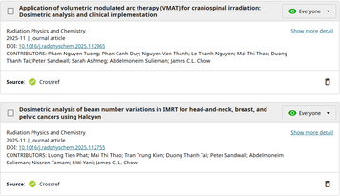
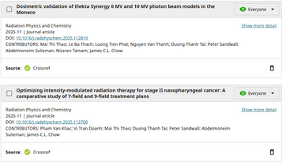
O - OPPORTUNITIES
2012 - 2017
2017 - 2019
2019 - 2021
2022 - NOW
HUST
FPT Sofware
CNU
Hospitals
“Opportunities don’t belong to a few; they are open to everyone who seeks them.”

Slide 7
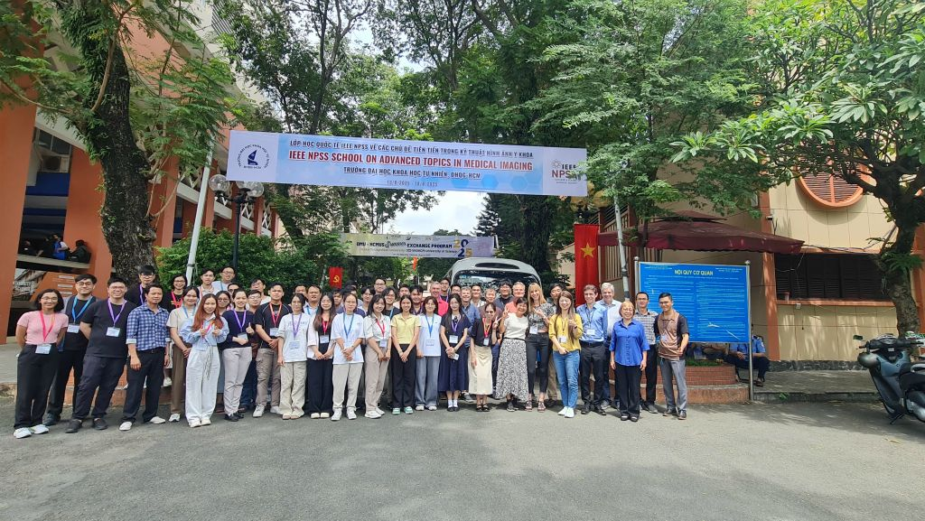
THANK YOU

