Slide 2

HISTORY OF RADIOLOGY
Student: Le Thu Phuong
Hanoi University of Science and Technology

Slide 3
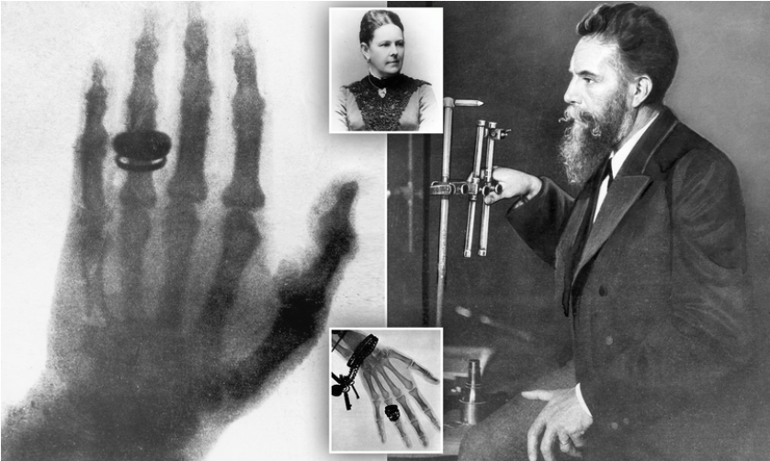
January 1896 – First use of X-rays
X-ray images are initially a novelty. However, by the end of the year, doctors around the world are using them.
The first X-ray image

Slide 4
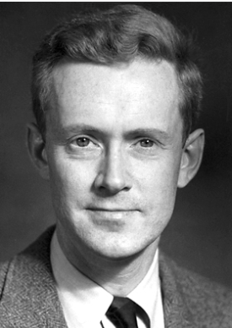
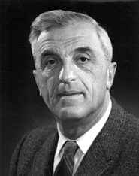
1946 – Nuclear Magnetic Resonance
American physicists Edward Purcell and Felix Bloch independently discover nuclear magnetic resonance (NMR).
Physicist Edward Purcell
Physicist Felix Bloch

Slide 5
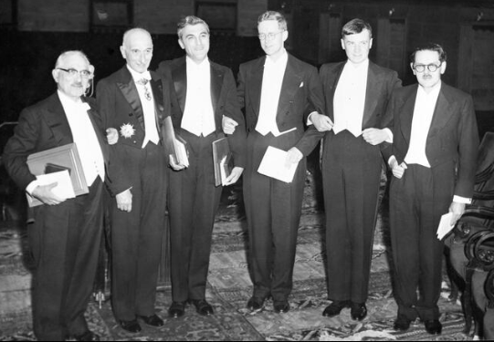
1952 – Nobel Prize
The Nobel Prize in Physics is awarded jointly to Felix Bloch and Edward Mills Purcell for “their development of new methods for nuclear magnetic precision measurements and discoveries in connection therewith”.
Ian Donald using the first ultrasound scanner

Slide 6
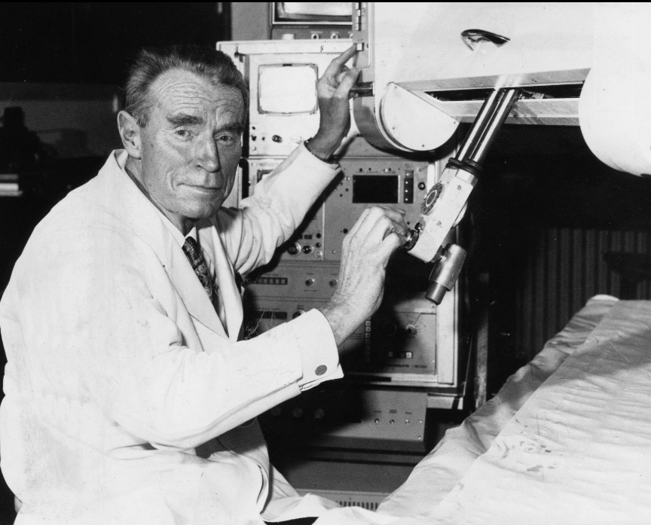
1955 – Ultrasound for medical diagnosis
Ian Donald, a Scottish physician, begins to investigate the use of ultrasound to diagnose gynaecological patients.
Ian Donald

Slide 7
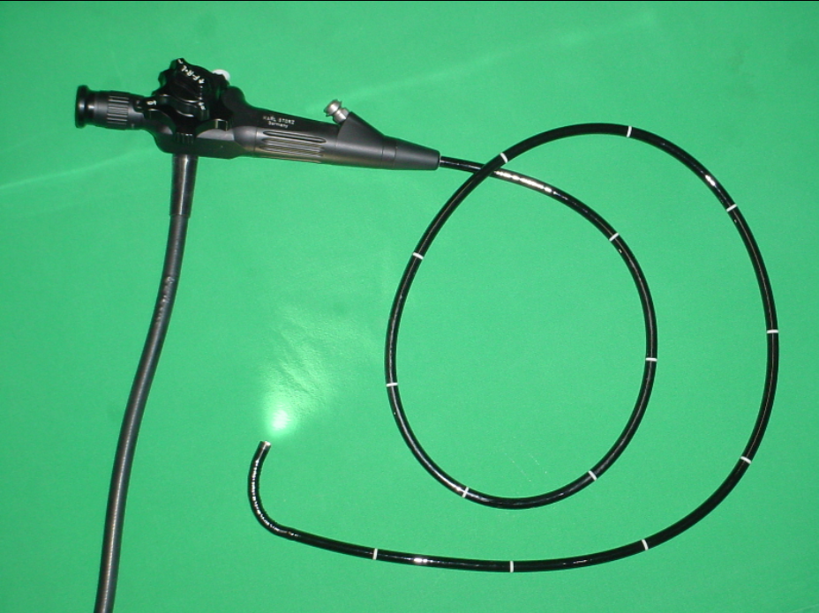
1957 – Fibre-optic endoscope developed
The first fibre-optic semi-flexible gastroscope is patented by gastroenterologist Basil Hirschowitz and co-workers at the University of Michigan.
Flexible fiber-optic gastroscope

Slide 8
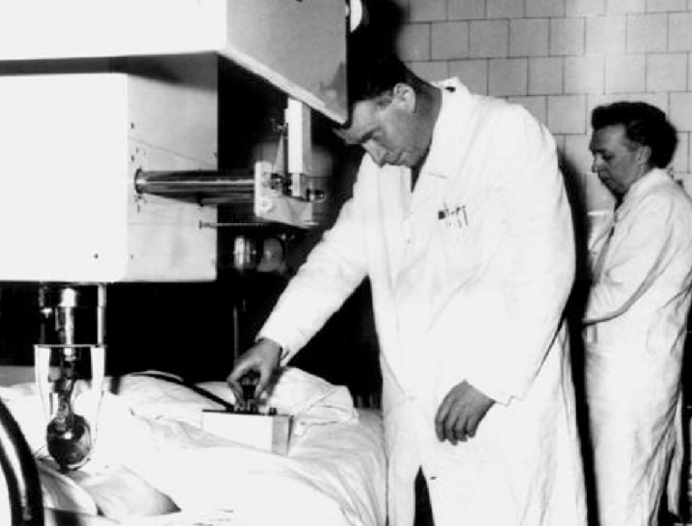
1958 – Ultrasound research published
Ian Donald publishes his defining paper on medical diagnostic ultrasound. He then turns his attention to the use of ultrasound in obstetrics and in investigating the growth of the foetus during pregnancy.
Ian Donald using the first ultrasound scanner

Slide 9
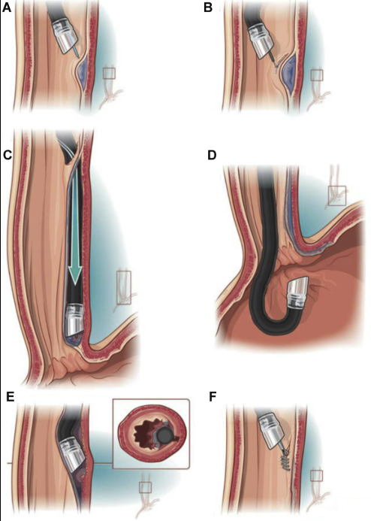
1960 – First use of endoscope
The endoscope, now in commercial production, is used to examine the stomach of a patient.
Stomach examination using an endoscope

Slide 10
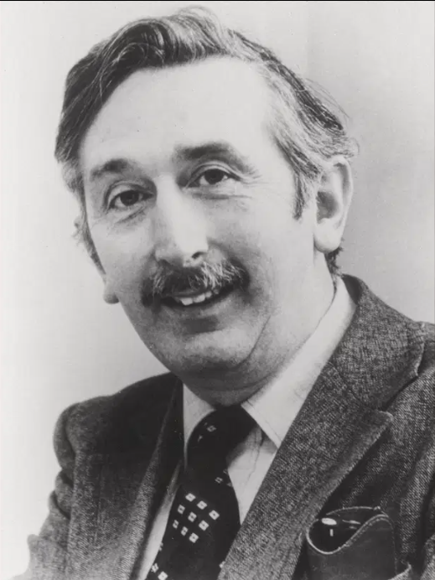
1967 – CT scanning conceived
Godfrey Hounsfield, an English electrical engineer, conceives the idea for computed tomography.
Godfrey Hounsfield

Slide 11
Early 1970s – NMR cancer detection
Scientists discover that normal and cancerous tissues produce different NMR responses.
Damadian demonstrated that cancerous tissues have longer T1 and T2 relaxation times compared to normal tissues, thereby allowing tumors to be distinguished using NMR signals.

Slide 12
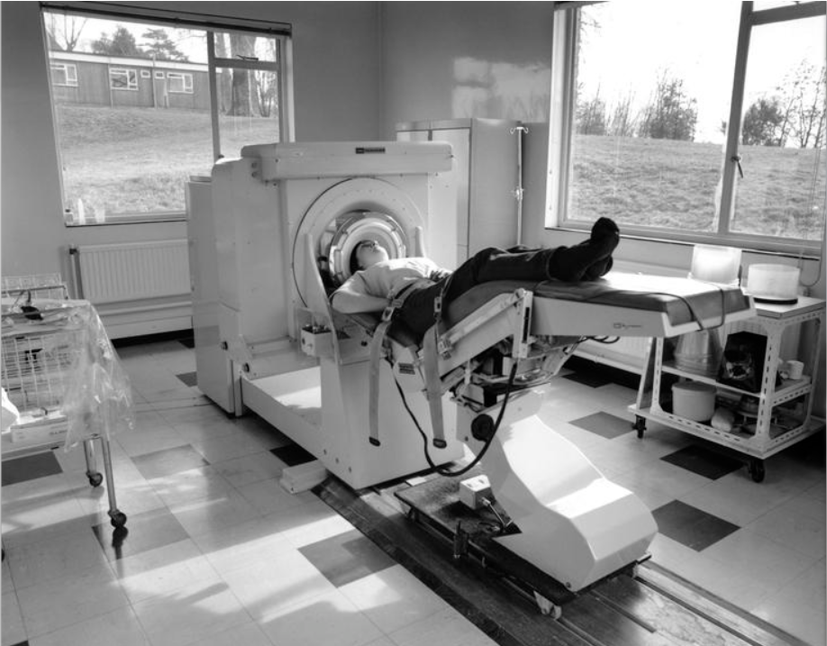
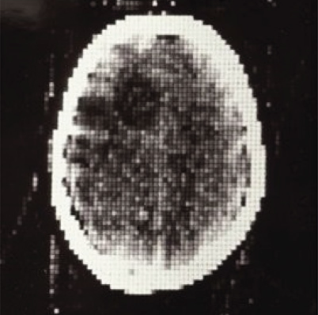
1971 – First CT scan of patient’s brain
The first CT scanner is installed in Atkinson Morley Hospital, Wimbledon, England, and the first patient brain scan is performed on 1 October 1971.
Image of the first CT scanner and the first brain scan in Wimbledon

Slide 13
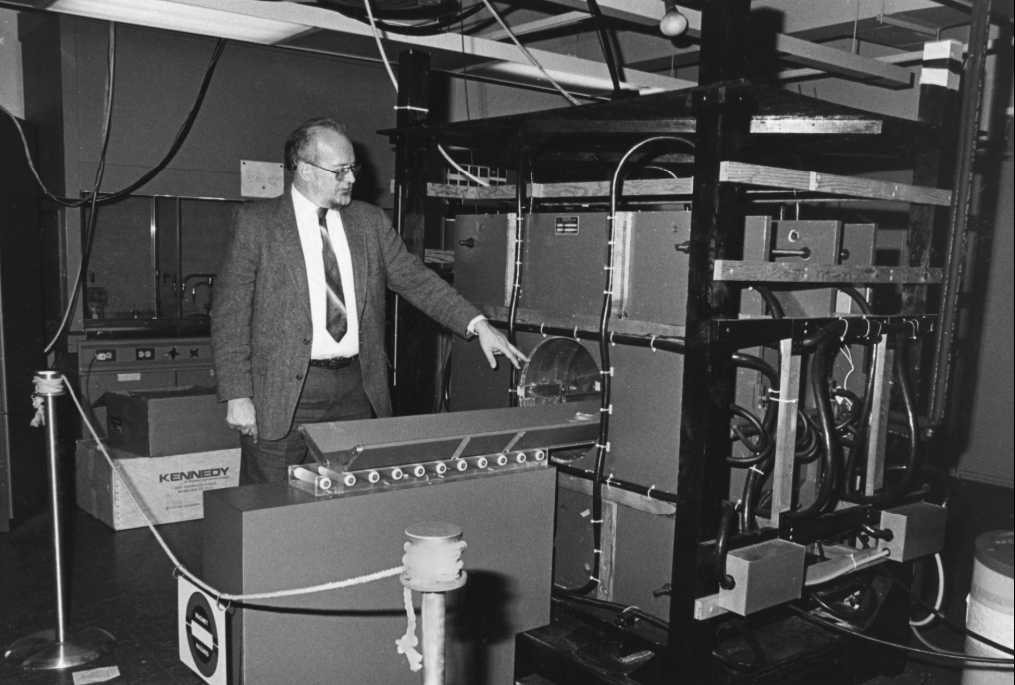
1973 – First MRI images produced
American chemist Paul Lauterbur produces the first magnetic resonance image (MRI) using nuclear magnetic resonance data and computer calculations of tomography.
Lauterbur demonstrates the MRI machine in the laboratory

Slide 14
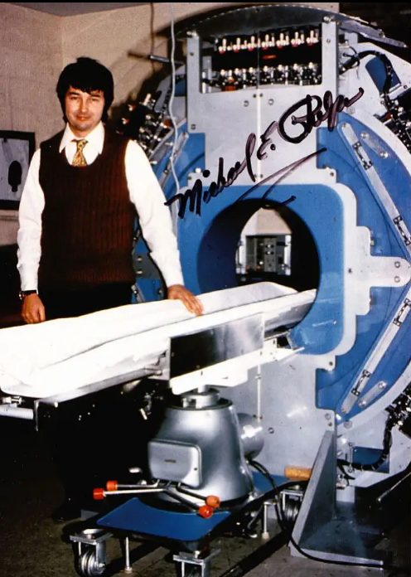
1974 – PET camera developed
American Michael Phelps develops the first positron emission tomography (PET) camera and the first whole-body system for human and animal studies.
Michael E. Phelps beside the first PET scanner

Slide 15
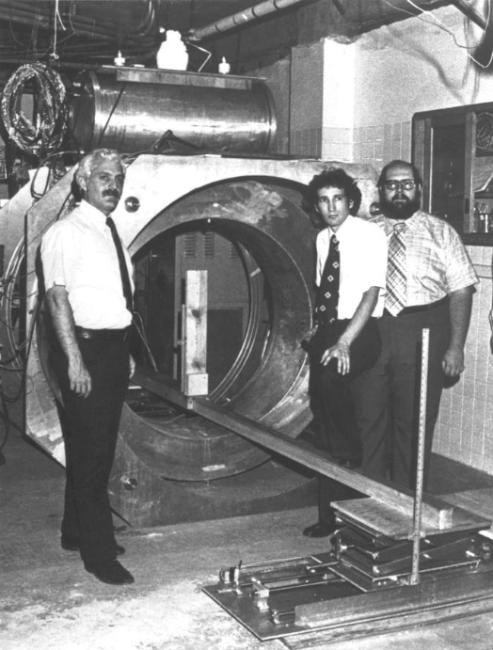
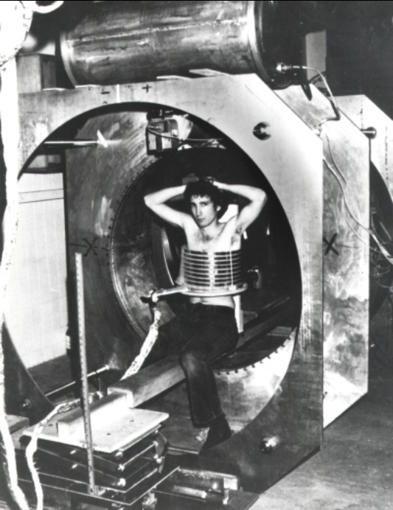
3 July 1977 – First human MRI body scan
The first MRI body scan is performed on a human using an MRI machine developed by American doctors Raymond Damadian, Larry Minkoff and Michael Goldsmith.
Raymond Damadian, Larry Minkoff, and Michael Goldsmith standing beside the world’s first MRI machine
Larry Minkoff sitting inside the Indomitable MRI machine for the first human thorax scan.

Slide 16
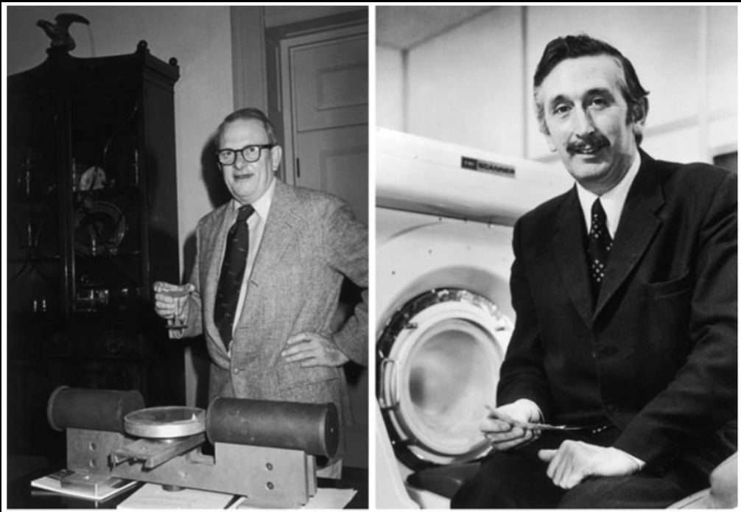
3 July 1979 – Nobel Prize
Godfrey Hounsfield and Allan McLeod Cormack share the 1979 Nobel Prize for Physiology or Medicine for their part in developing computer assisted tomography.
Allan McLeod Cormack
Godfrey Hounsfield

Slide 17
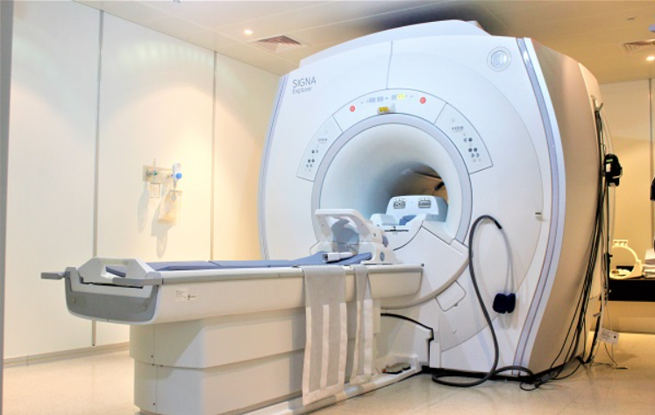
Early 1980s – MRI in hospitals
MRI scanners are installed in hospitals.
Image illustrating an MRI machine

Slide 18
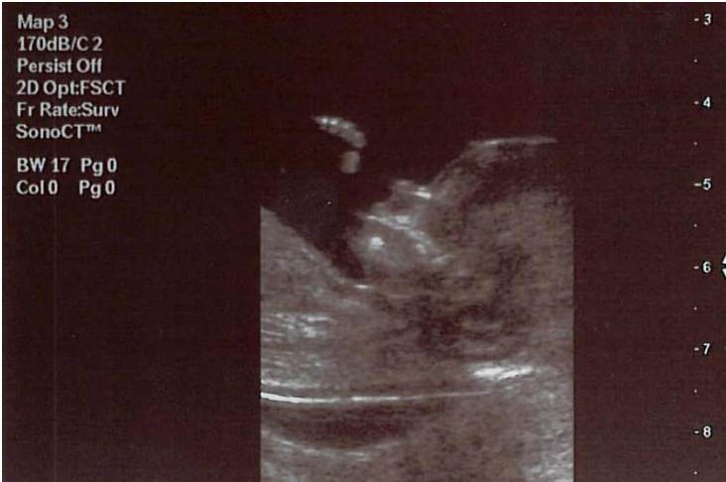
1990s – Prenatal ultrasound becomes routine
Ultrasound becomes a routine procedure in pregnancy to check the baby’s development and to pick up any abnormalities.
Image of a fetal ultrasound

Slide 19
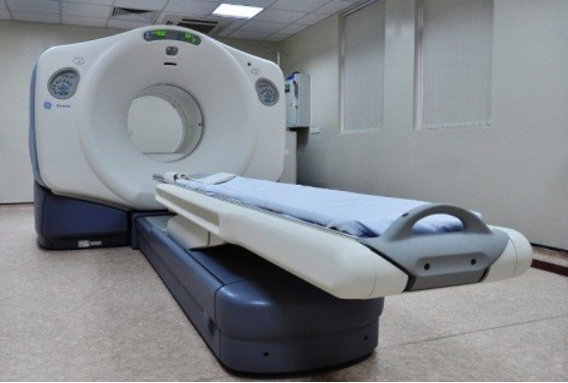
2000 – Medical invention of the year
Time Magazine names the PET/CT scanner the medical invention of the year.
Image of a PET/CT scanner

Slide 20
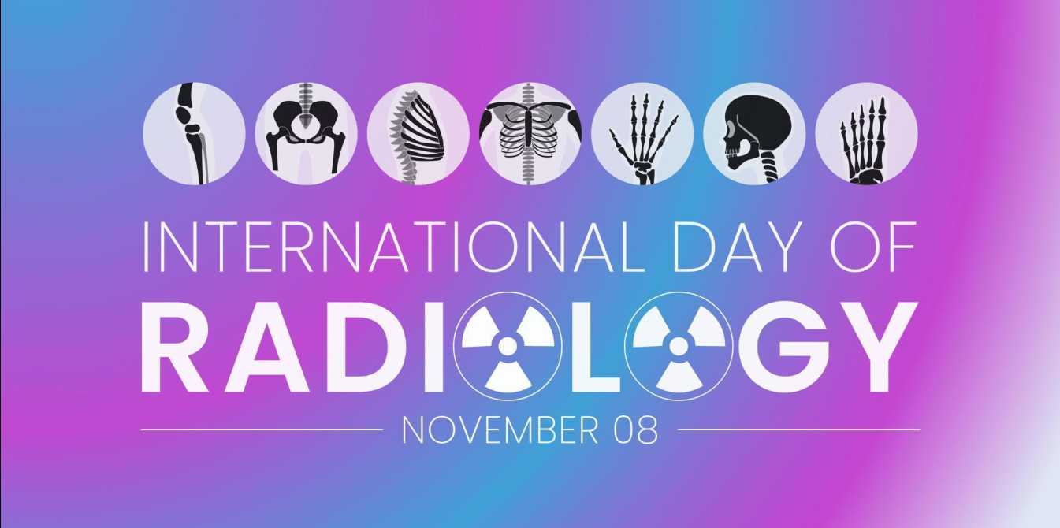
2012 – International Day of Radiology
The International Day of Radiology (IDoR) is introduced. It is recognized on November 8 annually.

Slide 21
THANK YOU !

