Slide 2



ABOUT ME
2019 - 2021
Nguyen Tat Thanh High School for the Gifted – Lao Cai
Class: Mathematics and Informatics
Participated in organizing and coordinating school events
Nguyen Tat Thanh High School for the Gifted – Lao Cai
Class: Mathematics and Informatics
Participated in organizing and coordinating school events
2021 - 2025
Hanoi University of Science and Technology
Faculty: Engineering Physics
Majoring in Medical Physics
Our slogan: “Physics today, engineering tomorrow!”

Slide 3

Topic Presentation:
Brain Tumor Segmentation on MRI images by applying deep learning techniques
Student: Nguyen Thuy Duong

Slide 4
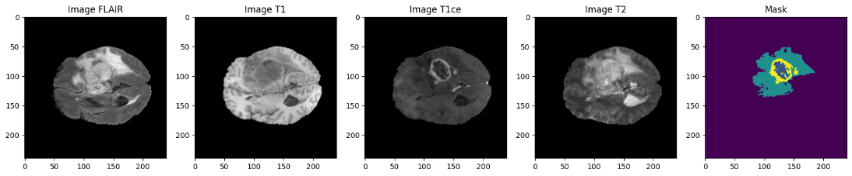
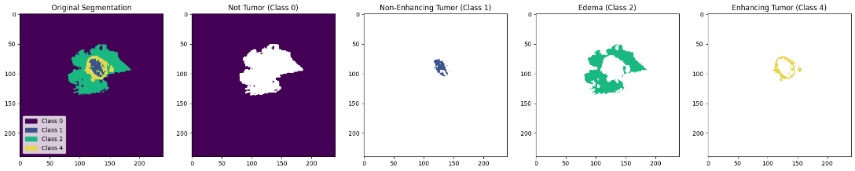
Research Subjects and Methods
BraTS2020 Dataset
Image sequences acquired from different pulse sequences
Label corresponding to a tumor subregion

Slide 5
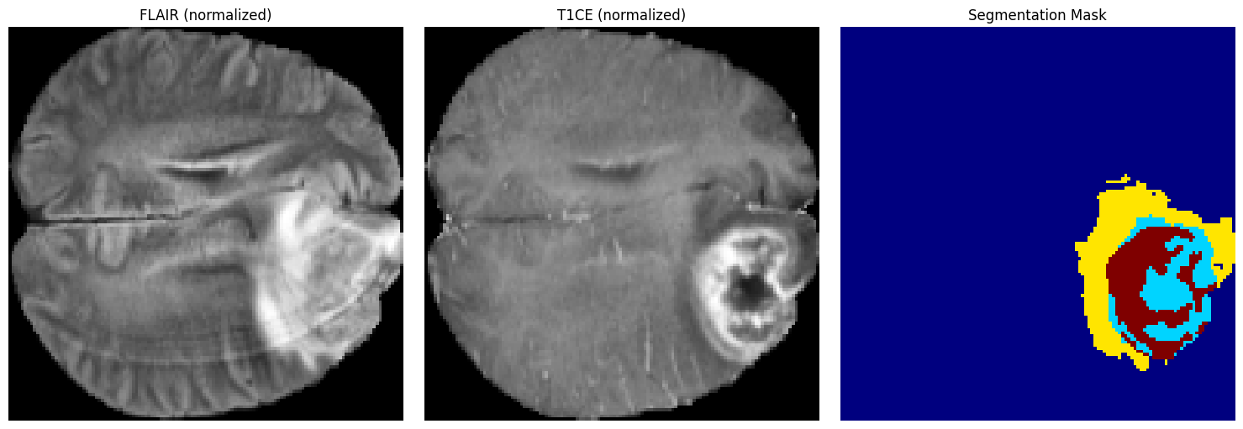
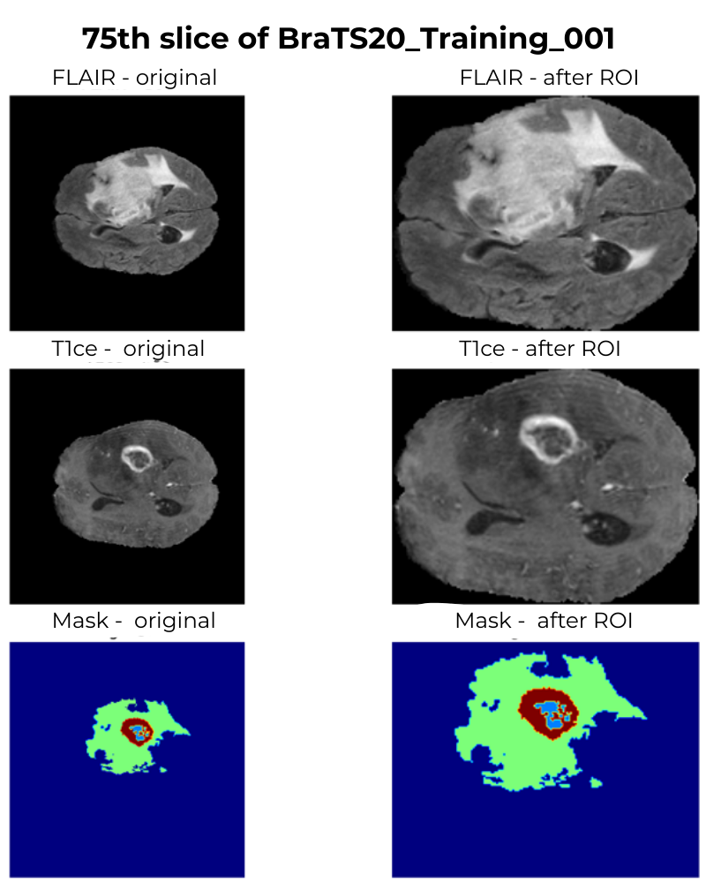
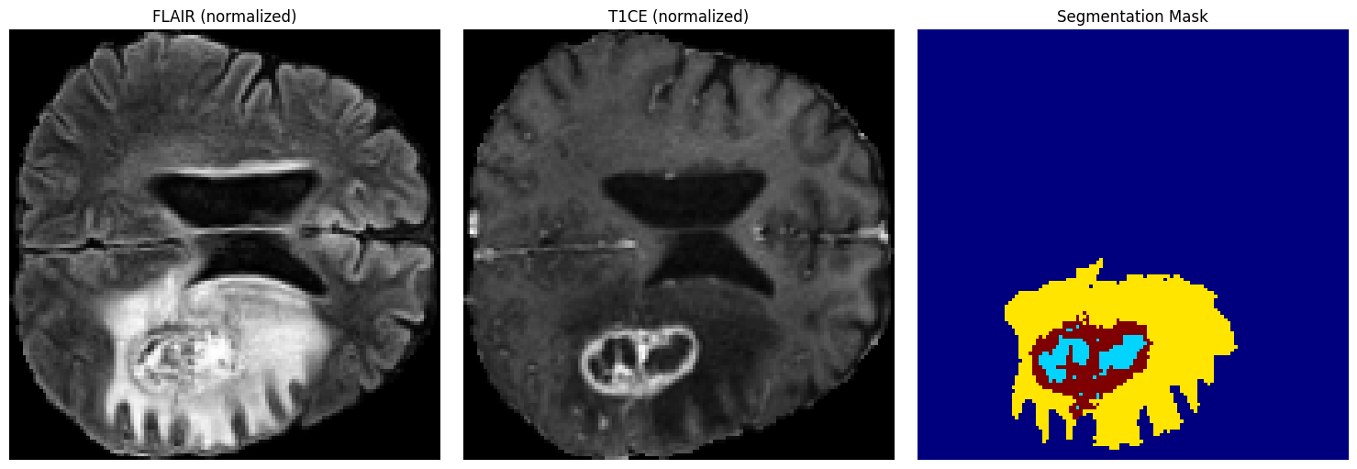
Research Subjects and Methods
Crop Region of Interest (ROI)
Image Intensity Standardization
Contrast Limited Adaptive Histogram Equalization
Enhance local contrast, improve lesion visibility, without losing information in abnormal bright/dark regions.
Example of slices after preprocessing
Concatenating T1ce and FLAIR into a two-channel input tensor
Data Augmentation
Deep Learning Networks
Geometric Transformations
Intensity Transformations
U-Net
Nested U-Net
Geometric Transformations
Intensity Transformations
Example of slices after ROI

Slide 6
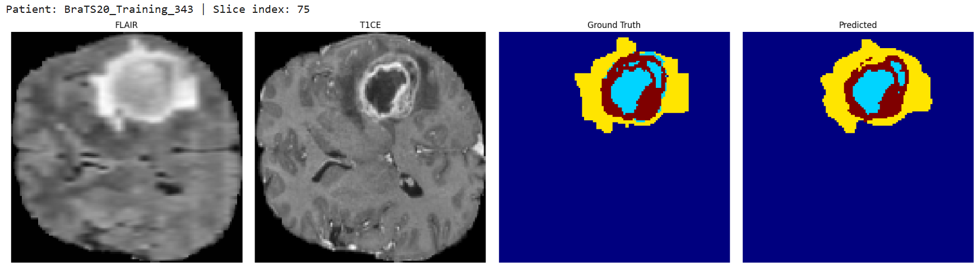
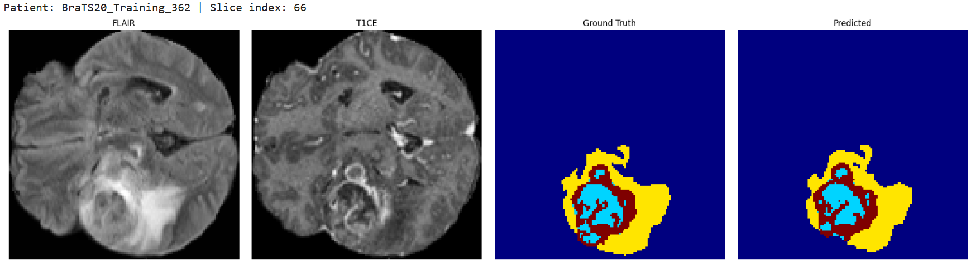
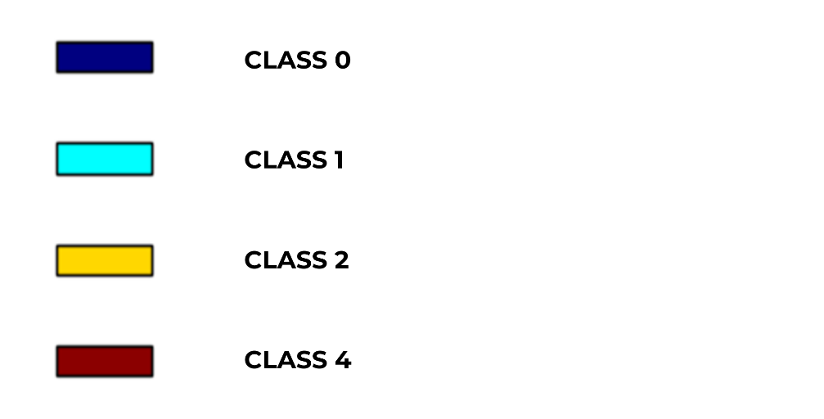
QUALITATIVE RESULTS
U-NET++

Slide 7
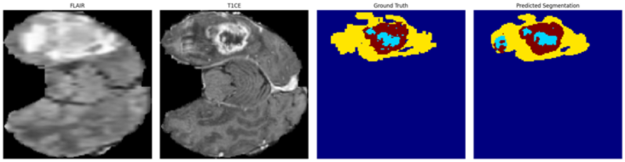
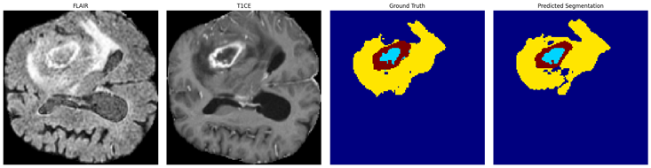
QUALITATIVE RESULTS
U-NET

Slide 8
THANK YOU!

