Slide 1


ATTENUATION CORRECTION IN PET IMAGING
Presenter: | Nguyen Minh Phuc
Notes:
Good morning doctors and medical physicists.
My name is Trinh Huy Vu, and today I’m honored to present my graduation thesis titled:
“Evaluation of Conventional and Hypofractionated Treatment Protocols for Prostate Cancer Using the Biological Indices TCP and NTCP.”
This research was conducted under the supervision of Dr. Pham Quang Trung.

Slide 2
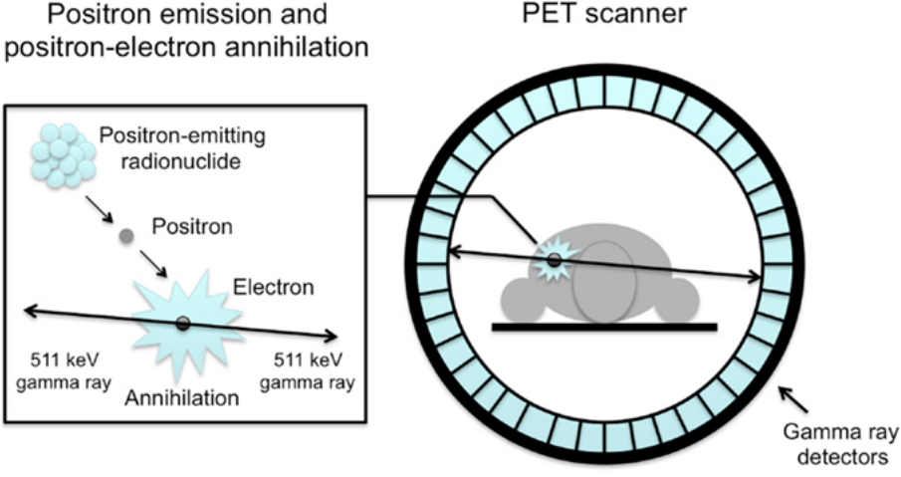
Introduction
Principle
Methods
Conclusion
Randoms corrections
Deadtime corrections
Correction in PET
Attenuation corrections
Partial volume corrections
Scatter corrections
Positron Emission Tomography - Basic Sciences
1

Slide 3
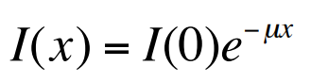
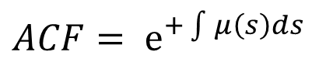
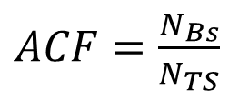
Introduction
Principle
Methods
Conclusion
Old PET scans
Modern PET/CT
$ACF=\frac{N_{Bs}}{N_{TS}}$​​
$ACF= ⅇ^{+\int{μ\left(s\right)ds}}$​​
I_{E}=I_{EM}×ACF
2
Notes:
Iem is the measured emission count rate after all other correction (e.g. normalization; scatter; randoms) and Ie is the actual emission count rate

Slide 4
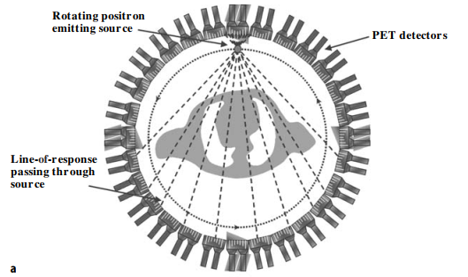
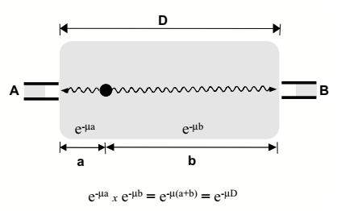
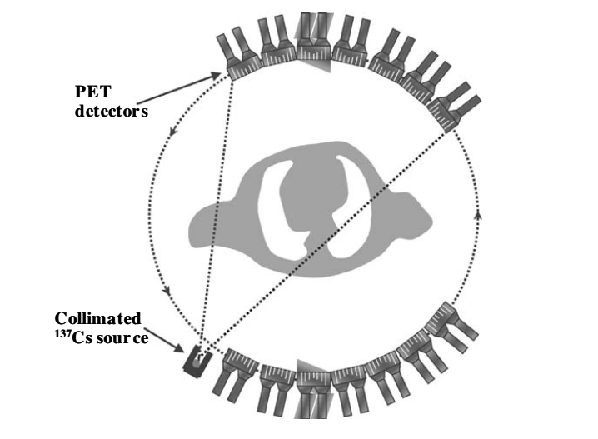
Introduction
Principle
Methods
Conclusion
Old PET scans
Attenuation Correction Using Coincidence Transmission Data
Attenuation Correction Using Single Transmission Data
3
Notes:
Coincidence: 68Ge
Single: Cs173
How does the radiotracker inside but measure outside?

Slide 5
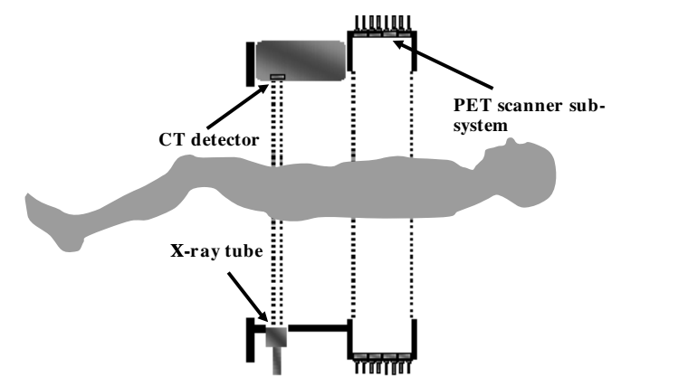
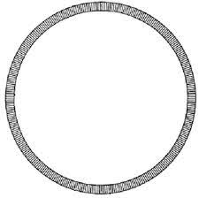
Introduction
Principle
Methods
Conclusion
Modern PET/CT
New approaches
Using LSO Background data
Attenuation Correction Using CT Data
4
Notes:
CT provides high-quality anatomical data
whole-body CT < 1 min vs ~20 min for transmission scans.
Convert HU → μ(511 keV) using bilinear transformation.
But you don’t want to do CT scan for each time you take a PET so…
Some new approaches
Lutetium-176
and in long axial field-of-view PET scanners,
Use this intrinsic background as a built-in transmission source.
Apply deep learning (CNNs) to enhance and match CT-like quality.

Slide 6
Introduction
Principle
Methods
Conclusion
Attenuation correction in PET imaging
Without attenuation correction, deep structures are underestimated and images cannot be interpreted reliably.
Correct attenuation correction ensures that PET images reflect true tracer distribution, free from artefacts.
Future Developments:
CT-based correction = current standard
LSO background and Deep Learning µ-maps → towards CT-free correction
Using AI to convert MRI to CT in PET-MR systems
5
Notes:
CT provides high-quality anatomical data
whole-body CT < 1 min vs ~20 min for transmission scans.
Convert HU → μ(511 keV) using bilinear transformation.
But you don’t want to do CT scan for each time you take a PET so…

Slide 7

THANK YOU !
Notes:
CT provides high-quality anatomical data
whole-body CT < 1 min vs ~20 min for transmission scans.
Convert HU → μ(511 keV) using bilinear transformation.
But you don’t want to do CT scan for each time you take a PET so…

